Slide 1
A Comprehensive Review of State Data Systems Supporting Early Childhood
Ginger Elliott-Teague
Howard Morrison
DaSy Center
Notes:
Ginger

Slide 2
Welcome & Introductions
Who’s in the room?
Name/role/organization
Notes:
Ginger

Slide 3
Pop Quiz!
What’s the percentage?
Programs that have data on all children referred, regardless of eligibility status
Programs with data systems that bill Medicaid directly
Programs with systems can accept electronic signatures
States with an SLDS
States with an ECIDS
Notes:
Ginger
Have data on all children referred, regardless of eligibility status: B 619 state programs: 72%
Bill Medicaid: 16%
Electronic Sigs: 31%

Slide 4
Agenda
Connecting Part B 619 to Other Data Systems
National Trends: Data Systems for Early Childhood
DaSy Data System (State of the States) Survey (2023)
Landscape Analysis: ECIDS and SLDS
Next Steps
Resources
Notes:
Ginger

Slide 5
Connecting Part B 619 to Other Data Systems
Notes:
Ginger

Slide 6
Why is it important for your state?
DaSy Critical Questions
How many children who receive Part C early intervention or Part B 619 early childhood special education services are…
In community child care?
In Head Start?
Receiving SNAP benefits?
Receiving other home visiting services?
Do services or outcomes differ across these groups?
Notes:
Ginger

Slide 7
Establishing Value with Leaders
Define:
Common ground and shared goals
What the program is ‘giving’ and ‘getting’ from participation
Value for your leadership (program, department, agency)
Costs (time, IT resources, funding)
Identify:
Who needs to be involved vs kept informed
Programmatic, legal, technical staff
Who are the champions who will go to bat for the project
Who will do the actual work (governance, data sharing, etc.)
Notes:
Ginger
Articulate value to the right people, including agency leadership

Slide 8
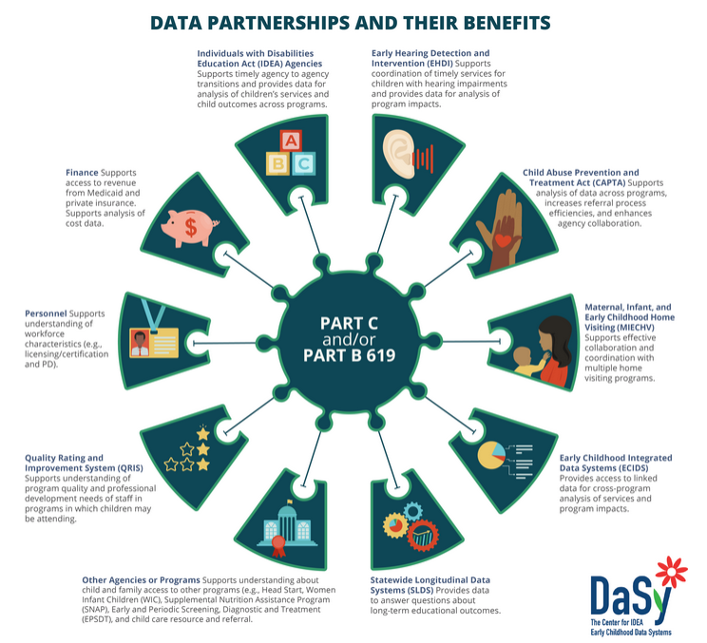
Data Partners and their Benefits
Notes:
Ginger

Slide 9
National Trends: Data Systems for Early Childhood
Notes:
Ginger

Slide 10
2023 Data System Survey Findings
Part C and Part B 619
Nearly 50 programs in each responded
States, territories and other entities
Topics
System features/functionality
Reporting (federal, state and local; public and secured)
Linkages across systems (internal and external)
External integration: billing, referrals, transition
Governance and management
Data elements and location
Child data: demographics, eligibility and services (IEP)
Workforce, fiscal, and monitoring data
Notes:
Ginger

Slide 11
States Have Many Key Data System Features
Child-level data system
Workforce data system(s)
Unique child identifier code
Use same ID for Part C & B 619 programs
Child-level data linked or all in one system
Notes:
Ginger

Slide 12
States Vary in Ability to Link Data Across Systems
Child and workforce data
Part C and 619 data
IDEA data with other EC program data
Part C/619 data with K12 SPED data
Part C/619 data with K12 gen ed data
Have data governance body
Notes:
Ginger

Slide 13
Facilitating Connections with Technology
The state program’s data system…
Fiscal
Supports direct Medicaid billing
C: 41% B: 16%
Contains financial data for billing/claims
C: 83% B: 51%
Families
Includes a parent portal
C: 11% B: 26%
Supports transfers across programs/LEAs
C: 67% B: 54%
Ease of Use
Supports electronic referrals
C: 41% B: 23%
Accepts electronic signatures
C: 27% B: 31%
Notes:
Ginger
The state data system…

Slide 14
Linkages to ECE & HHS Data
B 619 much more likely to link to EC education programs than health or human services EC programs
85% of states reported linking or integrating some data with K-12 special education data
75% of states reported linking or integrating some data with K-12 general education data
Notes:
Ginger
What does “linking” mean in these cases?
Survey defn: The process of joining or connecting electronic, individual records in one state data set/system with those in another state data set/system. Record matching may be through a common identifier in both data sets or by some other method. Data linking may happen externally to any existing data system.

Slide 15
DSLI Data Collection Challenges
C & B programs use the same unique ID for a child
C: 31% B 619: 26%
C and B 619 programs can link child data through their data systems
C: 25% B 619: 16%
77% of respondents in the same state agreed on the answer
56% of respondents in the same state agreed on the answer
State has an ECIDS (EC integrated data system)
C: 36% B 619: 38% Matched: 22%
Public data: 28%
Asking two programs in the same state the same question can generate different answers
Program staff are not always aware of all state data systems
Notes:
Ginger

Slide 16
Transition Data Linked Between C & B
Data Elements Linked | Reported by C | Reported by B
Transition notification date | 67% | 36%
Parent contact information | 70% | 48%
Part C service coordinator | 60% | 31%
Language spoken by child | 47% | 31%
Child Part C eligibility category | 40% | 19%
Part C entry date | 37% | 29%
Digital IFSP | 23% | 17%
Part B eligibility determination | 30% | 38%
Part B IEP date | 17% | 41%
Other | 27% | 17%
None of the above | 20% | 41%
Notes:
Ginger
The biggest discrepancies reflect what programs know about the data linked between C and B 619. On the prior slide, shared that only about half of programs have the same understanding of whether their programs can and do link child data. We see that reflected here. For example, 67% of C programs report that the transition notification date is linked between C and B child records, while only 36% of B 619 programs report the same.
To help states understand the differences and commonalities in the data reported by both programs in each state, we have produced state data tables that present data on several questions common to both programs. The intent is to encourage communication and collaboration with your colleagues in your counterpart office to improve DSLI and systems. We will be emailing these to you in just a couple of weeks!
PAUSE for reflection

Slide 17
How States Might Use the Survey Information
Results can be used to align Part C/Part B 619 data system enhancement priorities within your own state
States can use survey data as a reference point with onboarding new staff
Survey results can give insight on data system enhancement priorities at a national level
Survey can be used in conjunction with the DaSy Critical Questions About Early Intervention and Early Childhood Special Education
Notes:
Ginger
Mention state tables sent out

Slide 18
Published Resources and What’s Next
Existing resources:
State Data Tables
State of the States Maps with 2023 data
2023 conference presentations (online and here)
2021 data, briefs, and maps
Next up:
National Data Tables
Summary reports of 2023 data
Notes:
Ginger

Slide 19
Discussion
Questions
Surprises
Concerns
Challenges
Notes:
Ginger
Reactions?

Slide 20
Landscape Analysis
Review of current data sources to determine IDEA participation in statewide data systems
Data points leveraged for Part C and Part B 619 participation in and ECIDS/SLDS:
SLDS Data
State of the State Data
State Interviews
Notes:
Howard

Slide 21
ECIDS and SLDS Terminology
An ECIDS collects, integrates, maintains, stores, & reports information on children (birth to 8 years old) from programs across multiple agencies. The data are related to the individual child, the family, the classroom, &/or services provided.
A "Statewide Longitudinal Data System" stores student data accumulated over time for an SEA; helps manage and analyze education data. Often includes data from other state agencies.
Notes:
Howard

Slide 22
Which States have an ECIDS?
Florida
Georgia*^
Illinois*
Iowa
Kansas*^
Massachusetts*^
Minnesota*^
Missouri*^
Nebraska
New Jersey*^
New Mexico*^
North Carolina*^
Pennsylvania*^
Rhode Island*^
Utah*
Virginia
* = Part C
^ = Part B 619
Notes:
Howard
62% of ECIDS have B 619 data included (10 of the 16)
75% have C included (12 of the 16)
Any surprises here? Anything that you know that we don’t?

Slide 23
Examples of State ECIDS Variations
About 60% have EI and/or ECSE data in the systems
Agency leads vary (HHS most common)
Data sources and types vary (periodic aggregated uploads v real-time updates)
Some can “de-duplicate” counts when children participate in multiple programs
Some have accessible dashboards while others provide no public data
Some states building EC to workforce systems that include some EC data
Common programs included:
Public PK (80%)
Child Care
Child Welfare, incl WIC, SNAP
Health stats (40%)
Home-visiting
Head Start
Family stats, incl poverty, maternal health
Private PK (20%)
Notes:
Howard
The best systems with the most sophisticated data analyses use 1 unique ID across all program data sources. Those that don’t are able to provide single program counts but cannot match across program boundaries to understand—for example—how many families with children in Head Start receive SNAP benefits.
A few only include ECE participation, looking at public and private PK enrollment, while others pull in data from multiple agencies. But all fall under the general umbrella of an ECIDS if they contain child records.
Some consist of manually entered data at the classroom or child level, while others match existing data from multiple sources.

Slide 24
ECIDS: Do States Have One?
Notes:
Howard
The SOS data: Percent of programs that know their state has an ECIDS when it actually does. Not the percentage who reported having an ECIDS generally (whether right or not).

Slide 25
SLDS: Do States Have One?
Notes:
Howard
ECS = Education Commission of the States: define SLDS differently, as a longitudinal data system with at least two state agencies participating.

Slide 26
Challenges
Staff awareness of ECIDS/SLDS and the benefits to Part C and B 619
Part C and Part B staff not being engaged in the SLDS/ECIDS conversations
Lack of staff capacity to participate in an ECIDS/SLDS
No dedicated funding to link or integrate data with an ECIDS/SLDS
Data systems not being modernized and needing updating
De-duplicating across systems (no single unique ID)
Establishing a long-term contract with a vendor or entity to maintain the data system
Developing data sharing agreements that meet the requirements of both FERPA and IDEA
Notes:
Howard
Through interviews
Inquire if states have had others?

Slide 27
Successes/Advice
Successes/Strategies
Advice
Leveraged federal funding to get project off the ground
Identified state and foundation funds to support ECIDS work
Strong inclusion advocates to make sure data on children with disabilities was included in ECIDS
Dedicated staffing for program and research side
Strong collaboration and partnerships with other state agencies and universities
Priority for state governor or leader
Ensure conversations are had with local program leaders to identify needs and to provide input on available public reports
Build institutional continuity so it is not one person holding the knowledge
Document your processes so the work can continue and be passed to new or additional staff and/or teams
Engage program leaders about the data: how they are using it, what they are doing with it, and make sure they represent the data accurately.
Notes:
Howard
Through interviews

Slide 28
Discussion
Do you see your state represented?
What critical questions do you want to answer?
What plans do you have for data sharing, linking, or integration?
What format of TA or supports would be most helpful?
Notes:
Howard

Slide 29
Next Steps
Notes:
Howard

Slide 30
Phase I: Just Beginning
Constituent engagement and governance
Identify partners, define roles and responsibilities
Establish a data governance structure
Needs assessment
Identify the primary goals and objectives
Conduct a data inventory
Determine resource/funding capacity
Legal and privacy considerations
Review legal requirements and develop data sharing agreements
Data standardization and quality
Develop common data standards and definitions
Implement data quality measures
Notes:
Howard

Slide 31
Phase II: Midway There
Funding and Resources
Estimate expected costs
Procure immediate funding and plan for the future
Technical infrastructure
Design the data architecture
Select tools and technologies
Data collection and integration
Identify data sources
Implement data collection mechanisms
Data analysis and reporting
Develop analytic tools
Create reports
Notes:
Howard
– if there is time ask the audience this question then reveal the next steps listed on the slide.
Building an ECIDS involves several key steps to ensure it effectively collects, integrates, and utilizes data from various early childhood programs and services. You have heard many of these key steps today. After thinking through today’s presentation, what are steps you can take to begin or continue with developing your ECDIS?

Slide 32
Phase III: Almost There
Training and capacity building
Provide training on data use, analysis, and interpretation
Build capacity to use the data effectively for decision-making
Pilot testing and evaluation
Conduct pilot tests
Collect feedback
Evaluate and refine
Sustainability and continuous improvement
Develop a sustainability plan
Foster a culture of data use
Monitor and update
Notes:
Howard
– if there is time ask the audience this question then reveal the next steps listed on the slide.
Building an ECIDS involves several key steps to ensure it effectively collects, integrates, and utilizes data from various early childhood programs and services. You have heard many of these key steps today. After thinking through today’s presentation, what are steps you can take to begin or continue with developing your ECDIS?

Slide 33
Resources
DaSy
Informed & Ready: Questions Part C and Part B 619 Program Leaders Should Ask About an Early Childhood Integrated Data System
Critical Questions About Early Intervention and Early Childhood Special Education
DaSy Data Governance Toolkit
Automated Data Sharing or Linking Use Case: IDEA Part C to Part B 619 Transition Notification
SLDS
Partnering for Success: Key Elements of Effective ECIDS Data Governance
ECIDS Toolkit
Notes:
Howard

Slide 34
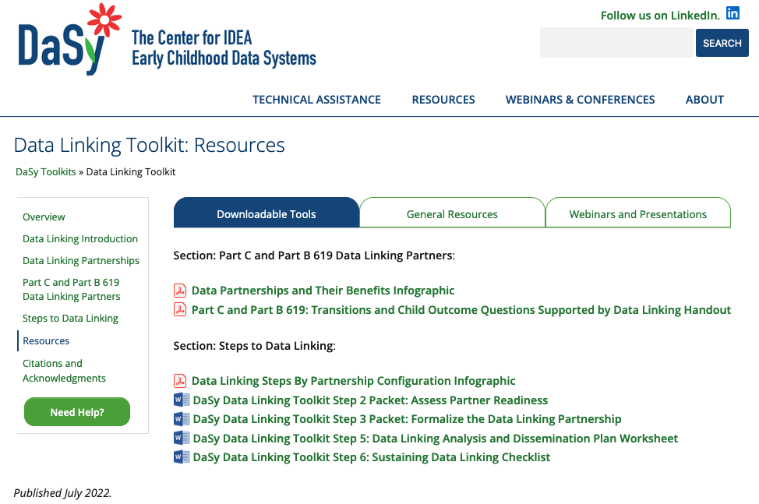
Resources in the Data Linking Toolkit
Notes:
Howard

Slide 35
Thank you
Visit us at http://dasycenter.org/
Follow us on LinkedIn:
https://www.linkedin.com/company/dasy-center/
Notes:
Howard

