Slide 1
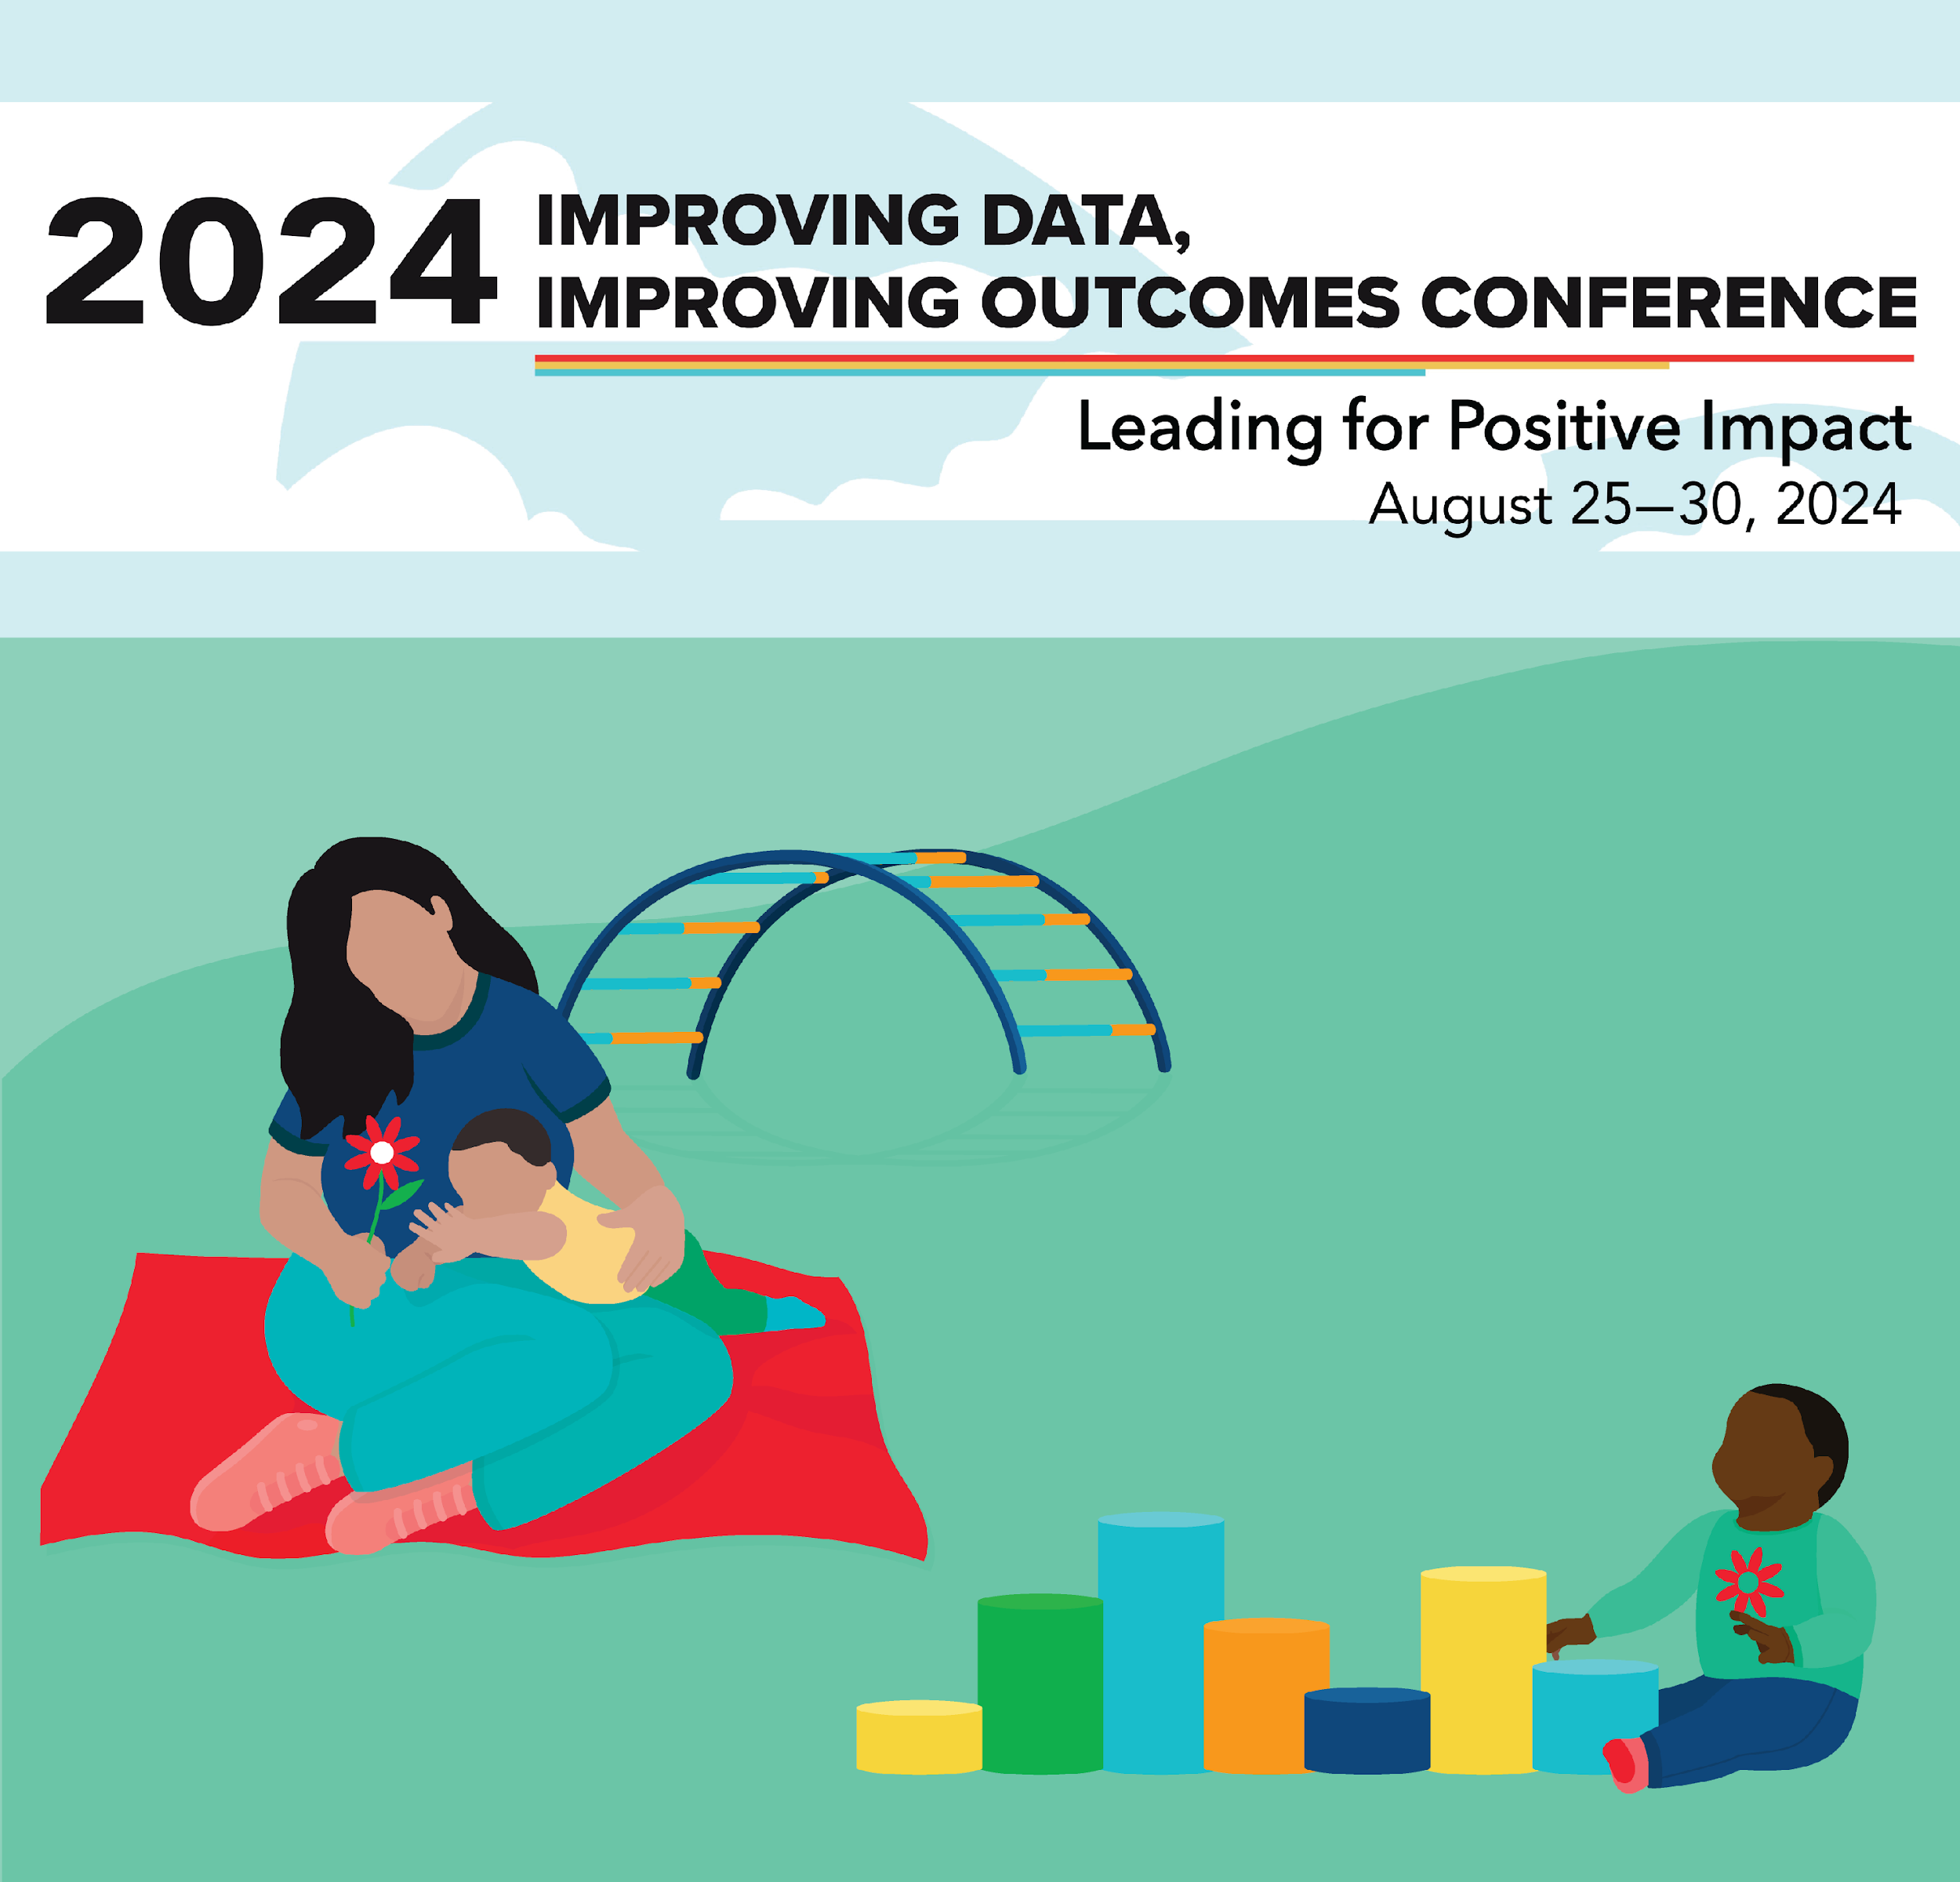
Using Data Frameworks to Improve Services and Address Inequities for Young Children with Disabilities
Kathleen Hebbeler, Ph.D., DaSy @ SRI
Jennifer Tschantz, Ph.D., DaSy @ SRI
Silvana Esposito Hackett, MPP, Child Trends
#IDIO2024
August 28, 2024

Slide 2
Session Outcomes
Understand when and how to use two frameworks that address data:
Early Childhood Data Collaborative at Child Trends System Transformation for Equitable Preschools (STEP Forward with Data) Framework
DaSy Data Systems Framework & Critical Questions
Explore ways data can be used to address inequities and improve services and programs for young children with disabilities.
Notes:
Jennifer

Slide 3
Agenda & Materials
Welcome and Introductions
Overview of the Frameworks
Why all the Frameworks?
STEP Forward with Data Framework
DaSy Systems Framework & Critical Questions
How the Tools Compliment One Another
Putting the Frameworks to Use
Notes:
Jennifer ---We want this session to be interactive so will build in opportunities for discussion, questions, and feedback
Will we hand out copies early on or wait until we get into the frameworks?

Slide 4
Who is in the Room?
Roles
Part C or Part B/619
Non-state participants
Families
TA providers
Researchers
How long have you been in your current position?
Notes:
Jennifer

Slide 5
Why all the Frameworks?
Notes:
Kathy

Slide 6
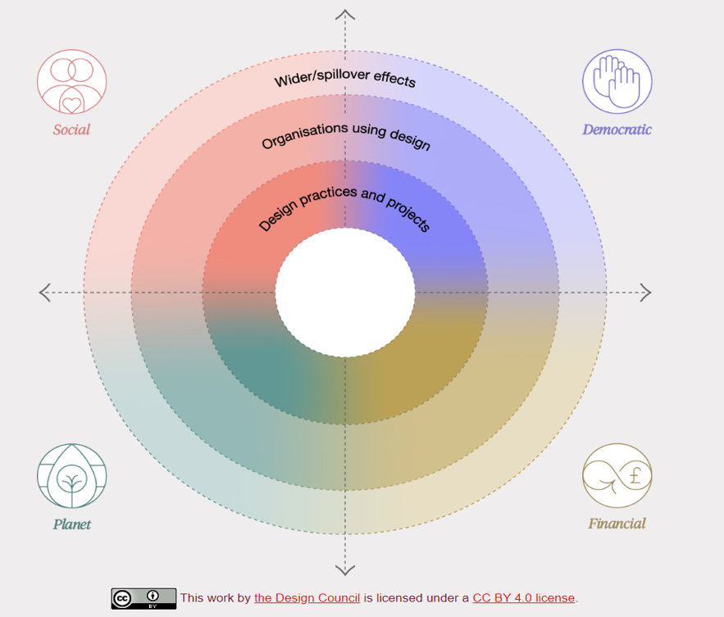
What and Why of a Framework
a system of rules, ideas, or beliefs that is used to plan or decide something (Cambridge Dictionary)
helps people do something - and do it more efficiently and/or to a higher level of quality
provides a common language and a common way of thinking about something

Slide 7
Multiple framework, multiple purposes
Different frameworks
Serve different purposes
Are designed for different audiences
Have different structures
Let’s talk about two frameworks that address data
But in different ways
Notes:
A framework is a tool and different tools do different things.

Slide 8
System Transformation for Equitable Preschool (STEP Forward with Data) Framework
Early Childhood Data Collaborative at Child Trends

Slide 9
STEP Forward with Data Framework
The STEP Forward with Data Framework is designed to help preschool leaders use data to promote greater equity at every step of their system.

Slide 10
What is the STEP Forward with Data Framework?
Research informed model that provides an understanding of concepts and associated variables to guide the development of research questions and analysis.
Helps identify research questions
Provides support for research questions based on pre-existing research and literature
Provides guidance on metrics, data collection, and data sources
Acts as the guiding structure for research and analysis.

Slide 11
STEP Forward with Data Framework
Designed to guide preschool system leaders to:
Answer key questions about their preschool systems, with a specific focus on experiences of focal populations
Establish standardized and consistent ways to collect and use data that address issues related to equity in preschool
Assess data gaps and integration needs to support the use of preschool data
Identify clear action steps for creating a more equitable preschool system based on the data they collect and the questions they answer

Slide 12
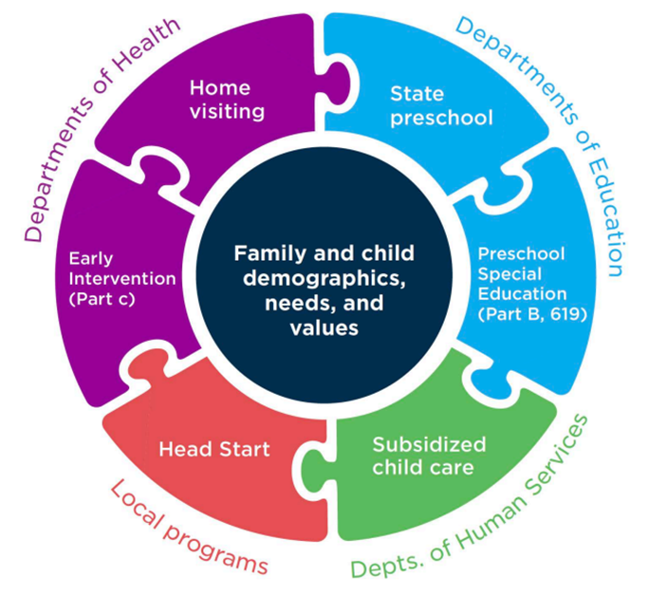
Approach to Early Childhood Systems
Publicly available programs are offered in a host of settings, administered differently, funded in various ways, and may have different standards
Child/Family experiences influenced by different system structures and policies
Program data are often housed within different state and federal agencies and in different data systems

Slide 13
Focal Populations
Black, Hispanic/ Latino, and Indigenous families
Families with multilingual learners
Families of children with disabilities or developmental delays
Preschool workforce members
Children in immigrant families
Families experiencing poverty

Slide 14
Intersectionality
The interconnected nature of social categorizations such as race, class, and gender, regarded as creating overlapping and interdependent systems of discrimination or disadvantage.
Having intersecting marginalized identities can compound and exacerbate challenges related to access and experiences in early childhood education and development programs and beyond.
For example, Black children with disabilities are suspended at disproportionately higher rates than White and Hispanic children and children without disabilities.

Slide 15
STEP Forward with Data Framework Structure
STEPS
ESSENTIAL QUESTIONS
METRICS
Supply Essential Questions
Supply
Outreach
Enrollment
Learning Experiences
Transitions
Administration
Essential Question Metrics
Data Sources
Data Collection
Data Analysis
Outreach Essential Questions
Enrollment Essential Questions
Learning Experiences Essential Questions
Transitions Essential Questions
Administration Essential Questions

Slide 16
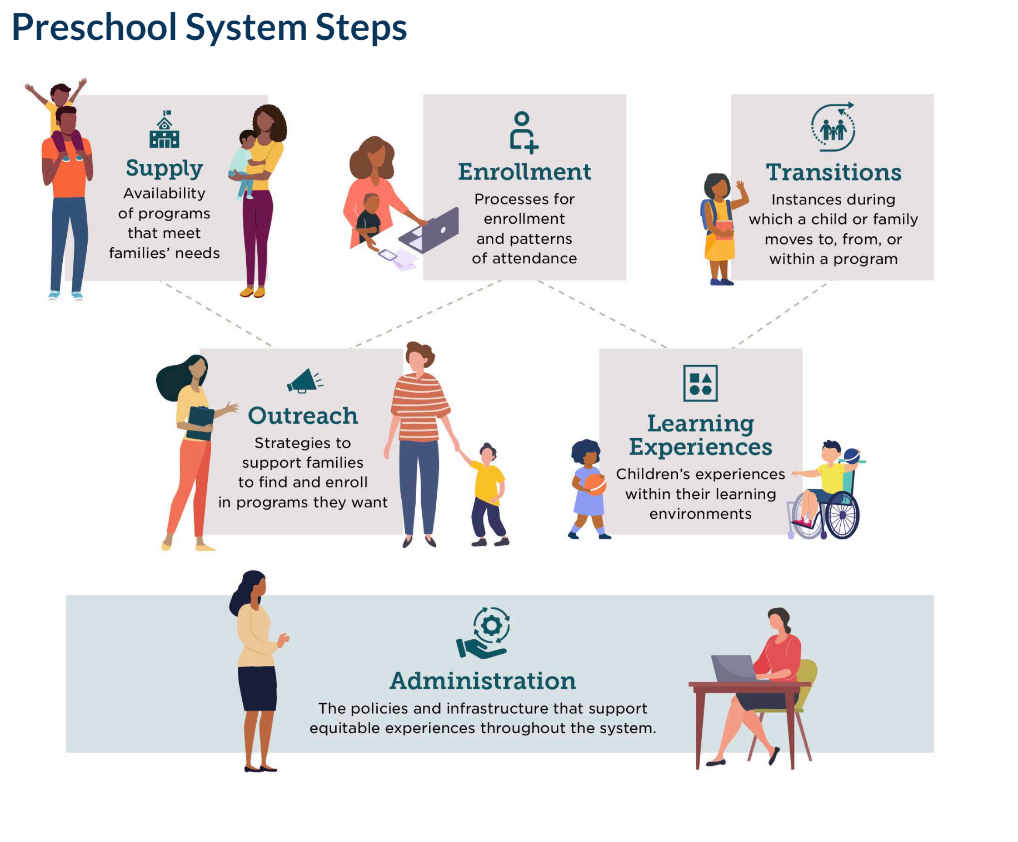
STEP Forward with Data System Steps

Slide 17
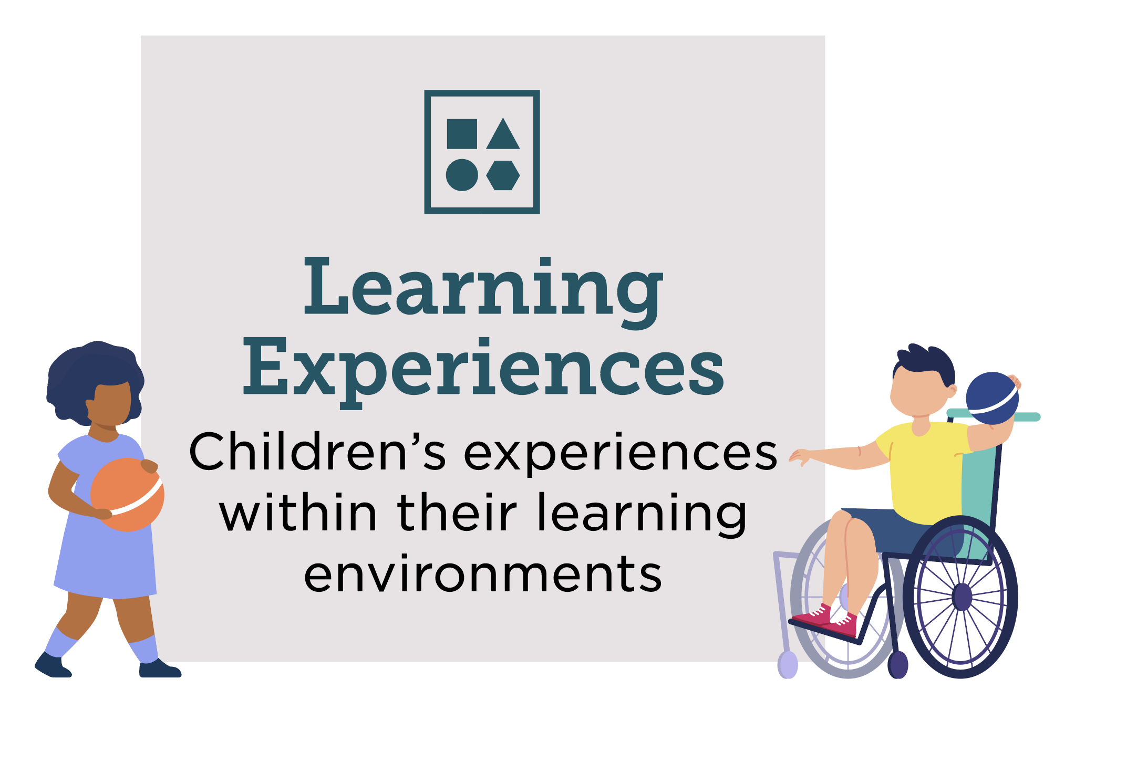
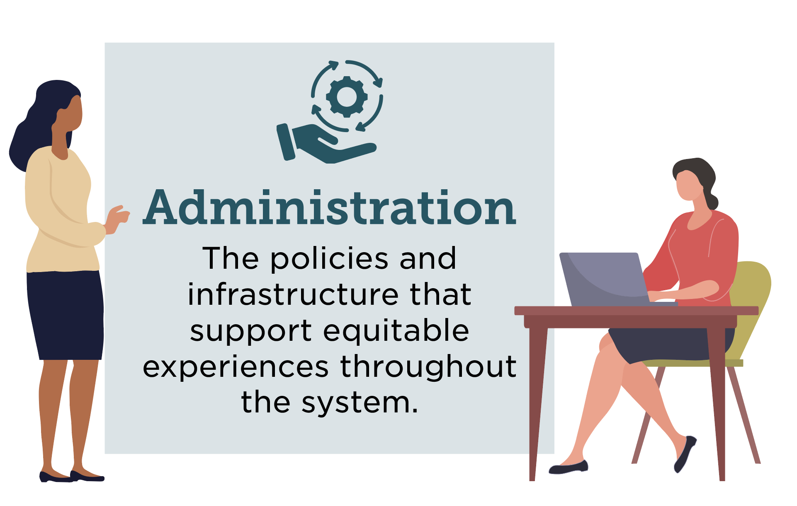
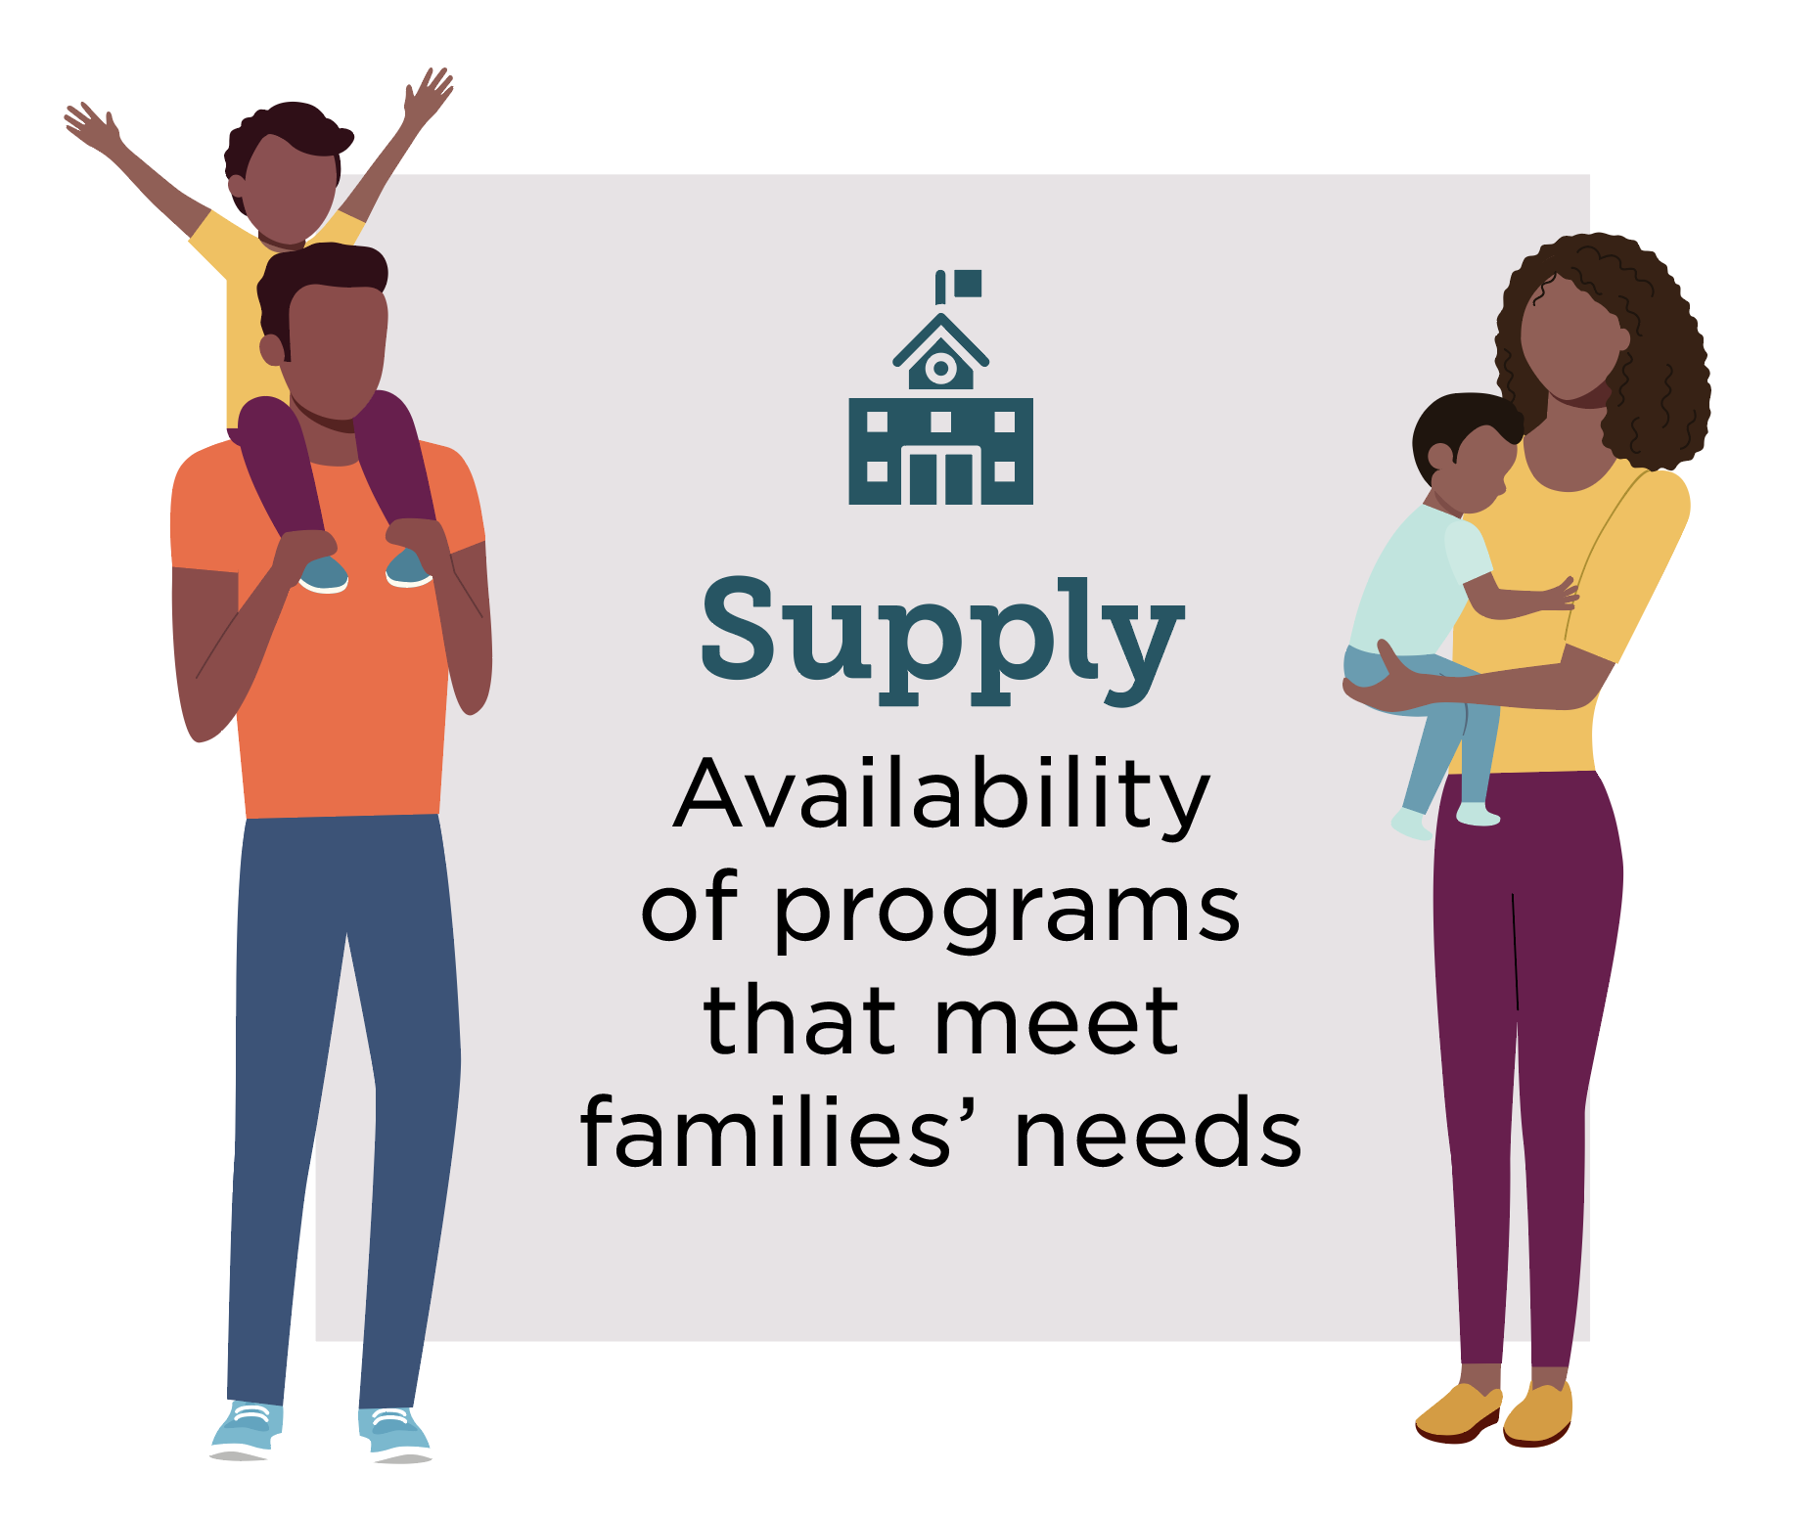
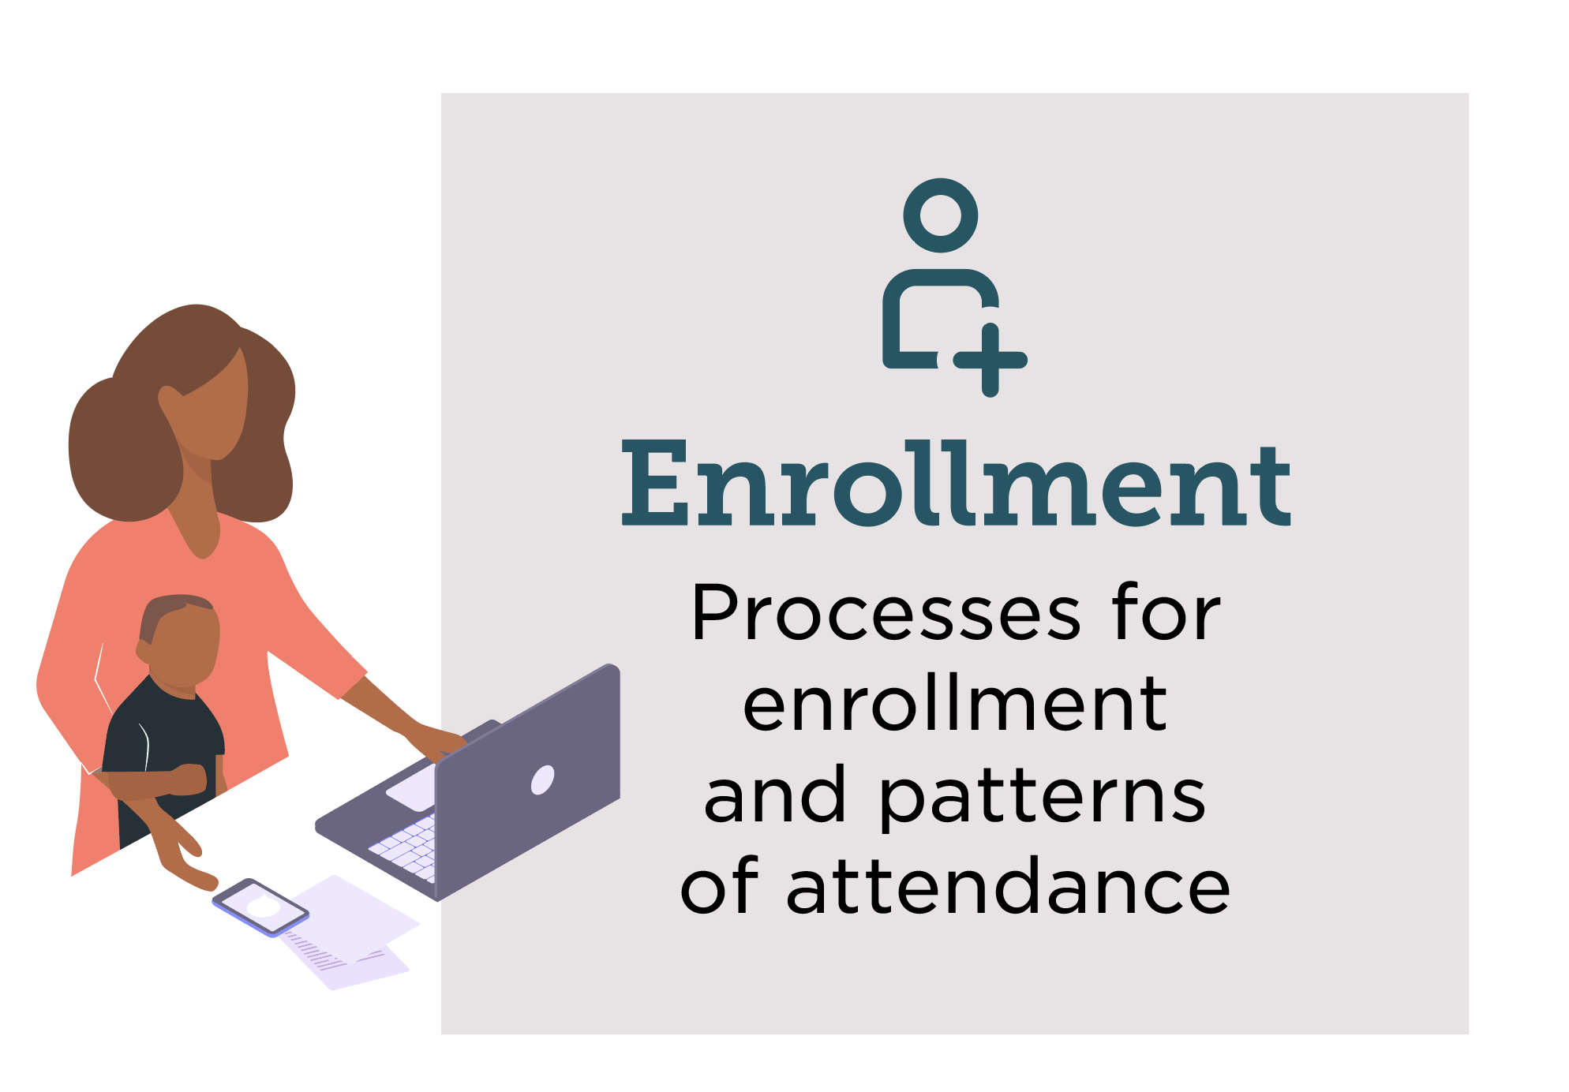
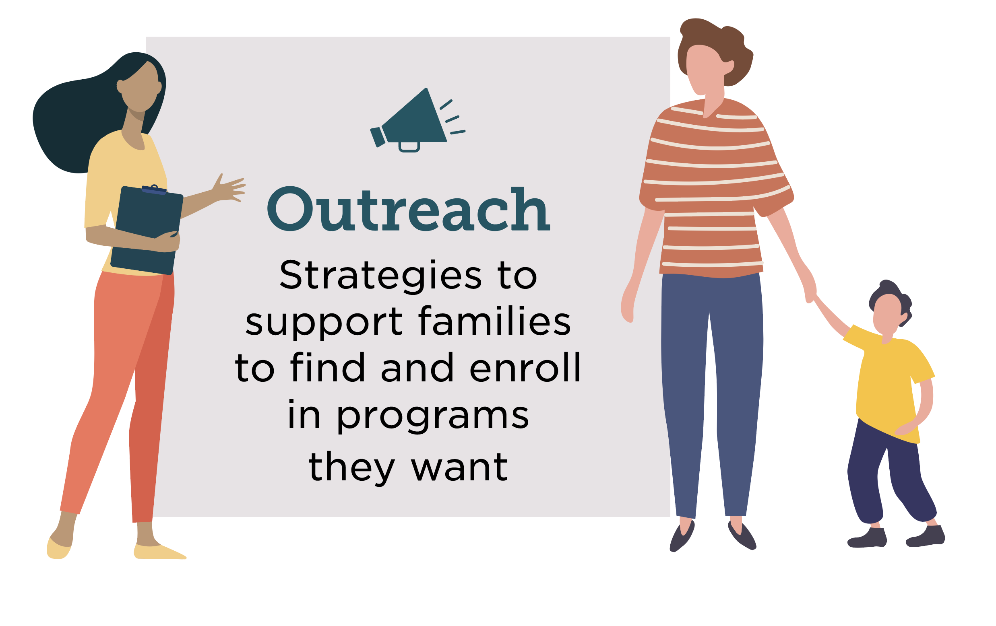
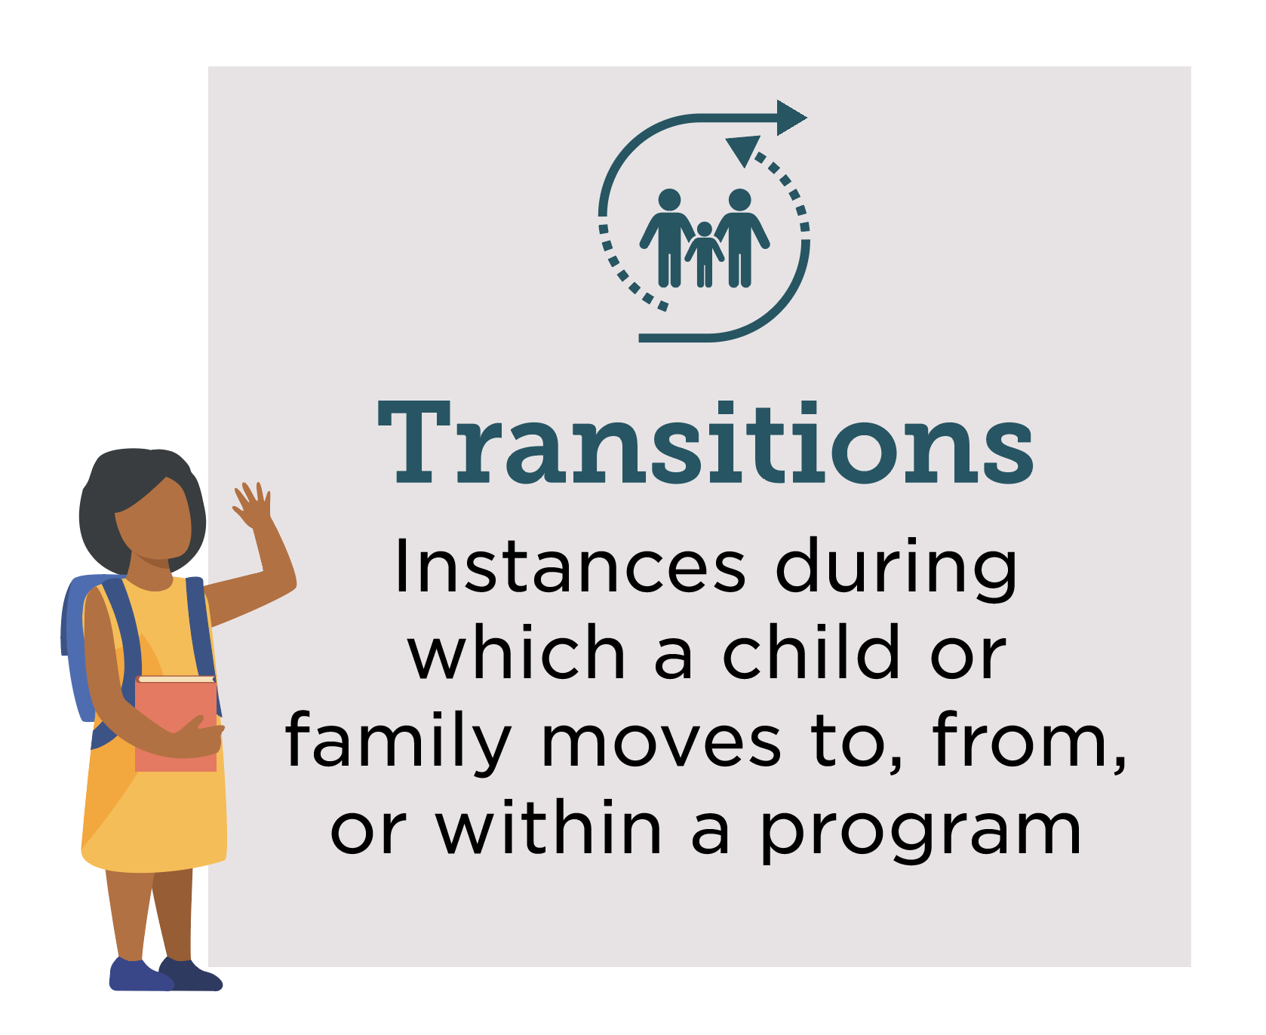
STEP Forward with Data Essential Questions
Learning Experiences
Are the identities of focal children and families reflected in programs?
Do workforce members receive training in supporting the needs of focal children and families?
Do focal children experience equitable discipline practices?
Do focal children have learning accommodations they need?
Does the program offer or connect families with whole family services?
Are multiple forms of evidence used to understand a focal child’s developmental progress, strengths, and needs across domains of development?
Do focal children attend programs in facilities that meet basic health and safety requirements?
Administration
Are focal families and workforce members engaged in shared leadership?
Are there funding mechanisms to support equitable experience for focal children, families, and workforce members?
Is there system-level guidance for how to support equitable experiences for focal children, families, and workforce members?
Are there mechanisms to support equitable experiences for workforce members from focal populations?
Supply
Does existing supply meet focal families’ needs?
Enrollment
Do enrollment procedures support focal families to attend programs they want?
Are focal children enrolled in proportionate or higher to their representation in the community?
Are focal children enrolled in programs rated as high-quality proportionate to their representation in the system?
Do focal children have consistent attendance?
Outreach
Do outreach strategies improve focal families’ knowledge and understanding of their options?
Do eligibility processes allow focal populations to attend programs they want?
Transitions
Do transition activities meet focal families’ needs?
Are focal children reaching developmental and learning milestones when transitioning to K?

Slide 18
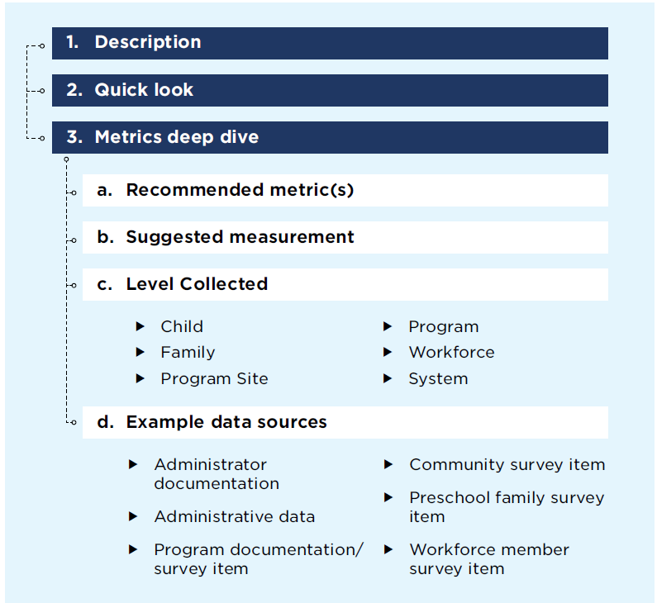
How the STEP Forward with Data Framework is organized

Slide 19
Quick Look

Slide 20
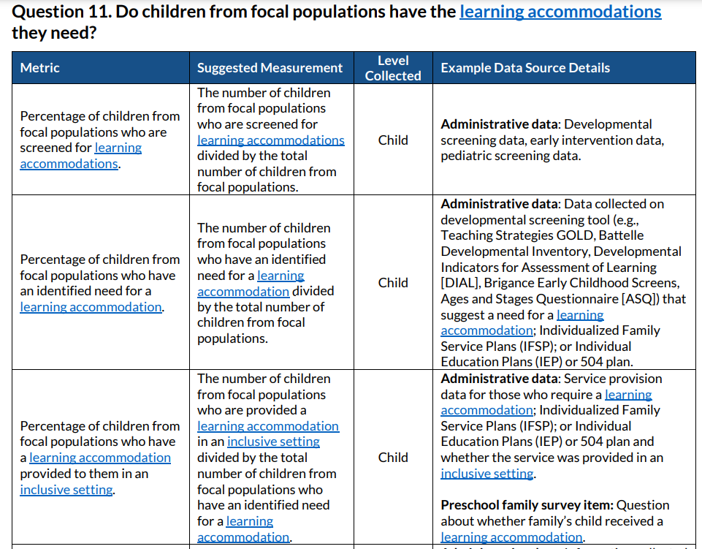
Deep Dive

Slide 21
Systems Approach
Outcomes Metrics:
Measure individual level outcomes
System Metrics:
Measure system policies and conditions that influence individual outcomes
Ex: Percentage of children who do not experience any of the following: in-school suspensions, out-of-school suspensions, disciplinary use of restraint and seclusion, or expulsions.
Ex: Presence of program-level policies aimed at offering alternative approaches to negative discipline and promoting positive behavior supports.

Slide 22
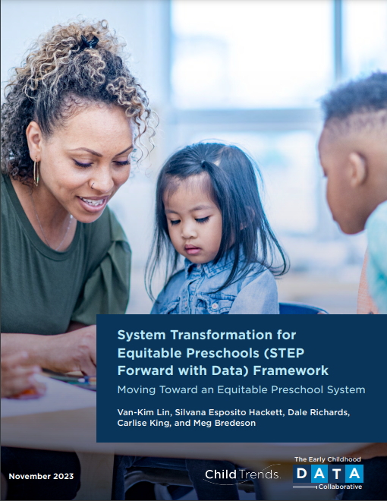
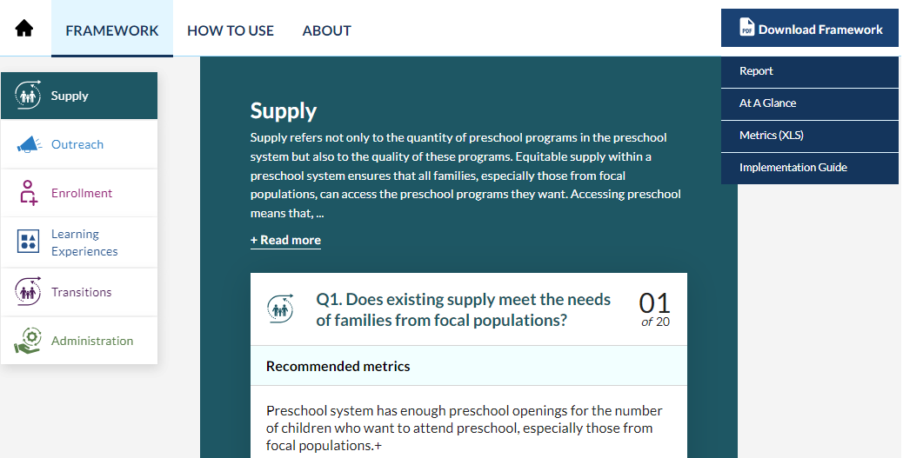
STEP Forward with Data Framework
Access resources at www.ecedata.org
Reach out directly to us at: prekdata@childtrends.org
Report
Interactive website with additional resources
Implementation Guide

Slide 23
Let’s Practice Activity
Look at the handout at your table (Part 1)
Which STEP Framework step(s) are a focus area for your team?
Which Essential Question(s) from the STEP Framework is your team interested in exploring?
What challenges exist in answering these questions?
What relationships does our team have with early childhood partners that can be leveraged to help answer these questions?

Slide 24
DaSy Data System Framework
Notes:
Kathy -Who is familiar with it? Who has used it? Take a few mins – look at it. Copies on the table
Now you are going to hear about a different way of talking about a framework. Remember frameworks are tools. Different tools serve different purposes.

Slide 25
The DaSy Data System Framework: What is it?
The Data System Framework specifies in detail the characteristics of a high-quality state data system
The Framework answers the question “What does a high-quality state data system for Part C or Part B 619 look like?”
Notes:
Kathy

Slide 26
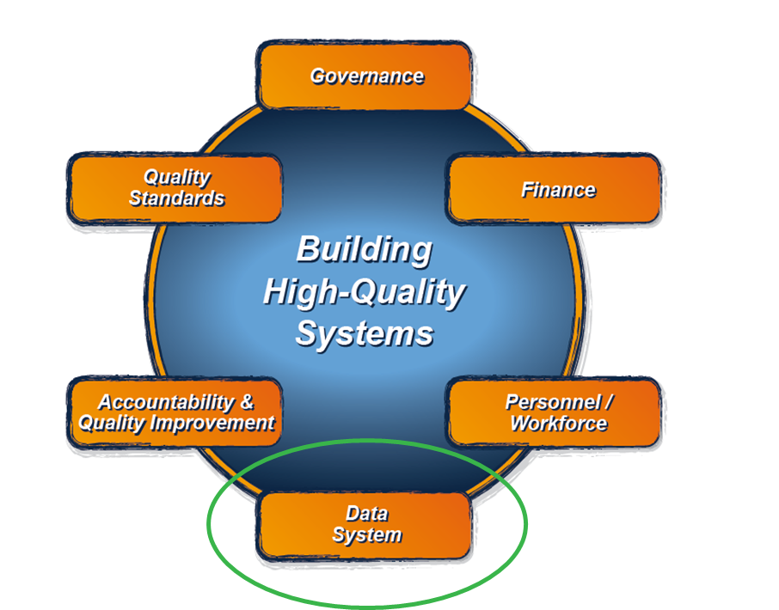
The DaSy Data System Framework: What is it?
It is the Data System component of the larger ECTA System Framework for Part C & Section 619.
The ECTA components are being revised and will be available in the coming months.
https://ectacenter.org/sysframe/
Notes:
How many of you are familiar with the ECTA framework?

Slide 27
Purpose of the DaSy Data System Framework
Enhance the capacity of Part C and Section 619 state staff to:
understand the characteristics of a high-quality data system, so they can
lead or actively participate in state data system development and enhancement efforts, so they can
use data for reporting and to answer important questions, which will
enable states to continuously improve their system of services in order to achieve positive outcomes.
Notes:
Data-informed decision-making is at the heart of improving the operation of the program and provision of evidence-based practices and supports
Reminder about supports available to help use the Framework and Self-Assessment

Slide 28
How DaSy Uses “Data System”
Data System refers to the hardware, software, and other applications and processes that enable Part C and Part B Section 619 programs to collect data about children, families, workforce, and/or program characteristics (e.g., program quality), as well as the analysis, reporting, and data use practices associated with those data.
Notes:
Data system is conceptualized broadly in the DaSy framework. It refers to the hardware, software, and other applications that enable Part C and Section 619 programs to collect data about children, families, workforce, and/or program characteristics (e.g., program quality), as well as the analysis, reporting, and data use practices associated with those data.

Slide 29
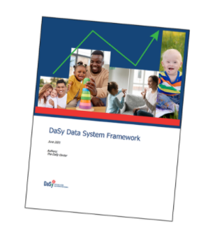
DaSy Data System Framework and Self-Assessment Tool
The Data System Framework and Self-Assessment Tool are available at: https://dasycenter.org/resources/dasy-framework-2022/
Notes:
Framework was revised in 2022.

Slide 30
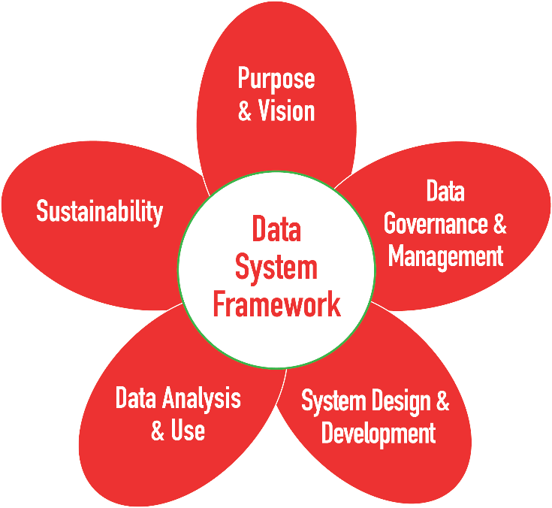
Five Subcomponents of the DaSy Framework
Notes:
The data system framework consists of 5 subcomponents..

Slide 31
Five Subcomponents of the DaSy Framework
Mission, usage, goals of the data system

Slide 32
Five Subcomponents of the DaSy Framework
Mission, usage, goals of the data system
Policies, roles, responsibilities, and procedures
Notes:
Includes privacy and confidentiality provisions, data security

Slide 33
Five Subcomponents of the DaSy Framework
Mission, usage, goals of the data system
Policies, roles, responsibilities, and procedures
Functional and technical requirements of the database applications
Notes:
Data system is conceptualized broadly in the DaSy framework. It refers to the hardware, software, and other applications used in the collection of data as well as the analysis, reporting, and data use practices associated with those data.
The data system framework consists of 5 subcomponents..

Slide 34
Five Subcomponents of the DaSy Framework
Mission, usage, goals of the data system
Policies, roles, responsibilities, and procedures
Data availability, processes for analysis, data leadership and ongoing use
Functional and technical requirements of the database applications
Notes:
Data system is conceptualized broadly in the DaSy framework. It refers to the hardware, software, and other applications used in the collection of data as well as the analysis, reporting, and data use practices associated with those data.
The data system framework consists of 5 subcomponents..

Slide 35
Five Subcomponents of the DaSy Framework
Mission, usage, goals of the data system
State’s capacity to support the database application over time
Policies, roles, responsibilities, and procedures
Data availability, processes for analysis, data leadership and ongoing use
Functional and technical requirements of the database applications
Notes:
Data system is conceptualized broadly in the DaSy framework. It refers to the hardware, software, and other applications used in the collection of data as well as the analysis, reporting, and data use practices associated with those data.
The data system framework consists of 5 subcomponents..

Slide 36
Structure of the DaSy Framework
Subcomponents (5)
Sections
Quality Indicators
Elements of quality
Notes:
KATHY: (notes)

Slide 37
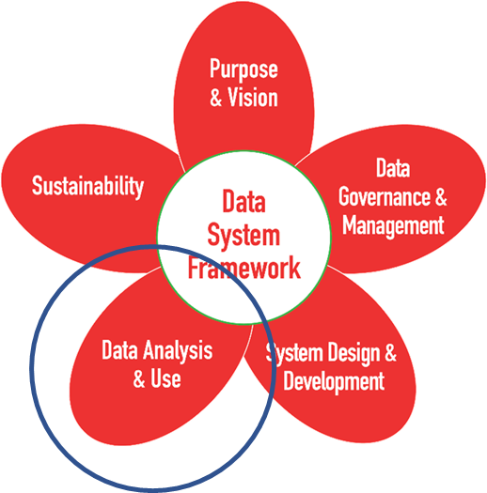
Data Analysis and Use
Section 1: Data Availability
Section 2: Data Analysis
Section 3: Data Leadership and Data Use
Notes:
Example of how a subcomponent is divided into sections

Slide 38
Data Analysis and Use
Section 1: Data Availability
Section 2: Data Analysis
Section 3: Data Leadership and Data Use
DU5. Part C/619 state staff lead an ongoing data-informed decision-making process (i.e., review of data analyses, interpret results, and make decisions informed by the data).
Notes:
Example of a quality indicator in a section.

Slide 39
DaSy Critical Questions

Slide 40
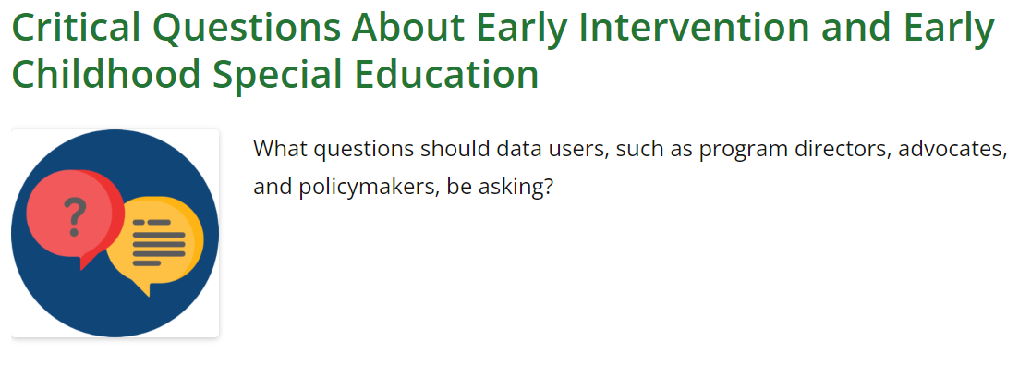
Critical Questions
https://dasycenter.org/resources/critical-questions/
https://dasycenter.org/resources/critical-questions-equity/
Notes:
DaSy has developed 2 sets of Critical questions that are used to assist states as they develop their data systems.
Critical Questions for Addressing Racial Equity in Early Intervention and Early Childhood Special Education
and Critical Questions About Early Intervention and Early Childhood Special Education which are more commonly known as DaSy’s Critical Questions

Slide 41
Similar Formatting
The Critical Questions are grouped into three sections that align with the recommended data elements in Quality Indicator SD3 in the DaSy Data System Framework:
Child and Family Questions
Practitioner Questions
Early Intervention Services (EIS) and Lead Education Agency (LEA) Questions
Includes two types of questions:
Essential
Aspirational
Notes:
Both sets of Critical Questions are very similarly formatted
They are divided into 3 sections: Questions about Children and families, Practitioners, and Local Early Intervention and Local Education Agency
Both sets also include essential questions, these questions are those that a comprehensive, well-functioning state data system should provide the data to answer and aspirational questions, these questions although valuable to ask and answer, are more complex and require more information or more linkages to other data systems than would be expected even with a high-quality system

Slide 42
DaSy Critical Questions
Focus on helping states develop a data system to answer questions that:
Support the state agency in effectively administering the program
Meet accountability requirements for early intervention (EI) and early childhood special education (ECSE)
Improve results for children and families through examination of program features
Notes:
Let's talk first about the DaSy Critical Questions . These are questions that focus on helping states develop a data system that will answer questions to support the state agency in effectively administering the program, meet accountability requirements for EI and ECSE, and improve results for children and families through an examination of program features.
The critical questions are a check on the comprehensiveness of the data your state is collecting. Are you collecting the data elements needed to answer the critical questions? (and are they in the same system? Does your program have the capacity to analyze them?)
These questions were developed about 10 years ago and are referenced in many other DaSy products

Slide 43
DaSy Critical Questions for Addressing Racial Equity
Support states in examining issues of equity in the provision of EI and ECSE services
Include a suggested metric for analysis
Help states identify disparities in their service delivery system
Spark discussion within states and support the long-term goal of equitable access, services and supports, and positive outcomes for all young children and their families, especially those who have been historically underserved
Notes:
DaSy’s Critical Questions for Addressing Racial Equity are newer. These are a set of questions that Part C and Part B 619 programs can use to develop a data system to examine equitable access, service provision, and outcomes
Can be used as a companion document to the original set of DaSy Critical Questions we just talked about
Includes questions that a high-quality state data system should be able to answer
Helps to identify additional data elements the state needs to collect so the state’s data system can address the full range of considerations for equitable service delivery
Includes policy and programmatic questions that help states and local agencies examine equity in the provision of EI/ECSE services.
These questions are also Intended to spark discussion within a program and support the long-term goal of equitable access, services, and supports.

Slide 44
DaSy Data Inquiry Cycle
Embedding Equity in Each Stage
Notes:
DaSy staff developed this resource for Part C and Part B 619 program staff, however, the content is applicable to all early care and education programs. Our goal was to provide program staff with an introductory guide to a data inquiry cycle that also includes equity considerations at each stage of the cycle. The Data Inquiry Cycle is how data should always be used when looking at your state data. You’ll notice the data inquiry cycle formalizes the process and that there are likely many stages you are already incorporating into your practice.
Our why behind this is that we know its critical to addressing disparities in early intervention and early childhood special education systems. We also know that data are essential to identifying disparities, tracking progress, and evaluating the effectiveness of Part C and Part B 619 programs. Data can also highlight the systemic barriers and root causes that prevent equitable access to programs and services

Slide 45
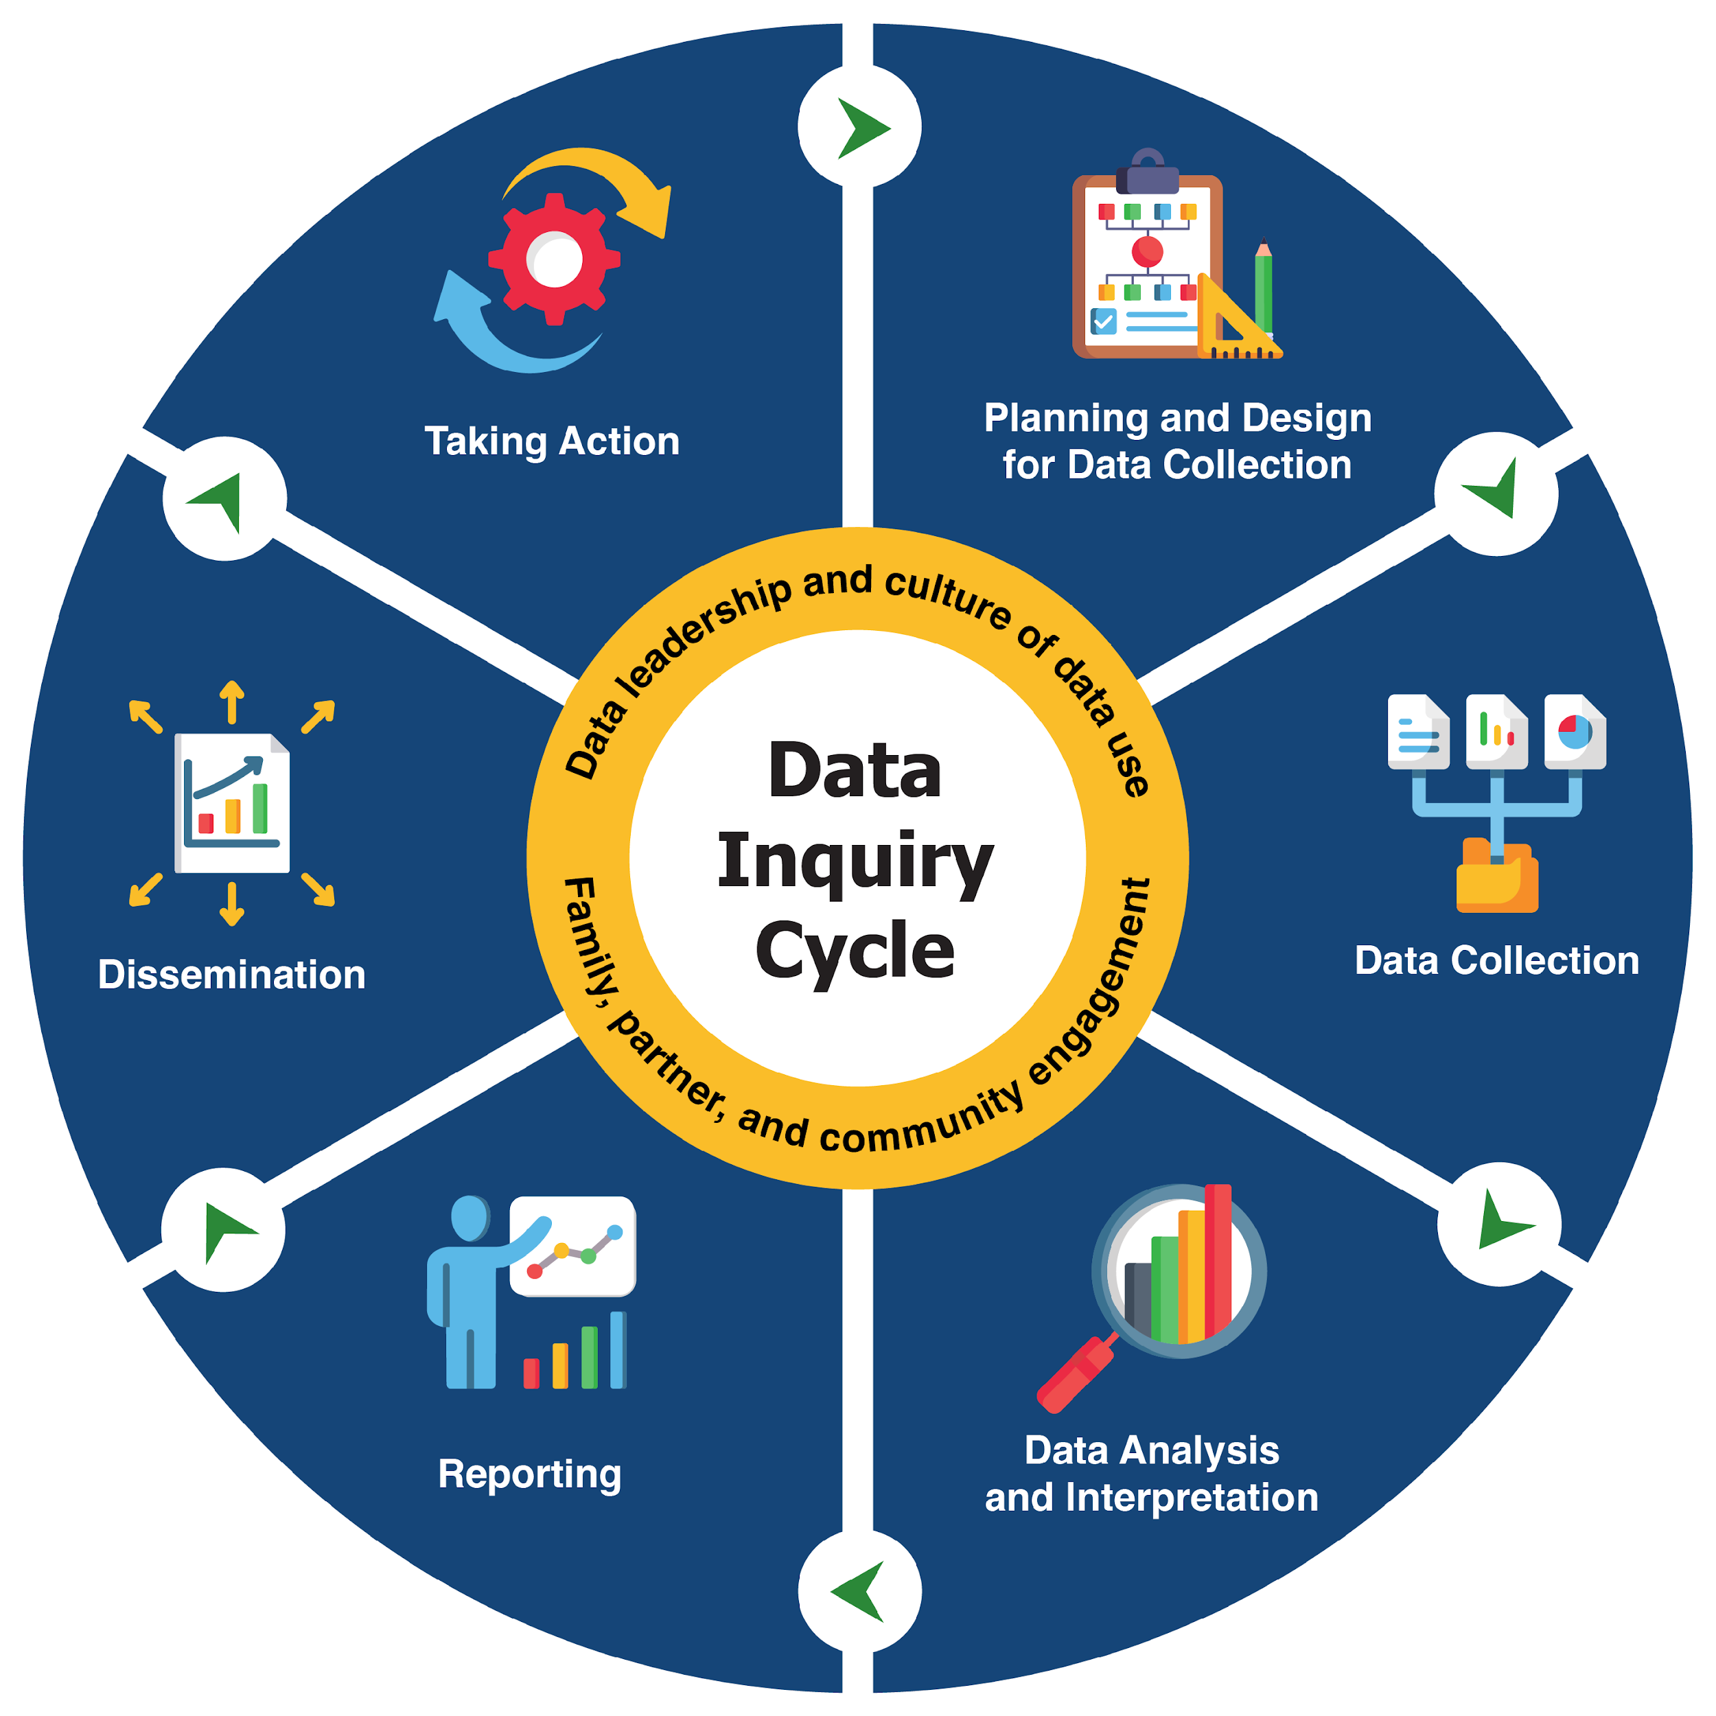
Data Inquiry Cycle
What is equity?
How can data support state programs’ efforts toward equitable systems?
What is the data inquiry cycle?
Why embed equity throughout the data inquiry cycle?
How can we embed equity in each stage of the data inquiry cycle?
What are the essential conditions for embedding equity in the data inquiry cycle?
What can I do next?
https://dasycenter.org/data-inquiry-cycle/
Notes:
So lets break down the components. On the left you will see the main section of the guide. Review sections for the guide
In the graphic on the right, we define the data inquiry cycle as an iterative sequence of six stages: planning and design for data collection, data collection, data analysis and interpretation, reporting, dissemination, and taking action
However, the data inquiry cycle is not a linear process, but an iterative process that states can enter into at any point and choose only one or multiple stages to work on at a time.
On the inner part of the graphic, you will notice the yellow circle – we refer to these as essential conditions for embedding equity – we’ll talk about those later in the presentation.
It’s also worth noting that each stage provides an overview and key considerations as well as links to relevant resources to provide more support such as the DaSy Data Systems Framework, DaSy Equity Statement, Data Leadership Competencies, Data Culture Toolkit, Data Visualization Toolkit, and others
Now that you have a better understanding about layout and sections of the guide, lets dive in to the first stage.

Slide 46
Let’s Practice Activity
Look at the handout at your table (Part 2)
Which DaSy Data Framework components are or should be the highest priority for your team? Or which components is your team currently working to improve?
Which Critical Questions for EI and ECSE or Critical Questoins for Addressing Racial Equity is your team interested in answering? (Does your current data system(s) have the data elements to answer those questions?)
What are the biggest challenges to answering your questions?
Notes:
Part 2

Slide 47
How these frameworks can complement one another

Slide 48
Which framework’s questions do I use?
Children, including children with disabilities, are served by multiple programs.
If you are asking about EI or ECSE, use the DaSy Critical Questions.
If you/your state is interested in children with disabilities in the larger system (especially compared to other children in those programs), use the STEPs framework.
Notes:
Jennifer ---NOTE this is just an example of where some programs sit in states! We know there is variation in the agency that oversees Part C

Slide 49
Which framework’s questions do I use?
DaSy Questions
DaSy Questions
STEP Framework
Notes:
Jennifer

Slide 50
How the Frameworks complement one another
Children under 5 with delays and disabilities and their families
Provides guidance on building a data system to examine critical issues related to services and outcomes for children with disabilities
Identifies focal populations at the center of equitable preschool systems, including children with disabilities
Notes:
Jennifer asks Silvana and Kathy --- How do you see these different tools and frameworks complimenting one another?

Slide 51
How the Frameworks complement one another
Child and family level
Practitioner/Workforce level
LEA\
program level
Notes:
Jennifer asks Silvana and Kathy --- Can you each say a bit more about how states might use these different tools at different levels of the system?

Slide 52
DaSy Critical Question Comparison
1.B.2. How do children enter and move through the early intervention/early childhood special education (EI/ECSE) system(s)?
DaSy Critical Question
STEP Framework Essential Question
Q11. Do children from focal populations have the learning accommodations they need?
Percentage of families from focal populations who report that their program offers transition supports that meet their needs.
Percentage of programs that minimize the number of transitions when supporting children with learning accommodations.
STEP Framework Metrics
Notes:
Jennifer asks Silvana and Kathy – How can these different frameworks and tools be used to help Part C and 619 programs address child level questions?
STEP Framework asks users to think about children’s experiences in early childhood spaces though a systems lens, by examining the conditions of systems that impact successful transitions within and between early childhood programs.

Slide 53
DaSy Equity Critical Question Comparison
1.C.1. Are general early care and education programs providing equitable access to young children with disabilities of all races and ethnicities?
DaSy Equity Critical Question
STEP Framework Essential Question
Q1. Does the existing supply meet the needs of families from focal populations?
Percentage of families from focal populations who were able to enroll in their preferred preschool program
Percentage of program sites where children with a disability or developmental delay are enrolled in which workforce members have early childhood special education training or experience working with children with special needs.
STEP Framework Metrics
Notes:
Jennifer asks Silvana and Kathy – How can these different frameworks and tools help Part C and 619 programs address questions about equity?
STEP Framework asks users to think about children’s experiences in early childhood spaces though a systems lens, by examining the conditions of systems that support access to early care and education for focal populations. Access related metrics aligned with the access framework.

Slide 54
Let’s Practice Activity
Look at the handout at your table (Part 3).
Which framework or tools would you use to:
-plan for or improve data collection
-develop research or policy questions of interest
-assess existing data governance efforts
-explore referrals to IDEA EC programs (relationships & patterns)
-identify non-IDEA data being collected about CWD
Notes:
Large group

Slide 55
Putting the Frameworks to Use
Examples & Discussion
Notes:
Kathy

Slide 56
Framework Use Cases – Developmental Screenings and Child Find
Partnering across ECE programs to:
Examine how many children are receiving no screenings or screenings from multiple programs
Examine how many failed screens are referred to Part C/Part B 619
Use data to track children from referral to evaluation to eligibility to receipt of services
Notes:
Kathy
Developmental screening should/could be occurring in multiple programs. Is it? Are children being served in multiple programs being screened multiple times? Are some children receiving no screening? How does this differ across different groups.
What happens to chidlren who fail a screen?
What happens once a referral is made?

Slide 57
Framework Use Cases – Preschool Inclusion
Partnering across ECE programs to:
Examine how many preschoolers with disabilities are attending inclusive programs
Identify the characteristics of those programs (i.e., quality)
Support general ECE teachers and programs to meet the needs of all children
Notes:
Kathy
Using data from both IDEA and general preschool programs on which programs CWD are attending and where they are receiving the special education services.

Slide 58
Framework Implementation

Slide 59
STEP Framework Implementation
Five activities to determine how to best engage with the Framework:
Define the preschool system
Understand the data landscape
Identify focal populations of interest
Consider data collection practices
Determine data analysis practices

Slide 60
STEP Framework Implementation
Five approaches to selecting a starting point with the Framework:
Start with a full assessment of the preschool system
Start with data strengths
Start with data needs
Start with priority systems areas
Start with priority focal populations

Slide 61
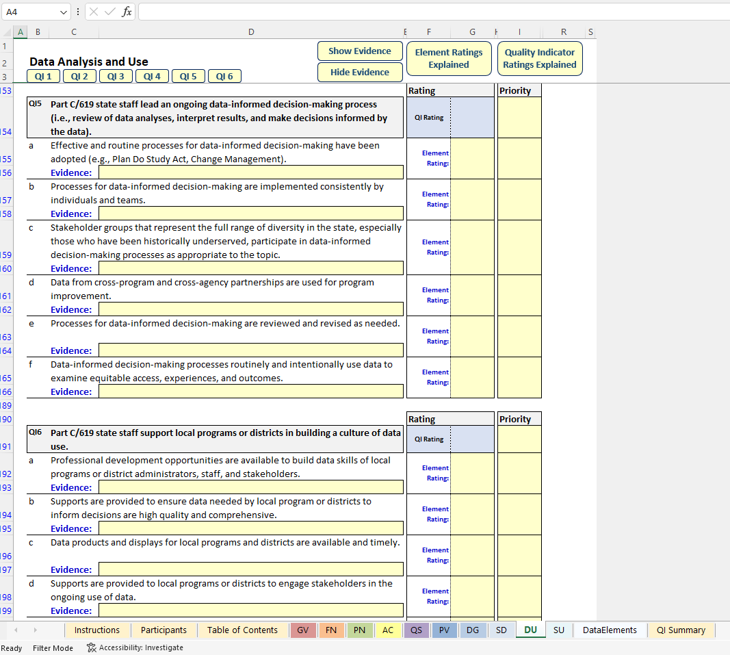
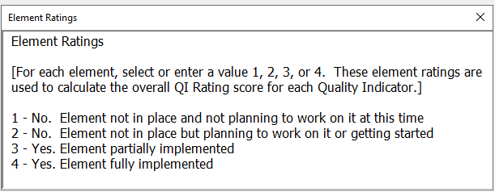
DaSy Data Framework Self-Assessment Tool

Slide 62
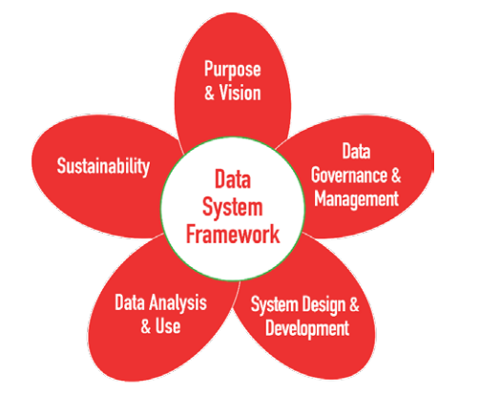
Framework Implementation
Identify priority sub-component(s)
Complete self-assessment
Develop action plan to address areas of greatest need
Implement plan

Slide 63
Let’s Practice Activity
Look at the handout at your table (Part 4)
What are some actions steps I can take?
Who do I need to connect with?
Notes:
KH: Not sure I understand this because the answer to the last one is “all of them” or is that the point, to get the participants to understand that?

Slide 64
Need support?
For DaSy resources contact
your DaSy TA Liaison, or
any DaSy TA provider you are working with, or
contact us through the DaSy web site
For STEP Forward with Data Framework resources
Reach out directly to us at: prekdata@childtrends.org

Slide 65
Thank you! Be sure to fill out your session evaluation. You might win a prize!
Visit us at DaSyCenter.org.
Follow us on LinkedIn: www.linkedin.com/company/dasy-center/
The contents of this presentation were developed under a grant from the U.S. Department of Education, #H373Z190002. The contents and resources do not necessarily represent the policy of the U.S. Department of Education, and you should not assume endorsement by the Federal Government. Project Officers: Meredith Miceli and Amy Bae.

