Slide 1
Automated Sharing of Transition Data: Next Steps for States
Workshop on Data Linking and Integration
#IDIO2024
August 27, 2024
Notes:
Team

Slide 2
Welcome!
Purpose
Introductions
Name
State
Position
Notes:
Ginger

Slide 3
Ice Breaker
What is your current desktop or cellphone wallpaper?
Why did you choose it?
Notes:
Ginger

Slide 4
Agenda
Level setting:
Diagram current processes
Consider opportunities for automation (use case)
Reframing:
Purpose and intent (critical questions)
Partnerships
Plans
Planning forward:
Consult with colleagues
Draft a use case
Set up the first step
Notes:
Ginger

Slide 5
Tools and Resources
Data Linking Toolkit
Data Processes Toolkit
Use Case: Automating Transition Notification
EI/ECSE Critical Questions & Equity Critical Questions
Stakeholder Knowledge Toolkit
Data Governance Toolkit
Notes:
Ginger
Links embedded

Slide 6
Current processes: How do you get data from C to B?
Activity and Discussion
Notes:
Ginger
Introduce transition, from notification to additional data sharing for program benefit. How does the notification and referral take place? What else is shared? Does it start with the resource coordinator sending it to the LEA who sends it on to the SEA, or are referrals batch sent from the program system?
We want you to map out what that looks like for your program. And if you don’t know, that’s ok. Those black boxes are the likely points of improvement.

Slide 7
Process Diagrams
Draw a diagram of your processes to:
Send/receive the transition notification
To SEA and LEA
Share/review EI record (assessments, eligibility, services, etc.), when parents give consent
If you offer the Part C service extension option, include that in your processes.
Notes:
Ginger
Activity: 10 to 15 minutes; share at tables
Who feels like their processes are a bit of a black box, that you aren’t sure how data gets from C to B?
Whose processes are really manual? Whose are more automated? –ask to share examples of each
Looking at your diagram, where are the bottlenecks and unknowns? What does the process fail to achieve compliance, for example?

Slide 8
What’s working… and what isn’t?
Successes
People, e.g. communication/collaboration
Processes
Systems, e.g. data, technology
Compliance
Challenges and break points
People
Processes
Systems
Funding
Notes:
Ginger
What's working well and why does it work well? What are the barriers to keeping things from not working well? What kind of barriers are they (people, processes, technology)? What impact are these barriers/issues having on children and families? What information do they wish they had, but don’t?
Hopes and dreams?—will come back to this later, but begin writing a few notes on what you’d like to change if you could.

Slide 9
State Data Comparisons
Part C
Part B
40% use full year of data
95% ave compliance (55%-100%)
7 reported 100% compliance
5 states reported different full year counts of C to B referrals
82% use full year of data
89% ave compliance (56%-100%)
1 reported 100% compliance
Range of determined not eligible: 0%-36%
Range of parents refusing Part B: 0%-48%
Range of late referrals from C:
0%-19%

Slide 10
Automating Data Sharing
Notes:
Ginger section notes:
Share scenarios as examples of automating notification
Beyond notification: examples and extensions; eg, B sharing back to C
Resist precise definitions and highlight state options

Slide 11
Why Consider Automation?
Reduce common challenges
Duplicated, missing, or late notifications
Disconnected LEA and SEA notification
Inefficient processes
Disorganized or wasteful documentation
Burdened families and lack of service continuity
Achieve additional goals
Reduce staff workload
Increase LEA engagement
Answer more service and program critical questions
Notes:
Ginger
We know that the transition between C and B presents challenges for both programs, and that notification is a key part of that. Common challenges include…
I won’t ask you to raise your hands, but consider which of these have your offices faced recently? If none of these, we need to hear what is working well for your state!
and programs hope to also achieve related goals …
Compliance, correction of non-compl, program improvement (finding missing kids)

Slide 12
Mapping Automation by Frequency: Workload Implications
Real-time Record
System sends individual notifications to LEA in real time
Person sends individual notifications to LEA daily
System automates a periodic aggregate report
Low
High
Degree of Automation
Person sends a periodic auto-generated aggregate report
Person sends a periodic report generated by hand
Frequency
Monthly Report
Notes:
Ginger
States vary in their approach to notification by the format that notification takes, specifically how automated and aggregated the data communication are. So we have several examples here. In the bottom left quadrant of the graph shows a common method of sharing notification data: one person generates a report by hand, maybe listing all the children potentially eligible for Part B services who have reached transition age in the past month. This method is labor-intensive, but it is straightforward. You have verified the list and can then send it to the SEA. This might even be more common at the LEA level, where the number of children could be fairly small. But aggregated reports must be dis-aggregated and processed on the Part B side, leading to a higher workload for staff.
At the top right is an opposite approach: full automation in real time, creating and updating records in both programs without a lot of manual labor. In between are other examples of methods that vary by frequency and degree of automation. None is right or wrong, but they do differ on how they impact the workload at every level and for both EI and ECSE programs. More automation generally means notification is less labor-intensive for everyone involved. And this is one of the primary benefits of moving toward greater data integration: greater work efficiency, likely also generating efficiencies for families and better timeliness in service continuity for children.
Of course, automation still depends on high quality data entry and management at the child record level. If data entry challenges exist, then no process changes will improve the notification process.

Slide 13
Terminology Level Setting
Data Sharing – The practice of providing partners information they can’t access in their own data systems. Data are typically sufficient for recipients’ needs. May occur once or repeatedly.
Data Linking – Manually connecting extracted information about an entity (e.g., child, service provider, service) from one data source with information related to that same entity from another data source. May occur once or repeatedly.
Data Integration – Combining data from disparate sources into a single data system to merge information about entities in one location. Maintained systematically through data management plans.
What’s the Difference Between Data Sharing, Data Linking and Data Integration?
Notes:
For Data Integration –A complete data integration solution encompasses discovery, cleansing, monitoring, transforming and delivery of data from a variety of sources.

Slide 14
Reflection
How automated are your data transfers, and what type of DSLI reflects your current system?
What would you like to do instead?
What opportunities exist for increasing the level of automation?
Notes:
Large group discussion for about 5 minutes or so, to share and generate ideas

Slide 15
Project Buy-in
Data Linking and Intergration for Transition

Slide 16
Being Flexible and Creative
Pull a team together with representation from both programs, state and local
Identify program expectations and needs
Determine shared goals and priorities
Be open to new methods and opportunities
Why are we doing this work?
Who needs to be involved?
What would be best for our state?
How will we use the data?
What elements need to be shared:
for reporting on transition?
for matching at the child level?
For Part C use?
Notes:
This is the core work needed to generate buy-in for the project, a key requirement for success.

Slide 17
Components for Success
Define the purpose and vision
Establish value with partners and leaders
Create one-pager
Elevator speech
Institute data governance processes and procedures
Create legal agreements:
memoranda of understanding (MOU)
data sharing agreements (DSA)
Generate the data inventory

Slide 18
Critical Program Questions
What percent of notifications from Part C to Part B were made in a timely manner?
Why were notifications missing or late?
What percent of the children exiting from Part C at age 3 were found eligible for Part B services?
How many subsequently had an IEP?
After notification, how many children did not have an IEP in place by the third birthday, and why?
Notes:
Some of these critical questions might include:
Share DaSy Critical Questions, https://dasycenter.org/resources/critical-questions/

Slide 19
Notification Data Elements
Required
With Parent Consent
Child name and date of birth
Parent Contact
Name
Home & email address
phone number
Child Part C eligibility category
Part C entry date
IFSP file
Other child and family data (e.g., child race/ethnicity, family language)
Ensuring implementation of IDEA Part B Child Find:
Sharing may also include the Part C service coordinator’s name and contact information as well as the language(s) spoken by the child and parent(s) to assist with meeting Part B’s child find responsibilities.
Notes:
What other data elements do they share with parent consent?
Background:
Policy Letter, https://sites.ed.gov/idea/idea-files/policy-letter-march-17-2023-to-nix/
The transition notification to the LEA and SEA must include the child’s name, date of birth, and parent contact information (name, home and email address, telephone number). 34 C.F.R. §§ 303.209(b)(1)(i) and 303.401(d). The transition notification by Part C to the SEA and appropriate LEA is critical to ensure that Part B can meet its responsibilities. The purpose of the transition notification is to ensure implementation of the IDEA Part B child find mandate in 34 C.F.R. § 300.111. Thus, the transition notification to the LEA/SEA may also include the Part C service coordinator’s name and contact information as well as the language(s) spoken by the child and parent(s) to further assist the LEA and SEA in meeting their child find responsibilities.

Slide 20
Break Time
This Photo by Unknown Author is licensed under CC BY-SA
Notes:
15 minute break

Slide 21
Designing a Use Case
Planning for Automation
Notes:
Amy

Slide 22
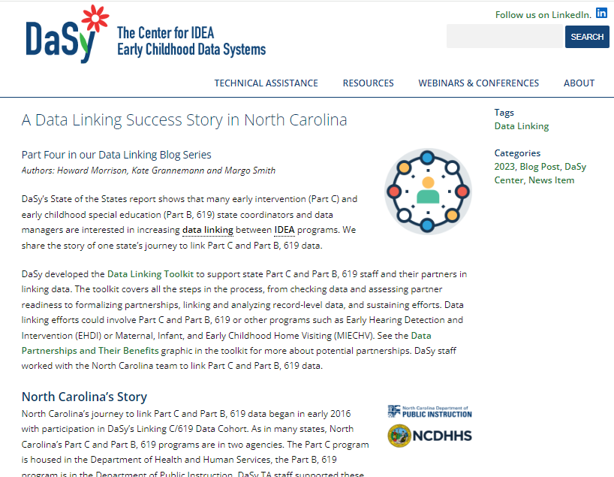
Integration Inspiration: A Data Linking Success Story in North Carolina
DaSy Blog (2023)
https://dasycenter.org/data-linking-success-story-north-carolina/
Leverages Early Childhood Integrated Data System (ECIDS) for shared unique ID
Transition-Related Analysis Plan – Initial Steps
Critical Questions
Considerations
Data Sets/Data Elements
Notes:
Amy
Handout – NC analysis plan

Slide 23
General Steps
Articulate the purpose/goal.
Identify the question(s) you want to answer.
Identify the primary users/audience for this information.
Define what data are needed to answer the question(s) of interest.
Review current processes for how the needed data are collected.
Identify changes/modifications required to data collection and sharing practices, if any.
23
Notes:
Amy

Slide 24
Planning Time!
First, take a few moments to share pertinent background information with your tablemates.
Share your process diagram, if needed.
As you plan: think big, start small.
What's your "pie in the sky" dream for automation?
How can you start now to make that dream come true?
Notes:
Amy
Handout - template

Slide 25
Table Discussion Topics
Data governance
Training/professional development
State and local data use
Collaborative data analysis
Data quality
Follow-up/technical assistance
Notes:
Amy
Handout - prompts

Slide 26
Closing Discussion
Planning for DSLI

Slide 27
Immediate Next Steps
Set an outreach goal for next week when you return:
Who can you pull together to support your work on the use case and the project?
Who should you speak to about generating support for changing the transition data processes?
Begin to plan additional next steps:
What data do you need to review to build your case for change?
What timeline and goals can you set in place?
What vision can you set for the project?
What roadblocks should you anticipate?
Contact your DaSy liaison for support!
Notes:
Data linking and integration take time, expertise and state commitment. Let’s review some potential next steps for you to consider.
What’s one thing you’ll commit to when you get home? Have share out.

Slide 28
Additional Resource Links
Data Linkages Between Part C and Part B – Transition Notification
What’s the Difference Between Data Sharing, Data Linking and Data Integration?
OSEP Response to Nix 03-17-23
Checklist and Tips for SPP/APR Indicator C-8(B) Early Childhood Transition Notification
Checklist and Tips for SPP/APR Indicator B-12 Early Childhood Transition Timeliness
Notes:
As mentioned, DaSy and other TA centers have a variety of resources you can use to support your data communication improvement efforts for transition. And if you haven’t read it yet, please check out the Letter to Nix about confirming that notification is referral.

Slide 29
Thank you! Be sure to fill out your session evaluation. You might win a prize!
Visit us at DaSyCenter.org.
Follow us on LinkedIn: www.linkedin.com/company/dasy-center/
The contents of this presentation were developed under a grant from the U.S. Department of Education, #H373Z190002. The contents and resources do not necessarily represent the policy of the U.S. Department of Education, and you should not assume endorsement by the Federal Government. Project Officers: Meredith Miceli and Amy Bae.

