Slide 1
Data Beyond IDEA: What Our Partners Know that You Should, Too!
Jennifer Tschantz, DaSy
Howard Morrison, DaSy
Sharon Walsh, DaSy
Ginger Elliott-Teague, DaSy
Deborah Ziegler, DaSy
#IDIO2024
August 27, 2024
Notes:
Jennifer

Slide 2
Planning Team
Purpose
Timeline
Participants
Jennifer Tschantz, DaSy
Ginger Elliott-Teague, DaSy
Howard Morrison, DaSy
Sharon Walsh, DaSy
Deborah Ziegler, DaSy
Notes:
Jennifer

Slide 3
Agenda
Icebreaker
Overview of Resource
Data Examples
Group Discussion
Data use
Product feedback
Closing & Next Steps
Notes:
Jennifer

Slide 4
Session Objectives
Build awareness of the data available from national EC partners (e.g., Head Start and child care)
Explore how to access and use data available from nation EC partners,
Consider critical questions that can only be answered using partner data, and
Provide feedback on a resource being developed by DaSy to support data sharing and data use.
Notes:
Jennifer

Slide 5
Icebreaker
Who is in the room?
At your table take 5 minutes and discuss:
Data from other sources that you already use; or
Data from other sources that you’d like to learn about and use
Large group Share
Notes:
Jennifer

Slide 6
Overview of New Resource
Notes:
Howard

Slide 7
New Resource
Review Resource
General format and readability
Content
Critical Questions
Obtain Feedback
Is the content useful and relevant
Are there additional data resources you think should be added

Slide 8
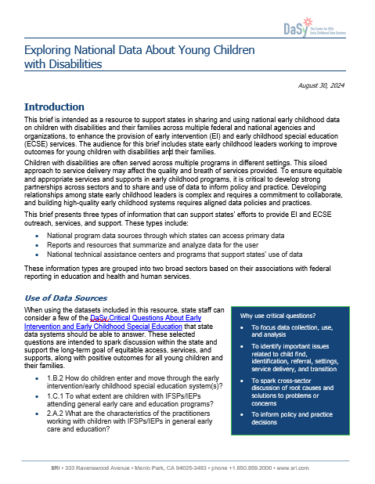
Exploring National Data About Young Children With Disabilities
Introduction
Use of Data Sources
Considerations When Exploring the Data
Data, Reports and Supports
U.S. Department of Education
Data and Reports
Supports
U.S. Department of Health and Human Services
Data and Reports
Supports
Next steps
Notes:
Howard

Slide 9
Use of Critical Questions
Notes:
DaSy has developed 2 sets of Critical questions that are used to assist states as they develop their data systems.
Critical Questions for Addressing Racial Equity in Early Intervention and Early Childhood Special Education
and Critical Questions About Early Intervention and Early Childhood Special Education which are more commonly known as DaSy’s Critical Questions

Slide 10
Example Critical Questions
1.B.5.a. What percentage of children with IFSP/IEPs are receiving IDEA services in settings that are for all children (e.g., state-operated prekindergarten, Head Start)?
1.B.5.e. What is the quality of the general early care and education settings in which young children with disabilities receive IDEA services?
1.C.1.a. What percentage of children enrolled in EI/ECSE are served in general early care and education programs3 (e.g., Early Head Start, Head Start, home visiting, child care, state Pre-K)? How does this compare with the overall population of children birth to age 5 in the state?

Slide 11
Examples
CAPTA and IDEA
Head Start and IDEA
Notes:
Sharon and Howard

Slide 12
CAPTA: Authority under Federal Law
The Child Abuse Prevention and Treatment Act (CAPTA), as amended by P.L. 111–320, the CAPTA Reauthorization Act of 2010, affirms, “Each State to which a grant is made under this section shall annually work with the Secretary to provide, to the maximum extent practicable, a report that includes the following:”
The number of children determined to be eligible for referral, and the number of children referred to agencies providing early intervention services under part C of the IDEA
Notes:
Let’s look at a few of these data sources and discuss how these data may be helpful to us in Part C.

Slide 13
2022 Data Available
Includes state-by-state reported data on number of children B-3:
With substantiated abuse or neglect; and
Of those children, how many were referred to Part C of IDEA.
Page 92 of PDF Report – Table 6-8
38 states reporting how many children were eligible to be referred to Part C
32 states reporting how many eligible children were referred
31 states reporting both eligible and referred

Slide 14
CAPTA Data
“Child Maltreatment Report 2022”
Released by Children’s Bureau at ACF under HHS
https://www.acf.hhs.gov/cb/data-research/child-maltreatment
National data collection and analysis of available state child abuse and neglect information
Notes:
CAPTA – PDF – Page 80
Show a few states and discuss limitations and opportunities
Caution: These data are not reported by every state and some of the abuse and neglect data are duplicated
Offers opportunity for child find activities and working with your child welfare agency about their policies and procedures related to referral to Part C and their submission of data related to part C.
Lets’ look at a state together.
Are any of you using these data? Can you share a bit for us?

Slide 15
Accessing Head Start Data
Current Head Start Enterprise System (HSES) users have access to the full PIR dataset via the “All Users: PIR Reports” tab at https://hses.ohs.acf.hhs.gov.
PIR Disability Services Report
provides comprehensive data on the services, staff, children, and families served by Head Start and Early Head Start programs nationwide
National-level data on children with disabilities and their families include program information, funded enrollment, cumulative enrollment, and disability services.
HSES Help Desk
Email: help@hsesinfo.org
Toll free: 866-771-4737
Email to request username and password

Slide 16
Example State Table 1

Slide 17
Example State Table 2

Slide 18
Example State Table 3

Slide 19
Example State Table 4

Slide 20
Let’s Pick a State
Review Filtering
Discuss Acronyms
Availability of EHS and HS

Slide 21
FY 2021 CCDF Data
AFC Preliminary data on the average monthly percentages of children with disabilities benefitting from CCDF:
https://www.acf.hhs.gov/occ/data/fy-2021-preliminary-data-table-21
NOTES:
This table provides a snapshot of the progress States are making in reporting these data, and should not be used to describe the national landscape of children with disabilities receiving child care services
Definition of child with disability is broader than those receiving IDEA services
Notes:
5 min Jennifer – another example of data that are available. Given the caveats around these data they might be good conversation starters in your State!

Slide 22
Group Discussion
Join a small group of 4-6 people
Choose a facilitator; a recorder; someone to report out
Small group discussion questions:
What actions could you take related to using other data for improving your system?
What feedback can you provide about the new resource?
Format
Readability
Content (Usefulness and relevance)
Additional data to include
Notes:
Jennifer
20 min

Slide 23
Next Steps
Sharing this resource with relevant colleagues within their program and discussing possible activities for state teams.
Reviewing the resource and identifying datasets that could enhance or provide additional context to existing data.
Meeting with cross-sector partners to discuss the implications of the data available to identify possible partner collaborative activities.
Contacting your DaSy TA Liaison for additional support.

Slide 24
What Can DaSy Do for You?
Support the identification and prioritization of critical questions
Champion the use of partner data
Consult on data sharing, linking or integration efforts
Facilitate the use of the Data Linking Toolkit

Slide 25
Thank you! Be sure to fill out your session evaluation. You might win a prize!
Visit us at DaSyCenter.org.
Follow us on LinkedIn: www.linkedin.com/company/dasy-center/
The contents of this presentation were developed under a grant from the U.S. Department of Education, #H373Z190002. The contents and resources do not necessarily represent the policy of the U.S. Department of Education, and you should not assume endorsement by the Federal Government. Project Officers: Meredith Miceli and Amy Bae.

