Slide 1
Cultivating Competencies: Growing the Community of Part C Data Managers
Annie Converse, AZ Part C
Stephanie Donald, SC Part C
Colleen O’Connor, MI Part C
Beth Scully, CO Part C
#IDIO2024
August 28, 2024

Slide 2
Welcome!
Reminder: please to use the #IDIO2024 hashtag
Who is in the room?
Data Manager Meeting Icebreaker Discussion

Slide 3
Agenda
DaSy (The Center for IDEA Early Childhood Data Systems) Overview
Part C Data Manager Opportunities
Part C Data Manager Panel
MyDaSyTA and Upcoming Activities
What can DaSy do for you?

Slide 4
DaSy Overview

Slide 5
DaSy Overview
Office of Special Education Programs (OSEP) Technical Assistance (TA) Center
Works with states to support Individuals with Disabilities Act (IDEA) early intervention and early childhood special education programs
Build high-quality data systems
Use data to improve results for young children with disabilities and their families

Slide 6
DaSy Vision and Mission
Vision: States and entities use data to improve programs and ultimately equitable outcomes for young children with disabilities and their families.
Mission: The DaSy Center builds relationships and provides high quality technical assistance (TA) to build the capacity of states to collect, report, analyze, and use data in Early Intervention and Early Childhood Special Education for program improvement and federal reporting.

Slide 7
DaSy’s Work
Knowledge Development
State of the States Data Systems
Data System Framework
Critical Questions
TA and Dissemination
Universal, targeted, and intensive TA
Develop guidance documents and tools
Leadership and Coordination
National projects and organizations

Slide 8
Part C Data Manager Opportunities

Slide 9
Part C Data Manager Opportunities
Monthly Community Calls
In-person Convenings
New Data Manager Orientation
Community of Practice
Data Leadership Competency Group
Office Hours
Child and Family Outcomes Office Hours
EC Data U
Advisory Board
Notes:
Ask participants by show of hands who has participated in each opportunity

Slide 10
Part C Data Manager Panel
Participation in the Data Manager Opportunities

Slide 11
Panel Questions (1 of 7)
Monthly Data Manager Community Calls
What are some key topics typically covered in the Data Manager Community calls?
How have these calls helped data managers in their day-to-day work?

Slide 12
Panel Questions (2 of 7)
Data Manager Community of Practice
How do the CoP sessions support data managers?
Can you share a success story or an example of how a data manager(s) benefited from these sessions?

Slide 13
Panel Questions (3 of 7)
Data Leadership Competencies
What is the purpose of the Data Leadership Competency Group, and who is it designed for?
How has this orientation program helped in developing leadership skills among data managers?

Slide 14
Panel Questions (4 of 7)
In-person Convenings
What role do the convenings play in shaping the community’s direction and activities?
Can you provide examples of key outcomes or support that resulted from these gatherings?

Slide 15
Panel Questions (5 of 7)
Idea Exchange
What are some innovative ideas or practices you have seen that could benefit other data managers?
How can these opportunities better facilitate the exchange of ideas and experiences among its members?

Slide 16
Panel Questions (6 of 7)
Leveraging Opportunities
How can data managers leverage the opportunities presented by the DaSy communities to enhance their roles and expand their networks?
What specific steps can data managers take to maximize the value of these engagement opportunities?

Slide 17
Panel Questions (7 of 7)
Future Directions
What would you like to see for future directions or upcoming initiatives for the communities?
How can data managers contribute to and shape the future of the communities?

Slide 18
MyDaSyTA and Upcoming Activities

Slide 19
MyDaSyTA
MyDaSyTA:
is an interactive online platform for Part C and Part B 619 state staff and partners working with the DaSy Center
supports opportunities for virtual TA, including online learning communities, topic cohorts, and intensive TA with states
members can join different communities depending on their role and involvement in TA with DaSy
Notes:
Show MyDaSyTA on screen.

Slide 20
Upcoming Activities
EC Data U
Revamp of Data Manager Orientation
Part C Differentiated Monitoring and Support (DMS) 2.0 Quarterly Calls
Notes:
Show upcoming activities on DaSy website.

Slide 21
What Can DaSy Do for You?
Support your use of MyDaSyTA
Identify needed DaSy resources for your work
Connect you with other Part C Data Managers

Slide 22
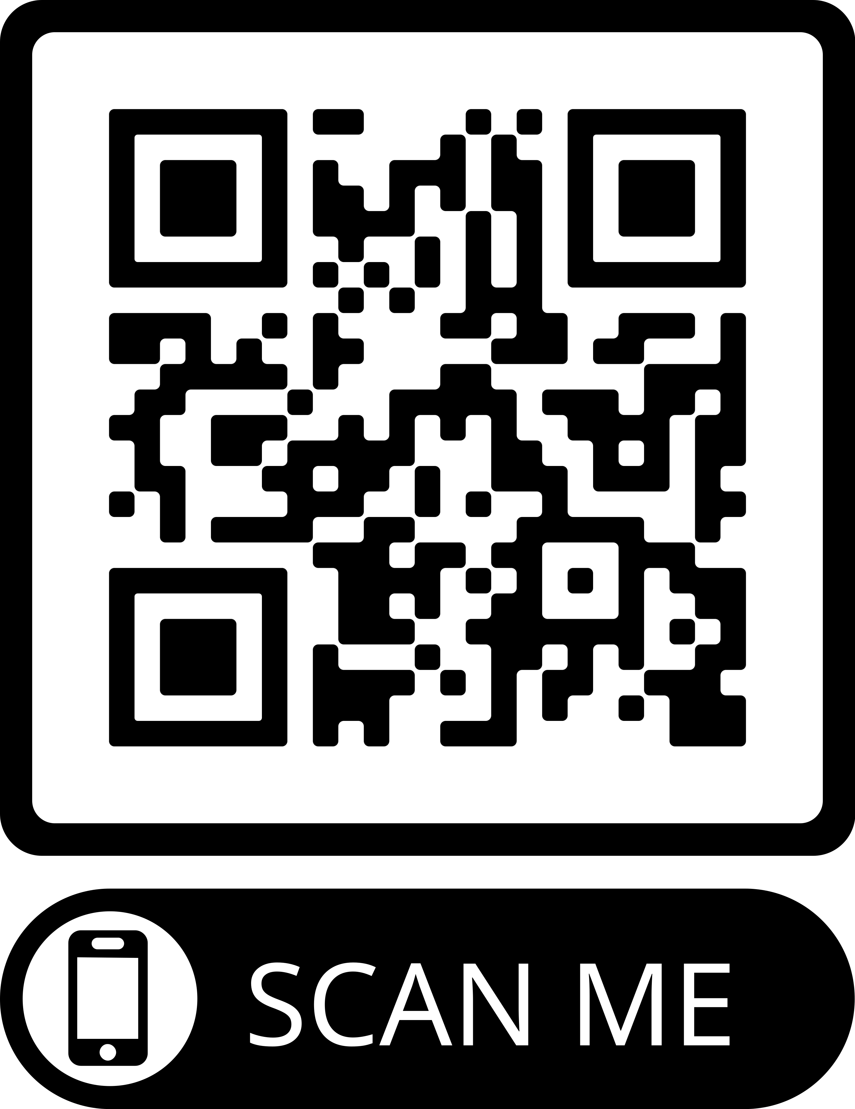
Thank you! Be sure to fill out your session evaluation. You might win a prize!
Visit us at DaSyCenter.org.
Follow us on LinkedIn: www.linkedin.com/company/dasy-center/
The contents of this presentation were developed under a grant from the U.S. Department of Education, #H373Z190002. The contents and resources do not necessarily represent the policy of the U.S. Department of Education, and you should not assume endorsement by the Federal Government. Project Officers: Meredith Miceli and Amy Bae.

