Slide 1
Workshop: Analysis Paralysis? A Multi-Layered Approach to Data Use and Decision-Making
Workshop: Analysis Paralysis? A Multi-Layered Approach to Data Use and Decision-Making
WELCOME!
BIENVENUE!
WiFi
Network: IHG ONE REWARDS
Password: MYSHA
Access this workshop’s listing in the Attendee Hub to download materials:
bit.ly/3Azc7it
Notes:
NICHOLAS
Welcome to NEW ORLEANS!
Assess everybody’s interest in working with a partner versus individually.

Slide 2
Analysis Paralysis? A Multi-Layered Approach to Data Use and Decision-Making
Nicholas Ortiz
Lisa Backer
Lauren Barton
Kellen Reid
Kathleen Hebbeler
#IDIO2024
August 27, 2024
Notes:
NICHOLAS
Introduce TA staff

Slide 3
What If We Want to Know…
Are EI/ECSE services producing equitable outcomes for children who speak English and children who speak other languages?
Notes:
NICHOLAS
So that… we can understand whether we are we using/training interpreters well? Are we modifying dosage of intervention to match additional need?

Slide 4
Let’s see what we can do...
Notes:
NICHOLAS
Switch to screen share of Kellen’s pivot tables/dashboard

Slide 5
Agenda
Icebreakers
Core Concepts:
Child Outcomes Data Crash Course
Orientation to Data Template
What Do We Mean By “Multi-Layered”?
Data Inquiry Cycle
Analysis planning and live demo: Analyzing a multi-layered critical question
Small Groups: Work with your critical question for deeper analysis
Large Group: Share your results!
Notes:
NICHOLAS
Reminder about having brought your critical question of interest. Keep it handy. Download the handout with sample critical question tied to the data template (we have some printed copies, too).
This is truly a workshop – this is a safe place to experiment with small-group guided facilitation.
Make sure to download materials, especially sample data to be used later.
If you don’t know Excel

Slide 6
What’s Your Favorite Excel Function/Formula?
For example:
Let’s say cell A1 = “Welcome to NOLA”
=LEFT(A1,7) returns “Welcome”
=RIGHT(A1,4) returns “NOLA”
=MID(A1,9,2) returns “to”
Let’s say cell A1 = “Welcome to” and cell B1 = “ NOLA”
=CONCATENATE(A1,B1) = “Welcome to NOLA”
Notes:
LISA

Slide 7
Who’s In the Room?
Notes:
LISA
Popcorn out your state name
Part C or Part B 619?
State data manager, state coordinators, family representative, TA provider, higher education, local program representative?
Approach to child outcomes measurement: COS, publisher algorithm, state-developed, other?

Slide 8
What’s Your Current Level of Knowledge About Child Outcomes Data?
– I can teach others
– A few years under my belt
– Finished my crash course
– Child outcomes? Huh?
Notes:
LISA
Show of hands by each category: What is your current level of knowledge about child outcomes measurement?

Slide 9
What’s Your Current Comfort Level with Microsoft Excel?
– I can teach others
– A few years under my belt
– Finished my crash course
– Spreadsheets? OMG
This Photo by Unknown Author is licensed under CC BY-NC
Notes:
LISA
Show of hands by each category: What is your current level of comfort with Excel?

Slide 10
Reminder: Progress Categories
70
60
50
40
30
20
10
0
Did not improve functioning
Improved functioning, no change in trajectory
Moved closer to functioning like same-aged peers
Improved functioning to that of same-aged peers
Functioning same-aged peers
Adds up to 100%
e
d
c
Growth in Outcome
b
a
0 6 12 18 24 30 36 42 48 54 60 66
Age in Months
Notes:
LAUREN

Slide 11
Reminder: The Summary Statements
Of those children who entered or exited the program below age expectations in each outcome, the percent who substantially increased their rate of growth by program exit.
$$\frac{Total\left(c+d\right)}{Total\left(a+b+c+d\right)}$$
X 100
The percent of children who were functioning within age expectations in each outcome by program exit.
$$\frac{Total\left(d+e\right)}{Total\left(a+b+c+d+e\right)}$$
X 100
Notes:
LAUREN

Slide 12
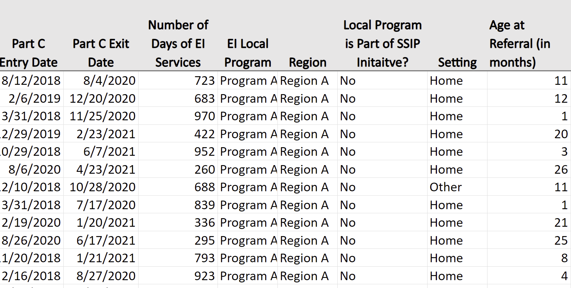
Orientation to the Data and Other Downloadable Resources
Cvent Attendee Hub for downloadable resources: bit.ly/3Azc7it
Notes:
LAUREN
Lauren navigates to Attendee Hub listing for this workshop.
Note the sample data in our workshop downloads. Also note the other resources downloadable under the Resources section of the Attendee Hub for this workshop.
Sample Data for Part C
Sample Data for 619
Critical Questions Aligned to Data Template
Small Group-Time analysis planning worksheet
Reference Sheet: Progress Categories/Summary Statements
Full analysis plan template (not using in-depth today – for your use later)

Slide 13
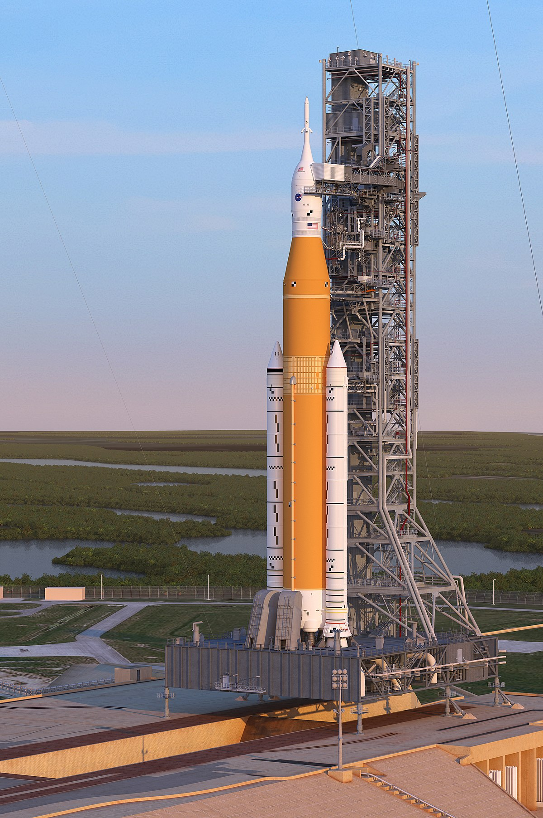
Checklist
Have you downloaded the sample data set?
Did you bring your own data?
Have you linked all your data in one worksheet/tab?
This Photo by Unknown Author is licensed under CC BY-SA
Notes:
LAUREN

Slide 14
What Do We Mean By “Multi-Layered”?
Notes:
KELLEN

Slide 15
Child Outcomes Data: 1st Level
Outcome A: Positive Social-Emotional Skills
Summary Statement 1: Greater Than Expected Growth
State Overall
55%
Notes:
KELLEN
First level = statewide. Technically, you’ve already made sliced the data by one factor as these are children with disabilities, not the overall population of children.

Slide 16
Disaggregating Child Outcomes Data: 2nd Level
Outcome A: Positive Social-Emotional Skills
Summary Statement 1: Greater Than Expected Growth
American Indian or Alaska Native | Asian | Black or African American | Native Hawaiian or Other Pacific Islander | Two or More Races | White
48% | 61% | 51% | 49% | 54% | 60%
Notes:
KELLEN
Second level = by race

Slide 17
Disaggregating Child Outcomes Data: 3rd Level
Outcome A: Positive Social-Emotional Skills
Summary Statement 1: Greater Than Expected Growth
 | American Indian or Alaska Native | Asian | Black or African American | Native Hawaiian or Other Pacific Islander | Two or More Races | White
Region A | 48% | 61% | 51% | 49% | 54% | 60%
Region B | 42% | 59% | 51% | 52% | 54% | 61%
Region C | 44% | 62% | 54% | 47% | 50% | 58%
Notes:
KELLEN

Slide 18
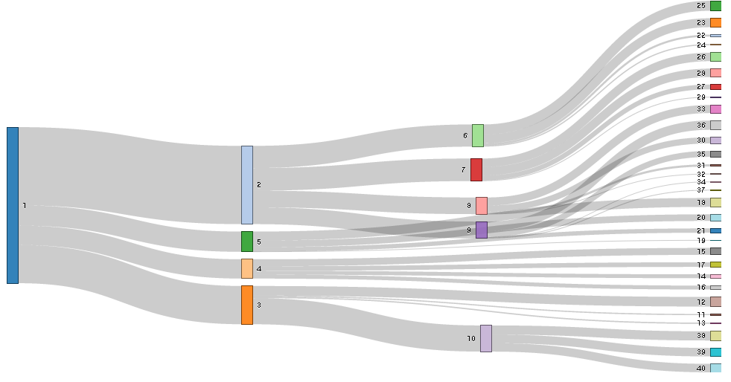
What About Small Ns?
Slicing data sets too small with too many variables can lead to:
Risk of disclosing personally identifiable information
Lack of statistical significance or meaningful difference
BUT…
Notes:
KELLEN

Slide 19
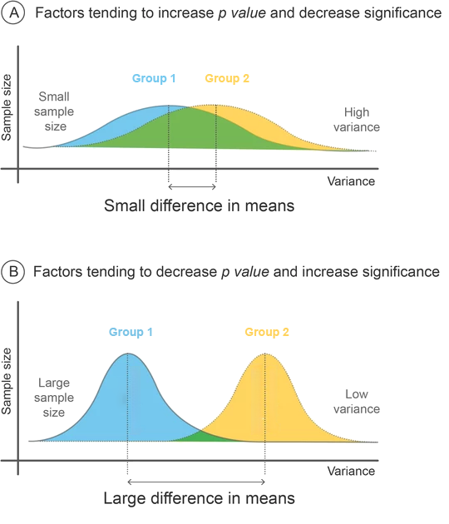
What About Small Ns?
Equity, burden, and the almighty p-value
Krause, H. (2022). Don’t Let the P in P Value Stand for Privilege.
It’s not always about, generalizing, public reporting, or research
https://www.medmastery.com/guides/interpreting-medical-literature-mini-guide/evaluating-statistical-methods
Notes:
KELLEN
P values highly dependent on sample size
Real vs. chance. It’s not that it isn’t real if p value is > .05 – it’s that we don’t know.
When we reject results from small N sizes, we privilege large groups while disadvantaging smaller ones.
Micro-decisions about data use reflect our implicit biases.
(segue into qualitative data as another way to use your data beyond public reporting/research)
Image contains two figures (A & B). Figure A is demonstrating the factors tending to increase p-value and decrease significance. The graph has two flattened parabolic curves representing two groups (1 &2)which are overlapping considerably. The x-axis is variance and the y-axis is sample size. Small sample size, high variance, and the small difference in means contributes to a low p-value. Figure B is demonstrating the factors tending to decrease p-value and increase significance. Two parabolic curves for groups 1 & 2 are shown again but are much taller and barely overlapping. Large sample size, low variance, and larger differences in means are increasing significance.
Figure retrieved from: https://www.medmastery.com/guides/interpreting-medical-literature-mini-guide/evaluating-statistical-methods

Slide 20
Qualitative Data: What’s the Story Behind the Numbers?
Qualitative data are used to illustrate the story behind the numbers and are often collected through case studies, surveys, interviews, focus groups, observations, documentation review. etc.
Qualitative data provide important context and meaningful differentiation for conversations.
Notes:
KELLEN
Table shows a cross-tabulation entry and exit ratings. Columns labeled 1-7 represent the number of children exiting with a rating of the respective column number. The rows labeled 1-7 represent the children entering at a rating of their respective column name. Each cell then corresponds to the number of children exiting with a given rating between 1-7 and exiting at a rating of 1-7. The expected pattern is that most children will enter and exit at the same rating +1-2 and -1. In the extreme, where an entry rating of 1 and an exit rating of 7 intersect, there is a relatively large number (5 of 76 total). All relatively large values are shaded progressively darker blue to indicate their size. With small numbers like 5 broken down here, you have the opportunity to do further analysis by collecting and using qualitative data.

Slide 21
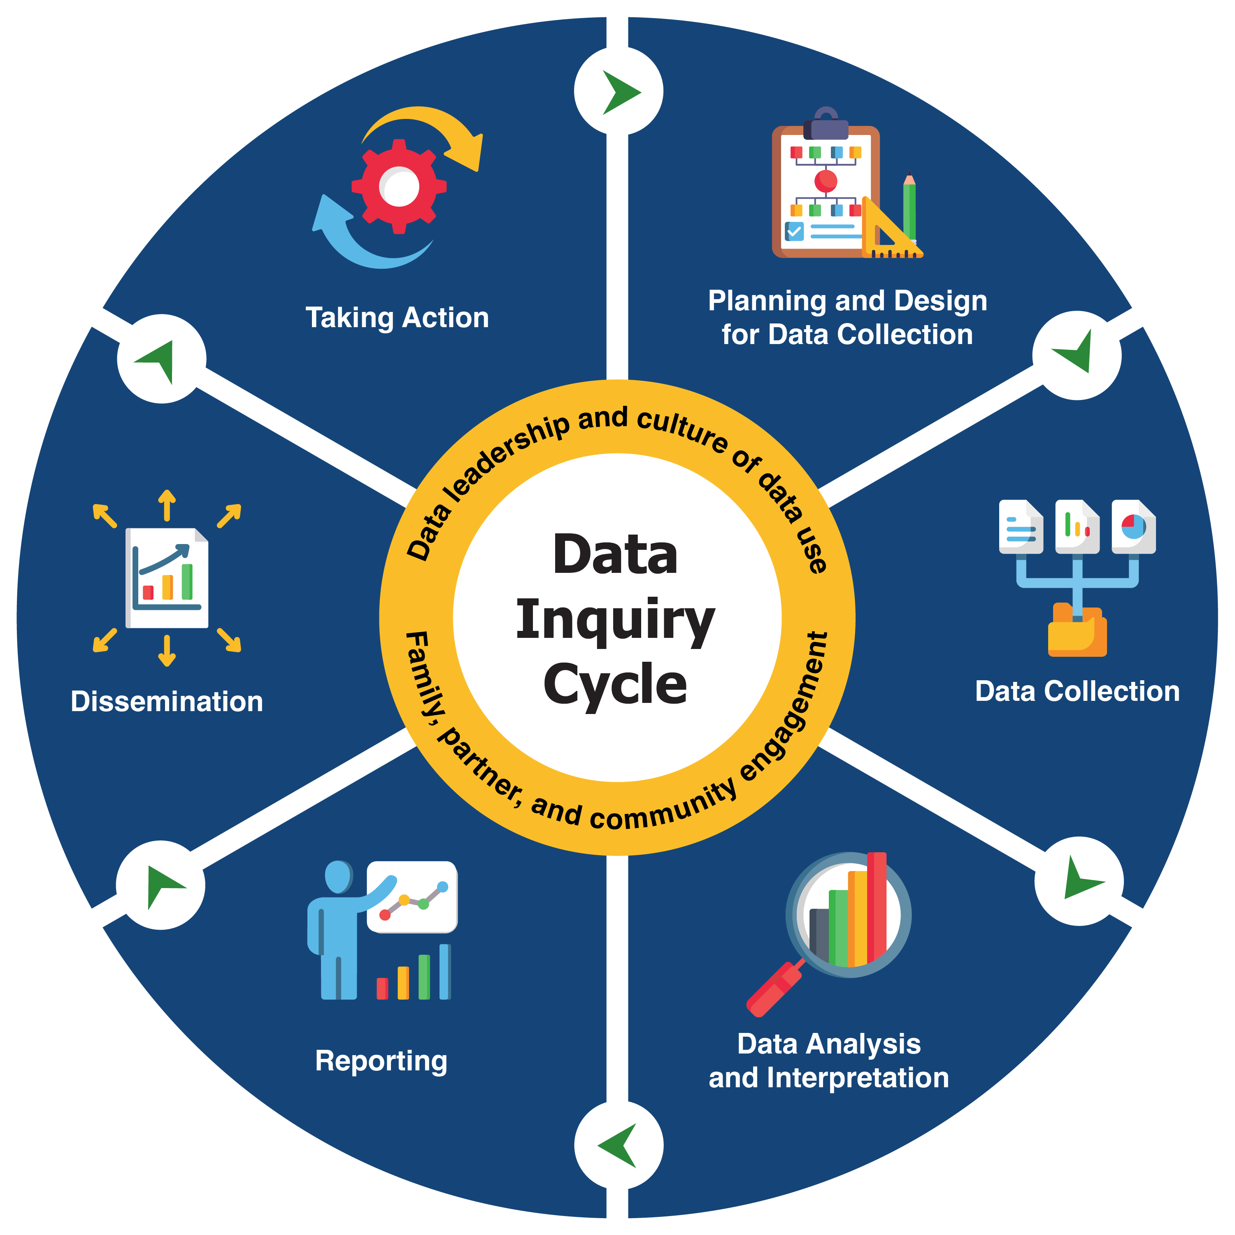
Data Inquiry Cycle
https://dasycenter.org/data-inquiry-cycle/
Notes:
KELLEN
Show where this workshop fits into the Data Inquiry Cycle

Slide 22
From Design to Execution
How to Turn Your Critical Question Into a Multi-Layered Analysis with Powerful Results!
Notes:
NICHOLAS

Slide 23
Plan Your Analysis: Document, Document, Document!
Download a sample analysis plan template in Attendee Hub
An analysis plan provides a roadmap for how you will analyze your data, ensuring consistency over time and across people.
Analysis plan components include:
Critical question
Purpose
Analytic considerations
Dataset
Data elements
Analysis steps/methods
Table shells/sample output
Example data tables and visualizations
Notes:
NICHOLAS

Slide 24
Critical Question and Purpose
Critical question: The well-defined focal question you are trying to answer
Purpose: The higher meaning or reason for conducting the analysis
For example, to identify inequities, inform program planning, or understand data quality
Notes:
NICHOLAS

Slide 25
Our Critical Question
Are EI/ECSE services producing equitable outcomes for children who speak English and children who speak other languages?
Let’s go a little deeper…
Are EI/ECSE services producing equitable outcomes for children who speak English and children who speak other languages across all regions?

Slide 26
Critical Question and Purpose
Our Critical Question | Are EI/ECSE services producing equitable outcomes for children who speak English and children who speak other languages across all regions?
Purpose | To understand whether there are inequities by language and region, so that: We train and deploy interpreters well We can prioritize translation of materials We can modify dosage of intervention to match need Etc.
Notes:
NICHOLAS
Notice… I can’t answer all the bulleted questions/strategies without further data

Slide 27
Analytic Considerations
Definition | Examples from Our Analysis
How you may need to conceptualize the analysis of the question and what to take into account Information that is important to understanding how to analyze and interpret the data Examples: data vintage, inclusion/exclusion criteria, data location (e.g., local vs state) | FY2020-21 reporting year (children who exited between 7/1/20-6/30/21) Only includes children with ≥6 mts of services Programs C and E have been conducting remote assessment the last few years Programs used a variety of anchor tools (GOLD, AEPS)
Notes:
NICHOLAS

Slide 28
Data Set and Data Elements
Definition | Examples from Our Analysis
Data set: Describe the data set that will be used and who is included in it Note if multiple data sets are required for the analysis Note if linkages across data systems are required to answer the question | Children with active IFSPs who exited Part C services in FY20 File extract received 8/2/21 from DHS lead data manager. Table name = “IndC3” from DHS Data Warehouse. Child demographic data have already been linked using child ID from table name = “StudentInfo”
Data elements: Include list/table of data elements and information about each that will be used for this specific question analysis | Progress Category Outcome A, “ “ B, “ “ C Primary Language Region
Notes:
NICHOLAS

Slide 29
Analysis Approach
Definition | Examples from Our Analysis
List the methods and steps for conducting the analysis. For example, you could say “run the frequency to generate N and percentage of X, Y, and Z variables” or “run the mean and standard deviation of X variable.” Determine which data elements require transformation or calculation and write out any related directions | For each Outcome (A, B, C), run frequency of progress categories cross-tabulated with Primary Language. Add another “slice” for language by region. Primary Language requires recoding due to many language options and additional Region slice. All values NOT IN English or Spanish become “Language Other Than English or Spanish.”
Notes:
NICHOLAS
AKA methodology
Note the choice we are making to collapse languages. Has equity implications.

Slide 30
Data Quality Issues
Definition | Examples from Our Analysis
Note any issues with data quality that might impact your interpretation of the data. For example: Are there known data system issues, data collection changes, or service provision changes in a certain year? Are there outliers or unexpected patterns? Are there missing data? Are data quality lower in certain pockets/groups? | This was the first year our state started using the COS process (switched from publisher algorithm) Region B was severely late submitting data for the reporting period Program A historically has had many children on IFSPs missing from the report who should have had entry/exit data
Notes:
Some data quality issues won’t show themselves until you conduct the first analysis.

Slide 31
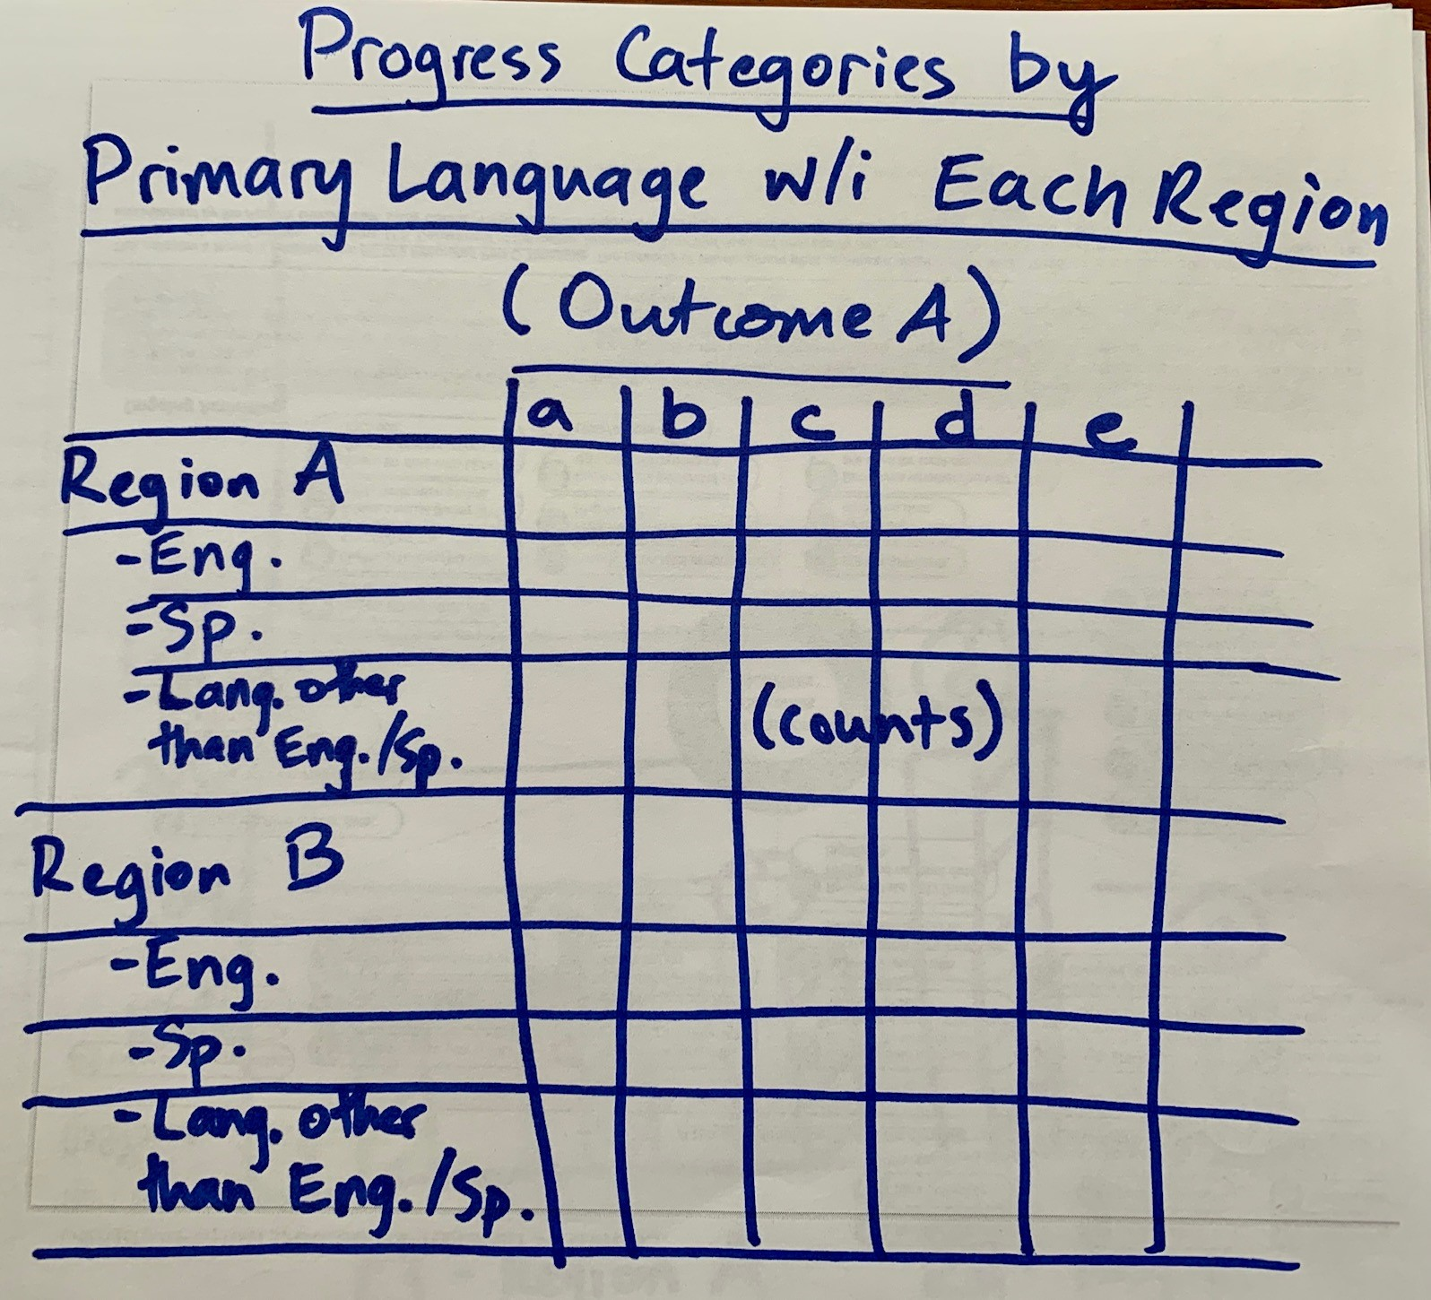
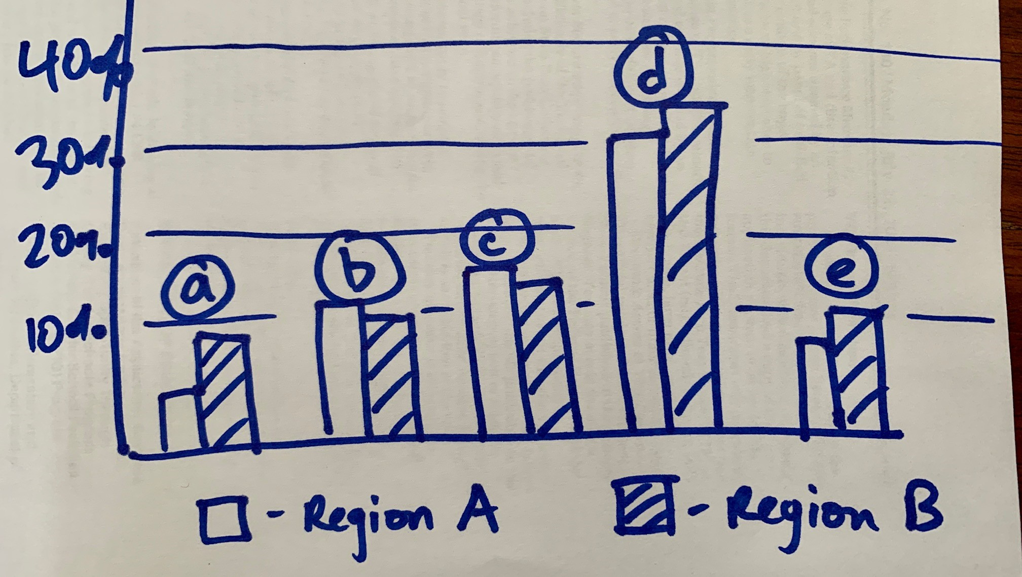
Sample Output (Table Shell) and Data Visualization
ChildID | Primary Language | Region | Prog Cat Outcome A | Prog Cat Outcome B | Prog Cat Outcome C
322496 | English | Region A | e | c | d
322513 | Spanish | Region B | d | b | d
323774 | Mandarin | Region C | a | c | e
Notes:
NICHOLAS

Slide 32
The Data You Have Available Will Never Tell the Whole Story
Consider:
Data available at the state and local levels
Data from partners
Additional data you may need to collect
Qualitative data
What support local programs and LEAs may need to make use of their outcomes data and improve their data quality
Notes:
NICHOLAS

Slide 33
Live Data Analysis in Excel
Notes:
NICHOLAS
Perform live demo of pivot table and chart creation in Excel aligned with our multi-layered critical question. Incorporate data equity best practices (color, ordering, etc.)

Slide 34
Checklist
Have you selected a critical question already?
This Photo by Unknown Author is licensed under CC BY-SA
Notes:
LISA
Pick a question that you have the elements for. It’s more about the process right now.
Refer to the handout with sample critical questions aligned with our data template.

Slide 35
BREAK
Notes:
LISA
Use the break to select a critical question if you have not already.
(Raygun)

Slide 36
Small Group Time
Dive deep and explore your critical question of interest.
DaSy staff available to support you during this time.
Notes:
NICHOLAS
Preview our shareback procedure. Provide privacy guidelines:
No direct identifiers
Aggregate groups
Copy/paste to new table and suppress small cells
Follow state guidelines,
Some may use the fake data set and it won’t matter.
If someone needs support with data linking, let us know.
Partway through small group time, mention data viz resources if anybody is interested.
Sharing visuals are encouraged, but not required – in which case, lesson learned.
As you start to gather results toward the end of this process, I want you to start discussing (Look Think Act) – what do you notice? What are some possible interpretations? What are some possible action items? What other data might you need to help interpret and take action?

Slide 37
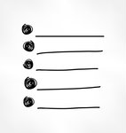
Worksheet
Download the worksheet from the Cvent Attendee Hub! Click on this session description, then Resources.
My critical question:
Levels of data to help dig deep include:
Key data elements to answer my question:
A data table to help answer my question looks like:
(Bonus points!) How will I present my findings as a data visualization with the large group?
Notes:
KELLEN
Keep this on the screen during small-groups

Slide 38
Data Visualization Resources
DaSy’s Data Visualization Toolkit: dasycenter.org/datavis-toolkit/
Key Considerations for Effective Data Visuals (EC Data U): https://bit.ly/4dHhpXy
Create a basic dashboard in Excel (EC Data U): https://bit.ly/3ACduwI
Google’s Looker Studio (EC Data U): https://bit.ly/3YKMyF6
Notes:
LAUREN

Slide 39
Share your results live! Zoom link: bit.ly/3YLKxZn
Notes:
KATHY facilitates discussion.
NICHOLAS manages Zoom permissions
Reminder: Try to have your data in aggregate groups, follow state guidelines, copy/paste to new table and remove small cells.
Some may use the fake data set and it won’t matter.
Encourage sharing on the Zoom link so we can all see. Some groups may not wish to share, though, that’s okay. Encourage sharing a few key insights.

Slide 40
Action!
How will you use these new skills? Jot down one action item for yourself as soon as you get home to extend your learning.
Notes:
NICHOLAS
What’s one thing you can do RIGHT AWAY when you get home to reinforce your learning?

Slide 41
Where Can I Learn More?
Planning, Conducting, and Documenting Data Analysis for Program Improvement (DaSy/ECTA)
Using Pivot Tables for Data Analysis (full tutorial series on DaSy’s EC Data U)
Data Visualization Toolkit (DaSy)
Crossing the Divide: An Intersectional Approach to Data Analysis (DaSy/ECTA Conference Session at DEC)
Intersectional Approaches to Research (Gendered Innovations – Stanford)
Introduction to Excel Formulas & Functions (LinkedIn Learning)
Look! Think! Act! Using Data for Program Improvement (DaSy)
Notes:
NICHOLAS

Slide 42
What Can DaSy and ECTA Do for You?
Address challenges with drilling into your data
Develop data analysis plans, including action planning
Support child outcomes professional development
…and more!
Notes:
NICHOLAS

Slide 43
Thank you!
Be sure to fill out your workshop evaluation. You might win a prize!
dasycenter.org
Follow DaSy on :
linkedin.com/company/dasy-center/
ectacenter.org
Follow ECTA on :
facebook.com/ECTACenter/
Developed under a grant, #H373Z190002, and a cooperative agreement, #H326P220002, from the Office of Special Education Programs, U.S. Department of Education. However, the content does not necessarily represent the policy of the U.S. Department of Education, and you should not assume endorsement by the Federal Government. DaSy Center Project Officers: Meredith Miceli and Amy Bae. ECTA Center Project Officer: Julia Martin Eile
Notes:
NICHOLAS

