Slide 1
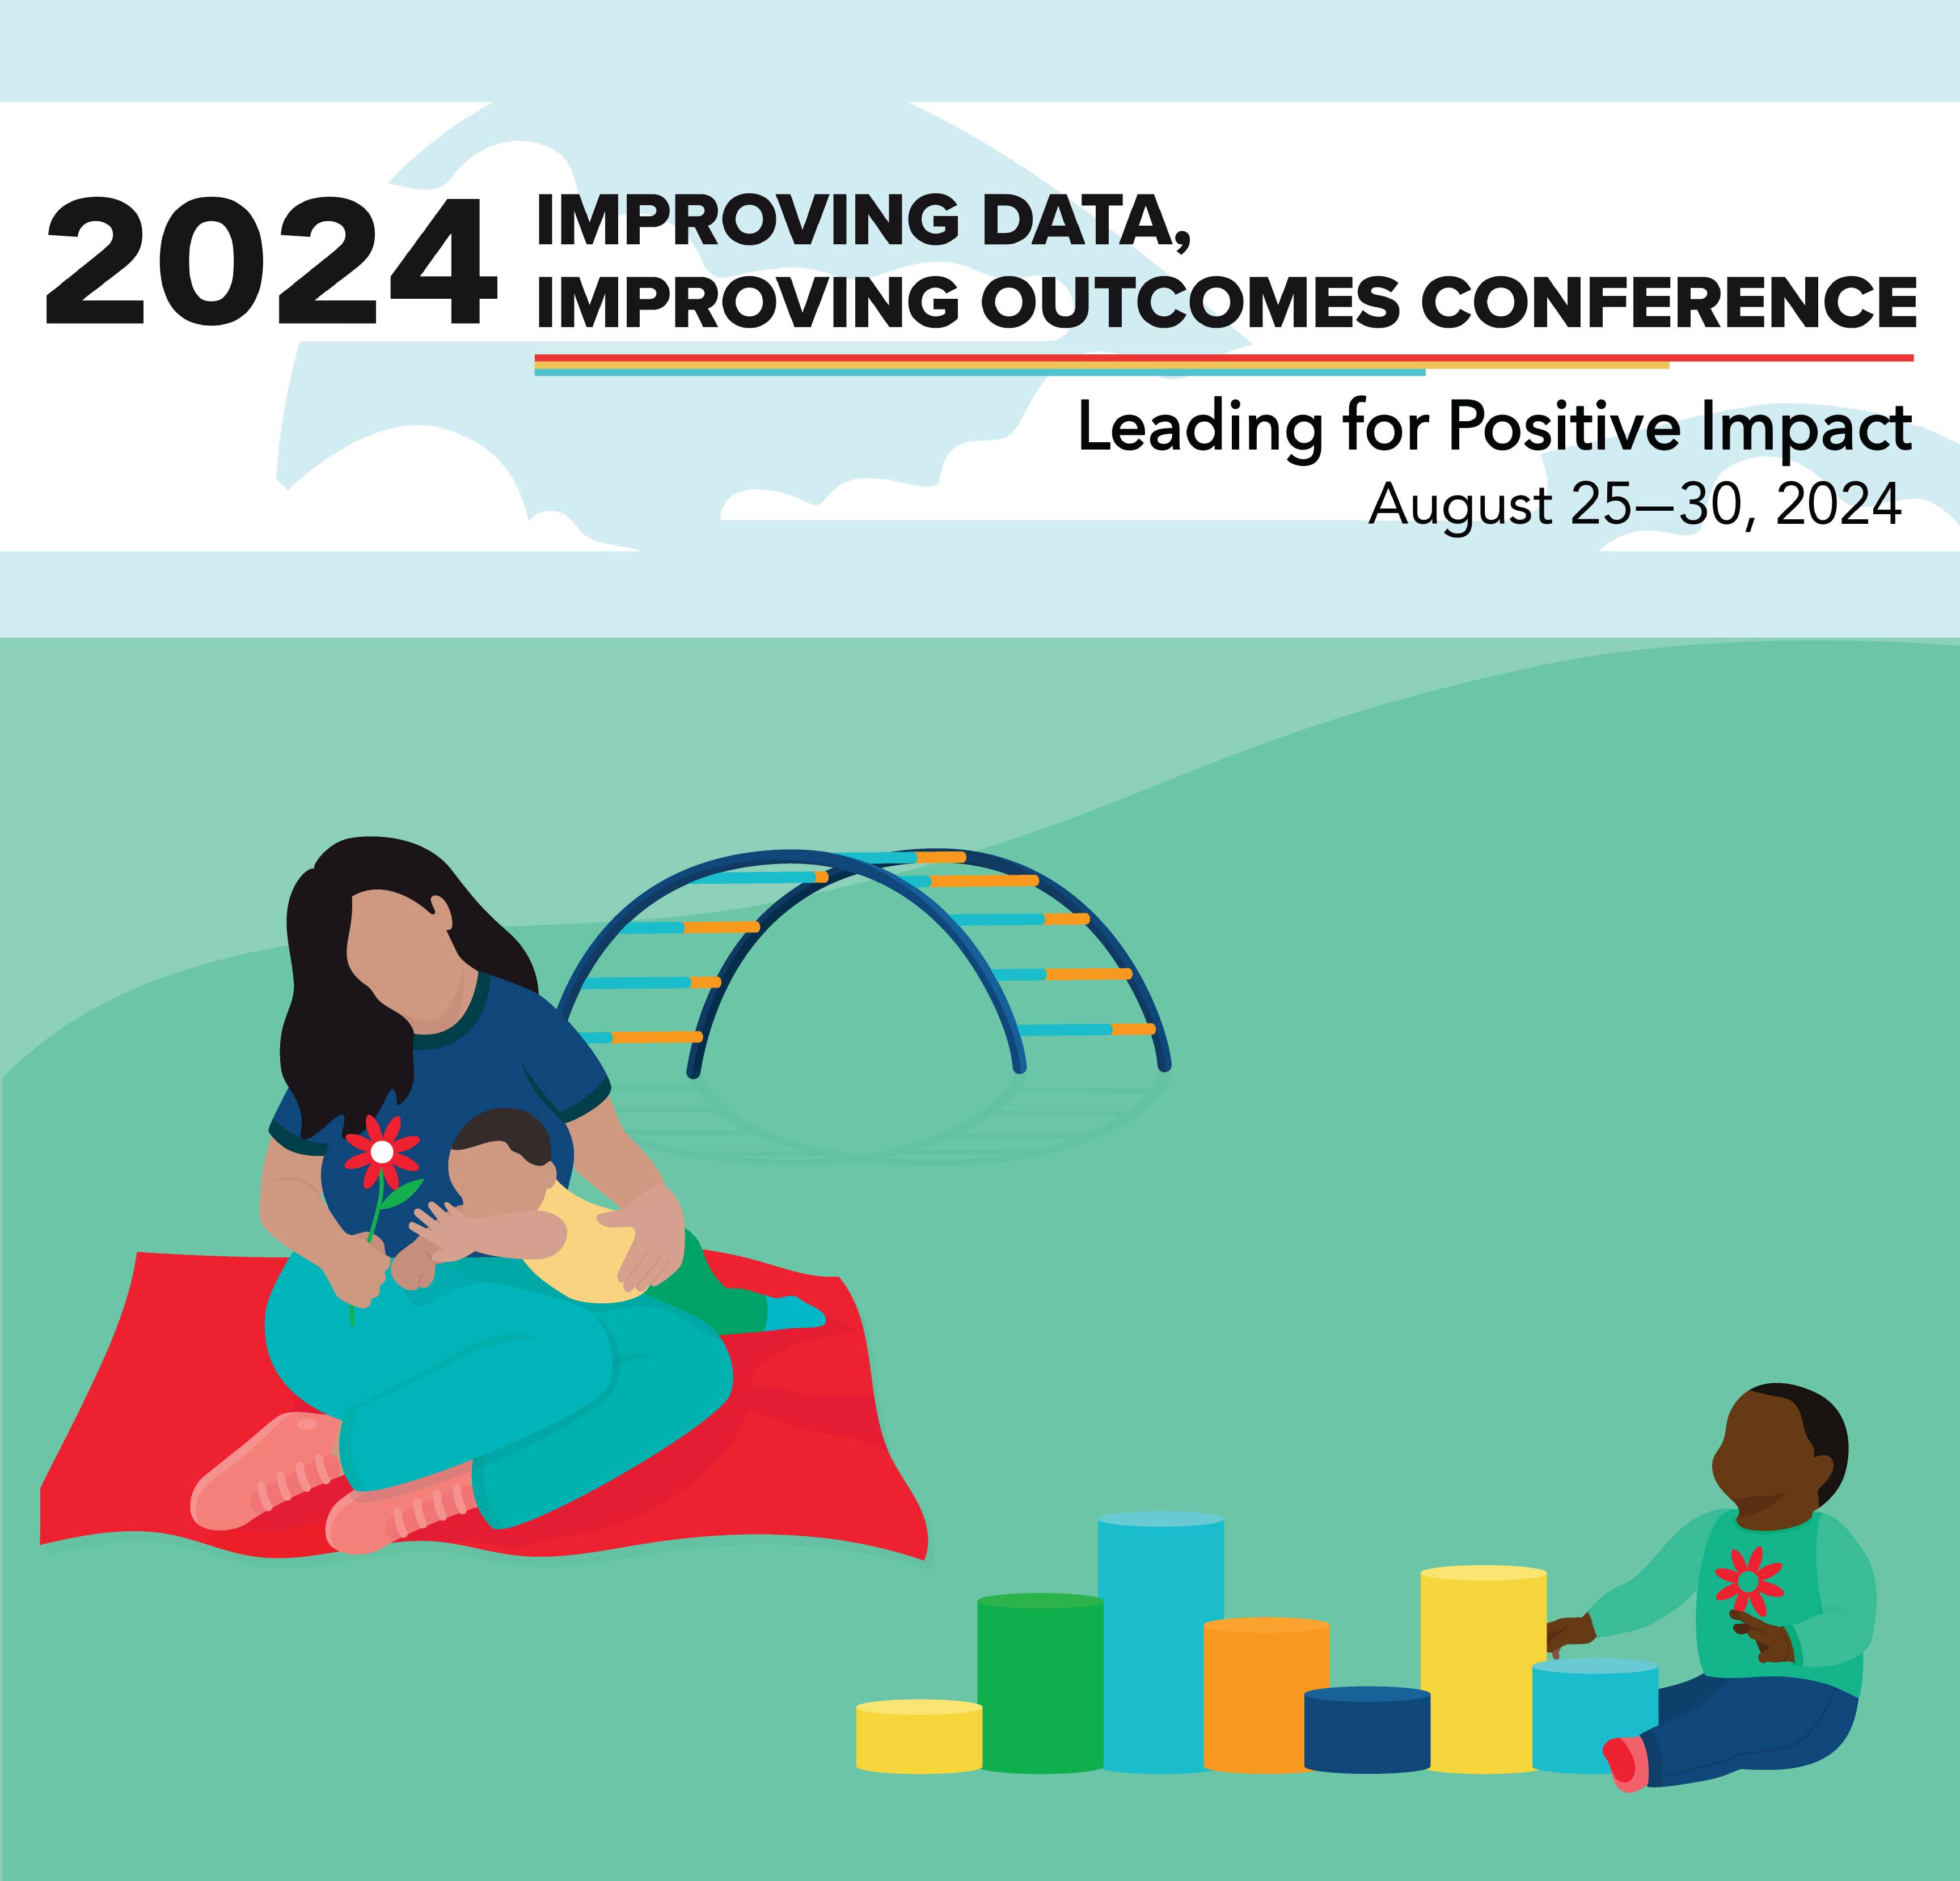
Create Positive Change Through Data Culture and Systems Thinking
Tracy Benson - Waters Center
Gabby Kibler - DaSy
Kathryn Morrison - DaSy
Jenna Nguyen - DaSy
Charlene Robles - ECTA
Sally Shepherd - DaSy
#IDIO2024
August 27, 2024
Notes:
Charlene

Slide 2
Continuum Activity
Learning about one another, by figuring out "where you stand."
Where you are from – distance from New Orleans
Length of time in your current role or position
Experience with Systems Thinking
Notes:
Tracy

Slide 3
Agenda
Overview
Data and Systems Thinking for Systems Change Cohort
Habits of Systems Thinker activity
Panel Discussion
Resources
Closing Activity
Notes:
Tracy

Slide 4
Data and Systems Thinking for Systems Change Cohort
Purpose: To harness data effectively and understand systems holistically to drive meaningful and sustainable change.
Who: Collaborative partnership between DaSy, ECTA and the Waters Center for Systems Change with four states: Arizona, Florida, Hawaii, Mississippi
How: By building a culture of data use and developing the power of systems thinking through cross-state learning and sharing combined with individual state support.
Notes:
Charlene
Purpose: To harness data effectively and understand systems holistically to drive meaningful and sustainable change.
Who: Collaborative partnership between DaSy, ECTA and the Waters Center for Systems Change with four states: Arizona, Florida, Hawaii, Mississippi
How: By building a culture of data use and developing the power of systems thinking through cross-state learning and sharing combined with individual state support.

Slide 5
Why it Matters
“This initiative empowers state teams to cultivate a culture in which data-driven decisions and systems thinking are integral to fostering positive and sustainable improvements in early childhood programs. No matter an individual’s role within a system, their actions influence the system’s behavior and the outcomes it produces. By equipping individuals and teams with the skills and knowledge to foster a culture of data use and adopt systems thinking, we can pave the way for lasting, impactful change.”
From Creating Positive Change Through a Culture of Data Use and Systems Thinking blog
https://dasycenter.org/creating-positive-change-through-a-culture-of-data-use-and-systems-thinking/
Notes:
Charlene
Taken from Creating Positive Change Through a Culture of Data Use and Systems Thinking blog
https://dasycenter.org/creating-positive-change-through-a-culture-of-data-use-and-systems-thinking/

Slide 6
Data & Systems Thinking Cohort Vancouver, Washington September 13-14, 2023
Notes:
Charlene

Slide 7
Rubber Band Exercise – where we are now and feeling the stretch to where we want to be.
Notes:
Charlene

Slide 8
Cohort Members at In-Person Meeting Doing an Activity
A balancing act…focus on the point of contact with your finger and see what happens…shift your focus up to the beautiful feather for a different experience!
Notes:
Charlene

Slide 9
Habits Warm-up Exercise
Notes:
Tracy

Slide 10
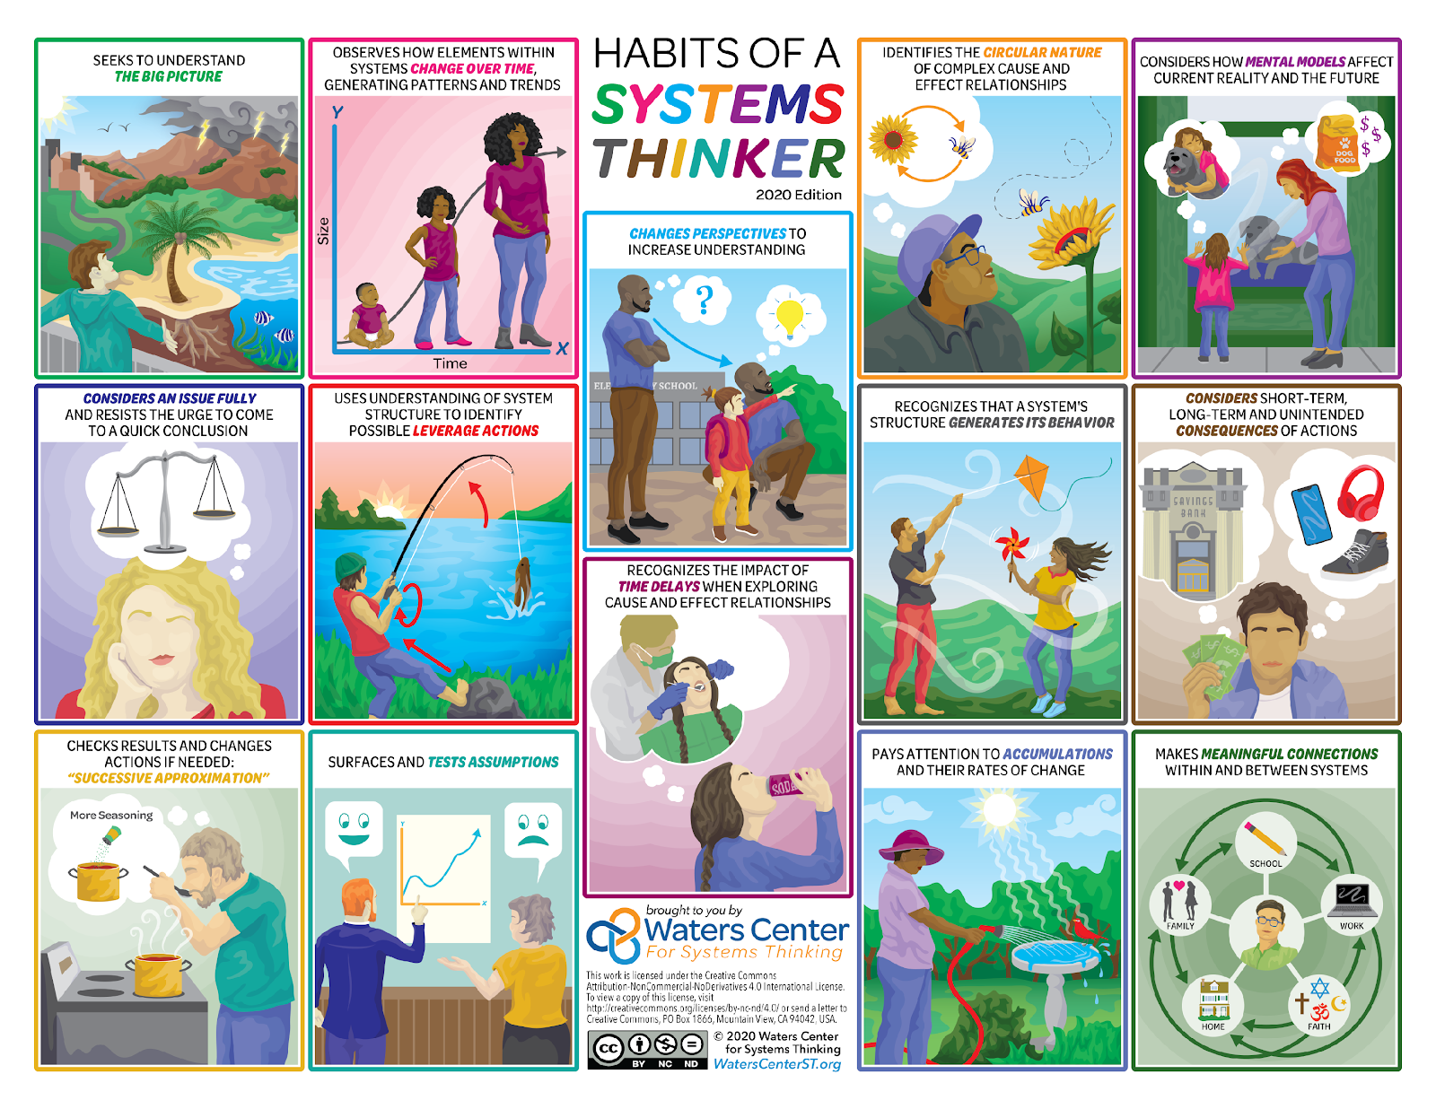
Habits of a Systems Thinker Card Deck

Slide 11
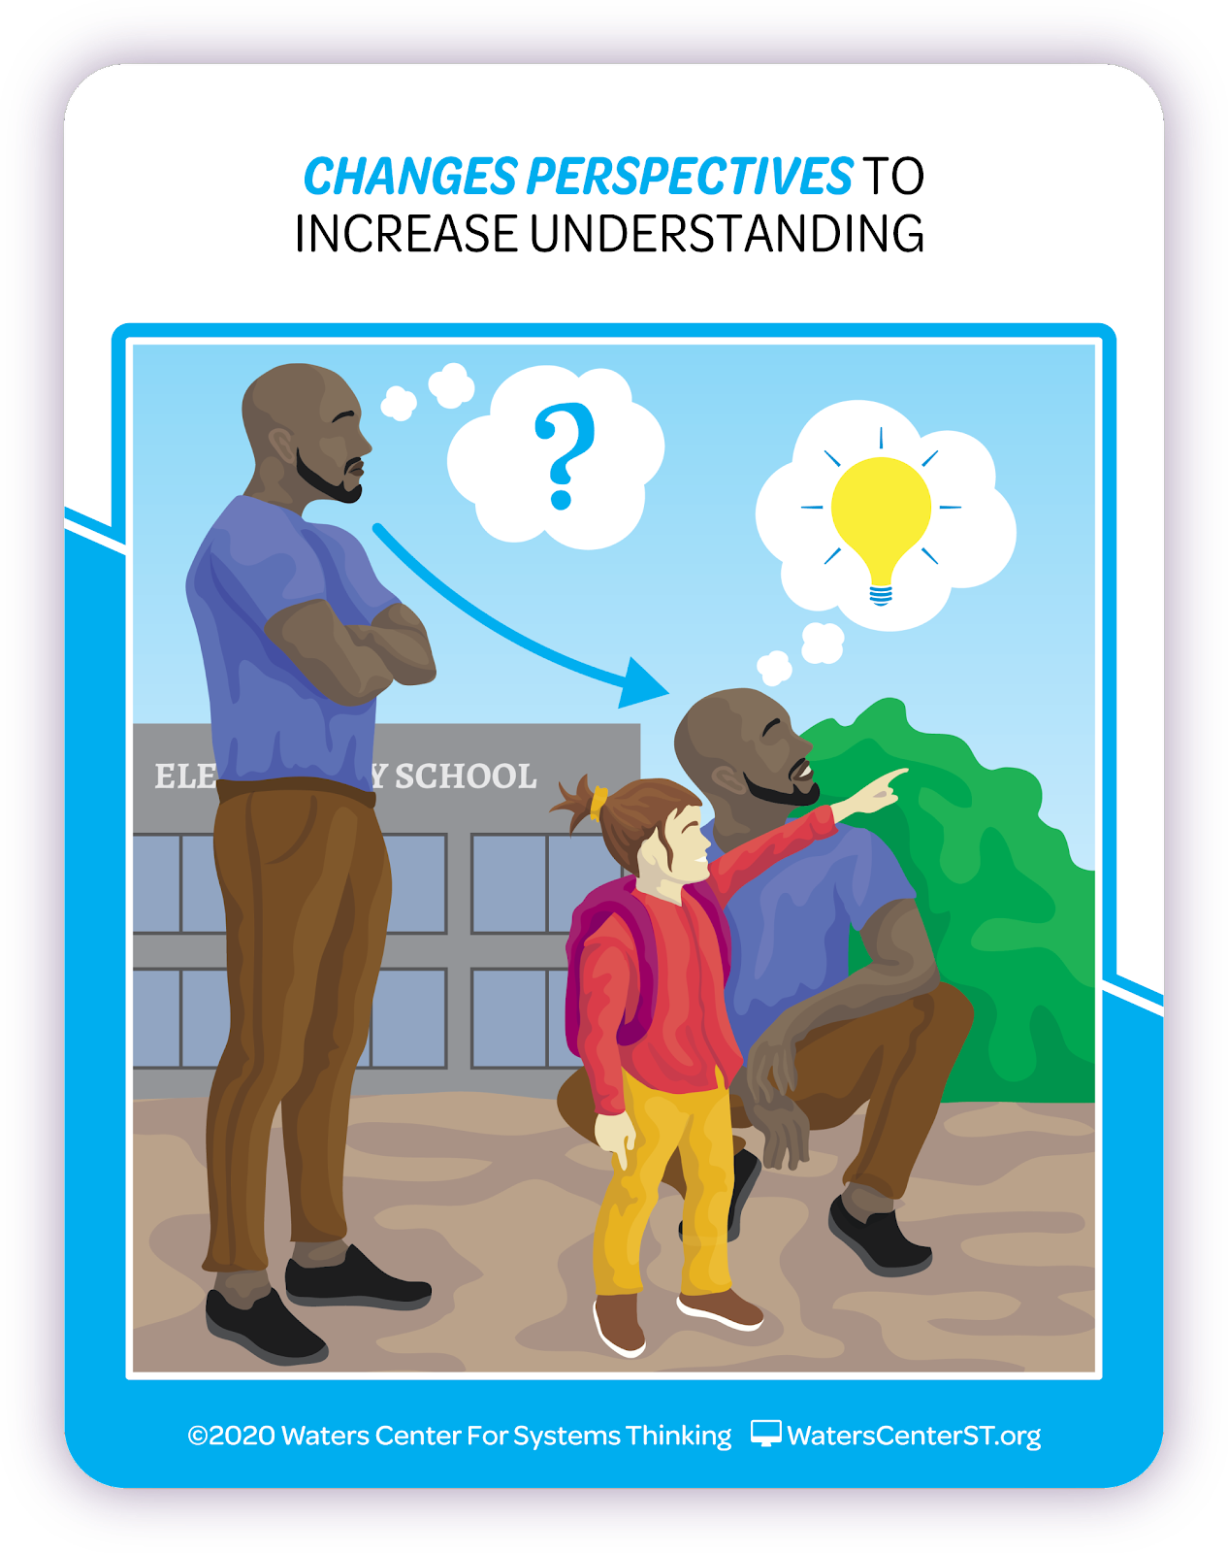
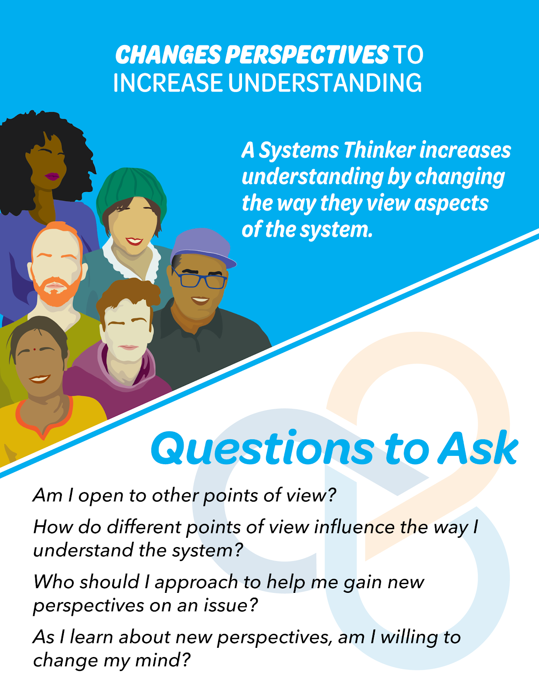
What to notice about each Habit card
Name of Habit & story image on front
On back, additional detail about the Habit including images of tools on many.
Questions to help you practice the Habit.

Slide 12
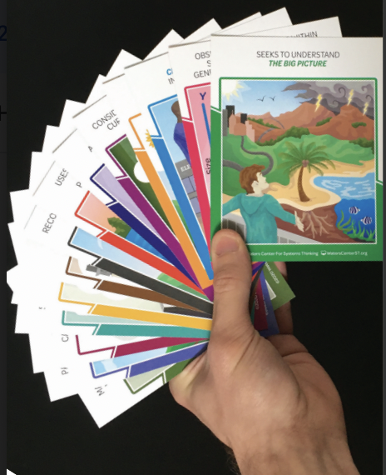
How are you already a Systems Thinker?
Go through your set of cards.
Choose 1 card that “speak to you,” and that you practice in work or life.
Move to the large poster that matches your Habit choice. Be prepared to share that card and a short, 1-minute story or explanation about the Habit with a partner.
In partners discuss, "What other Habits cards relate to my chosen card?"

Slide 13
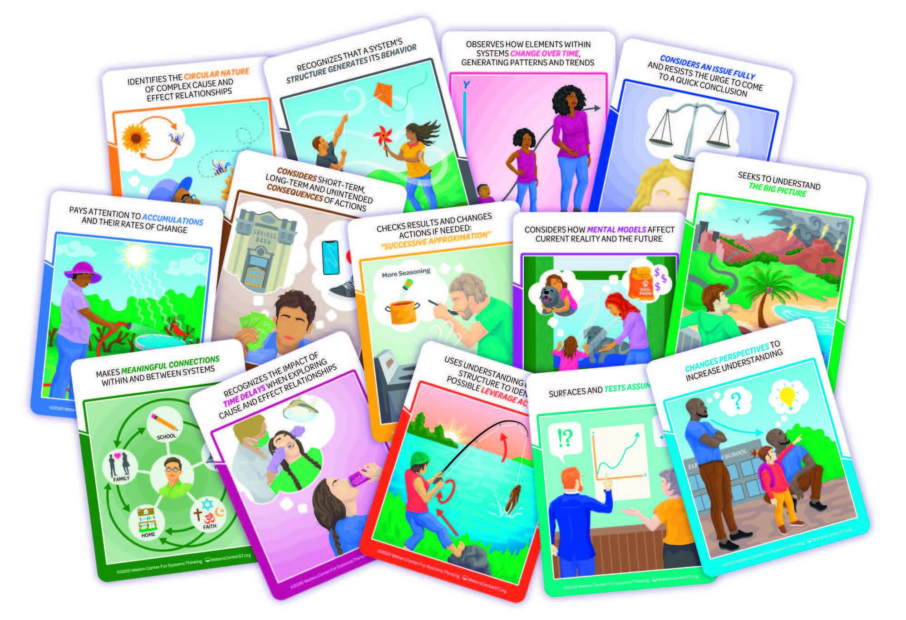
What do you hear?
Listen to panelists share about their cohort experience.
Pick cards for any Habits you hear them mention and mark them on your Bingo handout.
Think about how their experience might be different from how you work to create change in your program/organization.

Slide 14
Panel Discussion
Arizona
Florida
Hawaii
Mississippi

Slide 15
State Panelists
Arizona: Tami Philips
Florida: Jessica Meyer
Hawaii: Jeff Lee, Stacy Kong
Mississippi: Miranda Richardson
Notes:
Kathryn
Each state gives brief intro (name, state, C or B/619, lead agency, other agencies included in work, introduce other team members in room)

Slide 16
The System Thinking Iceberg
A Metaphor
A Framework
A Tool
Notes:
Kathryn

Slide 17
Panel Discussion 2
What was a key learning takeaway that you gained from the cohort content, facilitation or cross state interactions?
What has been under the water that this work brought to light?

Slide 18
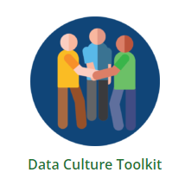
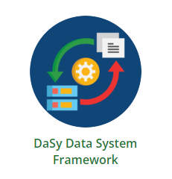
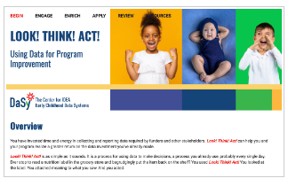
Resources
Notes:
Sally
MyDaSyTA- is an online platform from DaSy that is used by teams as a shared workspace. The platform also supports opportunities for virtual TA, including online learning communities, topic cohorts, and intensive TA with states. Members of MyDaSyTA can join different communities depending on their role and involvement in TA with DaSy.
https://dasycenter.org/technical-assistance/mydasyta/
Miro boards- Miro is a visual workspace that brings teams together to collaborate and make faster decisions. Its intelligent canvas with interactive tools makes it easy for anyone to get work done, from journey mapping to diagramming, and more. For this cohort, teams used this technical resource to store notes, share resources for collaboration, and manage some of their files. The TA Specialists also included resources directly through each team's Miro Board
https://miro.com/
Waters Center for Systems Thinking helps people understand what systems thinking is and how to incorporate the Habits, tools and concepts of systems thinking into their work and life to achieve desired results.
https://waterscenterst.org/
Data Culture Toolkit contains information, guidance, and templates to help program staff build effective data teams and support conditions for a culture of data use at state and local levels. The toolkit is organized around key steps to building a culture of data use in your state or local team.
https://dasycenter.org/data-culture-toolkit/
DaSy Data Framework- (DaSy Framework) used to assist Part C and Part B 619 programs in developing and enhancing high-quality state data systems for the collection, analysis, reporting, and use of their IDEA data. Organized around five interrelated subcomponents: Purpose and Vision, Data Governance and Management, System Design and Development, Data Analysis and Use, and Sustainability. Each subcomponent contains one or more quality indicators and multiple elements of quality.
https://dasycenter.org/resources/dasy-framework-2022/
Look!Think!Act!- is an online learning module that will support you in embedding the Look! Think! Act! process into your program and bring you one step closer toward strengthening your data infrastructure and creating a successful culture of data use, where staff and stakeholders across your program value and routinely use data for program improvement.
https://dasycenter.org/look-think-act/

Slide 19
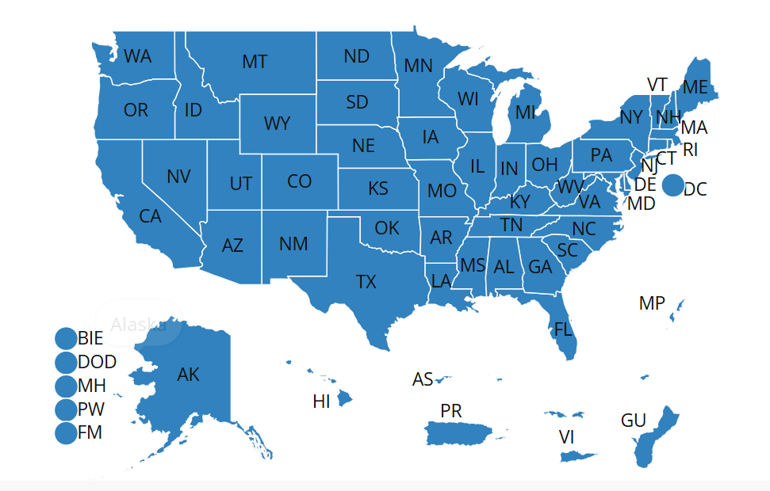
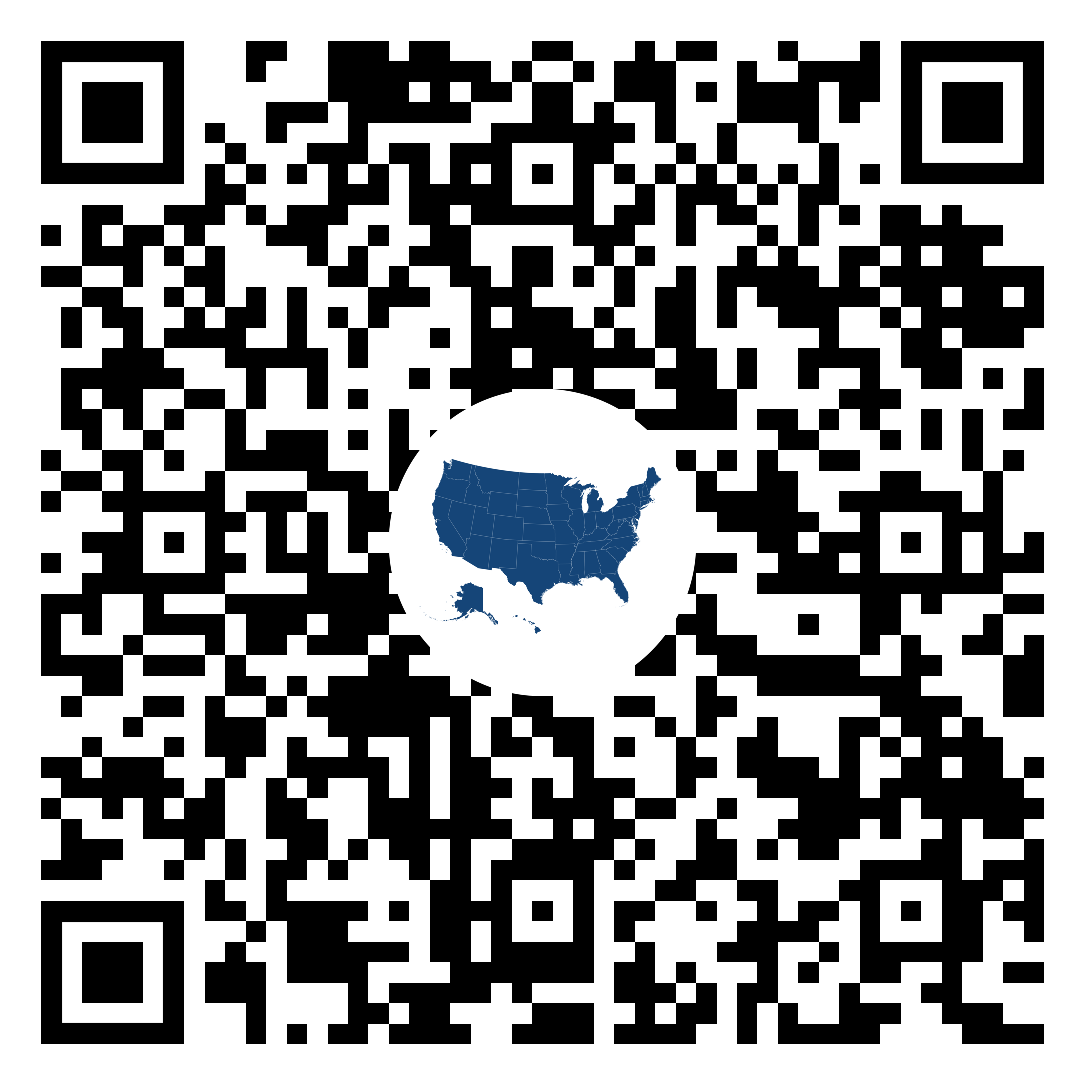
Connect With Your DaSy Liaison
Reach out to your DaSy TA liaison for information or a TA request​
Use the DaSy website to access the contact information for your state liaison
Notes:
Sally
For your convenience, we have a QR code and a link that you can use embedded in the slide deck to help you find the DaSy TA liaison for your state.

Slide 20
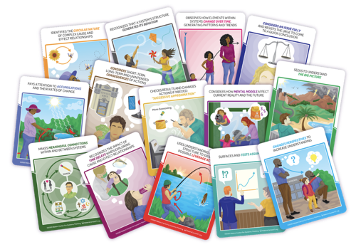
Wrap-Up Reflections
Who got Bingo?
Which Habits of a Systems Thinker did you hear from Cohort state leaders?
How might the Habits of a Systems Thinker be important to Data Leadership, Use & Culture?
Notes:
Jenna

Slide 21
Thank You, Evaluation Reminder, Center Info
Thank you!
Be sure to fill out your session evaluation. You might win a prize!
dasycenter.org
Follow DaSy on : linkedin.com/company/dasy-center/
https://waterscenterst.org/
Follow Waters Center on :
instagram.com/waterscenterst/
ectacenter.org
Follow ECTA on : @ECTACenter
Developed under a cooperative agreement, #H326P220002 and a grant, #H373Z190002, from the Office of Special Education Programs, U.S. Department of Education. However, the content does not necessarily represent the policy of the U.S. Department of Education, and you should not assume endorsement by the Federal Government. ECTA Center Project Officer: Julia Martin Eile. DaSy Center Project Officers: Meredith Miceli and Amy Bae.

