Slide 1
Examining Data to Improve
Child Find Systems Working Series
Session 2 – Identifying and Using Data to Dig Deeper into How Child Find is Working Across the State
Notes:
Margaret Gillis
Welcome to the second in our child find data working series. I’m Margaret Gillis with the DaSy Center, and I’m joined by my colleagues with the DaSy and ECTA centers, who have been involved in planning and will be helping facilitate today’s session.

Slide 2
Overview of the Working Series
Session 1 – May 21
  Introduction to Child Find and Data Reporting Requirements; Engaging Key Partners
  Focusing on OSEP’s 618 data collection and APR data and engaging key partners in analyzing and interpreting data
Session 2 – Today!
  Identifying and Using Available Data to Dig Deeper into How the Child Find System is Working Across the State
  Focusing on other Part C and Part B data and data from other sources that may be useful for understanding how child find systems are working
Session 3 – July 16
  Developing and Executing an Analysis Plan to Answer Critical Questions About Child Find
  Working with data! Bring your own or work with data we provide to develop and carry out an analysis plan focused on questions of interest to you.
Notes:
Margaret Gillis
As a reminder, in our last session, we set the context for child find, the federally reported data, and engaging key partners.
Today we are focusing on digging deeper into other available data.
In session 3 we will be working with data to develop and execute an analysis plan.

Slide 3
Session 1 Recap
Effective child find systems rely on critical partnerships with local programs/LEAs and cross-sector partners to ensure all potentially eligible children are identified, located, referred, and evaluated.
Federally-reported child find data provide some insight but tell a limited story about how child find systems are working.
Engaging key partners in analyzing and interpreting data is important for really understanding what is happening.
Notes:
Margaret Gillis
To recap, here we have a few take away messages from session 1 … (read slide)

Slide 4
At the end of this session, you should be knowledgeable about:
Purposes of digging deeper into your child find data
Sources of data other than the federally-reported (618 and APR) data that can provide insight into how your child find system is working
Strategies for disaggregating data to answer questions about your child find system
Notes:
Margaret Gillis
Here we have our session objectives. We’ll be spending some time as a whole group and have some opportunities for engagement with Padlet/chat, then we’ll have small group time where you can select the topic you would like to focus on
Aiming for 15-20 minutes in small groups, will reconvene briefly after small groups to wrap up and preview some info for session 3 before closing
{Read objectives}

Slide 5
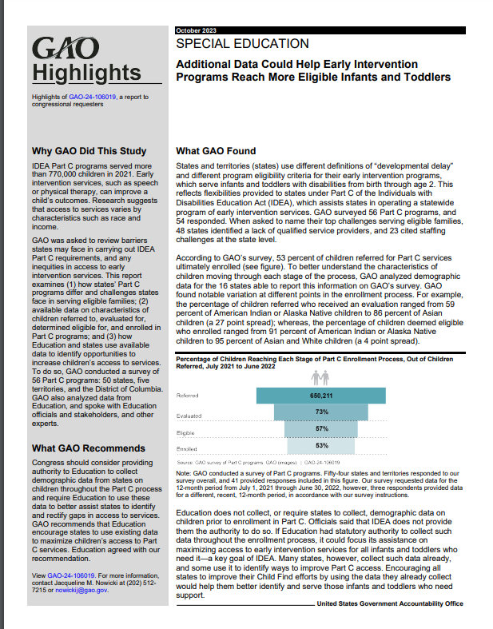
Important Context
Child find systems are complex and include activities related to identification, location, screening, referral, evaluation, determination of eligibility, and enrollment; however, the only data states report related to child find is on child count (Part C and Part B 619) and timeliness of evaluations (Part B 619).
The 2023 GAO report highlighted the promise of additional data states may already collect for shining light on how child find systems are working.
States vary widely in what data they collect at the state and local level and in how those data are structured.
Notes:
Margaret Gillis
As we discussed during our last session – child find systems are complex and really rely on cross sector collaboration for all those activities related to identification, location, screening, referral, evaluation, eligibility determination, and enrollment.
However, the data states report related to child find is really limited. {click}
The 2023 Government Accountability Office Report, highlighted the promise of additional data states may already collect for shining light on how child find systems are working. The report also renewed OSEP’s focus on child find data, and since release of the report, we have heard OSEP asking a lot more questions about child find and child find data, and it has been added as an area of focus for DMS. {click}
We know that states vary widely in what they collect at the state and local level – particularly prior to children’s enrollment in the program - and how those data are structured. This is going to impact how you will be able to dig into your data. {click}
2023 GAO report

Slide 6
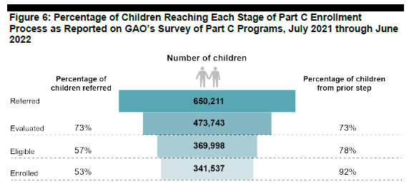
GAO Report
Tasked with reviewing barriers states face carrying out IDEA requirements and any inequities in access to early intervention services.
Surveyed Part C lead agencies and received responses from 54 States and territories
Identified physicians and other primary health care providers as the most common referral source, followed by families
Found variation in how children progress through the process from referral to evaluation to enrollment by race/ethnicity
GAO recommends, and Education agrees, states use existing data to maximize children’s access to Part C services.
Notes:
Margaret Gillis
To give just a bit more background about that GAO report, the GAO was tasked by the legislature with reviewing barriers states face in carrying out IDEA requirements and any inequities in access to early intervention services.
They carried out a number of activities in compiling the report, including surveying Part C lead agencies, from which they received responses from 54 states and territories. Unsurprisingly, they identified physicians and other health care providers as the most common referral source, followed by families.
They also found variation in how children progress through the process from referral to evaluation to enrollment by race ethnicity.
They found notable variation at different points in the enrollment process. For example, the percentage of children referred who received an evaluation ranged from 59 percent of American Indian or Alaska Native children to 86 percent of Asian children (a 27 point spread); whereas, the percentage of children deemed eligible who enrolled ranged from 91 percent of American Indian or Alaska Native children to 95 percent of Asian and White children (a 4 point spread).
The report found that the % of children referred who enroll in the program varied widely by state, from 28% to 90% - with an average of 53% - as shown in the chart {click}
As discussed during our last session, the Part C data collections for child find focus on children who are already enrolled, and IDEA does not currently grant the Department of Education the authority to require states to collect and report data on children prior to enrollment that would provide more information about those who are referred, evaluated, and found eligible for services. However, since many states do collect and maintain data on children prior to enrollment, GAO and the Department recommend states use the data they already have to examine whether disparities in access to early intervention services exist at steps prior to enrollment. There are numerous ways in which states can disaggregate their data to examine potential disparities in access and to understand better how the child find system is working for children and families across the state.
Also, while the GAO report focuses on Part C – we also know that Part B could benefit from this type of in depth look into available data to examine potential disparities and ways to promote earlier access to preschool special education.

Slide 7

Digging deeper into pre-enrollment data can help programs examine equity in access to early intervention and preschool special education.
Can help identify potential disparities in access related to
  Race and ethnicity
  Geographic area
  Primary household language
  Age
  Disability
  Local program/LEA
  Referral sources
  …
Comparisons to the general population may make it possible for you to also look at who may be missing from the program.
Data on subgroups makes it possible to look at practices, policies, and structures that may contribute to inequities.
Notes:
Margaret Gillis
In session 1 many of you indicated you were interested in digging into various aspects of your data to identify potential disparities, you might want to look at disparities in access related to (read list) – what else?
If population data are available for comparison, you may also be able to look at who is missing from the program – in other words, based on the population data who would you expect to be referred or enrolled versus who actually is. Note that these comparisons to the general population may be done at the state, regional, or local level – we often see that there is a lot of local variation that washes out when you roll up to the state level, so it’s really important that you do work with your programs and districts to dig in to more local data to see who might be missing.
This data on subgroups of children “pre-enrollment” allows you to begin to look more closely at practices, policies, and structures that may contribute to inequities, but quantitative data alone may not tell the whole story. This is where engaging your key partners can really be helpful to further digging in to what is happening..

Slide 8
What types of data may be useful?
Quantitative Data
Qualitative data
Data collected by Part C or Part B programs and entered into local or state data systems
Population data/demographics
Data collected and maintained by key partners
Child Find system mapping (e.g., Child Find Self-Assessment)
Family voice
Feedback from key partners, including referral sources
What else?
Notes:
Margaret Gillis
A combination of quantitative and qualitative data may be most useful for really understanding your child find system and how it is working.
Here are a few examples of the types of quantitative and qualitative data you might have or collect.
Examples of data collected that might by c and b include:
race/ethnicity
referral source
eligibility category
age at referral
geographic location
Referral outcome
C to B transition data
Population data/demographics might include census data, birthrates, local demographics
Data collected by key partners – for Part B that could be data shared from Part C as part of a data sharing agreement to support transition – what else? What about EHDI data? Data from DSS on children in substantiated cases of abuse/neglect that should be referred under CAPTA?
How about qualitative data?
Using a tool like the child find self assessment for mapping your child find system can be helpful for understanding how your key collaborative partners support child find activities across the state and in local communities.
Hearing from families about their experiences seeking services can also be helpful for understanding where breakdowns may be happening
Feedback from key partners, including referral sources can also shed light on some of those practices, policies, and structures that may need clarification or updating, may highlight where outreach is needed, etc.
What else? What other kinds of data would be helpful? – padlet next slide

Slide 9

Attendee Sharing: Quantitative and Qualitative Data
In the Padlet or the chat please share:
What quantitative and qualitative data are collected in your state (at the state or local level) that could be used to examine your child find system?
Notes:
Margaret Gillis
During our last session some of you mentioned looking at referral sources, referred/evaluated/eligible/enrolled, so we know some folks are collecting some data and already using it – feel free to note in your comments whether you are already using these data or whether you are collecting them but not using them for this purpose yet.
Padlet link: https://padlet.com/childfindaccess/what-quantitative-and-qualitative-data-are-collected-in-your-eebs1eaw5r58f7r3
Consider specific data elements you have in your data system that could help you drill down into how your child find system is working.

Slide 10
Resources to Support Data Exploration
Quantitative Exploration
  Child Find Funnel Chart Tool
  Meaningful Differences in Child Find Calculator
  Part B Indicator Data Display Wizard
Qualitative Exploration
  Child Find Self- Assessment (Part C and Part B 619 versions available)
  Local Contributing Factor Tool for SPP/APR Indicators including C4 and C5
Notes:
Margaret Gillis
Here are a few TA resources that can support your exploration of quantitative and qualitative data and engaging key partners with the data

Slide 11
How might you want to dig into your child find data?
To understand who is being referred and when
  Over or under identification for certain populations (who is missing?)
  Identification at kindergarten entry vs. before
To understand referral outcomes
  By group (e.g., race/ethnicity, geographic location, housing or language status)
  By referral source (e.g., pediatricians, parents, childcare programs, social services, etc.)
To understand other aspects of the program
  Child outcomes
  Family outcomes
  Transition
Other ideas?
Notes:
Margaret Gillis
These are just a few examples of how you might want to dig into your child find data, and many are things you mentioned during our last session. What other ideas do you have?
How you want to dig into your data impact how you will disaggregate your data – so let’s talk about that.

Slide 12
How to Disaggregate
To disaggregate, start by looking at a single variable, such as:
Race/ethnicity
Referral source
Eligibility category
Age at referral
Geographic location
Local program/LEA
Home language
Initial child outcomes rating
Disability category
Referral outcome or closure reason
Notes:
Margaret Gillis
How you disaggregate is initially dependent upon the data points you have in your system, and, as always, should be done in collaboration with key partners including program staff and families (at the least) plus representatives from other early childhood-serving partners in the state or community.
There are nearly endless ways to disaggregate your data, to start, let’s think about disaggregating by a single variable, such as these examples.

Slide 13
Data Disaggregation Example
Children Referred by Race/Ethnicity
Race/Ethnicity | # Referred
Hispanic/Latino | 952
American Indian or Alaska Native | 347
Asian | 142
Black or African American | 3896
Native Hawaiian or Other Pacific Islander | 63
White | 3231
Two or More Races | 652
Total | 9283
Notes:
Margaret Gillis
Here is an example of referrals disaggregated by one variable: race/ethnicity

Slide 14
How to Further Disaggregate
To further disaggregate, you might run cross tabulations of two variables:
Race/ethnicity
Referral source
Eligibility category
Age at referral
Geographic location
Local program/LEA
Home language
Initial child outcomes rating
Disability category
Referral outcome or closure reason
Notes:
Margaret Gillis
You can also further dig into and disaggregate your data by running cross tabulations of two variables, for example, by looking at race/ethnicity by referral source or eligibility category by home language. You could do this at the state level or at the local program or LEA level.
Let’s look at an example.

Slide 15
Data Disaggregation Example
Children Referred by Race/Ethnicity and Region
Race/Ethnicity | Region 1 Referrals | Region 2 Referrals | Region 3 Referrals | Region 4 Referrals | Region 5 Referrals | Total Referrals
Hispanic/Latino | 324 | 219 | 32 | 257 | 120 | 952
American Indian or Alaska Native | 135 | 65 | 87 | 42 | 18 | 347
Asian | 18 | 4 | 10 | 21 | 89 | 142
Black or African American | 2547 | 258 | 893 | 175 | 23 | 3896
Native Hawaiian or Other Pacific Islander | 12 | 21 | 14 | 2 | 14 | 63
White | 365 | 574 | 253 | 53 | 1986 | 3231
Two or More Races | 125 | 36 | 173 | 257 | 61 | 652
Total Referrals | 3526 | 1177 | 1462 | 807 | 2311 | 9283
Notes:
Margaret Gillis
Here we’re looking at the referrals across the state by region. Without any context, this probably raises more questions than it answers, so we won’t focus here on interpretations of the data, instead you might think about those questions that it does raise for you and what you would want to know about the regions, about the population of the children and families in those regions, and so forth, that would be necessary to have access to as you are digging into your own data.

Slide 16
The Cold Reality
You may have questions for which you don’t have data – what happens then?
You may have to regroup and modify the questions you want to answer or figure out if you can get the data you need somehow.
  This may include program data, comparison data, or some other type of data that is needed.
  If you don’t have it at the state level, consider whether it’s housed at the local level.
We will talk more about this process in session 3 in terms of what it means for developing and executing an analysis plan.
Notes:
Margaret Gillis
Keep in mind that when you don’t have data for questions you want to answer you may have to regroup – which could mean changing your questions or figuring out if there is some other way to get the data you need.
This might include thinking about data that you may not have at the state level but that may be housed at the local level.
We’ll talk more in session 3 about this process and what it means for analysis plans, but we wanted to plant this seed as you think about your available data.

Slide 17
Breakout Groups
Select the breakout you want to join!
  Child find and child entry data
  Referral sources
  Child Find Self-Assessment
15-20 minutes for breakout groups
Return to large group to wrap up and discuss planning for session 3.
Notes:
Margaret Gillis

Slide 18
Considering data collected to report child outcomes breakout
Notes:
Lisa Backer

Slide 19

Today’s Critical Question
Do the disability characteristics or severity of disability differ for children of different racial/ethnic groups?
Norwood, C., Shepherd, S., Ruggerio, T., Hebbeler, K. & Edora, F. (2023). Critical questions for addressing racial equity in early intervention and early childhood special education. SRI International.
Notes:
Lisa Backer

Slide 20
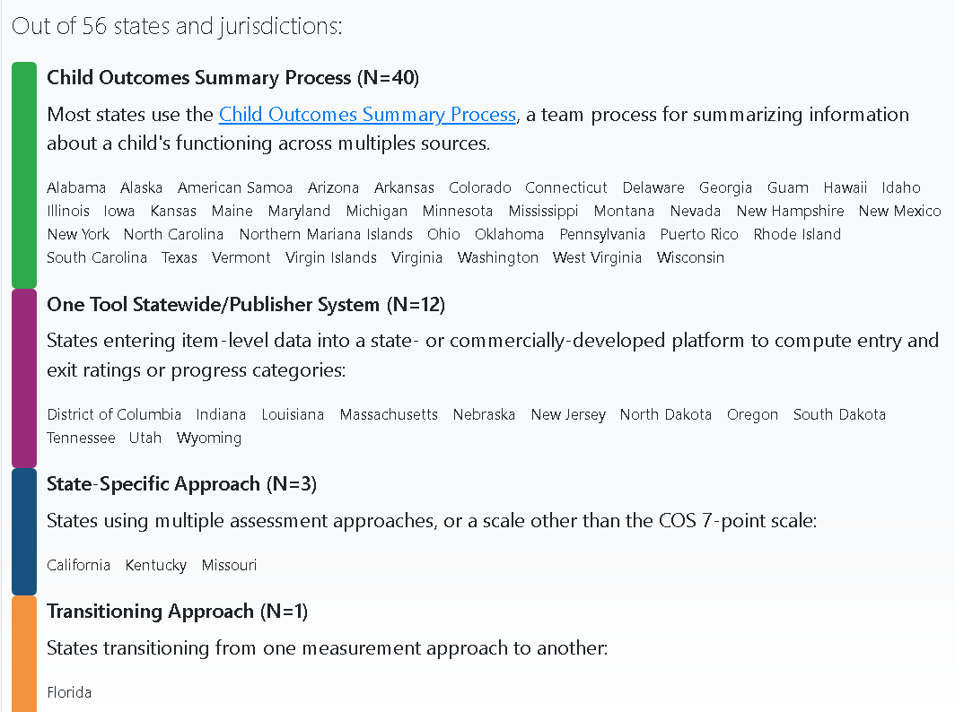
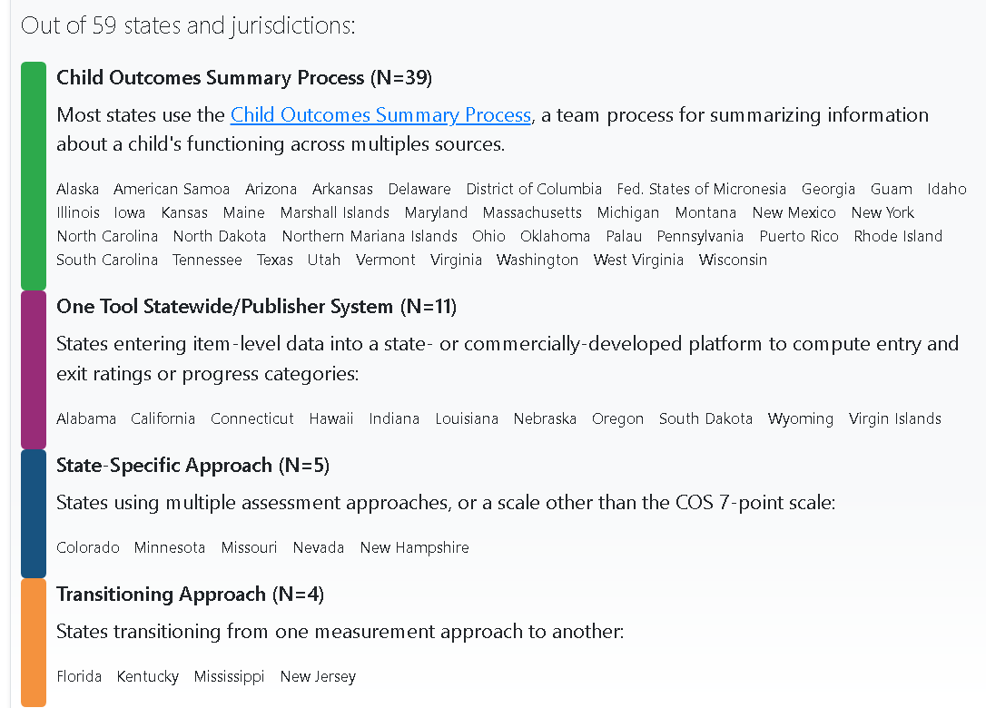
Child outcome measurement approaches:
Part C and Part B/619
Notes:
Lisa Backer

Slide 21
Data to be applied to the question
Entry data collected, at a minimum, for each child who can be served for six months or more under Part C or Part B / 619.
Subgroups for analysis:
Children demonstrating all age-expected skills at entry related to an outcome (COS 6 or 7)
Children demonstrating some age-expected skills at entry related to an outcome (COS 4 or 5)
Children demonstrating no age-expected skills at entry related to an outcome (COS 1, 2 or 3)
Notes:
Lisa Backer

Slide 22
Look! Think! Act!
LOOK | Make factual statements about the data.
What do you see?
What catches your attention?
How do results vary for different groups, topics, or time points?
THINK | Interpret the observations made in the Look stage.
Does anything you observed during the Look stage surprise you? If so, why?
What factors might explain the results?
What are your hypotheses, explanations, or conclusions about the observed data?
What do the data tell us about the question(s) we are trying to answer?
What are the limitations of the data ?
Are there contextual or data quality factors that should be considered?
What additional data do we need to interpret the results?
Notes:
Lisa Backer

Slide 23
Look! Think! Act! (2)
ACT | Identify actions based on conclusions made in the Think stage.
What do the results mean for our work?
Why do they matter?
What additional data do we need to determine actions?
What actions should be considered based on these results?
How will these actions lead to improvement?
When, how, and by whom will the actions be implemented? What resources are needed?
How will we monitor progress on these actions?
Notes:
Lisa Backer

Slide 24
Look at this data display. Make factual statements.
Notes:
Lisa Backer

Slide 25
Look at this data display. Make factual statements.
Notes:
Lisa Backer

Slide 26
Think: Attach meaning to this data display.
Notes:
Lisa Backer

Slide 27
Referral Sources Breakout
Notes:
Mary Lee Porterfield

Slide 28
Breakout Agenda
Examples of disaggregating by
  Referral source
  Referral closure reason
  Cross-tabulation of referral source by referral closure reason
Discussion and participant sharing
Notes:
Mary Lee Porterfield

Slide 29
Referrals by Referral Source
Referral Source | Number of Referrals
Physician | 1027
Parent | 347
Social Services | 369
Hospital/NICU | 145
Child Care | 24
Other | 88
Total | 2000
Notes:
Mary Lee Porterfield
First let’s look at an example of referrals disaggregated by referral sources. What are your impressions?

Slide 30
Referrals by Referral Closure Reason
Referral Closure Reason | Number of Referrals
Attempts to contact unsuccessful | 456
Evaluation complete-child not eligible | 131
IFSP developed | 435
Late referral | 411
Parent declined eligibility determination | 422
Parent declined enrollment although child found eligible | 145
Notes:
Mary Lee Porterfield
Now let’s look at referrals disaggregated by referral closure reason. What are your impressions of these data?

Slide 31
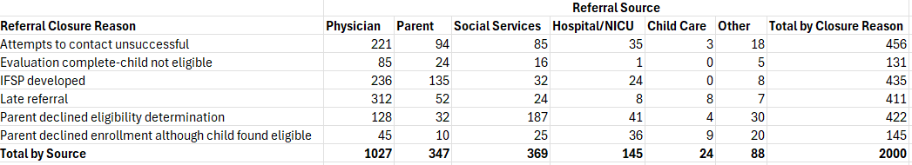
Referral Closure Reason By Referral Source
Referral outcomes for physician referrals
Percentage of “attempts to contact unsuccessful” attributed to each referral source
Notes:
Mary Lee Porterfield
Now let’s take those examples of referrals by source and referrals by closure reason a step further and look at the referral closure reasons by referral source. {click}
First let’s zero in on physician referrals and their closure reasons. We see that physician referrals account for more than half of all referrals – 1027 total referrals, and in the pie chart we can see the percentage of each referral outcome. {click}
What jumps out at you here? {pause for discussion}
{click} In the last session someone mentioned wanting to dig into the “unable to contact” so let’s look at that. Another way we might want to dig into these data is to see how each of our referral sources are contributing to those 456 “attempts to contact unsuccessful.” {click} {click}
In looking at the data table and the pie chart, physicians account for the largest proportion of “attempts to contact unsuccessful”– 48% (Physician referrals account for about 51% of referrals overall 1027/2000, so we may consider this a proportionate number of referrals ending this way). For other referral sources we see unable to contact with 20% of parent referrals, 19% of social services referrals, 8% of Hospital/NICU referrals, 1% of child care referrals, and 4% of other referrals.

Slide 32

Discussion
What are your thoughts about this type of look into your data?
How might you use this type of an approach?
What have been your experiences in digging into data about referral sources?
  What kinds of data have you explored?
  How have you engaged key partners?
  How has it gone?
Notes:
Mary Lee Porterfield

Slide 33
Child Find Self-Assessment Breakout
Part C and Part B 619 Versions!
Notes:
Margaret Gillis
https://ectacenter.org/topics/earlyid/tools.asp

Slide 34
Child Find Self-Assessment Tools
Background
Sections
Voluntary self-assessment tool
Developed by OSEP in collaboration with DaSy and ECTA
Designed to be used in collaboration with key partners rather than by the program alone
Regulatory requirements specific to child find
Child Find Best Practices
Technical Assistance and Resources
OSEP Policy Letters and Guidance
Notes:
Margaret Gillis
https://ectacenter.org/topics/earlyid/tools.asp
How many of you are familiar with the Child Find Self-Assessment for Part C or 619?
My plan for the breakout is to talk through the tools briefly and discuss how they can be used
We can also open up the tools and talk through what is in them
Can talk about people’s experiences using them (if anyone has exp using them)

Slide 35
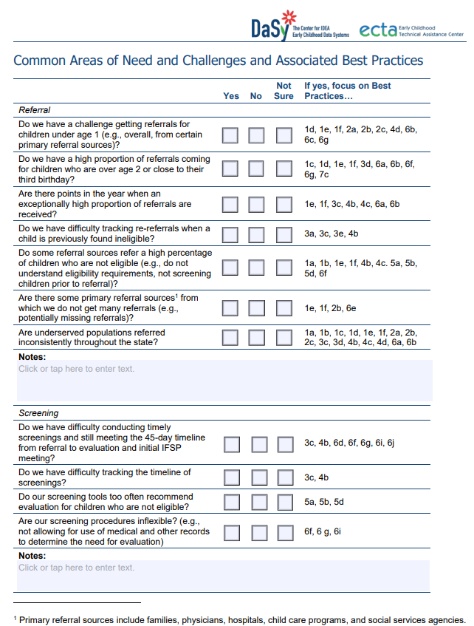
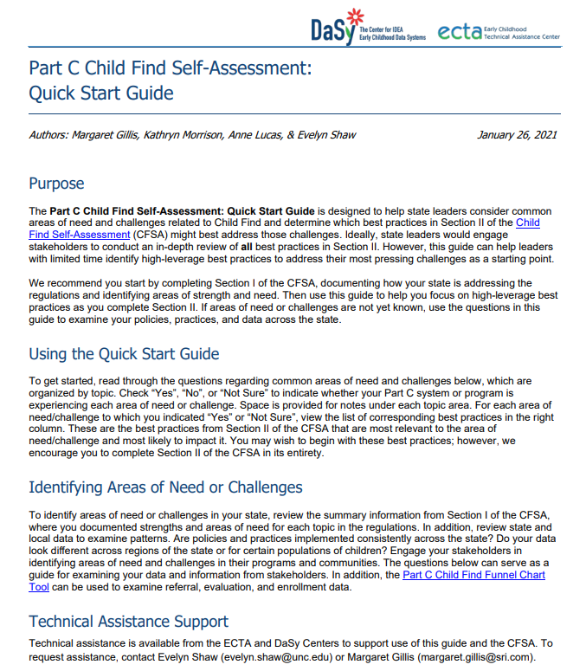
Part C Quick Start Guide
Identify areas of need and challenges
Guide points to the associated best practices as a starting place
Notes:
Speaker: Margaret
Time: 1-2 minutes
The Quick Start Guide includes a list of common areas of need or challenges related to child find and points you to the best practices in the Excel tool most likely to impact that challenge. This is a great way to get started with the tool, especially if you have limited time to complete the Excel tool – you can focus your energy

Slide 36
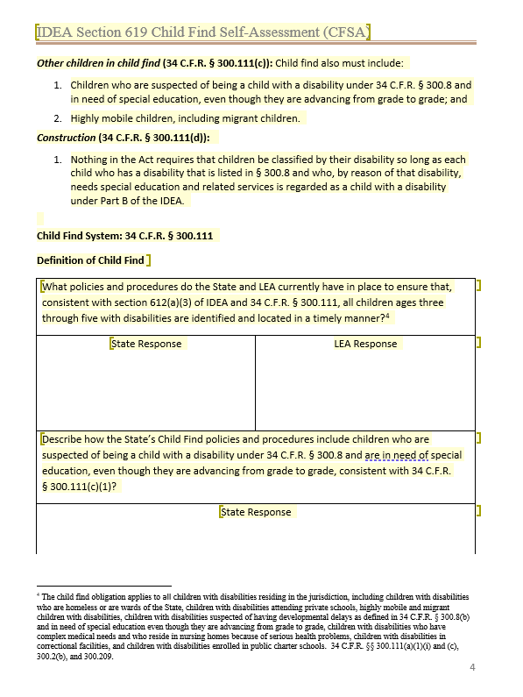
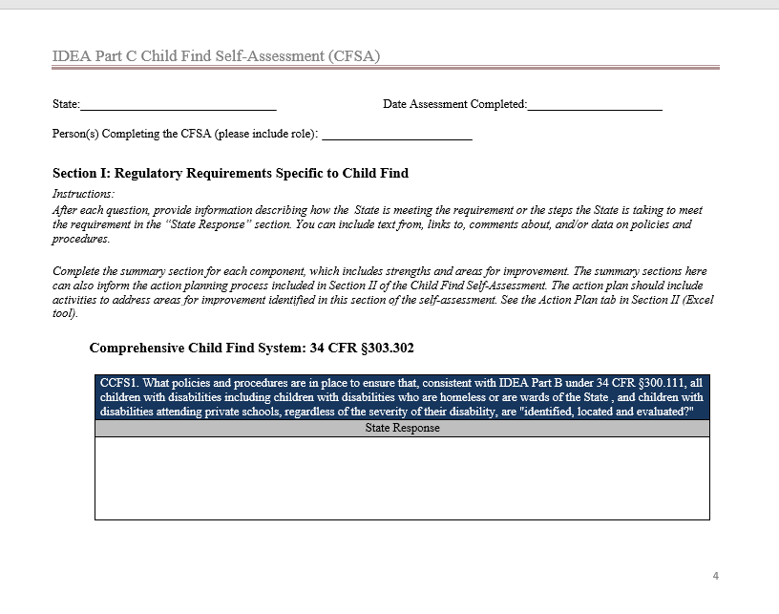
Section 1: Regulatory Requirements Specific to Child Find
Notes:
Speaker: Margaret
Time: 3-5 minutes
Go to document – show how to get there on the website then open
https://ectacenter.org/~xls/topics/earlyid/Part_B_619_CFSA_Section_II_Part_B_619_Child_Find_Best_Practices.xlsm
https://ectacenter.org/~xls/topics/earlyid/Child_Find_Self-Assessment_Section_II_09012020.xlsm

Slide 37
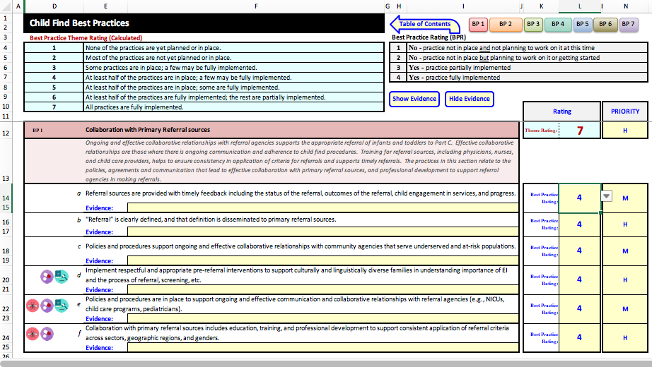
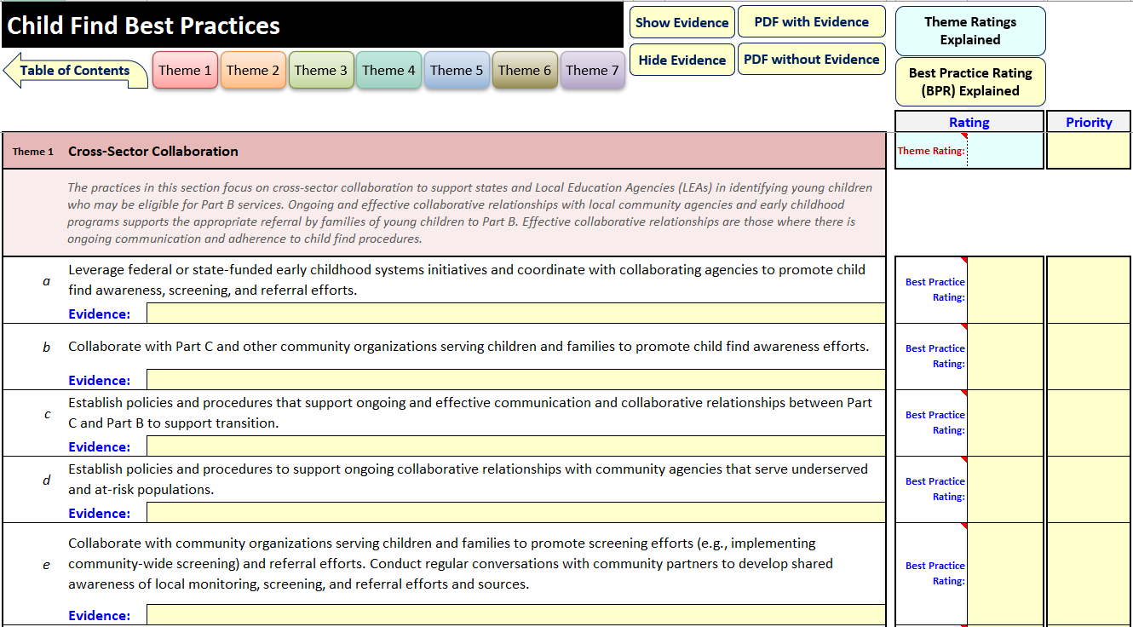
Section 2: Best Practice Excel Tool
Notes:
Speaker: Margaret
Time: 10 minutes
Go to Excel tool
Here we see a brief screenshot of the part of the Excel tool where you will do most of your work. Let’s open up the Excel tool and walk through it together. As you can see, there are some minor differences in formatting, but the Part C and Part B 619 versions function the same way.
Walk through either version – point out the best practice rating scale, the theme rating, and the priority rating.
Show each tab, including theme summary and action plan.
https://ectacenter.org/~xls/topics/earlyid/Part_B_619_CFSA_Section_II_Part_B_619_Child_Find_Best_Practices.xlsm
https://ectacenter.org/~xls/topics/earlyid/Child_Find_Self-Assessment_Section_II_09012020.xlsm

Slide 38
Differences Between the Tools
Part C Child Find Self-Assessment Tool
Part B 619 Child Find Self-Assessment Tool
Intended for use at the state level
Has icons that highlight special considerations for special populations
  Maltreatment
  Neonatal substance exposure
  Zika infection
Intended for use at the local or state level
Section I includes space for state and local responses
Notes:
Margaret Gillis

Slide 39
Session 2 Takeaways
Digging deeper into pre-enrollment data can help programs examine equity in access to early intervention and preschool special education.
A combination of quantitative and qualitative data may be most useful for really understanding what is happening within your child find system.
There are endless opportunities to disaggregate data by single variables and multiple variables at the state and local level to answer questions that are important to the program and key partners.
Notes:
Margaret Gillis

Slide 40
Planning for Session 3
Between now and session 3 identify which critical questions you would like to address and let us know (you can choose more than one).
  If there are questions not included in the critical questions that you would like to explore, let us know.
We will provide table shells that you can use to prepare data if you wish to bring your own state data to the session, or you can use the fake data set we provide.
During the session, we will use breakout groups to provide hands-on opportunities to dig into your chosen critical questions to develop and execute an analysis plan.
Notes:
Margaret Gillis
We’ll follow up via email with this information and the critical questions on the next slide, so no need to scramble to get it down.

Slide 41

Critical Questions Related to Child Find
DaSy Critical Questions
1.B.2. How do children enter and move through the system?
  3 sub-questions
DaSy Critical Questions for Equity
1.A.1. Are programs, processes, and procedures resulting in equal opportunity for receipt of EI/ECSE for children and families of all races and ethnicities?
  8 sub-questions
1.B.2. Are the programs, processes, and procedures to enter the system working well for all children/families?
  8 sub-questions
  Do these capture all the questions you want to answer with your child find data?
  What other questions do you have related to how your child find system is working?
Notes:
Margaret Gillis
Here are the DaSy Critical Questions related to child find.
We’ll be reaching out in the next week or so to get some more information from you about where you want to focus your time during session 3 so we can be sure we are providing the correct table shells for folks and to be able to plan for the breakout groups.
Between now and then, we ask that you spend a bit of time taking a look and thinking about these questions and think about the questions you want to ask related to your child find system. The questions you have may not all be captured in these, so please feel free to stray from these questions and let us know the questions you have. We will do our best to accommodate your needs and interests.
DaSy critical questions: https://dasycenter.org/wp-content/uploads/2020/12/DaSy_Critical_Questions_2020.pdf
DaSy Critical questions for equity: https://dasycenter.org/wp-content/uploads/2023/10/DaSy_RacialEquityCriticalQuestions_Acc.pdf
We will provide table shells in advance of our next meeting for you to bring to the call

Slide 42
Until next time,
Here are some resources to support your child find work:
  Child Find Funnel Chart Tool
  Meaningful Differences in Child Find Calculator
  Part B Indicator Data Display Wizard
  Child Find Self- Assessment (Part C and Part B 619 versions available)
  Local Contributing Factor Tool for SPP/APR Indicators including C4 and C5
In the Padlet or the chat please share:
What went well?
What could be improved?
Other comments
Notes:
Margaret Gillis
Before we leave, we wanted to provide you with some resources to support your work, and we especially want your feedback on this session. Please visit the padlet or type in the chat your response to these questions so we can improve our planning for the next session in this series.

Slide 43
Find out more at dasycenter.org and ectacenter.org

