Slide 1

The What, Why and How: The Critical Need to have Families at the "Table"
Grace Kelley, DaSy
Michelle Lewis, DaSy
Susan Barlow, CPIR
Region A Parent Center Conference
October 17-19, 2023
Notes:
Presenter Notes: Welcome to our Family Data Leader Training for Families! We will begin shortly.
Procedural Directions:
Trainers will fill in the dates and times for training and their agency name and logo
This slide will be shown as people log on or enter the room
Trainers may choose to have participants sign into the chat (if virtual) or sign in on paper (if in-person)
Links to go through ahead of time
Look Think Act Discussion Guide Look! Think! Act! Discussion Guide (dasycenter.org)
Stakeholder Knowledge Toolkit, Data as Information https://dasycenter.org/wp-content/uploads/2018/01/se-toolkit-datainfo-questions-infographic.pdf
Critical Questions doc https://dasycenter.org/wp-content/uploads/2020/12/DaSy_Critical_Questions_2020.pdf
SPP Indicators card cipr dasy program docs - OneDrive (sharepoint.com)
ECTA Center: Glossary

Slide 2
Objectives
Participants will:
Learn about a pilot project for training Family Data Leaders
Understand the importance of the family voice, and the multiple ways families can participate in data-based decision making at the local, state and national level
Understand why data is critical to inform systems change and program improvement across all levels​
Understand and apply their knowledge of the basics of data, data analysis, and data use to understand the function of data as it relates to Part C and Part B 619 programs
Notes:
Susan

Slide 3
Family Data Leader Pilot Project
Developed by:
Center for Parent Information Resources (CPIR) - The hub for information and products for Parent Centers serving families of children with disabilities.
Center for IDEA Early Childhood Data Systems (DaSy) - A national technical assistance center that supports IDEA Part C early intervention and IDEA Part B 619 early childhood special education state programs in building high quality data systems and using data to improve results for young children with disabilities and their families.
Pilot Parent Center Trainers - 28 Parent Center staff from 14 Parent Centers from across the country participated in the development and review of this series.
Notes:
Susan
Presenter Notes: This training is a project developed by Center for Parent Information and Resources (CPIR) together with The Center for Data Early Childhood Data Systems (DaSy).
CPIR is your central “Hub” of information and products created for the network of Parent Centers serving families of children with disabilities.
DaSy is a national technical assistance center that works with states to support IDEA Part C early intervention and IDEA Part B 619 early childhood special education state programs in building high quality data systems and using data to improve results for young children with disabilities and their families.
This Family Data Leader (FDL) Training will be a series of sessions on using data for improving programs and systems conducted by Parent Centers in partnership with DaSy for families and other key stakeholders in early intervention and early childhood special education.
Procedural Directions:
Links to be used during sessions (to paste into chat): CPIR https://www.parentcenterhub.org/ and DaSy https://dasycenter.org/

Slide 4

Goal
The goal of the Family Data Leadership (FDL) Training is to build the capacity of family members to participate in important data discussions about programs and systems that impact infants, toddlers, and preschoolers with disabilities and their families. These sessions promote an understanding of data and using data to make state or program level improvements.
Notes:
Susan
Presenter Notes: The goal of the Family Data Leadership Training is to build the capacity of family members to participate in important data discussions about programs and systems that impact infants, toddlers, and preschoolers with disabilities and their families. These sessions promote an understanding of data and using data to make state or program level improvements.
Our goal is that you will feel empowered, informed and ready to sit at a table to have meaningful, informal conversations, and ask great questions.
Procedural Directions: Presenter will read notes.

Slide 5

Overview of Sessions
Session 1
Overview of the Family Data Leader Project
What it means to be an FDL
Increase knowledge of early intervention (Part C) and Preschool Special Education (Part B, Section 619)
System change
Stakeholder engagement
Relationship between data and accountability
All about SPP/APR
Session 2
Recap of SPP/APR
All about data
Stages of data cycle
Using data to advance equity
Examining the importance of WHY
Successful participation and effective communication
Session 3
About Look! Think! Act!
How to Use Look! Think! Act!
Session 4
Apply learning to data scenarios
Learn strategies for FDL to be successful during data discussions
Notes:
Susan
Presenter Notes:
This series to divided into four sessions that build on each other. We will talk more in a minute about the objectives for each session. During this series you will hear the term "Stakeholders" We define stakeholders as family members, service providers, program administrators and various staff from state departments and other early childhood programs.
We will be covering:
Session 1
What it means to be an FDL
Increase knowledge of early intervention (Part C) and Preschool Special Education (Part B, Section 619)
System change
Stakeholder engagement
Relationship between data and accountability
All about SPP/APR
Session 2
All about data
Stages of data cycle
Using data to advance equity
Examining the importance of WHY
Session 3
About Look! Think! Act!
How to Use Look! Think! Act!
Session 4
Apply learning to data scenarios
Learn strategies for FDL to be successful during data discussions
Procedural Directions: Read the presenter notes.

Slide 6
Learning Objectives for Series
Participants will:
understand the role of a Family Data Leader, the importance of the family voice, and the multiple ways families can participate in data-based decision making at the local, state and national level (WHO)
understand why data is critical to inform systems change and program improvement across all levels (WHY)
understand and apply their knowledge of the basics of data, data analysis, and data use to understand the function of data as it relates to Part C and Part B 619 programs (HOW)
explore and begin to apply the Look! Think! Act! data-use framework to engage with data (including the state SPP/APR) for systems change, program improvement, and better child outcomes (WHAT)
Notes:
Susan
Presenter Notes: The learning objectives cover 4 big questions:
Who ...Why... How... and What
Participants will:
The Who: understand the role of a Family Data Leader, the importance of the family voice, and the multiple ways families can participate in data-based decision making at the local, state and national level
The WHY: understand why data is critical to inform systems change and program improvement across all levels
The HOW: understand and apply their knowledge of the basics of data, data analysis, and data use to understand the function of data as it relates to Part C and Part B 619 programs
The WHAT explore and begin to apply the Look! Think! Act! data-use framework to engage with data (including the state SPP/APR), for systems change, program improvement, and better child outcomes
Procedural Directions: Read the presenter notes.

Slide 7
What does being a Family Data Leader mean?
A Family Data Leader brings their family perspective and lived experience and their voice—to inform systems change efforts.
This is accomplished through becoming skilled data users by:
Building and using knowledge, skills, and bringing a broad perspective of the Individuals with Disabilities Act (IDEA), data use, and systems building activities, and
Applying these data-use knowledge and skills to provide feedback and inform decisions to support program improvement in
Part C and Part B 619.
Notes:
Susan
Presenter Notes: A Family Data Leader brings their family perspective and lived experience—their voice—to inform systems change efforts.
This is accomplished through becoming skilled data users by:
Building and using knowledge, skills, and a broad perspective of the Individuals with Disabilities Act (IDEA), data use, and systems building activities, and
Applying these data-use knowledge and skills to provide feedback and inform decisions to support program improvement in Part C and Part B 619.
In order to apply data use knowledge and skills, it is important to have foundational knowledge about Part C and Part B619
Procedural Directions: Read presenter notes

Slide 8
Part C and Part B 619 of IDEA
Part C – Early Intervention – focuses on infants and toddlers (birth to age 3) as well as their families
Part B 619 – Special education and related services for children ages 3-5
Notes:
Grace
Presenter Notes: Part C of the Individuals with Disabilities Education Act, called "Infants and Toddlers with Disabilities program," focuses on infants and toddlers (birth to age 3) as well as their families. Part B of the IDEA provides requirements for special education and related services for children and youth ages 3 to 22 with disabilities and to ensure they have access to a free appropriate public education. Part B 619 is specific to services for preschool children with disabilities ages 3–5. Neither Part C and Part B 619 are mandatory, but all states chose to offer them. Let's watch this video to learn more about Part C and Part B 619.
Procedural Directions: Click on the photo to start the video if for some reason it doesn't work the link is below Assure everyone can hear it
https://youtu.be/mHkLUp52vZ0

Slide 9
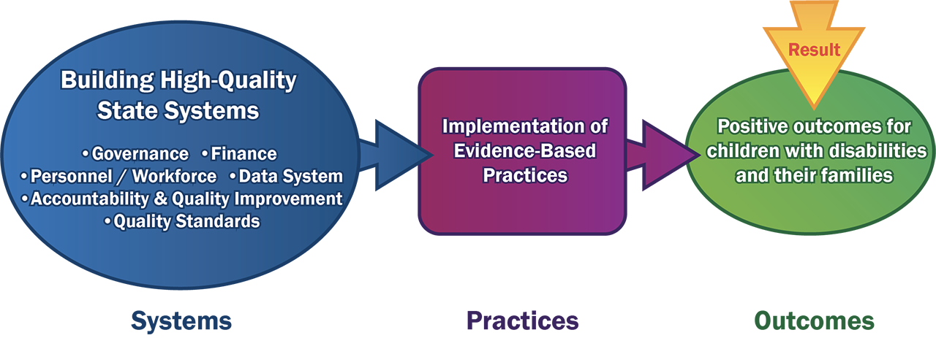
Why High-Quality Systems Are Important
Notes:
Grace
Presenter Notes: Why do we care about the system components? Because we care about positive outcomes for children with disabilities and their families. The state's system is responsible for critical functions that promote effective practice at the local level such as establishing personnel requirements, planning for a financially-sound system, providing policy and procedural guidance, and delivering technical assistance to support local programs and personnel. The local programs are responsible for the implementation of high-quality, individualized services as required under IDEA. A high-quality state system leads to the implementation of effective practices at the local level, that lead to achieving positive outcomes for young children with disabilities and their families.
Procedural Directions: Read Presenter notes

Slide 10
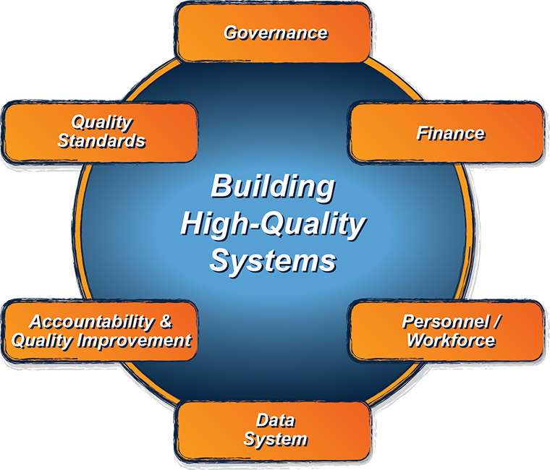
Building High-Quality Systems
Notes:
Grace
Presenter Notes: Let's talk about what Building High Quality Systems means. Although this conversation will focus on early childhood, these 6 components can be part of ANY system. Many systems have components that break down into these components or areas. When FDL gets invited to a conversation where systems change is the topic, several of these areas may be impacted. For example, making a change to the way Part C is delivered – this is part of governance – in turn impacts how data is collected—this is data system—and who needs to be hired—which is part of personnel/workforce—and costs, which is part of the finance component. Nothing happens in a vacuum.
http://ectacenter.org/sysframe/
Procedural Directions:
Below is some background on each of the bullets for trainers to become familiar with these terms; feel free to paraphrase:
Governance - The focus of this component is to make certain that structures and partnerships are in place to support effective, efficient service delivery systems that provide equitable access to services for all eligible children and their families.
Finance - This component is about ensuring that sufficient funds and resources are in place to support and sustain all components of the system, thereby facilitating the implementation of evidence-based practices relying on multiple funding streams at the federal, state and local level.
Personnel/Workforce - This component ensures that infants, toddlers, and all children with disabilities and their families, are provided services by knowledgeable, skilled, competent, and highly qualified personnel, and that enough of these personnel are available to meet service needs.
Data System - The data system component assists IDEA early childhood programs in developing and enhancing high-quality state data systems for the collection, analysis, reporting, and use of their IDEA data to ensure that children and families receive the needed services and have access to programs.
Accountability and Quality Improvement - This component assists state leaders in assessing and improving all other components of the framework. It provides direction on determining strategies that achieve a quality, effective, and efficient system to support implementation of evidence-based practices leading toward improved outcomes for children and their families. True accountability holds states responsible for a sustainable process that ensures ongoing quality and improvement.
Quality Standards - Infants, toddlers, and young children with disabilities have the right to receive services and participate in the full array of public and private early care and education programs that are available to all young children. In order to effectively support early learning and positive child and family outcomes, these programs must be guided by agreed upon, evidence-based standards for what all young children are expected to know and be able to do (child level standards), as well as agreed upon, evidence-based standards for what constitutes quality in early care and education programs (program level standards).

Slide 11

Systems Change is lasting change
That alters underlying structures, which can include:
policies,
routines,
relationships,
resources,
power structures and
values.
Notes:
Grace
Presenter Notes: Now that we have broken down the components of systems, let’s talk about when systems aren't working efficiently or need to be changed. Systems change aims to bring about lasting change by altering underlying structures and supporting mechanisms which make the system operate in a particular way.
Think about the systems in a car: engine, fuel, ignition, exhaust, and so on. Think about how those components interact and react to each other. Then think about the innovations that had to occur within those components when computer technology was added. In order to effectively achieve positive outcomes with the cars, all the underlying structures and supporting mechanisms within those components of the system had to be adjusted to align with the computerization. This includes things like removing mechanical parts, adding computer chips and retraining mechanics who service the cars.
In an example from early intervention, consider this: In one state all Early Intervention Providers had to bill for their services through each county. The county then in turn billed their state health department. Then someone had the great idea to revise the system so that providers could just bill the state through a central billing system saving hundreds of thousands of dollars in both time and resources. How does this affect providers, the state system, policies etc.?
Procedural Directions: Read Presenter notes and facilitate the last question.
Source: http://www.thinknpc.org/publications/systems-change/

Slide 12
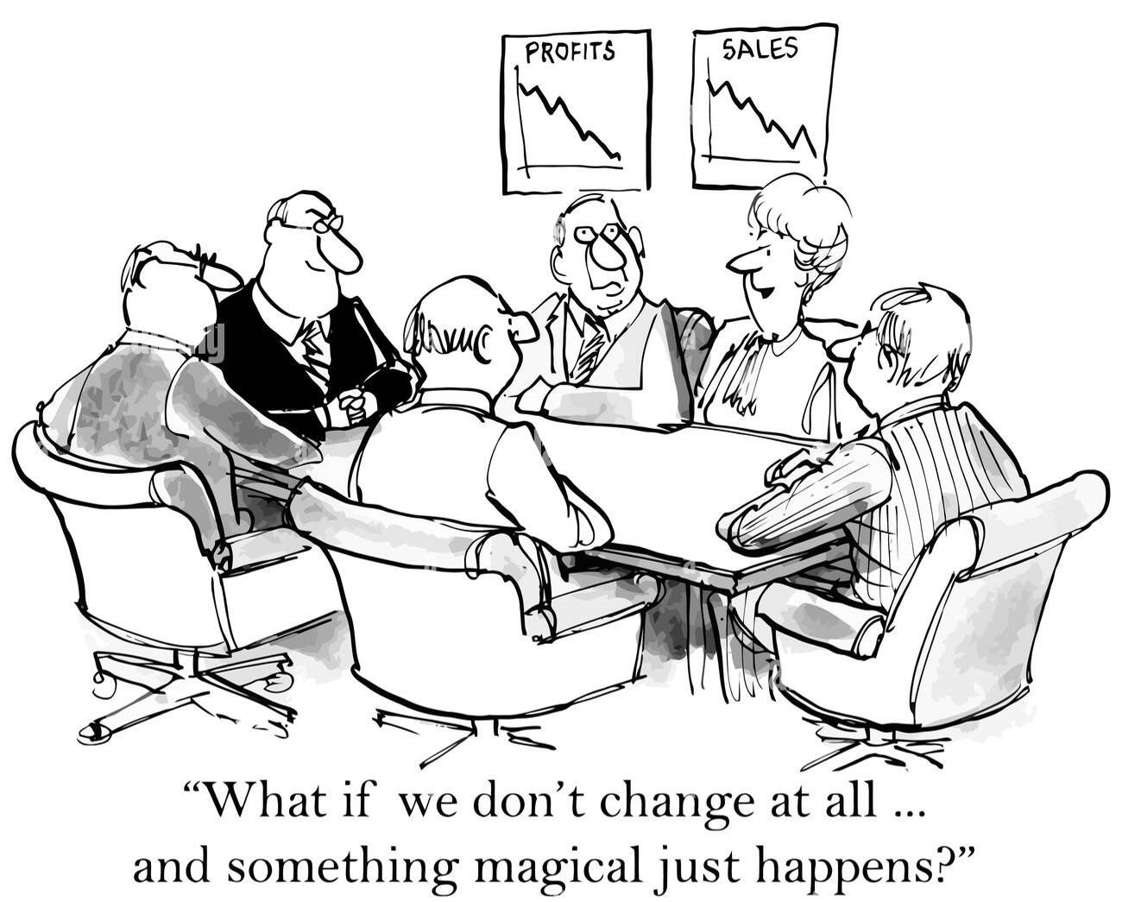
Unfortunately, systems change doesn’t just happen like magic!
Notes:
Grace
Presenter Notes: Unfortunately, systems change doesn’t just happen like magic..........What if we don’t change at all and something magical just happens?
Procedural Directions: Read the presenter notes

Slide 13

Importance of IDEA Data
Notes:
Michelle
Presenter Notes: High-quality IDEA data help ensure that children with disabilities receive the early intervention and special education services to which they are entitled. This video from IDEA Data Center (IDC) also provides a brief introduction to the history of IDEA and the evolution of data use in early intervention and special education. Let's listen.
Procedural Directions: Click on the photo to start the video if for some reason it doesn't work the link is below Assure everyone can hear it
https://youtu.be/H4IQS61R-bc

Slide 14
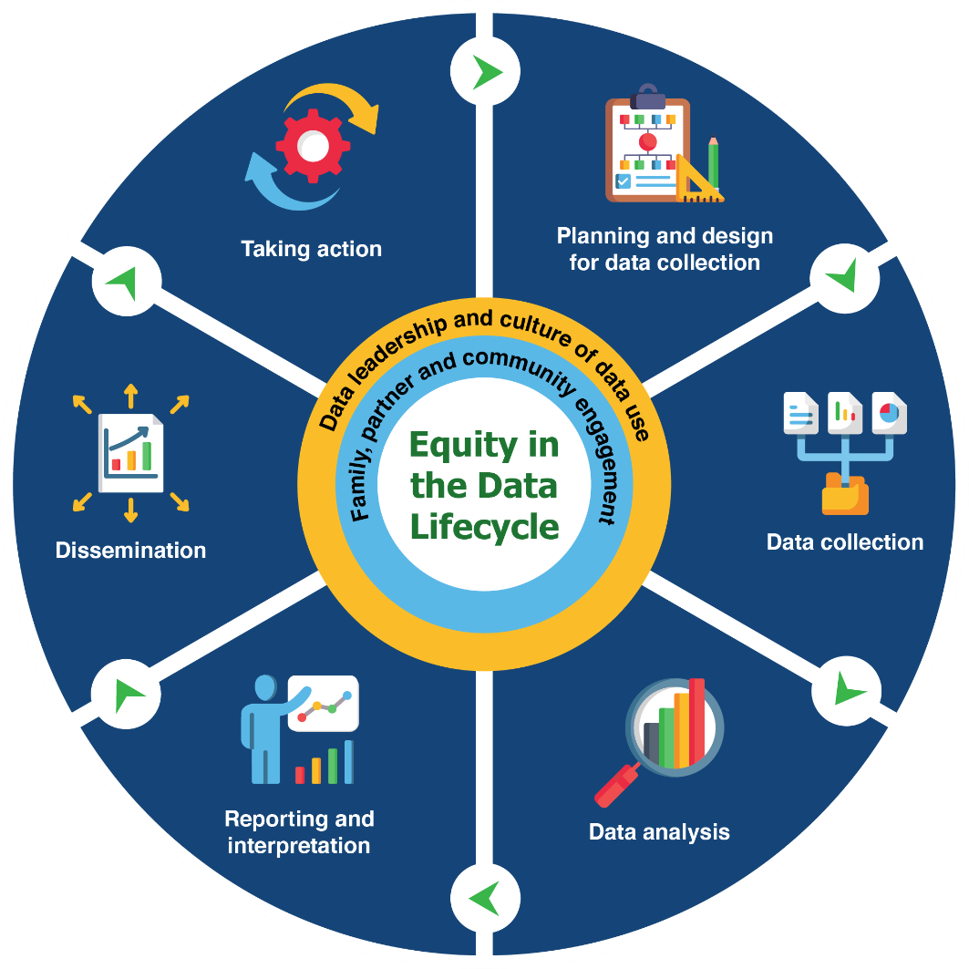
Engage in a Cycle of Inquiry
Inquiry is a cyclical process that takes time, and it’s important for data teams and communities to work together throughout.
Applying an equity-focused approach to inquiry prompts data teams to reexamine and assess power dynamics, policies, practices, mental models, and beliefs, that perpetuate systemic barriers and inequalities.
Draft representation of Embedding Equity in the Data Lifecycle. Will be available from dasycenter.org.
Notes:
Grace
Leaders follow four principles to use data for good
Expand opportunity – open doors to greater opportunity for families and children
Provide transparency and evidence – provide information to stakeholder on how data has informed policy or practices
Empower communities – empower stakeholder to hold systems accountable
Promote equitable outcomes – achieve equitable outcomes for all
Source (2020) Four Principles to make Advance Data Analytics Work for Children and Families. Annie E. Case Foundation

Slide 15
Reasons to Collect and Use Data
Assess and improve quality of services that benefit children and families
Examine disparities in access, services and supports
Advocate for federal, state, and local policy change and investments
Increase public awareness and understanding
Build trust within and across communities and systems
Achieve positive and equitable outcomes for children and families
Notes:
MIchelle
Presenter Notes:
There are many reasons to collect and use data. These are just a few! Data can help…
Assess and improve quality of services that benefit children and families
Examine disparities in access to services and supports
Advocate for federal, state, and local policy change and investments
Increase public awareness and understanding
Build trust within and across communities and systems
Achieve positive and equitable outcomes for children and families
Let us now spend some time looking at various perspectives on data use and equity.
Procedural Directions:
Presenter will review the list

Slide 16

How can data help?
Evaluating disaggregated data can help identify inequities, but data are not meant to be interpreted in a vacuum.
It’s important to remember that data can and have been used to harm groups and communities.
To use data to help identify and reduce inequities, it’s critical to look at data with families and communities and listen to lived experiences.
Adapted from Data Feminism.
See more here: https://data-feminism.mitpress.mit.edu/
Notes:
Michelle
Presenter Notes:
How can data help?
It’s hard to talk about racial inequities if you don’t first disaggregate (or break apart) your data by race. Tackling equity issues requires an understanding of the root causes of outcome disparities within our early intervention and early childhood special education programs and our communities. State data can provide clues as to where structural inequities exist. Through data disaggregation and looking at significant variations in outcomes, we can start to identify and dig into the root causes of inequities. Although disaggregated data can help identify inequities, it’s important to remember data are not meant to be interpreted in a vacuum. Context is key! What information, or context, is needed to provide meaning and clarity to the data? Is there a new teacher in the childcare room or classroom? Is there a high turnover rate in physical therapists? Did the budget get cut for programs in certain neighborhoods and not others? Understanding the context can change your perspective on a dataset and help you decide what the numbers represent and how to interpret them.
It’s also critical to keep in mind that data can and have been used to harm groups in the past.
And lastly, data conversations must center the voices of families and communities. Listening to lived experiences is essential to interpreting data and engaging in meaningful equity work.
Procedural Directions: Read Presenter Notes

Slide 17
Why it is important that families are involved in data discussions?
Families bring:
Unique life stories on behalf of all children and families, not just their own.
Different levels of access to information and support.
Different experiences with using data in both personal and professional lives.
Intersectional identities that inform their understanding of the data (e.g., identifying as female and Asian American).
Varied feelings about today’s “data-rich” culture.
Diverse voices.
Notes:
Michelle
What are the important ways that families are involved or could involve in data discussion?
Presenter Notes:
Families bring:
Unique life stories on behalf of all children and families, not just their own.
Different levels of access to information and support.
Different experiences with using data in both personal and professional lives.
Intersectional identities that inform their understanding of the data (e.g., identifying as female and Asian American).
Varied feelings about today’s “data-rich” culture.
Diverse voices.
And read this: Parents centers help families by giving them the knowledge and skills related to early intervention and preschool special education data.
Procedural Directions: Read Presenter notes

Slide 18

Look! Think! Act!
Notes:
Miehelle
Presenter Notes:
Look! Think! Act! Is a DaSy tool designed to build capacity to use data for program improvement. It can be used by state staff, local program staff and the diverse stakeholders, including families, that are a part of those rich, data discussions at all levels of the system.
Look! Think! Act! provides a valuable strategy for examining, reflecting, and acting upon data. As a family member, you can use these strategies anytime you are looking at data, including when you join a local, regional or state level discussion that includes understanding data. At its core, it helps us look closely at the data, think about what it means, and then consider how we might act.
Procedural Directions: Read presenter notes

Slide 19
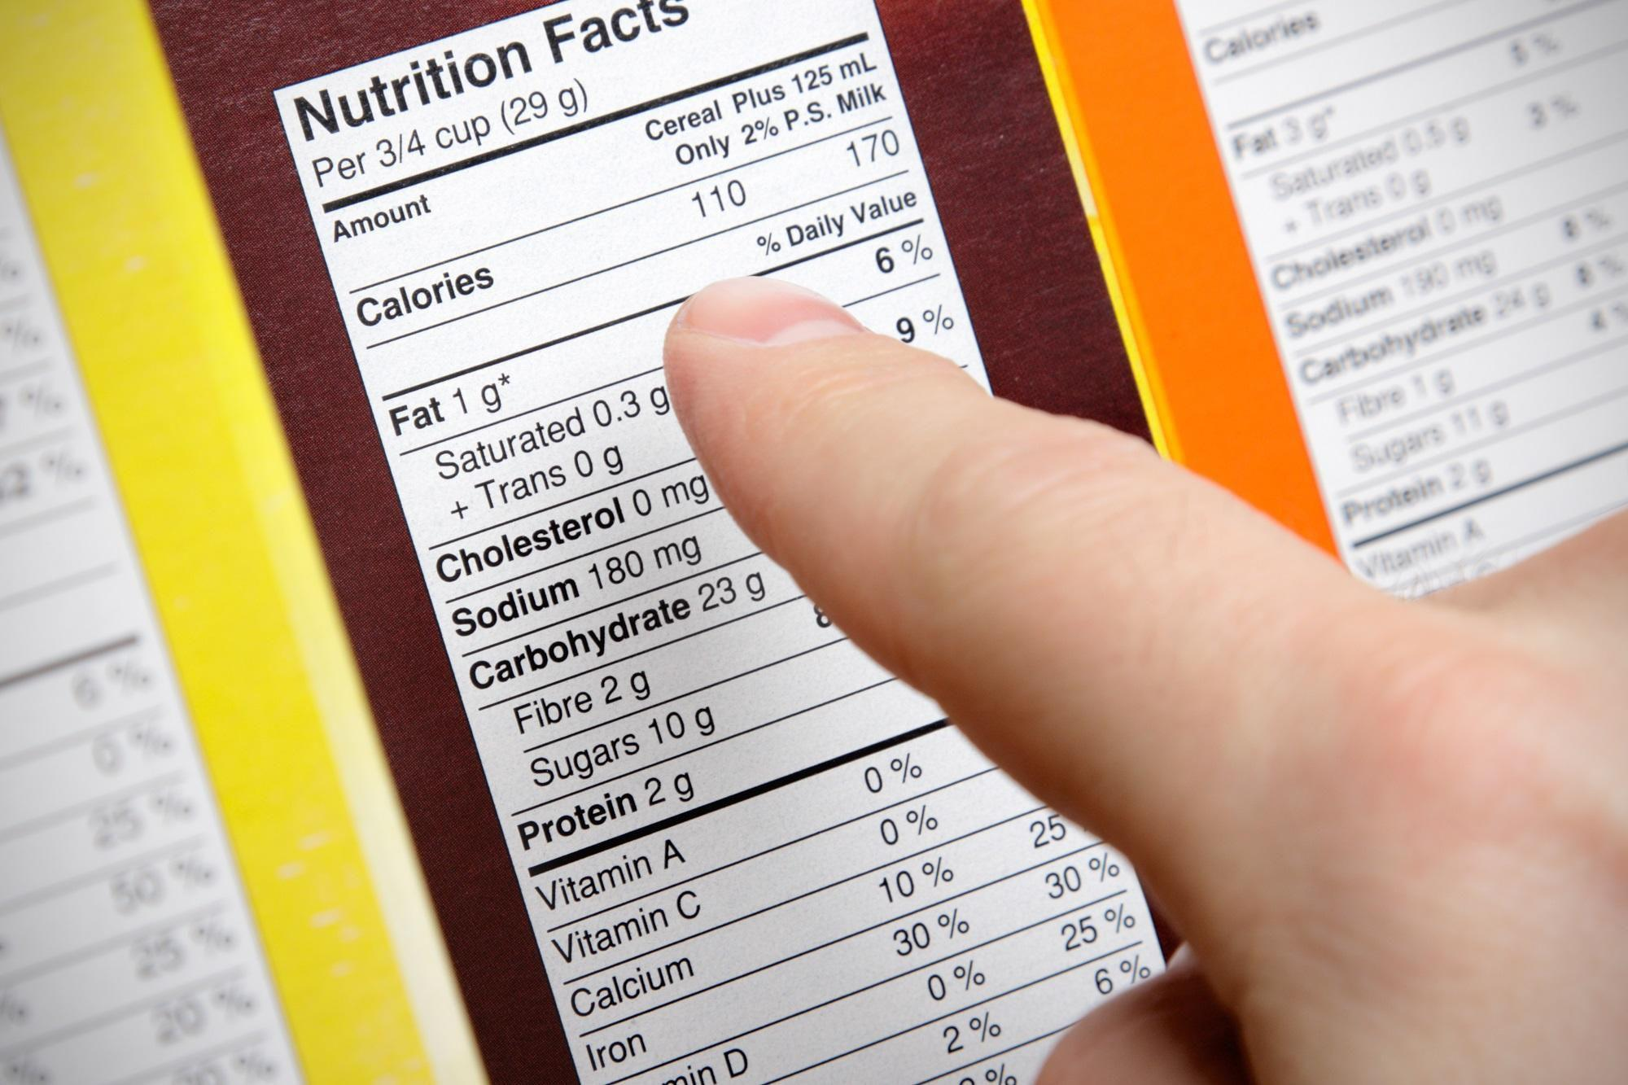


You may use Look! Think! Act! every day
Notes:
Michelle
Presenter Notes:
As humans, we use Look! Think! Act! every single day. Here are three quick examples of ways that you use Look! Think! Act! every day, whether you realize it or not. Imagine you're in the grocery store and you pick a product off the shelf. If you’re trying to choose nutritious items to bring home to your family, you may look at that nutrition label. Based on the data that you look at, you're either going to throw it in your cart or you're going to put it back on the shelf and move on to a new product. You used Look! Think! Act! You looked at the label, attached meaning to what you saw, and you acted.
Here's a dashboard display in your car. You look at your gas display and you attach meaning such as “Oh my gosh, I can probably only go another 10 miles before I run out of gas,” and then you head to the nearest gas station. You used Look! Think! Act! You looked at the gauge, attached meaning to what you saw, and you acted.
Many of you may have a fitness device on your wrist or you use the fitness app on your phone and you’re tracking your steps. You might look at that display and attach meaning such as “Oh, I've really done a good job today of getting my steps in,” or “Oh my goodness, I have not done a good job of getting my steps in.” And so, you act. Perhaps you take the stairs instead of the elevator, or you choose to park in the far corner of the parking lot rather than choosing a closer parking spot just to build in an opportunity to get some steps in. You based your decision on what data from your fitness device tells you. So, we all really do use, Look! Think! Act! every day and that simple process can be applied to lots and lots of data discussions that you might find yourself in.
Procedural Directions: Read Presenter notes

Slide 20

Data Discussion
What data do you use in your every day work?
How do you use the data?

Slide 21
Clarify the Purpose
Before looking at data, it is important to determine what critical question you would like to answer.
Are there specific populations, situations, or outcomes or concerns?
In looking at family outcomes, for instance, is it important to look at outcomes:
  By region or program?
  By race, ethnicity, and gender?
  By the child’s type of disability, developmental delay, or eligibility category?
Consider questions at multiple levels of the system: state, region, local program, practitioner, and the child and family.
Notes:
Michelle
Presenter Notes:
The Look! Think! Act! module was developed to help everybody that's part of the process of using data to make decisions, which includes the people who convene the data discussion group.
What questions are you trying to answer? Are you trying to understand the needs of the children and families served? Do you want to know how policies and procedures are affecting service delivery? Are you concerned about the quality of the services being provided? Do you want to understand why some children are reaching desired outcomes and others are not?
Before looking at data, determine what you are hoping to learn.
Be clear about the specific populations, situations, or outcomes that concern you.
In looking at child outcomes, for instance, is it important to look at outcomes by region or program?
By race, ethnicity, and gender? By socioeconomic status? By the type of disability, developmental delay, or eligibility category?
Consider questions at multiple levels of your system: state, region, local program, practitioner, and the child and family. For example, How does your state compare to a neighboring, similar state for serving infants and toddlers in their natural environment, both homes and childcare centers? How do different geographical regions in you state compare to each other? Is one local program enrolling more eligible children than all others? Which practitioners are using the evidence-based intervention practice with fidelity? How some children achieving their goals or outcomes and others are not? Determining the specifics of what you hope to learn will help you identify the most relevant data, determine how data should be analyzed, and communicate the purpose of the Look! Think! Act! data discussion to your participants.
If you join a data discussion and are unclear of the purpose, ask for clarity. This can be done in the meeting, or you can check with whoever invited you to see if they can shed light on what questions they are seeking to answer with the data they are talking about collecting or have already collected and are going to share.
Procedural Directions: Read presenter notes

Slide 22
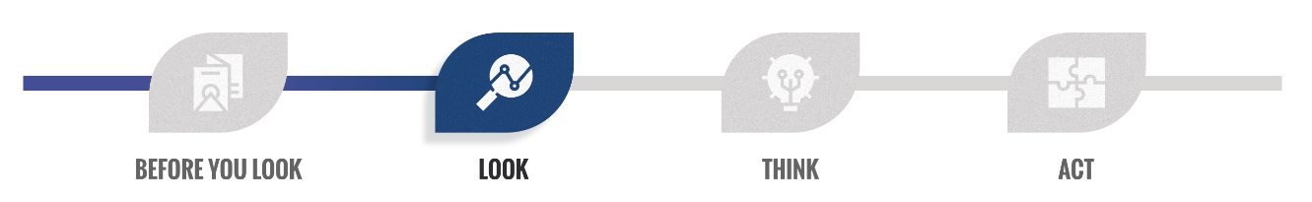
Look!
In the Look stage, you objectively examine data as a first step in answering an important question or solving a problem.
You look to identify information revealed in your data.
The information (or evidence) begins to create a picture or begins to tell a story.
  Do lines on a chart move up or down over time?
  Are some bars on a chart tall while others are short?
Notes:
Michelle
Presenter Notes:
In the video you heard them talk about the critical nature of the Look! stage and that it's often a part that’s skipped. There is sometimes a tendency for people to jump into drawing conclusions too quickly. In that Look! stage, the group takes the time to objectively examine data as that first critical step and you look to identify the information revealed in the data.
What is the evidence that you're going to use to begin to create a picture or tell that story? For example, if you're looking at a chart that has trend lines, do those lines go up or down over time. If you're looking at a chart that has bar graphs, are some bars tall and some short? You're not attaching meaning; you're just looking at the visual data display for what it tells you.
We want to make sure that we don't jump too fast to conclusions about what we see. If you find yourself in a data discussion and perhaps, unfortunately, it hasn't been set up in a way that naturally leads to Look! Think! Act! one of the roles that you can play as a member of that team is to try to slow people down. If they jump to conclusions, say something like, “you know, let's take a minute to really look at the data before we decide what it means. Let’s ask ourselves what the data shows us, what do we see, before we start attaching meaning to what is it tells us.
Procedural Directions: Read Presenter Notes

Slide 23
Look! (2)
The Look stage is often overlooked. There’s a natural tendency to jump to conclusions, which may be based on personal experiences or limited anecdotal observations and not on the data.
Discussion questions in the Look stage
What do you see? What catches your attention?
How do results vary for different groups, topics, or time points?
What trends or patterns do you see or not see?
Do you notice data points outside the middle range or anything unusual?
What do you not see? What data might be missing?
Notes:
Michelle
Presenter Notes: Michelle to fill the blanks
We just looked at the chart titles and other labels on the chart to make sure we know what data we are looking at, or the context for the data. Next, we want to look at the data in the chart, the bars, or pieces of a pie chart, or dots and lines, and ask some questions about what we see. At this stage we should not be interpreting the data or trying to figure out what it means. You are describing what you see.
These are some questions that you, as a participant in a data discussions, might want to ask during the Look! stage.
What do you see?
Is there something that catches your attention?
Sometimes you'll notice a bar on a bar graph that is much taller or shorter than the others. You might notice bars, dots, or lines that represent different groups are very different. You might see a line that goes up or down representing things that change over time.
Does the data reveal any pattern that might draw your attention?
Do you notice data points that just seem odd, something that’s very unusual or that seems to be an outlier which is a point that is by itself while all the other points are closer together.
Is there something that you don't see? Is there something that might lead you to believe that there's data that's missing that might help the group better understand the story that's still hidden in the data?
Procedural Directions: Read Presenter notes

Slide 24
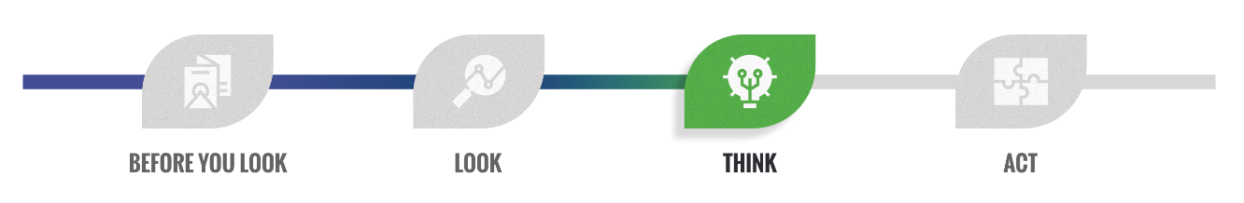
Think!
In the Think stage, you (and the team) interpret or attach meaning to the data.
While the facts you identified during the Look stage were not debatable, interpretations are.
Use the facts from the Look stage and other evidence you have and consider why you are getting the results that you see.
Getting to the bottom of the results is oftentimes called root cause analysis.
Different people will have different interpretations based on their unique perspectives and experiences. Diverse perspectives broaden the discussion about results.
Notes:
Susan
Presenter Notes:
Once we’ve taken time to look at data and identified facts that we see, then we move on to Think!, which is when you begin to interpret or attach meaning to the data. The things that you saw in the Look! stage aren't debatable. In our example, it was obvious that Cohort 2 started at a different place than Cohort 1. It was obvious that both groups made upward progress during the year; that's reflected in the data.
In the Think! stage, attaching meaning is always debatable. This is where the unique perspective each person brings to the table is important. As a team member, you're going to use the facts from the Look! stage and any other evidence that you have, to think about why we are getting the results that we see. This is getting to the bottom of what we are seeing in the charts and acknowledging that different people will have different interpretations based on their perspectives and experiences.
As family members, you bring a critically important set of experiences to the process. The diversity that the team brings is going to broaden the discussion. If everybody comes in like-minded, with the exact same background and the same set of experiences, that group may risk not really getting to the correct conclusion as they attach meaning to what they see in any data display.
Procedural Directions: Read Presenter notes

Slide 25
The 5 Whys: A Think Stage Resource
Digging Deeper:
When problems arise, it is reasonable to take steps to prevent the same thing from happening again. To do this, ask why things happened over and over until you reach the root of the problem.
In short, we ask, “why,” over and over until we reach the root cause. Typically, you will find the root cause by the time you’ve asked, “why,” five times.
Why
Why
Why
Why
Why
Notes:
Presenter Notes:
The 5 Whys is a very simple Think! stage resource that is highlighted within the Look! Think! Act! learning module and it provides an opportunity to really dig deeper in a very simple way. It's a strategy of asking “why” five times (or more) when you find a problem. By asking “why” repeatedly, the nature of the problem as well as its solution becomes clear. This is called a root cause analysis. Use of the 5 Whys strategy has shown that it really takes about five times of asking “why” before you really get to that bottom layer that shines a light on the potential solution. We have an example using the 5 Whys on the next slide.
Procedural Directions: Move the video to supplemental activities YouTube video - The Jefferson Memorial and the 5 Whys - by Jerilyn Edginton - https://www.youtube.com/watch?v=N7cR2gArCFE

Slide 26
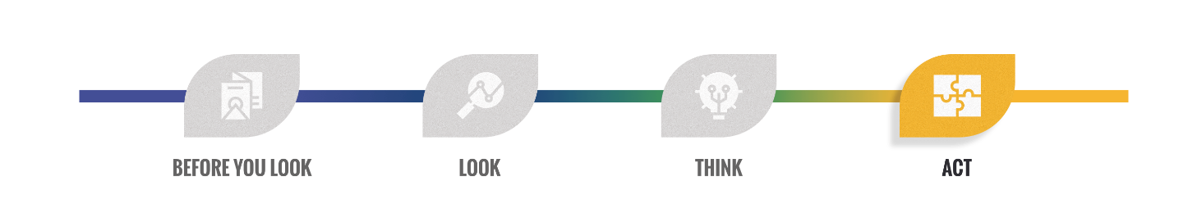
Act!
Using data for program improvement involves more than making decisions based on data—it involves identifying actions that will lead to meaningful change.
In the Act stage, you (and the team) identifies actions based on conclusions made in the Think stage. Actions may be small and short-term, or they may involve large changes in a program or system.
Improvement planning sounds very formal and sometimes it is. It can also be a simple set of action steps depending on what is needed to produce the change you want to see.
Notes:
ACT
Presenter Notes:
We’ve arrived at the Act! Stage.
You’re able to move on to the Act! stage if you’ve looked at data, you've attached meaning, you've done a good root cause analysis and the team thinks they understand not only what the data is telling them but has reached consensus around a proposed explanation or hypothesis.
Using data for program improvement involves more than making decisions based on data—it means doing something that will lead to meaningful change. In the Act! Stage the group can begin to identify what actions can be taken, either in the short term or the long term, that will result in an improvement in the program or a solution to the problem. Using data for program improvement means you go beyond looking and thinking about your data. You must take the next step where you ask, “So what are the actions that we're going to take that will lead to meaningful improvement or solving a problem?”
For example, you looked at outcomes data for children in your program and found that boys were doing better than girls. As part of Look! Think! Act! you used the 5 Whys root cause analysis process and discovered that teachers are spending more time each week working with the boys in the class than the girls. Now the team can focus improvement actions on addressing equitable instruction time, collect new data as changes are made, and repeat the Look! Think! Act! process with the new data. LTA is a continuous process for using data for program improvement.
Procedural Directions: Read Trainer notes

Slide 27

Group Activity
Notes:
Presenter Notes: Welcome to our Family Data Leader Training for Families! We will begin shortly.
Procedural Directions:
Trainers will fill in the dates and times for training and their agency name and logo
This slide will be shown as people log on or enter the room
Trainers may choose to have participants sign into the chat (if virtual) or sign in on paper (if in-person)
Links to go through ahead of time
Look Think Act Discussion Guide Look! Think! Act! Discussion Guide (dasycenter.org)
Stakeholder Knowledge Toolkit, Data as Information https://dasycenter.org/wp-content/uploads/2018/01/se-toolkit-datainfo-questions-infographic.pdf
Critical Questions doc https://dasycenter.org/wp-content/uploads/2020/12/DaSy_Critical_Questions_2020.pdf
SPP Indicators card cipr dasy program docs - OneDrive (sharepoint.com)
ECTA Center: Glossary

Slide 28

The Impact of COVID-19 on Early Intervention Services
Did the numbers of children served by early intervention drop during COVID? Why or why not?
  Break into small groups and look at the quantitative and qualitative data.
  As a team, answer the analysis questions together.
  What other questions did your analysis generate?
This Photo by Unknown Author is licensed under CC BY-SA-NC
Notes:
We’re going to have a group activity to give you some practice working with quantitative and qualitative data. Let’s break into small groups and imagine that you are a group of stakeholders working together to understand the impact of COVID on early intervention services. You have an idea that the numbers of children served dropped during COVID, but you don’t know the extent of the problem or why the numbers may have dropped. We’re providing some quantitative data on the numbers of children served in 2017-2018. We also have some qualitative data collected from interviews of parents in 2020. Together, have a data discussion about what you’re seeing in the different types of data.

Slide 29
Quantitative Data: Child Count by Age, 2017-2020
Notes:
This slide presents some quantitative data on the numbers of children served in early intervention during the years 2017-2020. The data to the left of the broken line shows number of children served.

Slide 30
Qualitative Data: Parent Interview Responses (2020)
Interview Question: Please describe the process of getting your child evaluated for early intervention.
Parent 1
“I had concerns about our daughter but didn’t know who to talk to. I wanted to ask the pediatrician, but we had so much going on during COVID. Working remotely, trying to deal with the kids. When we finally got around to calling the doctor, they weren’t taking appointments for well care visits. I finally got in last week and the doctor told me about early intervention.”
Notes:
We have some examples of parent responses to our open-ended survey questions. As we read them, see if you see any patterns or themes \in the data.
Here’s what parent #1 wrote:
“I had concerns about our daughter but didn’t know who to talk to. I wanted to ask the pediatrician, but we had so much going on during COVID. Working remotely, trying to deal with the kids. When we finally got around to calling the doctor, they weren’t taking appointments for well care visits. I finally got in last week and the doctor told me about early intervention.”

Slide 31
Qualitative Data: Parent Interview Responses (2020)
Parent 2
I finally found out about EI from our doctor, but by then our well-child visit had been delayed for about 4 months. Then we got a referral for EI services, but they were booked out for months and the first appointment was online. That was frustrating and did not accomplish much. I haven’t gotten around to calling back.
Parent 3
Our first appointment with early intervention was online. I don’t have good Wi-Fi so it was a very frustrating process to engage our child and have a useful session. The whole thing was stressful. After that we just waited until things opened up more. My son starts speech therapy next week.
Notes:
Here are two more parent responses

Slide 32
Analysis Questions
Do we have a problem?
How many children were served in 2019? In 2020?
Did the numbers of children served drop during COVID? By how much?
Why do we have a problem?
What did parents report about getting their children evaluated?
What challenges did families face around scheduling? Technology?
What other questions did your analysis generate? What else would you like to know about….
          How the data were collected?
          Who was and was not served in early intervention?
          ….other questions?

Slide 33

Final thoughts and questions
Notes:
Susan and Michelle
Presenter Notes: Any final questions evaluation
Procedural Directions:

Slide 34
Key Resources
Comprehensive list of acronyms with links:
Early Childhood Technical Assistance Center (ECTA): Acronym List
Printable Acronym list- great to print and bring to data discussions:
https://parentnetworkwnyorg-my.sharepoint.com/:w:/g/personal/srb_parentnetworkwny_org/EUwIxZIiviFPrAk-hD1T08MBt2rcu5MV06frpIBbB9zmNg?e=Erx3cI
State Performance Plan Indicator Cheat Sheet
https://parentnetworkwnyorg-my.sharepoint.com/:b:/g/personal/srb_parentnetworkwny_org/Ea_mplmy6gFBrI2OxTUzmQkBSn1PYl6PskrYWhpJq5XDdQ?e=dF574F
Notes:
Presenter Notes: This list of acronyms and key terms is available for your reference. We will try to avoid using professional jargon and abbreviations as much as possible. At any time, if there are terms you don’t recognize, feel free to ask.

