Slide 1
Early Childhood Results Matter: Understanding Preschool Child Outcomes Data
Nicholas Ortiz – Nicholas.Ortiz@sri.com
NASDSE Conference (October 30, 2023)
Notes:
Introduce myself
Introduce DaSy and ECTA
From Colorado
Note: download slides (app > swipe right to Documents) to follow along and access hyperlinks
Alan Coulter’s presentation: results!
Who’s in the audience:
Your role is primarily focused on preschool?
Your role is “Big B”?
All are welcome! Something for everyone.

Slide 2
Agenda
Why collect child outcomes data?
History of child outcomes measurement
The 3 child outcomes
Reporting requirements
Approaches to measurement
National data
Data quality
Timeline for collection/reporting
Additional resources and technical assistance support
Notes:
Purpose/history
Outcomes themselves, reporting, and approaches to measurement
National data, data quality
Activity: timeline
Resources & TA opportunities

Slide 3
Why Do We Collect Child Outcomes Data?
Notes:
Prompt audience: why should we measure outcomes?

Slide 4
Why Collect Child Outcomes Data?
Requirement
The Office of Special Education Programs (OSEP) requires it.
Public Accountability
Preschool special education is funded with public dollars. The public has a right to know that these dollars are well spent.
Accountability to Children and Families
Program Improvement
Children and their families are entitled to effective services. Outcomes data provide a window into whether they are getting them.
Outcomes data show which programs need to improve and whether program improvements are working.

Slide 5
We could answer important questions like…
?
?
Does our program serve some children more effectively than others?
Are we seeing improvements in services and outcomes over time?
?
?
Do programs that use certain intervention strategies or curriculum achieve better outcomes?
How do child outcomes differ by Local Education Agency?
Notes:
What is it about various groups of programs, children, and families that lead to better outcomes?

Slide 6
How Did the Reporting Requirement Come About and What Child Outcomes Are Measured?
Notes:
You may be wondering…

Slide 7
How OSEP Came to Require Child Outcomes Measurement
Accountability movement
Shift from compliance to results, from access to outcomes
Extensive 18-month input process with affected parties
OSEP uses child outcomes data to:
Justify the funding for Part C and Part B Preschool programs
Monitor state results through Results Driven Accountability processes (Part C only)
Notes:
Emerging importance of accountability in public programs over last several decades​
Dr. Coulter’s keynote: shift to results, Bush task force. Accountability is about demonstrating results​
Not enough to look at compliance, number of children served, amount of services provided, etc. to produce good results, so the focus has shifted to looking at results​
In special education in particular, the emphasis shifted from getting children access to services to focusing on the outcomes achieved.​
Now, all federal agencies are required to report on the outcomes achieved by their programs​
OSEP uses child outcomes data to: ​
Justify the funding for Part C and Part B Preschool programs ​
Monitor state results through Results Driven Accountability processes (Part C only)​
Any seasoned veterans involved in early input process?

Slide 8
Positive Outcomes for Young Children
“…the ultimate goal of [Early Intervention and Early Childhood Special Education] support is to enable young children to be active and successful participants during the early childhood years and in the future in a variety of settings – in their homes with their families, in child care, preschool or school programs, and in the community.”
-From Family and Child Outcomes for Early Intervention and Early Childhood Special Education, based on the Early Childhood Outcomes (ECO) Center stakeholder engagement process when identifying the 3 functional outcomes

Slide 9
The Three Child Outcomes
Beginning in 2005, OSEP required states to report data on 3 child outcomes:
Children have positive social emotional skills (including social relationships)
Children acquire and use knowledge and skills (including early language/communication)
Children use appropriate behaviors to meet their needs

Slide 10
The Three Child Outcomes Are…
Functional
Meaningful in the context of the child’s everyday life
Describe how child is using skills (not just does a child have a skill?)
Intentionally broad
Cross-cutting, not domain-centric
https://ectacenter.org/eco/pages/videos.asp
Notes:
The stakeholders made a very strong recommendation:
Treasure what you measure.​
Do not report on domains for the outcomes.
(Any seasoned staff out there part of stakeholder discussions in mid 2000s?)
You may have seen the great video called Child Outcomes Step by Step…​

Slide 11
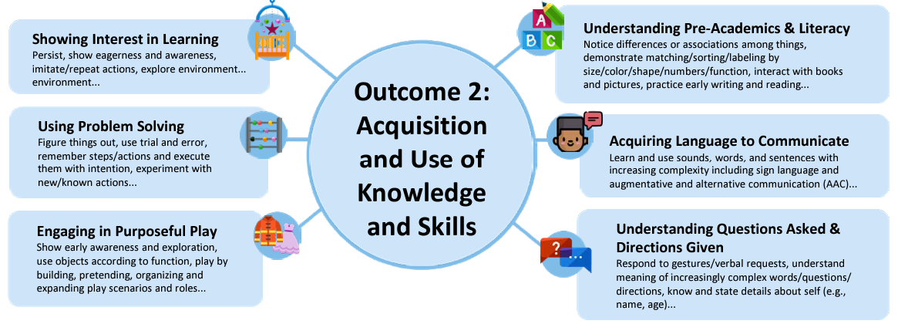
Functional Skill Bundles: Which Primary Outcome Does This Relate To?
Outcome 1: Positive Social-Emotional Skills?
Outcome 2: Acquisition and Use of Knowledge and Skills?
Outcome 3: Use of Appropriate Behavior to Meet Needs?
Notes:
Example of functional nature of the outcomes
Show the Outcome # you think corresponds to these skill bundles.​

Slide 12
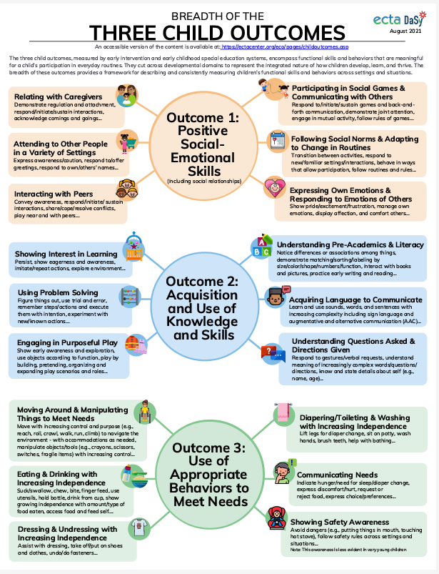
Breadth of Three Child Outcomes
Available at:
https://ectacenter.org/~pdfs/eco/three-child-outcomes-breadth.pdf
Notes:
These are important things for kids to be able to do. ​
​Domains vs functional – a domain doesn’t necessarily live in just 1 of these Outcomes (e.g. communication)​

Slide 13
What Data Are Reported to OSEP?

Slide 14
How many grand total “summary statement” indicators do states report on in the SPP/APR?
2
3
4
6

Slide 15
OSEP Progress Categories As Developmental Trajectories
70
60
50
40
30
20
10
0
% Did not improve functioning
% Improved functioning, no change in trajectory
% Moved closer to functioning like same-aged peers
% Improved functioning to that of same-aged peers
% Functioning like same-aged peers
Adds up to 100%
Growth in Outcome
0 6 12 18 24 30 36 42 48 54 60 66
6-minute video
Age in Months
Converting Child Outcomes Data to OSEP Progress Categories/Summary Statements

Slide 16
5 progress categories x 3 outcomes = 15 percentages

Slide 17
The Summary Statements
Of those children who entered or exited the program below age expectations in each outcome, the percent who substantially increased their rate of growth by program exit.
$$\frac{Total\left(c+d\right)}{Total\left(a+b+c+d\right)}$$
X 100
The percent of children who were functioning within age expectations in each outcome by program exit.
$$\frac{Total\left(d+e\right)}{Total\left(a+b+c+d+e\right)}$$
X 100

Slide 18
2 summary statements x 3 outcomes = 6 percentages

Slide 19
What Approaches Do States Use to Measure Child Outcomes?

Slide 20
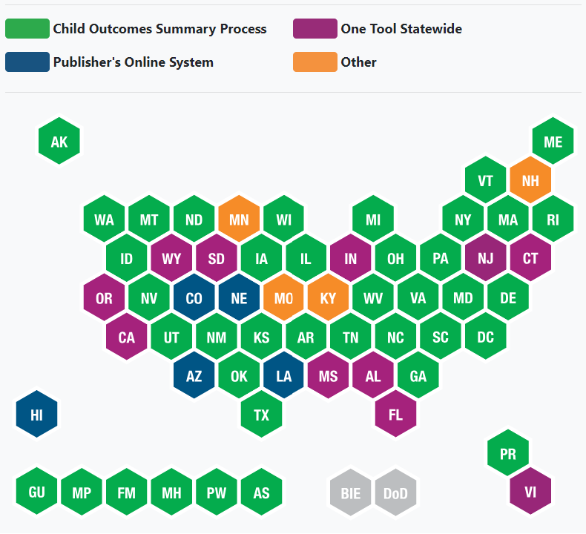
Approaches to Part B Preschool Child Outcomes Measurement by State (FFY 2020-21)
Notes:
You may be wondering, what approach does my state or entity use?
State of the states as of FY2020
In reality, there is significant variation in how states design and implement outcomes measurement even within each of these categories.
Example: publisher’s online system: 1 tool vs multiple tools

Slide 21
What Do the Nationwide Data Look Like?

Slide 22
Part B Preschool Child Outcomes Results (FFY 2020-21)
25-minute video
IDEA Child Outcomes Highlights for FFY2020
22
Notes:
These are actual national results.​
SS1: rather stable until FY 19 when it started to drop slightly nationally.
SS2: slightly downward last few years. Trends continued in OC 2/3 but reversed in OC 1.
Important to note there is considerable variation across and even within states.
Also important to note that states vary widely in their approach to measurement.
Dr Coulter’s keynote: “Lose the tertiles
f
(In case questions about historical trends come up, more details…)
Summary Statement 1: Prior to FFY 20, the percentage of children who made greater than expected growth while in Part B Preschool programs had been quite stable and similar across all outcomes. However, between FY 19 and FY 20, there was a decrease in all 3 outcomes.​
​
Summary Statement 2: In the last few years prior to FY 20, there had been a decline in all 3 outcomes. This trend continued slightly in FY 20 in Knowledge and Skills and Taking Actions to Meet Needs. However, this trend reversed in Social Relationships, which saw an increase in FY 20.​
​
States reported several key reasons for changes in Part C and 619 performance including changes to state data collection methods, potential impacts of COVID-19, and other data quality issues. Further analyses are needed, particularly at the state and local levels, to understand these trends.​

Slide 23
The Pandemic’s Impact on the Number of Children in the Child Outcomes Data Collection
Number of children nationwide exiting Part B 619 and Part C with child outcomes data between 2018-19 and 2020-21 (N=56)
8% drop for Part B 619
12% drop for Part C
Notes:
Still crunching numbers from FY 2021-22 data (late this year).

Slide 24
How Can We Consider the Quality of the Child Outcomes Data?
Notes:
Pandemic-era data beg the question: how good are the data?

Slide 25
Outcomes data are critical for accountability and program improvement
Program improvement requires using the data
BUT
Data are only useful if they can be trusted
BUT
Data quality only improves when the data get used
Notes:
And quality only improves when the data are being looked at by those who provide the data.​

Slide 26
What Do We Mean by “Data Quality”?
Accurate
Consistent
Timely
Complete
Notes:
It’s the whole system at multiple levels that supports data quality, checks and balances.
Examples of system elements: training, monitoring, PD

Slide 27
Discuss: Your Role in Ensuring Data Quality
Where do you see yourself having an impact on data quality?
In what aspects of child outcomes measurement is your system functioning well or not so well in terms of data quality? Or…
How would you begin to understand child outcomes data quality in your system?
Notes:
Pick 1 of 3 questions​

Slide 28
Interpreting Year-to-Year Trends
Type of Trend | 2011-12 2021-22
Small variations from year to year are expected
Large consistent increases are good news particularly when linked to programmatic changes
Large consistent decreases require explanation (e.g. changing population)
Large up and down changes are an indicator of questionable data quality and require explanation
Notes:
Use caution in interpreting large swings and how you attribute changes.​
In large up and down changes, consider reason behind them. Change in state approach? One large LEA with weird data pattern? Different submission process?​
Some states are looking at these patterns locally with local-level data profiles/dashboards/data boot camps/peer learning community data dialogue​.
Resources available to support your interpretation of data quality, including annual data quality profiles that are tailored to your state and sent to 619 coordinators each year. ​
​

Slide 29
What Does a Typical Year Look Like for Child Outcomes Data Collection and Reporting?

Slide 30
Discuss: Timeline of Child Outcomes-Related Activities
Handout
Where are you involved or where should you be involved in the cycle?
Where do you see your role fitting in?
How might the timeline be different in your state?
What activities might you need to shore up?
Notes:
Mention targets. Revisit targets periodically within a cycle​. Outcomes is not a compliance indicator, 100% usually not reasonable​.
Get feedback! (This is a draft)

Slide 31
Other Promising Practices with Child Outcomes Data Use
Notes:
…so that you can be inspired to make better use of your child outcomes data.

Slide 32
Other Promising Practices with Using Child Outcomes Data
Improvement planning and root cause analysis
Increased stakeholder engagement
State advisory groups
DaSy’s Family Data Leaders
Considering Part C exit scores during Part B 619 entry scoring
Incorporating outcomes data into LEA determinations
Monitoring child outcomes data quality
Linking child outcomes data with other APR indicators and beyond (e.g., services)
DaSy’s Data Leadership Competencies
Notes:
…As you consider which of these or other practices might be beneficial to you, check out DaSy’s Leadership Competencies to better understand your strengths and areas to improve with data.

Slide 33
Where Can I Learn More About the Child Outcomes?
Notes:
If you’ve ever thought – “I wish I had a tool for XYZ” – we probably have it. DaSy has been at this for over 15 years.

Slide 34
Additional Child Outcomes Data Resources
Take a Look at Your Child Outcomes Data Profile: Guidance on how to use your Child Outcomes Data Quality Profile
Considerations of the Impact of COVID-19 on APR Indicator Data: Considerations related to data disruption that occurred as a result of the COVID-19 pandemic
Year-to-Year Changes in State Child Outcomes Data: What Do They Mean?: Brief designed to help stakeholders learn what questions to ask to understand year-to-year changes in child outcomes data
SPP/APR Basics: What You Need to Know: Collection of self-directed modules that provide a basic understanding of the IDEA Part C and Part B 619 State Performance Plan/Annual Performance Report (SPP/APR) indicators and their requirement
TS GOLD, BDI, and COS Learning Communities
34
Notes:
Highlight just a few…
Here are some further resources on the ECTA and DaSy Center websites to support your child outcomes measurement work, including:​
a 2-page summary of the 2020 IDEA Child Outcomes Highlights, ​
a map of approaches to child outcomes measurement across the country, ​
guidance on how to use your child outcomes Data Quality Profile, ​
a document with practical strategies to examine the impact of COVID on your data quality and performance, and ​
a resource to help stakeholders ask questions to help understand year-to-year changes in child outcomes data. ​
Learning communities for some of the more common tools and measurement approaches in use across states​

Slide 35
COS Professional Development Resources
COS Practice Scenarios: Collection of scenarios of children, ages 6 months to 5 years, that allow you to practice aligning information about each child with the three child outcomes and anchoring the information by age.
Age Anchoring Guidance for Determining COS Ratings: Guidance on how to accurately age anchor a child’s functional skills and explanations of how that guidance applies to COS teams
Child Outcomes Summary (COS) Process Professional Development Resources: Collection of national resources to support training and TA on the COS process
COS Online Learning Module: Provides key information about the COS process, and the practices that contribute to consistent and meaningful COS decision-making
35
Notes:
Here are even more resources, including:​
Practice scenarios for the child outcomes summary process that provide an opportunity for staff using the COS to practice ratings and compare their ratings to the correct rating for the scenario. ​
Guidance for age anchoring to determine child outcomes summary ratings, and​
A collection of even more professional development resources for the COS process.​
An online learning module for the COS process, including the practices that contribute to consistent and meaningful COS decision-making​
​

Slide 36
Questions?

Slide 37
Technical Assistance Cohort Opportunity
Focus: Integrating Child Outcomes Measurement and IEP Processes
Link to Application
Deadline: November 9, 2023
States notified by December 15, 2023

Slide 38
Contact Us for Support
Contact your DaSy state liaison or ECTA state liaison
Presenter contact information:
Nicholas Ortiz – Nicholas.Ortiz@sri.com

Slide 39
Find out more at dasycenter.org/tag/child-outcomes and ectacenter.org/eco/pages/childoutcomes.asp

