Slide 1
Data Sharing, Linking & Integration: What is it and How do we Start?
Howard Morrison
Ginger Elliott-Teague
Center for IDEA Early childhood data systems (DASY)
October 29, 2023
Notes:
Timeline: (approx. 55 min as written below)
Intros, purpose: 2-3 min
Critical questions: 2-5 min (brief discussion)
Data comm types, key features: 5-8 min
Topical examples: 5-8 min
Discussion: 10 min
Leveling up considerations: 3-4 min
Use case discussion: 8-10 min
Resources/close: 5-10 min

Slide 2
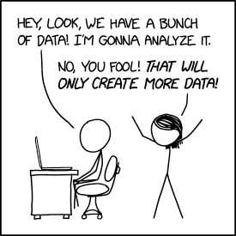
Data Comic
https://imgs.xkcd.com/comics/data_trap.png
Notes:
As we do introductions…First: Ask who’s in the room, by role.
Ginger

Slide 3
Purpose & AGenda
To discuss the various ways datasets can be combined to support special education data reporting and analysis, and to consider when it’s appropriate to “level up” your approach
Why? Critical questions
What? Terminology
When? Scenarios
How? Resources
Discussion and brainstorming
Notes:
Ginger
First: Ask who’s in the room, by role.

Slide 4
Purpose before practice: critical questions
What do I need to know that cannot be answered with the data I already have in hand?
Are EC outcomes positively associated with EI participation?
Does attendance affect IEP outcomes?
Do students with shortened days have better or worse school grades?
How does the quality of the IEP transition plan affect post-graduate outcomes?
What questions would you like to answer but can’t yet?
Notes:
Ginger
What are some questions you would like to answer but aren’t able to yet?

Slide 5
Differentiating TYPES of data communication
Data Sharing – The practice of providing partners information they can’t access in their own data systems. Data are typically sufficient for recipients’ needs. May occur once or repeatedly.
Data Linking – Manually connecting extracted information about an entity (e.g., child, service provider, service) from one data source with information related to that same entity from another data source. May occur once or repeatedly.
Data Integration – Combining data from disparate sources into a single data system to merge information about entities in one location. Maintained systematically through data management plans.
Notes:
Ginger
As I’m sure you are aware, you can get access to and use data from a variety of sources, having joined them in various ways. You may get aggregate data through a data share, or may get datasets that you manually join with your own data to produce reports. Or, you have access to integrated data in maybe an SLD.
What do these look like in context, and how do these data communication types differ in practice?

Slide 6
Key Features of types
KEY FEATURES | SHARING | LINKING | INTEGRATION
How sophisticated and complex is the data connection? | Low | Medium | High
Are paper or electronic files transmitted? | Either | Electronic | Electronic
Can record-level data be transmitted or only aggregate data? | Both | Both | Both
Are distinct records matched across databases? | Usually no | Yes, usually manual | Yes, usually automated
Is the data linking process facilitated by electronic automation? | No | Usually no | Yes
Is significant technical expertise required? | No | Some | Yes
Can updates to the source database(s) automatically refresh the linked data set? | No | No | Yes
Are the original data sets preserved afterward? | Yes | Yes | Yes
Are programmers required? | No | Usually no | Yes
Do the data sets need to be restructured? | No | No | Usually yes
Do the data have a unique identifier? | Sometimes | Sometimes | Yes
Notes:
Ginger

Slide 7
Topical examples: Part C to Part B Transition
Examples
SHARING | C local programs send printed lists of “potentially eligible for Part B” child referrals to LEAs monthly and the SEA quarterly through the mail. LEAs report aggregated Indicator 12 outcomes to the SEA annually.
LINKING | C local programs update child records at transition. Individual referrals are sent to LEAs via email, while the state EI program staff electronically send a spreadsheet of child referrals to the SEA bi-weekly. As LEAs create new online database records for referred children, you can monitor Indicator 12 outcomes periodically through the database by linking the C and B datasets.
INTEGRATION | The Part C data system generates a digital notification for each child who has been determined potentially eligible for Part B and sent to the Part B data system at the SEA. This notification automatically creates a new record for the child and simultaneously notifies the LEA of the referral.
Notes:
Ginger

Slide 8
Topical examples: assessment
Examples
SHARING | The assessment office provides a summary dataset of the annual state testing results that can be used for federal reporting. The units are school sites, and only required grades are included.
LINKING | The assessment office provides a student-level electronic spreadsheet with the annual state testing results that can be linked manually to a file pulled from the IEP database, using a common ID to match records.
INTEGRATION | The state testing results and IEP data are fully integrated into the SLDS at the student record level. Relevant reports can be pulled for outcome analyses or federal reporting at any time.
Notes:
Ginger

Slide 9
Discussion
Does your program use shared, linked or integrated data?
What is working well with your process?
What would you like to change?
What challenges do you face in the process?
Topic One: Transition
Topic Two: Assessment
Break into table groups of 3-4 by topic.
Notes:
Both walk
10 minutes
How many satisfied? How many want to change? What barriers or challenges have you faced?

Slide 10
Decision point: leveling up
Are you and your system ready for change?
Do you need to level up to report better data or answer critical questions?
Data partners’ support and engagement
Leadership support
Team ability to develop, manage, and implement new procedures
System and IT capacity to adapt key features
Financial capacity
Users’ capacity to adapt to new procedures
Notes:
Howard
Do you need to level up your system to answer your critical questions?
https://sriit.sharepoint.com/:w:/r/sites/Education/projects/DaSy/DaSy%20Blogs/1%20In%20progress%20blog%20posts/24.%20Part%20C%20Data%20Integration%20Blog%20Series/Part%201%20Blog/Blog%201%20Should%20I%20Stay%20or%20Should%20I%20Go%20Leveling%20Up%20Your%20Data%20Systems.docx?d=w0423a9fcc92d483b998a861d7295d394&csf=1&web=1&e=47AWum

Slide 11
Using use cases to level up
A Use Case can:
Explain the overall reason for linking or integrating two data sets
Create a common understanding of a specific need or currently unanswered question and establishes data linking as part of the solution
Formalize the concept and demonstrate the general impact and effort of the data linking
Notes:
Howard

Slide 12
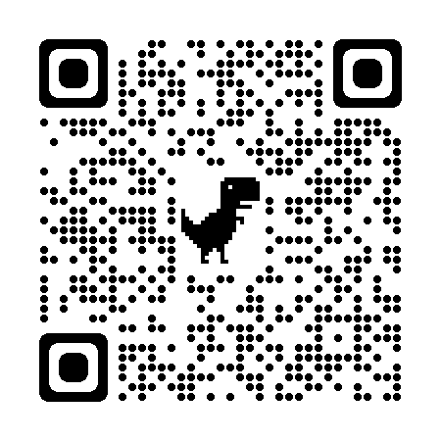
Use case example
Automated Data Sharing or Linking Use Case: IDEA Part C to Part B 619 Transition Notification
Google URL - https://bit.ly/45Me2Ks
Notes:
Howard
10 minutes discussion

Slide 13
How to utilize and apply a use case
Agency leadership
Data governance bodies
Partners
Policymakers
Notes:
Be used to present the use case to their respective leadership and other interested parties to gain support and solidify a common vision

Slide 14
Resources
DaSy Data Linking Toolkit
What’s the Difference Between Data Sharing, Data Linking and Data Integration?
Data Linkages Between Part C and Part B – Transition Notification
Critical Questions (Child & Family, Practitioner, EIS/LEA)
Critical Questions for Addressing Racial Equity in Early Intervention and Early Childhood Special Education
Notes:
Howard

Slide 15
Thank you.
Visit us at http://dasycenter.org/
The contents of this presentation were developed under a grant from the U.S. Department of Education, #H373Z190002. The contents and resources do not necessarily represent the policy of the U.S. Department of Education, and you should not assume endorsement by the Federal Government. Project Officers: Meredith Miceli and Amy Bae.

