Slide 1
Crossing the Divide: An Intersectional Approach to Data Analysis
Nicholas Ortiz (ECTA/DaSy)
Kellen Reid (ECTA/DaSy)
Elizabeth Schroeder (Desired Results Access Project - California)
DEC 39th Annual International Conference on Young Children with Disabilities and Their Families​ Minneapolis, MN | November 28–December 1, 2023​

Slide 2
What comes to mind when you hear the term “intersectional data analysis”?
Notes:
Invite audience – what comes to mind when you think of intersectional data analysis? Who is familiar with the term intersectionality?

Slide 3
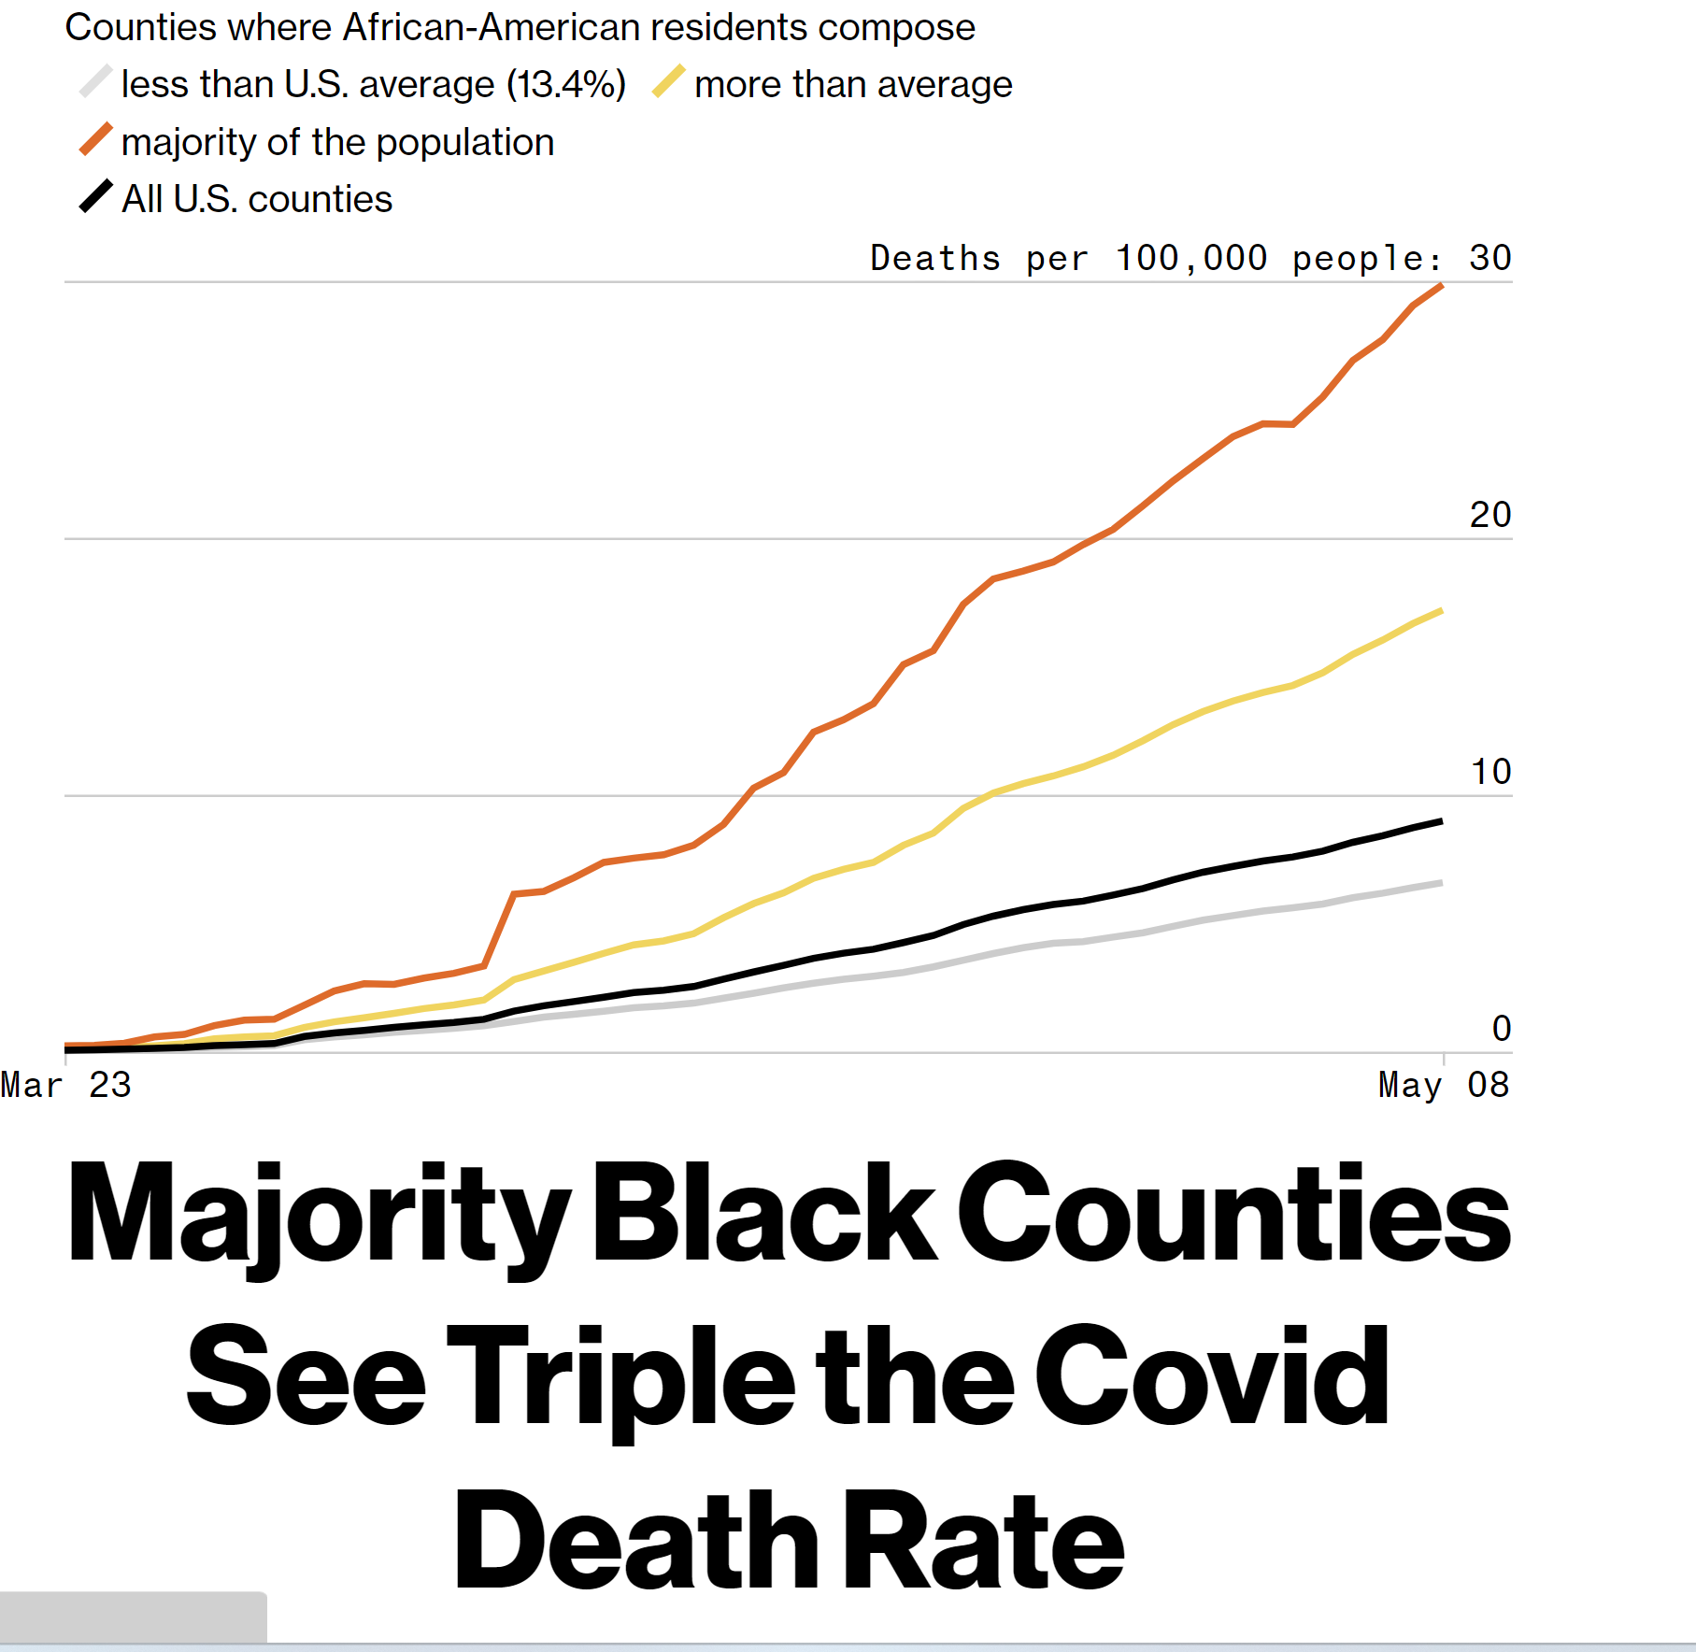
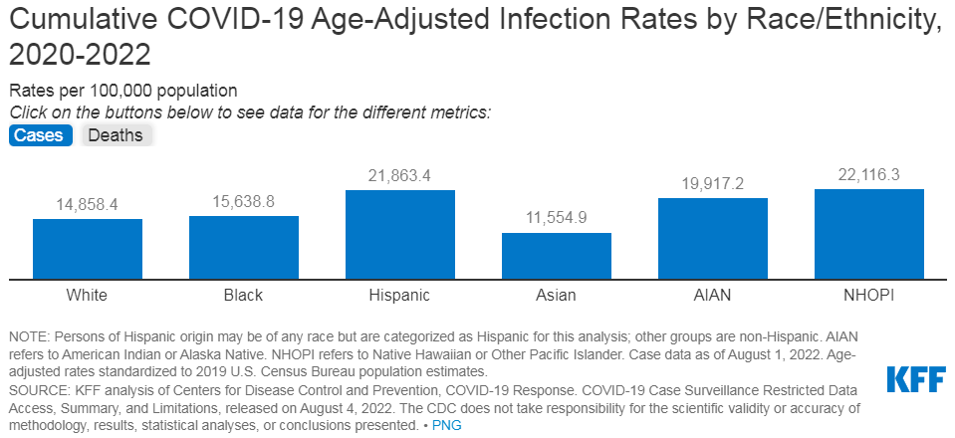
In the News
Child Mind Institute
FALSE Social Media Claim: COVID Engineered to Spare Asian Population
Bloomberg News, 5/11/20
Notes:
Gender & autism
Invite audience to think of examples. Use next slide to bridge any silence.
For the Image of retracted Lancet Journal article "RETRACTED: Ileal-lymphoid-nodular hyperplasia, non-specific colitis, and pervasive developmental disorder in children" (Dr AJ Wakefield et. al) was the original evidence base linking MMR vaccination with autism by using a highly improper research design to falsely conclude a causal relationship because 67% of the study population receiving MMR developed autism.

Slide 4
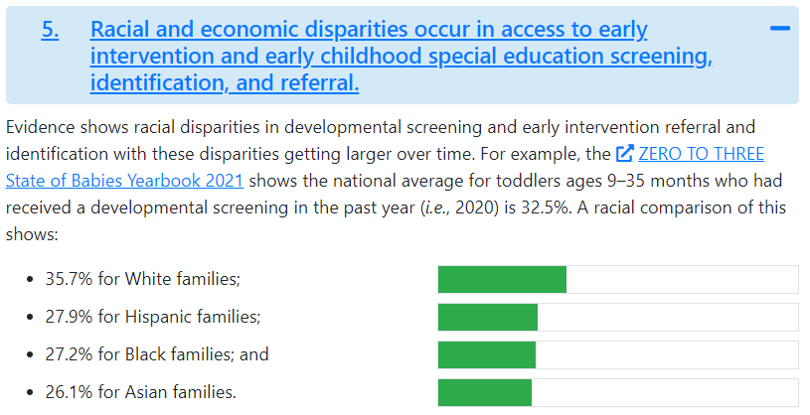
Closer to Home
Source: ECTA Racial Equity Fact Sheet (2023)

Slide 5
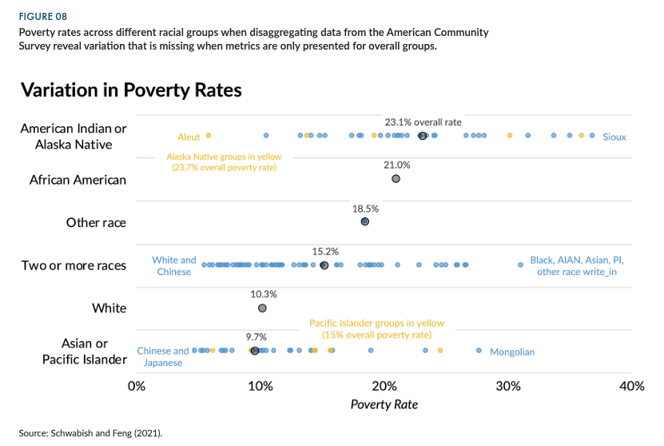
Yet Another Example
Source: Do No Harm Guide: Appling Equity Awareness in Data Visualization (Schwabish & Feng, 2021)

Slide 6
Intersectional data analysis is…
“…designed to illuminate the multiplicative effects of different but interdependent categories and factors.” (Gendered Innovations)
Related to many sociocultural, biological, and contextual factors—race, gender, ability, sexual orientation, geography genetics, and more
A way to help target strategies for program improvement
A way to shed light on micro-decisions about data collection, reporting, and use
Notes:
It’s about equity, and yes racial equity, but also gender equity, disability equity, and whatever equity or inequity you can illustrate through variables in your data.
It’s also about targeting improvement strategies – tailoring solutions to meet the needs of each group
Micro-decisions

Slide 7
Agenda for rest of session
Data analysis in context of data inquiry cycle
Child outcomes background and analysis examples
California’s story
Other considerations: small Ns and qualitative data
Resources
Reflection time
Notes:
Overcome overwhelming feeling of acting on inequities in the data when you only slice it one way
Analysis paralysis

Slide 8
Putting It in Context

Slide 9
The Data Inquiry Cycle
Define Critical Questions
Clarify Expectations
Analyze Data
Draw Inferences
Make Data-Based Program Improvements
Notes:
Place analysis in context of broader data inquiry cycle – from developing questions to analyzing to action planning

Slide 10
An Intersectional Approach to Measuring Early Childhood Outcomes for Children with Disabilities
Notes:
AKA Child outcomes
We'd like to dig into some concrete examples using the child outcomes data

Slide 11
Summary Statements
Child Outcomes
Children have positive social emotional skills (including social relationships)
Children acquire and use knowledge and skills (including early language/communication)
Children use appropriate behaviors to meet their needs
Of those children who entered or exited the program below age expectations in each outcome, the percent who substantially increased their rate of growth by program exit
The percent of children who were functioning within age expectations in each outcome by program exit
Notes:
These are not the only outcomes we measure for young children with disabilities – not by a long stretch. But these are what each state reports on to the federal Office of Special Education programs, and we will use them for the purpose of illustration.

Slide 12
Disaggregating Child Outcomes Data: 1st Level
Outcome 1 (Positive Social-Emotional Skills): Summary Statement 1 (Greater Than Expected Growth)
State Overall
55%
Notes:
First level = statewide. Technically, you’ve already made sliced the data by one factor as these are children with disabilities, not the overall population of children.

Slide 13
Disaggregating Child Outcomes Data: 2nd Level
Outcome 1 (Positive Social-Emotional Skills): Summary Statement 1 (Greater Than Expected Growth)
American Indian or Alaska Native | Asian | Black or African American | Native Hawaiian or Other Pacific Islander | Two or More Races | White
48% | 61% | 51% | 49% | 54% | 60%
Notes:
Second level = by race

Slide 14
Disaggregating Child Outcomes Data: 3rd Level
Outcome 1 (Positive Social-Emotional Skills): Summary Statement 1 (Greater Than Expected Growth)
 | American Indian or Alaska Native | Asian | Black or African American | Native Hawaiian or Other Pacific Islander | Two or More Races | White
Region A | 60% | 65% | 52% | 50% | 59% | 60%
Region B | 42% | 59% | 51% | 52% | 54% | 61%
Region C | 44% | 62% | 54% | 47% | 50% | 58%

Slide 15
California’s Story

Slide 16
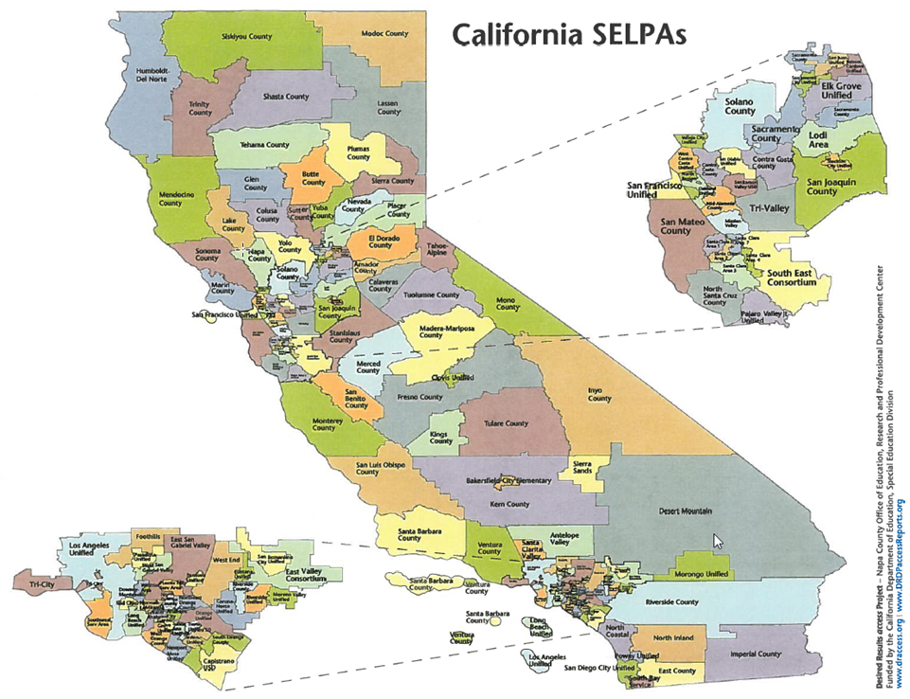
Setting the Stage: California
130 Special Education Local Planning Areas (SELPAs)
Over 800 districts serving preschool students with an IEP

Slide 17
What is the Desired Results Developmental Profile (DRDP)?
An authentic, observation-based assessment tool for individual children that is based on developmental research and theory
Includes developmental sequences of behavior
Observations are made during ongoing activities and routines in home-based and early care and education settings with familiar adults
Children are assessed twice a year, in fall and spring
The instrument is used in both special education and general education settings in California

Slide 18
Local Outcomes Reporting: DR Access Outcomes

Slide 19
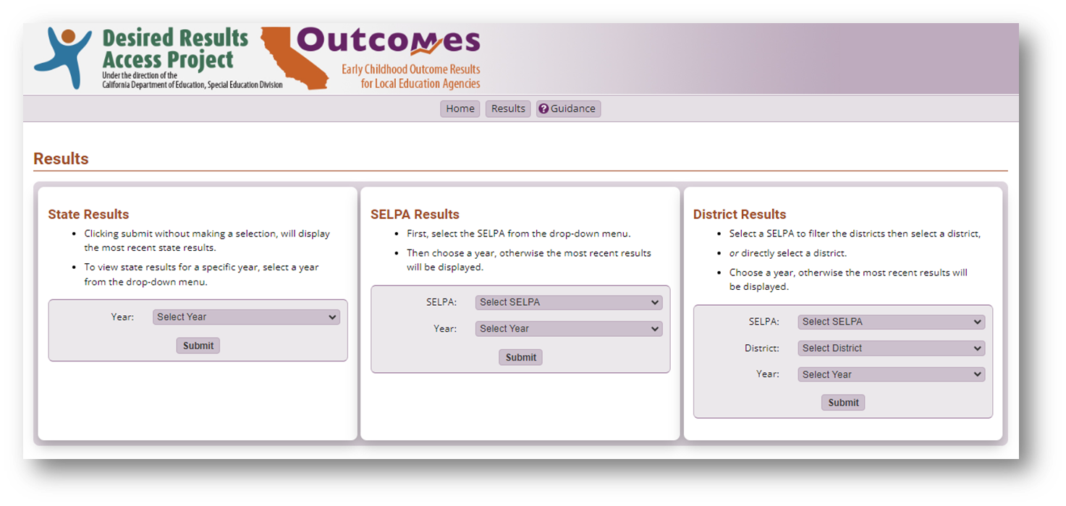
DR Access Outcomes: Results

Slide 20
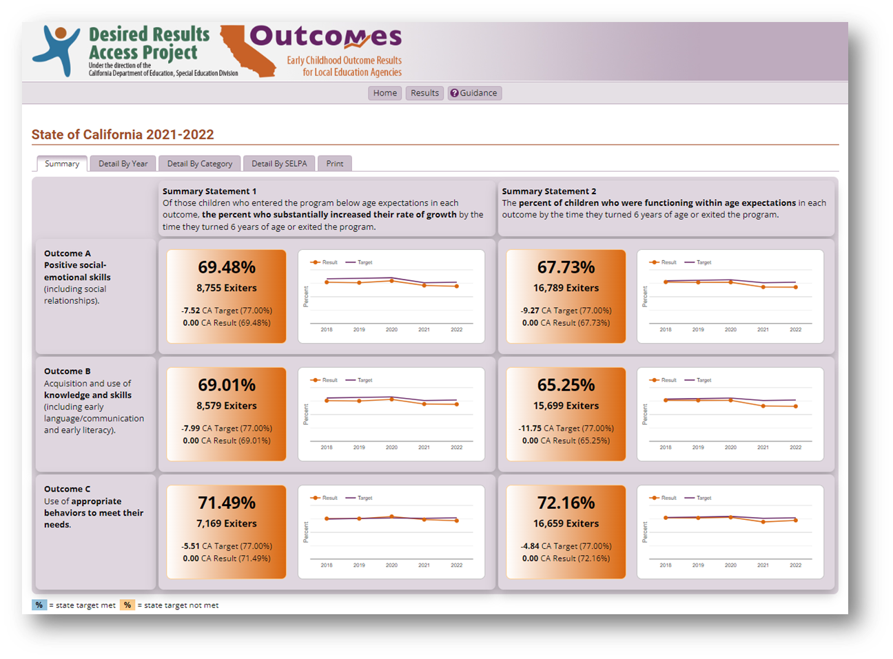
DR Access Outcomes: Dashboard

Slide 21
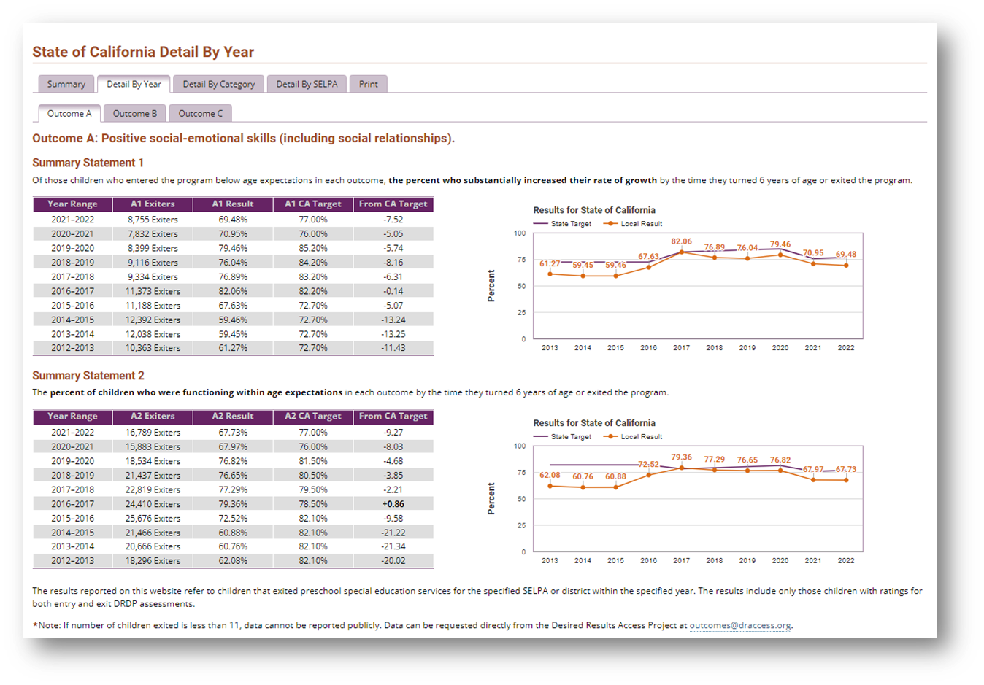
DR Access Outcomes: Detail

Slide 22
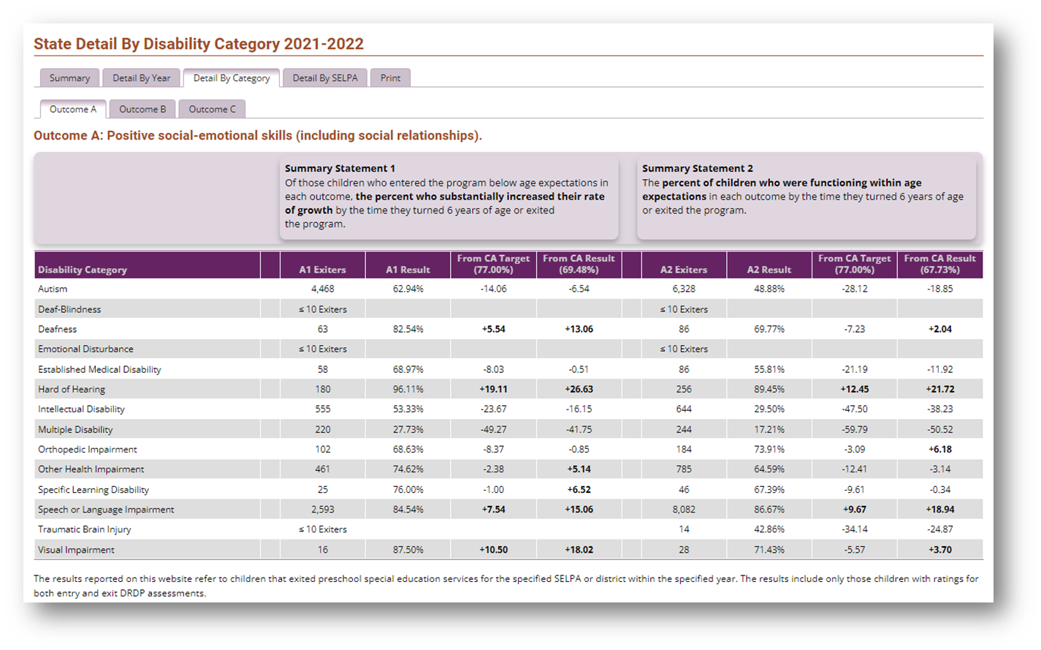
DR Access Outcomes: by Disability Category

Slide 23
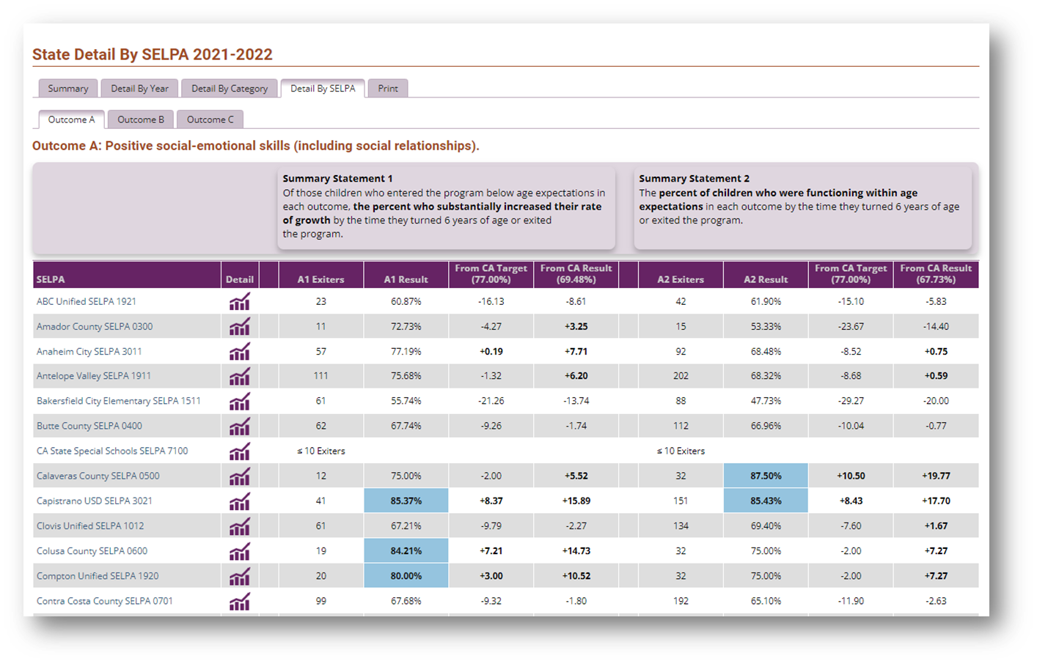
DR Access Outcomes: by SELPA

Slide 24
Preschool Outcomes (Indicator B7) State-Level Sub-Analyses
16,789 exiters in the 2022-2023 academic year
72% male, 28% female
48% speech and language impairment
38% autism
55% White, 6% Black or African American
60% English is primary language, 32% Spanish
60% Hispanic
Notes:
As a Project we have a lot more work to do to understand what is happening and we are still learning.... These are our interpretations from what we know.
Some basics about the state to help you understand some of the basic demographics of the children we serve in California.

Slide 25
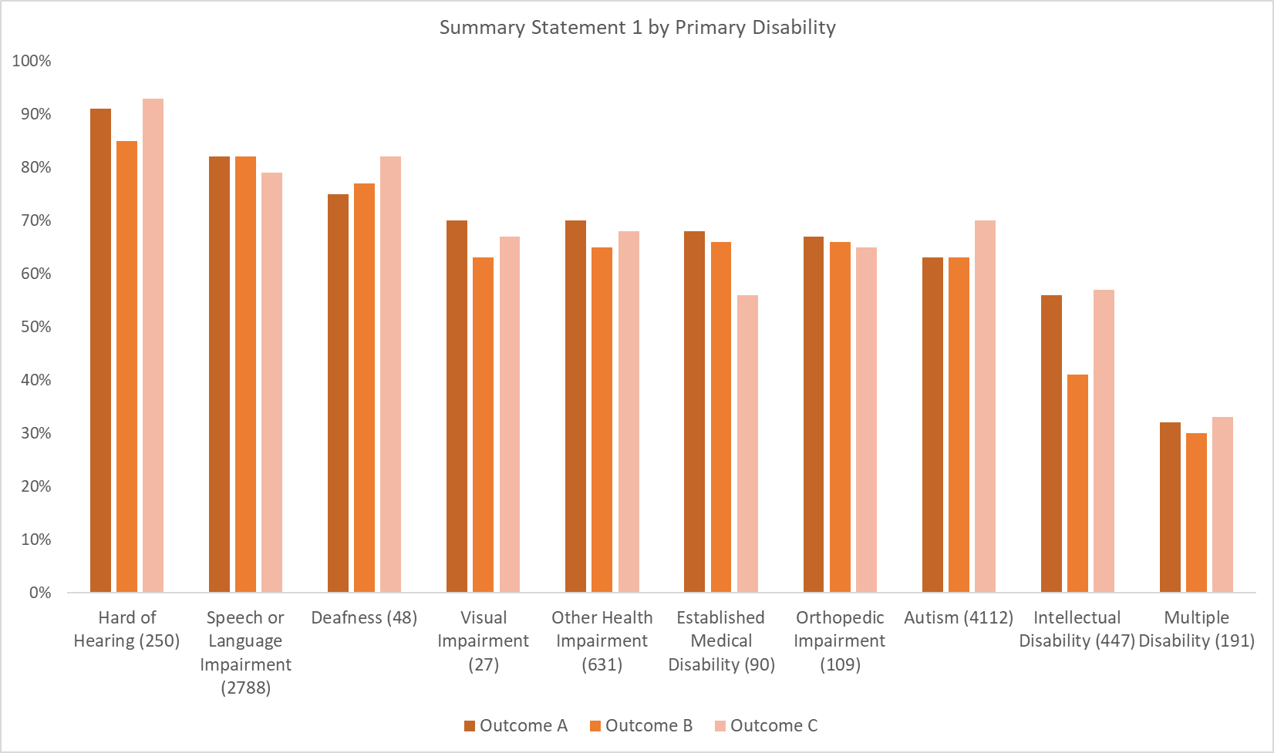
Summary Statement 1 by Primary Disability
Notes:
Review what is on the screen... pause for their observations.
Expectations about what we are expecting it to look like. There are patterns you would expect to see across disabilities. For example, you would expect that children who are HOH would have high performance on Summary Statement 1. You might also expect low performance for disability categories where you would expect to see more children who have a more moderate/severe disability.
Outcome C – highest across all disabilities, but for a few categories, such as Established Medical Disability, where outcome C is lower. Could be related to feeding and dressing and other measures within the PD-HLTH domain.
Pattern – Outcome A and B are pretty close to each other. Aside from Intellectual Disability – because of the strong cognitive component of that disability. Validity claims are supported with the patterning.

Slide 26
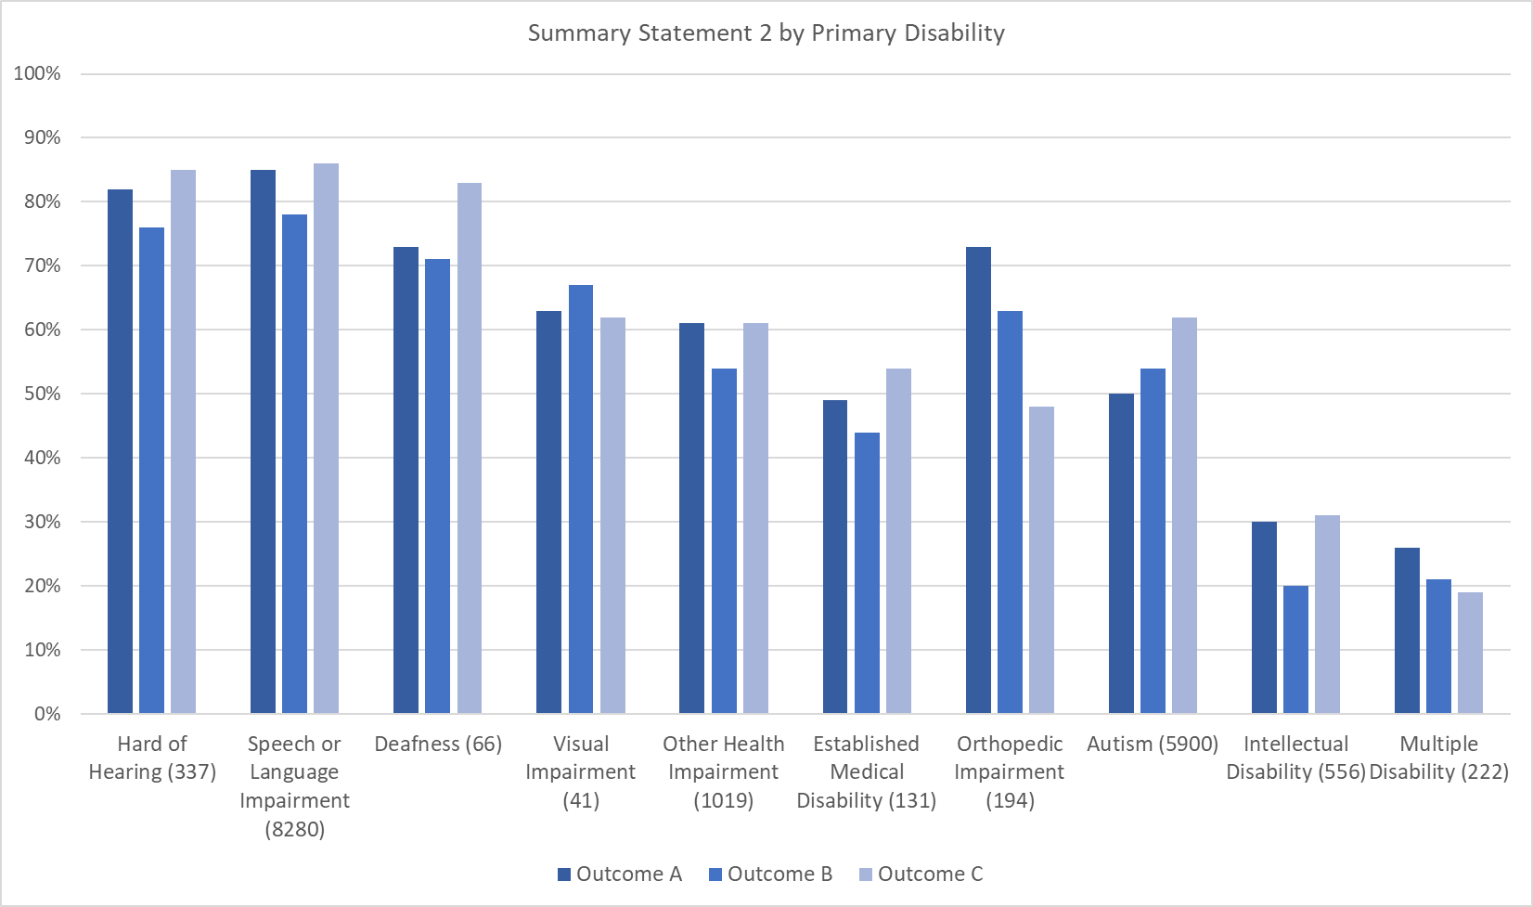
Summary Statement 2 by Primary Disability
Notes:
SS2 has more kids in it – it is easier to measure if children are meeting this metric in general.
Autism – positive SE skills lower than the other outcomes – this confirms what we know about the aspects of that disability.

Slide 27
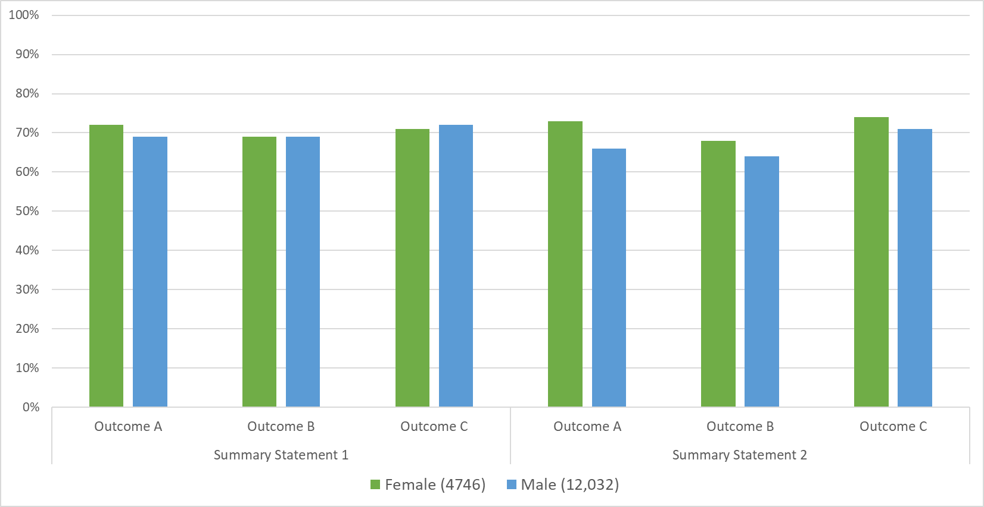
Summary Statements by Gender

Slide 28
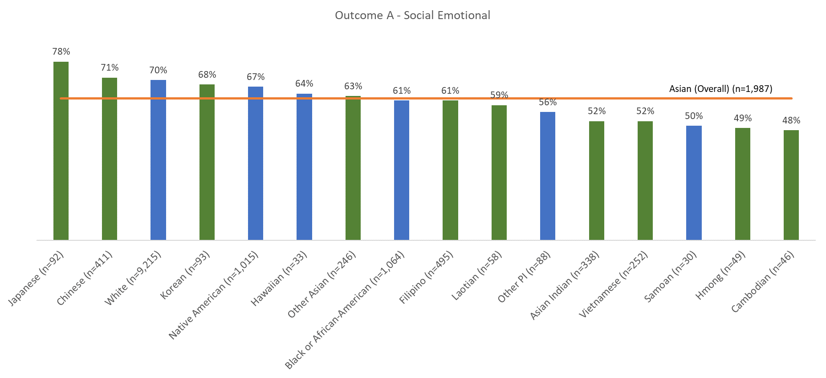
Summary Statement 2 by Primary Race
Notes:
Setting the context for this analysis:
Combining of “all AAPI students into one or two subgroups obscures cultural and historical differences that often shape students’ experiences and opportunities.” https://theticker.org/3617/opinions/not-distinguishing-asian-subgroups-distorts-research-findings/
Asian Americans are the fastest growing racial/ethnic group in the United States, with a population of more than 14 million as of 2010, and projected to grow to nearly 38 million in 2050 (1). The six largest Asian-American subgroups (Asian Indian, Chinese, Filipino, Japanese, Korean, and Vietnamese) comprise approximately 97% of the Asian American population (single race) (2). Asian Americans are also a heterogeneous group, with unique socioeconomic profiles and language abilities (Table 1) (3). There is a wide spectrum of education, household income, and language ability with Asian Indians in the higher and Koreans and Vietnamese in the lower range of these standard sociodemographic indicators. However, Asian-American subgroups are frequently combined into a single Asian category, masking heterogeneity among the subgroups. https://www.ncbi.nlm.nih.gov/pmc/articles/PMC4324759/
One stereotype that leads to the invisibility of Asian Americans is the model-minority myth, a generalization that all Asian Americans are self-sufficient, well-educated, and upwardly mobile. Such generalizationss do not account for the tremendous diversity among Asian Americans, or for differences in socioeconomic status, access to resources, migration patterns, and immigration histories that characterize various Asian American ethnic groups.4,5 https://www.ncbi.nlm.nih.gov/pmc/articles/PMC3086449/
Context about to frame these slides... where are these populations located in California. Hmong and Cambodian population are from more rural areas of the state.
Many times in California, data is presented and in race categories are combined into one Asian Aggregate category. When you aggregate all asian races – you do not get an accurate picture.

Slide 29
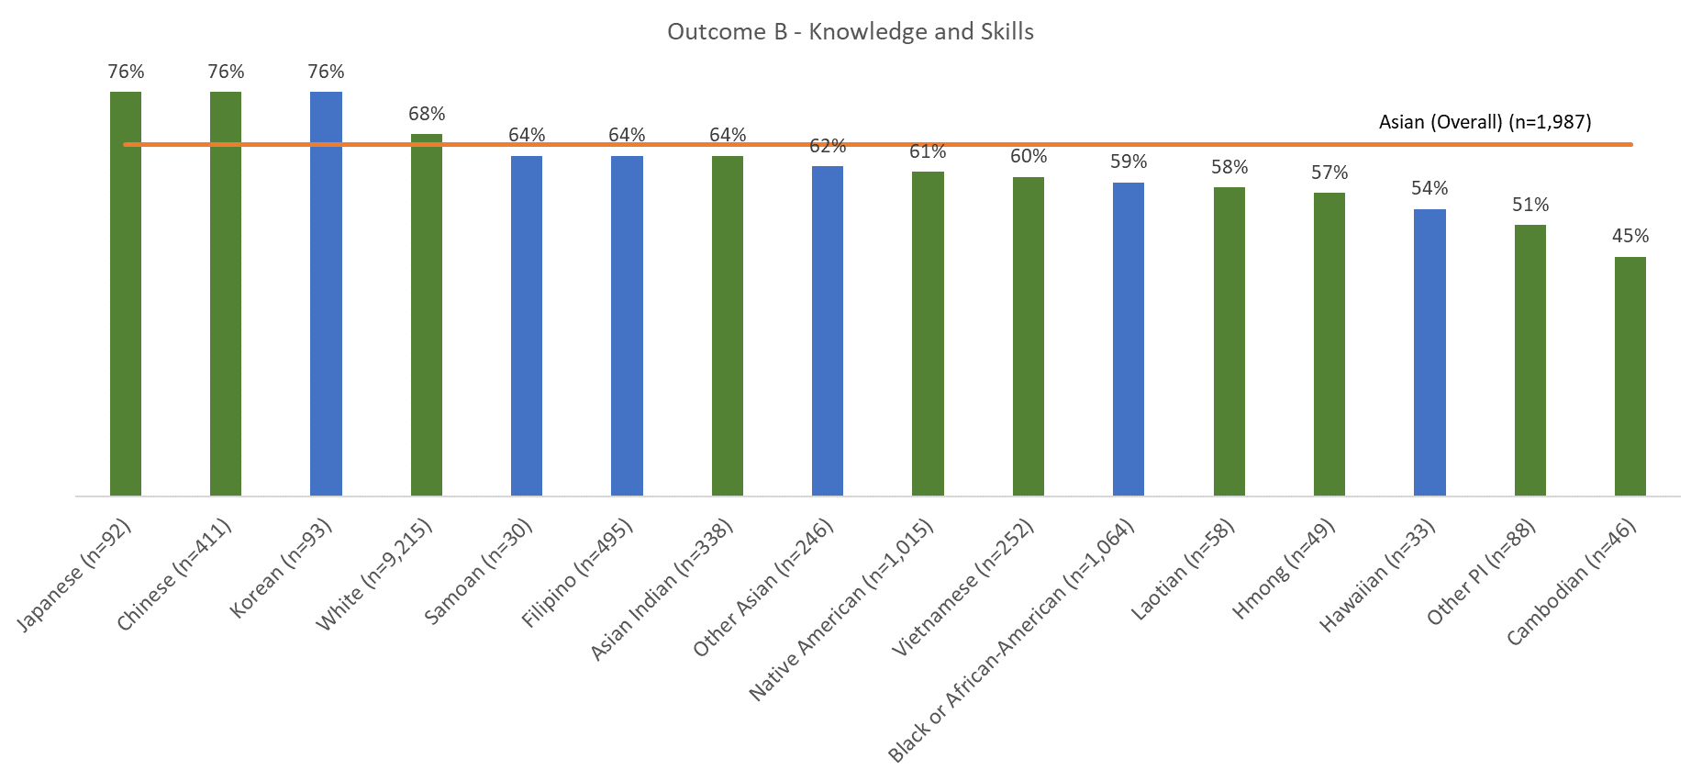
Summary Statement 2 by Primary Race

Slide 30
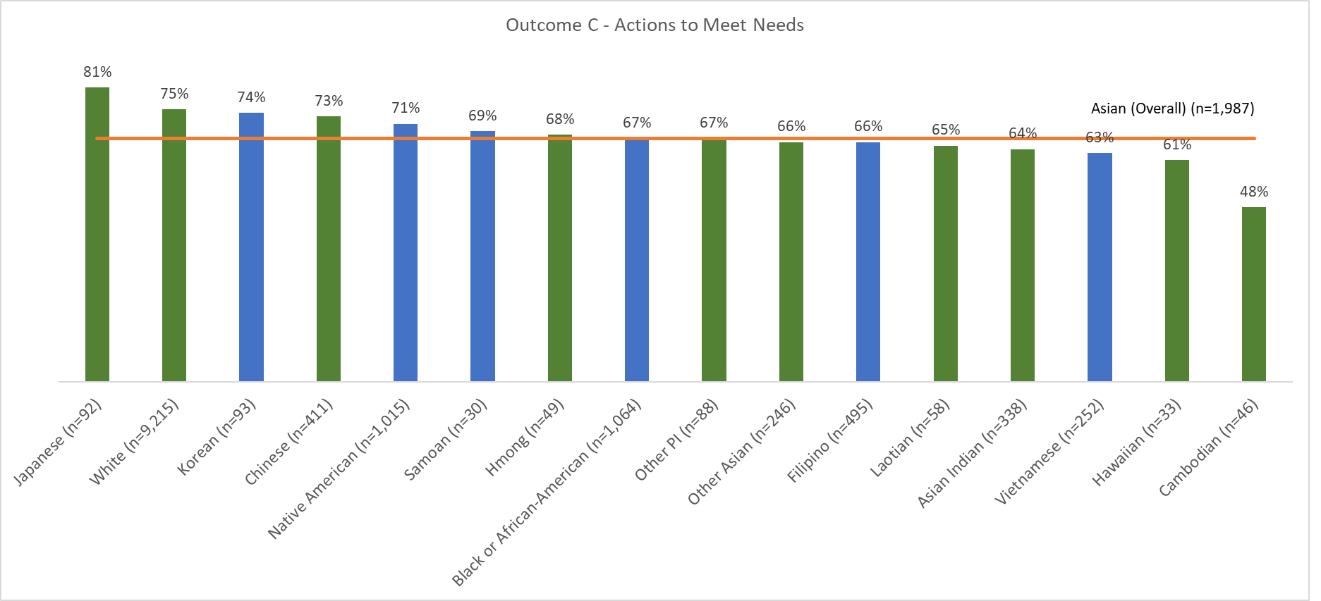
Summary Statement 2 by Primary Race

Slide 31
As a result of the analyses by race...
Deeper understanding of the population we serve in California
Importance of disaggregating the Asian category
If you are interested in more information about data disaggregation as it relates to Asian Americans: https://equitablegrowth.org/how-data-disaggregation-matters-for-asian-americans-and-pacific-islanders/
Caused us to ask "are there other groupings that are masking different outcomes as a result of differences?"

Slide 32
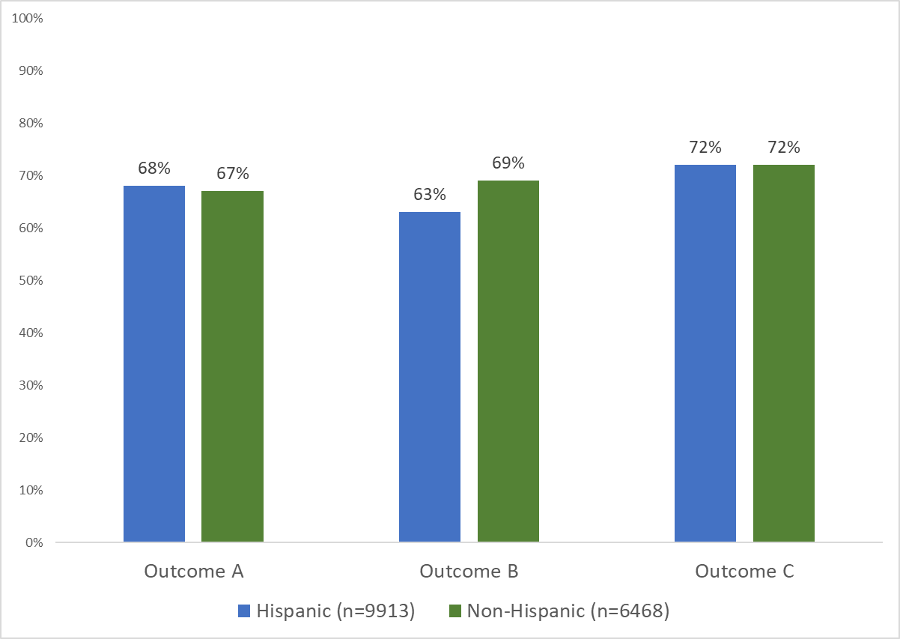
Exited At Age Expectations (Summary Statement 2) by Ethnicity
Notes:
We have more hispanic children in California than non-hispanic children. However, it is important to point out the over 50% of children who are hispanic speak a home language of English.

Slide 33
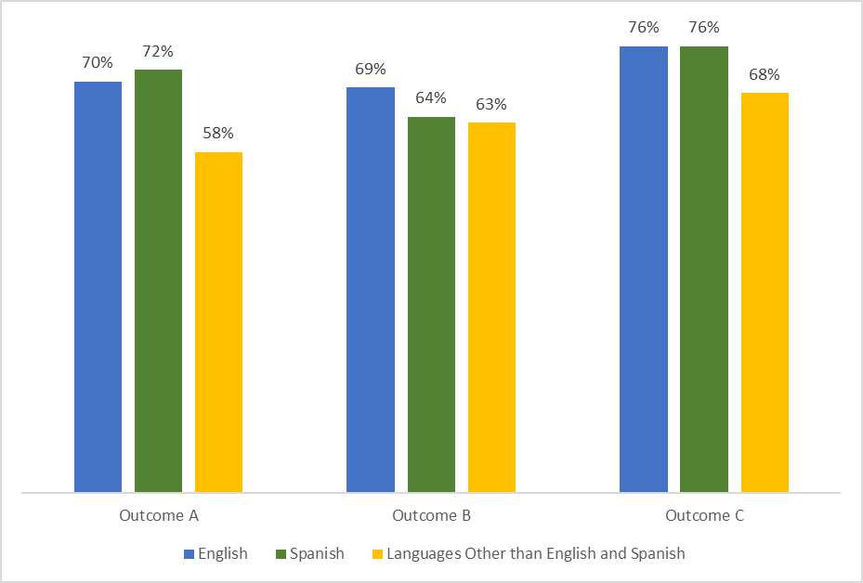
Exited At Age Expectations (Summary Statement 2) by Primary Language
Notes:
These results indicate that for the most part, CA programs have adapted to serving children who speak either English or Spanish. But, it appears we are not serving children who speak other languages as well.
Family engagement
Literacy materials
Classroom materials – book sin English/Spanish, but not other languages
How do districts improve service to children who speak a language other than English or Spanish?

Slide 34
Next Steps
Our team plans on recreate these analyses with the 2022-2023 outcomes data
We have reviewed the DaSy Center's Critical Questions for Addressing Racial Equity in Early Intervention and Early Childhood Special Education and plan to build upon several of the recommendations in this document for future analyses:
Are there differences by race/ethnicity in the length of time children receive EI/ECSE?
Are there differences by race/ethnicity in the percentage of children receiving IDEA services in settings that are for all children (e.g., state-operated prekindergarten, Head Start)? ...in specialized/special education settings?

Slide 35
Other Considerations

Slide 36
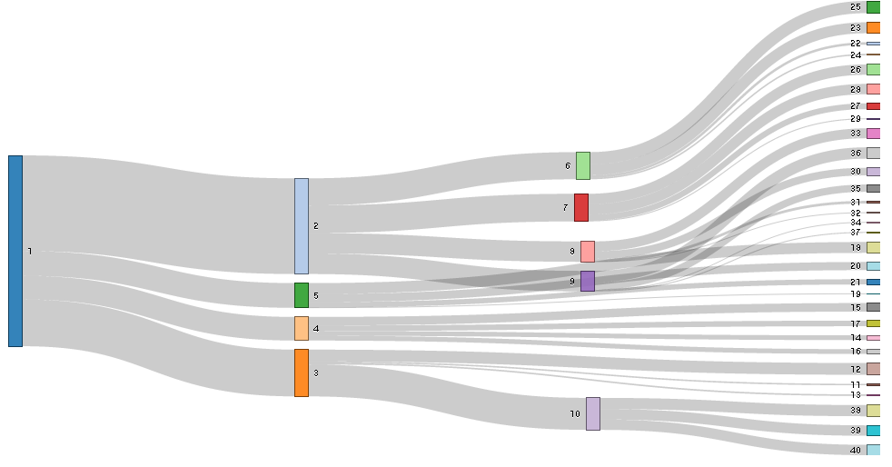
What About Small Ns?
Slicing data sets too small with too many variables can lead to:
Risk of re-identifying children
Lack of statistical significance
BUT…

Slide 37
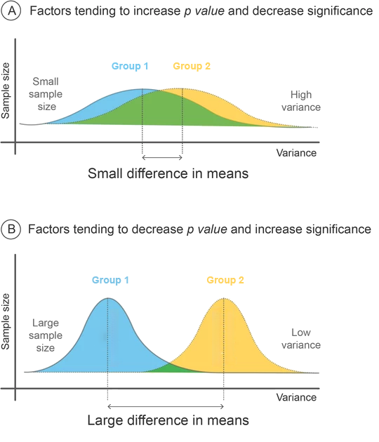
What About Small Ns?
Equity, burden, and the almighty p-value
Source: Krause, H. (2022). Don’t Let the P in P Value Stand for Privilege.
It’s not always about public reporting or research
Notes:
Kellen
P values highly dependent on sample size
Real vs. chance. It’s not that it isn’t real if p value is > .05 – it’s that we don’t know.
When we reject results from small N sizes, we privilege large groups while disadvantaging smaller ones.
Micro-decisions about data use reflect our implicit biases.
(segue into qualitative data as another way to use your data beyond public reporting/research)
Image contains two figures (A & B). Figure A is demonstrating the factors tending to increase p-value and decrease significance. The graph has two flattened parabolic curves representing two groups (1 &2)which are overlapping considerably. The x-axis is variance and the y-axis is sample size. Small sample size, high variance, and the small difference in means contributes to a low p-value. Figure B is demonstrating the factors tending to decrease p-value and increase significance. Two parabolic curves for groups 1 & 2 are shown again but are much taller and barely overlapping. Large sample size, low variance, and larger differences in means are increasing significance.
Figure retrieved from: https://www.medmastery.com/guides/interpreting-medical-literature-mini-guide/evaluating-statistical-methods

Slide 38
Don’t Neglect Your Qualitative Data!
Qualitative data are used to illustrate the story behind the numbers and are often collected through case studies, surveys, interviews, focus groups, observations, documentation review. etc.
Can provide important context and meaningful differentiation for conversations.
Notes:
Table shows a cross-tabulation entry and exit ratings. Columns labeled 1-7 represent the number of children exiting with a rating of the respective column number. The rows labeled 1-7 represent the children entering at a rating of their respective column name. Each cell then corresponds to the number of children exiting with a given rating between 1-7 and exiting at a rating of 1-7. The expected pattern is that most children will enter and exit at the same rating +1-2 and -1. In the extreme, where an entry rating of 1 and an exit rating of 7 intersect, there is a relatively large number (5 of 76 total). All relatively large values are shaded progressively darker blue to indicate their size. With small numbers like 5 broken down here, you have the opportunity to do further analysis by collecting and using qualitative data.

Slide 39
Resources
Critical Questions for Addressing Racial Equity in Early Intervention and Early Childhood Special Education (DaSy Center)
Equitable Research Communication Guidelines (Child Trends)
Equity in Early Childhood Data Webinar (PDG B-5 TA Center)
We All Count

Slide 40
How might you apply this analysis approach to other data? Jot your own question of interest to which you could apply an intersectional approach.

Slide 41
Find out more at: ectacenter.org dasycenter.org draccess.org

