Slide 1
Improving Data Quality Using the Child Outcomes Summary Knowledge Check (COS-KC)
Mary Lee Porterfield, Lauren Barton, Brandi Brown, Michelle Ogorek
DEC 39th Annual International Conference on Young Children with Disabilities and Their Families Minneapolis, MN | November 28–December 1, 2023
Notes:
Introduce all at the beginning

Slide 2
Intended Outcomes
Participants will know:
The purpose and features of the Child Outcomes Summary Knowledge Check (COS-KC)
How states are using the COS-KC in their systems
How the COS-KC supports improving COS data quality
How to sign up to use the COS-KC
Notes:
This session will include some background information as well as a panel discussion from two states implementing the COS-KC. We will reserve some time for Q & A at the end, but welcome clarifying questions throughout as needed.
LB: I deleted “in their states” because some could come who are practitioners or higher ed and they can take the assessment even if they don’t set it up for their state… Added picture with alt text.
LB: Was: How the COS-KC is impacting COS practices and data quality I changed it because we don’t have much info on impact, more how it influences activities.

Slide 3
Show of Hands: Who is in the room?
Do you work with?
EI /0-3
ECSE/3-5
Both
What is your primary role?
Family member/ Parent Center
Practitioner/Teacher/Therapist
Administrator
TA Provider
Other
Notes:
Let’s start by getting to know you.

Slide 4
Show of Hands: How familiar are you with the COS-KC?
Here to learn!
Heard about it – need more information.
Somewhat familiar with it – have been watching for updates.
Pretty familiar with it.
Notes:
What is your familiarity with the COS-Knowledge Check?
Here to learn. When I first heard of COS-KC, I thought I might win a trip to Kansas City.
I’ve heard others mention it, but I don’t really know what it is.
I’ve been watching for updates about the development of this tool for years and am eager to hear the latest.
I have learned about the COS-KC. Pretty familiar.

Slide 5
A Little Background on Child Outcomes and COS
Child outcomes measured in Part C Indicator 3 and Part B 619 Indicator 7:
Positive Social-Emotional Skills
Acquisition and Use of Knowledge and Skills
Use of Appropriate Behaviors to Meet Needs
Child Outcomes Summary (COS) Process
A team decision-making process
Discussing the child's functioning across settings and situations on three outcomes
Use consistent criteria to use all available information and rate a child's functioning relative to age-expected behavior at a specific point in time.
Notes:
In place for federal reporting

Slide 6
The Child Outcomes Summary Knowledge Check (COS-KC)
Why: It provides a way for states and local programs to know whether practitioners have the basic knowledge they need to participate effectively in the COS process. This is critical for quality COS implementation and gathering high quality data.
What: It’s a free, open-book, 30 multiple-choice question assessment about the COS process. Takes 45 minutes to 1 hour.
Assessment items may not be shared.
Where:
Information is available at https://dasycenter.org/cos-kc/
The tool is online at https://coskc.dasyonline.org/.
Tool was developed and items were validated in a field test with strong results.
Notes:
It was an outgrowth of information from the field about a need for a knowledge check. Several rounds of development. We are confident that the items are performing well and that it is a valid assessment.

Slide 7
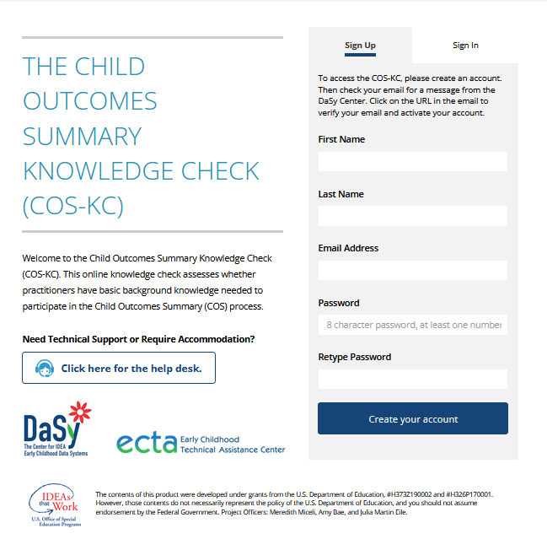
Features of the COS-KC Assessment
Six versions with 30 items each
Three versions for Birth–3
Three versions for 3–5
Assessment is pass/fail
Certificate upon passing
Option to retake after 24 hours
Different version of the form when retaking
Notes:
Self-sign up....
Raise hand if involved in the field test 3 C 3 B….
(no reports provided to states because items under development)
6 forms – 3 with children Part C age and 3 with children preschool age, 42 items per form
Same content assessed in each
Child examples use skills with children at different ages

Slide 8
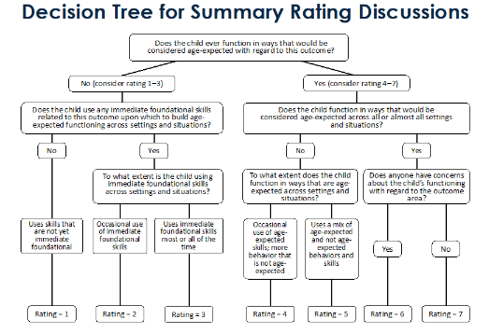
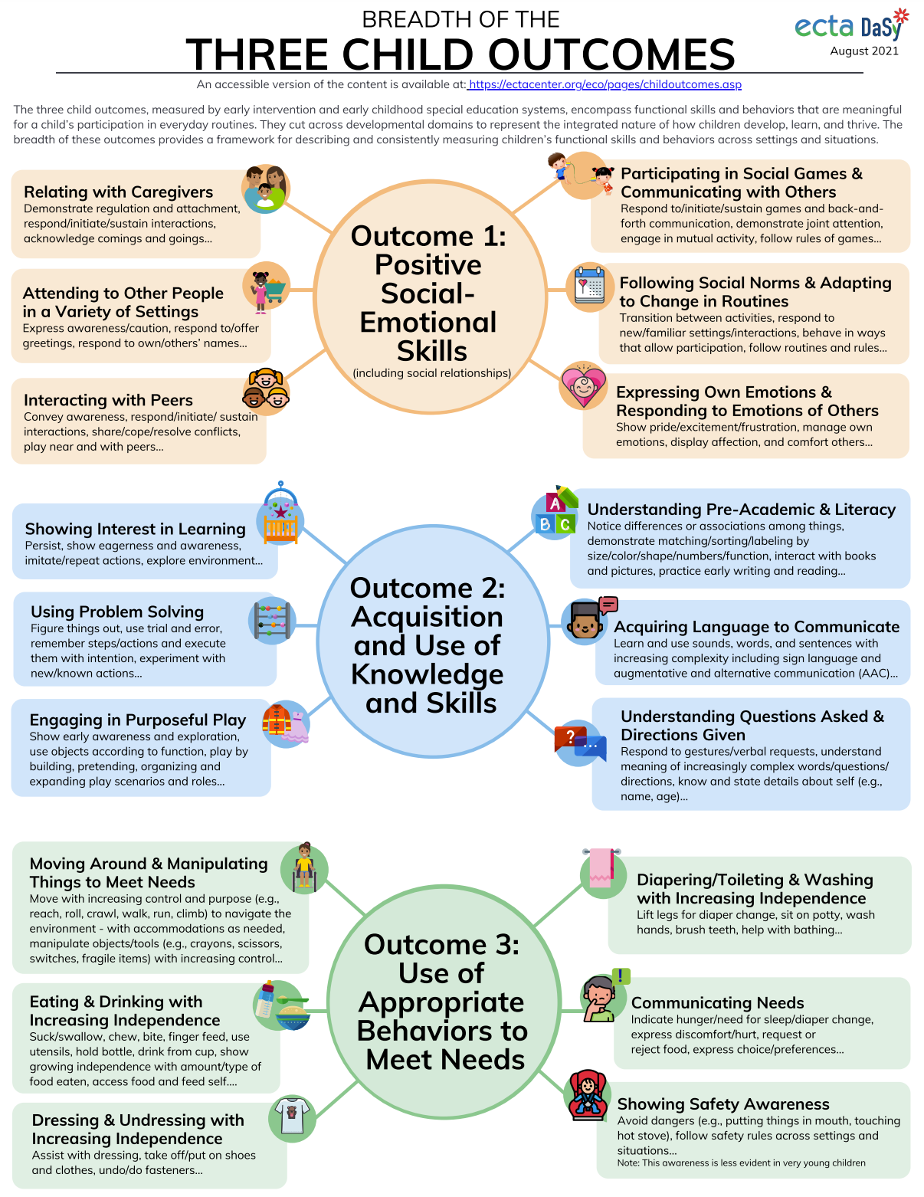
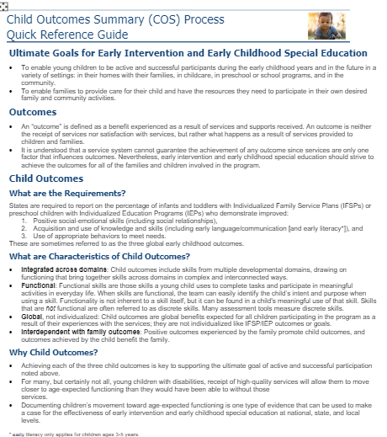
The COS-KC Is Open-Book
Users are encouraged to use resources during assessment
No time limit
https://ectacenter.org/~pdfs/eco/cos-quick-reference-guide.pdf
https://ectacenter.org/~pdfs/eco/cos-resources.pdf (resource links by topic)
Notes:
They have access to resources in everyday life when doing the COS … So allow them in this setting too….
Can save and come back to finish

Slide 9
What does the COS-KC cover? (Content is aligned with the national COS Process Module)
The three child outcomes and why they are measured
Functionality of skills and how they relate to the three child outcomes
COS teaming
The 1–7 COS rating scale
Age anchoring (AE, IF, and F)
Special considerations
Evidence/documentation
Notes:
Areas/topics/categories of information
It will not give you subtest scores on the indented bullets – only 30 items and that would require a lot more items. General assessment of knowledge of COS content
Put different versions to take it again in later….
A one-factor test to assess general knowledge of the COS process

Slide 10
COS-KC Reports
By Program. Show pass/fail and in progress rates by program/district or region
By Characteristics. Describe number and percent of participants who pass/fail/in progress by role, age group work with, years of experience, COS training received, and English language usage
For Individuals. Provide status of individuals in signing up and taking the COS-KC as well as if they pass/fail/in progress
About Permissions. Summarize who is authorized with different permissions to see reports about locations
Are Linkable. Are exportable to link to other data and analyze in more detail.
Notes:
COS-KC is part of a system that allows state and local reports about COS knowledge.

Slide 11
Special Thanks to COS-KC Early Adopter States!
Early adopters helped us work out enrollment processes and identified needed technical improvements in the system:
Alaska Part C
Alabama Part C
Hawaii Part C
Wisconsin Part B 619

Slide 12
State Experiences with the COS-KC
Tell us about your system, your decision to use the COS-KC, and how you set it up
Notes:
Why did you decide to adopt the COS-KC; (this question addressed earier
How did you start using –
who participates
(required/voluntary),
how did you roll it out; (this question addressed on overview slide

Slide 13
How States Are Using the COS-KC
Wisconsin Part B 619
Alabama Part C

Slide 14
Wisconsin’s COS-KC Story: Michelle Ogorek
Introducing the COS-KC as part of a child outcomes data quality professional development event
COS-KC participation - voluntary
Program support teachers will be COS-KC local admins
Will need to ‘sell’ the COS-KC

Slide 15
Alabama’s COS-KC Story: Brandi Brown
Service coordinators are required to take the COS-KC
Guidance: If service coordinators do not pass the COS-KC after taking it twice, they must complete COS Process Online Module
Building COS module and COS-KC into new hire orientation
Notes:
Shannon Foster from Alabama will try to be on the call.

Slide 16
Q&A
What questions do you have for Michelle, Brandi, or for us?

Slide 17
Panel Discussion Questions
What lessons have you learned in your implementation of the COS-KC?
What advice do you have for states thinking about using it?
How did you use reports from the COS-KC to learn about your system or plan improvements?
What have you learned about your workforce and/or professional development system since implementing the COS-KC?
Where do you plan to go next in your use of the COS-KC?
Notes:
Now that you’ve engaged in it for a while….
Other possible questions:
Now that you’ve engaged in it for a while….
What lessons have you learned in your implementation of the COS-KC? (timing, )
What advice do you have for states thinking about using?
What do you wish you had known before you started?
How did you use reports generated from the COS-KC to learn about your system or plan improvements?
Anything learned about how to describe and encourage use/participation in the COS-KC? (how it will be useful for them)

Slide 18
Interested in Learning More or Using the COS-KC?
For State Staff: Reach out to your DaSy liaison or ECTA contact, or go to the following link to request TA: https://dasycenter.org/technical-assistance/need-help/
For Everyone Else: Visit https://dasycenter.org/cos-kc/ for more information and check with your state staff about plans for use.

Slide 19
For More Information
Visit our webpage at https://dasycenter.org/cos-kc/
Notes:
Under development and improving regularly (based on feedback from users like you!)

Slide 20
Find out more at dasycenter.org and ectacenter.org

