Slide 1
Walking the Walk: Using Child Outcomes Data for Improvement
Marcia Blum & Kellen Reid

Slide 2


Session Objectives
Give context to the child outcomes measurement.
Introduce the latest national child outcomes findings.
Provide information about critical questions and how they can be used with child outcomes data for program improvement.
Show how Colorado is promoting preschool special education child outcomes data use at the state and local levels.

Slide 3
Child Outcomes Data
FFY 2021 Highlights
Kellen Reid

Slide 4

Children in
Part C &
Preschool
Education
Programs
879K
Total
471K
Preschool Special Education
408K
Early Intervention

Slide 5

General Background
Looking at compliance is not enough to produce good results so focus shifted to results.
All federal agencies are required to report on the outcomes achieved by their programs.
The Office of Special Education Programs (OSEP) uses child outcomes data to:
  Justify the funding for Part C and Part B Preschool.
  Monitor state results through Results Driven Accountability processes (Part C only).

Slide 6
Three Child Outcomes
OSEP required states to report data annually on 3 child outcomes:
2005
Children have positive social emotional skills (including social relationships)
Children acquire and use knowledge and skills (including early language/communication [and early literacy])
Children use appropriate behaviors to meet their needs

Slide 7
OSEP Progress Categories as Developmental Trajectories
Did not improve functioning
Improved in functioning, but not enough to change the growth trajectory
Moved closer to functioning like same- aged peers
Improved functioning and reached a level comparable to same aged-peers
Maintained functioning like same aged peers
e
d
c
b
a

Slide 8
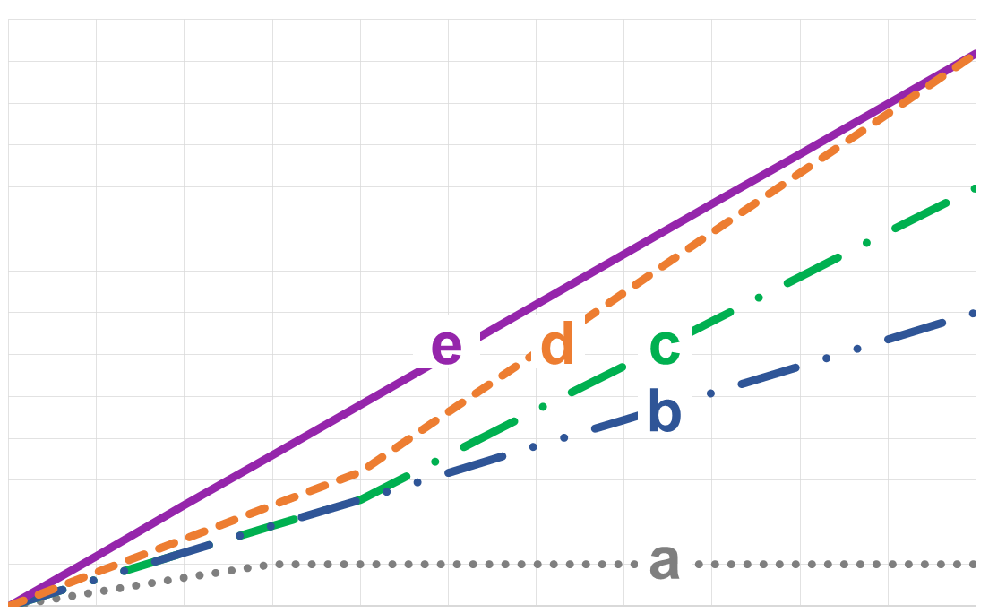
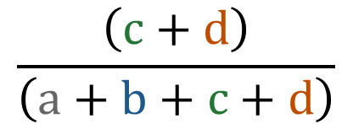
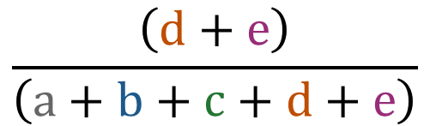
The Summary Statements
Of those children who entered or exited the program below age expectations in each outcome, the percent who substantially increased their rate of growth by program exit.
The percent of children who were functioning within age expectations in each outcome by program exit.
$$\frac{\left(c+d\right)}{\left(a+b+c+d\right)}$$
$$\frac{\left(d+e\right)}{\left(a+b+c+d+e\right)}$$

Slide 9
State Approaches to Measuring Child Outcomes FFY 2021
Approach | Part C |  | Part B 619
Child Outcomes Summary Process | 40 | (71%) | 39 | (66%)
One Statewide/ Publisher Online Tool* | 12 | (21%) | 11 | (19%)
State-Specific Approach* | 3 | (5%) | 5 | (8%)
Transitioning Approaches** | 1 | (2%) | 4 | (7%)
Total | 56 | (100%) | 59 | (100%)
Colorado Part B-619
*modified and **new categories this year

Slide 10
Reasons for Excluding States (FFY 2021)
Started with 51 states in each program
Reason for Exclusion | Part C # Excluded | Part B 619 # Excluded
Sampling | 2 | 3
Missing data* | 1 | 3
Unusual patterns in progress categories ‘a’ or ‘e’** | 2 | 2
Unusual patterns** AND Missing data* | 0 | 1
Data greater than 100% of child count | 0 | 2
Total number of states included in national analysis | 46 | 40
*For Part C: reported outcomes data on less than 28% of exiters. For Part B 619: reported outcomes data on less than 12% of child count.
**Had at least one outcome with category ‘a’ greater than 10% or category ‘e’ greater than 65%.

Slide 11
Number of Part C and Part B Preschool Programs that Met Criteria for Inclusion in the National Analysis over Time
School Year

Slide 12
National Child Outcomes Data for Children Exiting in FFY 2021
Outcome | Part C Early Intervention |  | Part B Preschool
 | Summary Statement 1 | Summary Statement 2 | Summary Statement 1 | Summary Statement 2
Social Relationships | 66% | 52% | 79% | 55%
Knowledge and Skills | 71% | 42% | 79% | 51%
Action to Meet Needs | 69% | 51% | 79% | 61%
Note: Data are based on 46 states' Part C programs and 40 states' Part B Preschool programs. Only states with high-quality data were included.

Slide 13
Part C Child Outcomes Data Trends: FFY 2012-2021
Percent making greater than expected growth (Summary Statement 1)
Percent exiting at or above age expectations (Summary Statement 2)

Slide 14
Part B Preschool Child Outcomes Data Trends: FFY 2012-2021
Percent making greater than expected growth (Summary Statement 1)
Percent exiting at or above age expectations (Summary Statement 2)

Slide 15
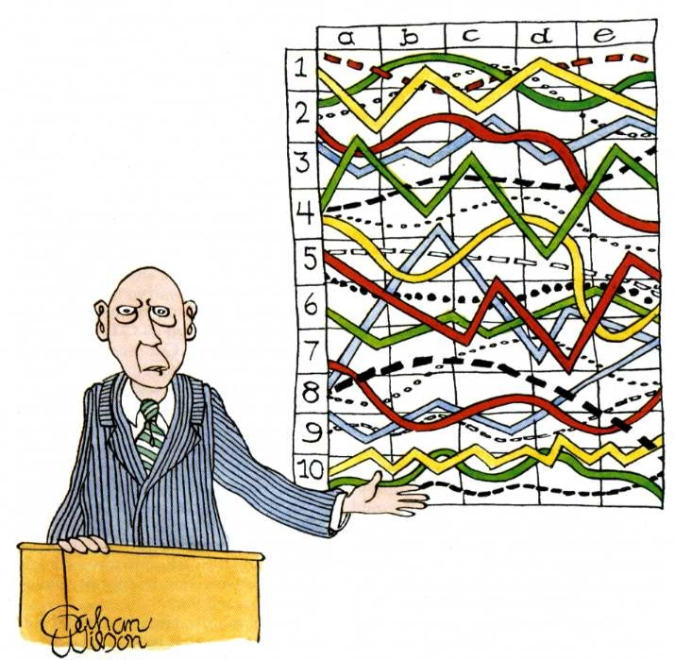
Child Outcomes Data Use
“I’ll pause for a moment so you can let this information sink in.”

Slide 16
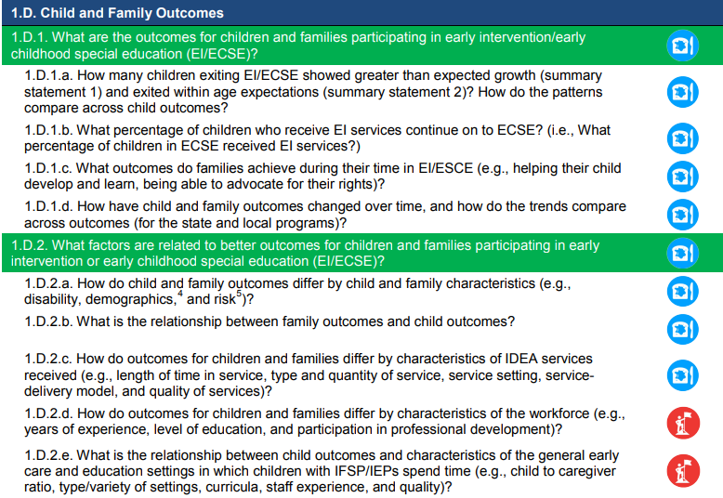
Critical Questions
3 Sections:
Child-/family-level
Practitioner-level
Local Early Intervention program-/ Local educational agency-level
Features:
Broad & specific example questions
Essential & aspirational questions

Slide 17
Telling the Story
Using Critical Questions to Improve Outcomes for Preschoolers Through Data

Slide 18

Starting with Questions

Slide 19





Colorado ECTA & DaSy Cohort
619 Coordinator - Heidi White
State Training Specialist - Marcia Blum
Part B Data Manager - Miki Imura
Early Learning Data Analyst - Tara Rhodes
State Preschool Programs - Liz Schroeder
LEA Special Education Director - LJ Garcia
Family Representative - Danae Davison

Slide 20

Results Matter!
Results Matter improves outcomes for Colorado’s preschool children who receive special education services by helping teachers, administrators, families, and other education partners use authentic assessment data to inform classroom instruction as well as program and policy decision-making.
Results Matter Website

Slide 21
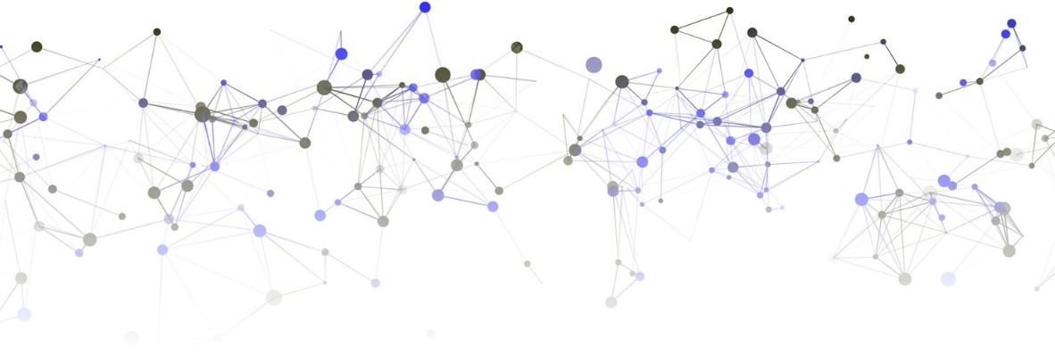
Implementation
Menu of three vendor tools
Online assessment platform provides real-time reporting and digital portfolios
Ongoing technical assistance and monitoring

Slide 22
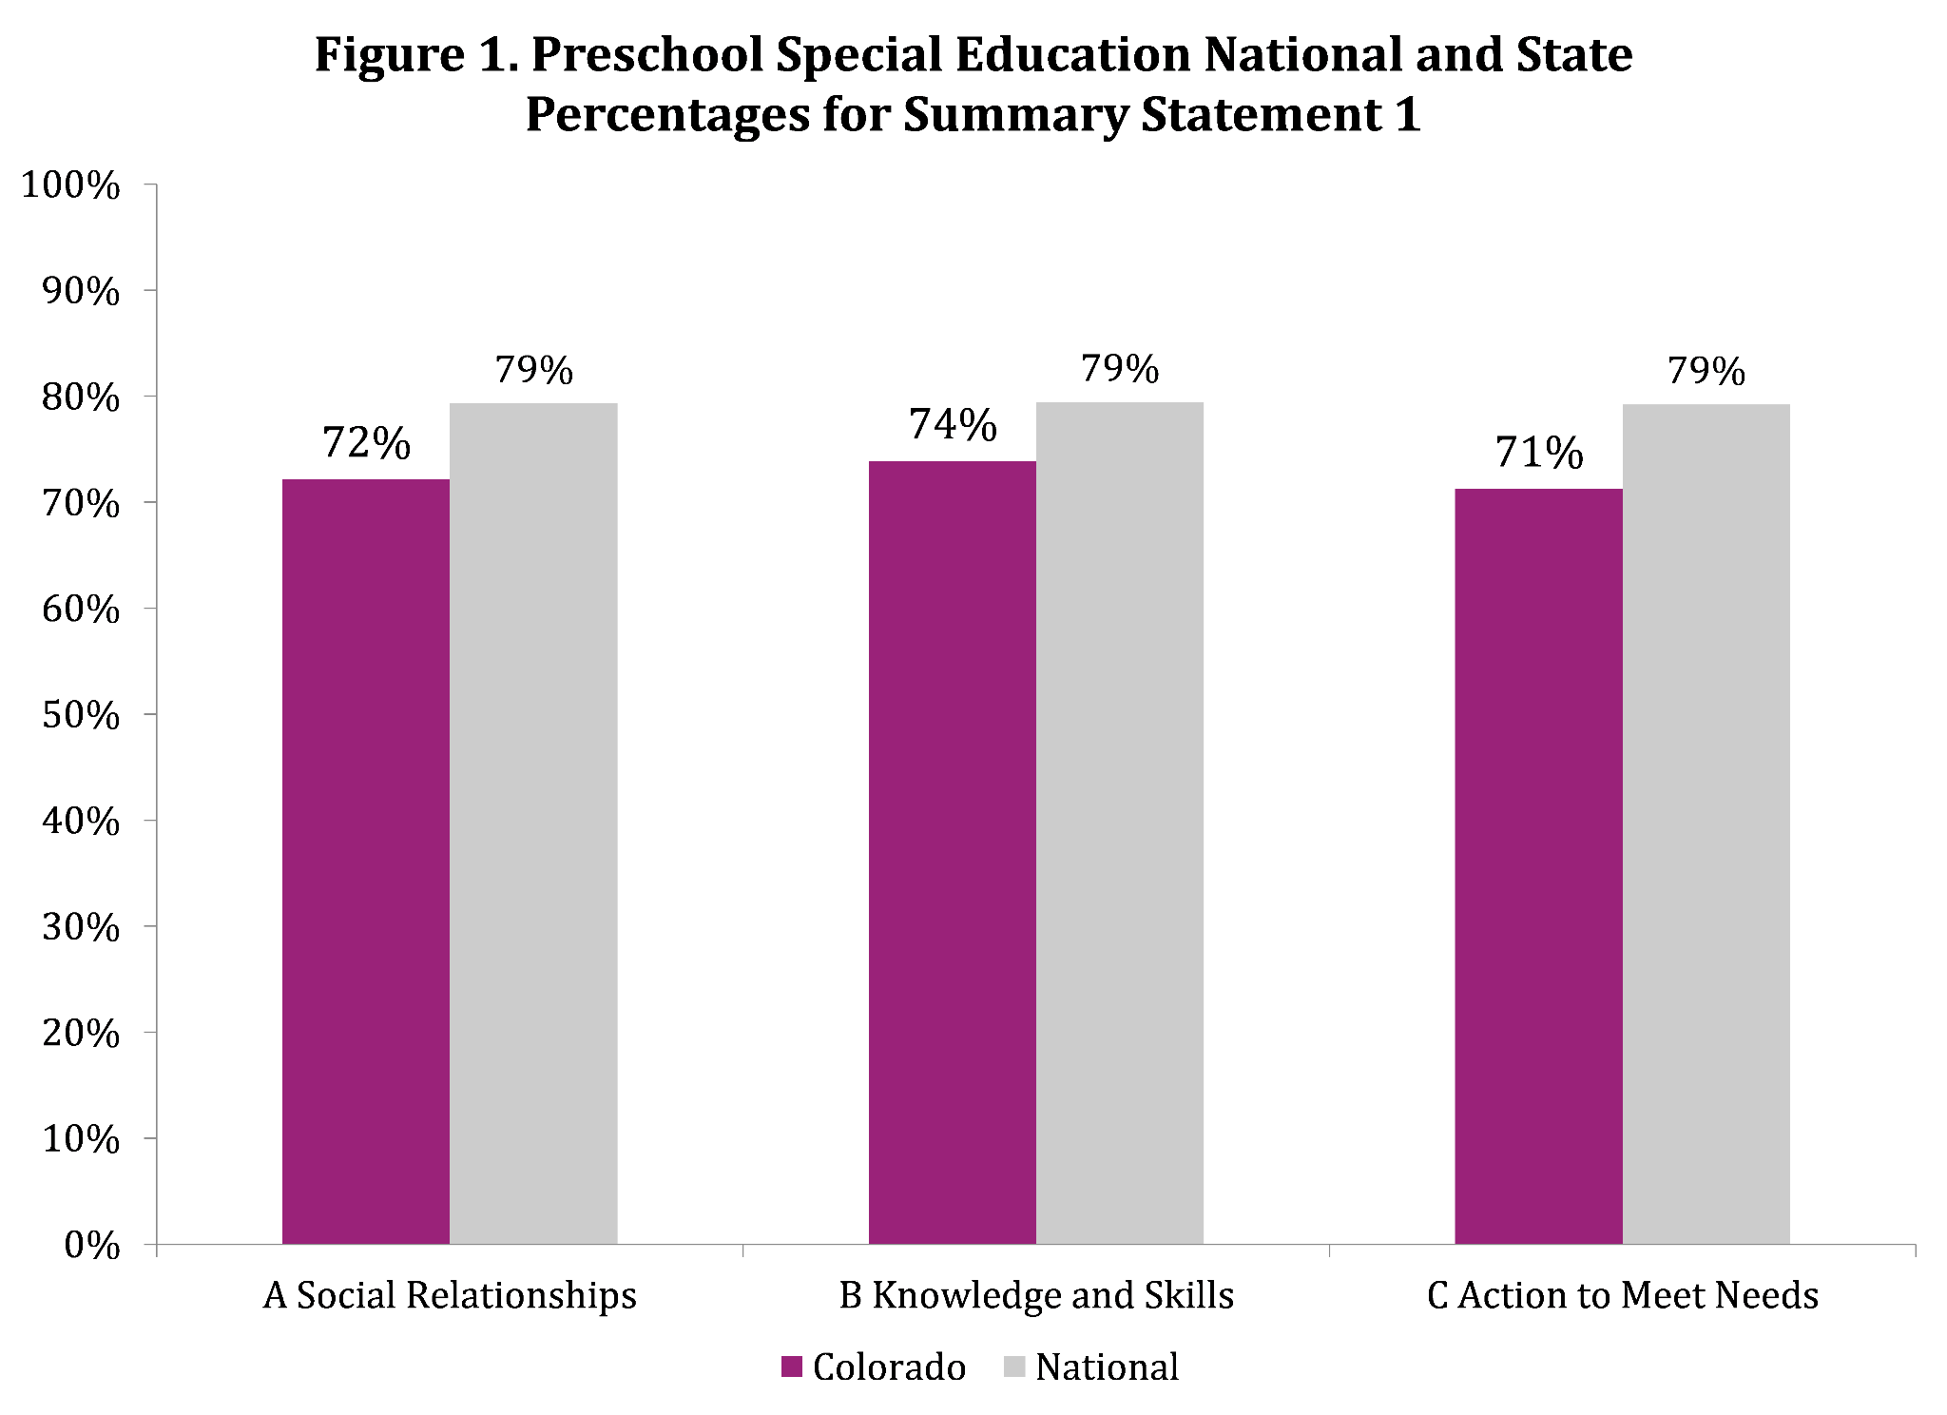
Summary Statement 1

Slide 23
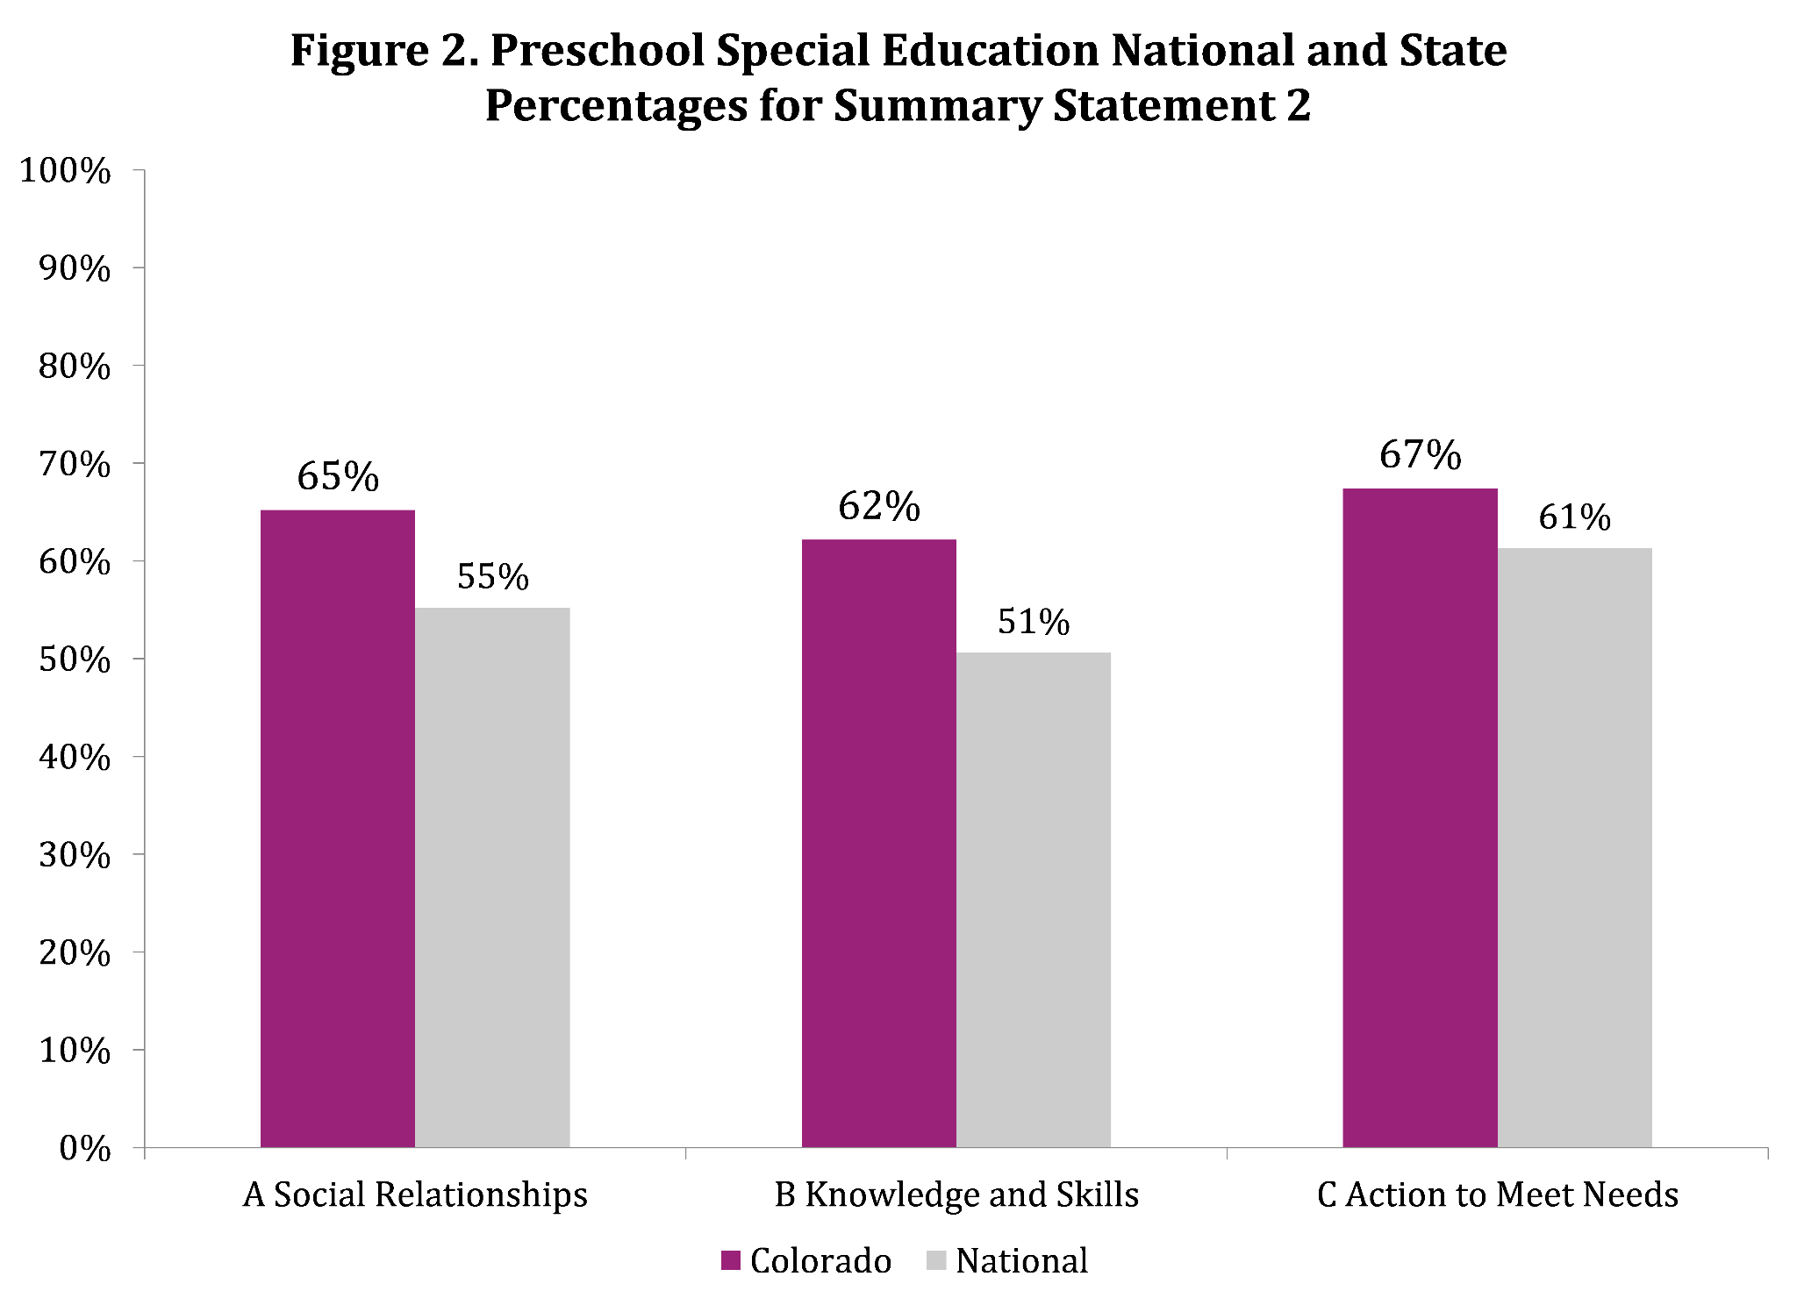
Summary Statement 2

Slide 24
Establishing a Baseline
Connecting initial assessment data, which includes family observations, to timely baseline ratings in progress monitoring tools gives the most accurate picture of a child’s outcomes from the time they enter preschool special education until the time they exit.

Slide 25
The Vision from our Colleagues
“We work together on data relevant to children and families that promotes inclusion and shows progress in routines. Data culture is part of the fabric of what we do- data helps us tell the story.”

Slide 26
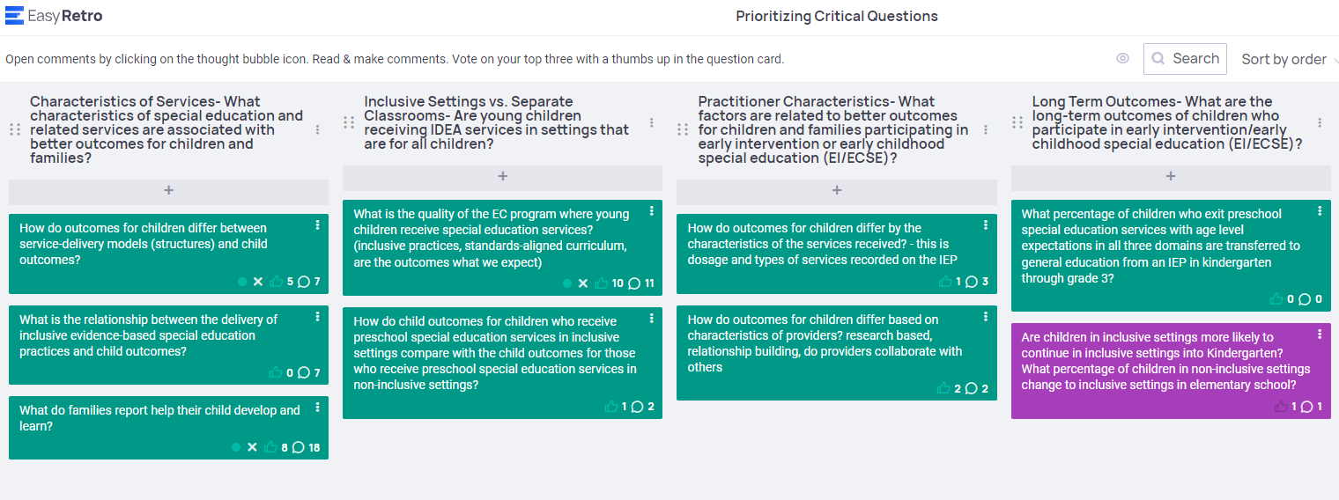
Prioritizing Critical Questions
EasyRetro Board

Slide 27


A data culture is a decision culture
Information Altitudes: Thinking about multiple sources of data
Solution Tree Press
Visit go.solution-tree.com/teams to download the handout.
National
State
District
Program
Classroom
Child

Slide 28
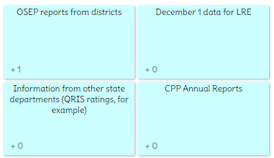
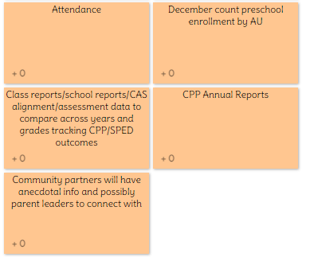
Data Decisions
Information Altitudes | Data Source | What decisions are made with this?
State |  | What is going well or not, overall, across many local systems? Where to focus additional supports or resources to improve performance Technical assistance and guidance? Understanding broad trends to match TA and PD for leaders and teachers. Long-term outcomes, disability employment Teacher training, compensation and retention
District |  | Ask questions to seek out root causes District values and missions reflect the community? Organizational structure and policies PD for staff for improved educator effectiveness Decision making on curricula for long term positive outcomes Policies and procedures to promote growth and change in learning experiences Funding and resource allocation Staffing patterns
Completed Information Altitude Exercise

Slide 29
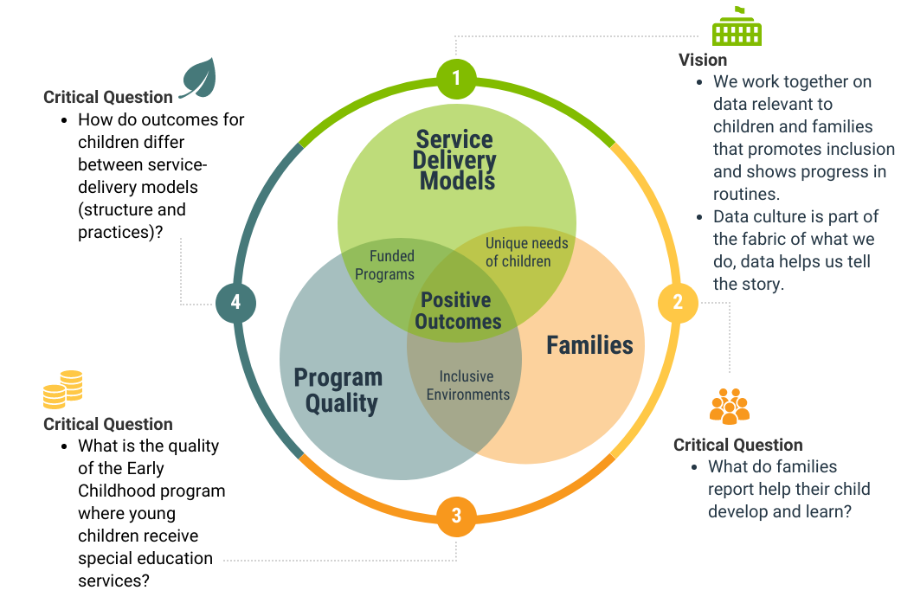
Improving Child Outcomes
Improving Preschool Outcomes in Colorado

Slide 30
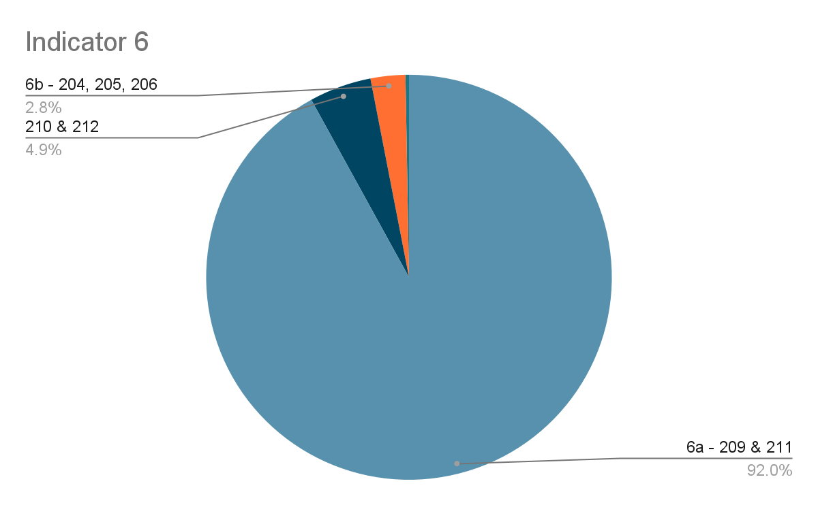
How do features of service delivery and LRE setting types impact outcomes?

Slide 31
Colorado Provider Data
In partnership with the PELE center at the University of Denver, a study showed that 26% of special education providers indicated they lack training and professional development on inclusion.
43% of 243 special education providers surveyed over 4 years did not have a clear understanding of the OSEP preschool outcomes.

Slide 32
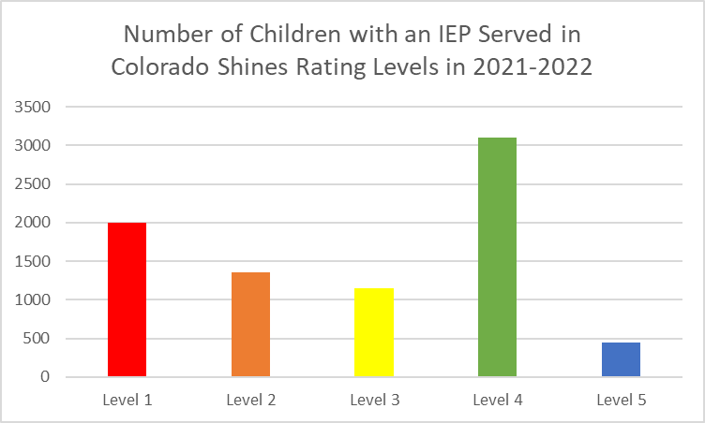
What is the quality of the general early care and education settings in which young children with disabilities receive IDEA services?

Slide 33
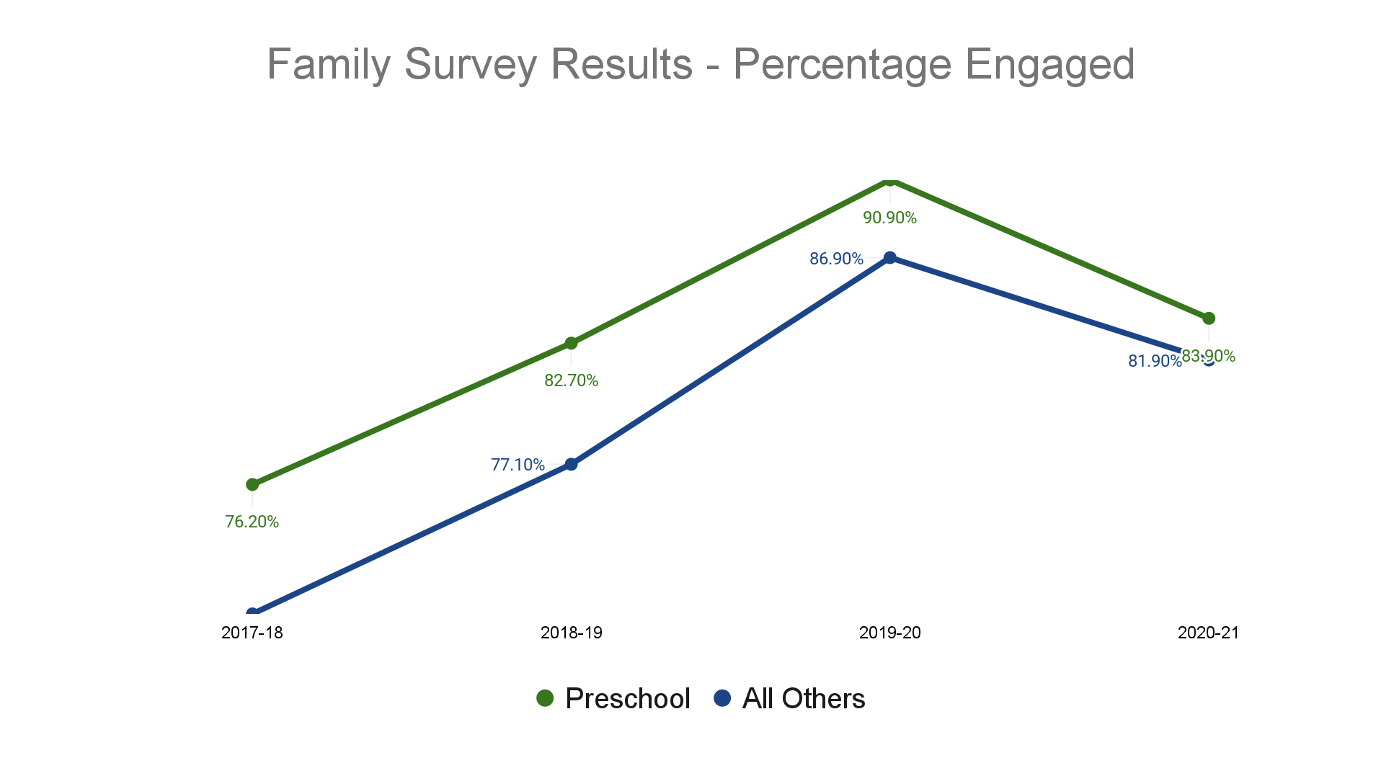
Family Data
Preschool Parents consistently report that their schools facilitate parent involvement at a greater rate than parents of the rest of the grades.
Pandemic Year

Slide 34
Developing a Culture of Data Use
Our critical questions and vision are a filter for our work
They help us frame professional learning activities
They allow us to identify additional sources of data to analyze in concert with the Preschool Outcomes Data
We want to partner with LEAs/AUs to define roles and expectations for developing the culture around data and using data for program improvement

Slide 35
Next Steps in Colorado
Planning for continued high quality data collection on Preschool Outcomes in a changing preschool landscape (funding, location of educational environments)
Identify ways for families to participate in placement decisions available to them, for their child, through the IEP process based upon data about preschool outcomes
Use family data from 2022 Indicator 8 and district preschool annual reports to analyze practices that benefit children (connect to Indicator 7)

Slide 36
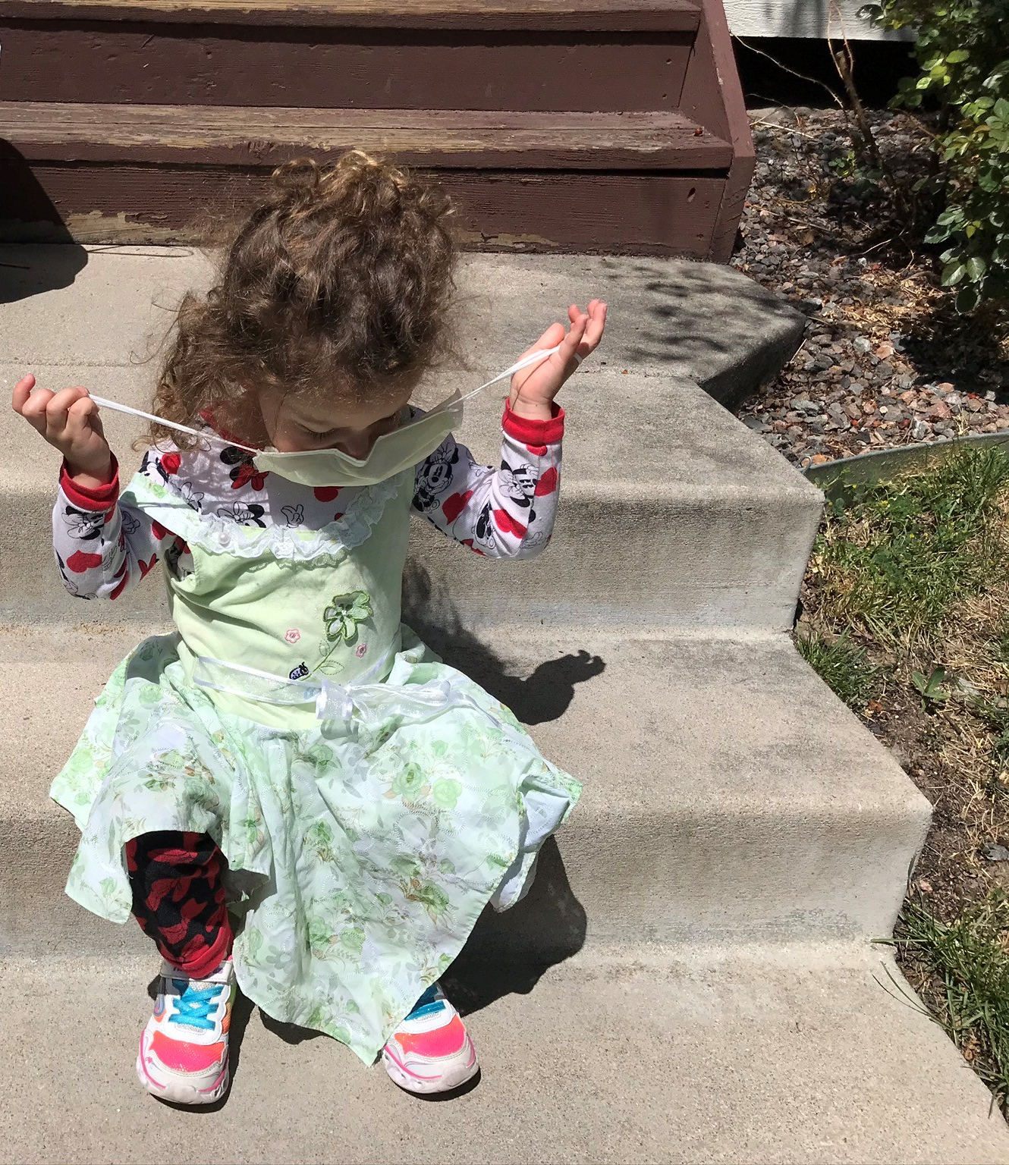
Discussion Questions
What vision does your team/program use to guide your data work?
What are the questions your program is trying to answer with your data?

Slide 37
Find out more at ectacenter.org and dasycenter.org

