Slide 1
Navigating IDEA and FERPA to Protect Privacy in Today’s Early Childhood World
Speakers:
Kala Shah Surprenant, Senior Counsel, Office of the General Counsel, U.S. Department of Education
Frank Miller, Deputy Director, Student Privacy Policy Office, U.S. Department of Education
Moderators:
Ross Lemke, Director, Privacy Technical Assistance Center
Sharon Walsh, DaSy & ECTA
September 22, 2023

Slide 2
Protecting Privacy in Today’s World
Participants will:
Have an increased understanding of IDEA and FERPA as related to data privacy in early childhood program.
Have an opportunity to discuss issues related to COVID-19 impact on service provision and data sharing across programs.
Identify & obtain resources related to privacy and data sharing.
Notes:
Sharon

Slide 3
Protecting Privacy in Today’s World
Speakers – U.S. Department of Education
Kala Shah Surprenant, Senior Counsel
Office of the General Counsel, U.S. Department of Education
Frank Miller, Deputy Director
Student Privacy Policy Office, U.S. Department of Education
Moderators & Key TA Providers
Ross Lemke, Director, Privacy Technical Assistance Center (PTAC)
Sharon Walsh, Policy Consultant, DaSy & ECTA
Notes:
Sharon

Slide 4
Poll Question 1: Select the option that best describes your primary role
Part C Coordinator or Data Manager
Part B 619 Coordinator or Data Manager
Other Part C State Staff
Other Part B State Staff
Regional or Local Provider
National or State TA Provider
Other (Put in the Chat)

Slide 5
Poll Question 2: How familiar are you with the IDEA/FERPA requirements?
I’m very familiar with these requirements/I’ve got this
I have knowledge of these requirements but could use a refresher
I’ve got the basics but need more information
I’m not familiar with these requirements and look forward to learning more about them

Slide 6
Agenda
Two New Data Sharing Resources –
ED/CDC Template &
DaSy/ECTA/NCHAM Checklist
Overview of Privacy Under IDEA & FERPA
Common Privacy Themes Under IDEA & FERPA
Applying Privacy Law – 4 Scenarios
Data Sharing Agreements
Q & A and Resources
Notes:
Sharon

Slide 7
Two New Resources

Slide 8
Data Sharing Agreements
IDEA Part C - Early Hearing Detection and Intervention (EHDI)
New data sharing agreement checklist developed jointly by DaSy, ECTA, and NCHAM
IDEA Part B, Section 619 and IDEA Part C
New data sharing agreement template developed jointly by the U.S. Department of Education and the Centers for Disease Control (CDC)
Notes:
Sharon

Slide 9
Data Sharing Agreement Checklist Between Part C and EHDI
Developed by the national EHDI Outcomes Committee, comprised of state Part C and EHDI representatives, federal staff and TA, and others
Published by DaSy, ECTA, and NCHAM
Designed as a resource for state Part C and EHDI staff as they develop Data Sharing Agreements

Slide 10
Data Sharing Agreement Checklist Between Part C and EHDI
Consistent with the federal requirements under IDEA and FERPA
Includes both essential components and suggested additions
State staff are encouraged to consider items as necessary and appropriate to state-specific circumstances, including any additional state requirements
State staff are encouraged to seek the guidance of their legal counsel

Slide 11
New Data Sharing Agreement Template
Notes:
Kala

Slide 12
Federal Requirements
Overview of Privacy under IDEA & FERPA
Common Privacy Themes under IDEA & FERPA

Slide 13
Overview
Data Sharing --
Requires a good understanding of –
IDEA &
FERPA
Notes:
Ross - Intro

Slide 14
Individuals with Disabilities Education Act (IDEA)
Parents of children referred to IDEA have the right to:
Access child’s records,
Seek to have the records amended, and
Consent to the disclosure of PII or personally identifiable information .
IDEA includes protections beyond FERPA.
When reading IDEA & FERPA together, always start with IDEA first.
Notes:
Kala

Slide 15
Family Educational Rights and Privacy Act (FERPA)
FERPA provides parents and eligible students the right to:
Access to their children’s education records,
Seek to have education records amended, and
Consent to the disclosure of PII or personally identifiable information, except as provided by law.
FERPA protects PII in education records of eligible students maintained by educational agencies and institutions.
Notes:
Frank

Slide 16
Who Does This Apply To?
Who
IDEA applies to —
Participating agencies
Different definitions for Part C vs. Part B
FERPA applies to —
Educational agencies and institutions that receive funds from the U.S. Department of Education
Notes:
Kala

Slide 17
When Do These Rights Apply?
IDEA privacy provisions apply —
once child is referred to IDEA.
FERPA privacy provisions apply to —
when a student attends a school (preschool, K12, Higher Education) receiving funds from the U.S. Department of Education.

Slide 18
Where Can I Find These Privacy Laws?
IDEA Part B and Section 619
34 CFR 300.611 through 300. 627
Last amended 2006
IDEA Part C
34 CFR 303.401 through 303.417
Last amended 2011
FERPA
34 CFR Part 99 and 20 U.S.C. § 1232g.
Last amended 2011, USA Amendment in 2013

Slide 19
What Are Some Differences Between IDEA & FERPA? - Definitions
Education Record/Early Intervention Record
Personally identifiable information (PII)
Parent (FERPA vs. IDEA)
Child vs. Student
When reading IDEA & FERPA, always start with IDEA first.
Notes:
Frank to cover education records and PII
Kala and Frank parent and child and student
Kala to cover participating agency
Education record is the same under IDEA Part B and FERPA, IDEA Part C uses early intervention records to includes records that are collected, maintained or used.
Participating agency is different under the IDEA Part B and Part C regulations and applies differently in different States under IDEA Part C depending on how the State delivers IDEA Part C services. In contrast, FERPA uses educational agency or institution to which funds have been made available
Parent all three have similar definitions for parent and student, but Part B and C include provisions for child, and FERPA includes eligible student.
the definitions of PII are generally the same across all three statutes; they are slightly different under IDEA Part B and Part C and the definition of PII under IDEA Part C is the same as FERPA.

Slide 20
What Are Other Differences?
IDEA incorporates FERPA privacy protections
IDEA has extra exceptions beyond FERPA.
IDEA has extra protections beyond FERPA.
34 CFR 300.622 and 303.414
When analyzing the privacy for children with disabilities, review the IDEA requirements before reading FERPA.
Notes:
Kala (Frank does bold)

Slide 21
Why Does Consent Matter?
IDEA & FERPA - Consent means obtaining prior written parental consent before the disclosure of PII from records.
IDEA & FERPA - Consent must specify the PII in record(s) that may be disclosed, the purpose & the parties receiving the records.
IDEA - Consent must be informed.
IDEA – Consent applies to other areas of IDEA not just disclosure of PII
(e.g., evaluation, service provision, use of insurance, etc.).
Notes:
Frank – first two bullets; Kala – Consent under IDEA last two bullets.

Slide 22
How Are IDEA & FERPA Similar? Inspection, Review, & Amendment of Records
IDEA & FERPA provide parents the right to:
Inspect and review records.
Copies of records (some free under IDEA).
Request amendment of records that are inaccurate, misleading, or violates the child’s privacy.
Request, aside from substantive decisions, a hearing relating to those amendment requests and the ability to submit an explanation or statement where the hearing does not result in the requested amendment.
Notes:
Frank
Parts B and C of the IDEA and FERPA provide parents the right to:
inspect and review education records. While Parts B and C of the IDEA require parents be provided copies of certain records, FERPA, generally, does not require parents be provided copies of records.
request the amendment of records that are inaccurate, misleading, or violates the student’s privacy.
Request, aside from substantive decisions, a hearing to relating to those amendment requests and the ability to submit an explanation or statement where the hearing does not result in the requested amendment.

Slide 23
What Is Different? Keeping Records
IDEA & FERPA
Record keeping requirements in terms of requests for access/disclosures and limitations on records related to multiple students.
IDEA
Safeguarding provisions for the designation of a specific individual responsible for ensuring the confidentiality of PII.
Record retention and destruction of records provisions.
Notes:
Frank first two bullets
Kala last bullet
While both Part C and B IDEA include express provisions for record retention and destruction of records, FERPA only discusses the destruction of records in the context of prohibition on destroying education records if there is an outstanding request to inspect and review the records.
All three have record keeping requirements in terms of requests for access/disclosures and limitations on records related to multiple students.
In contrast, only Part C and B of IDEA, have safeguarding provisions for the designation of a specific individual responsible for ensuring the confidentiality of personally identifiable information.

Slide 24
What Is Different About the Notice to Parents?
IDEA & FERPA require an annual privacy notice to parents.
IDEA requires additional notices to parents
Procedural safeguards, notice of proposed evaluation, notice of eligibility or non-eligibility, notice of use of public insurance, etc. and dictates when and how they must be provided.
Notes:
Kala
IDEA notices – subject process substance violations under IDEA;

Slide 25
What is Different About the Dispute Resolution Options Under IDEA & FERPA?
IDEA & FERPA both require some form of dispute resolution or complaint process.
IDEA dispute resolution provides parents with 3 options-
State complaints ;
Mediation at 34 CFR § 300.506 and 34 CFR § 303.431; and
Due process hearing requests at 34 CFR §§ 300.507 through 300.518 and 34 CFR § 303.430.
IDEA’s complaint process focuses on the role of the State agency.
FERPA permits complaints to be filed at the federal level with the Student Privacy Policy Office within the U.S. Department of Education. See https://studentprivacy.ed.gov/file-a-complaint.
Notes:
Kala –
Other State specific processes such as Resolution sessions and Facilitated IEP Meetings
Frank --

Slide 26
How Can Data Be Shared? 3 Ways
Consent under IDEA and/or FERPA;
De-identified or Aggregate (no PII); OR
Authority/Exception to Consent under IDEA and/or FERPA
Notes:
Kala

Slide 27
IDEA & FERPA Audit or Evaluation Exception
Federal, State, and local officials listed under § 99.31(a)(3), or their authorized representative, may have access to education records only –
in connection with an audit or evaluation of Federal or State supported education programs, or
for the enforcement of or compliance with Federal legal requirements which relate to those programs.
The information must be:
protected in a manner that does not permit disclosure of PII to anyone; AND
destroyed when no longer needed for the purposes listed above.
Notes:
Frank - The audit or evaluation exception permits federal, state and local officials (as well as authorized representatives) to have access to PII from education records only in connection with an audit or evaluation of Federal or State supported education programs or for the enforcement of or compliance with Federal legal requirements which relate to those programs.
This is the exception that was used to develop the two templates we showed earlier
For outside authorities receiving PII under this exception it is best practice to review data access policies and limit the number of employees that have access to personally identifiable data to those that need to have that level of access and does not permit for the disclosure of that data to anyone else. All employees should be trained in the proper use and protection of personally identifiable data, and destroy the data when no longer needed for the purpose it was acquired.
THIS 2ND PARAGRAPH IS AWKWARD. IT’S NOT THE EMPLOYEES THAT WILL “RECEIVE” PII UNDER THIS EXCEPTION, BUT AN OUTSIDE AUTHORITY. – does the edit address?

Slide 28
How Can We Apply IDEA & FERPA in the Real World?
Scenario 1 - Who can be a parent under IDEA & FERPA?
Scenario 2 - How Can Data be Shared with Referral Sources?
Scenario 3 - What Data can be Shared at Transition?
Scenario 4 - Data Sharing Agreement: Audit/Evaluation Exception
Notes:
Ross

Slide 29
Scenario 1 – Who Can Be a Parent?
Two parents are divorced, and the mother has physical custody of the children, one child has an IFSP and is served by the local early intervention service provider under IDEA Part C and the other has an IEP and is served by the IDEA Part B program in the local school district.
A child is referred to the IDEA Part C program from the child welfare agency. The child is placed in foster care and living with foster parents. The child’s biological parents decline to consent to disclose information back to the child welfare agency.
Notes:
Ross Frank first bullet
Kala second bullet Frank - See Qs 19 – 23 of May 2014 ED Guidance at-- https://studentprivacy.ed.gov/sites/default/files/resource_document/file/uninterrupted-scholars-act-guidance.pdf.

Slide 30
Scenario 2 – How Can Data Be Shared With Referral Source?
Primary referral sources, such as EHDI programs, physicians, and other primary referral sources, are interested in receiving follow-up information when they refer a child to the IDEA Part C program.
What information can be shared with referral sources (e.g., the IDEA program has not been able to make contact with the child’s parent or whether the child is determined eligible)?
Is the answer different under Part B of the IDEA when a child is referred to either Part B or Section 619 preschool services?
Notes:
Ross then Kala

Slide 31
Scenario 3 – What Data Can Be Shared at Transition?
A child is approaching age 3, and the Part C system is ready to conduct the Transition Notification to the state educational agency (SEA) and the local educational agency (LEA) (child’s name, the parent’s name and contact information). What else can Part C provide to the LEA?
The LEA requests the service coordinator send the IFSP and any current evaluations to them to expedite the evaluation process. Can this be done without parental consent?
What parent consent must be obtained if the service coordinator is invited to the initial IEP meeting or if other individuals show up?
Notes:
Ross
Kala

Slide 32
Scenario 4 – How Can Data Be Shared Through Written Agreements Under the Evaluation Exception?
The IDEA agency/provider is asked to share data with a referral source such as the EHDI program.
The IDEA agency/provider is asked to share data with another agency to evaluate outcomes for children served under IDEA.
This IDEA/FERPA exception is not intended for “tracking” individual children, but to improve outcomes for children with disabilities and evaluate the IDEA program.
Notes:
Ross asks the question
Frank introduce exception to parent consent under FERPA
Kala to discuss data sharing CDC sample and EHDI examples

Slide 33
Scenario 4 – Data Sharing: Relevant Resources
https://studentprivacy.ed.gov/resources/written-agreement-checklist
https://studentprivacy.ed.gov/resources/guidance-reasonable-methods-and-written-agreements
https://studentprivacy.ed.gov/resources/checklist-mapping-data-flows
https://dasycenter.org/data-sharing-agreement-checklist-for-idea-part-c-and-part-b-619-agencies-and-programs-2/
Notes:
Kala resources

Slide 34
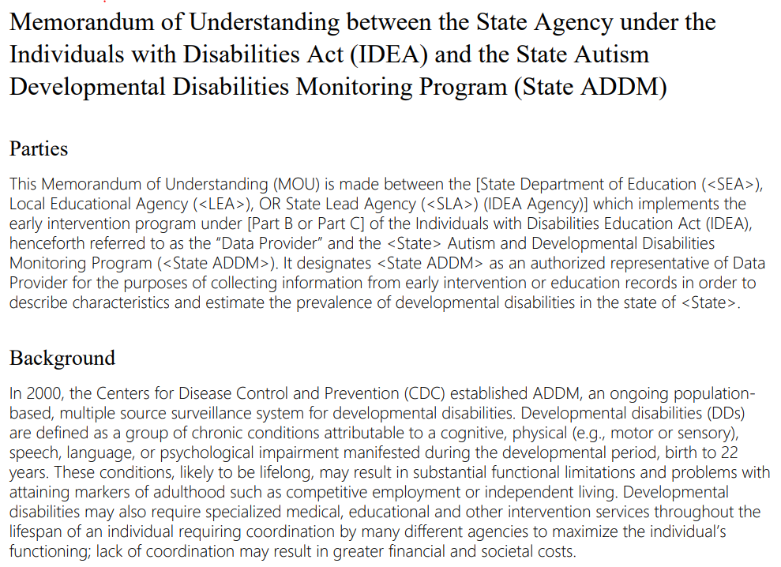
Remember Our Two New Resources
Notes:
Kala

Slide 35
Resources and Q & A

Slide 36
Resources on IDEA/FERPA Privacy
IDEA/FERPA Crosswalk –https://studentprivacy.ed.gov/resources/ferpaidea-cross-walk
Understanding the Confidentiality Requirements Applicable to IDEA Early Childhood Programs FAQs Oct. 2016 – https://studentprivacy.ed.gov/sites/default/files/resource_document/file/idea-confidentiality-requirements-faq_0.pdf
FERPA 101 Training Modules - https://studentprivacy.ed.gov/training/ferpa-101-local-education-agencies
Student Privacy Newsletter - https://studentprivacy.ed.gov/subscribe-student-privacy-newsletter
Data Sharing With CDC - https://www.cdc.gov/ncbddd/autism/pdf/Memorandum-of-Understanding-508.pdf
Notes:
Ross

Slide 37
Resources on IDEA/FERPA Privacy
Notes:
Ross

Slide 38
Open for Q & A
When looking at a Privacy Q, read IDEA & FERPA together.
Start with IDEA first.
Thank you all!
Notes:
Ross/Sharon

Slide 39
Contact Us
www.ed.gov Twitter: @usedgov | studentprivacy.ed.gov | dasycenter.org Twitter: @DaSyCenter | ectacenter.org Twitter: @ECTACenter
The contents of this presentation were developed under grants from the U.S. Department of Education, #H373Z190002 and #H326P170001. However, those contents do not necessarily represent the policy of the U.S. Department of Education, and you should not assume endorsement by the Federal Government. Project Officers: Meredith Miceli, Amy Bae, and Julia Martin Eile.
Notes:
Ross/Sharon

