Slide 1
Expanding your SLDS to Include Special Populations
Ginger Elliott-Teague - DaSy
Erik Friend - Oklahoma
Kathi Gillaspy – SLDS
Leah Piatt - DaSy
NCES STATS-DC
Bethesda, MD
August 9-11, 2023

Slide 2
Introductions
Presenters
Who is in the room?
Quick poll

Slide 3
Purpose and Agenda
Purpose
Agenda
Discuss how and why states should incorporate data about special child populations into the SLDS (and the ECIDS), specifically children with disabilities aged birth to five
Level Setting
National Context
Focus on ECIDS
State Example
Available Resources & Support
Discussion

Slide 4
Why is it important for your state?
How many children who receive Part C early intervention or Part B 619 early childhood special education services are…
In community childcare?
In Head Start?
Receiving SNAP benefits?
Receiving other home visiting services?
And…do services or outcomes differ across these groups?
What are the kindergarten through grade 3 outcomes for children enrolled in early intervention and/or early childhood special education?
DaSy Critical Questions

Slide 5
Terminology Level Setting

Slide 6
Commonly Used Terminology
ECIDS
SLDS
EIS
ECSE
Data Sharing
Data Linking
Data Integration

Slide 7
Defining Systems and Populations
Early Childhood Integrated Data System (ECIDS) – A data system that collects, integrates, maintains, stores, and reports information from early childhood programs across multiple agencies within a state that serve children and families from birth to age eight.
Statewide Longitudinal Data System (SLDS) – A unit-level data system designed for the collection, management, analysis, and reporting of statewide education data over time and across programs.
Early Intervention Services (EIS) – a general term referring to IDEA Part C programs’ services for birth to three.
Early Childhood Special Education (ECSE) – alternatively called IDEA Part B-619 programs for preschool children.

Slide 8
Types of Data Communication
Data Sharing – The practice of providing partners information they can’t access in their own data systems. Data are typically sufficient for recipients’ needs without linking locally. May occur once or repeatedly.
Data Linking – Manually connecting extracted information about an entity (e.g., child, service provider, service) from one data source with information related to that same entity from another data source. May occur once or repeatedly, typically outside of a data system.
Data Integration – Combining data from disparate sources into a single data system to merge information about entities in one location. Maintained systematically through data management/governance plans.

Slide 9
Example Processes
Sharing:
Providing aggregate ECSE program participation counts for three-year-olds to the EIS office (without child specific program information)
Linking:
Providing annual child-level EIS eligibility and enrollment status to the Dept. of Health for children identified by the state EHDI program
Integration:
The state foster care database auto-updates a child’s status and contact information in the state public health data system

Slide 10
Initial Setup Questions
What special population data systems does your state maintain?
Where are they housed?
Does an SLDS or ECIDS already exist?
What is the level of data collection within the systems?
Can the unique identifiers be matched across systems?
Are any data already shared or linked?
Will DSAs be required to share data across systems and are any in place?
Notes:
As you think about integrating special population data into your SLDS, whether EI, ECSE, or for some other population, we want you to think about some key questions. If you can answer these questions without a none or a no, then you are already on your way.

Slide 11
National Context for Integrated Data

Slide 12
EI & ECSE Data within an SLDS (P20W+)
Potential data for integration:
Disability status & category
Services received over time (incl. program eligibility)
Outcomes from kindergarten through grade 3 and beyond
Intersectionalities:
Poverty
Child welfare
Race and ethnicity
Attendance
Notes:
How is an ECIDS connected yet distinct from a P-20W+1 statewide longitudinal data system (SLDS)?
A statewide longitudinal data system (SLDS) is a data system that integrates unit-level, high-quality student, staff, and program data that are linked across entities and over time, and makes these data accessible through reporting and analysis tools. Some ECIDS data—potentially all in some states, depending upon the purpose—should be included in the state’s P-20W+ SLDS to provide a longitudinal view of children as they progress through their schooling and into the workforce.
The primary difference between an ECIDS and a P-20W+ SLDS is the scope—the sectors that are included. An ECIDS brings together data from multiple early childhood programs and agencies. A P-20W+ SLDS brings together data from numerous sectors, one of which is usually early childhood. In turn, an ECIDS is designed to answer questions focused on early childhood and a P-20W+ SLDS is designed to answer questions that span more than one sector. In many states, these systems are being designed simultaneously, and so it is important for states to establish the distinct purpose of each system and to leverage the commonalities and share best practices and lessons learned. 1 P-20W+ refers to data from prekindergarten (early childhood), K12, and postsecondary through post-graduate education, along with workforce and other outcomes data (e.g., public assistance and corrections data). The specific agencies and other organizations that participate in the P-20W+ initiative vary from state to state.
From “What is an ECIDS” by the SLDS SST

Slide 13
EI/ECSE Data Linked to K-12 Data (SLDS) in 2021
https://dasycenter.org/state-of-the-states-2021/child-data-linked-to-k-12-general-education-data/
Notes:
(As reported by states through the DaSy State of the States Survey.)
Important to note that the next several slides reflect different data sources between DaSy and SLDS that tell us what the status of ECIDS/integration for C/619 is across the country.
Source: DaSy state of the states map from 2021 – specifically looking at integration of Part C and 619 data linked in some way to other K12 general education programs.

Slide 14
Challenges to SLDS Expansion
Including extensive EI and ECSE data in a P20W+ is not always a priority
States focus on public preschool data
Part C data may not be part of the SEA data; it is often in Depts. of Health
As a separate sector, it is harder to prioritize getting into the system
Data matching is difficult across sectors
Perception that EI and EC programs are pre-kindergarten and therefore not part of the education pipeline
Critical policy questions often focus on children in general, and rarely identify children with disabilities as the focus of inquiry

Slide 15
Another Option: the ECIDS
Benefits
ECIDS bring in data across early childhood programs in many sectors (education, health, social services), reducing the barrier of bringing in data across sectors
Allows for a comprehensive look at early childhood experiences within a state (including the experiences of young children with disabilities)
Includes child data as well as family, classroom, program, and workforce data
Challenges
There is variation across states in which programs are included
Data governance is complex and can take a long time
Some programs' data is harder to include in an ECIDS than others’

Slide 16
EI & ECSE Data within an ECIDS
Potential data for integration:
Disability status & category
Service types and location
Intersectionalities:
Poverty
Child welfare
Childcare and EC education
Insurance and Medicaid
Race and ethnicity
Notes:
In an ECIDS, it is possible to look at the breadth of data for comparison and use, including health and human services data. This can increase the analytical capacity of the whole dataset.

Slide 17
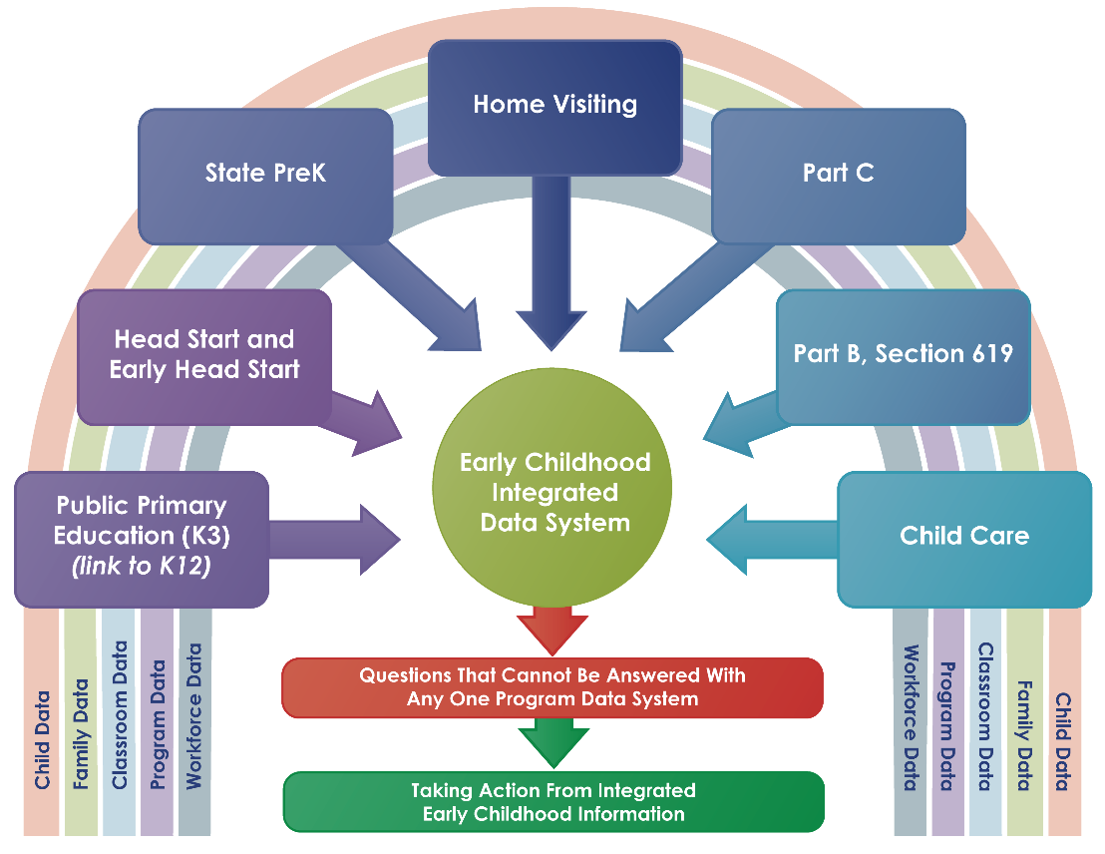
ECIDS Data Map

Slide 18
2018 – 2021 Early Childhood Trends
Pre-Release Results for the recent annual SLDS State Capacity Surveys

Slide 19
2018 Results: States Reporting ECIDS
Alabama
American Samoa
Arkansas
California
Florida
Georgia
Illinois
Mariana Islands
Maryland
Massachusetts
Michigan
Missouri
Montana
New Jersey
North Carolina
Pennsylvania
Rhode Island
Virgin Islands
Washington
West Virginia
Wyoming

Slide 20
Which programs link directly to K-12 data?
Of the 22 states with an ECIDS, >60% have special education Part B (619) and Part C program data included

Slide 21
Current National Outlook
Supports for ECIDS
PDG B-5 grant requirements and implementation approaches
SLDS funding for infrastructure and policy questions
DaSy technical assistance
Early childhood education agency and office creation in states, resulting in shared governance
Challenges to ECIDS
Inconsistent/insufficient funding
Political will and support
Inconsistent access to dedicated staff
Location and status of Part C/Section 619 data systems
Notes:
Basic needs not being met, so the specific challenges of incorporating special populations are even harder when facing these basic needs.

Slide 22
Oklahoma’s Work
Erik Friend, Chief Technology Officer
Oklahoma State Dept. of Education
Office of Management & Enterprise Services

Slide 23
Integrating EI and ECSE into the SLDS
Overview of the integration project and its goals
Seamless Transition Process
How the alignment of Part C and Part B transition processes was achieved.
Use of PCG’s EdPlan solution
Decision to use Public Consulting Group's (PCG) EdPlan solution for both Part C and Part B data transfer.
Integration with Oklahoma SLDS
Project to integrate Part B data into the Oklahoma SLDS.
Future Integration Projects
Upcoming plans for integrating Part C data and modernizing the SLDS.
Seamless Validation Process
How the integrated data allows for seamless validation and compliance monitoring.

Slide 24
Discussion Questions
Including special populations’ data in ECIDS or SLDS…
Where are you in the process?
Who is involved in current discussions?
What are the current challenges in your states or programs?
What strategies have you implemented?
What successes can you share?
What are your next steps?

Slide 25
Resources Available
DaSy
Data system guidance
Individualized TA
Cross State TA
SLDS
Individual Assistance
Multi-State Approach

Slide 26
Visit us at http://dasycenter.org/ and https://slds.ed.gov/#program
Thank you
The contents of this presentation were developed under a grant from the U.S. Department of Education, #H373Z190002. The contents and resources do not necessarily represent the policy of the U.S. Department of Education, and you should not assume endorsement by the Federal Government. Project Officers: Meredith Miceli and Amy Bae.

