Slide 1
Improve Your Child Outcomes Data: Introducing the Child Outcomes Summary Knowledge Check (COS-KC)
Mary Lee Porterfield, Lauren Barton, Robin Rooney, Kathleen Hebbeler
April 20, 2023

Slide 2
Intended Outcomes
Participants will know:
The purpose and features of the Child Outcomes Summary Knowledge Check (COS-KC)
What they can learn through reports from the COS-KC system
How states have incorporated the COS-KC into their larger systems for improving data quality
How to sign up to use the COS-KC in their states

Slide 3
Agenda
Introduction to the COS-KC system: what it is
Review of examples of data available from COS-KC reports
Implementation glimpses from early adopter states
Next steps: how to sign up
Notes:
From early adopter states: – how they are implementing the COS-KC as part of larger strategies to improve child outcomes data

Slide 4
Poll Question: Who is in the room?
What is your primary role?
Part C Coordinator
Part C Data Manager
Other Part C State Staff
Part B Preschool Coordinator
Part B Data Manager
Other Part B State Staff
National or State TA Provider
Parent/Family Member
Practitioner
Federal Government
Higher Education
Other
Notes:
Let’s start by getting to know you

Slide 5
Poll Question: How familiar are you with the COS-KC?
Here to learn!
Heard about it – need more information.
Somewhat familiar with it – have been watching for updates.
Pretty familiar with it.
Notes:
What is your familiarity with the COS-Knowledge Check?
Here to learn. When I first heard of COS-KC, I thought I might win a trip to Kansas City.
I’ve heard others mention it, but I don’t really know what it is.
I’ve been watching for updates about the development of this tool for years and am eager to hear the latest.
I have learned about the COS-KC. Pretty familiar.

Slide 6
What are the child outcomes?
Part C Indicator 3, Part B 619 Indicator 7:
Positive Social-Emotional Skills
Acquisition and Use of Knowledge and Skills
Use of Appropriate Behaviors to Meet Needs

Slide 7
Why do we care about the quality of our child outcomes data?
Know whether the program is making a difference
Confidence using data for program improvement
Data used in high-visibility public reports
May be comparing numbers in determinations (local or state)
Helps tell the story about the difference programs make in helping all children achieve overarching goals/outcomes
Notes:
Why do we care in the first place? If you don't know that the data is high quality, you can't use it for anything.
Need confidence in data when using it to inform program improvement.
Practitioners see it as a valuable activity to invest time in if confident of quality.
Need consistency in how go about discussions with families and generating ratings from one team to another and one local area to another.
It is visible in public reports at local, state, and national level.
It may be part of determinations at state and/or local level (and comparing numbers year to year or region to region).
It helps us tell the story about the difference our programs make. High-quality data tells us how well our program is making a difference to help all children in the state achieve overarching goals/outcomes.

Slide 8
Where does the COS-KC fit in improving data quality?
COS supports
COS-KC
Professional development
(on many related topics)
Practitioner knowledge
Guidance and policies
Quality COS implementation
Quality data useful for federal reporting and program improvement
Leadership investment and culture of data use
Infrastructure supporting quality COS implementation
Monitoring and feedback
Data use and review of data quality

Slide 9
The Child Outcomes Summary Knowledge Check (COS-KC)
Why: It provides a way for states and local programs to know whether practitioners have the basic knowledge they need to participate effectively in the COS process.
What: It’s a free, open-book, 30 multiple-choice question assessment about the COS process. Takes 45 minutes to 1 hour.
Assessment items may not be shared.
Where: It’s online at https://coskc.dasyonline.org/.
Notes:
Check out earlier version, successful items into a system that allows state and local reporting. History. Items performing well. Confident valid assessment.

Slide 10
The COS-KC Is a Valid Assessment
The COS-KC was field tested with early intervention and early childhood special education practitioners.
Results showed the assessment was valid:
Items are strong.
User training/experience/knowledge was related to assessment performance.
Positive feedback from users.
Thanks to all the states that participated in the field test!!

Slide 11
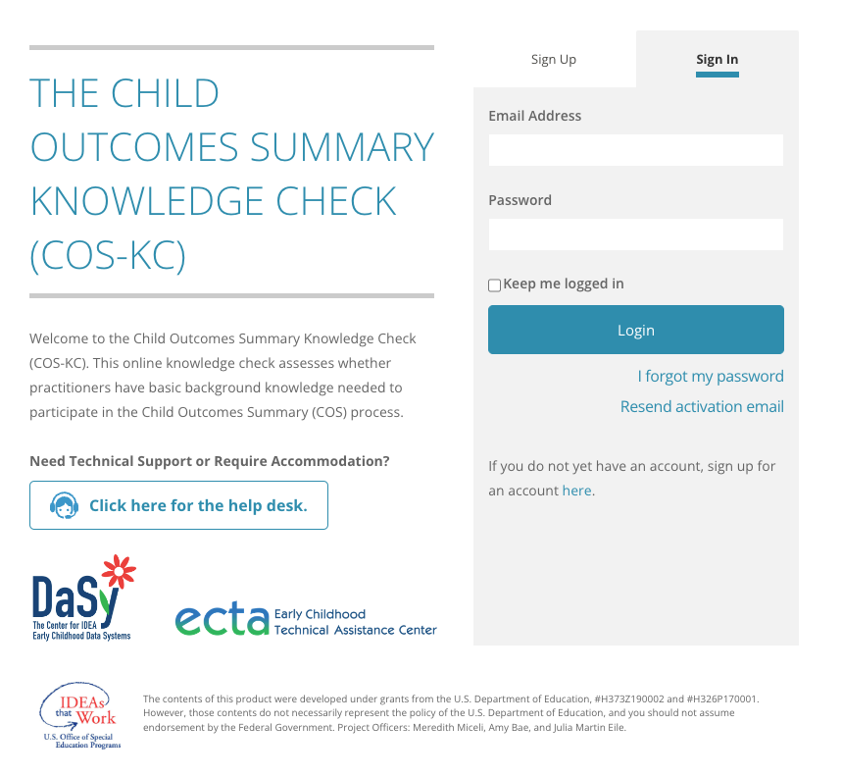
Features of the COS-KC Assessment
Six versions with 30 items each
Three versions for birth–3
Three versions for 3–5
Assessment is pass/fail
Certificate upon passing
Option to retake after 24 hours
Different version of the form when retaking
Notes:
Self-sign up....
Raise hand if involved in the field test 3 C 3 B….
(no reports provided to states because items under development)
6 forms – 3 with children Part C age and 3 with children preschool age, 42 items per form
Same content assessed in each
Child examples use skills with children at different ages

Slide 12
What does the COS-KC cover? (Content is aligned with the national COS Process Module)
The three child outcomes and why they are measured
Functionality of skills and how they relate to the three child outcomes
COS teaming
The 1–7 COS rating scale
Age anchoring (AE, IF, and F)
Special considerations
Evidence/documentation
Notes:
Areas/topics/categories of information
It will not give you subtest scores on the indented bullets – only 30 items and that would require a lot more items. General assessment of knowledge of COS content
Put different versions to take it again in later….
A one-factor test to assess general knowledge of the COS process

Slide 13
Example Question
The team would assign a COS rating of 6, rather than 7, to:
Be able to show progress at the next assessment point
Ensure the child can continue to receive early intervention or early childhood special education services
Indicate that the team has concerns about this child's development in this outcome area
Indicate that the team feels that some aspects of this child's development are below an age-expected level in this outcome area
Notes:
Criteria differentiation C is correct

Slide 14
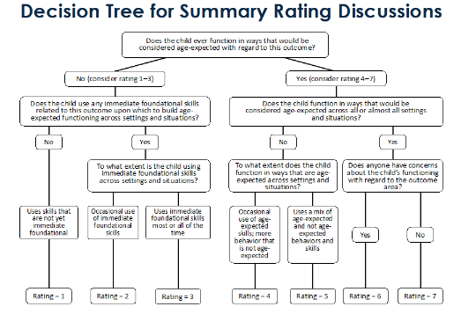
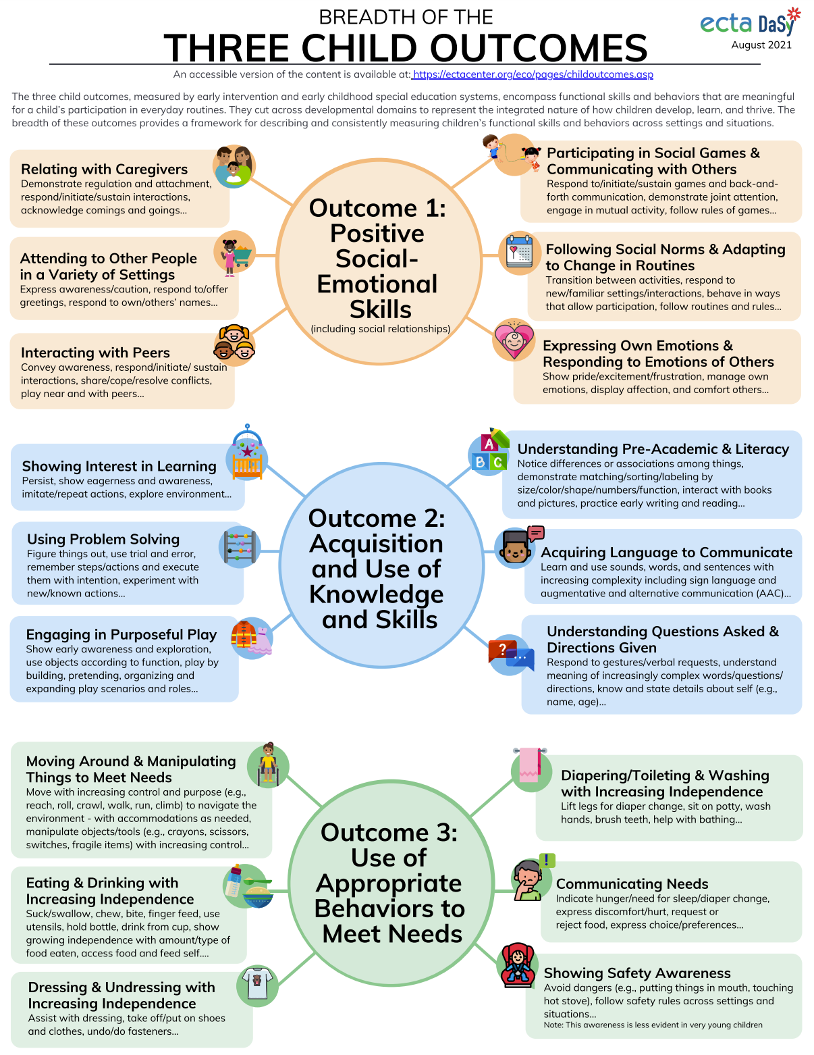
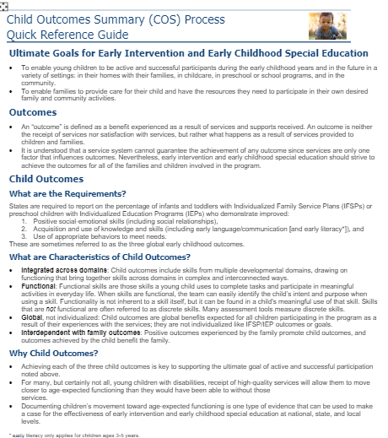
The COS-KC Is Open-Book
Users are encouraged to use resources during assessment
No time limit
https://ectacenter.org/~pdfs/eco/cos-quick-reference-guide.pdf
https://ectacenter.org/~pdfs/eco/cos-resources.pdf (resource links by topic)
Notes:
They have access to resources in everyday life when doing the COS … So allow them in this setting too….
Can save and come back to finish

Slide 15
Benefits of Participation: Individual Practitioners
Check your knowledge of the COS process
Identify areas where refresher professional development is needed

Slide 16
Benefits of State Participation: Improved Data and Outcomes!
State and local admins can run completion and passing reports.
Reports can inform deployment of professional development.
Notes:
There are also reports in Excel that look at completion and passing by practitioner background and training characteristics, and reports that show individual practitioners' status, used especially for user management issues.

Slide 17
Special Thanks to COS-KC Early Adopter States!
Early adopters helped us work out enrollment processes and identified needed technical improvements in the system:
Alaska Part C
Alabama Part C
Hawaii Part C
Wisconsin Part B 619

Slide 18
How States Are Using the COS-KC
Hawaii Part C
Wisconsin Part B 619
Alaska Part C
Alabama Part C

Slide 19
Hawaii’s COS-KC Story: Kathy Kubo
Hawaii’s rollout of the COS-KC
Using data for program improvement
Next steps: COS-TC

Slide 20
Wisconsin’s COS-KC Story: Michelle Ogorek
Introducing the COS-KC as part of a child outcomes data quality professional development event
COS-KC participation will be voluntary
Program support teachers will be COS-KC local admins
Will need to ‘sell’ the COS-KC

Slide 21
Alaska’s COS-KC Story: Susan Kessler
Program locations: Regional early intervention (EI) programs (15)
COS-KC local admins: Program coordinators
Target participants: Providers who have completed the COS Process Online Module
LMS: Module embedded in LMS; after completion, providers directed to the COS-KC
Notes:
Statewide structure: Program location set up for each regional EI program (15) with program coordinator designated as Local Administrator.
Target participants: Providers who have previously completed the COS Process Online Module, according to state records and/or program coordinator attestation.
Rollout: Program locations were bulk uploaded with 3-digit location ID created. Local administrators were added manually by state staff.
Implementation: Providers are currently completing KC. Feedback has varied across programs. More recent completion of training seems to lead to better outcomes on KC. After completion of COS modules, providers are directed to the COS-KC. May be difficult for second language learners.
Lessons learned: It is better to have local administrators and providers create their own logins, so that they are immediately watching for the confirmation email. Good idea to give guidance that completion of background and COS experience section is required. May require periodic follow-up with local programs to ensure timely completion.

Slide 22
Alaska’s COS-KC Story (continued)
Findings thus far: More recent completion of training seems to lead to better COS-KC outcome. May be difficult for second language learners.
Lessons we’re learning: Have users create their own logins, so they can immediately watch for the confirmation email. Remind users they must complete registration questions. May require periodic follow-up with local programs to ensure timely completion.
Notes:
Statewide structure: Program location set up for each regional EI program (15) with program coordinator designated as local administrator.
Target participants: Providers who have previously completed the COS Process Online Module, according to state records and/or program coordinator attestation.
Rollout: Program locations were bulk uploaded with 3-digit location ID created. Local administrators were added manually by state staff.
Implementation: Providers are currently completing KC. Feedback has varied across programs. More recent completion of training seems to lead to better outcomes on KC. After completion of COS modules, providers are directed to the COS-KC. May be difficult for second language learners.
Lessons learned: It is better to have local administrators and providers create their own logins, so that they are immediately watching for the confirmation email. Good idea to give guidance that completion of background and COS experience section is required. May require periodic follow-up with local programs to ensure timely completion.

Slide 23
Alabama’s COS-KC Story
Providers are required to take the COS-KC
Guidance: If providers do not pass the COS-KC after taking it twice, they must complete COS Process Online Module
Building COS module and COS-KC into new hire orientation
Notes:
Shannon Foster from Alabama will try to be on the call.

Slide 24
Questions or comments?

Slide 25
Interested in Using the COS-KC … Now? In a few months? Next year?
Please reach out to your DaSy liaison or ECTA contact, or go to the following link to request TA: https://dasycenter.org/technical-assistance/need-help/
We will reach out and set up a time to discuss the details and schedule enrollment.

Slide 26
For More Information
Visit our webpage at https://dasycenter.org/cos-kc/
Notes:
Under development and improving regularly (based on feedback from users like you!)

Slide 27
Find out more at dasycenter.org and ectacenter.org

