Slide 2
Leadership, Equity, Impact: Federal Programs Supporting Early Care, Education, and Well-Being
Sharon Walsh
Center for IDEA
Early Childhood Data Systems
Moderator
Improving Data, Improving Outcomes (IDIO) 2022: Leadership, Equity, Impact
#IDIO2022
August 25, 2022

Slide 3
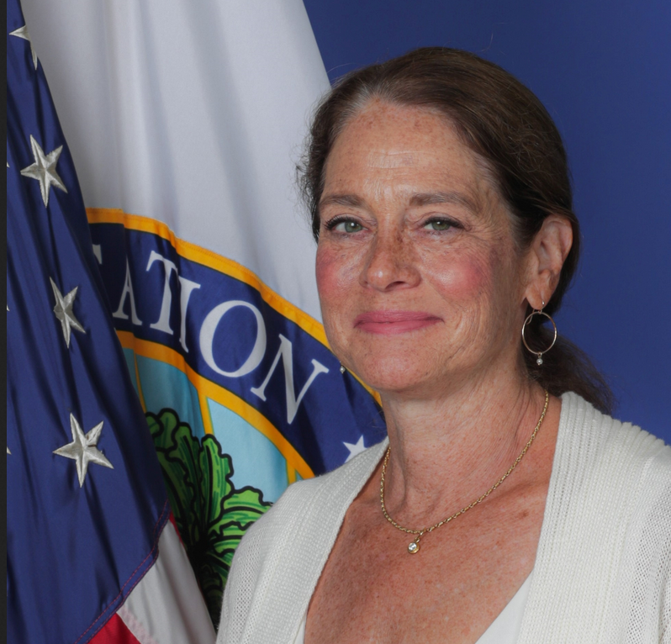
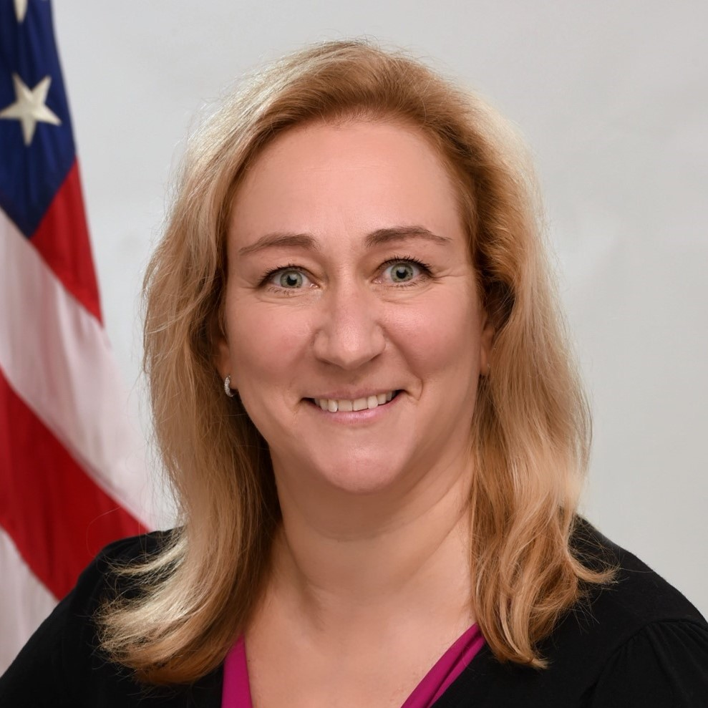
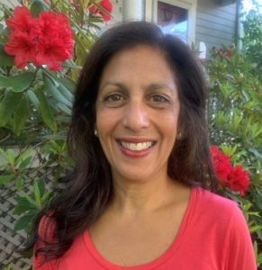
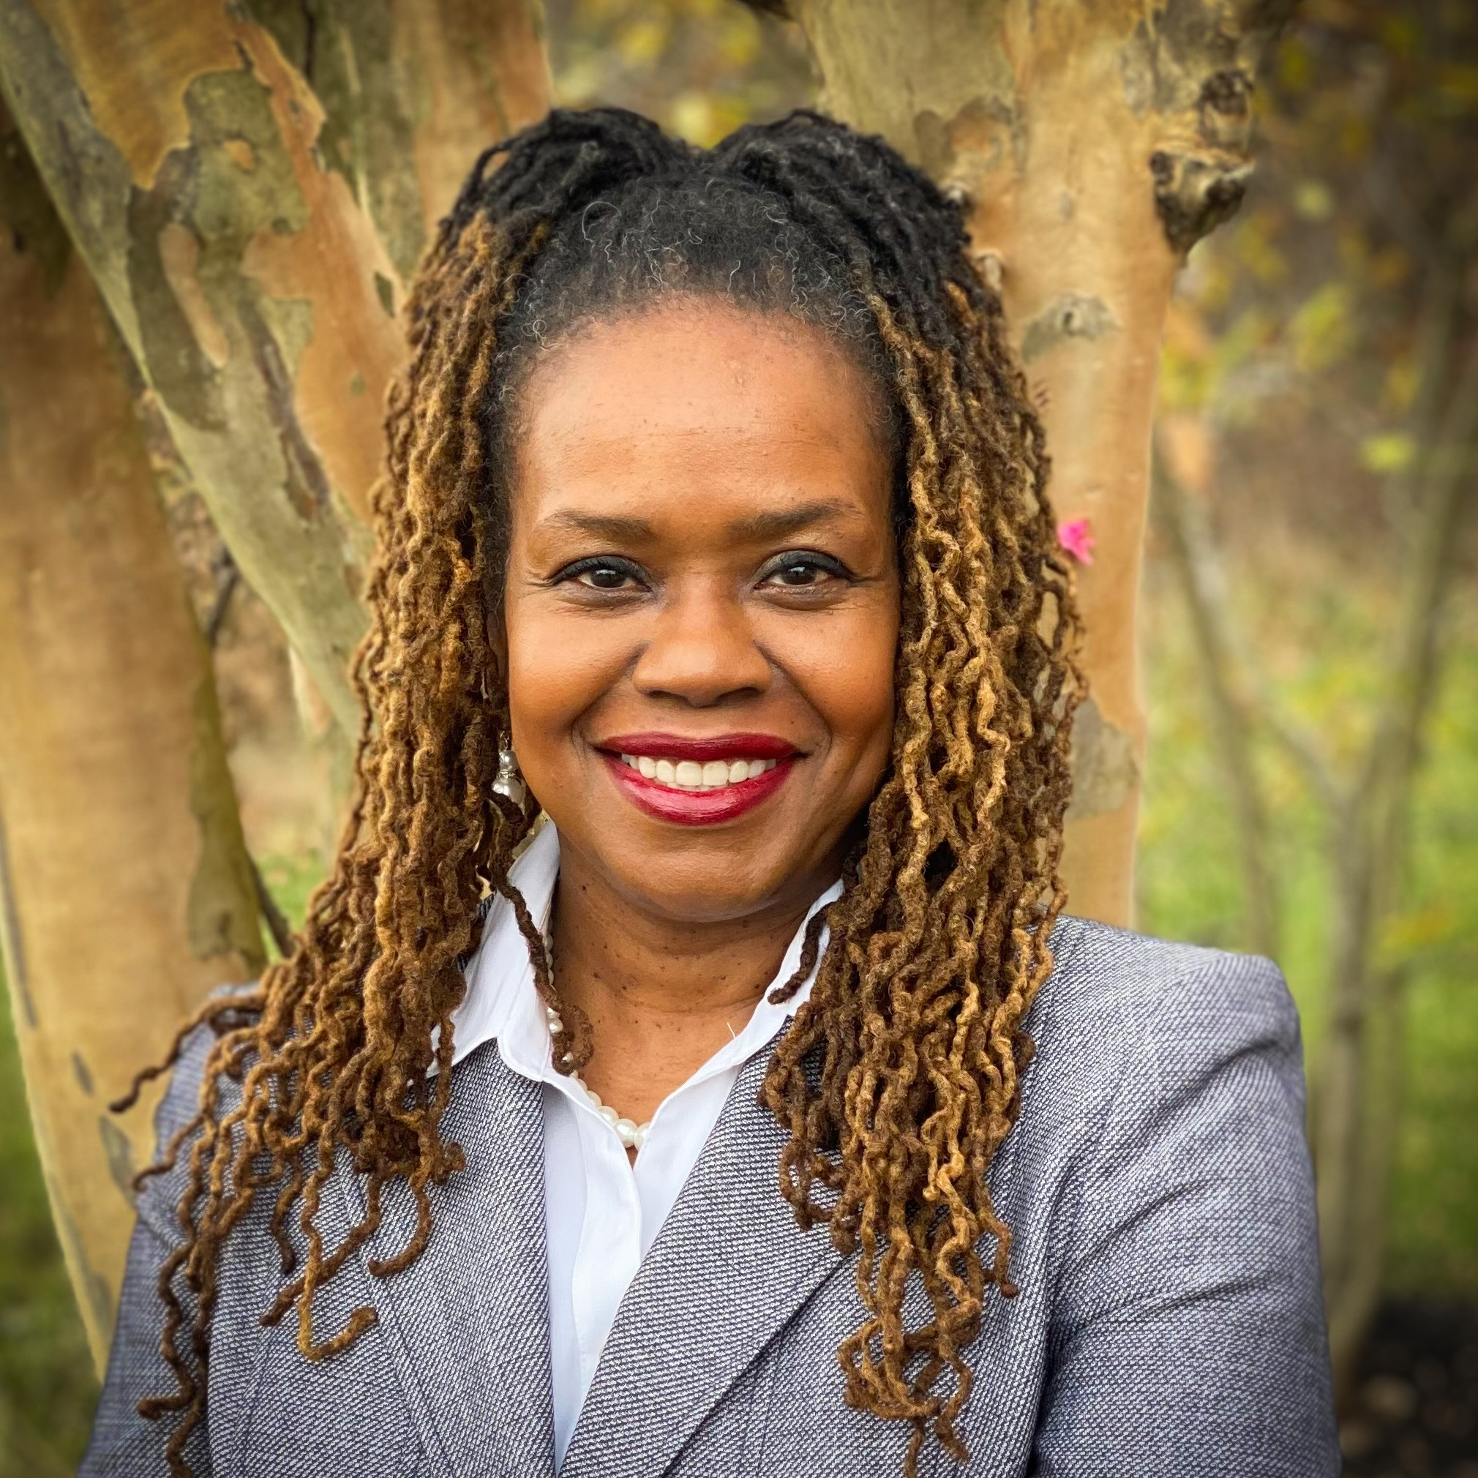
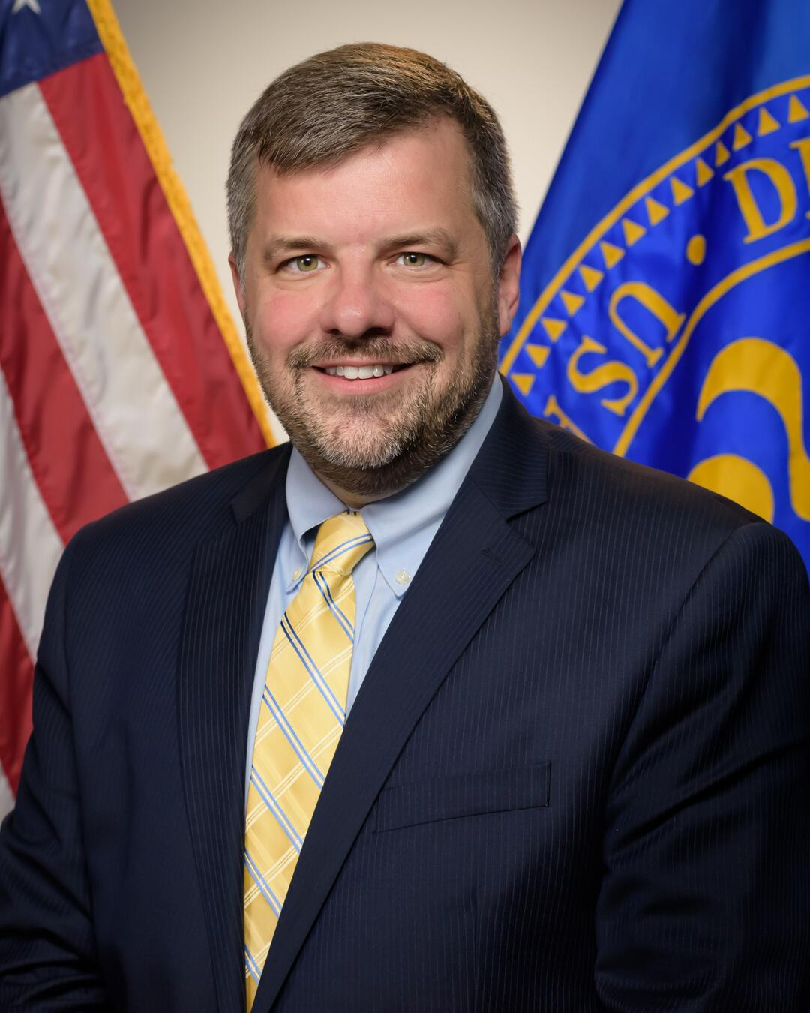
Closing Plenary Panel
Katherine Neas
Office of Special Education and Rehabilitative Services - ED
Ruth Friedman
Office of Child Care - HHS
Swati Adarkar
Office of Elementary and Secondary Education - ED
Valerie Williams
Office of Special Education Programs - ED
Michael Warren
Maternal and Child
Health Bureau - HHS

Slide 4
Katherine Neas
Office of Special Education and Rehabilitative Services

Slide 5
Improving Data, Improving Outcomes Leadership, Equity, Impact: Federal Programs Supporting Early Care Education and Well-Being
August 25, 2022
Notes:
Thank you for that warm introduction
So very nice to be with you today and to discuss the Biden Harris Administration’s priorities for children with disabilities and their families.
I’m very pleased to have this opportunity to reaffirm the essential role that robust data collection has on the implementation of services under the Individuals with Disabilities Education Act.
As I was reading through the conference details – one of the intended out comes jumped out at me.
Participants of this conference will increase their knowledge on the need to enhance, streamline, and integrate early childhood data systems to address critical policy and practice questions that will facilitate program improvement and improve compliance accountability and outcomes for young children with disabilities and their families.
I hope my remarks today will contribute to this outcome.

Slide 6
Biden-Harris Administration Priorities
$200 billion new funds to states for education
In person, safe and learning
Data-driven best practice
Equity
Whole Child
Following the law is the baseline – not the gold standard
Notes:
It’s an historic time to be in education, especially for SWD.
We have seen unprecedented resources go to states. They can provide a foundation to address long-standing challenges in early learning
Secretary laser-focused on having all students be in school, in person, where they are safe and learning. And he really means all students. Equity is a high priority – both meeting for the diverse needs of our children as well as to ensure that university faculty, educators, specialized instructional support personnel and other essential staff reflect the backgrounds of the families they are serving.
Supporting the whole child – (1) Positive Developmental Relationships (2) Environments Filled With Safety and Belonging, (3) Rich Learning Experiences and Knowledge Development, (4) Development of Skills, Habits, and Mindsets & (5) Integrated Support Systems – CORE tenets of our disability community
Following the law is not the gold standard

Slide 7
Federal Investments in Early Learning
Existing federal early education programs
Title I, Title II, Title III of the Elementary and Secondary Education Act
Part C and Section 619 of the Individuals with Disabilities Education Act
Elementary and Secondary Education Relief (ESSER) Funds
Governor’s Emergency Education Relief (GEER) Funds
American Rescue Plan funds
Preschool Development Grants
Child Care and Development Block Grant
Head Start and Early Head Start
Maternal Infant Early Childhood Home Visiting Program
Medicaid
Notes:
My colleagues on the panel will provide additional information on these federal programs, but as you can see, there are robust federal resources going to states to help them deliver high quality early education and care experiences for our nation’s families with young children.

Slide 8
“There is an urgent need for SEAs and LEAs to improve the implementation of IDEA so that all eligible children with disabilities are served appropriately and equitably. For years, data have demonstrated clear disparities in the use of discipline for children with disabilities.”
OSEP Dear Colleague Letter, July 19, 2022
Notes:
Last month, the Department released guidance designed to improve the overall implementation of IDEA and to reduce the use of discriminatory disciplinary practices on children with disabilities.
The IDEA guidance was part of a set of resources that included guidance from the Office for Civil Rights on the implementation of Section 504 of the Rehabilitation Act and the discriminatory disciplinary practices on students with disabilities.
DATA is one of the primary reasons we were able to craft such strong guidance
Here is just a sample of what the data show

Slide 9
Pre-school students under IDEA:
Accounted for 22.7 percent of total preschool enrollment
Accounted for 56.9 percent of preschool students who were expelled
Source: U.S. Department of Education, EDFacts Data Warehouse (EDW): “IDEA Part B Discipline Collection,” 2019-20
U.S. Department of Education, Office for Civil Rights. “An Overview of Exclusionary Discipline Practices in Public Schools for the 2017-2018 school year: Civil Rights Data Collection.” June 2021.

Slide 10
School-age children under IDEA:
Represent 13.2 percent of total student enrollment
Yet received 20.5 percent of one or more in-school suspension and 24.5 percent of one or more out-of-school suspensions.
Source: U.S. Department of Education, EDFacts Data Warehouse (EDW): “IDEA Part B Discipline Collection,” 2019-20
U.S. Department of Education, Office for Civil Rights. “An Overview of Exclusionary Discipline Practices in Public Schools for the 2017-2018 school year: Civil Rights Data Collection.” June 2021.

Slide 11
Students with disabilities under IDEA:
Made up 80.2 percent of students subject to physical restraint and 77.3 percent of all students subject to seclusion
Despite making up only 13.2 percent of students enrolled in public schools.
Source: U.S. Department of Education, EDFacts Data Warehouse (EDW): “IDEA Part B Discipline Collection,” 2019-20
U.S. Department of Education, Office for Civil Rights. “An Overview of Exclusionary Discipline Practices in Public Schools for the 2017-2018 school year: Civil Rights Data Collection.” June 2021.

Slide 12
Black children with disabilities:
Made up 17.2 percent of children with disabilities served under IDEA during the 2019-20 school year
Yet made up 43.5 percent of all children with disabilities aged 3-21 served under IDEA who were suspended out-of-school or expelled for more than 10 school days
Source: U.S. Department of Education, EDFacts Data Warehouse (EDW): “IDEA Part B Discipline Collection,” 2019-20
U.S. Department of Education, Office for Civil Rights. “An Overview of Exclusionary Discipline Practices in Public Schools for the 2017-2018 school year: Civil Rights Data Collection.” June 2021.

Slide 13
“The use of exclusionary disciplinary practices places large numbers of children with disabilities at risk for short- and long-term negative outcomes, including lower achievement and increased likelihood of not graduating.”
OSEP Dear Colleague Letter, July 19, 2022
Notes:
Simply put, kids can’t learn if they are not in school.

Slide 14
Two resources:
Dear Colleague Letter
Questions and Answers: Addressing the Needs of Children with Disabilities and IDEA’s Discipline Provisions
Positive, Proactive Approaches to Supporting the Needs of Children with Disabilities: A Guide for Stakeholders

Slide 15
Fun with Numbers
47
22
15
14
36 (28)
30
Notes:
So, now I’d like to move to some numbers.
47 – the number of years children with disabilities (k-12) have been guaranteed a free, appropriate public education in the least restrictive environment.
22 – the number of states that “meet requirements” under Part B in the most recent round of determinations.
15 – the number of states that have fewer than 1% of students taking the alternate assessment based on alternate achievement standards in reading
14 – the number of states that have fewer than 1% of students taking the alternate assessment based on alternate achievement standards in math
36 – the number of years the Part C program for infants and toddlers with disabilities, and Section 619 services for preschoolers has been the law of the land
28 – the number of years all states have established statewide systems of early intervention services
30 – the number of states that “meet requirements under Part C.

Slide 16
Rolling Up our Sleeves and Working Together
What’s it going to take to change the current state?
How can we work together to make a difference for our infants, toddlers, students and their families?
We are experiencing unprecedented collaboration between ED and HHS.
Money alone is not the answer.
Notes:
When you return home, please think about what can be done to change our current state.
What are the circumstances of our current environment that we can leverage to make things different?

Slide 17
Katherine.Neas@ed.gov
Notes:
Please don’t hesitate to contact me with your ideas.

Slide 18
Ruth Friedman
Office of Child Care

Slide 19
DaSy IDIO Conference
Leadership, Equity, Impact: Federal Programs Supporting Early Care, Education, and Well-Being
Ruth Friedman, Ph.D., Director, Office of Child Care

Slide 20
Payment rates barely cover operating expenses
Family costs are very high
Providers
Families
CCDF serves too few children
Not enough supply
Uneven quality
Priced out of care, underemployment
Provider wages are very low
The child care sector is Broken
20

Slide 21
ACF’s Early Childhood Mission and Vision
Mission: Advancing an early childhood sector that meets the developmental needs of children and their families in communities across the country.
Vision: It is our responsibility to create opportunities for children and their families and the early childhood workforce, so they have -
Children & Families
Safe and supportive environments that promote child development across multiple domains - physical, cognitive, social-emotional.
Access to high-quality programs that meet families’ unique needs - logistically, linguistically, culturally, and financially.
Early Childhood Workforce
System that attracts, prepares, supports, and retains a qualified, diverse workforce across settings and programs.
Compensation, including benefits, that demonstrate the value of the workforce to our communities.
Notes:
FRAMING
Here, this is both a reflection of the work happening and a destination we are traveling to together.
ACF priorities were broad. This helps bring us into the moment and the opportunities we have right now!
Verbatim:
- Mission: Promoting an early childhood sector that meets the needs of children and their families in communities across the country.
- Vision: It is our responsibility to create opportunities for children and their families and the early childhood workforce, so they have –
- Children and families: Safe and supportive environments that promote child development across multiple domains - physical, cognitive, social-emotional.; High-quality opportunities that meet families’ unique needs - logistically, linguistically, culturally, and financially.
- Early childhood workforce: System that attracts, prepares, supports, and retains a qualified, diverse workforce across settings and programs; Compensation, including benefits, that demonstrate the value of the workforce to our communities.

Slide 22
Create Opportunities For:
Children and Families
Early Childhood Workforce
Safe and supportive environments
System that attracts and retains a qualified, diverse workforce
Compensation that demonstrates value
Access to high-quality programs and supports that meet families’ needs
Notes:
- THEMES: We want to hone in how exactly how we'll deliver for children and families and the early childhood workforce.
- CHILDREN AND FAMILIES: We'll work to create opportunities for and ensure safe and supportive environments and access to programs that meet families' needs. We'll work to name both the tremendous work ALREADY happening across the offices in these areas – but we will continue to deliver on this areas for families and children, given the stakes!
- WORKFORCE: We will build a system that attracts and retains a qualified, diverse workforce and compensation that demonstrates values
OPPORTUNITIES: We know we aren’t the ones doing it – we are a critical leader for these to happen.
Our APPROACH of course includes PROVIDERS
WORKFORCE IS SUPPLY: We know that at this point, quality and access are one and the same. For too long, we allowed early childhood to be subsidized by poor wages – we have to continue the path forward here

Slide 23
Children and Families
Safe and Supportive Environments For All Children
Partner with agencies on lead remediation in early childhood settings
Support COVID-19 vaccine access for early educators, families, and young children and distribute public health resources and guidance
Promote compliance with health and safety measures in CCDF and Head Start
Dear Colleague Letter to promote social-emotional development and mental health
Promote Head Start children's mental health and social and emotional well-being
Notes:
- ASPIRATION: Build an inclusive approach for workforce across programs and settings, including family child care and home visiting.
- Safe and Support environments: We're not seeking to provide all work possibly happening here, but to provide a glimpse and snapshot across the offices to the tremendous outcomes already delivered. For instance, the work that has and will continue to happen with the lead remediation and the COVID 19 support
Build inclusive approach for workforce across programs and settings, including family child care and home visiting.

Slide 24
Children and Families
Early Childhood Workforce:
System that Attracts and Retains a Qualified, Diverse Field
Developing a $30 million National Early Care and Education Childhood Workforce Center
Partnering with the Department of Education on Public Service Loan Forgiveness
Head Start and Child Care Development Fund grantees providing bonuses or increased compensation with American Rescue Plan funds
Guidance and letters to Head Start, Child Care Development Fund grantees, and Preschool Development Grant recipients, and states and agencies leadership encouraging federal funding streams to support increased compensation
Tribal College and University partnerships to increase the number of qualified education staff working in American Indian and Alaska Native Head Start programs
Notes:
- ASPIRATION: Build inclusive approach for workforce across programs and settings, including family child care and home visiting.
- Maintain diversity of the workforce

Slide 25
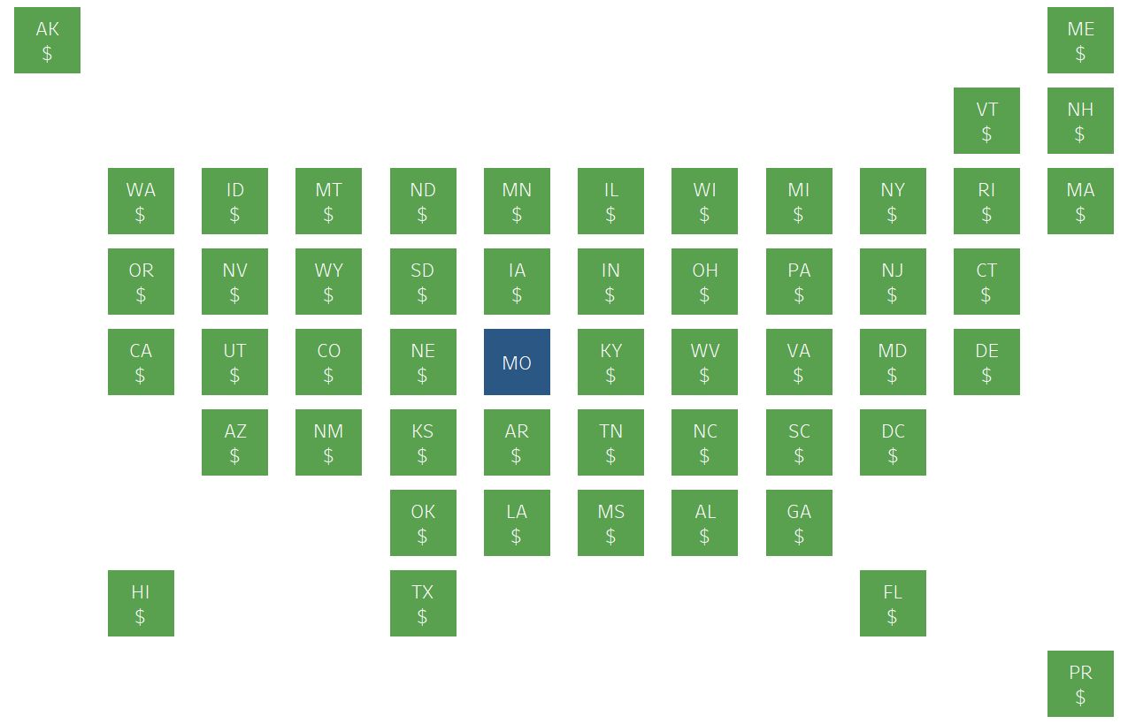
ARP Stabilization can help address barriers
49 states have released ARP Stabilization Grant applications and sent payments to providers
200,000+ child care providers have received a stabilization award so far
Over ½ of states have implemented strategies to direct funds to the child care workforce
At least ⅓ of states incorporated equity into their funding formula

Slide 26
ARP Supplemental can support families with children
with special needs
How States are Spending ARP Supplemental Funding
Building Supply of Child Care
Investing in the Workforce
Supporting
Providers
Helping Families
Staff Compensation
Increasing Payment Rates
Direct Services
Start Up Grants
Reducing/Waiving
Copayments
Child Care
Networks
Professional Development
Improving Payment Practices
Expanding Eligibility
Grants and
Contracts
Extending Stabilization Grants
Scholarships

Slide 27
Preschool Development Birth to Five Grants can help develop systems of support for young children with disabilities

Slide 29
Swati Adarkar
Office of Elementary and Secondary Education

Slide 30
Valerie Williams
Office of Special Education Programs

Slide 31
Michael Warren
Maternal and Child Health Bureau

Slide 32
MCHB Early Childhood Connections and Opportunities for Partnership Improving Data, Improving Outcomes (IDIO) Conference 2022 August 25, 2022
Michael D. Warren, MD, MPH, FAAP
Associate Administrator
Maternal and Child Health Bureau (MCHB)

Slide 33
Maternal and Child Health Bureau Strategic Plan
Mission
To improve the health and well-being of America’s mothers, children, and families.
Vision
Our vision is an America where all mothers, children, and families thrive and reach their full potential.
MCHB Goals
ACCESS
EQUITY
CAPACITY
IMPACT
Assure access to high-quality and equitable health services to optimize health and well-being for all MCH populations.
Strengthen public health capacity and workforce for MCH.
Maximize impact through leadership, partnership, and stewardship.
Achieve health equity for MCH populations.

Slide 34
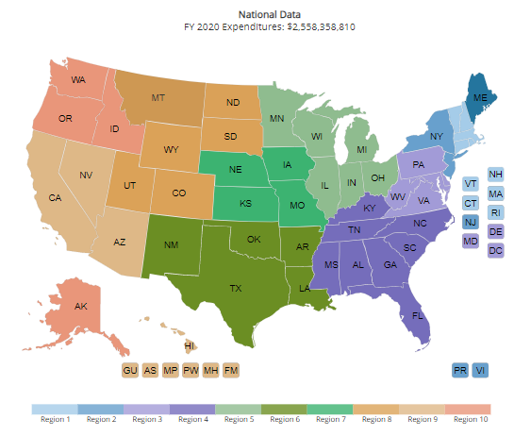
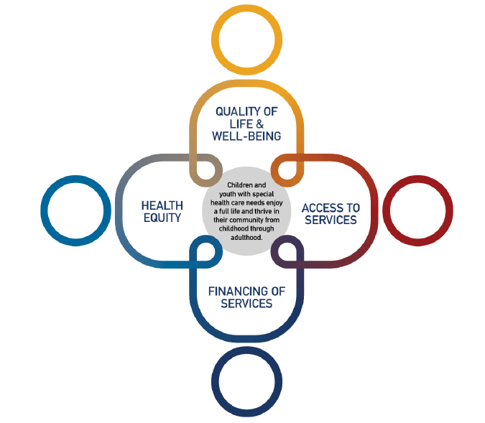
MCHB Early Childhood Connections
Early Childhood Comprehensive Systems
MCH Block Grant
National Survey of Children’s Health
MIECHV
Blueprint for Change
Early Childhood Developmental Health Systems

Slide 35
Early Childhood Comprehensive Systems

Slide 36
What Can You Do?
Check State NSCH Developmental Screening Rates
Partner with ECCS Programs
Partner with Health and Child Welfare Systems
Implement QI Initiatives
Connect with State MIECHV and Title V Programs
Childhealthdata.org
mchb.tvisdata.hrsa.gov

Slide 37
Contact Information
Dr. Michael Warren, MD MPH FAAP
Associate Administrator
Maternal and Child Health Bureau (MCHB)
Health Resources and Services Administration (HRSA)
Email: mwarren@hrsa.gov
Phone: 301-443-2170
Web: mchb.hrsa.gov

Slide 38
Connect with HRSA
Learn more about our agency at:
www.HRSA.gov
Sign up for the HRSA eNews
FOLLOW US:

Slide 39
Closing Plenary Panel
Katherine Neas
Office of Special Education and Rehabilitative Services - ED
Ruth Friedman
Office of Child Care - HHS
Swati Adarkar
Office of Elementary and Secondary Education - ED
Valerie Williams
Office of Special Education Programs - ED
Michael Warren
Maternal and Child
Health Bureau - HHS
Notes:
Slide up for Q&A

Slide 40
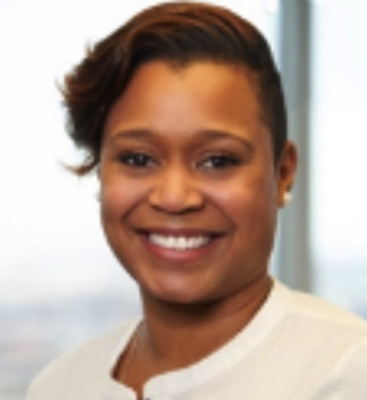
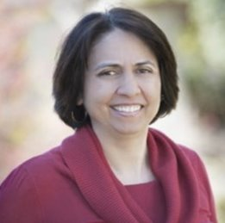
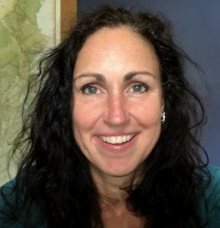
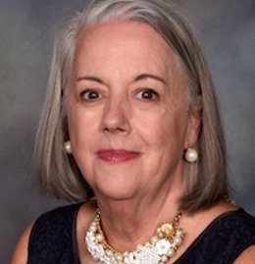
IDIO Conference Planning Team
Kate Borelli
Sarah Criscuolo
Kate Ferguson
Kori Hamilton Biagas
Roxanne Jones
Kathryn Morrison
Tanesha Patrick
Faith Scheibe
Deb Ziegler

Slide 41
Parting Reflections
"I have always been delighted at
the prospect of a new day,
a fresh try,
one more start,
with perhaps a bit of magic waiting
somewhere behind the morning."
J.B. Priestley

Slide 42
IDIO Partners

Slide 43
IDIO Conference Evaluation Surveys
Please complete the evaluation surveys for:
Each session you attended
The overall IDIO Conference
Go to the IDIO Attendee Hub App to find and complete the evaluation surveys

Slide 44
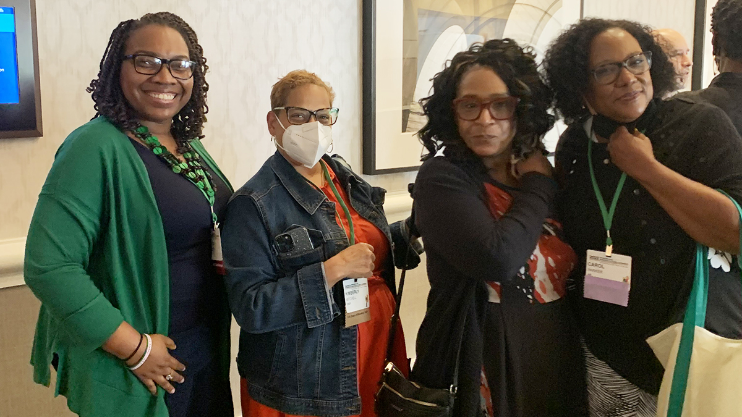
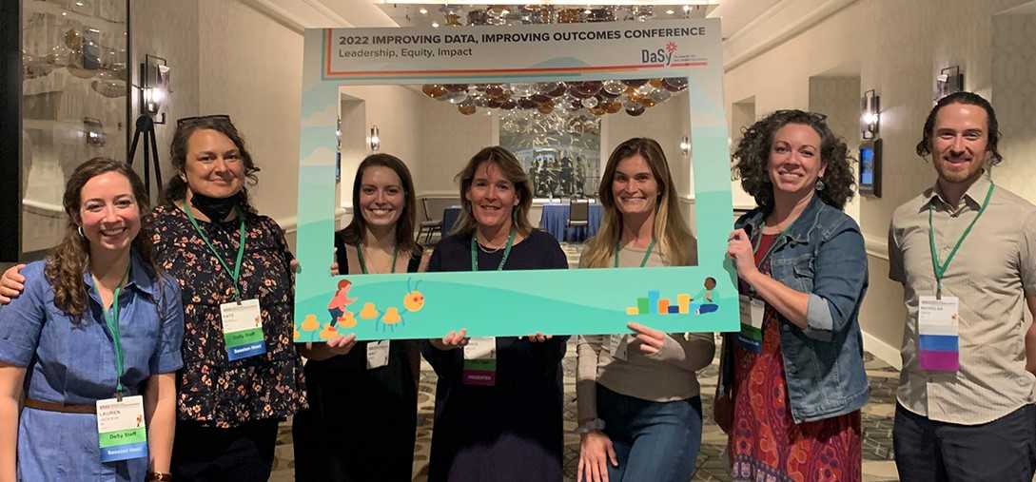
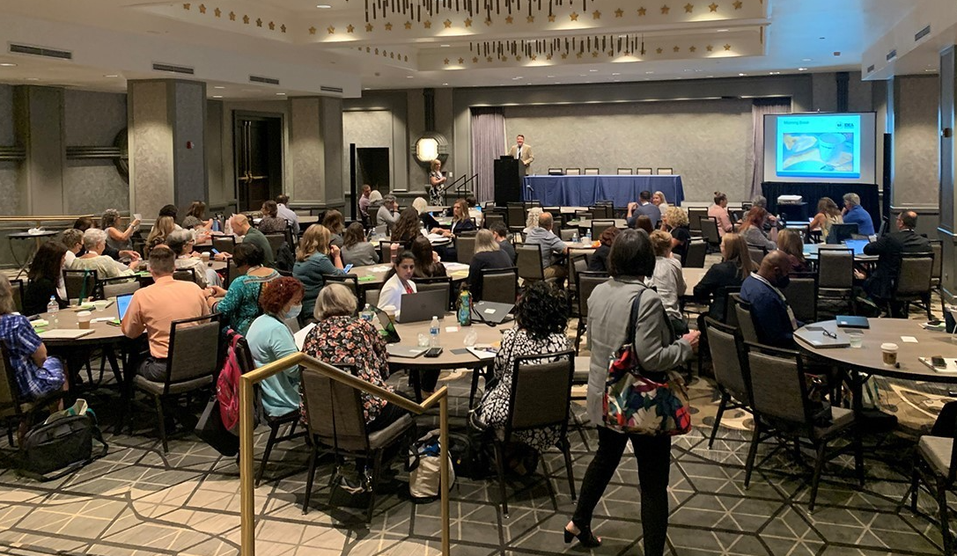
Thank You To Our Community
It was great to be together in person!
A week filled with robust content, learning, networking, and fun.
We hope you have reinvigorated your WHY!
Safe Travels Home!

Slide 45
Thank you
Visit us at DaSyCenter.org.
Follow us on Twitter: @DaSyCenter
The contents of this presentation were developed under a grant from the U.S. Department of Education, #H373Z190002. The contents and resources do not necessarily represent the policy of the U.S. Department of Education, and you should not assume endorsement by the Federal Government. Project Officers: Meredith Miceli and Amy Bae.

