Slide 1
DaSy Dynamic Impact for Improvement
Implement Stage
Notes:
Welcome to Session 3 of the DaSy Dynamic Impact for Improvement training for DaSy TA providers. This PPT is a resource for facilitation of the Implement stage, to use when providing intensive TA to a team.
PPT slide notes provide Content as well as Facilitation Tips.

Slide 2
Session Outcomes
Identify the purpose of the Implement stage of the DaSy Dynamic Impact approach.
Understand how to use available resources to effectively document implementation of action steps as identified in your team’s action plan.
Notes:
Recommended Time: 30 seconds
Content:

Slide 3
Activity
Notes:
Recommended Time: 5 - 10 minutes
Facilitation Tips:
Conduct any icebreaker or introduction activity

Slide 4
Implement Stage
Document evidence of implementation
Organize evidence to allow for ongoing monitoring
Store evidence of completion in the Team File Cabinet
Add folders and organize materials based on the context of your work
Agendas, meeting notes, any documentation or evidence of team’s work
Notes:
Recommended Time: 3 minutes
Content:
During the Implement Stage, teams implement their activities. They store the “evidence of the completion”
for each activity in the Team File Cabinet. The Team File Cabinet provides a shared storage space for
The Teams, enabling everyone to monitor the completion of activities along the way. In addition, teams use
this space to keep meeting agendas and notes and other artifacts of their work. Teams can add and
organize folders as needed based on the context of
their work.
Facilitation Tips:
Remind teams that decisions about organization are up to them. Identify and select a method of organizing that makes sense to the entire team and be consistent with where you are documenting the evidence.
Be sure that the team adheres to all data sharing requirements of their state.

Slide 5
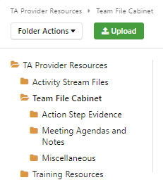
Team File Cabinet
Action Step Evidence
Documents, images, data charts
Meeting Agendas and Notes
DaSy Dynamic Impact Agenda and meeting notes
Miscellaneous
Any additional information necessary to implement the team’s work
Notes:
Recommended Time: 3 - 5 minutes
Content:
The site is configured with three folders: Action Step Evidence, Meeting Agendas and Notes, and Miscellaneous.
The Action Step Evidence folder can store documents, images, data charts, etc. The Meeting Agendas and Notes folder can store the team’s DaSy Dynamic Impact Agenda and meeting notes, and the Miscellaneous folder may be used for any additional information necessary to implement the team’s work.
Facilitation Tips:
1. The MyDaSy TA space is flexible and team members can add additional folders at any time.

Slide 6
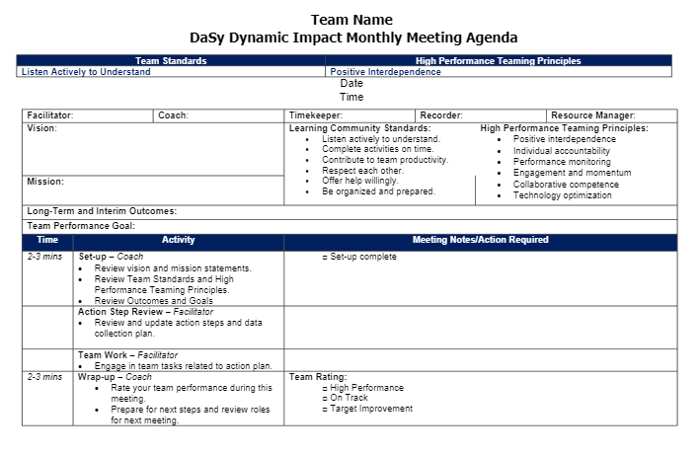
DaSy Dynamic Impact Agenda Template
The agenda template helps teams stay aligned to the DaSy Dynamic Impact process.
6
Notes:
Recommended time: 5 minutes
Content:
An agenda template is provided for teams to work through the DI process which includes a space for
vision and mission, team operating standards, and team member roles. As teams have ongoing meetings,
it is recommended to use this template to stay aligned to the DI process.
Facilitation Tips:
1. The DI agenda template was configured intentionally to incorporate the characteristics of high performance teams, and using it consistently helps teams sustain high performance over time by keeping critical elements such as the vision, mission, team goal, standards and principles at the forefront.

Slide 7
Questions
7

Slide 8
Thank You
Thank you
Visit us at http://dasycenter.org/
Follow us on Twitter: @DaSyCenter
The contents of this presentation were developed under a grant from the U.S. Department of Education, #H373Z190002. The contents and resources do not necessarily represent the policy of the U.S. Department of Education, and you should not assume endorsement by the Federal Government. Project Officers: Meredith Miceli and Amy Bae.

