Slide 1


Data Detective: Looking for Patterns in Child Outcomes Data to Assess Data Quality
Please check in for the session through your laptop and download attachments under “Session Content”
https://cvent.me/mEqvVy
Session code: idioW11
Wifi
Network: idio22
Password: dasy2022!
Pre-Conference Workshop
Nicholas Ortiz (DaSy/ECTA)
Kellen Reid (DaSy/ECTA)
Naomi Younggren (ECTA)
Improving Data, Improving Outcomes (IDIO) 2022: Leadership, Equity, Impact
#IDIO2022
August 23, 2022
Notes:
Nicholas Ortiz, Kellen Reid, Naomi Younggren

Slide 2


Be a Good Data Detective
This Photo by Unknown Author is licensed under CC BY-ND
This Photo by Unknown Author is licensed under CC BY-NC-ND
  https://youtube.com/clip/UgkxJ232b4fI8hROCUfIzJpSnVetq2bfRqS2
Notes:
First, a little story. Yes, I’m going there. Don’t think you could come to a session called Data Detective and not have the Pink Panther make an appearance.
Inspector Clouseau
Incompetent, bumbling, fake it ‘til you make it, lucky – DON’T BE INSPECTOR CLOUSEAU.
Have an approach in mind, don’t destroy the data while you’re at it.
Hook/story about why it is important to assess your data quality before going any farther…
Putting the cart before the horse with data use…
Consider using a magnifying glass
Backup scenario: what do you see here? Could be something entirely different? Zoom in/out

Slide 3

What do we mean by data quality?
Accurate
Consistent
Timely
Complete
3
Notes:
Nick

Slide 4

Question
Question: What do you do if the data are not as good as they should be?
Answer: Continue to improve data collection through ongoing quality assurance
If you conclude the data are not (yet) valid, they cannot be used for program effectiveness, program improvement, or anything else.
4
Notes:
Nick

Slide 5

Looking for Patterns
Do you have all the information you need to make an informed decision?
Notes:
Nick

Slide 6
Learning Outcomes
Increase your ability to interpret expected and unexpected issues with child outcomes data quality and prioritize areas for data quality improvement.
Be able to apply a framework of analysis planning and critical question development to investigating data quality issues.
Notes:
Nick

Slide 7

Agenda
Structuring your analysis plan
01
Exploring your child outcomes data quality profile
02
Checking for patterns in your child outcomes data
03
7
#IDIO2022
Notes:
Nick

Slide 8

Housekeeping
Tables organized by state approach to child outcomes measurement
Download the session content:
  Data Template Pattern Checking EXAMPLE (XLSX)
  Data Template Pattern Checking Example Handout (PDF)
  (optional) Data Template Pattern Checking BLANK (XLSX)
  Data Quality Profile Review Worksheet (DOCX)
8
Notes:
Nick
Ask if anyone has inserted their own data into the Pattern Checking BLANK template?

Slide 9

How proficient do you feel in addressing data quality issues with your child outcomes data?
1) Extremely – I can teach others
2) Pretty – I can make sense of it on my own
3) Sort of – I still need some help to understand all the pieces
4) Not really – I see the data, but I’m not sure what to do with it
5) Not at all – I’m not sure what the data are, but I’m interested
Notes:
Nick
Everybody starts sitting, go in order from 1-5

Slide 10
Structuring Your Analysis Plan
Notes:
Naomi

Slide 11

Detectives need a plan
Notes:
Naomi

Slide 12
Analysis Plan Considerations
Team
Purpose
Questions
Data Needed
Analysis
Results
Use
Sharing
Notes:
Naomi

Slide 13
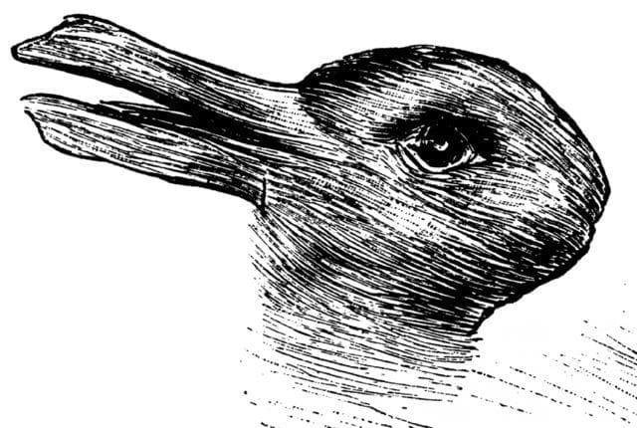
What do you see here?
Notes:
Naomi
This might seem like a rough transition but please entertain the question here... and we'll show you the connection in a second.
What do you see here?
Please use the chat to enter your response.....
Duck or Rabbit?

Slide 14

Engage Stakeholders
Hearing from different stakeholders is key to understanding different perspectives.
Diverse stakeholder involvement is important at all points in the process...
  Before, during, and after asking, analyzing, and acting on the questions and data findings.
Notes:
Naomi
The connection here, is that different perspectives are crucial for determining the questions you want to answer.
And engaging diverse stakeholders is important at all points in the process
- in planning
- in data collection
- in data access
- in algorithms/use of statistical tools
- in data analysis
- in reporting and dissemination
- in decision making... and so on
Equity, transparency, and diverse stakeholder involvement is core to exploring outcomes
Specific examples of when to engage stakeholders (Source: A Toolkit for Centering Racial Equity Throughout Data Integration, AISP)

Slide 15

Know the Purpose
Data analysis without a clear purpose can be pointless and time consuming.
Child Outcomes Measurement
  The goal of early intervention and early childhood special education is to enable young children with disabilities to be active and successful participants during their early childhood years and in the future. States collect, analyze, and use data on three child outcomes to measure individual child and family progress toward improved results and to improve their systems and services.
Notes:
Naomi

Slide 16



Use Questions to Guide Analysis
Data analysis without a clear questions can also be pointless and time consuming.
What exactly do you want to find out?
Be mindful of rabbit holes.
Start with good questions.
Notes:
Naomi
Data analysis is most successful when it starts with an analysis plan. Planning before an analysis nsures that the analysis and interpretation will be manageable with the resources available. When planning includes making predictions about the expected results of the analysis, planning can improve the validity of the conclusions drawn from the data.
One think we want to avoid is going down rabbit holes. If we don't have a clear plan – that is a question we are trying to answer we run the risk of venturing too far and going down data rabbit holes.
There are lots of different ways to look at your data – when you have a clear focus and purpose the answers to your questions can likely be found.
This is why taking the time to identify what you want to know is a very critical part of using data.

Slide 17
Ask the Right Questions
Good questions
Less than Good questions
Have a clear focus (specific)
Form from what diverse stakeholders wonder about, based on a hypothesis and a need to know
Generate other questions for deeper understanding
Are neutral, do not support prejudice
Start with a broad topic or unclear focus
Have simple yes/no answers
Have no answer at all
Imply a bias
Notes:
Naomi
Beyond equity and diverse stakeholder engagement it is also critical that the right questions are being asked.
Good questions are those that have a clear focus – those that are formed from what diverse stakeholders wonder about and generate questions for deeper understanding, and of course good questions are neurtal so as to not support prejudice
On the contrary less good questions are those that are too broad or unclear or so narrow that a simple yes or no answers the question. Or those that truly have no answer at all or those that imply a bias.
Considering these brief considerations about good and less good questions, let's now look at an example and see what you think.
___________________________
e.g., How do child outcomes differ by child and family characteristics? VS. Are child outcomes better for a particular race of children?
https://www.nationalservice.gov/sites/default/files/resource/Asking_the_Right_Research_Questions.pdf
Do black children have lower outcomes compared to other children?
How can we increase our outcomes ratings?
How do child outcomes differ by child and family characteristics (e.g., race/ethnicity, time in program, age at entry, use of a particular practice)?
Do children with different disabilities show different outcomes?
What impact does time in program have on children's school readiness?
Which practitioners are not producing improved outcomes for children?
What is the relationship between child outcomes and time in program?

Slide 18
Which Question is the Right Question?
Do Black children have lower outcomes compared to other children?
How can we increase our outcomes ratings?
How do child outcomes differ by child and family characteristics (e.g., race/ethnicity, time in program, age at entry, use of a particular practice)?
Do children with different disabilities show different outcomes?
What impact does time in program have on children's school readiness?
Which practitioners are not producing improved outcomes for children?
What is the relationship between child outcomes and time in program?
Which of these questions represents a “good” question?
Notes:
Naomi
Asking the right question is key – which of these questions represent a good question – that is one that does not imply bias.
That would be c and d. and g

Slide 19

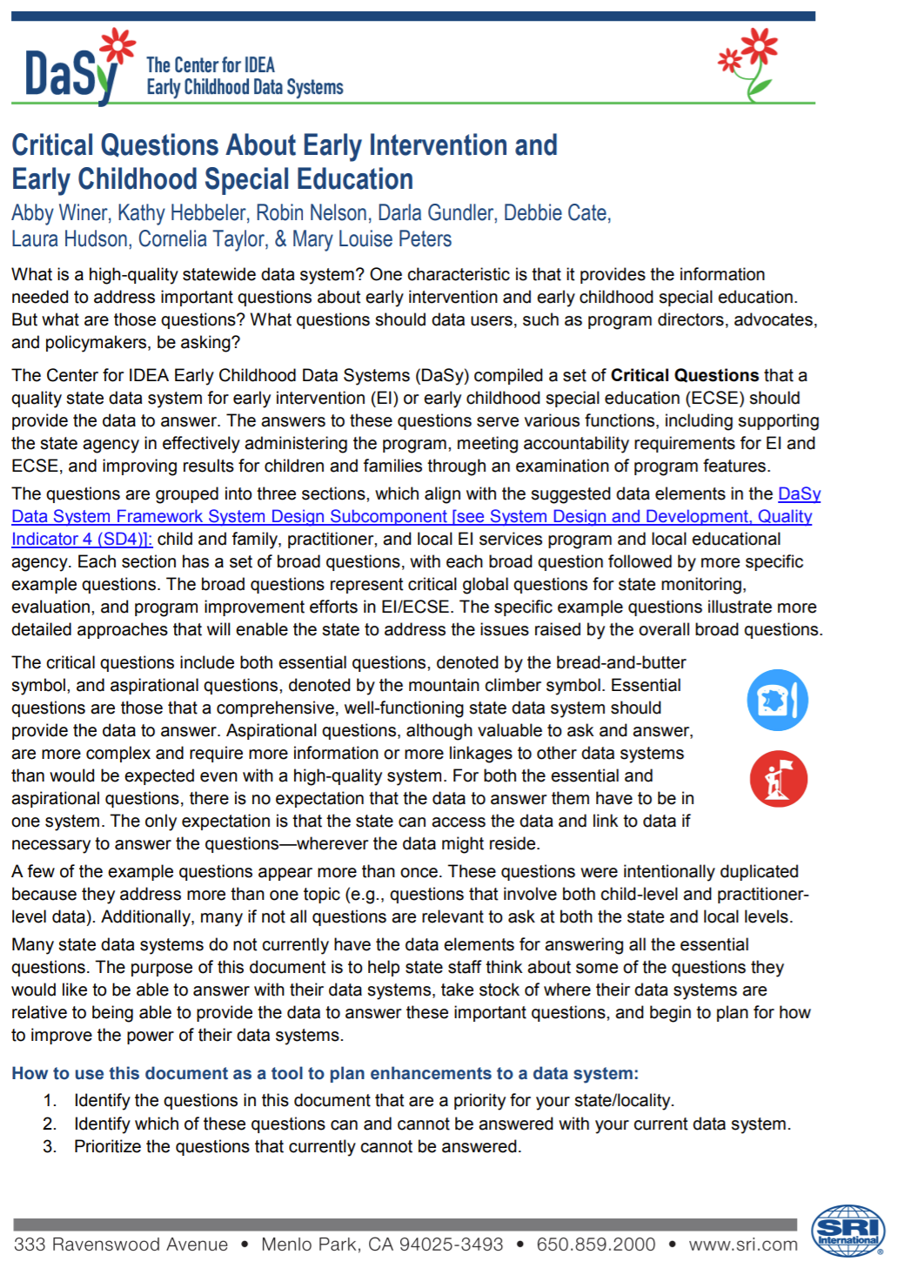
Resources
Notes:
Naomi
Here is a resource we've shared and you'll have time to look at it more closely in our next break out activity.

Slide 20

Identify the Data Needed
Ensure the data needed to answer the question are attainable
Clearly define what data are needed
  Sources
  Timeframes
  Populations
Notes:
Naomi

Slide 21

Define the Analysis
Clarify how the data collected will be examined
  Aggregate
  Disaggregate
  Point in time
  Longitudinal
  Relationships
Notes:
Naomi

Slide 22

Review Results
What are the findings?
What do they mean?
What additional questions emerge?
Notes:
Naomi

Slide 23

Use the Data
What actions will we take as a result of the findings?
What can we celebrate?
Notes:
Naomi

Slide 24

Share the Results
With whom and how?
Ensure access and understandability.
Notes:
Naomi

Slide 25
Analysis Plan Considerations
Team
Purpose
Questions
Data Needed
Analysis
Results
Use
Sharing
Notes:
Naomi

Slide 26

Developing Intentional Questions
Notes:
Naomi
Remember: all good detectives start their investigations with developing intentional questions. As we transition to diving into your data, put on your detective thinking cap and consider what are a few priority areas you’d like to explore?
For example…
State data not in line with nation
Unexpected fluctuations over time
Progress category A is high
These are just examples for you to use if you do not yet have an intentional question in mind. Definitely use your own, though, if you have it in mind.

Slide 27
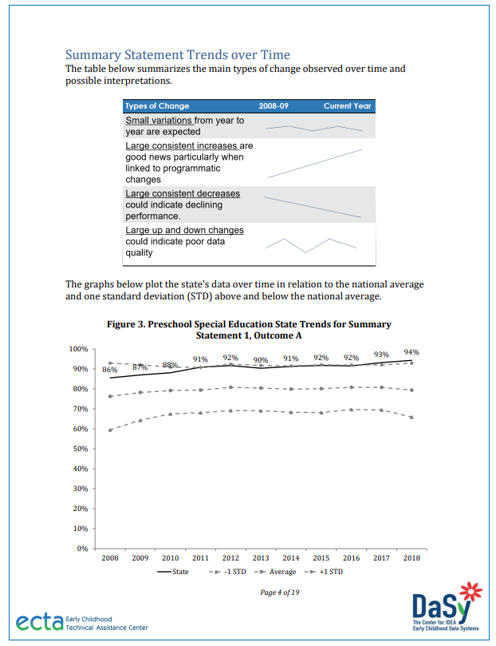
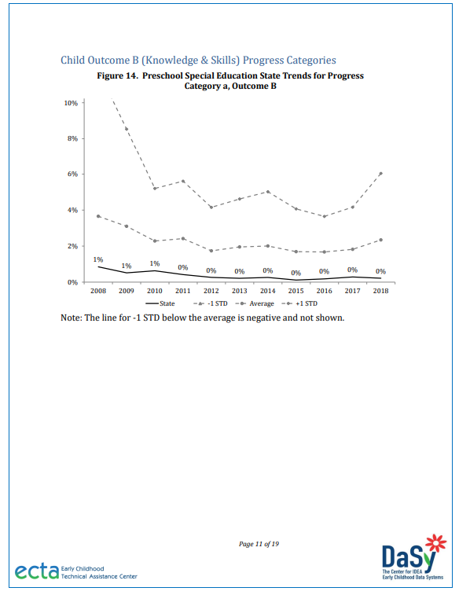
Exploring Your Child Outcomes Data Quality Profile
Notes:
Nick

Slide 28
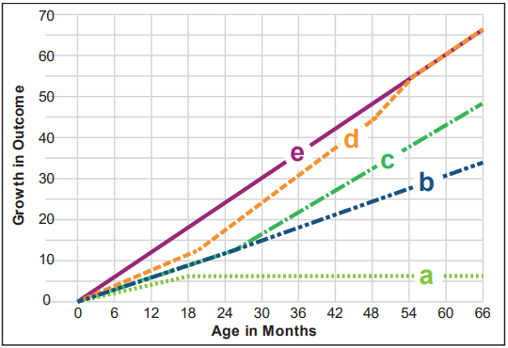
Recap:
Child Outcomes Indicators (C3 and B7)
3 Child Outcomes:
Positive social relationships
Acquisition and use of knowledge and skills
Taking action to meet needs
2 Summary Statements:
Summary Statement 1 is the percentage of children who made greater than expected growth.
Calculation from progress categories =
(c + d) / (a + b + c + d)
Summary Statement 2 is the percentage of children who exited at or above age expectations.
Calculation from progress categories =
(d + e) / (a + b + c + d + e)
Progress Categories a-e
Notes:
Nick
Is everyone familiar with the SPP/APR child outcomes indicator (C3 and B7) or does anyone need a bit more explanation?
Progress Categories:
Did not improve functioning
b. Improved in functioning, no change in trajectory
c. Moved closer to functioning like same-aged peers
d. Improved functioning to that of same-aged peers
e. Functioning like same-aged peers

Slide 29
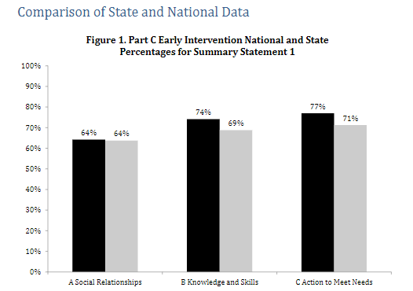
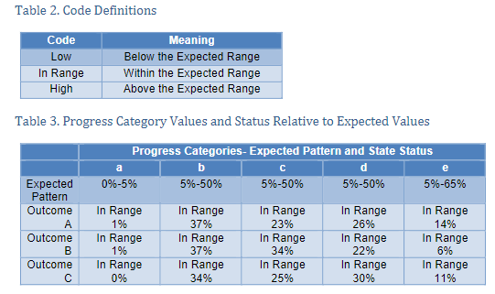
Orientation to the
Data Quality Profile
State compared to national data
State data in relation to quality criteria used for inclusion in the national analysis
  Reporting data on enough children
  Within expected patterns in the data
Trends over time
Progress category data
Part C profiles include criteria for determinations
Notes:
Nick

Slide 30
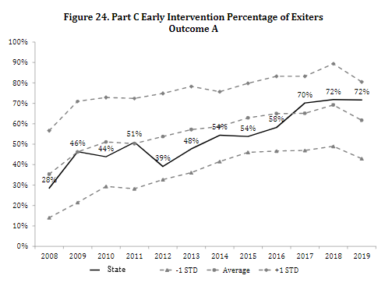
Part C Specific: Data Completeness
Notes:
Nick

Slide 31
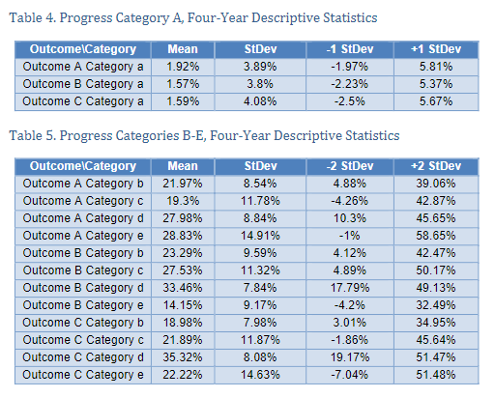
Part C Specific:
Progress Category Data Anomalies
Notes:
Nick

Slide 32


Small Group Discussion
Review and discuss unexpected patterns in your State Child Outcomes Data Quality Profile with your state team. ​
Use the Child Outcomes Data Quality Profiles Worksheet to guide your discussion.
Notes:
Nick

Slide 33

Unexpected Patterns: Reasonable or Not?
Unexpected patterns may be red flags for data quality issues… OR
There may be differences in actual population or other aspects.
Ask:
What patterns would be expected?
Is there a reasonable explanation for unusual patterns?
How could we check to see if unusual differences were actual differences or bad data?
Notes:
Nick

Slide 34

Small Group Discussion:
Review Data Quality Profiles
Example priority questions/areas of concern:
State data are not in line with nation
Unexpected fluctuations over time
Progress category A is high
Using your priority question to focus on relevant charts in the Data Quality Profile, consider:
What unusual or unexpected patterns do you notice?
How could you tell that the pattern is a sign of a data quality issue as opposed to actual differences?
What hypotheses do you have about why the data are problematic?
What additional questions arise from exploring the data quality profile?
What strategies could you use to improve the quality of your data?
Jot your notes in the worksheet.
34
Notes:
Nick
What additional questions arise from exploring the profile? We’ll talk about this during the wrap-up.

Slide 35

Checking for Patterns in Your Child Outcomes Data
35
Notes:
Nick
We don't know what you found in the previous exercise, but we do want to equip you with an illustration of going deeper with this process.
What might you further assess if your data quality profile from ECTA isn't showing you enough information?
These are the some of the most helpful patterns to analyze, generally speaking.
Most of these can all be independently analyzed even further at levels lower than the state level – notably, by race/ethnicity, gender, etc.

Slide 36
Data Completeness: State-Level Over Time
(Part C Example)
 | 2015-16 | 2016-17 | 2017-18 | 2018-19 | 2019-20 | 2020-21 | 2021-22
# Children Expected e.g., annual child count | 1101 | 1031 | 1062 | 1230 | 1337 | 1304 | 1505
# Children in Child Outcomes Data | 460 | 598 | 627 | 763 | 869 | 861 | 957
Overall Completeness Rate | 46% | 58% | 59% | 62% | 65% | 66% | 64%
Notes:
Nick
Looking at data completeness is a good place to start. In fact, it may be the most important place to start before going much further.
Explain how we use child count for denominator
Remind everyone about the completeness section of the data quality profile. OSEP considers completeness as a measure of data quality for Part C.
Understandably, this data may be hard to access in some states so we did not ask for this in your data template.
Analagous to representativeness with family outcomes data.
No small group breakout here since we would have needed more data than we asked you to prepare.

Slide 37
Data Completeness by Local Programs
(Part C Example)
 | Program A | Program B | Program C | Program D | Program E | Program F | Program G | Total
# Children Expected | 900 | 200 | 140 | 80 | 8 | 2 | 175 | 1505
# Children in Child Outcomes Data | 531 | 196 | 60 | 41 | 2 | 1 | 126 | 957
Completeness Rate | 59% | 98% | 43% | 51% | 25% | 50% | 72% | 64%
Notes:
Nick
Caution with small n sizes
You could also provide characteristics with Programs e.g. Urban, Rural, Suburban (if that works in your state)

Slide 38
Data Completeness by Race
(Part C Example)
 | American Indian or Alaska Native | Asian | Black or African American | Native Hawaiian or Other Pacific Islander | Two or More Races | White | Total
# Children Expected | 0 | 92 | 275 | 5 | 33 | 1100 | 1505
# Children in Child Outcomes Data | 0 | 66 | 124 | 1 | 18 | 748 | 957
Completeness Rate | N/A | 72% | 45% | 20% | 55% | 68% | 90%
Notes:
Nick
Equity is a consideration here too. Completeness can vary by subgroups.
You can check on statistical significance of these differences – simple online calculators can quickly and easily give you this info e.g.
https://www.thecalculator.co/math/Statistical-Significance-Calculator-786.html

Slide 39
Data Completeness by Primary Language
(Part C Example)
 | English | Spanish | Chinese | Other Language | Total
# Children Expected | 1400 | 78 | 20 | 7 | 1505
# Children in Child Outcomes Data | 911 | 37 | 6 | 3 | 957
Completeness Rate | 65% | 48% | 30% | 40% | 64%
Notes:
Nick

Slide 40

Key Questions to Ask About Data Completeness
What percentage of children in your program are represented in the child outcomes data?
Does the raw number of children pass the smell test?
Are there missing data?
Is missing data random or systematic?
Does your data include impossible child outcomes data (e.g., entry of 4 and exit at 5 with “no progress”)?
Are completion rates, unusable data, etc. roughly similar across demographic groups?
40
Notes:
Nick
In other words, is there bias in your data across all or certain groups?

Slide 41

Diving into the Data
This Photo by Unknown Author is licensed under CC BY
Notes:
Naomi
Time to get messy with your own data.

Slide 42
Pattern #2: Distribution, and
Pattern #3: Means of COS Ratings
PATTERN: Children will differ from one another in reasonable ways
ANALYSIS: Distribution of COS ratings. Mean of COS ratings at entry and exit.
RATIONALE: EI/ECSE programs serve children with a variety of functional levels, but generally serve more children with mild delays. Children with severe disabilities tend to have impaired functioning across more domains, whereas children with milder delays have less impaired functioning and may show functioning typical of their chronological age in some domains. Children tend to improve as they get older.
Notes:
Naomi
Shown here is the pattern, rationale, and analysis.

Slide 43
Pattern #2. Distribution of COS Ratings at Entry for Outcomes A, B, and C
Notes:
Naomi
Shown here are data on the distribution of the COS ratings for children entering Part C and their initial ratings on each outcome based on the 7-point COS scale.
The pattern you'd expect to see here relatively fewer children entering at a 1 and relatively fewer children entering at a 7. So that the 'book ends' are relatively less.
EI/ECSE programs serve children with a variety of functional levels but generally, serve more children with mild delays. Children with severe disabilities tend to have impaired functioning across more domains, whereas children with milder delays have less impaired functioning and may show functioning typical of their chronological age in some domains. Children tend to improve as they get older.

Slide 44
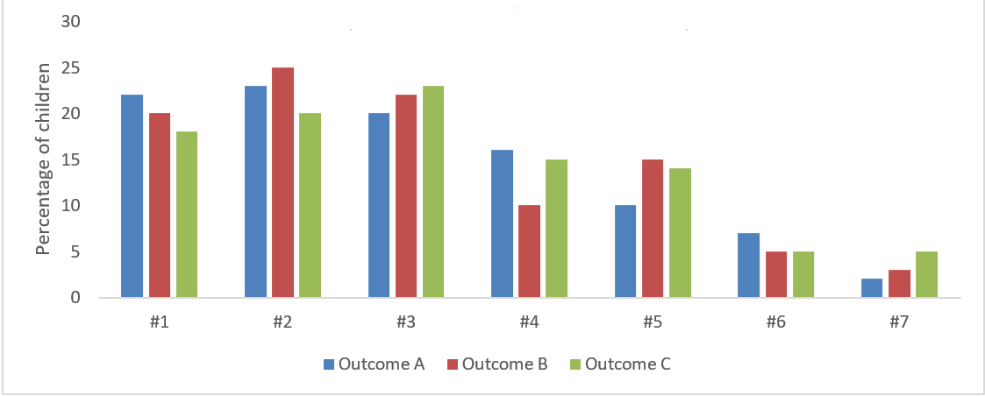
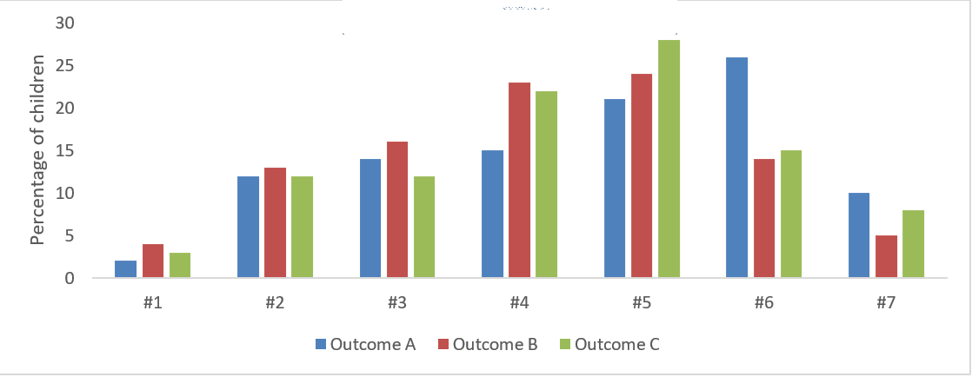
Pattern #2: Distribution of COS Ratings at Entry
Which is the expected pattern? 1 or 2?
Example 1
Example 2
Notes:
Naomi
The expected pattern is Pattern 2. Notice how the data are generally skewed to the right showing that more children have mild type delays versus severe delays.
In pattern one, the data pattern is not expected because of the very high percentage of children entering with a rating of 1.
We would expect to see more children entering with some AE in an outcome area versus no AE in all 3 outcomes.

Slide 45
Pattern #3: Mean COS Ratings at Entry vs. Exit for Outcomes A, B, and C
Outcome | Entry | Exit
A | 3.8 | 5.2
B | 3.5 | 4.7
C | 3.6 | 6.0
Notes:
Naomi
Shown here are data means for Part C and Part B.
What do you notice? The exit is greater than entry for all 3 outcomes in B and C.

Slide 46
Pattern #3: Mean COS Ratings at Entry and Exit
Example 1
Example 2
Outcome
A
B
C
Mean at Entry | Mean at Exit
5.0 | 3.2
5.7 | 4.6
4.2 | 2.5
Mean at Entry | Mean at Exit
4.2 | 5.3
4.0 | 5.6
4.8 | 5.8
Which is the expected pattern?
Notes:
Naomi
Shown here are the means calculated for children at entry and exit for each outcome. The expected pattern would be that the mean at exit is higher than the mean at entry.
Interpretation. The expected pattern (#1) indicates that the exit ratings have a mean of 6 or 7 and the entry ratings a mean of 4 or 5. This shift indicates that the children in this group were rated higher at exit than entry.
The unexpected pattern (#2) shows that the exit ratings have a mean between 2 and 4 while the entry ratings have a mean of 4 or 5. This shift indicates that the children in this group tended to be rated lower at exit than entry. This is unexpected because most children make progress.

Slide 47
Small Group: Look at your COS Rating Entry Distribution and Entry and Exit Means of COS Ratings
Consider:
Do the number of children included in the data seem to represent your population (data completeness)?
Do your data match the expected pattern?
Is it what you expected? If not, what seems different/unexpected?
Are there relatively fewer children with entry ratings of 1 and 7?
Are the means higher at exit than at entry?
What questions emerge as you look at these data?
Notes:
Naomi
20 minutes small group

Slide 48

BREAK (10 min)
Notes:
Nick
Music to play toward the end of break https://www.youtube.com/watch?v=lp6z3s1Gig0

Slide 49
Pattern #4: Percentage of Children Who Entered At or Above Age Expectations on All 3 Outcomes
PATTERN: Few children will have entry COS ratings at or above age expectation on all 3 outcomes
ANALYSIS: Percentage of children who scored at or above age expectations on all 3 outcomes at entry
RATIONALE: Children with an identified disability tend to have impaired functioning in at least one outcome area. Conversely, most children with an identified disability are not expected to enter services at or above age expectations in all areas. National data trends indicate that 10-15% of children will enter the program/district functioning like their same-age peers on all three outcomes.
Notes:
Naomi
Shown here is the pattern, rationale, and analysis.

Slide 50
Pattern #4: Percentage of Children Who Entered At or Above Age Expectations on All 3 Outcomes
Pattern A
Which pattern is more likely?
Pattern B
Notes:
Nick

Slide 51
Small Group: Look At Your Percentage of Children Who Entered At or Above Age Expectations on All 3 Outcomes
Consider:
Are there reasonably few children with disabilities who entered EI/ECSE services at or above age expectations across all 3 child outcomes?
Could this pattern represent a data quality issue or perhaps something about the identification process?
Is there anything unexpected about the percentages based on known contextual factors about the cohort, programming, initiatives, etc.?
Notes:
Nick

Slide 52
Pattern #5: Frequency Crosstabulation of Entry and Exit COS Ratings
PATTERN: Functioning at entry in an outcome area will progress and be relatively similar to functioning at exit in the same outcome area.
ANALYSIS: Cross tabulation between entry and exit ratings for each outcome.
RATIONALE: Most children served in EI/ECSE programs will maintain or improve their rate of growth in the three outcome areas over time given participation in intervention activities that promote skill development. Children who enter with relatively high ratings will exit with relatively high ratings.
Notes:
Kellen
Explain how the expected vs. Unexpected patterns were based on ENHANCE study.

Slide 53
Expected Crosstabulation Distribution Pattern
 |  | Exit Rating
Entry Rating |  | 1 | 2 | 3 | 4 | 5 | 6 | 7
 | 1
 | 2
 | 3
 | 4
 | 5
 | 6
 | 7
 |  | Exit Rating
Entry Rating |  | 1 | 2 | 3 | 4 | 5 | 6 | 7
 | 1
 | 2 |  |  |  | 20-40% |  | 35% (1,754)
 | 3
 | 4 |  |  | 60-70%
 | 5
 | 6 | < 10%
 | 7
Notes:
Kellen

Slide 54
Example Frequency Crosstabulation for Outcome A
 |  | Exit Rating
Entry Rating |  | 1 | 2 | 3 | 4 | 5 | 6 | 7 | Total
 | 1 | 35 | 48 | 55 | 40 | 34 | 6 | 5 | 223
 | 2 | 10 | 76 | 83 | 101 | 114 | 39 | 11 | 434
 | 3 | 4 | 10 | 55 | 111 | 143 | 87 | 18 | 428
 | 4 | 4 | 12 | 22 | 117 | 242 | 202 | 61 | 660
 | 5 | 1 | 5 | 8 | 34 | 200 | 317 | 161 | 726
 | 6 | 5 | 2 | 4 | 13 | 37 | 190 | 165 | 416
 | 7 | 0 | 0 | 1 | 4 | 12 | 33 | 95 | 145
Total |  | 59 | 153 | 228 | 420 | 782 | 874 | 516 | 3,032
Difficult to analyze and interpret
What is the pattern?
Notes:
Kellen
Here is another version of what we just looked at using a heat map that shows darker colors for the greater values.
Here we can notice that the majority of children falling in the 0 to +/- 1 point change on the COS. Notice too that the values are shifted slightly to the right of the expected pattern. There is a greater concentration of the values just to the right of the center values (0 +/-1)
The concentration gradient shows the distribution in and outside of the expected boundaries. So the darkest colors would typically be in the middle boundary and then lighter colors outside of the boundary.
The pattern shown here is what we'd expect to see.

Slide 55

Example Crosstabulation Distribution for Outcome A
 |  | Exit Rating
Entry Rating |  | 1 | 2 | 3 | 4 | 5 | 6 | 7
 | 1
 | 2 |  |  |  | 1,077 (36%) |  | 35% (1,754)
 | 3
 | 4 |  |  | 1,880 (62%)
 | 5
 | 6 | 75 (2%)
 | 7
Between 20-40%?
Between 60-70%?
Less than 10%?
Notes:
Kellen

Slide 56
Example Crosstabulation “Heat Map” for Outcome A
 |  | Exit Rating
Entry Rating |  | 1 | 2 | 3 | 4 | 5 | 6 | 7 | Total
 | 1 | 35 | 48 | 55 | 40 | 34 | 6 | 5 | 223
 | 2 | 10 | 76 | 83 | 101 | 114 | 39 | 11 | 434
 | 3 | 4 | 10 | 55 | 111 | 143 | 87 | 18 | 428
 | 4 | 4 | 12 | 22 | 117 | 242 | 202 | 61 | 660
 | 5 | 1 | 5 | 8 | 34 | 200 | 317 | 161 | 726
 | 6 | 5 | 2 | 4 | 13 | 37 | 190 | 165 | 416
 | 7 | 0 | 0 | 1 | 4 | 12 | 33 | 95 | 145
Total |  | 59 | 153 | 228 | 420 | 782 | 874 | 516 | 3,032
Notes:
Kellen
Here is another version of what we just looked at using a heat map that shows darker colors for the greater values.
Here we can notice that the majority of children falling in the 0 to +/- 1 point change on the COS. Notice too that the values are shifted slightly to the right of the expected pattern. There is a greater concentration of the values just to the right of the center values (0 +/-1)
The concentration gradient shows the distribution in and outside of the expected boundaries. So the darkest colors would typically be in the middle boundary and then lighter colors outside of the boundary.
The pattern shown here is what we'd expect to see.

Slide 57
Small Group: Look at your Crosstabulations
Do your data match the expected distribution pattern?
  Are approximately 60-70% of the children showing an increase or decrease of 1?
  Are approximately 20-40% showing an increase of 2 or more?
  Are approximately 10% showing a decrease of 2 or more?
Does the “heat map” show patterns that you expect? If not, what seems different/unexpected?
What questions emerge as you look at these distributions and heat map?
Notes:
Kellen
20 minutes small group

Slide 58

Pattern #5: Large Group Share-Out
Was this a valuable pattern to investigate?
What were the take-aways or “ah-ha” moments at your table?
Notes:
Nick

Slide 59
Wrap-Up
Notes:
Nick

Slide 60
In Summary
High-quality data are essential for using data for program improvement, Results Driven Accountability, etc.
Drill deeper with your detective skills
Structure your analysis approach starting with a critical question
Notes:
Nick

Slide 61

Many Steps to Ensuring Quality Data
Good data collection and training
Good data system and data entry procedures
During
Ongoing supervision of implementation
Feedback to implementers
After
Review of records
Data analyses for validity checks
Before
Notes:
Nick
Clean, circular process of data use. These steps are also not necessarily linear.

Slide 62
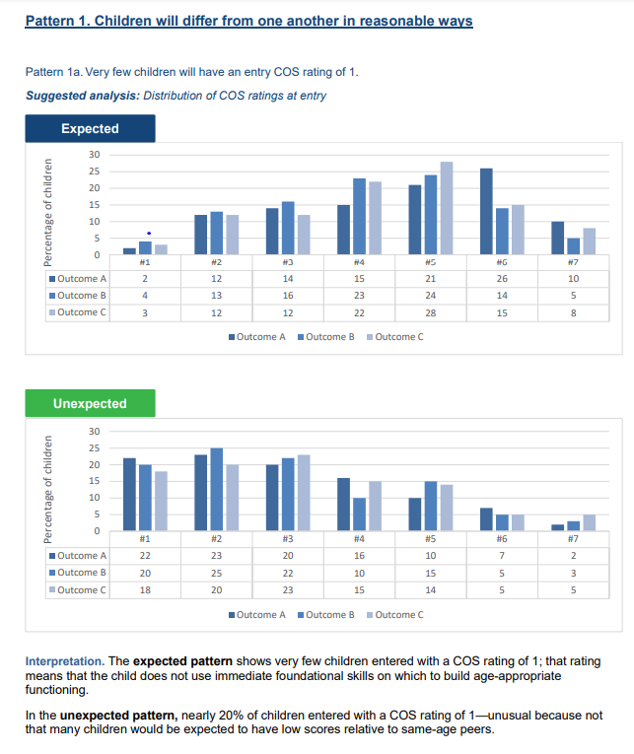
Resources
ECTA Data Quality Materials
  Data Patterns for COS Ratings: What to Expect and What Questions to Ask
Notes:
Nick

Slide 63
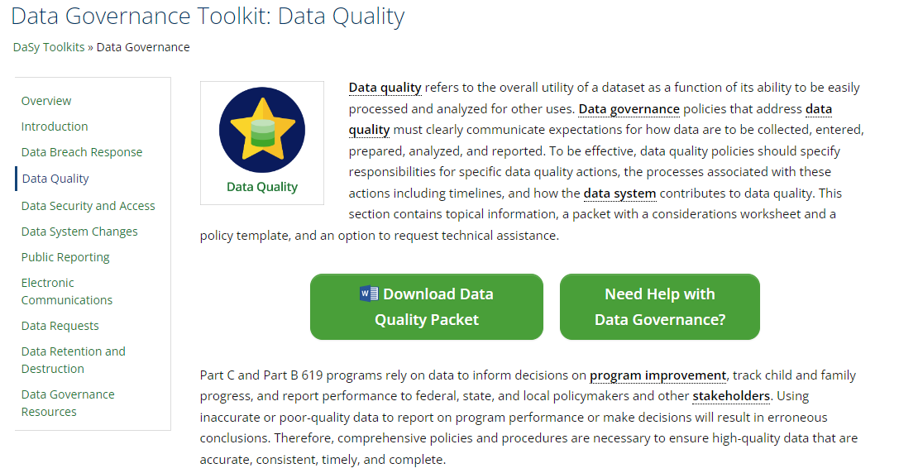
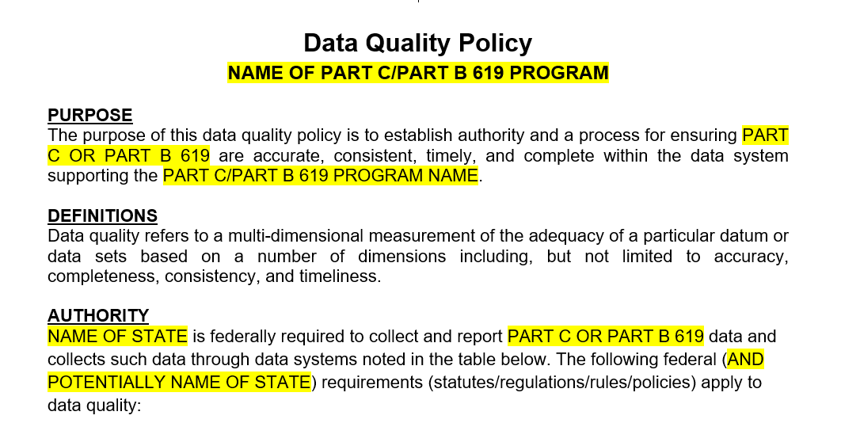
Resources
DaSy Data Governance Toolkit: Data Quality
Data Quality Policy Template
Notes:
Nick
Backup: data culture toolkit

Slide 64

Your Next Step
1
Identify one data quality-related question you wish to investigate next
Reminder:
Is your question clear, measurable, answerable, and unbiased?
64
Notes:
Nick
Think back to small group discussion about data quality profile. We asked you think about what additional questions arise from exploring the data quality profile?

Slide 65
What Can DaSy Do For You?
Support your use of pattern checking resources
Help develop your critical questions and related analysis plans
Provider further training on data quality, analysis planning, etc.
Engage you in learning communities
Connect you with further resources
Support development of data quality policies
Notes:
Nick

Slide 66




Thank you
Please check in for the session on
the app to complete the evaluation.
Visit us at DaSyCenter.org.
Follow us on Twitter: @DaSyCenter
#IDIO2022
The contents of this presentation were developed under a grant from the U.S. Department of Education, #H373Z190002. The contents and resources do not necessarily represent the policy of the U.S. Department of Education, and you should not assume endorsement by the Federal Government. Project Officers: Meredith Miceli and Amy Bae.

