Slide 1


Using Qualitative Data to Inform Programming and Engage Stakeholders
Jessica Edwards, PIRE
Kathy Atwood, PIRE
Betsy Mercier, DaSy
Improving Data, Improving Outcomes (IDIO)
Washington, DC
August 23, 2022

Slide 2
Outcomes for Today’s Workshop
Participants will:
Gain and practice interview and focus group design and facilitation skills
Understand how qualitative data can help state staff examine Diversity Equity and Inclusion Issues and elevate voices of hard-to-reach stakeholders
Understand and practice qualitative data analysis techniques

Slide 3
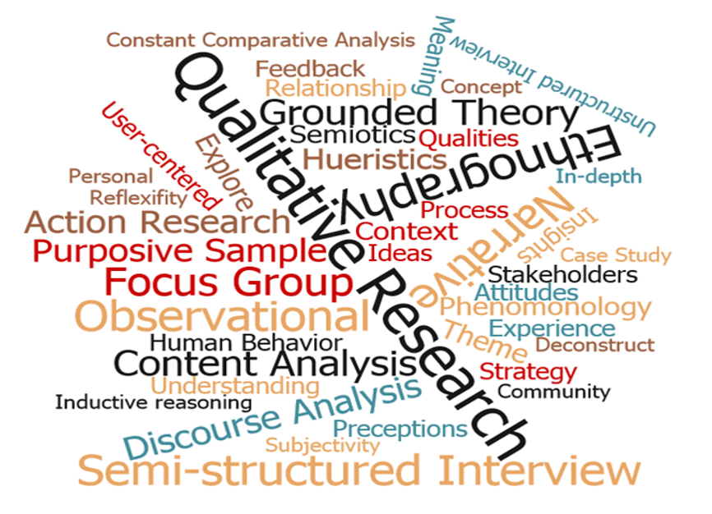
What Is Qualitative Data?
Information that cannot be fully expressed or understood through numbers.​
Provides a more complete understanding of an issue, from the perspectives of those most involved with or affected by the issue.​
Quantitative data help to answer the question: ​
  “Do we have a problem?”​
Qualitative data help to answer the question:
  "Why do we have a problem?”​
Like quantitative data, qualitative data involve a systematic process of collecting and using information.
This Photo by Unknown Author is licensed under CC BY

Slide 4

Building from Anecdotal Information to Systematic Qualitative Data
You may have anecdotal information related to various aspects of your work (e.g., feedback from families, staff).
This can be a springboard to collecting and using qualitative data more systematically, including to:
  Assess the landscape or context before beginning a more extensive assessment
  Inform the development of key questions you'd like to answer
  Generate discussion among stakeholders
    What else do we need to know?
    What do we do next?

Slide 5

Why Use Qualitative Data?
To explore, understand, and explain what is happening, especially that which cannot be easily or fully understood through numbers.
To bring numbers to life and help stakeholders relate to the findings.
Including qualitative data is a best practice for collecting, analyzing, and using data with an equity lens.

Slide 6





Sources of Qualitative Data
Open-ended survey items
Interviews allow you to gain perspectives without influence of others
Focus groups
draw on the synergy between members
Document reviews (e.g., policy documents)
Other data not collected as part of a systematic inquiry

Slide 7
Protecting the Rights of Those Represented in Qualitative Data
Before collecting or using qualitative data, confirm any reviews or approvals that are necessary.
  For example, universities and research organizations have an Institutional Review Board (IRB) that reviews and approves the use of data about people.
Your agency/partner may have policies and processes to consider.
At minimum, inform those you are collecting information from or about:
  What is involved in data collection
  How information will be used
  What their rights are (e.g., voluntary participation, who to contact with questions).

Slide 8



Examining Diversity, Equity and Inclusion in Data Collection and Use

Slide 9
Using an Equity Lens When Collecting and Using Qualitative Data
As you plan to collect and use qualitative data, incorporate attention to equity throughout the process:
  Considering the purpose of the data collection activity and the implications of the questions that will be examined.
    Determine how qualitative data will provide contextual information to better understand and make decisions about issues you are working on.
  Identifying a diverse and representative group of stakeholders to engage in the data collection, interpretation, and reporting process.

Slide 10
Using an Equity Lens When Collecting and Analyzing Qualitative Data
Step | Equity Consideration
Design and data collection: Determine key research questions, develop protocols for collecting data, develop templates for storing and analyzing data, collect data, transcribe notes from data collection | Gather stakeholder perspectives and work with a diverse team. Consider community preferences in deciding on how to collect data (e.g., interviews versus surveys or focus groups).
Data analysis: Use multiple reviewers to identify evidence for expected and new themes; assess level of agreement and different perspectives. | Disaggregate data, discuss data trends with appropriate context, beware of implicit bias, seek input from community about interpretation
Source: Child Trends, How to Embed a Racial and Ethnic Equity Perspective in Research: Practical Guidance for the Research Process​
https://www.childtrends.org/publications/a-guide-to-incorporating-a-racial-and-ethnic-equity-perspective-throughout-the-research-process​

Slide 11
Developing Interview & Group Discussion Guides

Slide 12

Developing Interview & Group Discussion Guides
Make questions clear; avoid ambiguity, vagueness, and lengthy questions
Avoid yes/no questions; aim to obtain details and an explanation in the response
Avoid leading and biased questions/terms
  Rather than leading with, “Do you agree…?,” consider phrasing such as, “Can you describe for me…”

Slide 13
Developing Interview & Group Discussion Guides
Avoid multiple questions in one item
  Are there unmet needs among this population and are there efforts to address the needs?
Avoid negatively worded items when possible. People tend to read over “no” and “not”
Use inclusive language (e.g., "disadvantaged" vs. "historically underserved")

Slide 14
Avoiding Bias When Leading an Interview or Group Discussion
Interviewer’s Bias - Do we choose participants who agree with our view? Do we ask leading questions to get the answers we want? Or, ignore data that don’t support our views?
Reactivity - How is the interviewer affecting participants’ engagement in the interview or group discussion and the responses they’re providing?
Respondent’s Bias – Respondent/s may withhold information to protect their privacy or tell you what they think you want to hear

Slide 15

Tips for Leading Interviews and Group Discussions
Prepare interview questions in advance and practice
Setting - aim for privacy, comfort, and minimal distractions
Ensure confidentiality – explain how participants’ responses will be used and safeguarded
Keep pace - brief small talk helps with rapport but then keep on topic; stay mindful of the allotted time and prioritize key questions if you begin to run out of time

Slide 16

Tips for Leading Interviews and Group Discussions
Be engaged - engage in active listening (e.g., use verbal or visual affirmations & encourage flow of the discussion)
Probe - seek sufficient details and ask for additional details about important and interesting comments
Watch for group dynamics - balance dominating voices to allow free flow of ideas

Slide 17
Small Group Activity: Refine an Interview Guide and Practice Interviewing Skills

Slide 18
Small Group Activity
Using a practice interview guide, break into pairs or small groups to make improvements to the guide
Talk through proposed changes in your group
Debrief and share back in large group discussion

Slide 19
Reminders for Revising the Interview Guide
Make questions clear
Avoid yes/no questions
Avoid writing biased questions/terms
Avoid multiple questions in one item
Avoid negative items when possible. People tend to read over “no” and “not”
Use Inclusive language

Slide 20

BREAK

Slide 21
Qualitative Data Analysis

Slide 22

Build Your Analysis Team(s)
Assemble teams with diverse perspectives to work together on:
Developing themes to answer your question
Analyzing the data by organizing evidence for themes
Summarizing data findings
Sharing findings and considering action steps

Slide 23

Analyzing Qualitative Data Using Thematic Analysis: An Example
From quantitative data, we know that Part C referral rates dropped during COVID.
To support programs to increase referral rates to pre-COVID levels, Part C staff want to understand:
Why did Part C referral rates drop between 2019 and 2021?
Data from a parent survey may help answer this question.

Slide 24

Review Raw Data
Identify the open-ended survey items that are relevant to the key question:
  Please describe the process of getting your child evaluated for early intervention.
Read through a few completed surveys.
Make a list of preliminary themes.

Slide 25
Review Raw Data: Example Survey Responses
Parent 1
“I had concerns about our daughter but didn’t know who to talk to. I wanted to ask the pediatrician, but we had so much going on during COVID. Working remotely, trying to deal with the kids. When we finally got around to calling the doctor, they weren’t taking appointments for well care visits. I finally got in last week and the doctor told me about early intervention.”

Slide 26
Review Raw Data: Example Survey Responses
Parent 2
I finally found out about EI from our doctor, but by then our well-child visit had been delayed for about 4 months. Then we got a referral for EI services, but they were booked out for months and the first appointment was online. That was frustrating and did not accomplish much. I haven’t gotten around to calling back.
Parent 3
Our first appointment with early intervention was online. I don’t have good Wi-Fi so it was a very frustrating process to engage our child and have a useful session. The whole thing was stressful. After that we just waited until things opened up more. My son starts speech therapy next week.

Slide 27

Identify Themes
Discuss the common themes or patterns with team members and refine.
Come to group agreement about initial themes and document them.
Use color coding to show which evidence fits with each theme.
Team members may identify additional themes in the data that you did not consider initially.

Slide 28
Identify Themes: Possible Themes From Our Example
Family stress surrounding COVID
Family frustration with getting into providers
Families delaying assessment
Technology Issues with online interactions

Slide 29
Review All Data: Organize the Data into Themes
Record evidence from your data for each theme.
As time allows, have multiple people analyze the same data and discuss any differences in the evidence they identified.
Have team members identify evidence that supports and contradicts the themes.
Flag illustrative stories and quotes that could help tell a story.

Slide 30
Synthesize Your Findings
Look for similarities and difference across sources (e.g., agreement across families, differences across regions).
How much consistency is there (e.g., clear consensus, prevailing view with some variation)?
May combine themes or separate one theme into multiple themes or sub-themes.

Slide 31
Synthesize Your Findings
Iterate with your team to see if you agree about what the data are telling you.
Bring inconclusive data back to your larger team or stakeholders.

Slide 32
Small Group Activity: Analyze Qualitative Data by Identifying Key Themes

Slide 33
Small Group Activity
Break into small groups and review excerpts from interviews
Use the handout to guide your analysis and discussion of potential themes
Debrief and share back in large group discussion

Slide 34

Next Steps: Ways to Strengthen Your Findings
Triangulation - Use 2 or more sources (e.g., use of survey responses and interview data) to achieve a comprehensive picture of the issue/topic studying; provides a consistency check on the findings.
Colleagues’ feedback - Present findings to colleagues for their views on the results and interpretations
Stakeholders’ feedback - Share findings with respondents and broader stakeholder groups to get their views about the results and interpretations

Slide 35

Discussion
How can you use the information shared today in your state?

Slide 36
Qualitative Data Resources
General Resources
Analysis Tools
Qualitative Data Analysis Methods 101:https://gradcoach.com/qualitative-data-analysis-methods/
Intellspot: Qualitative Data Analysis Methods and Techniques: https://www.intellspot.com/qualitative-data-analysis-methods/
Microsoft Excel, Word
Nvivo, Atlas.ti, Dedoose
Data Visualization Tools
DaSy Data Visualization toolkit: https://dasycenter.org/datavis-toolkit/qualitative-data/
http://stephanieevergreen.com/qualitative-chart-chooser/

Slide 37


Thank you
Visit us at http://dasycenter.org/
Follow us on Twitter: @DaSyCenter
The contents of this presentation were developed under a grant from the U.S. Department of Education, #H373Z190002. The contents and resources do not necessarily represent the policy of the U.S. Department of Education, and you should not assume endorsement by the Federal Government. Project Officers: Meredith Miceli and Amy Bae.

