Slide 1
Getting to Know the Child Find Self-Assessment Toolkits for Part C and Part B 619!
Margaret Gillis, DaSy
Faith Scheibe, DaSy
2022 Improving Data, Improving Outcomes Conference
Washington, DC
August 21-26, 2022

Slide 2
Agenda
Welcome
Overview
Challenges
Child Find Self-Assessment (CFSA)
Best Practices
Resources
Please check in for the session on Attendee Hub
Session code: idioS32

Slide 3
Who’s in the Room?
What is your Role?
Part B? Part C? Something else?
Have you seen either of the Self-Assessments?
Have you used them in any way?

Slide 4
Child Find Overview

Slide 5
Child Find System
Coordination with referral sources
Clear definition of eligibility
High quality data systems
Evaluation and appropriate identification
Public awareness

Slide 6
Why Focus on Child Find?
Earlier identification
Underserved communities
Ineffective / unequitable implementation
Mitigate pandemic effects

Slide 7
National Context 2021 % served under IDEA, Part C
% By State
% By Age
1.14% Birth to One
3.05% One to Two
5.34% Two to Three
*Data Downloaded from https://data.ed.gov/dataset/78757f8e-0a96-4c06-ab5e-3a65d7d55db7/resource/4ab75c84-8cfb-4187-9a87-1f28e700fdad/download/2021-cchildcountandsettings-4.xlsx

Slide 8
Number of infants & toddlers (Birth to 3) received Early Intervention in US & Outlying Areas
2016 through 2021
*Data Downloaded from https://data.ed.gov/dataset/78757f8e-0a96-4c06-ab5e-3a65d7d55db7/resource/4ab75c84-8cfb-4187-9a87-1f28e700fdad/download/2021-cchildcountandsettings-4.xlsx

Slide 9
National Context 2021 % served under IDEA, Part B 619
% By State
*Data Downloaded from https://data.ed.gov/dataset/78757f8e-0a96-4c06-ab5e-3a65d7d55db7/resource/4ab75c84-8cfb-4187-9a87-1f28e700fdad/download/2021-cchildcountandsettings-4.xlsx

Slide 10
Number of children ages 3 to 5 received Early Intervention in US & Outlying Areas
2016 through 2021

Slide 11
Opportunities to Strengthen Child Find
Develop systems to better track and improve earlier identification.
Close gaps in integrating Part C early identification systems within States and local communities.
Reduce gaps in tracking children from concerns to referral, evaluation, and services.
Combine developmental monitoring and screening systems to increase earlier identification / more targeted and appropriate referrals

Slide 12
Discussion

Slide 13
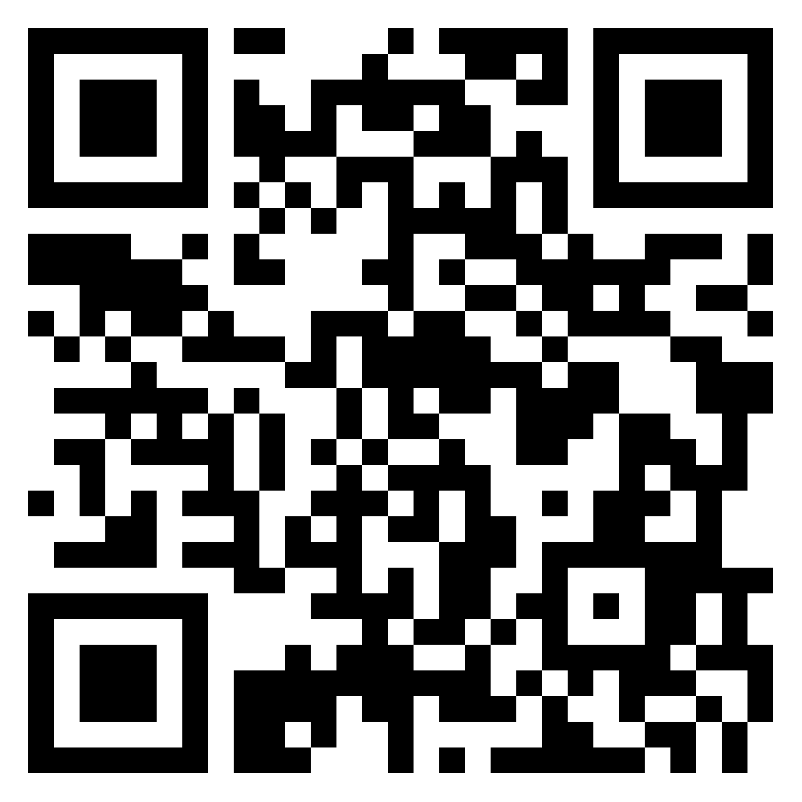
Challenges
What challenges have you encountered related to your state or local Child Find system?
Identification/location
Referral
Screening
Evaluation
Tracking
Evaluating Child Find
Padlet : https://tinyurl.com/572jzp7v

Slide 14
Child Find Self-Assessment (CFSA)

Slide 15
Background on the CFSA
Voluntary self assessment tool
Developed by OSEP in collaboration with DaSy and ECTA
Can be used as
a monitoring tool to ensure they have met the regulatory components of a Comprehensive Child Find system
an informational tool to assist with implementing best practices for Child Find

Slide 16
How is the CFSA Organized?
Regulatory requirements specific to Child Find
Child Find Best Practices
Technical Assistance and Resources
OSEP Policy Letters and Guidance

Slide 17
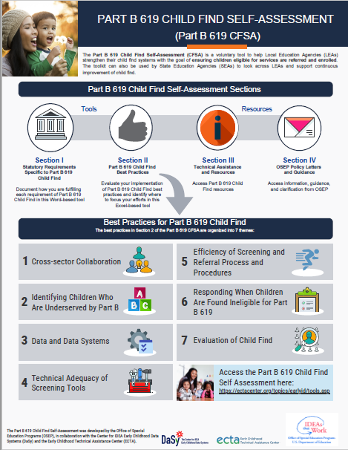
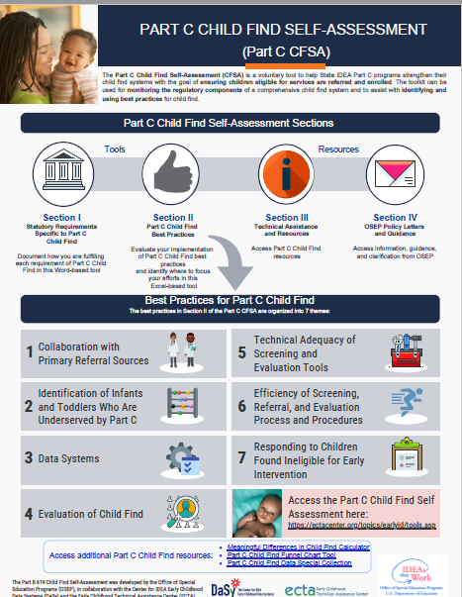
Child Find Self-Assessment Infographics

Slide 18
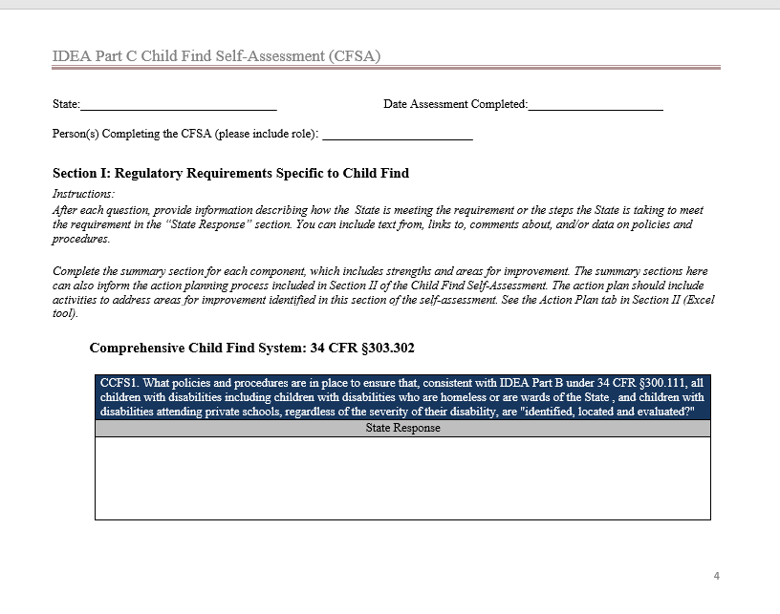
Section I: Regulatory Requirements Specific to Child Find

Slide 19
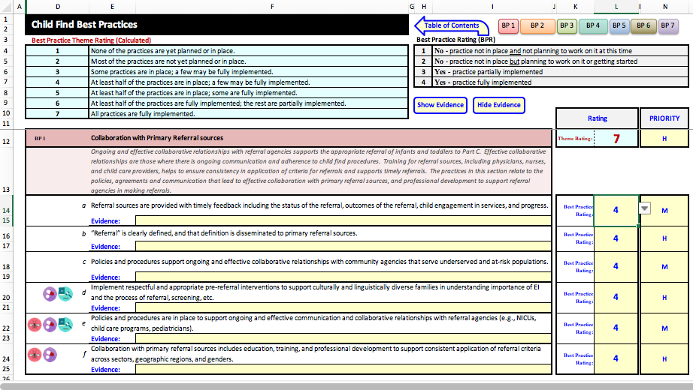
Section II : Best Practices Excel Tool
Part C CFSA Section II
Part B 619 CFSA Section II

Slide 20
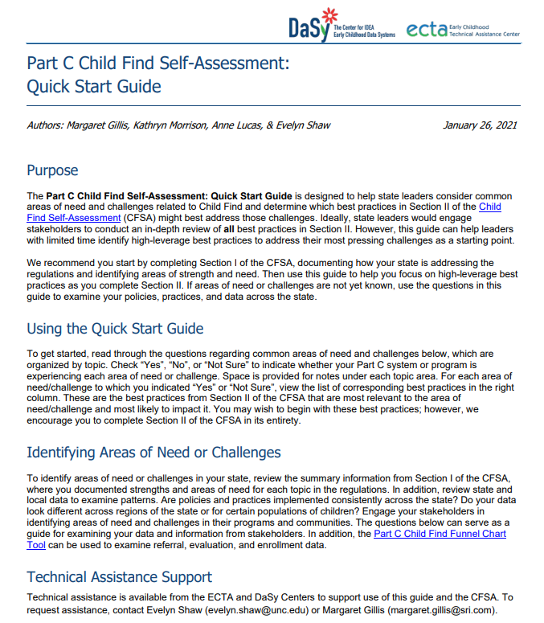
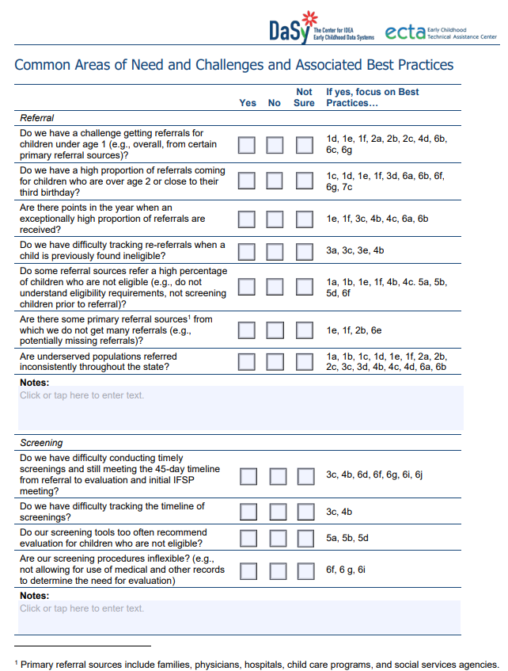
Quick Start Guide
Part C available
Part B 619 forthcoming

Slide 21
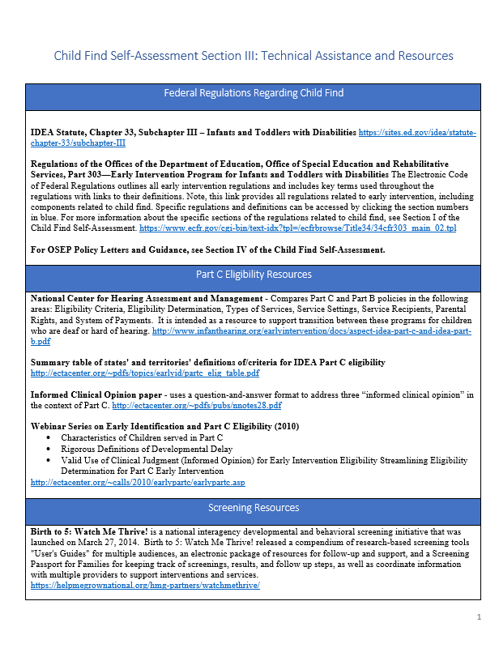
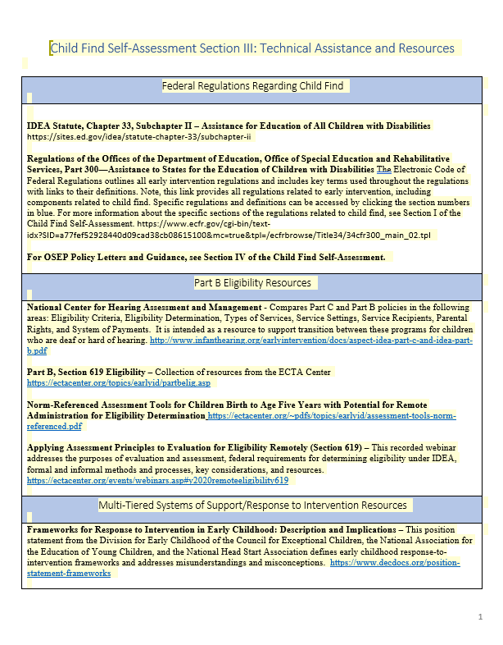
Section III: Technical Assistance & Resources

Slide 22
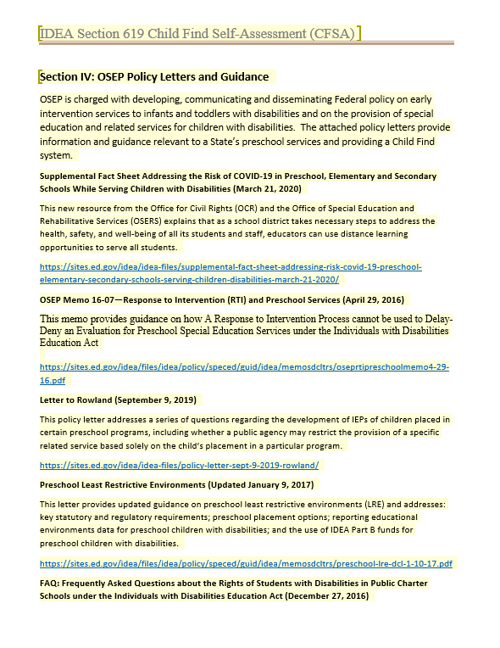
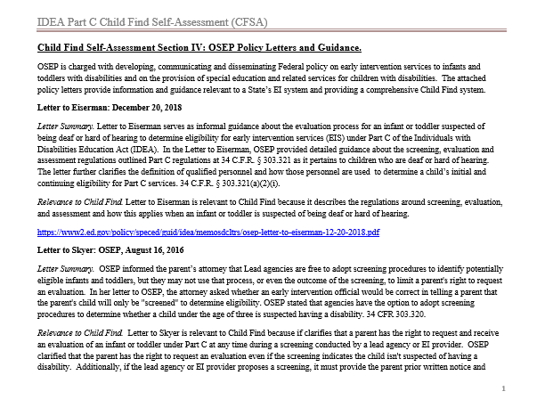
Section IV : OSEP Policy Letters & Guidance

Slide 23
Differences Between the Tools
Part C Child Find Self-Assessment Tool
Part B 619 Child Find Self-Assessment Tool
Intended for use at the state level
Has icons that highlight special considerations for special populations
Maltreatment
Neonatal substance exposure
Zika infection
Intended for use at the local or state level
Section I includes space for state and local responses

Slide 24
Reflection & Resources

Slide 25
Reflection Activity
Best Practice Rating Scale
Color | # | Rating Description
 | 1 | No – practice not in place and not planning to work on it
 | 2 | No – practice not in place but planning to work on it / get started
 | 3 | Yes – practice partially implemented
 | 4 | Yes – practice fully implemented

Slide 26
Resources
Tools for Improving Child Find
Taking a Critical Look at Your Child Find Efforts
Identify Meaningful Differences in Child Find
Child Find Funnel Chart Tool

Slide 27
Large Group Discussion
What do you need to advocate for additional resources in your State?
What other resources do States and local programs/ LEAs need?

Slide 28
Thank you & Please complete the evaluation!
Visit us at http://dasycenter.org/
Follow us on Twitter: @DaSyCenter
The contents of this presentation were developed under a grant from the U.S. Department of Education, #H373Z190002. The contents and resources do not necessarily represent the policy of the U.S. Department of Education, and you should not assume endorsement by the Federal Government. Project Officers: Meredith Miceli and Amy Bae.

