Slide 1

Practical Tips for Evaluating and Analyzing Data on Practitioners’ Use of Evidence-Based Practices
Margaret Gillis, DaSy
Mary Lee Porterfield, DaSy
Stacy Kong, Hawaii Department of Health
Sheri Umakoshi, Hawaii Department of Health
IDIO Conference 2022

Slide 2


Welcome!
Please check into the session on the conference app
Who is in the room?

Slide 3
Agenda
Tips for evaluating and analyzing data on practitioners’ use of evidence-based practices
Hawaii’s journey
Small group discussion
Resources

Slide 4
Tips for evaluating and analyzing data on practitioners’ use of evidence-based practices

Slide 5
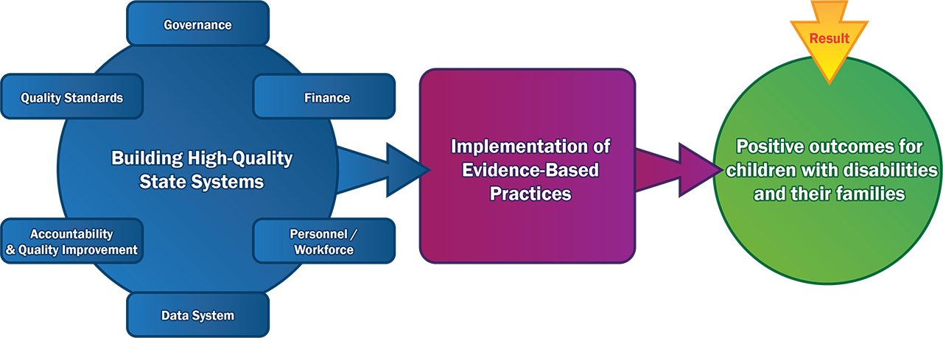
Practice Implementation Improves Results

Slide 6

Definitions
Practices: The teachable and doable behaviors that practitioners use with children and families which can be used, replicated, and measured for fidelity
Practice Change: Increase or decrease in the number, frequency, precision, or quality of practices implemented by a practitioner as compared across at least two points in time.
Fidelity: The extent to which practitioners are implementing an evidence-based program or practice as intended, as measured against a threshold or predetermined level. Fidelity implies strict and continuing faithfulness to the original innovation or practice that is expected to lead to the desired child/family outcomes.

Slide 7
Relationship Between Practice Change and Fidelity
Both practice change and practice fidelity are about the implementation of evidence-based practices (EBPs)
  Are practitioners changing their implementation of EBPs?
  Are practitioners implementing EBPs as intended?
Practitioners can demonstrate changes in practices without reaching fidelity.

Slide 8
Why measure practice change and practice fidelity?
To ensure practices are implemented as such that improved outcomes are expected
To determine whether practitioners maintain fidelity over time
To obtain information for monitoring progress
  Incremental increases toward fidelity can indicate that improvement strategies are working and highlight areas where practitioners need additional support
  Corrections/adjustments in practice can be made in a timely manner

Slide 9
Defining and Operationalizing Evidence-based Practices
Practices that are not clearly defined and operationalized are not measurable
A Practice Profile is a way to define and articulate acceptable and non- acceptable practices (National Implementation Research Network)
A Practice Profile is not a measurement tool but can be used as a starting place to develop or identify a tool for assessing practice change and fidelity

Slide 10
Balancing High-Quality and Practical Measurement
The higher the quality of the measurement approach, the more useful and actionable the data are
The key is to ensure you get the most meaningful, accurate, and reliable information possible
Measurement also needs to be doable, practical

Slide 11
Characteristics of High-Quality Measurement
The tool is:
Aligned to the selected evidence-based practices
Valid – accurately measures the essential functions of the practice
Reliable – produces consistent information across users, settings, activities, and time points
Practical – can be used with the staff and resources available

Slide 12
Characteristics of High-Quality Measurement
The tool:
Can produce a meaningful fidelity threshold score that indicates whether practitioners have reached a level of implementation that is sufficient for achieving targeted child or family outcomes
Allows for variation (e.g., over time, across practitioners)
Provides useful information to practitioners to identify areas of strength and areas for improvement to move toward, reach, and maintain fidelity

Slide 13
Other Considerations to Improve Quality
Timing/frequency. The tool is used at sufficient frequency to measure incremental improvement (practice change) and the maintenance of fidelity over time.
Training. Clear instructions and training are provided to improve data quality.
Purpose of data collection is clear--Practitioners and data collectors understand how data will be used to improve implementation.
Use consistent tools/instruments statewide

Slide 14
Data Collection Advantages and Disadvantages
Method | Advantages | Disadvantages
Observation | May provide the most objective information Data are collected in natural environments | Resource intensive (time, staff) Presence of the observer may influence behavior
Self-report | Relatively easy to collect Closed-ended questions can be easily analyzed | May be positively or negatively biased Response options are often limited Questions may be misunderstood
Document Review | Relatively inexpensive Unobtrusive Good source of background information Can provide information about things that may not be observable Can provide information to confirm data collected by other means | Information may be incomplete or inaccurate Information may not be written in an objective manner Can be time consuming to collect, review, and analyze many documents

Slide 15
How to Make it Practical
Leverage existing processes and structures (e.g., supervisors, coaches)
Start with existing tools (e.g., fidelity tools associated with a model, tools related to DEC Recommended Practices)
Prioritize the practices to be evaluated—it is not practical to evaluate all practices
Start small—select a subgroup of practitioners and/or programs for more intensive measures (e.g., observations)

Slide 16
Now you have the data and need to analyze it…

Slide 17

Preparing for Data Analysis and Use
Ask stakeholders (families, practitioners, staff) what they want to know about the practice.
Translate into simple analysis questions with a way to measure progress, for example:
  What percentage of practitioners are meeting the fidelity threshold?
  Do practitioner scores on the measure improve over time?
  Do practitioner scores vary by region?
  Are there differences between groups of practitioners by discipline?

Slide 18
Identify Data Relevant to Your Questions
What data are available on fidelity of implementation or practice change?
What level of data are available – do you have data at the component level?
What contextual data are available:
  Practitioner education
  Practitioner training on the practice
  Practitioner length of time in current position
  Practitioner length of time implementing the practice

Slide 19
Determine Analysis Approach or Method
Fidelity of implementation: | Point in time assessment scores
Practice change: | Comparing practitioner scores over at least two time points
Variation in implementation**: | Comparing practitioner scores by components of the measure, by geographic region, by training or education, or by other practitioner or program characteristics

Slide 20
Considerations for Conducting the Analysis
Document each step of the process (sample size, methods, limitations) – this will help as you go to interpret the results and plan additional analyses
Revisit your analysis goals, and engage stakeholders to look at whether the goals were met
Consider how you will use the results. Engage stakeholders to help you interpret the results and determine how to apply them to program improvement, and how to communicate them in effective, engaging ways

Slide 21
Tips for high-quality practice evaluation and analysis of data
- Hawaii’s Journey-
Stacy Kong, EIS Supervisor/Part C Coordinator
Sheri Umakoshi, Personnel Development Coordinator

Slide 22
Hawaii SSIP: Professional Development (PD) & Technical Assistance (TA)
Primary Service Provider (PSP) Approach to Teaming
Coaching Practices within natural learning environments

Slide 23
Coaching Fidelity Process
Initial Coaching Training
Monthly Coaching Log & Group Mentor Meeting
Coaching Fidelity Criteria shared
Mentors continue to coach providers
Coaching Fidelity Process & Training Modules

Slide 24
Challenges
Identified
Frustration as coaching fidelity criteria guidelines were shared after 6 months of mentoring.
Coaching fidelity criteria was confusing which impacted mentors’ ability to support providers
Mentors needed coaching support from their peers
High Staff Turnover
Limited Mentors
Data – used manual calculation and hard copy data

Slide 25
Excel Coaching Summary Workbook
  Excel coaching workbook was created by a demo site provider as a tool to support coaching conversations.
  Shared with all demo sites and received positive feedback from mentors & providers.
  Consulted with our DaSy TAs (Margaret Gillis, Kathryn Morrison & Cat Hall) to expand use of the workbook as a data gathering and analysis tool.
  Worked with our DaSy TAs to use the workbook to accurately and consistently measure progress towards coaching fidelity for providers.
    Modification to the Natural Learning Environment Practice (NLEP) workbook.
    Carried over to the Resource Based Practice (RBP) and Mentor fidelity workbooks.

Slide 26
How data informed our process
Identified clarifications needed & gaps in our coaching criteria
Quarterly coaching log inter-rater activity gave mentor opportunities for discussion and clarification to coaching criteria component definitions and process.
Supported coaching conversations, visual feedback on progress
Revisions made to coaching fidelity criteria and excel workbook.
Improved accuracy and consistency in mentoring and coaching fidelity data collection.
Data Points to inform infrastructure and practice needs

Slide 27
Celebrations & Next Steps
Mentor Community of Practice
Final revisions excel coaching summary workbooks
  NLEP
  RBP
Updated Coaching Fidelity Criteria for NLEP & RBP
Mentor excel coaching workbook (in progress)
Roll-Up Data Points (in progress)

Slide 28
Excel Coaching Workbook
Demonstration

Slide 29
Small Group Discussion

Slide 30
Discussion
How are you currently using/sharing data on practice implementation?
How would you like to enhance how you are using/sharing data on practice implementation?
How are you looking at variation in your evaluation?
Are local programs/sites using data on practice implementation? How?
Are you using qualitative data to better understand practice implementation? How?

Slide 31
Resources
Coming soon: EC DataU Course on Evaluation of Evidence-Based Practices
Tip Sheets on Evaluating Implementation of Evidence-based Practices https://dasycenter.org/ebp-tip-sheets/
Look! Think! Act! Using Data for Program Improvement https://dasycenter.org/look-think-act/
For more information on data aggregation and use at different systems levels:
  ECTA Learning Lab--Exploring Coaching for Practice Change: Data Decision-making and the Implementation of Practice-Based Coaching: http://ectacenter.org/~calls/2017/learninglab.asp#session4

Slide 32


Thank you &
Please complete the evaluation!
Visit us at http://dasycenter.org/
Follow us on Twitter: @DaSyCenter
The contents of this presentation were developed under a grant from the U.S. Department of Education, #H373Z190002. The contents and resources do not necessarily represent the policy of the U.S. Department of Education, and you should not assume endorsement by the Federal Government. Project Officers: Meredith Miceli and Amy Bae.

