Slide 1
Broader than PreK: State Transition Planning from a Comprehensive ECCE Lens
Howard Morrison and Laura Kassner
National Technical Assistance Center for Preschool Development Grants Birth through Five
(PDG B-5)
Notes:
Laura
Welcome. <Introduce ourselves and the Center>
Direct folks to the handout – PDF in the Cvent app – or editable version available by following this QR code. Let us know if you have any trouble accessing and we will support you.

Slide 2
Agenda
Why transition matters
Introduction to PDG B-5 and innovations in transition
State sharing and featured presentations
Small-group discussions
Share-out
Reflection
Notes:
Laura
To give you an overview of where we're going today...
Why transition matters
Introduction to PDG B-5 and innovations in transition
State sharing and featured presentations
Small group discussions
Share out
Reflect and resources
Again the handout is available both in the app as a static PDF – or via this QR code in editable form.

Slide 3
Objectives
Learn how transitions fit in a comprehensive early childhood care and education (ECCE) system
Learn about the progress states have made in their transition activities and identify what key takeaways may be helpful for your state to consider
Connect with colleagues from other states to gauge potential involvement in state transition planning
Notes:
Laura
Review objectives
This is the last chance to scan the QR code up here before we take it off the slides, but there's a static copy in the app.

Slide 4
Why transitions matter?
Child perspective
Parent perspective
Educator perspective
System perspective
Notes:
Laura
So why do transitions matter?
Child perspective – Excitement, nervousness, anxiety, different expectations, needing to feel safe before they can learn
Parent - USING THIS TERM INCLUSIVELY. Finding child care is a significant stressor for families – not to mention high quality care. Their child is their very best they're entrusting to someone's care. Hard to navigate access, eligibility, and enrollment – creating the potential for anxiety and negative feelings before the relationship ever starts. And they're helping manage their child's big emotions.
Educator - want to be maximally prepared for meeting an individual child’s needs, make them feel comfortable, and build strong partnership with families. Sharing appropriate information supports this preparation and bridge building. It helps to thinking about the setting the child is coming from - as well as to share information in the handoff for the transition to the next step.
System - Programs need to plan for enrollment and related staffing needs. And at the state and federal level, the aggregation of information helps support policy and planning. Data indicates trends, alignment helps support compliance with mandates.

Slide 5
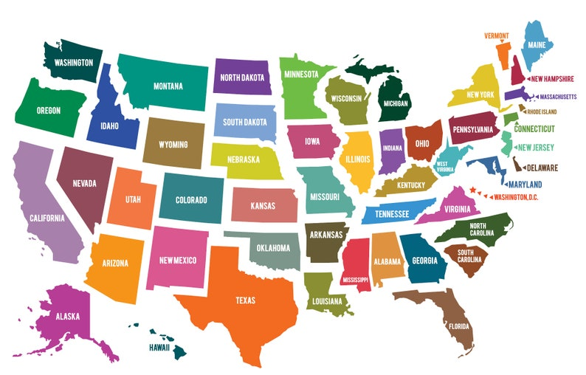
Tell us about you
What state or territory do you represent?
And what is your role?
  Part C coordinator
  Part B 619 coordinator
  Part C data manager
  Part B data manager
  TA provider
  Other
Notes:
Laura
Which states and territories are in the room? Call by region –
New England (which states?)
Mid-Atlantic (which states?)
South (which states?)
Deep South (which states?)
Central/Midwest (which states?)
Pacific Northwest (which states?)
Southwest (which states?)
What roles are represented?
Part C coordinator?
Part B 619 coordinator?
Part C data managers?
Part B data managers?
TA providers?
Other?
Excellent! We’ll tailor our presentation to those in the room, so this information is helpful.
Next I’ll turn it over to Howard to jump in a bit to the PDG B-5 efforts around transition.

Slide 6




When we say "transition Planning"...
We do not mean planning for the individual child (Ayla’s services changing from Part C to preK in her IEP).
We do mean planning at the local/community and state levels (child care providers communicating with kindergarten programs their students attend), which includes Ayla’s transition at a macro level.
Notes:
Laura
We want to clarify what we mean by “transition planning” in the context of this presentation.
We know that transition occurs at the individual child level – and that is very important. But think more about aggregating information up several levels to transition planning at the local/community and state levels. This INCLUDES those individual transitions as well, but it’s taking a more macro approach.
Does that make sense?

Slide 7





Familiar transition points
What other transitions can you think of?
Home to infant/toddler care or preK
Infant/
toddler care to preK
PreK to kindergarten
Kindergarten to elementary schools
Adapted from Early Childhood Transitions: Supporting Children and Families.
Notes:
Laura
Home to infant/toddler care or preK
Infant/toddler care to preK
PreK to kindergarten
Kindergarten to elementary schools

Slide 8






Inclusive Transitions in ECCE System
Home visiting to kindergarten
Part C
to Part B
Infant/
toddler care to preK
Classroom transitions within early childhood programs
Home to infant/toddler care or preK
PreK to kindergarten
Child care (center and home) to kindergarten
Kindergarten to elementary schools
Head Start to kindergarten
Notes:
Laura
Review example transitions in an ECCE system – not an exhaustive list, and realize there are many specific examples in the Individuals with Disabilities Act (IDEA), such as Part C to preK, Part B to preK, etc.
And even in this more exhaustive list, there are still transitions at the individual level that may not be captured, such as students who attend different programs in the morning and afternoon.

Slide 9
What is PDG B-5?
The Preschool Development Grants Birth through Five (PDG B-5) initiative is designed to improve states’ early childhood systems by building on existing federal, state, and local early care and learning investments.
Major activities:
  Needs assessment
  Strategic plan
  Parent knowledge, choice and engagement
  Sharing best practices
  Improving overall quality
  Monitoring, evaluation, and data use for continuous improvement
Notes:
Howard

Slide 10
Transitions and PDG B-5
The purpose of the PDG B-5 Renewal Grant remains focused on strengthening a state’s integrated ECCE system to:
  prepare students from socioeconomically disadvantaged circumstances to enter kindergarten, and
  improve their transitions across early childhood and into the early elementary grades.
Adapted from the PDG B-5 funding opportunity announcement.
Notes:
Howard
Transitions are an intentional focus for PDG B-5 and were included in the funding opportunity announcement. Note the orange text. It further explained that it could be accomplished through the major activities by:
Using existing federal, state, and local resources efficiently to strengthen the delivery of existing programs.
Improving the coordination and delivery of services across models and funding streams in the state's mixed delivery system.
Developing recommendations to better use existing resources to improve the overall participation of children, particularly vulnerable, underserved, or unserved children and children with, or at risk for, disabilities, in a mixed delivery system.
Maximizing family and parental choice.
Enhancing school readiness for children from low-income and disadvantaged families, effectively transitioning children into elementary school.

Slide 11
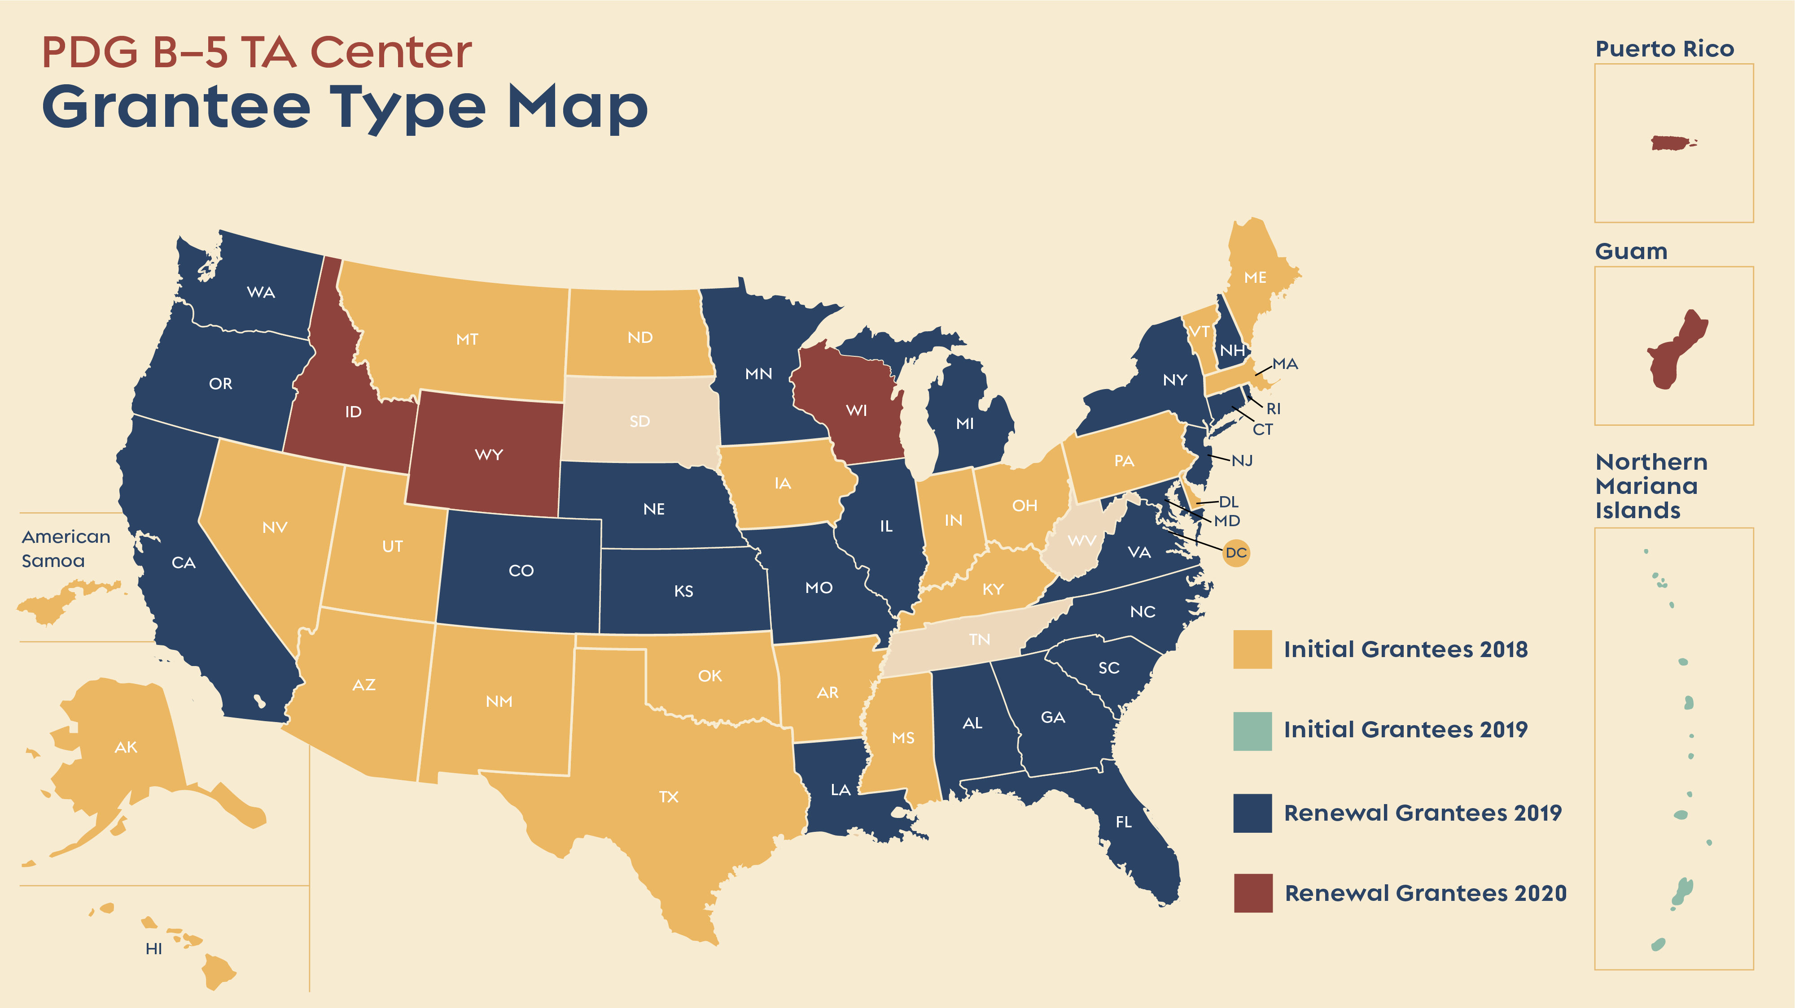
PDG b-5 TA Center Grantee Type Map
Notes:
Howard
Do you see your state’s or territory’s status in this map? Is this new information to you? Or are you already familiar – or better yet involved – with the work?
The Administration for Children and Families (ACF) has released the forecast, but the full application is coming soon for the next round of initial and renewal grants.

Slide 12

PDG B-5 Support for Innovative State transition Activities
Supporting children transitioning from Part B to Part C services under the Individuals with Disabilities Education Act (IDEA)
Providing readiness support
Creating relevant professional development tools and activities
Developing transition summits, toolkits, and guidelines
Supporting Smooth Kindergarten Transitions
Notes:
Howard
In 2020, ACF and the Office of Early Childhood Development reported on the innovative transition activities in states’ renewal applications. In the report, transitions activities are broken out across 4 areas. [STRATEGIES ARE INCLUDED ON the 2nd PAGE OF YOUR HANDOUT]
The first is Support for children transitioning from IDEA Part B to Part C. Some state activities include:
Using a family engagement specialist to support transitions
Increasing availability of information for parents about developmental targets, screenings, and readiness
Providing subgrants to communities to support IDEA transition practices
Providing families with resources, community trainings, and coaching related to eligibility, accessing services, and screenings
Piloting a program called “Bridges,” which is a coordination program for families aging out of Part C
Piloting a program called “Lighthouse,” which is a program that promotes alignment of screening practices between Part C and Part B
Gathering a strategic group to assess family needs related to Part C to Part B transitions, with the intention of developing a warm hand-off system
Developing an online parent portal and mobile app to support families navigating special education transitions (the app will include a texting component)
Creating materials to guide and support families through the transition from Part B to Part C
Creating a Family Navigator program that will provide information to families and support them in accessing services, including the transition from Part C to Part B
Increase families’ awareness of supports and transitions from Part C to Part B for Deaf children or children who are hard of hearing, including a peer-coaching program
The second is Readiness support. Activities include:
Kindergarten readiness public awareness campaigns
Public awareness campaign to promote parent involvement
For the third area, professional development, activities include:
Developing training to support best practices for facilitating transitions
Facilitating joint professional development with early childhood and elementary educators to foster collaboration
Expanding content on transitions to professional development for early childhood educators, targeted knowledge of evidence-based transition practices, ways to prepare and support families during the transition to kindergarten, ways to align curricula to kindergarten and the early grades, and assessment practices to ensure that receiving districts have a full picture of children entering kindergarten
Including transitions content as a requirement for credentials
Finally, under transitions summits, toolkits, and guidelines, activities include:
Convening task forces or workgroups
Hosting annual summits to foster collaboration between early childhood and elementary educators
Developing transition guidelines, toolkits, or roadmaps at the district and local levels
Piloting transition guidelines with the intent to scale up statewide
Some other activities include:
Expanding data systems to include early childhood education experiences
Creating a transition coordinator position at the state level
Expanding home visiting programs where kindergarten teachers visit incoming students

Slide 13
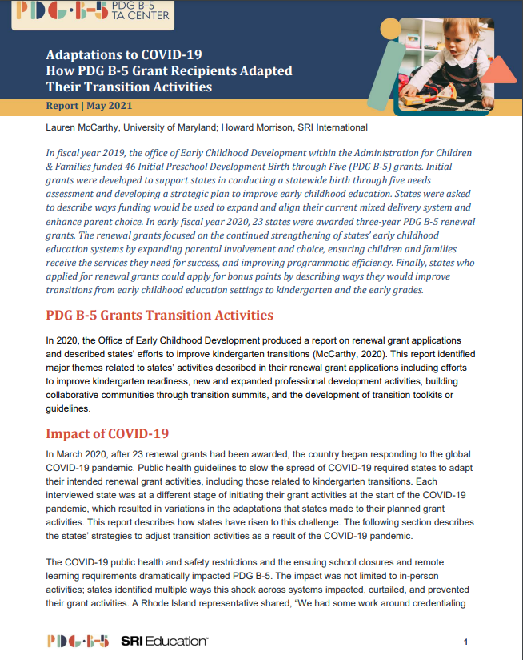
PDG B-5 Grantees adapted transition activities due to COVID-19
Delayed beginnings
Shifting of priorities
Addressing staffing concerns
Adapting to virtual environments
Unexpected benefits from COVID-19
Adaptations to COVID-19
Notes:
Howard
In May 2021, the PDG B-5 TA Center released a brief about how PDG B-5 Grantees adapted their transition activities due to the pandemic. Through interviews and state reports, we learned the following:
There were delayed beginnings: Contracting/procurement had to prioritize COVID-19 response over grant activities.
There was a shifting of priorities: State teams had to focus on supporting the immediate needs of children and families. This delayed workgroup activities, decreased bandwidth to participate on advisory councils, and put the development of resources and tools on hold.
States had to address staffing concerns: Some states experienced staffing freezes during the pandemic, or hiring took longer than normal for state agencies. This caused delays in beginning some of the grant work and connecting with communities.
States also had to adapt to virtual environments: Some states had planned summits on transitions but had to adapt them to virtual summits or series of informational webinars to convey the information. However, in some cases, this led to increased flexibility, and more people were able to attend. Which leads me to my next point.
With all these challenges, there were some unexpected benefits from COVID-19: Some states will continue to offer parents and families virtual and face-to-face learning experiences on transitions. Additionally, the pandemic forced programs to streamline the process for parents and families to enroll their children, which resulted in a smoother transitions process.

Slide 14
National Lessons Learned
Transitions are bidirectional
Developing strategic partnerships
Strong family engagement components
Shared language/understanding
Joint professional development
Building strong relationships
“I think we focus on the mechanics and really need to remember that the mechanics are only as good as the relationships that underlie them.”
—Dr. Kristie Kauerz, Executive Director, National P-3 Center, and Associate Clinical Professor, School of Education and Human Development, University of Colorado Denver
Notes:
Howard
Let’s discuss some national lessons learned through research, practice, as well as some things we have learned from states.
First, transitions are bidirectional. There is a sending and a receiving side.
Developing strategic partnerships across agencies, within agencies, and within the community.
Strong family engagement components: culturally and linguistically responsive to family needs, and ensuring that families are at the center of program design.
Shared language/understanding across programs and services. Ensuring programs and services are all on the same page (shared vision or purpose).
Joint professional development across ECCE, kindergarten, and elementary programs.
Building strong relationships: Building trusting relationships can take time; strong relationships within and across agencies and community organizations are key. This quote really resonated with me [read quote].

Slide 15

How states have used PDG B-5 Grants to make progress
Washington
Minnesota
Kansas
Notes:
Howard
In many PDG B-5 renewal states, exciting transitions work is happening. However, I wanted to focus on a Washington, Minnesota, and Kansas to share their recent developments.

Slide 16

Washington
2020
2021
2022
Early Learning Transitions in Washington
Notes:
Howard
In Washington:
Department of Children, Youth, and Families (DCYF) and Office of Superintendent of Public Instruction (OSPI)
100 Schools Initiative and Transitional Kindergarten
Accomplishments from 2020 to 2022
In 2020, the state focused on:
Aligning its work streams, expanding collaboration, and leveraging partnerships
Starting to implement the 100 Schools Initiative, which is an initiative through the Office of Head Start, selected as an initial approach to support community-school and birth-5/kindergarten-12th grade partnerships
Reviewing existing work streams to identify support opportunities for engagement. This resulted in expanded support and participation of the Office of Head Start, OSPI’s Office of Native Education, Title I Part A/Learning Assistance Program, Migrant Education, Bilingual Education, Early Childhood Special Education, DCYF Inclusion and Trauma Informed Care, and the Washington Association for Head Start and Early Childhood Education and Assistance Program (ECEAP).
In 2021:
Transitional Kindergarten was identified as a pivotal access point to strengthening transitions for underserved families and demonstrated need for inclusive classrooms across Washington.
WA leads identified a need for systems to incorporate family voice, leadership, and advocacy to support effective transitions. Their specific populations of focus include historically marginalized and underserved groups: including children with disabilities, children from migrant and immigrant communities, children of Black/African American or Native heritage, among others.
In 2022:
DCYF and OSPI are offering family voice listening sessions through spring 2022. This has included the engagement of tribal families.
Strengthening early learning transitions to explore an inclusive learning collaboration with the Washington Pyramid Model.
WA 0-5 and Beyond Transition Manual is in development.

Slide 17

Minnesota
Ready Community
Ready School
Ready Family
Ready Child
Developing and Supporting the School-Ready Child
Notes:
Howard
Minnesota has embraced the ready community, ready school, ready family, ready child framework
General transitions overview:
Partnering with families
Getting to know the child
Collaborating with schools, programs, and community partners
Developed a transitions toolkit
Created videos on transitions, from various perspectives
Has a variety of additional resources: Early Learning Outreach, Enrollment, Transition and Instruction

Slide 18
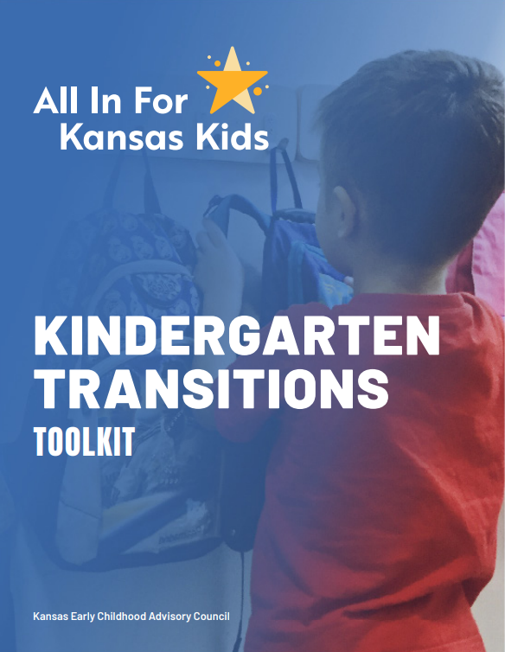
Kansas
Launched subgrants to support successful transitions
Developed a Transitions Toolkit
Kindergarten Transitions Toolkit
Notes:
Howard
In Kansas, the focus is on developing subgrants for Kindergarten Readiness.
The goal is to support the successful transitions of children from early childhood settings.
The grant helps to sustain and support community-led efforts to meet the individual needs and learning levels of children as well as provide education and training opportunities for parents and early child care professionals.
The grantees will form teams of 6-10 members, select priority areas of focus, and identify strategies to improve kindergarten readiness in their communities.
The state recently developed a new transitions toolkit. It includes the benefits of transition planning, a memorandum of understanding (MOU) work plan template, example milestones, data sharing activities, and potential partners for communities' kindergarten transitions MOUs.

Slide 19

State Sharing - Alabama
Amy Blakeney, Director of Early Intervention, Alabama Department of Rehabilitation Services
Stephanie Frucci Bear, Education Specialist, Alabama State Department of Education
Notes:
Laura to start
And now we have a real treat – a chance to hear from a state live and in person! Before we begin, please know no state has fully cracked the nut on all the transitions, so our guests are here to be transparent, hopefully share some strategies, but also be real about the challenges they face. Think of this as a fishbowl activity – or a chance to be a fly on the wall in a conversation. ☺
Please join me in welcoming two representatives from Alabama, their Part C and Part B coordinators, Amy and Stephanie.
Ladies, thank you so much for joining us.
Conversation with state leaders - Questions for Amy and Stephanie:
Can you begin by introducing yourselves, your roles, and how long you've served in these capacities?
When you think about what's going well in transition planning in Alabama, what comes to mind? <share about the importance and power of relationships>
What advice would you have for folks who are new to their roles - or who don't have a strong relationship across agencies right now? How could they foster trust and partnership like you have?
In addition to having good rapport, I know there's information sharing across your offices. Can you tell us a bit more about the way you share data to ensure that there's a smooth transition for children and families between part C and part B? <tell us about the monthly data sharing>
Alabama recently developed a transitions toolkit. Can you share a bit about what's in the toolkit - and how you are planning to leverage the toolkit to build a more systematic approach to transitions? <share about how you share it at trainings, conferences, newsletter, etc.>
ASK THE AUDIENCE: What resonates with you from what Amy and Stephanie shared? And what questions do you have for them?

Slide 20
Small-Group Activity
Find 4 to 5 group members with a mix of levels of involvement. Then discuss these questions:
How or to what extent does your state include IDEA Part C and Part B in transitions planning?
With what groups are you currently connecting on transitions? (e.g., early learning councils, advisory councils/boards)
What transition challenges do you face in your role?
What disaggregated data are needed to understand the experiences of diverse children and families?
Notes:
Laura to kick off
Now it’s time for you to get to talk to colleagues in small groups. We’re going to form groups that hopefully represent a range of experiences.
On a scale of 1 to 3 (1 = not involved; 2 = somewhat involved; 3 = very involved), how involved are you in your state’s transition planning.
Hold up your fingers to indicate your answer.
Now find a group of 4 or 5 people who represent a mix of involvement levels so you have a heterogenous group.
Now take a peek at the questions on the screen and chat in your group. Specifically:
How does your state include Part C and Part B in transition planning?
With what groups are you currently connecting on transitions?
What transition challenges do you face in your role?
What disaggregated data are needed to understand the experiences of diverse children and families?
We will share out in a few minutes.

Slide 21
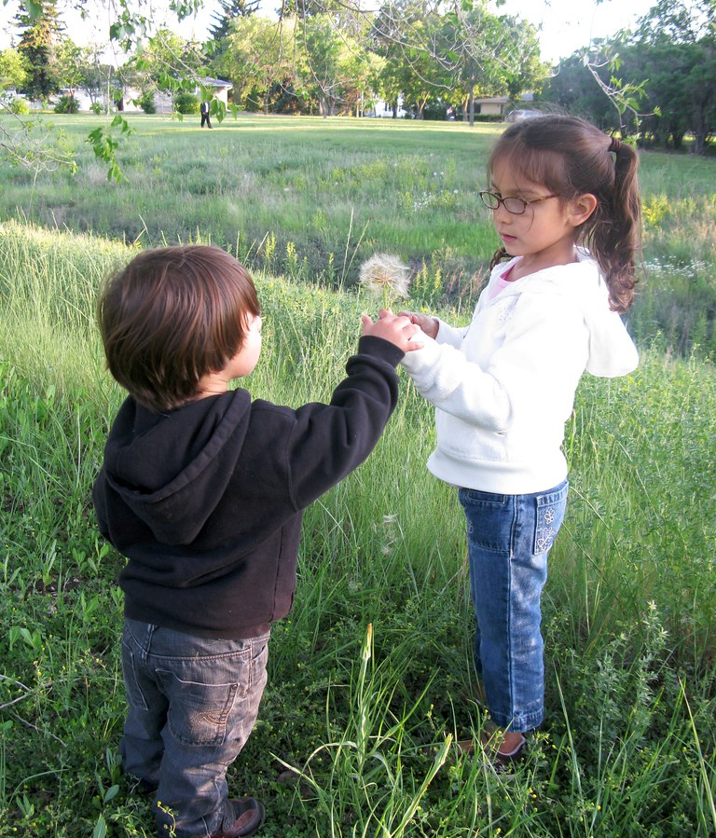
Let’s share!
“Sharing” by Alec Couros is licensed under CC BY-NC-SA 2.0.
Notes:
Laura and Howard
Photo credit: https://www.flickr.com/photos/51035553780@N01/3708151311 Creative Commons license
So what did you learn? What surprised you? What resonated with your experiences? What new strategies did you discover?
[in case we need more questions]
What is your state’s approach to transitions?
How are you including IDEA Part C and Part B in your transitions work?
What have been your challenges?
What have been your successes?

Slide 22

If you are interested in Learning more
Read TA resources and state reports to learn strategies
Listen to the EC Policy Matters podcast (transition episode)
Request state TA through PDG B-5 staff
Notes:
Howard
If you are interested in learning more, there are a couple of options:
Read technical assistance (TA) resources and state reports to learn new strategies. Check out the resources linked in your handout!
Listen to the transitions podcast (coming soon), which features Dr. Kristie Kauerz, Matt Weyer, and two state leaders from Maine.
Request tailored TA from PDG B-5 staff.

Slide 23
Resources
Best Practices and Policies that Support Students Transitions Across Systems (episode 12)
Supporting Smooth Kindergarten Transitions
Adaptations to COVID-19: How PDG B-5 Grant Recipients Adapted Their Transition Activities
Early Childhood Transitions: Supporting Children and Families
Notes:
Howard
Check out the resources linked in your handout!
IF THERE’S EXTRA TIME:
Have states look at 2nd page of handout, read, talk to someone in the room about a new idea.
Guide them through podcast following.

Slide 24
PDG B-5 TA CENTER
A Service of the Office of Child Care

Slide 25

Thank You!
Notes:
Thank you for attending today.
If you have additional questions or would like support, please reach out to your TA Specialist!
Thank you.

