Slide 1



Improving Data Quality Using the
Child Outcomes Summary Knowledge Check (COS-KC) with Practitioners
Kathy Hebbeler and Lauren Barton
August 23, 2022
Remember to
Check in to this session on the Cvent app!
Wifi: Network: idio22 Password: dasy2022!
Session code S13
Improving Data, Improving Outcomes Conference
Washington, DC

Slide 2
Session Focus Today
Show how the Child Outcomes Summary – Knowledge Check (COS-KC) is connected to high quality child outcomes data
Present the content, format, and the reporting features of the COS-KC
Discuss how states can implement the COS-KC and use its reports to improve data quality and target groups for professional development

Slide 3

Getting to Know You…
What is your primary role?
  Part C Coordinator or Data Manager
  Other Part C State Staff
  Part B Preschool Coordinator or Data Manager
  Other Part B State Staff
  National or State TA Provider
  Parent/Family Member
  Practitioner
  Federal Government
  Higher Education
  Other

Slide 4
What is Your Familiarity with the COS-KC?
1 - Here to Learn… COS-Kansas City?
2 - Heard of it. Need details.
3 - Know basics. Listening for updates.
4 - Pretty familiar with it.

Slide 5

Is Your State Considering Being an Early Adopter State?
Yes
Not that I know of
Don’t know
For those arriving late, remember to
Check in to this session on the Cvent app!
Wifi: Network: idio22 Password: dasy2022!
Session code S13

Slide 6

Why Do We Care about Having Quality Child Outcomes Data?

Slide 7
Why Do We Care about Having Quality Child Outcomes Data?
Know whether program is making a difference
Confidence using data for program improvement
Data used in high visibility public reports
May be comparing numbers in determinations (local or state)
Helps tell the story about the difference programs make in helping all children achieve overarching goals/outcomes

Slide 8
Challenge: Where to Start if COS Data Quality Concerns? Is it a Practitioner Knowledge Gap or Something Else?

Slide 9
Challenge: Where to Start if COS Data Quality Concerns? Is it a Practitioner Knowledge Gap or Something Else?
COS Supports
COS-KC
Professional Development
(On Many Related Topics)
Practitioner Knowledge
Guidance and Policies
Quality COS Implementation
Quality Data Useful for Federal Reporting and Program Improvement
Leadership Investment and Culture of Data Use
Infrastructure Supporting Quality COS Implementation
Monitoring and Feedback
Data Use and Review of Data Quality

Slide 10




The Child Outcomes Summary Knowledge Check (COS-KC)
Why: Provides a way for states and local programs to know whether practitioners have the basic knowledge they need to participate effectively in the COS process.
What: A new, free, open-book assessment comprised of 30 multiple-choice questions to test knowledge of the COS process. Takes about 45 minutes.
Where: Online, with links on the DaSy and ECTA websites.

Slide 11
The Child Outcomes Summary Knowledge Check (COS-KC)
When: The COS-KC will be available for early adopter states later this fall and to everyone in late winter 2023.
How validated: COS-KC items were validated in a successful field test. The item have good psychometric properties and the assessment received positive feedback.
Notes:
Items performing well. Confident valid assessment.

Slide 12

Looking Back…
Began work on an assessment at state request to see if practitioners had the knowledge and skills to generate quality COS data.
Raise your hand if you have heard of or were involved in any way with the COS-Competency Check….
Notes:
Began quest for tool at state request for “competency check” to see if practitioners had the knowledge and skills to generate quality data.
Earlier version of COS-CC was a competency check with both knowledge and case study application
Picture could have been one of a crying child

Slide 13
Looking Back…
  COS-CC had knowledge items and case study application
  Poor field test validation results
    Users had to respond to a long case study
Notes:
Began quest for tool at state request for “competency check” to see if practitioners had the knowledge and skills to generate quality data.
Earlier version of COS-CC was a competency check with both knowledge and case study application
Crying child

Slide 14

Where We Are Now
COS-KC focuses on knowledge questions.
  Field tested 6 forms (3 for Birth to 3, 3 for 3-5) with 42 items in each form
  Results showed the assessment was valid
    Items are strong
    User training/experience/knowledge was related to assessment performance
    Positive feedback from users and user reactions
Resulted in 6 forms with 30 items each and pass/fail certification
Notes:
Raise hand if involved in the field test 3 C 3 B….
(no reports provided to states during the field test since items at that time were under development)
6 forms – 3 with children Part C age and 3 with children preschool age

Slide 15

Where We Are Now
COS-KC focuses on knowledge questions.
  Field tested 6 forms (3 for 0-3, 3 for 3-5) with 42 items in each form
  Results showed the assessment was valid
    Items are strong
    User training/experience/knowledge was related to assessment performance
    Positive feedback from users and user reactions
Resulted in 6 forms with 30 items each and pass/fail certification
Big thank you to the states
that participated in the field test!!
Notes:
Raise hand if involved in the field test 3 C 3 B….
(no reports provided to states since items under development)
6 forms – 3 with children Part C age and 3 with children preschool age

Slide 16
What Content Does the COS-KC Cover?
Questions cover:
    The three child outcomes and why they are measured,
    Functionality of skills and how they relate to the three child outcomes,
    COS teaming,
    The 1-7 COS rating scale,
    Age anchoring (AE, IF, and F)
    Evidence/documentation
No subtest scores on each of the content areas (too few questions). It provides general assessment of COS knowledge.
Notes:
Areas/topics/categories of information
It will not give you subtest scores on the indented bullets – only 30 items and that would require a lot more items. General assessment of knowledge of COS content
Put different versions to take it again in later….
A one-factor test to assess general knowledge of the COS process
Note: only one question on each test related to evidence/documentation…

Slide 17
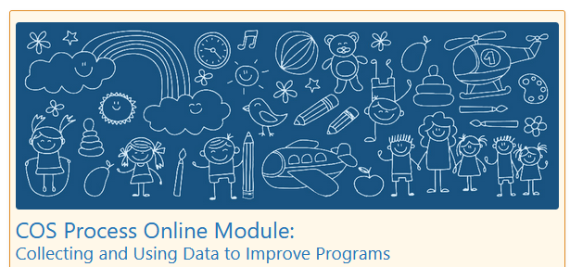
What Content Does the COS-KC Cover?
Content is aligned with information in national COS Process Module
Implication:
  If practitioners know the content in the module, they will pass the COS-KC
Notes:
Areas/topics/categories of information
It will not give you subtest scores on the indented bullets – only 30 items and that would require a lot more items. General assessment of knowledge of COS content
Put different versions to take it again in later….
A one-factor test to assess general knowledge of the COS process

Slide 18

The COS-KC
Different assessments for practitioners working with Birth to 3 & 3-5; three forms for each
  Same content assessed in each; items vary
  Child examples in COS-KC use skills with children at different ages
If users do not pass, they will take a different form the next time
Notes:
Areas/topics/categories of information
It will not give you subtest scores on the indented bullets – only 30 items and that would require a lot more items. General assessment of knowledge of COS content
Put different versions to take it again in later….
A one-factor test to assess general knowledge of the COS process

Slide 19

Example Question
The team would assign a COS rating of 6, rather than 7, to:
  A) Be able to show progress at the next assessment point
  B) Ensure that the child can continue to receive Early Intervention or Early Childhood Special Education services
  C) Indicate that the team has concerns about this child's development in this outcome area
  D) Indicate that the team feels that some aspects of this child's development are below an age-expected level in this outcome area
Notes:
Criteria differentiation C is correct

Slide 20

Example Question
Which of the following BEST describes key aspects of a child’s functioning on Outcome 1 (Positive Social-Emotional Skills)?
How the child expresses wants and needs, sings, and moves to music
How the child uses critical thinking and problem-solving skills and engages in purposeful play with books, objects, and toys
How the child eats and drinks with increasing independence, moves around and manipulates things to meet needs, and shows safety awareness
How the child relates with caregivers, plays with other children, follows rules and expectations in different settings, and uses social communication with others
Notes:
Answer D

Slide 21
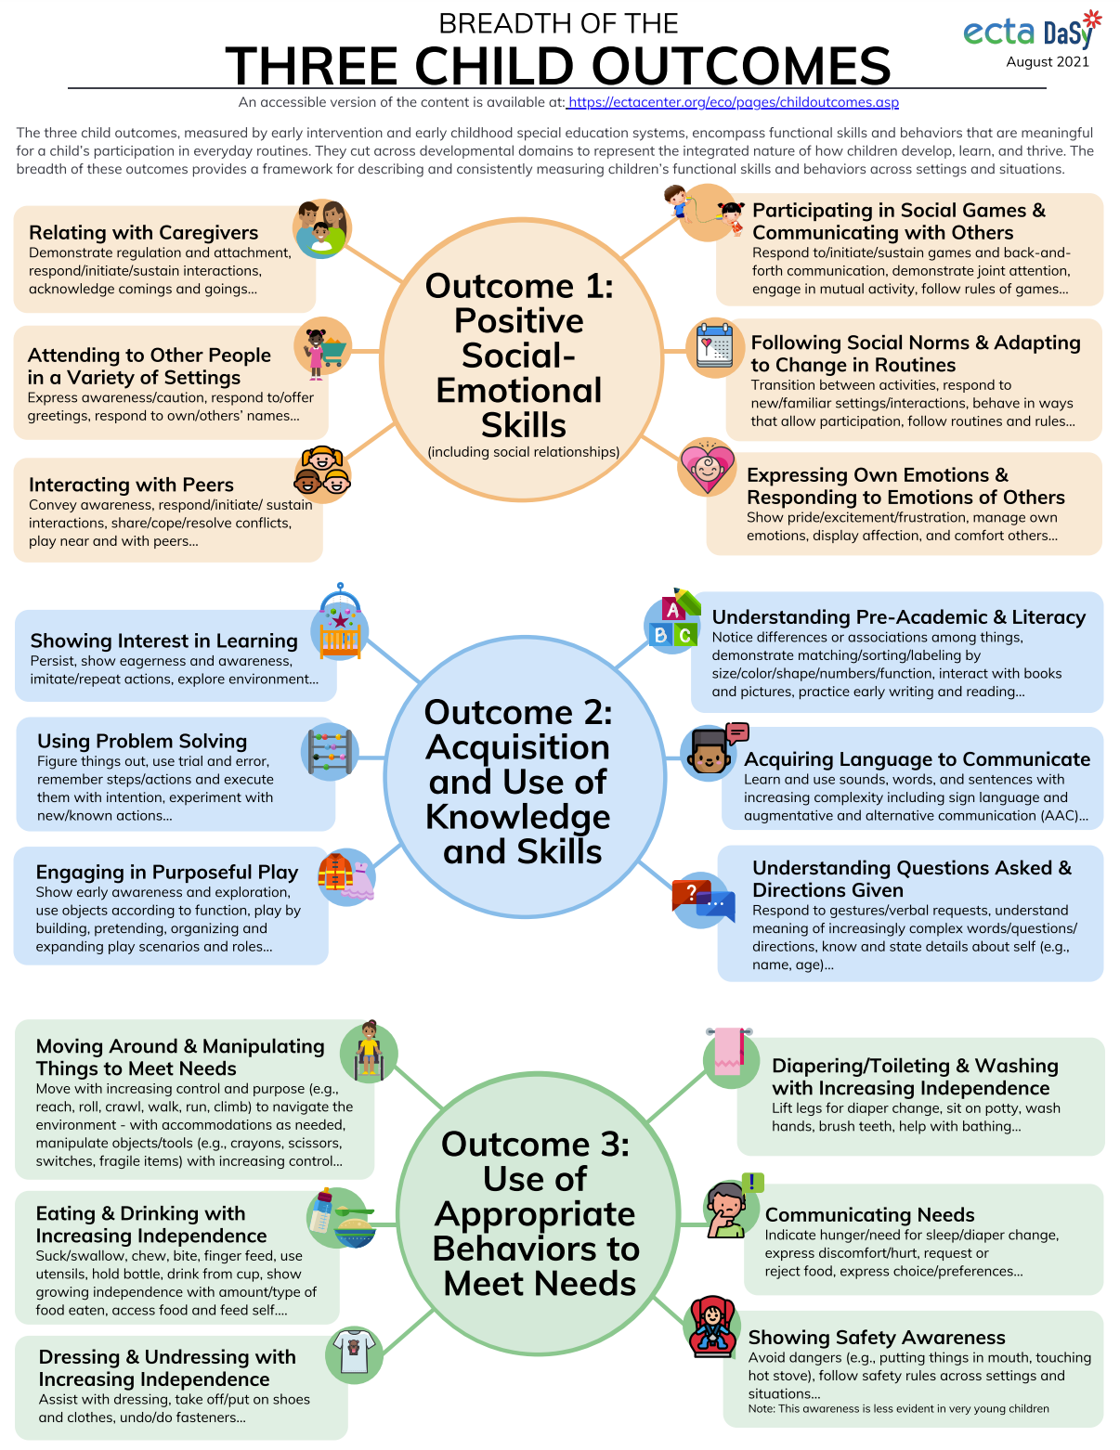
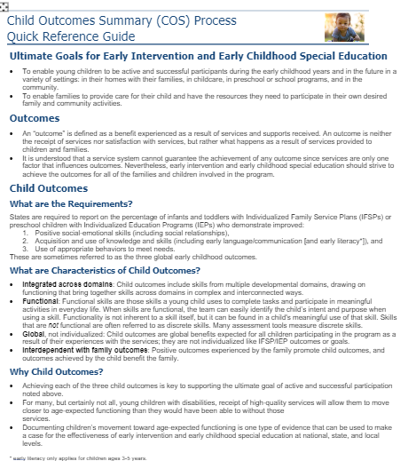
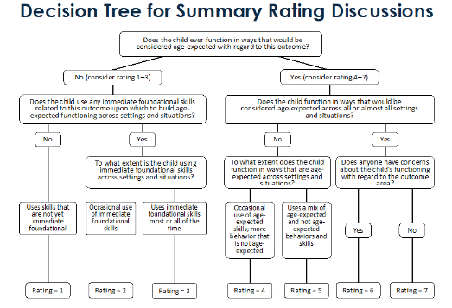
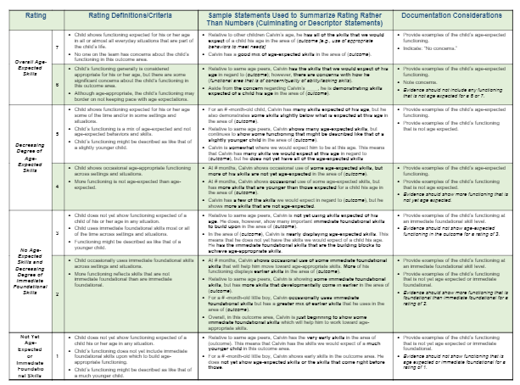
COS-KC is open-book
Users are encouraged to use resources during assessment
No time limit
https://ectacenter.org/~pdfs/eco/cos-quick-reference-guide.pdf
https://ectacenter.org/~pdfs/eco/cos-resources.pdf (resource links by topic)
Notes:
They have access to resources in everyday life when doing the COS…. So allow them in this seting too….
Can save and come back to finish

Slide 22

Reactions to Example Questions?
How do questions like these samples seem to you?
If practitioners can answer these kinds of questions, would that improve the quality of your COS data?
Notes:
Not tricky questions, but comprehensive…

Slide 23

Recommendations for States
RECOMMENDATION
Provide COS PD that reaches all practitioners involved in the COS and offer ongoing feedback and support for improvement
Consider value of practitioner time (~45 min) and if they are likely to have skills to pass before requiring the COS-KC
Set aside time and capacity to review COS-KC reports and use them to target state guidance or PD locations and activities
Self-reflection following COS-KC is powerful.
WHY AND COMMENTS
COS-KC taps into a lot of content. Without training, practitioners will not pass.
If know PD is minimal everywhere, do that first. If highly variable and trying to figure out where to target, it may be more useful.
Reports suggest who and where, not what, is needed.
Users taking the COS-KC may know which content was hard if you provide a way for them to request follow up soon after taking its completion.
Notes:
Not tricky questions, but comprehensive…
Side notes: This is a way to see if COS knowledge is a problem in our state – encourage to find out how good their PD system is by using the COS-KC. Recommend all states use it to check provider knowledge Critical component of getting information about your data quality.
The better your PD, higher your pass rates will be. If not sure how strong it is, learn from this. If suspect not that strong, don’t be surprised if get fairly low pass rates.
Geared toward a low level of knowledge; if someone does not pass, it is a real red flag.

Slide 24
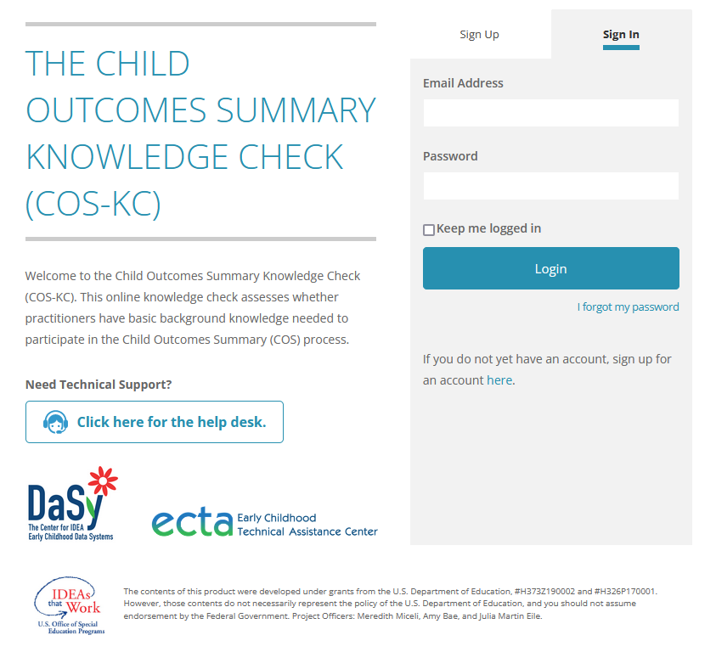
How State Participation Works (Big Picture)
Free, online system
State Part C and/or Part B Preschool Program signs up
State has access to state level and local level reports on performance of users in the state who take the COS-KC
Local programs have access to reports about the performance of their practitioners
Notes:
More details later
System is pretty structured, not much option for customization. Not an option to release the questions to a state to put in their own system.

Slide 25
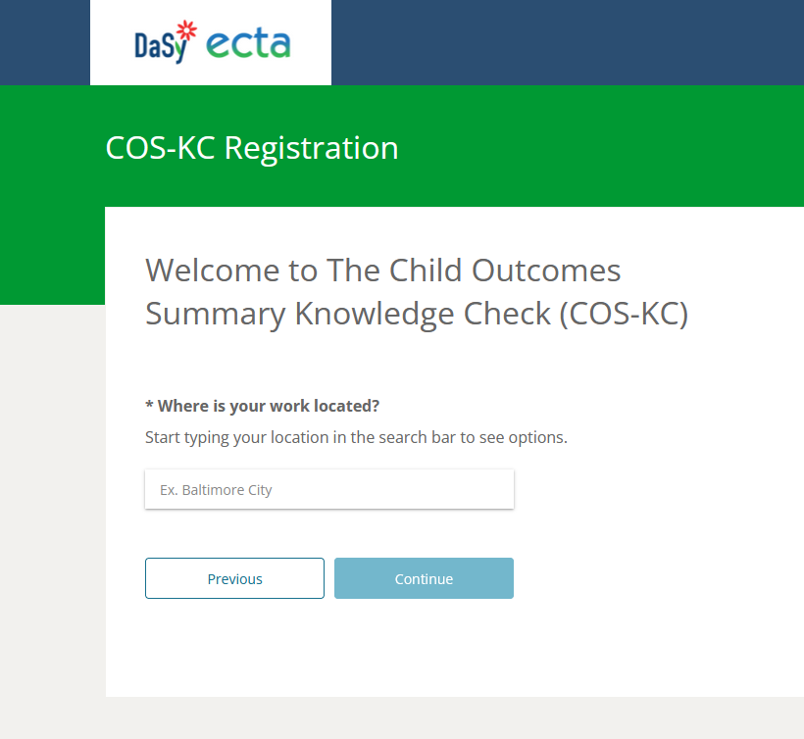
If State Programs Do NOT Participate…
Individual users may register and take the assessment
No unit/program level data is recorded (the user is not assigned to a program)
No state/local reports are available (only DaSy “admin” can see).
Notes:
If not participate and then join, system will collect state data once state sets up system
Moved from the slide – we don’t need to say this here. Too much detail.
Note: States can sign up to participate and set up the system to work for individual users with interest even if they don’t require/recommend/push out widespread emails to all staff/contractors about taking the COS-KC.

Slide 26
Practitioner/User Experience
Web link to sign up and create a user name and password
Users provide information about themselves when they register
  State, program, job role, age of kids work with
  Years experience, language(s) spoken
  Types and amount of COS training
Take 30 multiple choice item assessment (can save and return), then submit
Immediate response if passed (with certificate) or did not yet pass
No details about number of items correct or which ones were missed. Pass/fail.
Notes:
85%

Slide 27
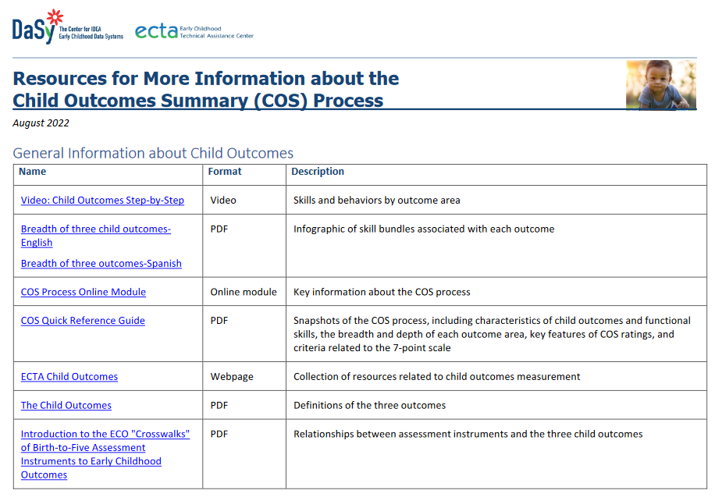
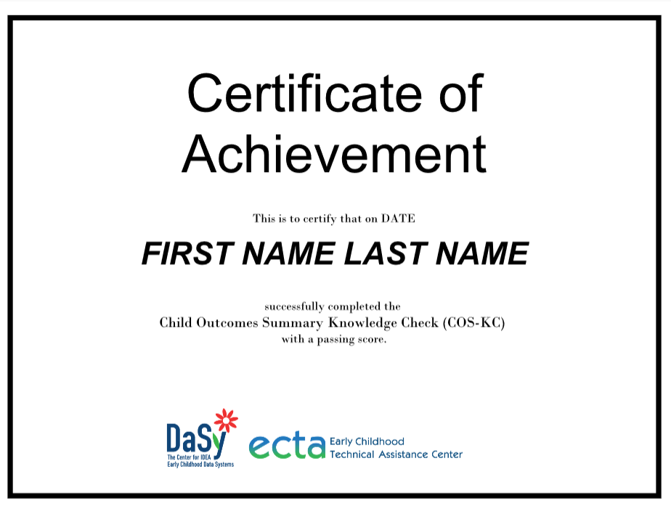
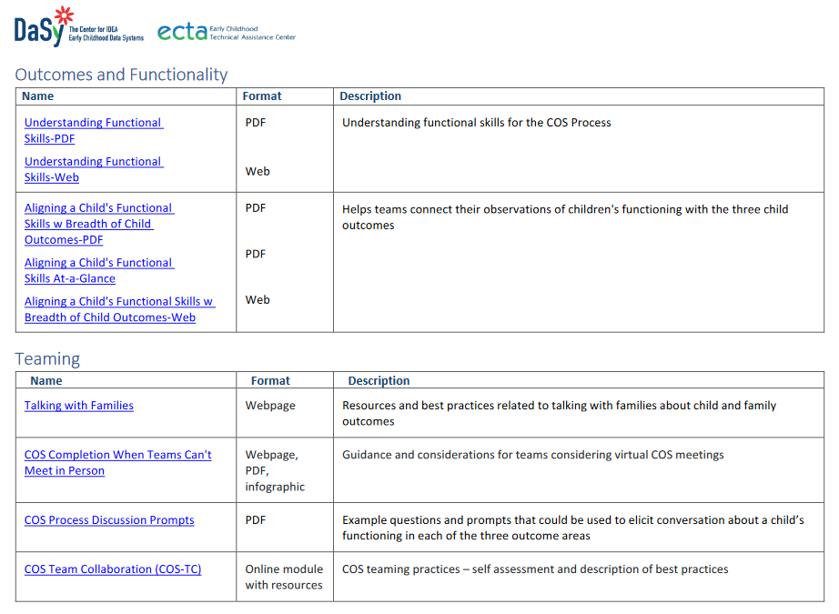
System Produces Certificate (if pass) and COS Resource List (for all)

Slide 28

What if a practitioner does not pass?
Encouraged to study
Must wait 24 hours before re-taking
Will be randomly assigned to take another form in the same age group next
Users are able to see their history
  a list of dates, outcomes (pass/fail), and certificate links in profile
If do not pass on 3rd try, encouraged to study and wait 3 months before re-take.
Notes:
Not specific detail about which score or what questions/content missed.
States may set their own requirements/recommendations about what is expected, how frequently need to take it, what to do with certificate, etc.

Slide 29

Questions About the COS-KC System Before Looking at Reports?

Slide 30
Reports
COS-KC produces a several reports for people with permission at state and local levels
Option to export data to an Excel file
  State can do own analyses
    E.g., link data with other PD or personnel information for their own analysis
Reporting feature is new. It is what is being tested in fall 2022.

Slide 31
Permissions
State identifies the people who are granted access to data at the state or local level
Permissions determine what data can be seen:
  State permissions: State, local, or individual levels
  Local permissions: Local or individual levels
  DaSy will have access to all data.

Slide 32
Example Report: Completion Report
Local Level Sees…(only their program) | State Level Sees Local Info Plus…
- Overall # and % who completed - Which practitioners completed or are in progress – Overall passing rate - Which practitioners passed | - Overall # and % who completed for state - Statewide completion and passing rate
Notes:
Look at data by region/local area, by practitioner role, by age group they work with, by COS training background/experience

Slide 33
Example Report: Pass Rate by Characteristics
Local Level Sees… | State Level Sees Local Info Plus…
- Pass rates and completion status for groups of practitioners in local area based on registration questions (roles, training experience, years in role, etc.) | -Statewide pass rates and completion status for groups of practitioners in state based on registration questions (roles, training experience, years in role, etc.)
Notes:
Look at data by region/local area, by practitioner role, by age group they work with, by COS training background/experience

Slide 34

Discussing Sample Reports
What stands out in this report?
How might you use this report?
What questions do you have?
What might be needed to support local use of reports like this?
Notes:
What kinds of questions would it answer?
our programs one poor completion rate (local reports)
Training or providers characteristics state erport.
Let them think about questions it helps them answer (paper copies on table) 3 types.
Interactive? How would you use the report?
Locals have access to these reports… will they have the capacity to interpret the data?
Potential Uses:
Identify extent reaching people, target PD, passing rate by local programs (where providers good grasp and where they don’t) – local programs use it to think about local policies and practices that are working/ not working well – inform practice.
Combine with what COS-KC can answer
If helpful can consider:
Which programs or regions are associated with higher passing rates among practitioners who have taken the COS-KC? Where should we target PD?
Are certain practitioner role categories associated with higher passing rates on the COS-KC? Which target groups need more PD?
Are practitioners who work with infants and toddlers more likely to pass the COS-KC than those who work with preschoolers?’
Do practitioners who have completed more COS training pass the COS-KC at a higher rate than practitioners who have not completed COS training?
Do practitioners conducting COS training have the requisite knowledge to participate in a quality COS process?
(review levels)

Slide 35
Ways to Get Involved
Early Adopter States (Late Fall 2022/ Likely November)
All Other Participating States (Late Winter 2023)
NOTE: This is the early roll out of the COS-KC system. All data entered by early adopters will remain in the system. The state will be able to access these data (and add more data) going forward.

Slide 36

Early Adopter Feedback Will Help Improve the COS-KC Reports and Processes
All involved in state (designees, staff) provide feedback on:
State enrollment procedures
Process for accessing reports generated in the COS-KC system
Contents of the reports

Slide 37
Advantages of Being an Early Adopter
Early access to information about practitioners’ knowledge of the Child Outcomes Summary Process
Early access to information that can be used to improve quality of the child outcomes data reported to OSEP (C3, B7)
Opportunity to provide feedback for state enrollment process and the reports states and local programs receive from the COS-KC system
Notes:
KH; I added this slide.

Slide 38
Interested in Being an Early Adopter?
For more information, please talk to one of us, leave your information on sign up sheet, or email Robin Rooney at robintheresarooney@gmail
Notes:
KH; I added this slide.

Slide 39





Questions/Comments?
Notes:
Thanks to unsplash.com for pictures throughout the presentation.

Slide 40
Available TA Support & Contact Information…
Check with your state contacts or talk with one of us:
  DaSy state contacts & TA requests https://dasycenter.org/technical-assistance/
  ECTA state contacts: https://ectacenter.org/contact/state-assignments.asp
Notes:
TA on data quality issues as well as start up support with COS-KC

Slide 41
Find out more at dasycenter.org and ectacenter.org

