Slide 1
The Critical Need to Have Family Members “at the Table”
IDIO August 23, 2022

Slide 2
Welcome
Who is CPIR - Your central “Hub” of information and products created for the network of Parent Centers serving families of children with disabilities
Who is DaSy - A national technical assistance center that works with states to support IDEA Part C early intervention and IDEA Part B 619 early childhood special education state programs in building high quality data systems and using data to improve results for young children with disabilities and their families.
What is the Family Data Leader Training - A series of sessions on using data for improving programs and systems conducted by Parent Centers in partnership with DaSy for families and other key stakeholders in early intervention and early childhood special education.

Slide 3
Goal
The goal of the Family Data Leadership Training is to build the capacity of family members to participate in important data discussions about programs and systems that impact infants, toddlers, and preschoolers with disabilities and their families. These sessions promote an understanding of data and using data to make state or program level improvements.

Slide 4
What does being a Family Data Leader mean?
A Family Data Leader brings their family perspective and lived experience—their voice—to inform systems change efforts.
This is accomplished through becoming skilled data users by:
Building and using knowledge, skills, and a broad perspective of the Individuals with Disabilities Act (IDEA), data use, and systems building activities, and
Applying these data-use knowledge and skills to provide feedback and inform decisions to support program improvement in Part C and Part B 619.

Slide 5
Importance of IDEA Data

Slide 6
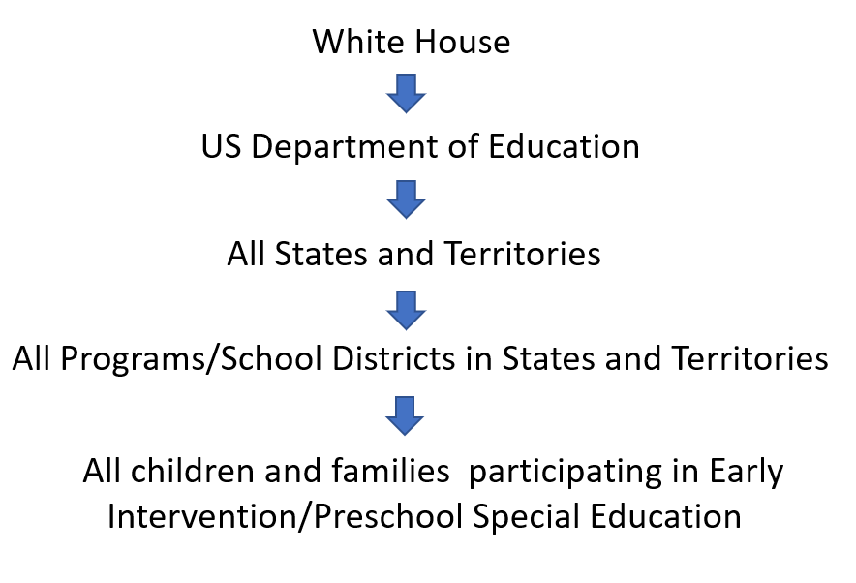
Accountability...how it works

Slide 7
OSEP Stakeholder Requirements
Source: OSEP MSIP Presentation, https://osepideasthatwork.org/resources-grantees/program-areas/monitoring-and-state-improvement-planning-msip?tab=measurement

Slide 8
Effective Engagement
To be effective, family representatives need to:
Understand why data are important;
Understand what data are being collected and how those data are used;
Know who is involved in data conversations and their roles in decision-making;
Understand how they are/can be involved in data use.
It is essential for families to feel comfortable asking questions about data.

Slide 9
Table-Top Discussion
At your table identify a recorder and discuss the following questions
1. What strategies do you use to engage stakeholders, especially families? What worked? What challenges?
2. How can state and local agencies help families feel comfortable
asking questions about data?

Slide 10
Tool for Families - Data as Information
Click image to go to the document
Note:
SICC = State Interagency Coordinating Council for IDEA Part C state early intervention systems
SAP = State Advisory Panel for IDEA Part B special education systems

Slide 11
Reasons to collect and use data:
Assess and improve quality of services that benefit children and families
Examine gaps in access to services and supports
Advocate for federal, state, and local policy change and investments
Increase public awareness and understanding
Build trust within and across communities and systems
Achieve positive and equitable outcomes for children and families

Slide 12
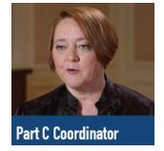
Perspectives on Data Use

Slide 13
Review types of data
Quantitative data are data that can either be counted or compared on a numeric scale. This type of data tends to answer questions focused on ‘what’ or ‘how many’.
Qualitative data describes qualities or characteristics. This type of data tends to answer questions about the ‘how’ and ‘why’ of a phenomenon.

Slide 14
What visual comes to mind when you hear the word equity?

Slide 15
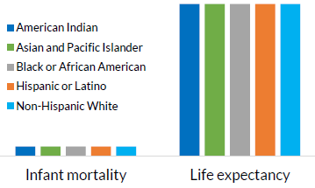
What do we mean by equity?
Equity is fair treatment, access, opportunity, and advancement for all people, while at the same time striving to identify and eliminate barriers that have prevented the full participation of some groups.
The Early Childhood Data Collaborative defines racial equity in two ways:
As an outcome: Our race no longer predicts how we fare
As a process: The work it takes to get there
Adapted from Early Childhood Data Collaborative. See more here: https://earlysuccess.org/data-and-racial-equity-in-early-childhood-policy

Slide 16
How can data help?
Questions to consider:
Who collected the data?
Whose lives are embodied in the data?
Who is it serving?
Who is harmed potentially?
Addressing inequities requires an understanding of the root causes of outcome disparities within our communities
Evaluating disaggregated data can help identify inequities, but data are not meant to be interpreted in a vacuum.
It’s important to remember that data can and have been used to harm groups and communities.
To use data to help identify and reduce inequities, it’s critical to look at data with families and communities and listen to lived experiences.
Adapted from Data Feminism. See more here: https://data-feminism.mitpress.mit.edu/

Slide 17
Data Use Life Cycle
Planning/design for data collection
Data collection
Data analysis
Reporting and interpretation
Dissemination
Taking action
(Data use)
Equity needs to be embedded into every step of the data use life cycle

Slide 18
Using Data to Advance Racial Equity
Webinar clip: Data and Racial Equity in Early Childhood Policy Advocacy
Presenter: Esther Gross, Child Trends
Watch full webinar here.

Slide 19
Why it is important that families are involved in data discussions?
Families bring:
Unique life stories that give them motivation to serve as thought leaders and change agents on behalf of all children and families, not just their own.
Different levels of access to information and support.
Different experiences with using data in both their personal and professional lives.
Intersectional identities that inform their understanding of the data (e.g., identifying as female and Asian American).
Varied feelings about today’s “data-rich” culture.
Diverse voices

Slide 20
Ways families can become involved?
Your child
Data Teams
Interagency Coordinating Council/State Advisory Panel
Focus Groups
Target Setting Groups
Surveys
Boards of Directors
School-based management teams

Slide 21
How can families successfully participate?
Ask questions
Come prepared, ask for materials ahead of time
Ask what your role is and who else will be there
Find out the purpose of the meeting
Understand this is about improving systems

Slide 22
CPIR and DaSy Connecting the Dots...
You
are invited.....

Slide 23
FDLP Training Topics
Session 1 –
What does it mean to be an FDL
The importance of family involvement in data discussions
Types of data
How data drive improvement/perspectives on data use
Session 2 –
Look, Think, Act as a strategy for examining, reflecting, and acting on data
Session 3 –
SPP/APR Overview
Connecting with your Why
Applying Look, Think, Act to Part C and Part B 619 Data

Slide 24
Connect with Part C and 619B Directors

Slide 25
Final thoughts and questions

