Slide 1
Making Sound & Equitable Preschool LRE Decisions Improving Data, Improving Outcomes Conference August 2022
Debbie Cate & Mary Peters

Slide 2
Valuing Inclusion
OSEP Dear Colleague Letter EC Inclusion
All young children with disabilities should have access to inclusive high-quality early childhood programs where they are provided with individualized and appropriate supports to enable them to meet high expectations.

Slide 3
Welcome
Please share your:
name
state
role
word or phrase on
the meaning of inclusion

Slide 4
National Early Childhood Environments Data Over Time
_______________________
- - - - - - - - - - - - - - - - - - - - - -
SPP/APR Indicator 6a: Children attending a regular early childhood program (RECP) and receiving the majority of special education services in the program
SPP/APR Indicator 6b: Children who do not attend an RECP, who receive their special education services in a separate class, separate school or residential facility
https://data.ed.gov/dataset/idea-section-618-data-products-static-tables-part-b-count-environ-tables12/resources

Slide 5
SPP/APR Indicator B6: Preschool Environments
Used to be called Early Childhood Environments
619 Coordinators & B Data Managers advocated for change
Children 5 in K now reported in B5, school age LRE
Home added as a reporting category
Indicator data taken from 618 Data Collection - point in time
Charts in this presentation do not include data from entities
Data is from US DOE Static Table12: https://www2.ed.gov/programs/osepidea/618-data/static-tables/index.html percentages are rounded
New Data Platform:
https://data.ed.gov/dataset/idea-section-618-data-products

Slide 6
IDEA State Performance Plan, Annual Performance Report SPP/APR Indicator B6: Preschool Environments
B6a Children enrolled in a Regular EC Program (RECP) and receive majority of special ed services in the program
B6b Children who do not attend a Regular EC Program and receive services in special education class, special education school, residential facility
B6c Children who do not attend a Regular EC Program or Special Ed Program, receive services in the home

Slide 7
Children Attending a Regular PS Program and Receiving Services in the Program, 20-21
92%
National Average: 40%
13%
Each bar represents a state. Ed.gov Static Table: https://www2.ed.gov/programs/osepidea/618-data/static-tables/index.html

Slide 8
Children Not Attending a Regular PS Program, Receiving Services in a Special Education Program, 20-21
71%
National Average: 30%
1%
Each bar represents a state. Ed.gov Static Table: https://www2.ed.gov/programs/osepidea/618-data/static-tables/index.html

Slide 9
618 Data and SPP/APR Indicator 6a, Children Attending a Regular EC Program and Receiving Services in the Program

Slide 10
618 Data and SPP/APR Indicator 6b Attending Separate Special Education Class, Separate School or Residential Facility.

Slide 11
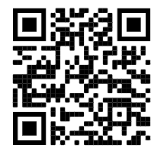
Making Sound Preschool LRE Decisions
https://ectacenter.org/topics/iep/iep-placement.asp

Slide 12
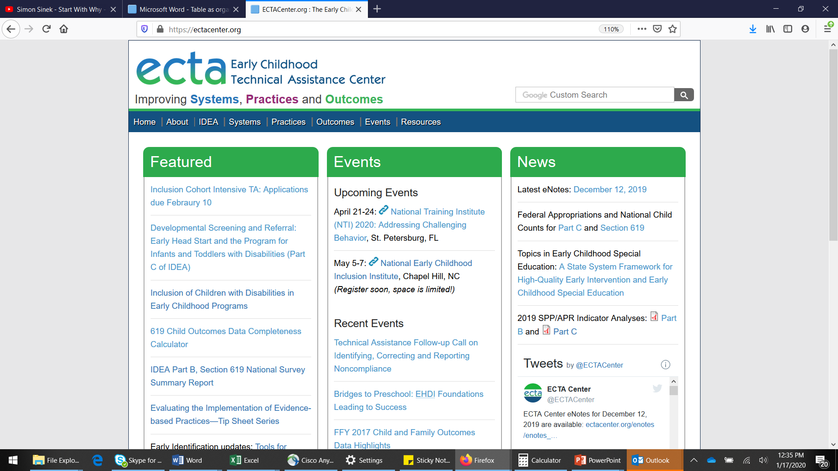
The ECTA Center
https://ectacenter.org/
Information & Resources:
Inclusion Indicators
State
Program
Environment/Class
Rules, Regs, Memos
Collaboration
Funding for Inclusion
DEC Recommended Practices
…and more

Slide 13
National EC Inclusion Indicators Initiative
State, Program and Environment Indicators
Self-Assessments
& Resources coming very soon!!
PLEASE ASK
https://ectacenter.org/topics/inclusion/indicators-partners.asp

Slide 14
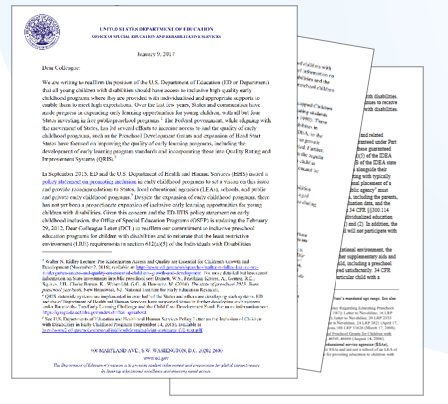
OSEP Dear Colleague Letter – Preschool LRE
January 2017
Updates a previous DCL
LRE Requirements
Key Statutory and Regulatory Requirements
Preschool Placement Options
Reporting Educational Environments
Use of IDEA Funds for Preschool

Slide 15
HHS and ED Policy Statement on Inclusion of Children with Disabilities in Early Childhood Programs
Purpose
Overview
Foundations
Inclusion in Early Childhood programs
Scientific base
Legal Foundations
Challenges
The Path Ahead – Collaboration
Recommendations for State Action
Recommendations for Local Action

Slide 16
Find out more at ectacenter.org
The ECTA Center is a program of the FPG Child Development Institute of the University of North Carolina at Chapel Hill, funded through cooperative agreement number H326P170001 from the Office of Special Education Programs, U.S. Department of Education. Opinions expressed herein do not necessarily represent the Department of Education's position or policy.

