Slide 1

Introduction to DaSy's Data Linking Toolkit
Howard Morrison, DaSy Center
Denise Mauzy, DaSy Center
Bruce Bull, DaSy Center
Webinar
August 4, 2022
Notes:
Howard
Good morning/afternoon. My name is Howard Morrison, and I will be your host for today’s webinar, titled Introduction to DaSy’s Data Linking toolkit webinar. My co-presenters today are Denise Mauzy and Bruce Bull from the DaSy Center.

Slide 2
Welcome!
Use the CHAT to communicate with facilitators and other attendees:
  Introduce yourself and use the chat throughout the webinar.
  Select “To: Everyone” so that everyone can see your message.
Use the Q&A to ask questions of facilitators.
We will monitor the chat/Q&A to address your questions and comments during or at the end of the webinar.
CLOSED CAPTIONING is available:
  Click on “Closed Caption” at the bottom of the screen, then “Show Subtitle.”
We will post a recording of this session and the slides on the DaSy website following the event.
Notes:
Howard
A few logistics
Feel free to ask question in the chat throughout the presentation

Slide 3

Today's Agenda
OSEP's Perspective on Data Linking
What is Data Linking?
Overview of the Data Linking Toolkit
Opportunities and Next Steps
Notes:
Howard

Slide 4
OSEP's Perspective on Data Linking
Meredith Miceli, Office of Special Education Programs (OSEP)
Notes:
We’d like to begin with a special guest speaker. Today we have Meredith Miceli, DaSy Project Officer from OSEP share the federal perspective on data linking.
Meredith Slide – 3 min

Slide 5
Intended Outcomes
State participants will:
  increase awareness about the existence of the Data Linking Toolkit
  increase knowledge of the content within the Data Linking Toolkit
  learn about future technical assistance opportunities to support data linking
Notes:
Howard

Slide 6
What is Data Linking?
Notes:
Howard
We’re now going to transition to what is data linking…

Slide 7
Data Linking
What is data linking?
What is the goal of data linking?
Notes:
Howard
We will start with what is data linking definition and then discuss the goal of data linking.

Slide 8
What is Data Linking?
Connecting information about an entity (e.g., child, service provider, service) in one data source with information related to that same entity in another data source.
Notes:
Howard
This could include connecting data related to one child participating in multiple programs (e.g., child receiving services from Part C and EHDI), or linking different types of data about the same child within a single program (e.g., child’s Part C service provider and child’s Part C outcome data).

Slide 9
What is the Goal of Data Linking?
To create and analyze a new data set to answer important questions, inform program improvement, and ultimately better support children with disabilities and their families.
See DaSy Critical Questions
Notes:
Howard
So why do you need to link data or what drives the need for data linking? This is to answer one or more complex questions that program staff cannot answer with only Part C or Part B 619 data. So these questions may come from within the Part C or Part B 619 program, within the lead agency, conversations between administrators in different programs or agencies, state legislators, stakeholder groups, advisory committee members—anyone with an interest in early intervention or preschool special education.
To link data, there may be different partner configurations
Partnership configurations:
Single agency, single program: A program linking two data sets within the same program (e.g., linking Part C child outcome data with Part C child demographic data).
Single agency, multiple programs: Two programs within the same agency linking data sets (e.g., linking Part C demographic data with Early Hearing and Detection Intervention data when both programs reside in a state health department).
Multiple agencies, multiple programs: One program within one agency linking data with data from another program within a different agency (e.g., linking Part B 619 data with data from the Child Abuse Prevention and Treatment Act program).
.
Show DaSy Critical Questions and pull up on screen – https://dasycenter.org/resources/critical-questions/

Slide 10
Poll Questions
How much data linking experience (of any kind) do you have?
  None
  Some
  A lot
If you have experience with data linking, which partners have you worked with on data linking? (Select all that apply)
  IDEA Agencies (e.g., Part C with Part B)
  Finance
  Personnel
  Child Welfare and/or Child Abuse Prevention and Treatment Act (CAPTA)
  Quality Rating and Improvement System (QRIS)
  Early Hearing Detection and Intervention (EHDI)
  Maternal, Infant, and Early Childhood Home Visiting (MIECHV)
  Early Childhood Integrated Data System (ECIDS)
  Statewide Longitudinal Data System (SLDS)
  Internal Part C or internal Part B program data (no partnership needed)
Notes:
Howard
Type any other types in the chat

Slide 11
Padlet Questions
If you have never linked data, why not?
If you have linked data with another program, how has that worked out?
What questions have you been able to answer with linked data?
If you have linked data, what were the challenges?
Notes:
Howard
Throughout the next part of the presentation, please think about the following questions and respond appropriately in the padlet.
https://padlet.com/DaSyCenter/tbynxhkbu1enwmdt
Handoff to Denise
Feel free to ask question in the chat throughout the presentation

Slide 12
Overview of the Data Linking Toolkit
Notes:
Denise
Switch to data linking toolkit URL to display. Link to share, https://dasycenter.org/data-linking-toolkit/
Reminder to continue working on the padlet exercise

Slide 13
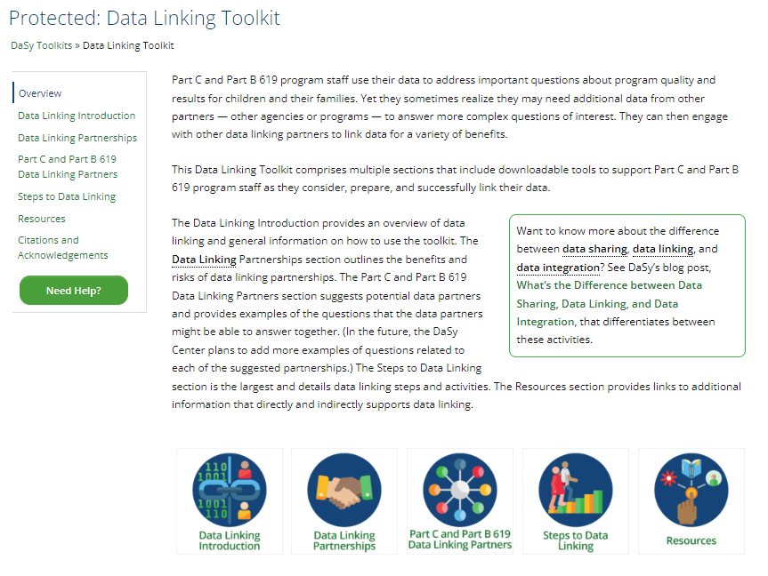
Data Linking Toolkit
Notes:
Denise
How does this toolkit support Part C and Part B 619 program staff with data linking?
Tried to focus this toolkit on the kinds of activities we know many of you are engaged in and or are seeking to engage in.
Who is this toolkit designed for?
What is not included in this toolkit?
How should this toolkit be used?

Slide 14
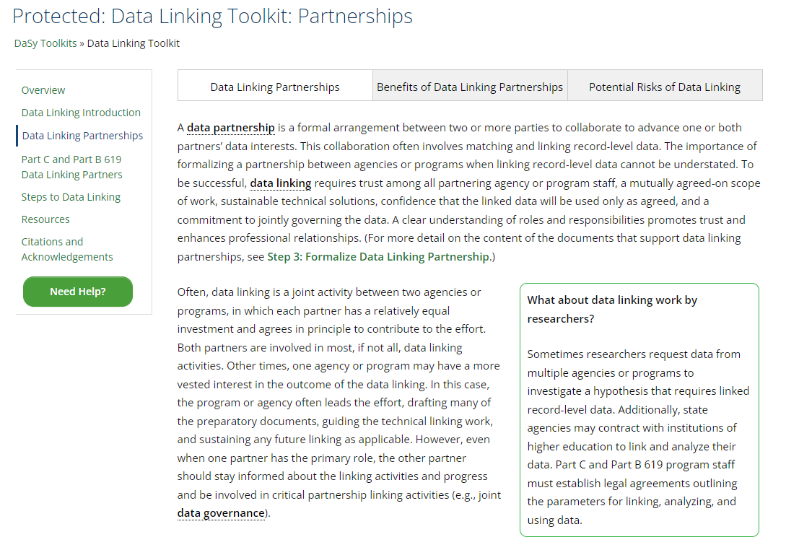
Data Linking Toolkit: Partnerships
Notes:
Denise
Data Linking Partnerships
What about data linking work by researchers?
Benefits of Data Linking Partnerships
Potential Risks of Data Linking

Slide 15
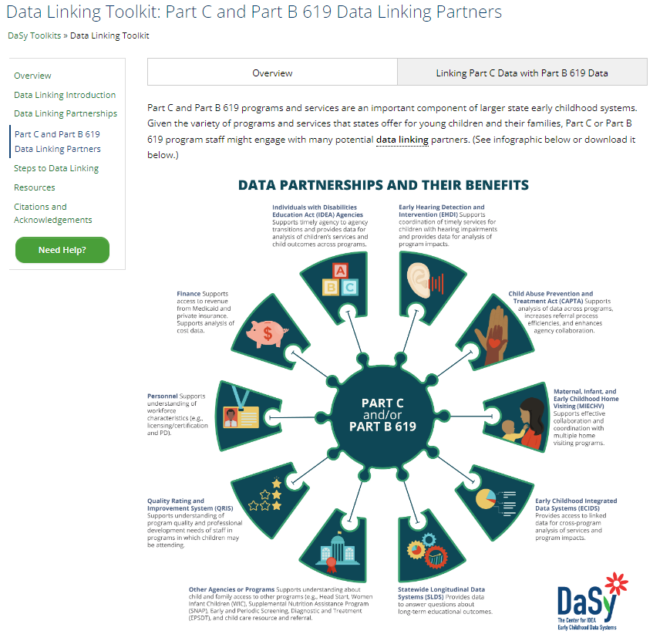
Data Linking Toolkit: Part C and Part B 619 Data Linking Partners
Notes:
Denise
Overview
Linking Part C Data with Part B 619 Data
Data Linking of Part C Transition Data with Part B 619 Data
Data Linking of Part C Child Outcomes Data with Part B 619 Child Outcomes Data
Questions That Linked Part C Data and Part B 619 Data Can Answer

Slide 16
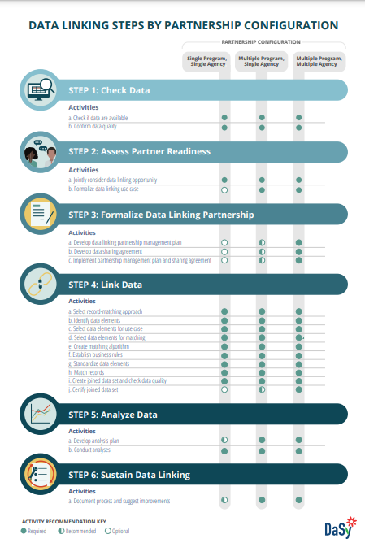
Data Linking Steps by Partnership Configuration
Notes:
Bruce
Graphic link, https://dasycenter.org/wp-content/uploads/2022/03/Data-Linking-Steps_v17.pdf?

Slide 17
Opportunities & Next Steps
Notes:
Howard
Let’s discuss the data linking opportunities and next steps

Slide 18

Consider Joining DaSy’s Data Linking Working Series
Learn more about data linking
Talk with Part C and Part B 619 colleagues
Notes:
Howard
DaSy will be offering a series of meetings focused on data linking.
Maximum 5-6 states
2-3 call happenings
An announcement will be forthcoming to apply for the data linking working series

Slide 19

IDIO Sessions on Data Linking
Everything You Need to Know to Successfully Link Your Data: A New Resource and a State Success Story
  August 23 @ 3:00-4:30PM (ET)
Take a Walk on the Data Side: Arizona’s Collaborative Approach to Data Integration
  August 25 @ 8:30-10:00AM (ET)
Notes:
Howard
Share session dates/times if available.
Arizona presentation description (if needed for reference): Since 2014, Arizona and its system partners have worked to build a shared, population-level integrated data system that combines data from a range of programs that serve children and young adults. The associated interactive mapping tools serve as a clearinghouse for census, school, health, and family engagement data related to school readiness and early literacy. These tools provide users with graphic views of select data for all Arizona public or charter elementary schools and preschool sites. The interactive tools allow users to process and analyze data from the big picture down to focalized data so they may make informed decisions on behalf of children, families, schools, and communities.

Slide 20


Individual State TA on Data Linking
Reach out to DaSy by contacting TA providers or via our website:
https://dasycenter.org/technical-assistance/need-help/
Notes:
Howard

Slide 21
Review Responses to Padlet Questions
If you have never linked data, why not?
If you have linked data, what were the challenges?
If you have linked data with another program, how has that worked out? (Are you continuing to link program data on a regular basis?)
What critical questions have you been able to answer with linked data?
Notes:
Howard

Slide 22

Questions Discussion

Slide 23
Resources
Data Linking Toolkit
Data Linking Toolkit Resources
DaSy Critical Questions

Slide 24


Thank you
Visit us at http://dasycenter.org/
Follow us on Twitter: @DaSyCenter
The contents of this presentation were developed under a grant from the U.S. Department of Education, #H373Z190002. The contents and resources do not necessarily represent the policy of the U.S. Department of Education, and you should not assume endorsement by the Federal Government. Project Officers: Meredith Miceli and Amy Bae.
Notes:
Thank you for joining the data linking toolkit webinar. You will be receiving an evaluation email from DaSy. Please take a few minutes to complete that so we can continue to improve your webinar experience.

