Slide 1

The Power of Families at the Table: Using Data to Advance Equity
Michelle Lewis, DaSy
Thomas McGhee, DaSy
Region B Parent Center 2021 Conference
September 16, 2021

Slide 2
Session Outcomes
Participants will be better able to:
Articulate the role of families and community members on effective, equitable data teams
Apply potential strategies for engaging stakeholders in meaningful data conversations
Collaborate with stakeholders and community partners to use and interpret data to understand and address inequities

Slide 3
Reasons to collect and use data:
Assess and improve quality of services that benefit children and families
Examine gaps in access to needed services and supports
Advocate for federal, state, and local policy change and investments
Increase public awareness and understanding
Build trust within and across communities and systems
Achieve positive and equitable outcomes for children and families
How are families engaged and empowered in achieving these purposes of data use?

Slide 4
Equity within the Early Childhood Context
“Achieving the outcomes we want for all young children requires an intentional focus on equity. That means understanding the current conditions in your community that contribute to disparities among different populations, and how those conditions affect families.”
Equity in Early Childhood Systems: A Community Action Brief,
Center for the Study of Social Policy, National Collaborative for Infants & Toddlers

Slide 5
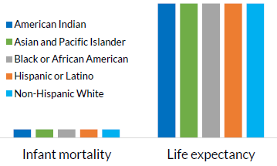
What do we mean by equity?
Equity is fair treatment, access, opportunity, and advancement for all people, while at the same time striving to identify and eliminate barriers that have prevented the full participation of some groups.
The Early Childhood Data Collaborative defines racial equity in two ways:
  As an outcome: Our race no longer predicts how we fare
  As a process: The work it takes to get there
Adapted from Early Childhood Data Collaborative. See more here:
https://earlysuccess.org/data-and-racial-equity-in-early-childhood-policy

Slide 6
How can data help?
Addressing inequities requires an understanding of the root causes of outcome disparities within our communities
Evaluating disaggregated data can help identify inequities, but data are not meant to be interpreted in a vacuum.
It’s important to remember that data can and have been used to harm groups and communities.
To use data to help identify and reduce inequities, it’s critical to look at data with families and communities and listen to lived experiences.
Questions to consider:
Who collected the data?
Whose lives are embodied in the data?
Who is it serving?
Who is harmed potentially?
Adapted from Data Feminism.
See more here: https://data-feminism.mitpress.mit.edu/

Slide 7
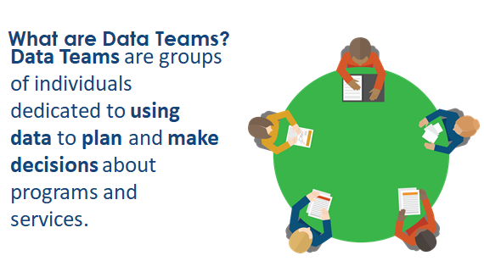
Teaming for
Data Use
Image from the Data Culture Toolkit: Supporting State and Local Data Use
See more here: https://dasycenter.org/data-culture-toolkit/

Slide 8
Family and family organization stakeholders come to the decision-making table with…
Unique life stories that give them motivation to serve as thought leaders and change agents on behalf of all children and families, not just their own.
Different levels of access to information and support.
Different experiences with using data in both their personal and professional lives.
Intersectional identities that inform their understanding of the data (e.g., identifying as female and Asian American).
Varied feelings about today’s “data-rich” culture.
Considering intersectional identities is not about adding one aspect of identity to another. It is about how people with overlapping identities experience systems of power. (Catalyst, 2020)

Slide 9

To effectively serve as program stakeholders, families and family organization representatives need to…
Understand why data are important;
Understand what data are being collected and how those data are used;
Know who is involved in data conversations and their roles in decision-making;
Understand how they are/can be involved in data use.
It is essential to create a safe environment and provide support for families to feel comfortable asking questions about data.

Slide 10
Assembling the Table
Consider these questions throughout the process to ensure no one is overlooked:
Who will be representing the interests of the individual community members whose data are being used?
Which people or organizations will be affected by the results of your data team’s effort now and in the future?
Who is influential within your area, community, or organization?
Who has been involved in this issue in the past?
Who has not been involved in past engagements, but should have been?
Are there any barriers to engagement that may be/have been deterring some stakeholders?
AISP, (A Toolkit for Centering Racial Equity Throughout Data Integration)

Slide 11

How can data teams work toward equity?

Slide 12
Engage in a Cycle of Inquiry
Define Your Question
Gather Data
Analyze Data
Interpret Results
Share and Apply Findings
Inquiry is a cyclical process that takes time, and it’s important for data teams and communities to work together throughout.
Applying an equity-focused approach to inquiry prompts data teams to reexamine and assess policies, practices, mental models and beliefs, and even power dynamics that perpetuate systemic barriers and inequalities.

Slide 13

Define Your Question(s)
What do we want to know? What question(s) are we trying to answer?
Why are we asking this question?
  Why is this work necessary?
  Who does this work benefit or potentially harm?
  How does it benefit the community at large?
Is our research question concrete, measurable, and something that can be answered with data?

Slide 14
Gather Data
What information is needed to answer the question? Is the data available?
What quantitative data do we have that could help answer our question?
What qualitative data do we have that could help answer our question?
  What perspectives and experiences (e.g., family, community, provider) would help contextualize the quantitative data we have?
  Who are we missing from the conversation? What can we do to gather this perspective (e.g., interviews, focus groups, narrative, long-form surveys)?
What data are we missing?
Quantitative data are data that can either be counted or compared on a numeric scale. This type of data tends to answer questions focused on ‘what’ or ‘how many’.
Qualitative data describes qualities or characteristics. This type of data tends to answer questions about the ‘how’ and ‘why’ of a phenomenon.

Slide 15

Analyze Data
Analyze with context
in mind:
  While looking at the data, consider location-specific historical policies and social conditions that contribute to disparities in outcomes.
What do the aggregate data suggest?
What patterns, trends, outcomes, and relationships do we see in the data?
Were there data changes (e.g., marked increases or decreases) over time?
  Consider characteristics and factors related to the child, family, provider, program, and system.
What strengths and challenges do these patterns point to?
Are our observations specific, factual, and related to the question?

Slide 16
Analyze Data
Analyze with context in mind:
“Without disaggregating data by subgroup, analysis can unintentionally gloss over inequity and lead to invisible experiences.
On the other hand, when analysts create a subgroup, they may be shifting the focus of analysis to a specific population that is likely already over-surveilled.”
(AISP, Toolkit for Centering Racial Equity Throughout Data Integration)
What do the disaggregated data suggest?
How can we break apart, or disaggregate, the data to look for patterns related to equity (e.g., race, ethnicity, gender, neighborhood, or community)?
Are data disaggregated in a way that allows us to analyze intersectional experiences (e.g., looking at race by gender)?
What are the limitations of the data?
What do the data contain and what do the data omit?
Do we know who collected the data and how?

Slide 17


Why is disaggregating data important?
Webinar clip: Data and Racial Equity in Early Childhood Policy Advocacy
Presenter: Esther Gross, Child Trends
Watch full webinar here.

Slide 18
Interpret Results
How can we understand and make sense of the data?
What hypotheses do we have to explain what we see in the data?
  Use the 5 Whys or other root cause analysis tools to reexamine the systems and structures in place that maintain barriers to equitable outcomes
  Test and review hypotheses
What are the limitations of our interpretation?
  What are the potential biases of our analysis?
  Do we need to add team members or otherwise seek input from families/community members to help with interpretation?

Slide 19
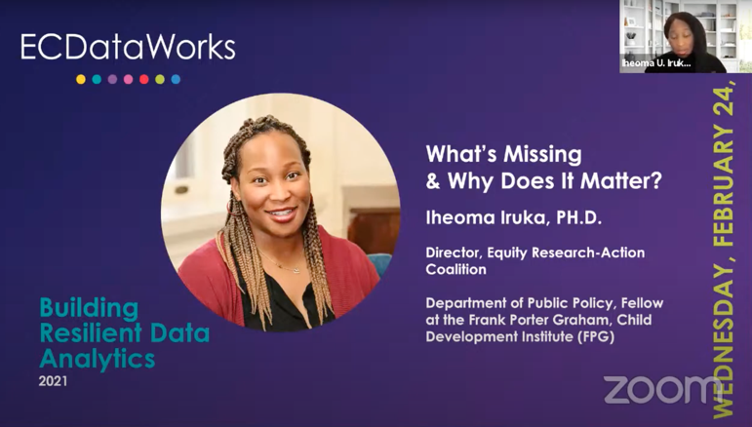
What do our data tell us?
Webinar clip: What's Missing & Why Does It Matter?
Presenter: Iheoma Iruka, Equity Research-Action Coalition
Watch full webinar here.

Slide 20
Share and Apply Findings
Share the findings of your analysis in context:
Presenting disparities in data without context can be harmful.
When sharing findings, ask, “Did we provide the reader with sufficient context to interpret this finding? How could this finding be misinterpreted?”
How do we apply what we’ve learned? How do we disseminate the information?
How are we sharing this information and with whom?
  Is there opportunity to invite additional feedback from families and community members?
  Are we sharing information in ways that are accessible to the families and community members we want to reach?
What are our data team’s goals for next steps?
  What equity work can this analysis move forward? Who should be involved?
What questions are still unanswered?
See more here: Equitable Research Communication Guidelines, Child Trends

Slide 21
Recommended Resources
Select resources for:
Engaging stakeholders
Data teams
Equity in early childhood
Cycle of inquiry

Slide 22
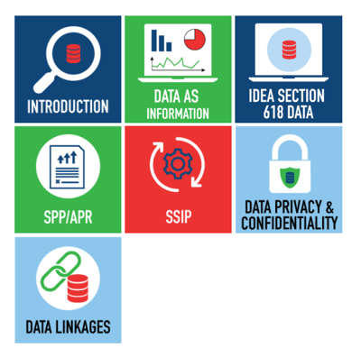

Resources for Engaging Stakeholders
Stakeholder Knowledge Toolkit: Building Knowledge about Data
Provides stakeholders with an orientation to IDEA data and other data-related topics to help them meaningfully participate in conversations about important programmatic issues and decisions.

Slide 23
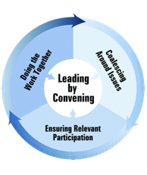

Resources for Engaging Stakeholders
Serving on Groups that Make Decisions: A Guide for Families
Leading by Convening
NCSI framework to engage stakeholders in improving results for infants, toddlers, children and youth with disabilities.
WI FACETS guidebook for anyone who is currently serving, or wants to serve, on a decision-making group.

Slide 24
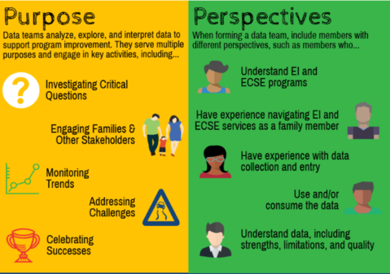
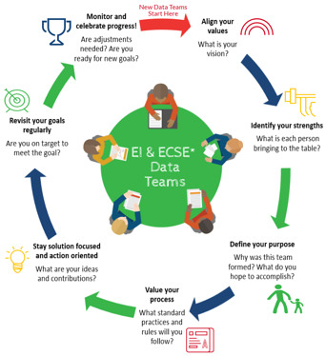
Resources for Data Teams
What are Data Teams?
Guidelines for Building Great Data Teams
DaSy Center infographic
DaSy Center infographic

Slide 25

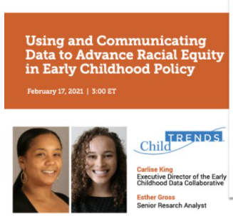
Resources for Equity
Using and Communicating Data to Advance Racial Equity in Early Childhood Policy
What's Missing & Why Does It Matter?
Equity in Early Childhood Systems: A Community Action Brief
Center for the Study of Social Policy, National Collaborative for Infants & Toddlers
Child Trends webinar recording and slides:
Carlise King & Esther Gross
ECDataWorks webinar recording:
Iheoma Iruka, PhD

Slide 26
Resources for Cycle of Inquiry
Overall
A Toolkit for Centering Racial Equity Throughout Data Integration, Actionable Intelligence for Social Policy (AISP), University of Pennsylvania
Five steps for structuring data-informed conversations and action in education, IES, National Center for Education Evaluation and Regional Assistance, REL Pacific
Define Your Question
  What is a Research Question?, We All Count
  Framing Research Questions that Reflect Who is Expected to Change, We All Count
Gather Data
  Need to collect new data? Consider Getting Past Identity to What You Really Want, We All Count

Slide 27
Resources for Cycle of Inquiry
Analyze & Interpret Data
  Root Cause Analysis Tool: 5 Whys, GENROE
Share and Apply Findings
  Equitable Research Communication Guidelines, Child Trends
  Order Matters, The FrameWorks Institute

Slide 28


Thank you
Visit us at http://dasycenter.org/
Follow us on Twitter: @DaSyCenter
The contents of this presentation were developed under a grant from the U.S. Department of Education, #H373Z190002. The contents and resources do not necessarily represent the policy of the U.S. Department of Education, and you should not assume endorsement by the Federal Government. Project Officers: Meredith Miceli and Amy Bae.

