Slide 1
Workshop: Developing Advanced Pivot Tables
Nicholas Ortiz, MPA
Robin Nelson, PhD
Oct 14, 2021

Slide 2
Learning Objective
Discover how to create more user-friendly, interactive pivot tables through advanced features in Excel that allow deeper analysis of raw data.

Slide 3
A few notes before getting started
This workshop assumes you have basic knowledge about Microsoft Excel, structuring data sets for pivot tables, and using the PivotTable feature in Excel.
We recommend using a computer running Microsoft Excel 2010 or later to practice using PivotTable features during the workshop. We will demo some PivotTable features that were not available in earlier versions of Excel.
We will go step by step and try to follow a moderate pace to allow time for you to follow along. We have built in periodic breaks for you to practice.
We will not cover all advanced features of PivotTables but rather focus on features that are most useful for state analysts in our experience.

Slide 4
PivotTable features we will highlight
Value field settings
Filtering, slicers, timelines
Design options
Refreshing data
Grouping/ungrouping variables
Nested rows
Spinning off multiple pivot tables from one
Pivot charts
Dashboards

Slide 5
PivotTable features we will highlight
Formatting data for use in a pivot table
Inserting a PivotTable
Manipulating PivotTable fields via filters/rows/columns/values
Filtering, slicers
Summarizing values through different calculations (value field settings)
Multi-level disaggregation (nested rows)
Pivot charts

Slide 6
Benefits of PivotTables
Easy to use
Interactive
Quick and easy way to summarize data
Easy analysis of data
Expand and collapse levels of data, drill down
Filter, sort, grouping
Efficient creation of reports
Notes:
Supporting staff in the use of pivot tables can help develop data literacy skills and build a culture of data use. Experience with PivotTables can help staff, especially those other than data analysts, explore and interact with the data, better formulate questions and requests for data, and even do their own analyses. For example, staff or program consultants can look at data for the local programs they work with, and/or examine data for special initiatives, e.g., the SSIP.
PivotTables without PII could also be made available to stakeholder groups collaborating on special initiatives, e.g., target setting.
Querying large amounts of data in many user-friendly ways.
Subtotaling and aggregating numeric data, summarizing data by categories and subcategories, and creating custom calculations and formulas.
Expanding and collapsing levels of data to focus your results, and drilling down to details from the summary data for areas of interest to you.
Moving rows to columns or columns to rows (or "pivoting") to see different summaries of the source data.
Filtering, sorting, grouping, and conditionally formatting the most useful and interesting subset of data enabling you to focus on just the information you want.
Presenting concise, attractive, and annotated online or printed reports.

Slide 7
PivotTable Terminology
PivotTable: a tool that summarizes and reorganizes selected columns and rows of data. It does not actually change the data, it just "pivots" or turns the data to view it from different perspectives.
Four main components of a pivot table:
Columns: fields that define data in the rows; unique values are listed across the top
Rows: all row labels in the first column are unique values
Values: the field containing values that are displayed as summarized information, e.g., count, sum, average, minimum, and maximum.
Filters: (optional) apply a restriction to the entire table, i.e., to examine a subset.

Slide 8
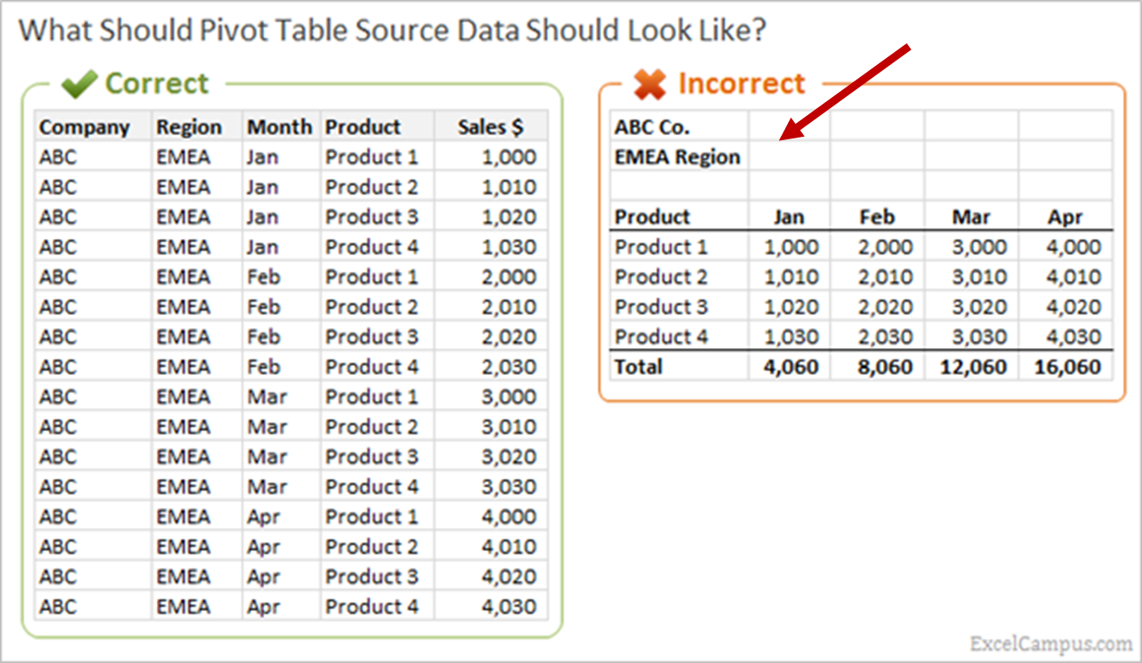
Structure of Source Data

