Slide 1

Welcome
Welc
Say “Hi” in the Whova chat and let everyone know
  Where you are from (state, agency)
  If you have collected any data on the impact of using teleservices in your program
Notes:
Cindy
While we are waiting for everyone to enter the room, please take a minute to say hello to each other in the Whova chat. Let us know where you are from and indicate if you have collected any data on the impact of using remote service delivery or teleservices in your program.

Slide 2
Looking Back to Move Forward
What We’ve Learned About Part C Remote Service Delivery
Amy Nicholas, DaSy
Barbara Simpson, North Carolina
Cindy Weigel, DaSy
Division for Early Childhood
of the Council for Exceptional Children
37th Annual International Conference
Virtual Event, September 23, 2021
Notes:
Thank you for joining us today.
My name is Cindy Weigel from the Center for IDEA Early Childhood Data Systems or DaSy. I am here today with my colleague Amy Nicholas.
Amy has provided cross-state and individual technical assistance to states around the impact of COVID-19 on the IDEA, Part C programs for infants and toddlers with disabilities. She is going to share information about what has been learned so far from several states.
I am also here with Barbara Simpson from North Carolina’s IDEA Part C Infant-Toddler Program. Barbara will share her state’s story on the impact of COVID-19 including the impact of using remote service delivery or teleservices.

Slide 3

Agenda
Agenda
Review cross-state IDEA Part C data collected to address COVID-19 related questions
State story of the impact of COVID-19 and use of teleservices
Q&A and technical assistance resources
Notes:
Cindy
In this session we will share cross-state data from the Individuals with Disabilities Education Act, or IDEA, Part C programs for infants and toddlers with disabilities and their families. You will hear about different types of data that programs are collecting and using to address questions about COVID-19 related issues.
We will hear from North Carolina about the impact of COVID-19 and use of remote service delivery or teleservices.
We will leave time for questions and share technical assistance resources available to support your program improvement efforts.

Slide 4

What We Have Learned So Far
Amy Nicholas, The Center for IDEA Early Childhood Data Systems (DaSy)
Notes:
Cindy
I will now turn this over to my DaSy colleague, Amy.

Slide 5
Disruption is the New Norm
Over time, individual states/territories have experienced large-scale disruptions in early intervention service delivery for a variety of reasons (e.g., natural disasters).
With COVID-19, we can assume that all states/territories have experienced some form of disruption.
  Some continued offering all in-person services, but individual families may have declined to receive them.
  Some paused service delivery (of any kind), needing time to coordinate the shift to remote service delivery.
  Some immediately pivoted from in-person to remote service delivery.
Notes:
Amy

Slide 6

DaSy Center TA: Examining the Impact of COVID-19 on Part C Programs
Provided a mix of cross-state and individualized technical assistance to 6 state Part C teams from June through August 2021
Main intended outcome for participating states was to gain knowledge of data analysis strategies related to the impact of COVID-19 on Part C programs
Notes:
Amy

Slide 7
COVID-19 Impact Analyses
Types of Data to Analyze
How Data Can Be Examined
Referral
Evaluation & Eligibility
Enrollment
Services
Exit/Transition
Child Outcomes
Changes over time (e.g., pre-, mid-, post- state-issued COVID-19 emergency orders)
Differences by child characteristics (e.g., age, race/ethnicity, time in program, Medicaid status)
Differences by region/county within state
Notes:
Amy

Slide 8

Analysis Considerations
Critical start/end dates (e.g., state emergency order/closure of state agency, pause in taking referrals and/or conducting evaluations, virtual services offered to families)
Access to current/real-time data
Intended uses of available data
Technology and staff available to conduct analyses
Exploratory post-hoc analysis vs. research design
Notes:
Amy

Slide 9
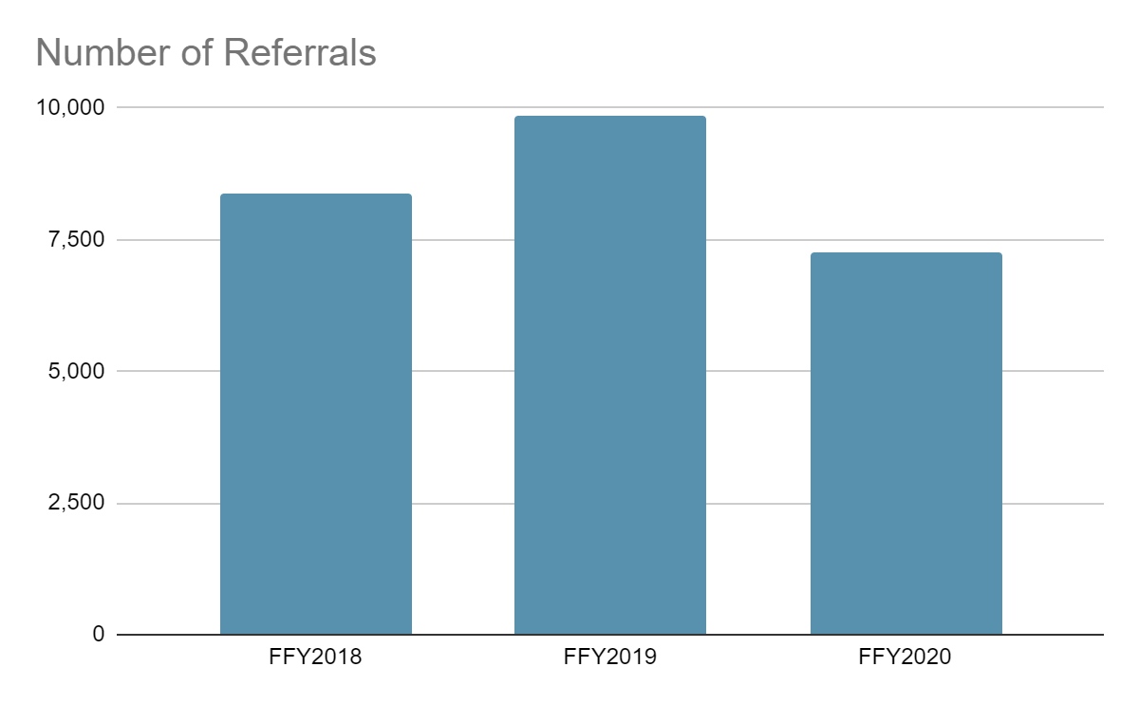
Example: Referrals
How have Part C referrals been impacted by the COVID-19 pandemic?
Notes:
Amy

Slide 10
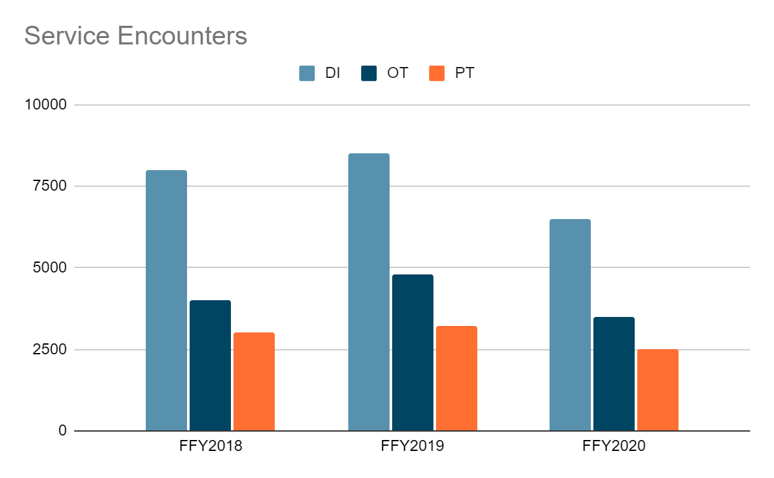
Example: Service Utilization
Has the number of services delivered by type changed across years?
Notes:
Amy

Slide 11
Example: PA Part C Family Survey re: Remote Service Delivery
How helpful were tele-intervention early intervention services in meeting your needs during COVID 19?
How helpful was the early intervention program in connecting your family to other services and supports to address COVID-19?
If your child started receiving early intervention services during COVID-19, how helpful was the referral and evaluation process for your family?
If available, would you be interested in continuing to receive telehealth/virtual EI services?
Notes:
Amy

Slide 12
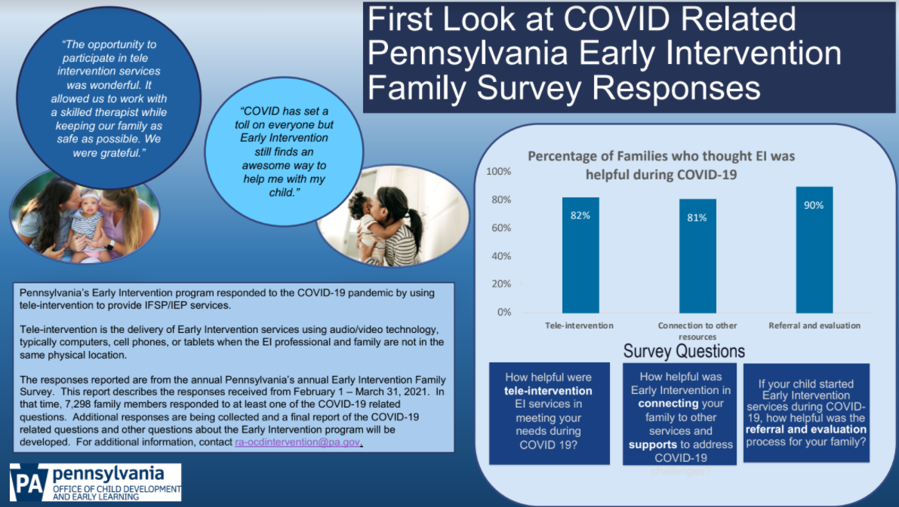
Handout: PA Part C Family Survey Responses
Notes:
Amy
Will provide full publication as session handout (PA approved)

Slide 13
What We’ve Learned So Far About COVID-19 Impact
The COVID-19 pandemic has impacted Part C programs in a variety of ways, but the impact differs from state to state!
For example:
Drops in numbers of referrals (but rebounding this fall)
Drops in enrollment
Decreases in the amount of services provided
Greater number of children being served for longer periods of time
Changes in reasons for exiting Part C (e.g., higher counts of Part B Eligibility Not Determined and Attempts to Contact Family Unsuccessful)
Notes:
Amy

Slide 14

The Impact of the COVID-19 Pandemic on North Carolina’s
Part C Program

Slide 15
N.C. Infant Toddler Program (NC ITP)
North Carolina’s Part C program
16 local lead agencies (Child Development Services Agencies – CDSAs)
  12 state run
  4 contracted through local partners
CDSA staff provide:
  Eligibility evaluations
  Targeted Case Management
  Other IFSP services where required
Majority of IFSP services by contracted providers in the community

Slide 16
Why NC ITP?
As an example of what to do when you don’t have direct data
Our data system is not robust – difficult to change or add fields
Our data system only collects billing/utilization data for services provided by CDSA staff
2nd largest CDSA uses a different data system for billing and entering IFSP services
No direct access to Medicaid billing data for our contract providers

Slide 17
Our Story: The Early Days of COVID-19
Manual tracking
Weekly data tracking
Added COVID-19 related Referral Closure reasons
Added COVID-19 related Exit Reasons
Added COVID-19 related Reasons for Delay
Work on Family Outcomes
Implemented Tele-Services and evaluations
Added modifiers for billing for Tele-Services and evaluations

Slide 18
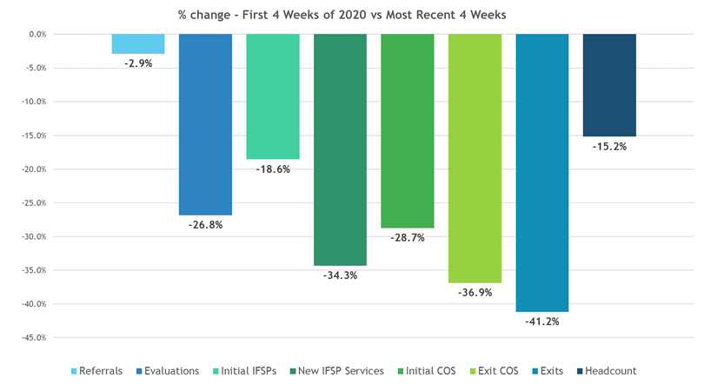
Weekly Data Tracking
Referrals
Evaluations/
Assessments
Initial IFSPs
New IFSP Services
Initial COS
Exit COS
Exits
Headcount

Slide 19
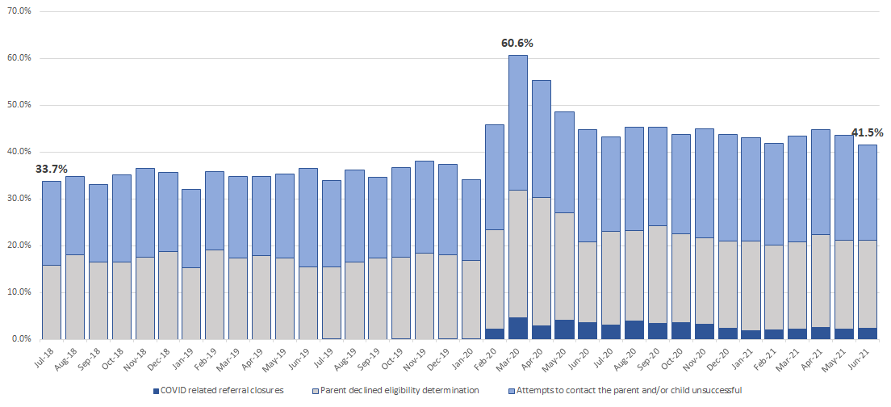
COVID-Related Referral Closure Reasons
Notes:
Can use data from a provider billing system to analyze changes in the number of encounters billed for across "most salient" service types: DI, OT, PT, SC, and Speech. Can look at this further by service type across months. This examples shows a drop in the number of DI, OT, PT, and Speech services provided starting in March 2020, but increase in Service Coordination.

Slide 20
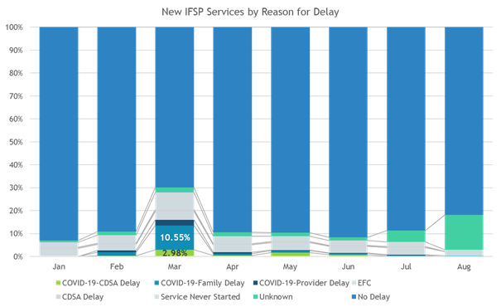
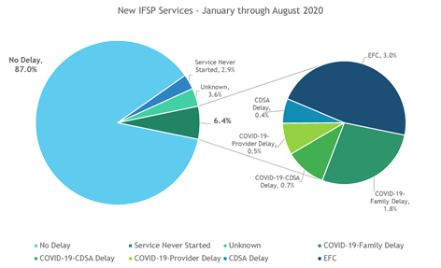
COVID-Related Reasons for Delay Were Useful During the Height of the Pandemic

Slide 21
Tele-Services Surveys
Surveyed staff, providers, and families
Questions related to:
  Effectiveness of tele-services compared to face-to-face
  Challenges related to the technology involved
  Whether children continues to make progress
  Whether tele-services were a desired option post-pandemic
  Whether coaching training made a difference in the effectiveness of tele-services
  What was working well and what were the challenges

Slide 22
Survey Results: What is Working Well
Across surveys:
Scheduling flexibility/No travel time
Increased availability of therapists
Continuity of care
Staff and provider surveys:
Increased parent directed interaction/Encouraged coaching
An ability to see a variety family routines

Slide 23
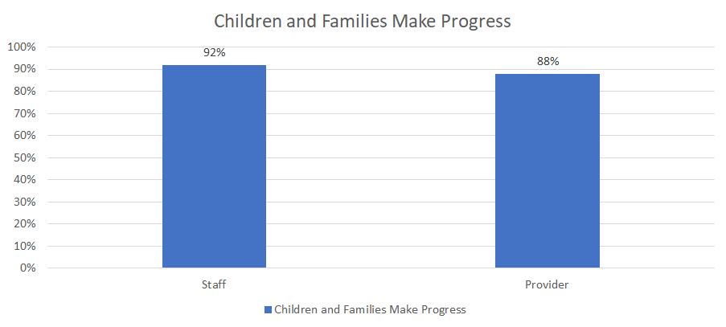
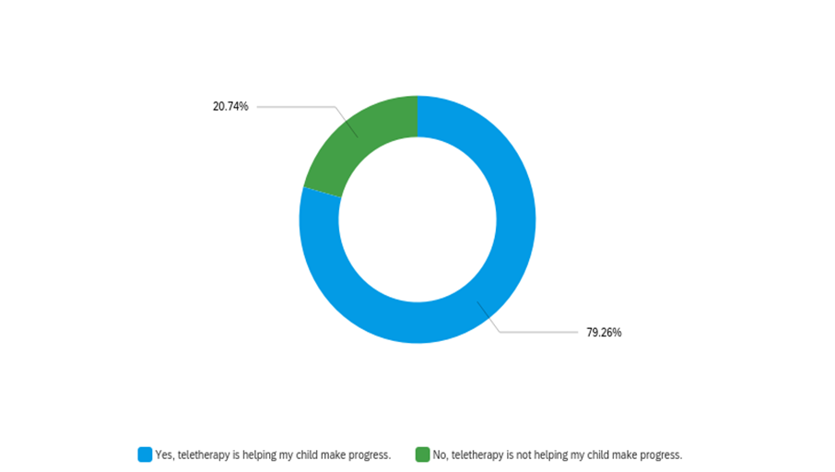
Survey Results: Child and Family Progress

Slide 24
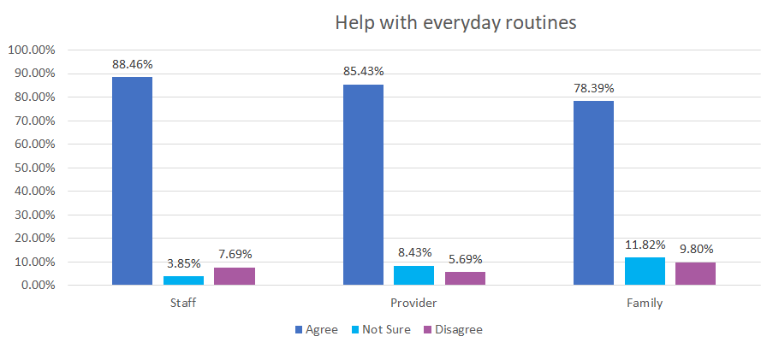
Survey Results: Help with Everyday Routines

Slide 25
Survey Results: What is Challenging
Across surveys:
Difficulty in maintaining toddlers’ attention
Distractions in the home
Staff and provider surveys:
Connectivity issues; poor audio and/or visual quality
Demonstrating exercises, especially motor skills tasks and feeding therapy
No-shows/cancellations
Families opting not to participate in teletherapy/trial the model

Slide 26
Survey Results: Looking Forward
Providers and staff are interested in delivering sessions via teletherapy at their discretion post-pandemic.
Across all surveys there was interest in a hybrid option in the future.
  35% of families would choose either teletherapy or both teletherapy and face-to-face if given the choice
  78% of providers said they would like to continue to offer teletherapy as an option
  81% of staff said they would like to continue to offer teletherapy as an option

Slide 27
Provider Survey - Coaching Level and “How often are you using coaching when providing services via teletherapy?”
How often are you using coaching
Coaching Level | Never | Rarely | Sometimes | Often
No coaching | 10% | 2.2% | 18.9% | 68.9%
Book/Webinar | 0% | 8.3% | 13.9% | 77.8%
Some training | 0% | 0.7% | 11.6% | 87.6%
Master Coach | 0% | 0% | 0% | 100%

Slide 28
Provider Survey - Coaching Level and “How effective is teletherapy compared to face-to-face therapy?”
How effective is teletherapy
Coaching Level | Less effective | About the same | More effective
No coaching | 45.8% | 40.6% | 13.5%
Book/Webinar | 50% | 36.1% | 13.9%
Some training | 33.9% | 52.6% | 13.5%
Master Coach | 7.1% | 64.3% | 28.6%

Slide 29
Provider Survey - Coaching Level and “Do you think that providing services via teletherapy is made more effective by using a coaching approach?”
Is teletherapy made more effective by using coaching
Coaching Level | Yes | No | Not sure
No coaching | 67.4% | 5.4% | 27.2%
Book/Webinar | 69.4% | 11.1% | 19.4%
Some training | 81.1% | 4% | 14.9%
Master Coach | 92.9% | 0% | 7.1%

Slide 30
Parent Survey - “Do you think teletherapy is helping your child make progress?” vs. “Teletherapy has given me ways to help my child during our everyday routines.”
Making Progress | Agree | Disagree | Not Sure
Yes, teletherapy is helping my child make progress | 89.34% | 1.84% | 8.82%
No, teletherapy is not helping my child make progress | 37.14% | 41.43% | 21.43%

Slide 31
Parent Survey - “Do you think teletherapy is helping your child make progress?” vs. “Are you comfortable with the technology used in teletherapy?”
Comfortable with Technology | Yes, teletherapy is helping my child make progress. | No, teletherapy is not helping my child make progress.
Yes | 81.8% | 18.2%
No | 46.2% | 53.8%
Not sure | 53.8% | 46.2%

Slide 32


Parent Survey
What is Working Well
What is Challenging

Slide 33
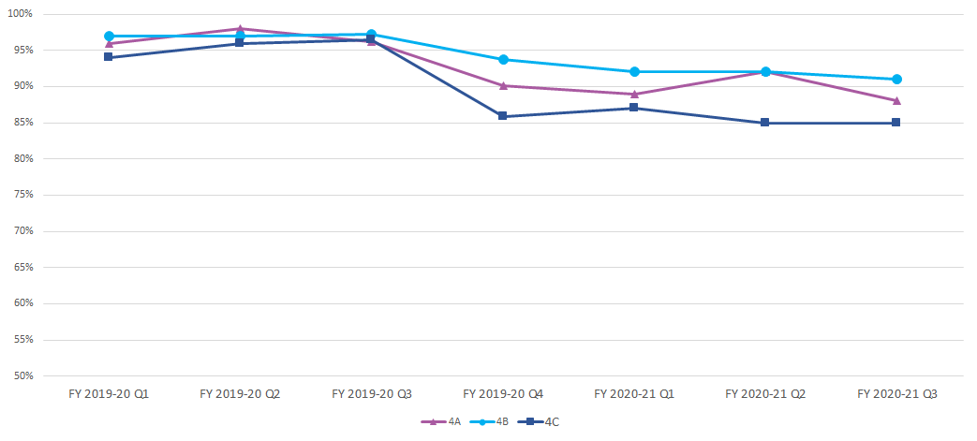
Family Outcomes Survey (Part C SPP/ARR Indicator 4)
Family Outcomes Scores have decreased over the course of the pandemic.
How much is due to teleservices vs the pandemic generally is difficult to untangle.

Slide 34
Differences in Family Outcomes Results Before and During the Pandemic
 | FY 2019-20 Q1 | FY 2019-20 Q2 | FY 2019-20 Q3 | FY 2019-20 Q4 | FY 2020-21 Q1 | FY 2020-21 Q2 | FY 2020-21 Q3 | Pre- COVID Avg. | Post- COVID Avg.
4A | 96% | 98% | 96% | 90% | 89% | 92% | 88% | 97% | 90%
4B | 97% | 97% | 97% | 94% | 92% | 92% | 91% | 97% | 92%
4C | 94% | 96% | 97% | 86% | 87% | 85% | 85% | 96% | 86%

Slide 35
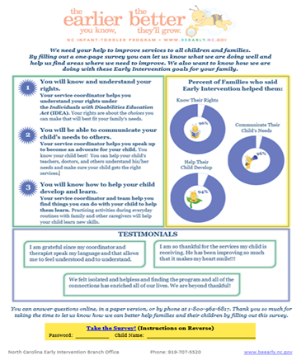
Working to Improve Family Outcomes Data
Revised Family Outcomes Survey Flyer
Reviewing quarterly data with CDSAs
Agency-wide effort to improve response rates, especially among under-represented groups
Implemented 1-800 number option for completing survey

Slide 36
Billing and Utilization Data: What happens when you get data you’ve never gotten before and didn’t expect to get!
Hope that tele-services modifiers would provide useful utilization data
Data entry issues make the data unreliable for determining percent of services provided virtually
Data can be useful for showing trends and for overall utilization data

Slide 37
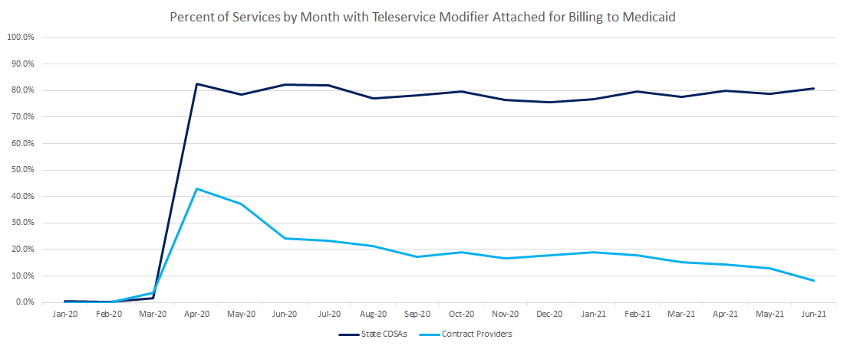
Data on % of Services Provided Virtually (Not Reliable)

Slide 38
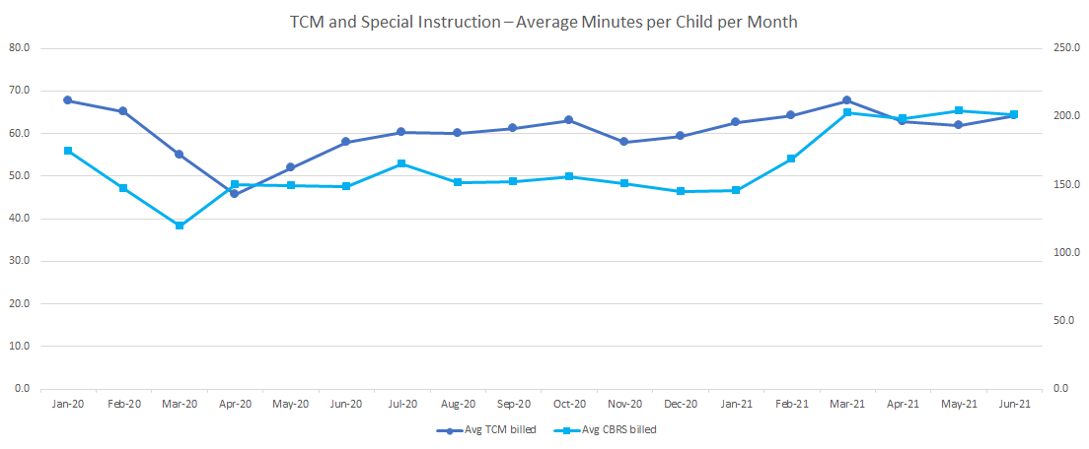
Service Delivery Appears to be Rebounding to Pre-Pandemic Levels

Slide 39
Lessons Learned
Training and Tracking
Be Creative
Guidance documents are not enough when you’re adding new data elements.
Providing tracking reports isn’t enough. Must ensure staff actually understand how to use them and that they identify and MAKE needed corrections.
Need for increased review at the central office level.
When your data system isn’t what you need, consider what you do have and come at the problem from every angle you can.
Surveys can be powerful.
Listen to your local leadership and staff.
Listen to families.

Slide 40

Questions?
Notes:
Cindy

Slide 41
Resources
Early Childhood Technical Assistance (ECTA) Center’s COVID-19 Resource Collection: https://ectacenter.org/topics/disaster/coronavirus.asp
ECTA Center’s Remote Service Delivery and Distance Education Resource Collection: https://ectacenter.org/topics/disaster/tele-intervention.asp
Part C Data During COVID-19: Navigating the Next Six Months Together (DaSy Improving Data, Improving Outcomes Conference, Oct. 2020): https://dasycenter.org/part-c-data-during-covid-19-navigating-the-next-six-months-together/
Key Part C Data Considerations during COVID-19 (DaSy Center, March 2019): https://dasycenter.org/key-part-c-data-considerations-during-covid-19/
Responding to COVID-19: Ongoing Considerations for Part C Data (DaSy Center webinar, July 2020): https://dasycenter.org/responding-to-covid-19-ongoing-considerations-for-part-c-data-webinar/
Notes:
Cindy

Slide 42


Thank you
Thank you
Visit us at http://dasycenter.org/
Follow us on Twitter: @DaSyCenter
The contents of this presentation were developed under a grant from the U.S. Department of Education, #H373Z190002. The contents and resources do not necessarily represent the policy of the U.S. Department of Education, and you should not assume endorsement by the Federal Government. Project Officers: Meredith Miceli and Amy Bae.

