Slide 1
Using Child Outcomes To Shift The Focus From Problems To Possibilities
Naomi Younggren & Lauren Barton
With Insights From A Parent and Practitioner
Presented at the Division for Early Childhood (DEC) Conference September 22, 2021

Slide 2
Session Topics
How the three child outcomes help shift the focus from domains and deficits to functional participation and possibilities.
How a shared understanding of the breadth of the outcomes can serve as a consistent framework for understanding, describing, and measuring children’s functioning.
How the functional basis of the three child outcomes can build family capacity to communicate their child’s functional strengths and needs.

Slide 3
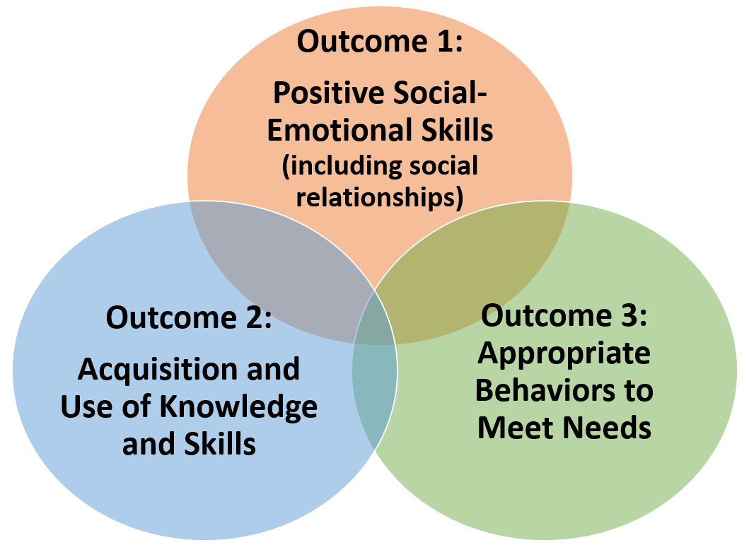
First….About The Three Child Outcomes
Notes:
The three child outcomes refer to actions that children need to be able to carry out knowledge they need to participate functionally across setting and situations. They also represent the integrated nature of how children develop and learn and intersect the five developmental domains and different curricular areas.

Slide 4
Meet Aimee, a Parent Liaison with a Local Part C program
“
Two daughters, one is 19-years old with Autism and one is 21-years old with Down Syndrome and Autism
Works with families “to understand their services and to help them find local resources and support and to talk about my experiences raising daughters with disabilities. I help them through their early intervention process up until and during their early childhood transition.”
“I love being a parent liaison.”

Slide 5
Meet Julie, EI Provider with a Local Part C Program
Early Intervention provider for 20 years
Occupational Therapist
Working with military-affiliated families overseas in the Educational and Developmental Intervention Services (EDIS) program

Slide 6
Shift the focus
How the three child outcomes help shift the focus
from domains and deficits to functional participation and possibilities.
Notes:
Talking about development in terms of the three global child outcomes helps to shift the focus from domains and deficits to functional participation and possibilities. It includes observing how children integrate skills to accomplish meaningful tasks. Considering children’s development in terms of function requires a shift in thinking from domains, deficits, and discrete skills to thinking about children’s actions and interactions is holistic and functional ways.

Slide 7
A Case for Teaching Functional Skills By Preston Lewis, Office of Education for Exceptional Children December 1987 TASH newsletter
Notes:
An excerpt from the full article is shown next.

Slide 8
Daryl is 18 years old, TMH (30-40 IQ) and has been in school for 12 years. Daryl can now do lots of things he couldn’t do before!
He can put 100 pegs in a board in less than 10 minutes while in his seat with 95% accuracy.
… But, he can’t put quarters in vending machines.
Upon command he can “touch” nose, shoulder, leg, foot, hair, ear. He’s still working on wrist, ankle, hips.
… But, he can’t blow his nose when needed.
He can walk a balance beam forwards, sideways, and backwards.
… But, he can’t walk up the steps or bleachers unassisted in the gym to go to a basketball game.
He can put the cube in the box, under the box, beside the box, and behind the box.
… But, he can’t find the trash bin in McDonald’s and empty his trash into it.
I guess he’s just not ready yet.

Slide 9
We’ve come a long way
Notes:
Although the focus on functionality is highly regarded, the eligibility determination process often still tends to focus on domain-based delays. Unfortunately, that focus can linger well past the identification of those delays.
When this happens there can be an overemphasis on domains and test results which can overshadow the necessary focus on children’s organic functioning within the settings and situation in which the child participates.
Photo: Upsplash

Slide 10
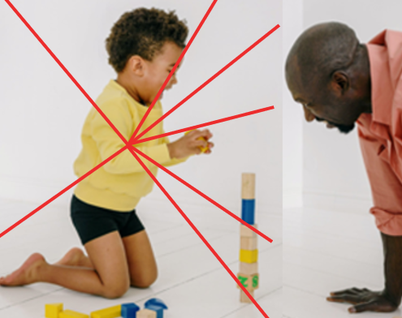
Whole Child and Whole Picture To Understand Functionality
Notes:
An important aspect of assessment is seeing the whole child.
So rather than just a domain focus we have to consider how children participate in day-to-day life.
This focus on children functioning encourages holistic assessment rather than dicing the child’s abilities into discrete domains alone.
Picture: Free source Ksenia Chernaya: https://images.pexels.com/photos/7301173/pexels-photo-7301173.jpeg?auto=compress&cs=tinysrgb&dpr=3&h=750&w=1260

Slide 11
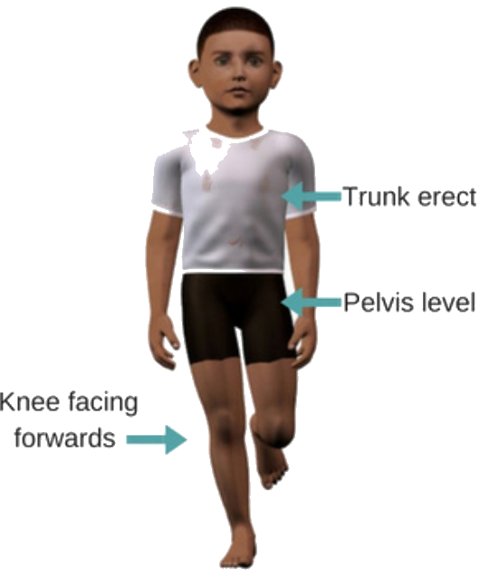
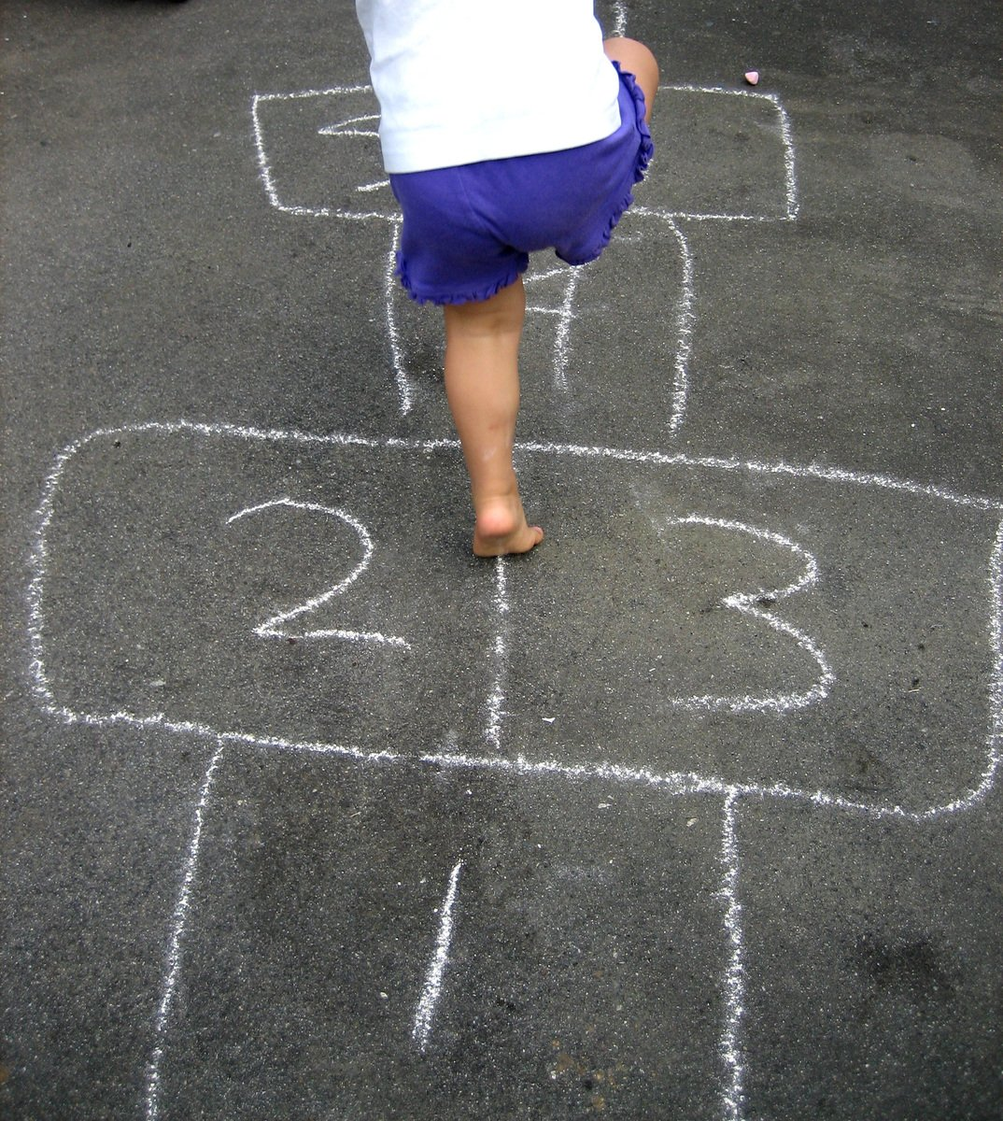
Discrete Skills
Notes:
This is not to say that discrete skills are not important. They are. However, they are important in the context of meaningful tasks not isolated skills.
For example, the discrete skills illustrated on the left are integrated when we think about how a child participates in a game of hopscotch. It is this integration of these skills in a meaningful context that makes them functional.
Picture: https://www.freeimages.com/photo/hopscotch-1436566 hopscotch source

Slide 12
Practitioner Insight
What benefits come to mind when you think of the shift in focus to children’s functioning emphasized with the child outcomes?
“....sometimes when we just do an evaluation and look at the five domains, it does not capture what a child really can do. Sometimes it doesn’t help a parent see how capable their child is.... when we talk functionally through the child outcomes, I think it can help us highlight how much more sometimes the child is able to do than maybe what our testing indicated…”

Slide 13
Practitioner Insight
How does thinking about the child’s functional skills in the three outcome areas influence service planning?
It helps us identify …
“what are next steps, what are things that we would actually anticipate a child could do at a particular age and their child is not yet doing but they can see those gaps maybe in a more functional way that will help us work towards that when we develop IFSP goals and start to working together on those.”

Slide 14
Parent Insight
What benefits come to mind when you think about the shift in focus to children’s functioning emphasized with the child outcomes?
“I think it encourages families to see the benefit of working with your team on your day-to-day activities…. I think the way the child outcomes is explained now to families does encourage them to explore ways to utilize their therapist in their day-to-day activities. I think that is a huge benefit to families.”
This is an important shift. “Back when I was in EI, day-to-day activities wasn’t something that they would emphasize as much as they do now or as we should. We worked a lot on sitting at a table and working on skills.”

Slide 15
Your turn…
In what ways have you seen the three child outcomes help shift the focus from domains and deficits to functional participation and possibilities?

Slide 16
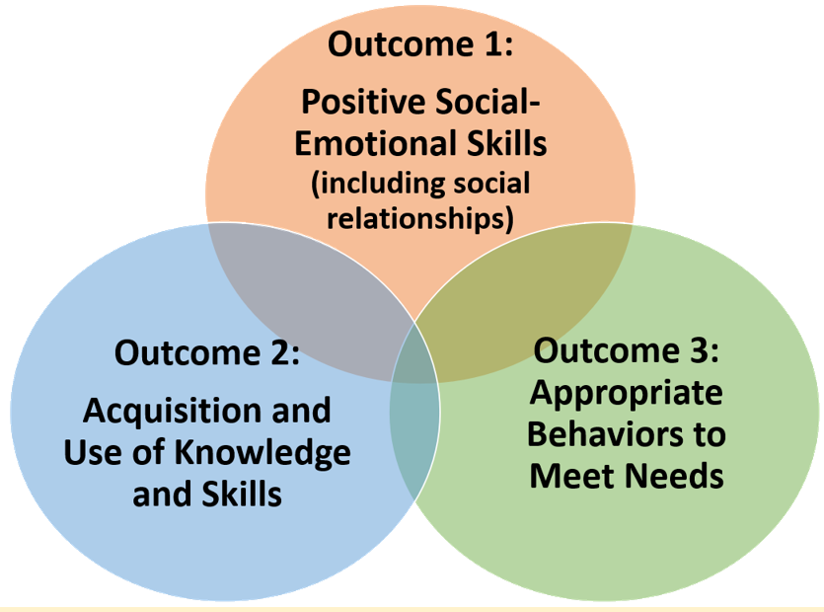
Breadth of the outcomes
How a shared understanding of the breadth of the outcomes can serve as a consistent framework for understanding, describing, and measuring children’s functioning.
Notes:
The three outcomes help us keep a focus on functionality and the whole child. These three outcomes represent the intersection of skills needed for children to participate in their day-to-day activities, actions, and interactions.
The breadth of the three child outcomes provides a consistent framework for understanding and measuring children’s functioning.

Slide 17
Parent Insight
How easy or difficult do you think the outcomes are for families to understand?
“There’s so much literature that lays the three outcomes out in a great way for parents to understand them and be able to apply their own child’s skills and the things they observe. I think they are laid out really well and laid out in a way that is very easy for parents to understand.”

Slide 18
Practitioner Insight
“It has been positive in helping families understand that their child is not just these 5 separate areas that we do still happen to evaluate, but how much these areas link up with each other and lean on each other. We get a lot of children who the parent’s main concern is communication and as we go through the 3 child outcomes with them it is really a helpful way to help them understand that their child’s delay may be more than just communication and look at how it’s showing up in each of these areas of your child’s functional development.”
How has the framework of the three outcomes influenced your practice?

Slide 19
Practitioner Insight
How has talking about functional skills observed across the three outcomes influenced your understanding of a child’s skills?
“...talking more functionally about the child, how all of these developmental skills actually show up in day-to-day life and more meaningful ways than just the evaluation.
[The evaluation] was just a little more of checking can they do this, can’t they do this, but the child outcomes helps us look at not only can he or she do this or not do it, but how is it showing up or where is it missing in day-to-day function.”

Slide 20
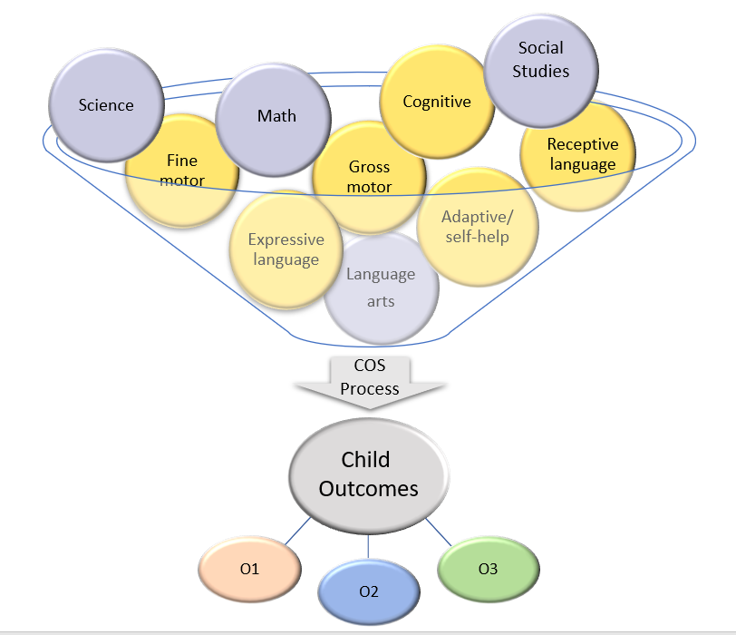
Functional skills across domains and curricular areas inform the three child outcomes
Image created by DaSy & ECTA
Notes:
This illustration shows how the different domains and curricular areas inform the three child outcomes. It also shows how a particular domain or curricular area does NOT just map to a single child outcome.

Slide 21
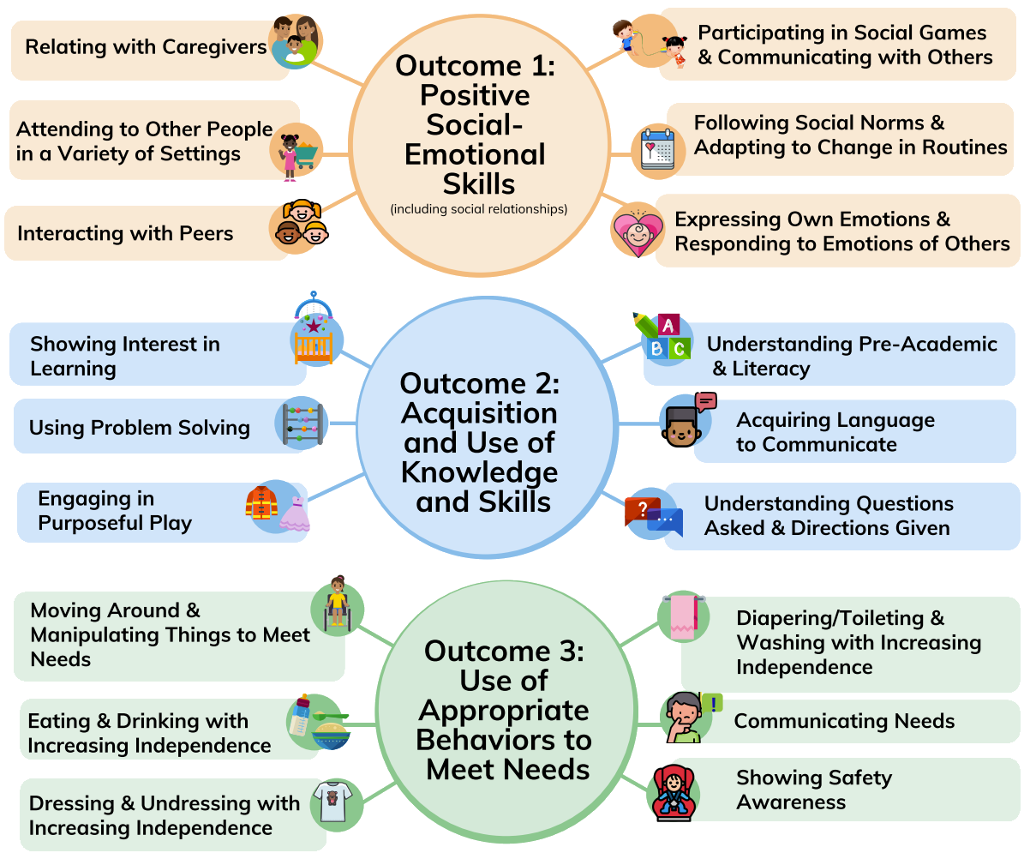
Outcomes
Notes:
Each of the three outcomes includes a span of functional skills and abilities that are meaningful for a child’s participation in day-to-day routines. Information about the child’s functioning across the breadth of each of the three outcome areas is necessary for accurate child outcome summary (COS) rating decisions.

Slide 22
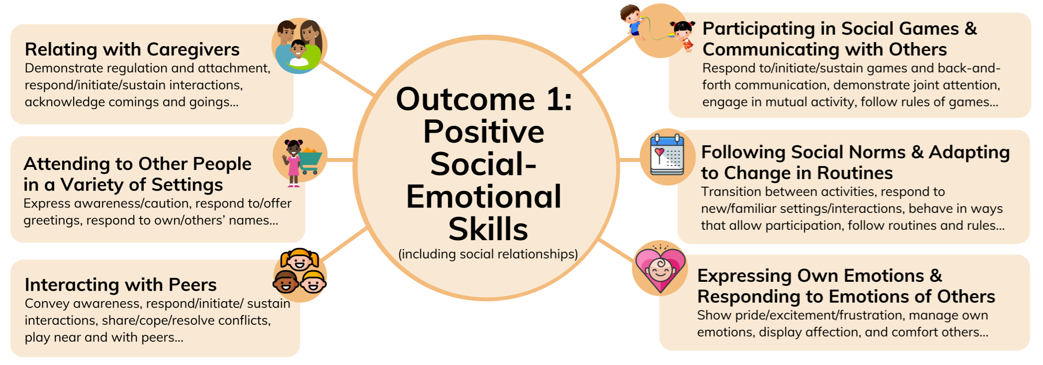
Outcome 1
Notes:
This graphic shows the six major skill bundles associated with outcome 1. Teams should consider and discuss the full breadth of the outcome to fully understand the child’s functioning and when making rating decisions.

Slide 23
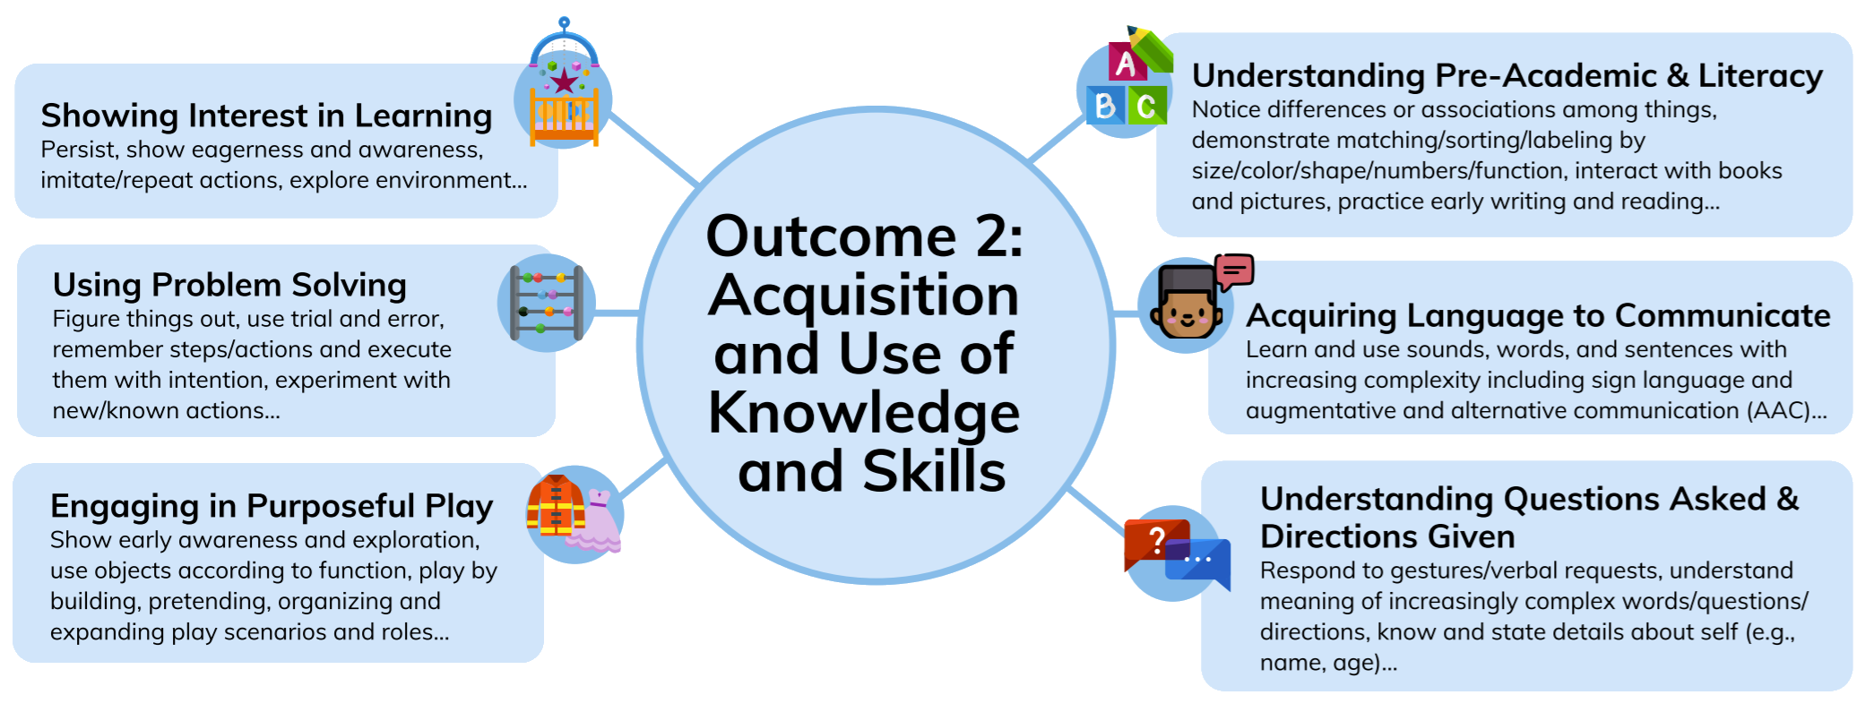
Outcome 2
Notes:
These are the six major skill bundles across the breadth of outcome 2.

Slide 24
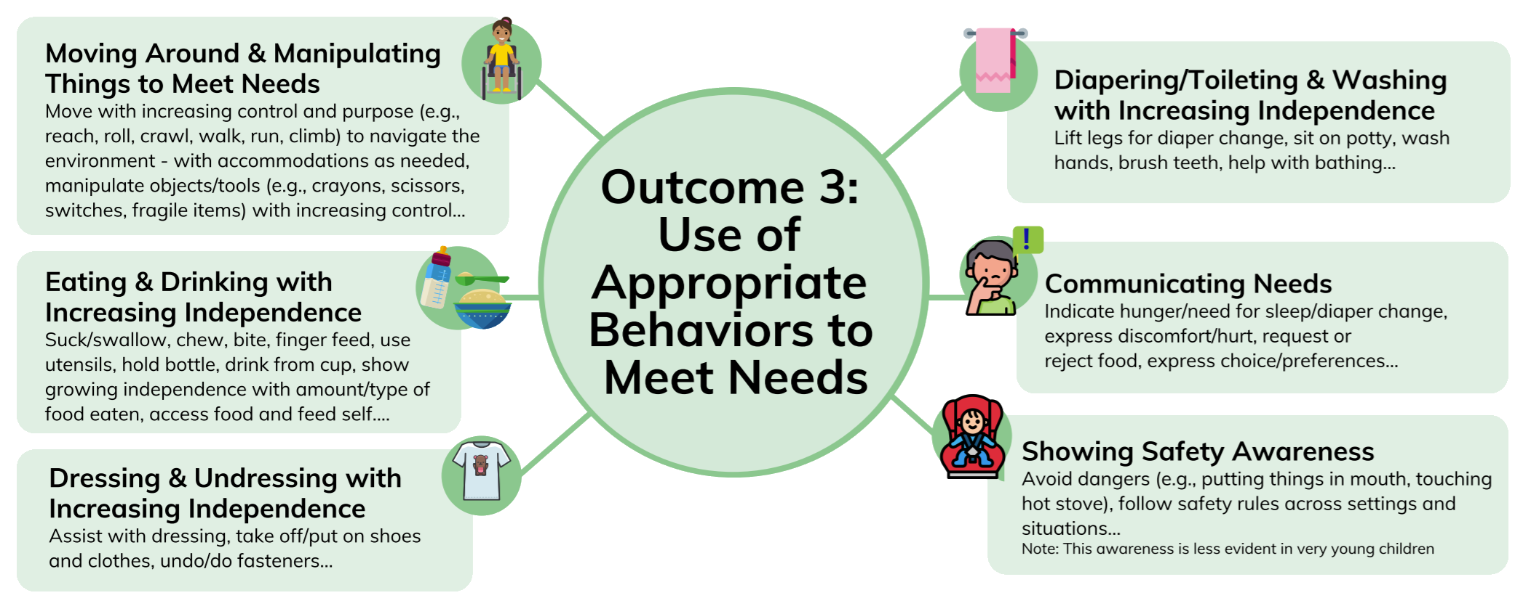
Outcome 3
Notes:
These are the six major skill bundles across the breadth of outcome 3

Slide 25
Focus on breadth leads to shared understanding, greater consistency, and higher quality ratings
Team One
Team Two
Notes:
Identifying the child’s functional skills across the breadth of each outcome provides the most accurate understanding of the child’s abilities within each of the three outcomes. The breadth of the three outcomes can form a framework for describing and uniformly measuring children’s functioning. Using the full functional basis of the three outcomes also can help build family capacity to understand and effectively communicate the range of their child’s functional strengths and needs, now and in the future.
Teams must understand the breadth of the outcomes to fully consider functioning that is part of each outcome. This shared understanding is critical because the child outcome ratings represent a synthesis of all that is known about a child’s functioning. Having a complete and consistent understanding of the outcomes will improve the accuracy of the COS rating.
For example, as illustrated here, Team One may base their child outcomes ratings for O3 primarily on how children move around, use tools, and manipulate things while Team Two looks at those skills, but also considers children’s functioning relating to eating, dressing, diapering/toileting, communicating needs, and showing safety awareness. Under these conditions, Team One and Team Two could rate the same child very differently. Using the breadth illustration, the difference between Team One and Team Two’s consideration of Outcome 3 might look like this:

Slide 26
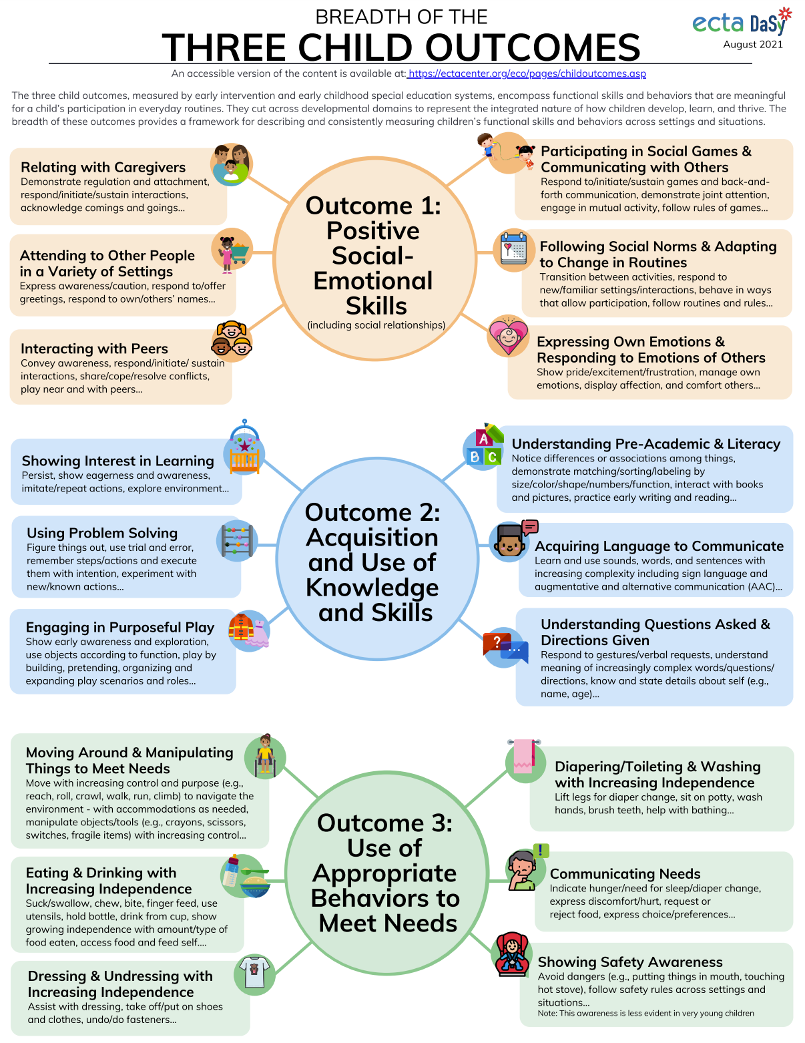
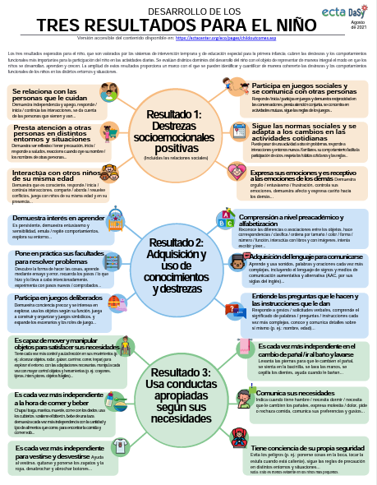
Three Child Outcomes
https://ectacenter.org/~pdfs/eco/three-child-outcomes-breadth.pdf
Notes:
This resource is available online and is provided in Spanish as well https://ectacenter.org/eco/pages/childoutcomes.asp#breadth

Slide 27
Your turn…
How might you use the breadth of the outcomes as a framework for describing & measuring children’s functioning?

Slide 28
Build family capacity
How can the functional basis of the outcomes build family capacity to communicate their child’s functional strengths and needs?

Slide 29
Parent Insight
How can child outcomes measurement help build family capacity?
“I feel like the child outcomes process helps families understand how early childhood would benefit their child based on where their child’s skills are in comparison to a typical child or a child without a delay. That, for sure, is helping them.”

Slide 30
Parent Insight
What comes to mind when you think about the outcomes and your prior experience?
“I definitely think [the outcomes] are a helpful concept now for sure.”
“It would have been nice to have that framework or to have been able to sort of slowly gradually and with support around me recognize just how delayed [my kids] actually were instead of being shocked, surprised, and dismayed when we ended up in a family gathering and I was noticing in real time on the spot those differences.”

Slide 31
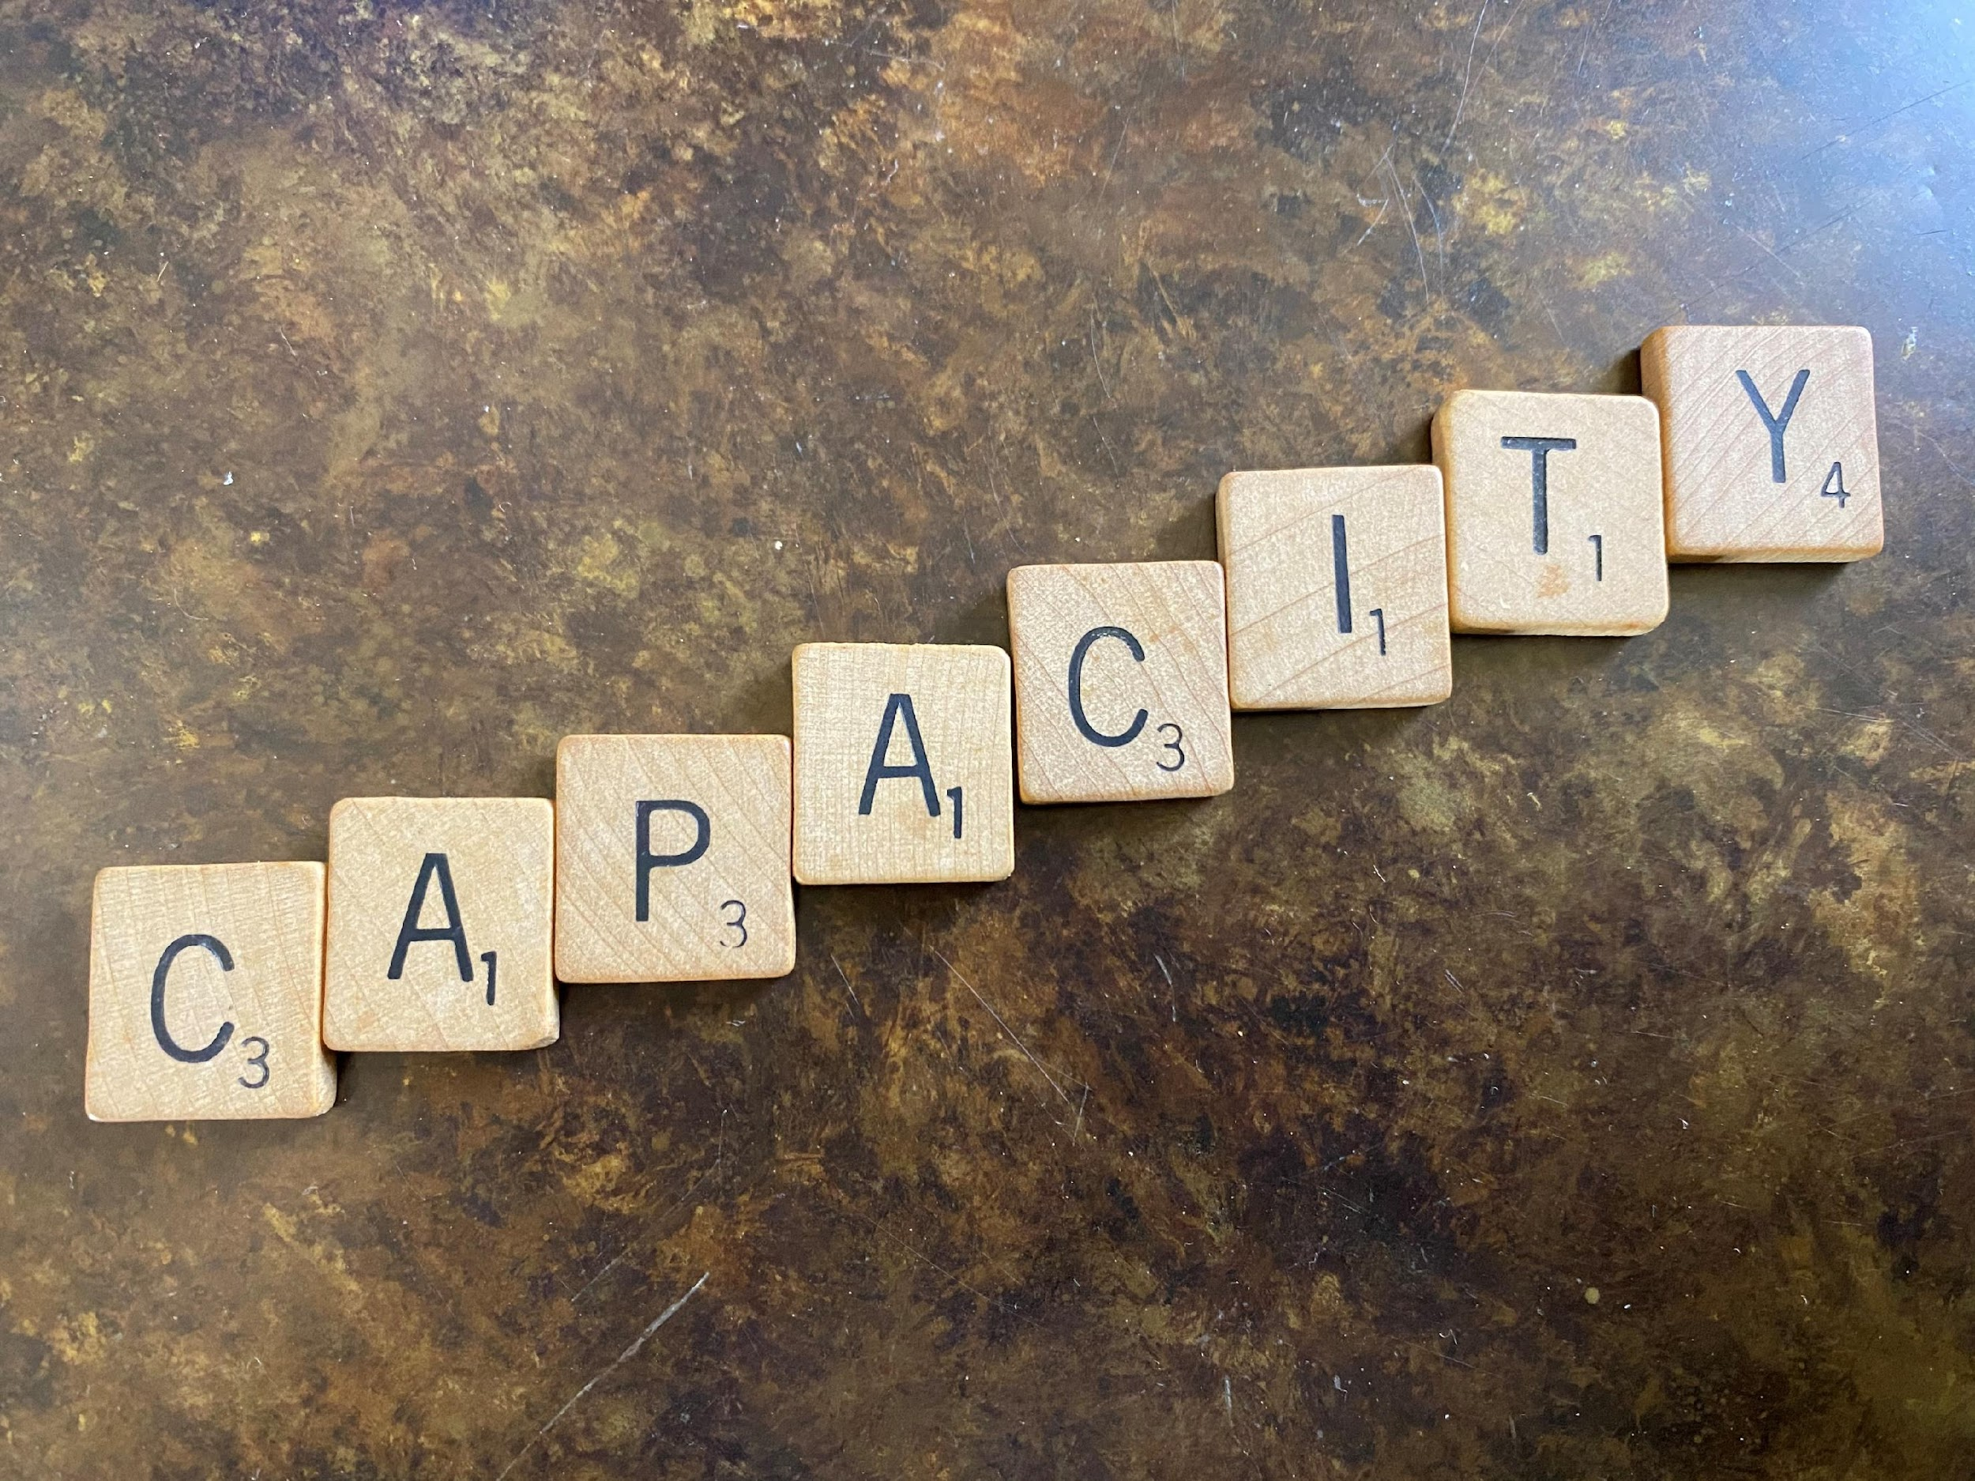
The Framework of the 3 Child Outcomes Helps Build Family Capacity In Many Ways Over Time
Deepen understanding of their child’s functioning
Increased understanding of child development
Communicate their child’s strengths and needs
Appreciate the significance of day-to-day routines
Identify and enhance natural learning opportunities
Advocate for their child
Understand the purpose and benefits of EI and ECSE
Recognize how partnership is essential for children’s progress
Engage in and add to discussions, knowing they sometimes can be difficult
Notes:
The framework of three child outcomes builds family capacity. Note too that it builds the capacity of providers and other team members.
Shown here are some of the different ways that discussing the three outcomes over time can help build family capacity overtime.
(picture from Lauren Barton)

Slide 32
Practitioner Insight
We acknowledge that having these conversations with families can be difficult. What has been your experience?
Some families say “this COS meeting was the most challenging because it really hit home and kind of solidified maybe their biggest worries about their child because he wasn’t… in fact he was much further away from where they thought he was developmentally and that, of course, was hard to hear. [That] is the hard part about doing the COS.”

Slide 33
Parent Insight
From a parent perspective, what are your thoughts about having these sometimes-difficult conversations?
“ I think that this conversation is important and it’s helpful in the long run…”
“I think ...that not having the conversation at all is not the way to go. Just figuring out at the right pace for each family the way to introduce it…”
“We have to know as providers when the conversation would just be too much for the family. If we decide that this family is just not going to be able to handle that right now, I feel like we just have to explore different ways to even more gradually have the conversation than we would otherwise.”

Slide 34
Practitioner Insight
“Some parents find that it really helps them feel like they have a better sense of where their child is and have a better sense of what the expectations are at their child’s age and where there might be some gaps and where there are some strengths. In fact, probably most parents say that.”
“I haven’t had a family say they wouldn’t go through it again…. it was difficult, but it seems to help them have a realistic expectation going forward of what the next steps are going to be as we plan together outcomes to support their child.”
How do parents benefit from these conversations?

Slide 35
Practitioner Insight
“...the better job I do to prepare a family with the materials to have this discussion, the easier it goes, the more involved the parents are in the discussion and because they’ve had a chance to really think and prepare and kind of understand what are we going for there, what are we looking to talk about and what’s the end point.”
What helps these difficult conversations go well?

Slide 36
Key COS Practices
Key COS Practices
Engaging Families & Teaming
Focus on Functionality
Sharing Outcomes Measurement Purpose
IFSP/IEP
Processes
3 Outcomes Breadth
Referral/Intake
Determining & Using COS Ratings
Evaluation/Assessment
IFSP/IEP Development
Age Anchoring
IFSP/IEP Implementation
Transition
Notes:
This illustration highlights key COS practices, shown around the outside of the spiral. The spirals illustrate the different general steps in the IFSP and IEP processes. Notice how each of the key COS practices has a place during each of the IFSP and IEP processes?
By effectively weaving the key COS practices into the IFSP and IEP processes we can help build family capacity not only to understand COS, but also be truly active partners in the entire process.
Each of these key COS practices has a place at each and every step in the IFSP and IEP processes. By starting early, we can most effectively scaffold families’ understanding and valued contributions.
Graphic developed by Naomi Younggren

Slide 37
Parent Insight
What else comes to mind when you think about how the outcomes can help build family capacity throughout the process?
“I think talking about the outcomes helps families in general realize if their child is ready for a typical preschool or not, and so I think it gives them a better idea, especially those families who are either on the fence or haven’t realized all along that their child really should be receiving some kind of special education services.”
“The more they are talking about their [child’s] skills and abilities to do things independently for their age range helps them make that decision about whether or not they should be accepting the special education services from their early childhood program.”

Slide 38
Your turn…
How can the functional basis of the outcomes build family capacity to communicate their child’s functional strengths and needs?

Slide 39
The Results
The three child outcomes helps us shift the focus from domains & deficits to functional participation & possibilities.
The breadth of the outcomes forms a consistent framework for understanding, describing, & measuring children’s functioning.
The functional basis of the outcomes helps build family capacity to communicate their child’s functional strengths & needs.
NOW
Functional Participation & Possibilities

Slide 40
Throughout your IFSP/IEP processes, how are you currently using the framework of the three outcomes to: * shift the focus to function, * address the breadth of the outcomes, and * build family capacity? What is something you’d like to try or do differently? How will you know it’s working?

Slide 41
Contact Us
Please let us know if you have questions or would like to discuss further.
Naomi.younggren@gmail.com
Lauren.bartonconsulting@gmail.com

Slide 42
Find out more at ectacenter.org and dasycenter.org

