Slide 1

What DaSy Can Do for You!
June 21, 2021
Notes:
Renee
Welcome & Housekeeping
All are in listen only mode (Mute sound).
Encourage people to put questions in the chat during the call.
We will answer questions at the end of the webinar, time permitting, or will follow up via email after the webinar .
We will share the slides and ways to sign up for opportunities immediately after this call.
Introduce Federal Project Officer, Meredith Miceli.

Slide 2

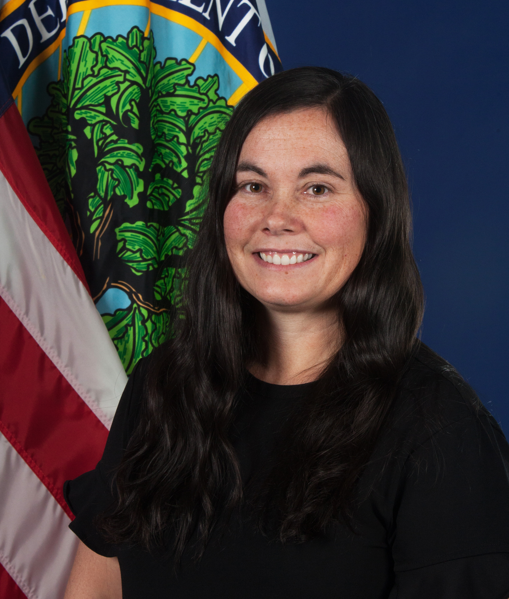
Office of Special Education Programs
Project Officers
Meredith Miceli
  Amy Bae​
Notes:
5 minutes for this slide

Slide 3

Systems Change – the WHY for DaSy
Improve states’ capacity to collect, report, analyze, and use high quality IDEA Part C and IDEA Part B preschool data.
Enhance, streamline, integrate statewide child-level early childhood data systems to address critical policy questions that will:
  facilitate program improvement,
  improve compliance accountability, and
  improve federal and public reporting.

Slide 4








DaSy can help with many types of data:
Child & Family Outcomes Data | Fiscal Data | Accountability Data | Child Find Data
Part C 618 Data | Transition Data | SSIP/APR/SPP | Other types of data… just ask!

Slide 5






We can help you build capacity in:
Data Collection & Transmission | Data Analysis & Reporting | Data Linking & Integration | Data Governance | Data System Design & Technology | Data Use

Slide 6
We are committed to supporting data leaders:
Building the knowledge and skills of state coordinators and others:
  Understand IDEA data requirements
  Know how to examine data quality
  Data literacy skills
Supporting leaders to build the capacity of stakeholders to understand and work with data
Building a culture of data use

Slide 7

New Products from DaSy
Data Linking Toolkit
Data Governance Toolkit
Target Setting Guide
Processes for Documenting Part C Data Toolkit
State of the States Resources
Notes:
Introduce next speaker: Bruce Bull who will tell us about the Data Linking Toolkit

Slide 8
Data Linking Toolkit (coming soon)
Purpose: Guidance for Part C and Part B 619 staff on linking both internal program data (e.g., outcomes with demographic data) and external program-to-program data (e.g., EDHI with Part C).
Description: Information, guidance, and tools to consider, prepare, and successfully link data.
Intended audience: Part C and Part B 619 program staff, data managers, and staff from potential linking partners.
Notes:
Help link data: INTERNAL and EXTERNAL data linking (different agencies and programs configurations: different levels of work)
EDHI: Early Hearing Detection and Intervention

Slide 9
Data Linking Toolkit
What is data linking?
Connecting information contained in an individual record (e.g., child, service provider, service) in one data source with information related to that same record in another data source.
What is the goal of data linking?
The primary goal of linking Part C and Part B 619 data is the creation and analysis of a new dataset to answer more questions, inform and support program improvement, and ultimately better support children and families.
Notes:
More complex than data sharing.
Less complex than data integration.
Goal . . .

Slide 10
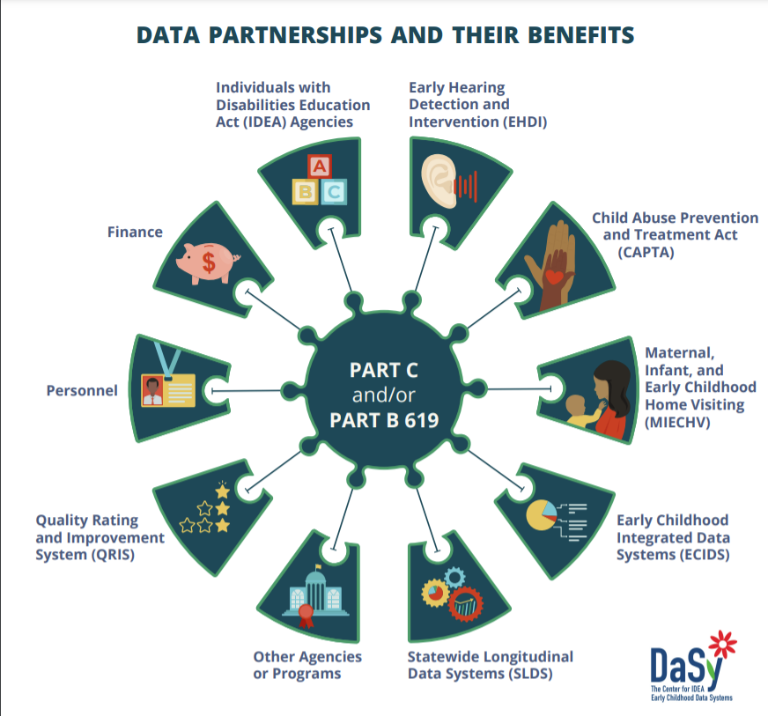
Data Partnerships and Their Benefits
Notes:
Potential partners shown here
The benefits of linking data with each partner is part of the figure in toolkit, but for this overview, that small text regarding benefits was removed.

Slide 11
Data Linking Toolkit: Content
Introduction
Data Linking Partnerships
Benefits of Data Linking Partnerships
Potential Data Linking Partners
Limitations and Risks of Data Linking
Steps to Data Linking
  Step 1: Check Data
  Step 2: Assess Agency Readiness
  Step 3: Formalize Data Partnership
  Step 4: Link Data
  Step 5: Sustain Data Linking
Part C and Part B 619 Data Linking
  Data Linking of Part C to Part B 619 Transition Data
Data Linking of Child Outcome Data
  Data Sharing and Data Integration
Resources and Tools
Notes:
TOC
Partnerships work and time
DSA for authority to share, data linking partnership management plan,

Slide 12
Data Linking Toolkit: Some Considerations
Intra-agency vs inter-agency
Use case (Why are we linking data?)
Data quality
Partner readiness
Data partnerships
Data governance – single agency, multi-agency
Matching records
Sustainability
Notes:
Use case
Data quality
Readiness
Matching records – not overly technical, a high level technical description

Slide 13
Data Linking Poll
In the next 6–12 months are you interested in: (select all that apply)
Linking Part C or 619 data sets that are within your program
Linking Part C data with 619 data
Linking Part C or 619 data with data from another program within your lead agency
Linking Part C or 619 data with data from another program outside your lead agency
We’re not interested in linking data within the next 6–12 months
Notes:
Team of DaSy providers that would enjoy engaging with you on this topic.
Curious, where is your state with regards to data linking:
Introduce next speaker: Sara Argue who will tell us about the Data Governance Toolkit

Slide 14
Data Governance Toolkit
Purpose: To provide Part C and Part B 619 staff support in developing or updating data governance policies for their activities and data systems.
Description: The Data Governance Toolkit is a resource containing information, guidance, and policy templates to assist in creating or enhancing data governance policies and procedures.
Intended audience: Part C and Part B 619 program staff.
Contact your DaSy State TA Liaison or Sarah Argue at sarah.argue@sri.com.
Notes:
The Data Governance Toolkit is designed to help Part C and Part B 619 program staff develop new data governance policies and procedures or enhance existing policies and procedures.
We recognize that often Part C and Part B 619 programs are embedded in larger division or agencies with their own data governance policies and procedures. This toolkit is designed to work alongside those policies and procedures, or independently, however best meets the needs of the program.
While the toolkit was designed with Part C and Part B 619 programs in mind, they are good frameworks for developing data governance policies for any data system.
As I share the toolkit with you, think about how your program might be able to use this toolkit.

Slide 15
Sections of the Data Governance Toolkit
Notes:
There are eight toolkit packets each addressing a specific area of data governance, plus an introduction to data governance and a separate section for governance of data partnerships. There are also additional data governance resources.
Each of the eight sections address different areas of data governance compliance:
Data Breach Response – A data breach response policy establishes a set of procedures to be followed in the event of a data breach: how and when the breach should be reported to authorities; how and when to inform the public, especially those at risk because of the data breach; recommendations to the public to reduce the post-breach risk; sanctions the agency might consider; and strategies to minimize future risk of a breach.
Data Quality – Data quality refers to the overall usefulness to be easily processed and analyzed for other uses. Data governance policies that address data quality must clearly communicate expectations for how data are to be collected, entered, prepared, analyzed, and reported.
Data Security and Access – Data security and access is making sure that data are protected from unauthorized access and defining who may access the data.
Data Systems Change – Establishing a process for Part C and Part B 619 program staff to be actively involved in partnering with IT staff when considering data system changes that will affect their data and work.
Public Reporting – Public reporting is the publishing of information that has no restricted access. Information or data that contain personally identifying information cannot be released in public reports.
Electronic Communications – Policies to minimize the risks introduced by electronic communications by addressing its use.
Data Requests – State agencies for Part C and Part B 619 regularly receive requests for data from internal and external parties. Helps to establish what data are available, to whom, in what formats, for what purposes, and how data requests are to be handled.
Data Retention and Destruction – Part C and Part B 619 governance policies must address record retention and data destruction to establish the responsibilities and timeliness for the retention and destruction of multiple types and formats of Part C and Part B 619 data, consistent with federal and state requirements.

Slide 16
Data Gov Considerations Worksheet
Notes:
Each packet consists of a considerations worksheet and a policy template. The considerations worksheet contains questions to consider and recommended policies/procedures/documents to collect prior to completing the policy template. Each consideration is marked with a red letter that corresponds to the same red letter within the policy template.
DaSy is available to facilitate these conversations and help programs discuss the various questions posed within the Considerations Worksheets. And once you have completed the Considerations Worksheet and move the information collected through the process into the Policy Template, you will instantly have a draft policy!

Slide 17
Data Gov Policy Template
Notes:
The policy template is a completely customizable word document that can be edited to fit each state’s needs. The policy templates each have the same 12 sections, so as you go through the eight data governance sections, there is continuity to them – although they are each unique to the particular data governance topic being addressed. The policy templates are designed to be specific enough to be relevant but high level enough that they don’t have to be changed frequently (e.g., identifies role responsible rather than person responsible).

Slide 18
Data Governance Toolkit Poll
Notes:
Introduce next speaker: Sharon Walsh who will tell us about the Target Setting Guide
Add a multi-select poll: If you were going to start on a Data Governance project, what would be the top three areas you would address first?
Data Breach Response
Data Quality
Data Security and Access
Data Systems Change
Public Reporting
Electronic Communications
Data Requests
Data Retention and Destruction

Slide 19
Target Setting Guide

Slide 20
Federal Requirements: Target Setting
State Part C lead agencies are required to set targets for results indicators
Targets must be set for 6 years (Federal Fiscal Year (FFY) 2020–2025)
Targets must be set with broad stakeholder input
Targets should be rigorous and aspirational but realistic
These targets must be included in the Part C State Performance Plan and Annual Performance Report (Part C SPP/APR) submitted 2/1/22

Slide 21
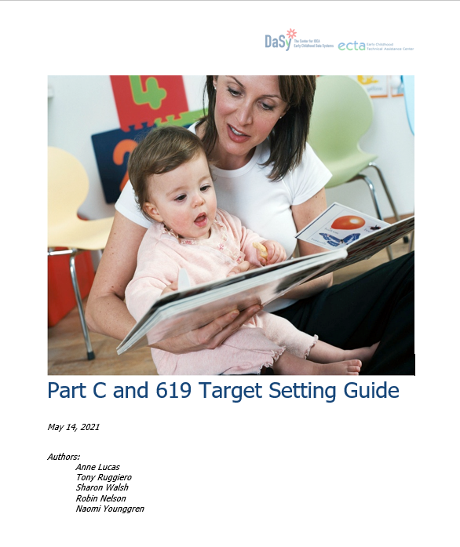
Part C and 619 Target Setting Guide
Introduction
Federal Requirements and OSEP Guidance
General Considerations for Baselines and
Targets
Notes:
Sharon

Slide 22
Includes Steps for Setting Targets
Step 1: Identify and prepare stakeholders
1
Step 2: Compile data and resources and conduct analysis
2
Step 3:
Facilitate discussions to develop target recommendations
3
Step 4:
Make decisions about targets
4
Step 5:
Share final targets
5
Notes:
Sharon

Slide 23
Approaches for Target Setting
Percent or Percentage Point Improvement
Start with the End Goal
Trend Analysis and Forecasting
Statistical Modeling/Analysis
Additional Considerations
Notes:
Sharon

Slide 24
Examples of Data Visualization
Figure 1. Historical data for Indicator C3 or B7.
Figure 2. Bar graph with contextual information.
Figure 3. Percent Birth to Three Served by County.
Figure 4. Family Outcome Results vs. Targets, Bar Graph.
Figure 5. Family Outcome Results vs. Targets, Line Graph.
Figure 6. Percent Birth-to-Served and Population Data, by County.
Figure 7. Using Filters or Slicers to Focus on Specific Information.
Figure 8. Summary of Target-Setting Approaches.
Notes:
Sharon

Slide 25
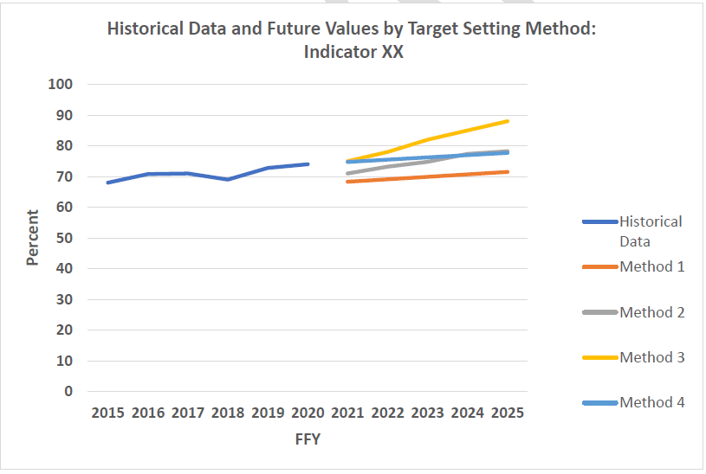
Data Visualization: Approaches for Target Setting
Notes:
Tony
This graph is a summary of target-setting approaches.
This graph displays the historical data for an indicator and the future values (targets) for each of the methods used.

Slide 26
Indicator Specific Guidance
C2: Settings
C3 and B7: Early Childhood and Preschool Outcomes
C4: Family Outcomes
C5: Child Find Birth to 1
C6: Child Find Birth to 3
B6: Preschool LRE
C9 and C10: Dispute Resolution
C11 and B17: State Systemic Improvement Plan

Slide 27
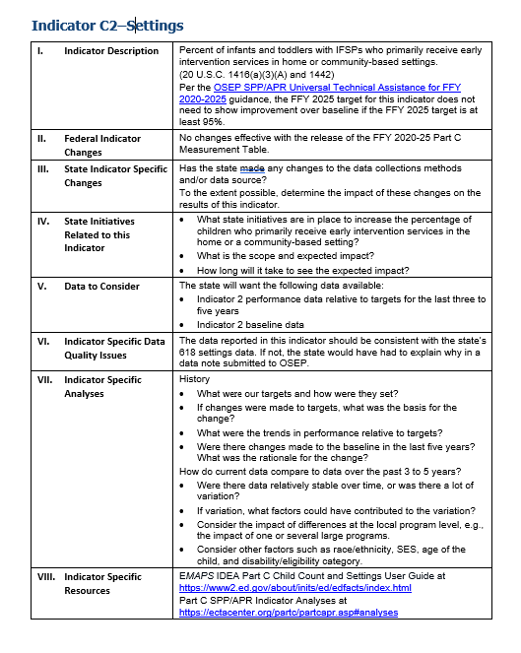
Topics Included in Indicator Specific Guidance
Indicator Description
Federal Indicator Changes
State Indicator Specific Changes
State Initiatives Related to this Indicator
Data to Consider
Indicator Specific Data Quality Issues
Indicator Specific Analyses
Indicator Specific Resources
Notes:
Sharon

Slide 28
Available Target Setting TA from ECTA/DaSy
Understanding federal requirements
Planning an overall state approach and timelines
Planning for engaging takeholders
Preparing data and understanding approaches
Analyzing and displaying data
Setting targets considering stakeholder input
Indicator specific target setting TA
Notes:
Sharon

Slide 29
Next Step
Contact your DaSy State Technical Assistance Liaison or your ECTA State Contact to provide assistance with target setting or other aspects of IDEA data work.
Notes:
Introduce next speaker: Bill Huennekens who will tell us about the Processes for Documenting Part C Data Toolkit

Slide 30
Processes for Documenting Part C Data Toolkit
Documenting data processes can help a lead agency:
  Improve processes by identifying inefficiencies in the process;
  Train employees by helping them understand the processes and their role in them;
  Preserve agency knowledge when there is staff turnover; and
  Mitigate risks and maintain consistent data practices.

Slide 31
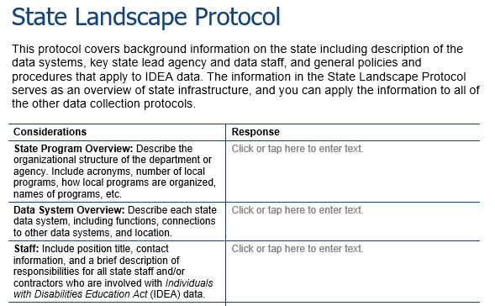
Processes for Documenting Part C Data Toolkit
The toolkit contains customizable data collection protocols to document data processes for the lead agency.
State Landscape Protocol
Protocols for local EI program determinations, child count settings, dispute resolution, exiting
Protocols for each of the 10 indicators
Further documents include:
Overview
Data Collection Calendar
Resources documents

Slide 32
Processes for Documenting Part C Data Toolkit
DaSy strongly recommends a team approach to completing the protocols.
Staff members who are typically included are:
  Part C Coordinator,
  Part C Data Manager,
  Data Governance Coordinator or Manager,
  Program staff,
  IT Steward, and
  Other staff as appropriate.
When completed by a team, the work itself assists with enhancing communication and increasing collaboration for data processes.

Slide 33
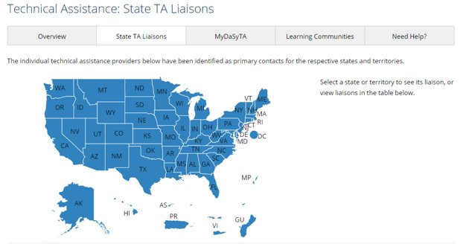
Processes for Documenting Part C Data Toolkit
Contact your DaSy State TA Liaison if you are interested in receiving support to complete all or portions of the Processes for Documenting Part C Data Toolkit.
Notes:
Introduce next speaker: Donna Spiker who will tell us about the State of the States Resources

Slide 34
State of the States: Data System Quality
The purpose is to provide a national picture of IDEA early childhood state data systems.
DaSy has several resources on the status of state data systems:
  Maps - status of quality indicators
  State of the States report (coming soon!) & conference presentations
Part C and Part B 619 Coordinators, Data Managers, and other early childhood state and local staff can understand:
  how their state is doing on data system quality indicators
  how states are doing and where their state is relative to other states.

Slide 35
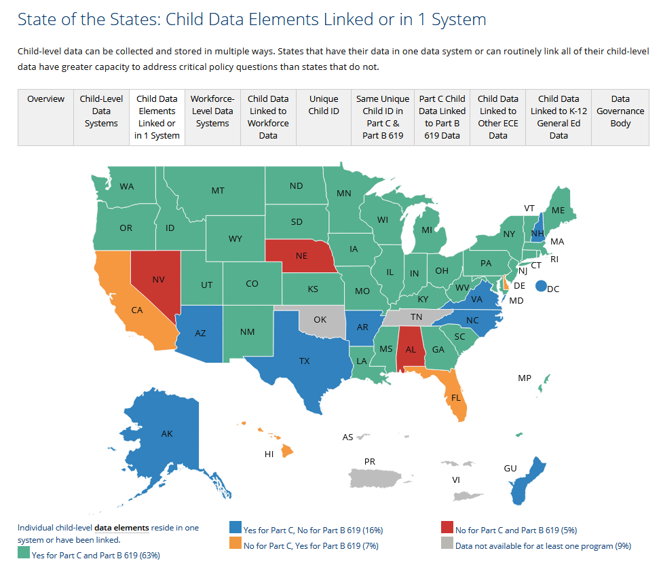
State of the States: Maps
Maps display each indicator item for Part C and Part B 619 programs at a national level and state level

Slide 36
State of the States: Some Key Findings
About one third of Part C and Part B 619 programs use the same unique identifier (31%) – a feature important to linking data!
A little less than half (41%) of Part C and Part B 619 programs have linked their data between programs.
About one-fourth of Part C (26%) and a little over half of Part B 619 programs (56%) have ever linked to another early care and education program (i.e., Head Start, Early Head Start, state preK, child care, or home visiting).
A little over half of Part C programs (56%) and almost all Part B 619 programs (93%) have a data governance body that oversees their child data.
Notes:
Introduce next speaker: Now I (Donna) will tell you a little more about DaSy and lead the Q&A section

Slide 37

Additional Products and TA Opportunities
Notes:
Donna

Slide 38

TA
State individualized TA
Cross–state cohorts
Webinars
On-line working series
Learning Communities
Toolkits
Resources
Conference on Improving Data Improving Outcomes

Slide 39

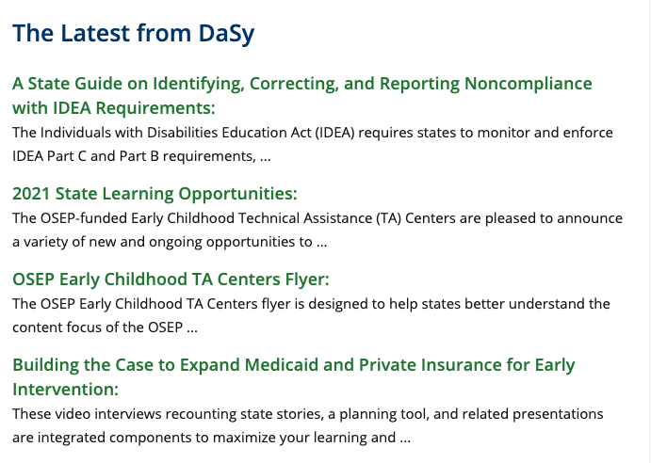
Additional Products and TA Opportunities
Notes:
Sam: put DaSy website in chat
Donna suggested mentioning 2021 Data System Framework
Maybe also mention:
Tech series with links – Virtual Engagement Toolbox
Updated Accountability Materials
DMS Resources
ARP Funds – DEC Guidance
Child Outcomes Summary LMS

Slide 40
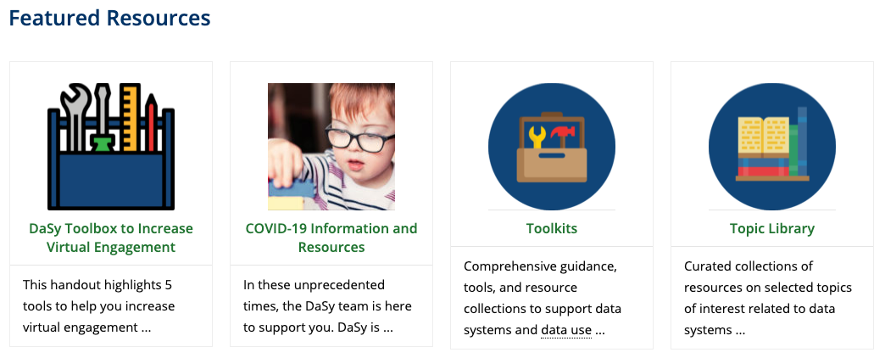
Additional Products and TA Opportunities

Slide 41

How to Request TA
Contact your State TA Liaison – list located on DaSy website
  https://dasycenter.org/technical-assistance/state-technical-assistance-liaisons/
Request TA directly on the DaSy website
  https://dasycenter.org/technical-assistance/
Notes:
Sam will put links in chat
Mention types of TA available: informational, targeted and more intensive TA with states on individual basis; we also have CoPs...

Slide 42

Questions?

Slide 43

Evaluation Reminder
Please complete the webinar evaluation that will be emailed to you today.

Slide 44


Thank you
Visit us at http://dasycenter.org/
Follow us on Twitter: @DaSyCenter
The contents of this presentation were developed under a grant from the U.S. Department of Education, #H373Z190002. The contents and resources do not necessarily represent the policy of the U.S. Department of Education, and you should not assume endorsement by the Federal Government. Project Officers: Meredith Miceli and Amy Bae.

