Slide 1
Using IDEA Part C and 619 Data in the PDG 0-5 State Systems Needs Assessment
Date: Tuesday, August 27
Time: 3-4:30 est

Slide 2
Partners and Presenters
Kathleen Hebbeler, DaSY
Christina Kazprzak, ECTA
Grace Kelley, DaSY
Haidee Bernstein, DaSY
Jim Lesko, PDGB-5
State Presenters:
Debra Anderson, Ginger Elliot-Teague & Jackie Adusumilli
Presented by:
DaSy, ECTA & PDG B-5 TA.

Slide 3
Purpose
Support state PDG managers in taking a comprehensive approach to develop the needs assessment which will inform the strategic plan by
Sharing information about the IDEA Part C and Part B 619 data
Highlighting types of data collected and where the data is located
Sharing state examples of how the data can be used and analyzed for effective decision-making

Slide 4
Overview of the IDEA Requirements
IDEA Part C contains the reporting requirements for eligible infants and toddlers with disabilities ages birth to 3 and their families. There are 10 Annual Performance Reports (APRs) Indicators and 1 State Systemic Improvement Plan (SSIP)
IDEA Part B contains the reporting requirements for eligible children with disabilities ages 3-21. There are 14 APR Indicators and 1 SSIP.

Slide 5
Relevant Part C Indicators
Child Count
Birth to 1
Birth to 3
Percent of birth to 3 served (state and national level)
By race/ethnicity
By race and by settings
Child Outcomes
Positive social emotional skills
Acquisition and use of knowledge and skills
Use of appropriate behavior to meet needs

Slide 6
Relevant Part C Indicators
Family Outcomes: The percent of families served who:
Know their rights
Effectively communicate their child’s needs
Help their child develop and learn
Percent of infants and toddlers primarily served at home or in the community

Slide 7
Percentage of Children Served from Birth to Age Five (N=36,664) by Race/Ethnicity for Hypothetical State
Notes:
Would also be interesting to see % served by language spoken at home or poverty status.

Slide 8
Question:
What percentage of children referred are enrolled in EI services?

Slide 9
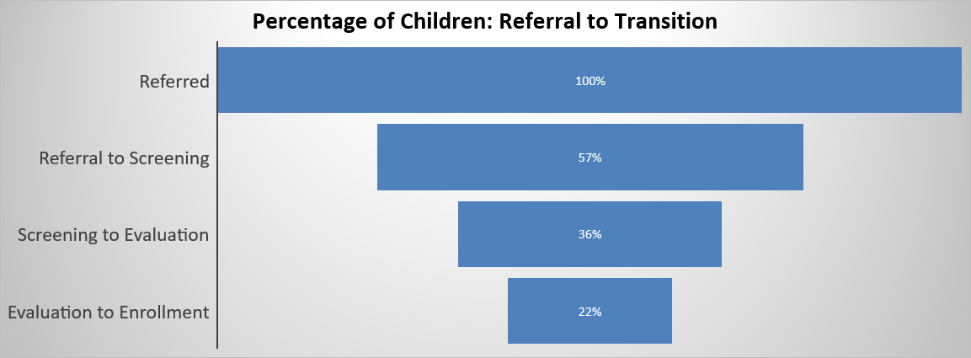
Sample Chart Using IDEA Data – Part C

Slide 10
Question
How many children who are referred, receive services and transition to preschool special education programs ?

Slide 11
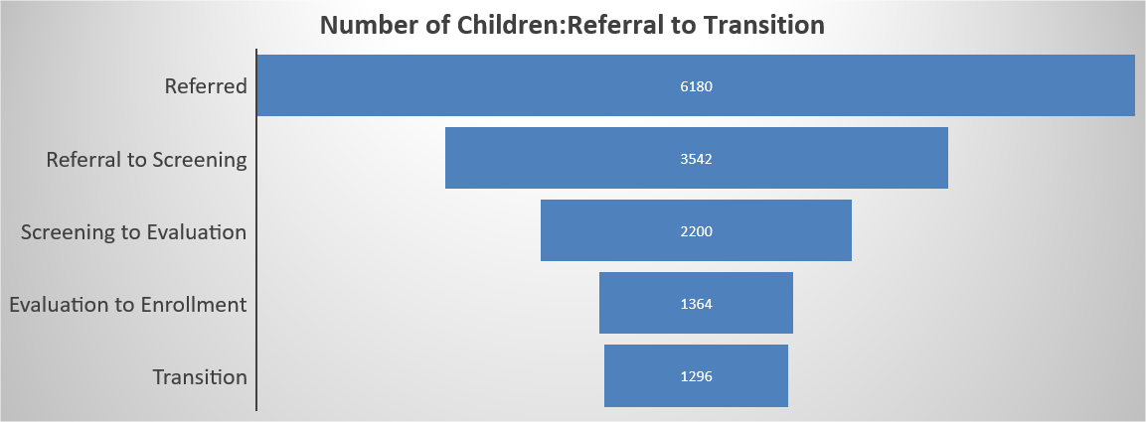
Sample Chart Using IDEA Data –Part C

Slide 12
North Dakota Part C and PDG
Our experience with IDEA Data, Part C Stakeholders and the Preschool Development Grant

Slide 13
Part C Involvement
North Dakota Office Of Early Learning (OEL)
Department of Public Instruction (DPI)
Part B 619
Head Start Collaboration Administrator
OEL Director and Assistant Director
Department of Human Services (DHS)
Part C Coordinator
Child Care Administrator
This Photo by Unknown Author is licensed under CC BY-SA-NC

Slide 14
Part C Involvement
Involved in grant writing process
Contributed information about Part C’s needs in all areas, including SSIP
Directed specific grant activities related to Part C
Helped to determine overall OEL goals and outcomes
Collaborating with OEL to work toward goals during this grant period
This Photo by Unknown Author is licensed under CC BY-NC-ND

Slide 15
Part C Involvement
Needs Assessment
Part C/618 Data- demographics from most recent APR
Feedback from ICC
What information are we missing?
Where can we get that information?
Who else do we need to talk to?
Feedback from Part C Parents
Transition focus groups and surveys
Child Care focus groups
This Photo by Unknown Author is licensed under CC BY-SA

Slide 16
Next Steps
Follow-up with ICC and other Part C Stakeholders
Integrated Data System
Pulling together other 0-3 state programs (EHDI, Home Visiting Programs, etc.)
Next Grant Cycle
Will remain involved with writing
Building off of current goals and program needs

Slide 17
Relevant IDEA Preschool Data
Preschool settings: Percent of Children ages 3-5 attending:
Regular early childhood program and receiving the majority of their special education services in a regular early childhood program
Separate special education class, separate school or residential facility
Child Outcomes
Positive social emotional skills
Acquisition and use of knowledge and skills
Use of appropriate behavior to meet needs

Slide 18
Relevant IDEA Preschool Data
Transition to Preschool: The percent of children referred by Part C prior to age 3 who are found eligible for Part B and have an IEP developed and implemented by Part B by their third birthday
Parent Involvement: The percent of parents with a child with disabilities age 3-5 who report that schools facilitated parent involvement

Slide 19
Relevant IDEA Preschool Data
Child Count age 3-5
Percent of children aged 3-5 served (state and national level)
By race/ethnicity
By race and by educational settings

Slide 20
Question
How many children transition directly or indirectly from EI(Part C)to preschool special education (619)?
How many children have not received EI services but enter preschool special education (619)?

Slide 21
Sample Bar Graph on Preschool Special Education
Notes:
The green represents children who exit from EI but re-enter Preschool special education at some point
Aqua – represents children who were not in EI but enter to Preschool Special Education

Slide 22
State Systemic Improvement Plan (SSIP)
In 2015, states were required to develop 2 SSIPS. They are an achievable multi-year plan to improve results for: (1) improving results for infants and toddlers with disabilities and their families and (2) improving results for children ages 3-21 with disabilities
In the first year (Phase 1), states were required to submit:
Data Analyses (includes child counts and child outcome data related to the work they want to accomplish)
Analyses of the state infrastructure to support improvement and build capacity
State identified Measurable results for children with disabilities
Selection of Improvement strategies
Theory of Action

Slide 23
State Systemic Improvement Plan (SSIP)
Phase II (2016) required states to:
Develop the infrastructure needed to support their improvement strategies
Support local education agencies implementation of evidence-based practices
Conduct evaluations of progress
Phase III (2017- now)
Continue implementation of strategies and report progress

Slide 24
Oklahoma

Slide 25
Development of Oklahoma’s ECIDS*
How SoonerStart (Part C) data became the first step in linking data
Dream big – 10 year journey
Focus on one identifiable action
Link to existing efforts
DISCUSS (Interagency body to create data system interoperability)
Unique Identifier (Master Person Index)
W.K. Kellogg Foundation and George Kaiser Family Foundation
Project SHINE
*Early Childhood Integrated Data System

Slide 26
What Did We Want to Know?
Created several research questions about enrollment in HV programs and how that might impact later outcomes and which children are enrolled in programs in addition to HV
The MIECHV program identified a reason to link with SoonerStart to answer one performance measure
Do children enrolled in HV programs who are referred to SoonerStart receive an assessment within 45 days of the referral?

Slide 27
Opportunities and Challenges
The Master Person Index analytics had been completed on both sets of data.
Part C and MIECHV services are both administered through the Department of Health, providing the opportunity for data managers within the same agency to create and manage data linkages.
Even though they are in the same agency, their data systems do not automatically link.
Department of Education is the lead agency for SoonerStart – which required legal counsel from two state agencies needed to agree and approve this data linkage.

Slide 28
Project SHINE
State-level Home Visiting Integration with Early Childhood Data Systems (SHINE) initiative.
Oklahoma one of five states
Goal in ensure the HV data is integrated into state level early childhood data systems
Oklahoma’s objective was to create a schedule in the existing interagency data sharing agreement to link HV data

Slide 29
Results and Benefits
A total of 163 records matched
35 received an initial assessment with SoonerStart within the 0-45 day window
118 of them had actually received an initial assessment prior to the ASQ-3 being administered by the Home Visitor
Ability to match these records increase in accuracy of the data
Reduced burden for the providers to remember to enter the data, so they can focus on service provision

Slide 30
Future Questions under development
The extent to which constrained supply and restrictive eligibility requirements limit access to Part B/C services.
How these issues might differ across regions and/or populations.
Help Oklahoma understand which factors drive the significant number of SoonerStart referrals that do not lead to service in order to increase its ability to serve children with developmental delays and ensure continuity of care.

Slide 31
Links
Current Part C and Preschool Coordinator Contacts for each state:
http://ectacenter.org/contact/ptccoord.asp
Office of Special education
Indicator Analyses: https://osep.grads360.org/#program
State Performance Plan (SPP)/ Annual Performance Plan (APP):
https://osep.grads360.org/#report/apr/publicView
Annual Report to Congress:
https://www2.ed.gov/about/reports/annual/osep/2018/parts-b-c/40th-arc-for-idea.pdf

Slide 32
Links
Critical Questions about EI/ECSE
https://dasycenter.sri.com/downloads/DaSy_papers/DaSy_Critical_Questions_FINAL_20151023v2.pdf

Slide 33
Final presentation slide
Visit the DaSy website at: http://dasycenter.org/
Follow DaSy on Twitter: @DaSyCenter
Visit the ECTA website at: http://ectacenter.org/
Follow ECTA on Twitter: @ECTACenter

Slide 34
Thank you
The contents of this tool and guidance were developed under grants from the U.S. Department of Education, #H373Z120002 and #H326P170001. However, those contents do not necessarily represent the policy of the U.S. Department of Education, and you should not assume endorsement by the Federal Government. Project Officers: Meredith Miceli, Richelle Davis, and Julia Martin Eile.
Notes:
Instructions to presenters: This slide is to be included as the last slide in your deck but you are not expected to show it to the audience. Please be sure to delete these instructions from this slide’s notes page in your presentation.

