Slide 1
Engaging with Your EHDI Partner in Data Sharing Activities: Improving Outcomes for Young Children with Hearing Loss
August 28, 2019

Slide 2
Welcome
Haidee Bernstein, DaSy
haidee.bernstein@sri.com
Evelyn Shaw, ECTA
evelyn.shaw@unc.edu
Sharon Walsh, DaSy
walshtaylo@aol.com

Slide 3
Outcomes
Participants will gain an increased understanding of the requirements related to data sharing under IDEA and FERPA.
Participants will gain knowledge of the data sharing arrangements from 2 states’ representatives including challenges and strategies.
Participants will become aware of resources related to data sharing.
Notes:
Evelyn presents

Slide 4
Polling Questions

Slide 5
Brief Reminders of IDEA and FERPA Requirements Related to Data Sharing

Slide 6
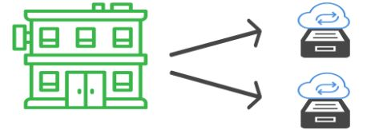

Consider Two Scenarios
Scenario A
Scenario B
Single lead agency, Health Department, two separate data systems for Part C and EHDI
Two different lead agencies, Health for EHDI and Non-Health for Part C, each has its own data system

Slide 7
Brief Reminders: IDEA and FERPA
Obtaining written parental consent is always the safest way to share data
If you are sharing aggregate data without releasing personally identifiable data (PII) no consent is needed
Must follow regulations under IDEA Part C at 34 CFR Part 303 (Consent and Confidentiality Provisions)
IDEA requires states to also follow the regulations for the Family Education Rights and Privacy Act (FERPA) at 34 CFR Part 99 (Consent and Exceptions to Consent)
FERPA consent exception for evaluation and audit permits data sharing without parental consent with development of a data sharing agreement
Check with your privacy office regarding any HIPAA implications for your state

Slide 8
IDEA Part C Participating Agency
PII data can only be shared outside of participating agencies with parental consent
Any individual, agency, entity, or institution that collects, maintains, or uses personally identifiable information to implement the requirements in Part C.
Includes LA. EIPs, and any individual/entity that provides any part C services.
Does not include primary referral sources or public agencies or private entities that act solely as funding sources for Part C services.

Slide 9
Disclosure of PII From Records under FERPA
FERPA permits disclosure of PII without parental consent from early intervention records under several exceptions:
  Staff or employees who need access to perform duties
    School official exception
    “Legitimate educational interest”
  External entities
    Studies exception
    Audit or evaluation exception
    Uninterrupted Scholars Act
    Other (e.g., court order, health or safety emergency)
  Requires a data sharing agreement according to FERPA requirements

Slide 10
Privacy Considerations
?
Where do the data reside?
What federal, state, and local laws apply to data sets?
What data sharing agreements need to be in place? Requirements?
What data do you want to share, how will the data be shared AND where will it be stored?

Slide 11
Arizona
Notes:
Annie-Data Manager with the Arizona Early Intervention Program, IDEA Part C

Slide 12


Arizona Early Intervention Program
Annie Converse-Arizona Part C Data Manager
KConverse@azdes.gov
Fran Altmaier-Newborn Screening Manager
Fran.Altmaier@azdhs.gov
Notes:
ANNIE (less than 1 minute)
Arizona has a 5 state intergovernmental agreement with Arizona Department of Economic Security as the lead agency.
Challenges:
Physical location can be miles apart.
Privacy/Security-HIPPA, Hybrid, FERPA

Slide 13
Early Hearing Detection & Intervention
Office of Newborn Screening
  Early Hearing Detection and Intervention Program (EHDI)
Notes:
FRAN (1-2 minutes)
EHDI location: program is within Department of Health Service
Strengths:
Close physical proximity across the street
Former early intervention colleagues in new roles understand us
Willingness to work through challenges
Knowledge of both programs
Patience and persistence
Challenges
Different Systems (Hi-Trac vs. Homegrown database)
Records retention schedule
HIPPA, FERPA, hybrid

Slide 14
Reasons for Data Sharing
Improve federal reporting for both programs
Improve compliance with state law for reporting hearing screenings
Analysis of Child Find Activities
Answering critical questions like: Are we making a difference?
Notes:
FRAN (2 minutes)
Improved reporting to the Centers for Disease Control and on Child Find Activities Office of Special Education Program
Hearing screenings for children under age 2 are required to be submitted.
Part C provides programs with OAE hearing screening machines and have the duty to make sure they are using and reporting appropriately under our state law.
Did we catch all the kids that are deaf or hard of hearing? We missed a few last year. How well are we doing?
Ultimately, we would like to analyze Child Outcomes Data because we want to know if we are making a difference.
Educating each other and learning about the other system
Advantage of EHDI person coming from Part C
Mutual respect and we have the same goals of making sure children are enrolled in timely services, we both have challenges but we worked through them together

Slide 15
Process of Development
Education on FERPA requirements
Identification of critical questions
Review of documents, policy, best practice
Directed towards available tools
Facilitated review by the Privacy Technical Assistance Center (PTAC)
Regular phone calls and check-ins
Accountability
Cheerleading
Notes:
ANNIE (1-2 minutes)
We’ve been able to get this far due to technical assistance with DaSy. Used tools and resources such as critical questions document, data sharing checklists. Taken approximately 2 years with a majority of the work within the last 6-7 months.
DaSy helped to understand and follow the FERPA requirements. We learned that FERPA does not prevent sharing or disclosing the information. It just states that it has to be done in certain ways.

Slide 16
Data Elements and Match Date
Part C
Unique Identifier
Demographic
Child Outcomes
Referral and IFSP Date
Exit Reason and Date
OAE Hearing Screening Results
Early Hearing Detection and Intervention
Unique Identifier
Demographic
Diagnosis
Birth Facility
Notes:
ANNIE (4 minutes)
As part of the data sharing agreement we had to specific the data elements being shared.
For enrollment, we specified referral and IFSP date
The Data Sharing Agreement is the a place to refer back to know what can be shared and what can’t to respect the privacy of the family.
We explored using the same unique identifier but it wasn’t possible in our data system. We learned as part of the TA other methods for matching the data. Each agency has a unique identifier which we are matching up. We are working on automating the matching process. When we report, we use both IDs so we can both match. Able to match the data up at the child level to provide aggregated reports and evaluate the process.
Aligning the data elements like Date of birth vs. birthdate.
Helps to develop understanding between both programs about what can and cannot be shared.

Slide 17
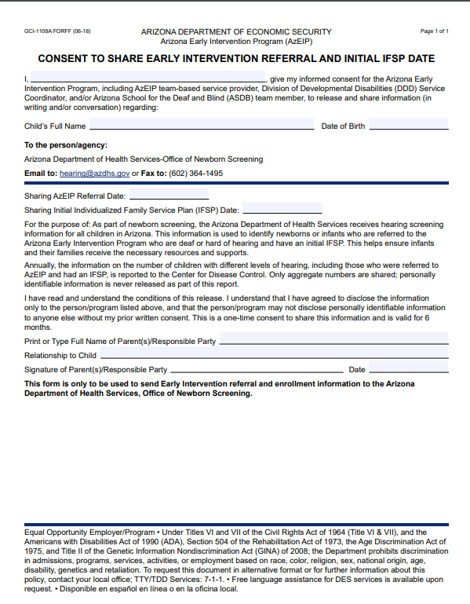
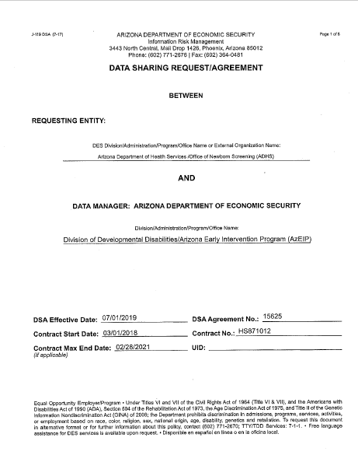
Before and After

Slide 18
Lessons Learned
Filling the gaps with complete data
Improvement for policy and form updates
Identified technical assistance needs for our local early intervention programs
Better data manager
Notes:
ANNIE (4 minutes)
Data Sharing Agreement Completed July 2019
Data linking provides complete data.
The knowledge about the group of children’s referral outcomes. How many were referred, how many declined
Discovered some children that were not in the Part C database
EHDI didn’t know what happened but Part C data showed they were referred and exited before IFSP, parent declined services, loss of contact with the family
EHDI wasn’t mentioned in policy and although it was a requirement to share hearing screenings the form wasn’t part of the official Arizona Part C forms library. There was general misunderstanding of the policy as it relates to what was required to be shared.
As a new data manager, it helped me to by job better. Data sharing and safeguarding data is a key part of my job. I’ve been able to turn around other data sharing agreements as we had contract changes with out local early intervention program.
It was a positive process and I would have started sooner because the information we gathered has been so valuable for evaluating our systems. Don’t hesitate to get TA. Get TA if you need it. Our TA providers were a neutural third party that just helps facilitate the conversations.

Slide 19
Next Steps
Increase transparency with families by updating privacy policy and Procedural Safeguards
Use as a template for other data linking projects with Part B 619 and Child Safety
Automation of the data linking
Notes:
ANNIE AND FRAN (2 minutes)
Data Sharing Agreement Completed July 2019
Discovered some children that were not in the Part C database
EHDI didn’t know what happened but Part C data showed they were referred and exited before IFSP
Keep going and work on larger project with Part B counterparts on transition and longitudinal data
Working with our ICC on updating the Parent Right’s booklet with new phrasing on how data are shared across programs.
Sharing the data is helping us
Improving Child Find activities
Analyze program efficacy for Child Outcomes
Assessing for compliance with state law
EHDI: Educating referral sources on when and how to make a referral
Part C: Educating early intervention providers on requirements around hearing screening and enrollment data reporting
Keep going and work on larger project with Part B counterparts on transition and longitudinal data
Working with our ICC on updating the Parent Right’s booklet with new phrasing on how data are shared across programs.

Slide 20
Georgia EHDI – Part C Partnership
Judith Kerr / Brandt Culpepper / Lisa Pennington

Slide 21
EHDI and Part C Organizational Structure
Georgia Department of Public Health
Health Promotion
EHDI
Part C
Health Protection
Maternal and Child Health

Slide 22
Request to Share Data
EHDI Program Goals
  1-3-6 milestones
  Data Completeness
  EHDI-IS Functional Standard
  Evaluate impact and identify areas of improvement
Interdepartmental Agreement
  Purpose
  Scope
  Responsibilities of each program
  Frequency of data sharing
  Variables to be shared

Slide 23
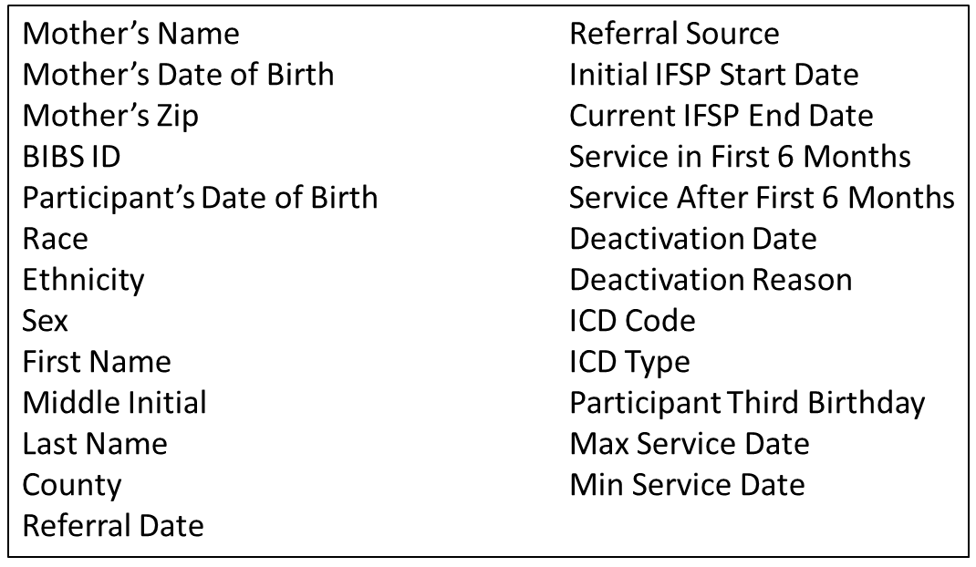
Part C Variables Available to EHDI Program

Slide 24
Challenges to Sharing Data
Data entry practices across programs
Reports vs. direct access to database
Reasons for sharing

Slide 25
Lessons Learned
Buy-in from each program
Focus on what you can do

Slide 26
Next Steps
Quarterly data reports
Explore storing data in EHDI database
Automation

Slide 27
Thank You
Judith Kerr, MPH
Child Health Screening Senior Manager
Maternal and Child Health Section
Georgia Department of Public Health
Email: Judith.Kerr@dph.ga.gov
Lisa Pennington, MS, MA, LPC
Deputy Director, Early Intervention
Maternal and Child Health Section
Georgia Department of Public Health
Email: Lisa.Pennington@dph.ga.gov
Brandt Culpepper, PhD, CCC-A
Early Hearing Detection and Intervention Team Lead
Maternal and Child Health Section
Georgia Department of Public Health
Email: Brandt.Culpepper@dph.ga.gov

Slide 28
Questions and Discussion
What success have you had in data sharing activities between EHDI and Part C?
What challenges exist in your state for sharing Part C and EHDI data?
Notes:
Privacy, technical, data elements, unique ID

Slide 29
Resources
Data Sharing Agreement Checklist for IDEA Part C & Part B 619 Agencies and Programs https://dasycenter.sri.com/downloads/DaSy_papers/DaSy_Data_Sharing_Agreement_Checklist_Acc.pdf
DaSy Resources: Special Collections on Privacy/Confidentiality and Linking Data http://dasycenter.org/other-resources/
Understanding the Confidentiality Requirements Applicable to IDEA Early Childhood Programs Frequently Asked Questions (FAQs) https://www2.ed.gov/policy/speced/guid/idea/memosdcltrs/idea-confidentiality-requirements-faq.pdf
2014 side‐by‐side guide of the IDEA and FERPA Confidentiality Provisions https://studentprivacy.ed.gov/sites/default/files/resource_document/file/IDEA%20FERPA%20Confidentiality%20Provisions%20Comparison%20Chart%2006.06.14.pdf
Critical Questions About Early Intervention and Early Childhood Special Education https://dasycenter.org/resources/critical-questions/
US Department of Education: Protecting Student Privacy https://studentprivacy.ed.gov/

Slide 30

Thank you!

