Slide 1
The Importance of a Strong Infrastructure in Providing Evidence-Based Early Intervention Practices
Kathleen Hebbeler, SRI International
Grace Kelley, SRI International
Christina Kasprzak, Frank Porter Graham Child Development Institute
Megan Vinh, Frank Porter Graham Child Development Institute
International Society on Early Intervention Conference
Sydney, Australia | June 2019

Slide 2
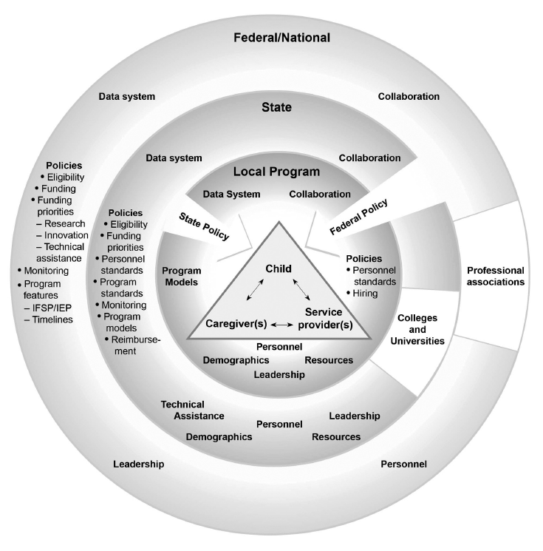
Influences on EI Service Delivery in the United States
Ecological representation of proximal and distal influences on EI service delivery in the United States
Notes:
Distal and proximal, invisible but important.

Slide 3
System for Producing Good Child and Family Outcomes
Research
Prof’l Development
Knowledge Base: Evidence Based Practice
High quality services and supports for children 0-5 and their families
Good federal infra-structure
Good state infra-structure
Good local infra-structure
Good outcomes for children and families
Strong Leadership
Adequate funding
Data system and high quality data
Notes:
Not just distal or proximal. The things in the outer circle interact. Part of the intentionality we need to building our systems is the availability and use of good information about the direct service component and the other components in the systems. Without good information, we are operating in a “pay and pray” mode. Without good data, we don’t know what we are buying with our money.

Slide 4
Infrastructure
The basic underlying features of a system or organization
Notes:
So what do I mean by an infrastructure for Recommended Practices? Infrastructure is defined as the basic underlying features of a system or organization. The infrastructure of our communities are its roads, bridges, schools, electricity. Our early intervention and early childhood special education program also require basic underlying features.

Slide 5
Why do we care about infrastructure?
Infrastructure either supports or impedes service provision.
If we don’t see and address negative infrastructure issues, we are asking practitioners to swim upstream with ankle weights.
Example: Personnel shortages
Notes:
Personnel shortages – systems challenges rarely have a single cause.
Do we have a service delivery model that relies too much on therapists? Is the solution necessarily to have more people?

Slide 6
What is a system?
A system is a set of interacting or interdependent
component parts forming a complex/intricate whole. A
system’s overall purpose or goal is achieved through
the actions and interactions of its components.
Notes:
Unlike water and electricity which are independent components of our infrastructure, the infrastructure in EI is a system.

Slide 7
Definition of a system
Your system …any system is perfectly designed to produce the results you are obtaining.
(Attributed to several people)

Slide 8
There are multiple systems in early intervention
Family system
Program level system
Local service delivery system/infrastructure
State system

Slide 9
A good service delivery system is really and truly a system
Teaming
Intervention
Child Find
Service Plans
Support for Transition
Assessment
Etc.
Instruction
Communication with Families
Notes:
Good assessment – Good service planning – good intervention/instruction –– good communication with families. Which of this pieces can you do without? Sorry. The bad news for those looking for easy answers is that we can’t have a single piece missing or poorly implemented.

Slide 10
System for Producing Good Child and Family Outcomes
Research
Prof’l Development
Knowledge Base: Evidence Based Practice
High quality services and supports for children 0-5 and their families
Good outcomes for children and families
Good federal infra-structure
Good state infra-structure
Good local infra-structure
Strong Leadership
Adequate funding
Data system and high quality data
Notes:
Not just distal or proximal. The things in the outer circle interact. Part of the intentionality we need to building our systems is the availability and use of good information about the direct service component and the other components in the systems. Without good information, we are operating in a “pay and pray” mode. Without good data, we don’t know what we are buying with our money.

Slide 11
Some of the variations in the U.S. in state systems
All states are unique!
Extent of state control/authority
Size of state Size of state staff
Different state agencies administer early intervention
Configuration of service delivery within state
  Network of private programs
  Public schools
  Public and private programs
  Many independent providers

Slide 12
What constitutes a good state infrastructure?
What are the functions of the state (the level above the locals)?
What are the criteria for how well these functions are carried out?
How does one know if the state infrastructure is functioning effectively?
  At a minimum, not impeding the local service delivery
  Ideally, supporting the local service
How does one know if the state system is supporting or impeding local service delivery?
These are empirical questions but have not been researched.
Notes:
Make policy, monitor, oversight, provide professional development, distribute funds
What are some of the functions of your state system?

Slide 13
To build a strong state system…
Must be able to articulate…
  The components of the system
  What constitutes quality within each of the components

Slide 14
Why do we need a System Framework?
Provides common definitions and understanding of high quality EI and ECSE systems
Identifies components and elements of a high quality system
Provides states with a framework (and self-assessment) for evaluating and improving their system
Data from the self assessment provides focus for program planning and information to track improvement over time
Notes:
Should this be why does EI and ECSE need a….?
Need to make clear that the framework is about state agency functions, processes, policies.

Slide 15
Purpose and Audience
Purpose: to guide states in evaluating their EI/ECSE system, identifying areas for improvement, and providing direction on how to develop a more effective, efficient system that supports implementation of effective practices.
Broader Relevance: Although there are pieces that are unique to EI/ECSE, much of the content has relevance and applicability across service systems

Slide 16

What does a state need to put into place to support implementation of effective practices?
Governance
Result
Quality
Standards
Finance
Implementation
of
Effective Practices
Good outcomes for children with disabilities and their families
Building
High-Quality
Systems
Accountability & Quality Improvement
Personnel / Workforce
Data
System
ectacenter.org/sysframe

Slide 17
Cross Cutting Themes
Engaging stakeholders, including families
Establishing/revising policies
Promoting collaboration
Using data for improvement
Communicating effectively
Family Leadership & Support
Coordinating/Integrating across early childhood

Slide 18
Framework Self-Assessment
Provides states a current status ‘snap shot’ to help them prioritize improvement efforts.
Encourages participants to engage in rich conversations about the current status of the state system.
Quantitative self-assessment score provides states ability to measure progress over multiple points in time.

Slide 19
Features of the Self-Assessment
Excel-based tool (downloadable)
Structure allows states to record current status and set priorities for improvement
Complete one component at a time
Different stakeholders can complete different Components or Sub-components.
Self-Assessment Comparison Tool allows states to look at change over time

Slide 20
Framework Structure
Subcomponent 1
Quality Indicator 1.1
Element of Quality 1.1a
Element of Quality 1.1b
Quality Indicator 1.2
Element of Quality 1.2a

Slide 21
Quality Indicator and Elements of Quality
Quality Indicator DU1: Part C/619 state staff plan for data analysis, product development, and dissemination to address the needs of the state agency and other users.
Elements of Quality
DU1a. Part C/619 state staff develop recommendations for effective data use.
DU1b. Part C/619 state staff identify potential data users (state and local) and periodically gather information about their specific data needs.
DU1c. When planning documents, products, resources, and timelines, Part C/619 state staff consider accountability and program improvement questions that drive data analysis and use.
Notes:
So for example for the indicator under Planning for Data Use there are 6 elements of quality
Did staff develop recommendations for effective data use; identify potential users and gather information about their data needs
On so on…

Slide 22
Stakeholders rate the Elements of Quality
4-point scale
Stakeholders…
  Read each element
  Discuss and write down evidence
  Based on the evidence, determine a rating
Subcomponent 1
Quality Indicator 1.1
Element of Quality 1.1a
Element of Quality 1.1b
Quality Indicator 1.2
Element of Quality 1.2a

Slide 23
Element Rating Scale
Element of Quality Rating Scale
1 | No |  | No - element not in place and not planning to work on it at this time
2 | No, planning |  | No - element not in place but planning to work on it or getting started
3 | Yes, partially |  | Yes - element partially implemented
4 | Yes, fully |  | Yes - element fully implemented
DU1b. Part C/619 state staff identify potential data users (state and local) and periodically gather information about their specific data needs.
Notes:
An element can be partially implemented in a variety of ways. It might be that some aspects of the element are implemented while others are not. It might be that the element is implemented in some areas of the system but not others. For an element to be fully implemented, it must be in place and of high quality.

Slide 24
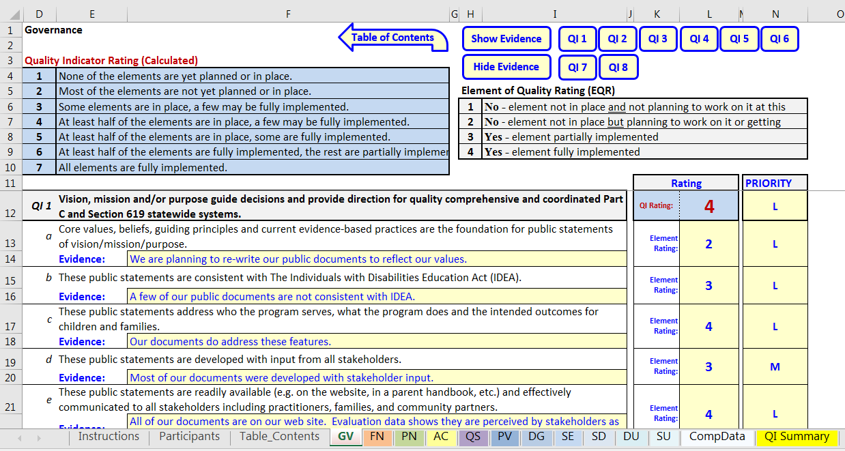
DaSy/ECTA Center Self-Assessment Tool
http://dasycenter.org/self-assessment-for-ecta-and-dasy-frameworks/

Slide 25
Quality Indicator Rating Scale
1-7 point scale
Stakeholders must rate all Elements of Quality in the Quality Indicator
Rating is not selected by the stakeholder group but rather auto-calculated based on the element ratings
Stakeholders also can assign a priority rating of High, Medium, Low to each of the elements and each Quality Indicators.

Slide 26
ECTA/DaSy Self-Assessment Tool
http://dasycenter.org/self-assessment-for-ecta-and-dasy-frameworks/

Slide 27
Quality Indicator Rating Scale
Quality Indicator Rating Scale
1 | None of the elements are yet planned or in place
2 | Most of the elements are not yet planned or in place
3 | Some elements are in place, a few may be fully implemented
4 | At least half of the elements are in place; a few may be fully implemented
5 | At least half of the elements are in place; some are fully implemented
6 | At least half of the elements are fully implemented, the rest are partially implemented
7 | All elements are fully implemented
Notes:
Why didn’t we go with an average?

Slide 28
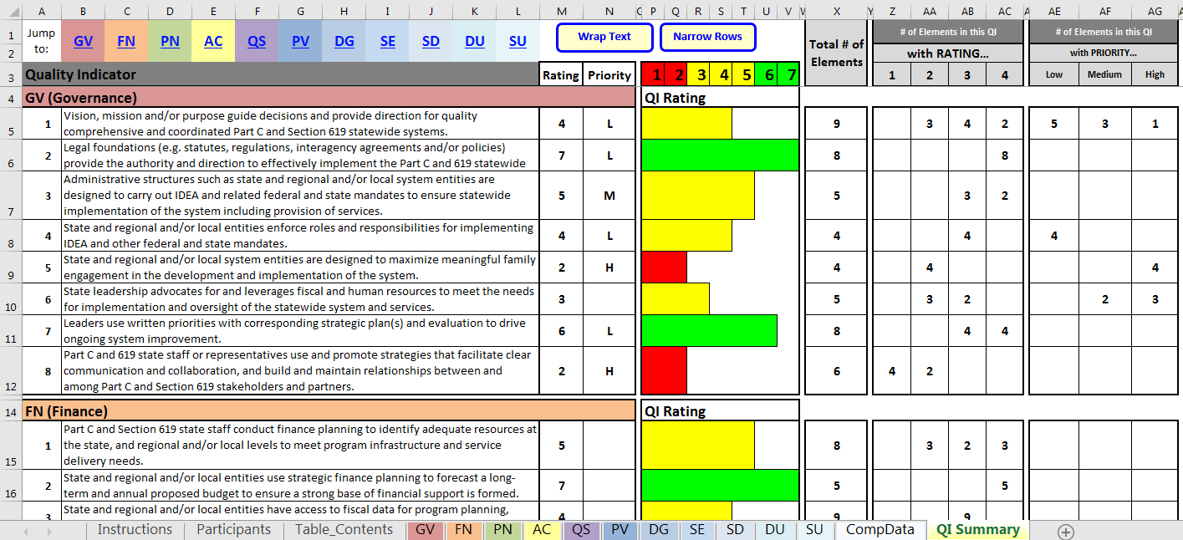
Quality Indicator Summary Tab
Quality Indicator Summary Tab
Notes:
No further scoring beyond the quality indicator level

Slide 29

What is a System for Part C and 619?
IDEA Part C and Part B 619 by design is a system – and a complex one
  We manage multiple partners, funding streams and priorities
  Leading and managing a system takes certain skills and habits
  Understanding how systems work and the role we play helps us to function more effectively

Slide 30

Element of Systems Thinking

Slide 31
Systems Thinking
Recognizes the complex, interconnectedness of systems and system components
Steps back and looks for the big picture
Attempts to see things from many different perspectives
Thinks through the short term and the long term impacts of actions
Invests time in order to make informed decisions rather than acting quickly

Slide 32
Personnel Workforce

Slide 33
Process
Review the mission and key principles
Complete the self assessment
Identify 2 areas
  Inservice personnel
  Recruit and retain personnel

Slide 34
Inservice Personnel
Workgroup develop a plan for in service personnel development and technical assistance
Conduct a needs assessment of the workforce
Develop competencies based on the mission and key principles
Document the current PD and TA available
Coordinate with other early care and education programs

Slide 35
Recruit and retain personnel
Track personnel shortages by program
Target discipline-specific shortages
“traveling” teams to provide services ( short term)
Districts develop recruitment plans
Mentoring, recognitions programs
Work with higher education to include coursework and internships related to early intervention

Slide 36
Infrastructure Building lessons from a State
Respect the groups values and the organizations integrity
SLOW DOWN…. Systems change takes time
Top leadership commitment is important but a bottom up strategy is needed to ensure everyone is attuned to the change.
Pay attention to your feelings as well as those of the workforce

Slide 37
Infrastructure Building
Lessons from a state
Have a compelling vision that touches people’s hearts
Focus first on people and emotional bonds and then on strategy
Vision must be turned into action
Manage the myths, legends and symbols of the office (but we’ve always done things this way)
  (from The New Leaders-Transforming the are of leadership into the science of results. Goleman, Boyatzio and Mckee)

Slide 38
What states are saying?
We have used components of the framework to help guide change/set goals/see what we should be doing,
To help you understand characteristics of a quality system
To help you evaluate your state infrastructure
Engage broad stakeholders in understanding the importance of infrastructure

Slide 39
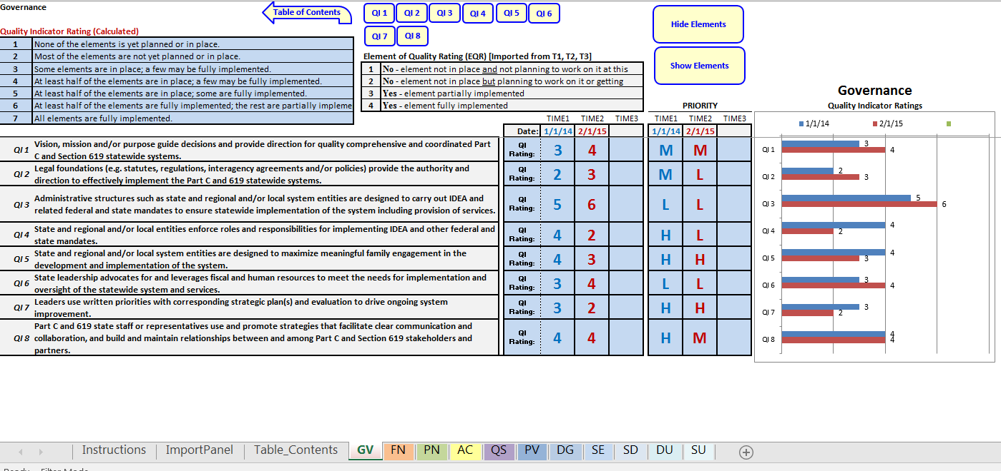
Self-Assessment Comparison Tool
Self-Assessment Comparison Tool
http://dasycenter.org/self-assessment-comparison-tool/

Slide 40
Small Group Discussion
How might the systems framework support your work ?
What systems thinking skills would you need to address this?:
  Recognizes the complex, interconnectedness of systems and system components
  Steps back and looks for the big picture
  Attempts to see things from many different perspectives
  Thinks through the short term and the long term impacts of actions
  Invests time in order to make informed decisions rather than acting quickly

Slide 41
Small Group Discussion
What systems leadership skills would you need to address this?:
  have an explicit “making-a-difference” sense of purpose,
  use strategies that mobilize many people to tackle though problems,
  be held accountable by measured and definable indicators of success, and
  be ultimately assessed by the extent to which it awakens people’s intrinsic commitment, which is none other than the mobilizing of everyone’s sense of moral purpose
*How can the System Framework assist in this effort?*

Slide 42
Supporting practice

Slide 43
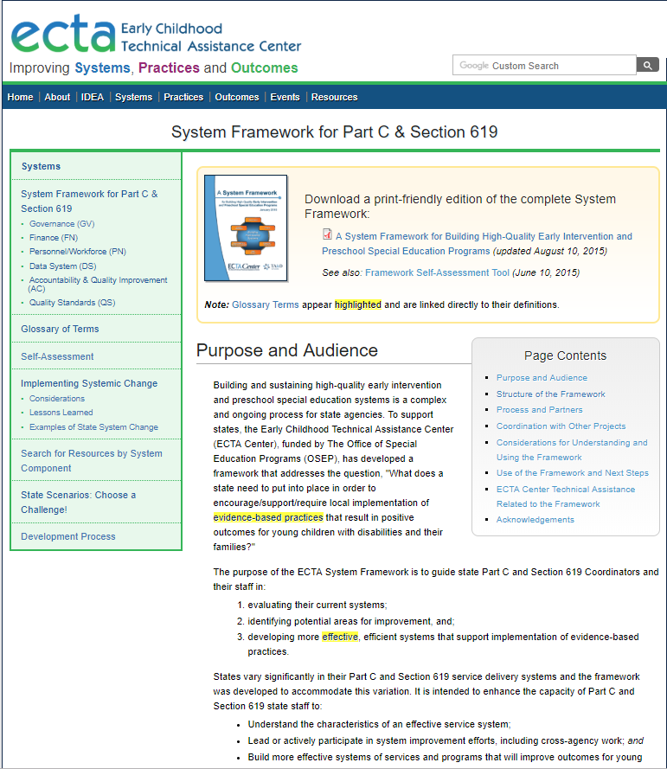
ECTA Center System Framework
http://ectacenter.org/sysframe/

Slide 44
Contact DaSy or ECTA
Visit the DaSy website at:
http://dasycenter.org/
Follow DaSy on Twitter:
@DaSyCenter
Visit the ECTA website at:
http://ectacenter.org/
Follow ECTA on Twitter:
@ECTACenter

Slide 45

Thank you
The contents of this tool and guidance were developed under grants from the U.S. Department of Education, #H373Z120002 and #H326P170001. However, those contents do not necessarily represent the policy of the U.S. Department of Education, and you should not assume endorsement by the Federal Government. Project Officers: Meredith Miceli, Richelle Davis, and Julia Martin Eile.
Notes:
Instructions to presenters: This slide is to be included as the last slide in your deck but you are not expected to show it to the audience. Please be sure to delete these instructions from this slide’s notes page in your presentation.

