Slide 1
Collecting and Using Evaluation Data on Implementation of Evidence-Based Practices
Kathy Hebbeler & Margaret Gillis
National Early Childhood Inclusion Institute
May 8, 2019

Slide 2
Welcome!

Slide 3
Outcomes
Participants will increase understanding of
Basic evaluation principles related to evaluating practice implementation
Features of high-quality tools and methods for evaluating practice implementation
Strategies for making evaluation of practice implementation more practical
Strategies for summarizing data on practice implementation for different purposes

Slide 4
Agenda
What are we measuring and why?
How are we measuring?
What do we do with all this data?
Working with data

Slide 5
Whose Here?
How many of you are…state staff? Local program staff? Family member? Other?
What brings you to this session?
What are your experiences with collecting and using data on implementation of EBPs?

Slide 6
What are we measuring and why?

Slide 7
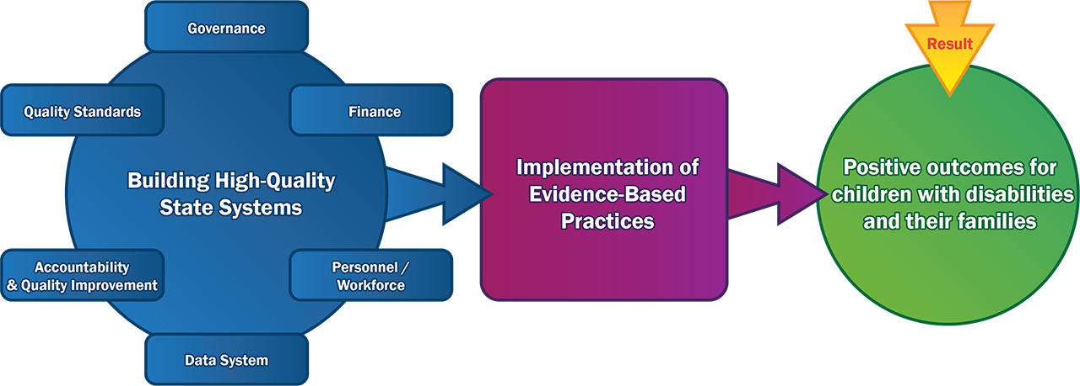
Practice Implementation Improves Results

Slide 8
Definition of Practices
The teachable and doable behaviors that practitioners use with children and families which can be used, replicated, and measured for fidelity
The practice needs to be clearly defined in order to be measured.

Slide 9
Definitions
Practice Change: Increase or decrease in the number, frequency, precision, or quality of practices a practitioner implements across at least two points in time.
Fidelity: The degree to which an intervention or practice is delivered as the developers intended. Fidelity implies strict and continuing faithfulness to the original innovation or practice that is expected to lead to the desired child/family outcomes.

Slide 10
Relationship Between Practice Change and Fidelity
Both practice change and practice fidelity are about the implementation of evidence-based practices (EBPs)
Are practitioners changing their implementation of EBPs?
Are practitioners implementing EBPs as intended?
Practitioners can demonstrate changes in practices without reaching fidelity.

Slide 11
Measuring Practice Change and Fidelity
Use the same tools or methods to evaluate fidelity versus practice change.
Practice change can be evaluated in relation to a fidelity threshold*.
*Fidelity threshold – predetermined level or score the practitioner must meet or exceed to demonstrate the EBP has been implemented as intended.

Slide 12
Why measure practice change and practice fidelity?
To ensure practices are implemented as intended so that improved outcomes are expected
To determine whether practitioners maintain fidelity over time
To obtain information for monitoring progress of practitioners
Where are improvement strategies working? Where is more help needed?
Corrections/adjustments in practice can be made in a timely manner

Slide 13
Evaluation Plan Components
Outcomes
Evaluation Questions
Performance Indicators
Measurement/Data Collection Methods

Slide 14
Alignment of Outcomes, Questions, and Performance Indicators
Outcomes
Describe what you intend to achieve as a result of activity(ies) related to EBPs
Evaluation Questions
Describe what you need to know to determine if you have achieved the outcome
Performance Indicators
Describe how you will determine if you have met the outcome
Based on measurement data (e.g., extant or new)
Often interconnected
Define steps toward achieving long-term outcomes

Slide 15
Large Group Activity: Alignment
Outcome Description | Evaluation Question | Performance Indicator
Providers use evidence-based practices to support social-emotional skills with parents and infants/toddlers identified with social emotional needs | Do providers know how to use evidence-based practices to support social-emotional skills with parents and infants/toddlers identified with social-emotional needs? | 80% of providers completed training on evidence-based practices to support social emotional skills with parents and infants/toddlers identified with social-emotional needs

Slide 16
Large Group Activity: Alignment
Outcome Description | Evaluation Question | Performance Indicator
Providers use evidence-based practices to support social-emotional skills with parents and infants/toddlers identified with social emotional needs | Do providers use evidence-based practices to support social-emotional skills with parents and infants/toddlers identified with social-emotional needs? | 80% of providers use evidence-based practices to support social emotional skills with parents and infants/toddlers identified with social-emotional needs

Slide 17
How are we measuring?

Slide 18
Defining and Operationalizing Evidence-based Practices
Practices that are not clearly defined and operationalized are not measureable
A Practice Profile is a way to define and articulate acceptable and non acceptable practices (National Implementation Research Network)
A Practice Profile is not a measurement tool but can be used as a starting place to develop or identify a tool for assessing practice change and fidelity

Slide 19
Sample Practice Profile
Example Practice Profile for DEC Recommended Practices: Interactions (INT2)
Core Component | Contribution to the Outcome | Expected/Proficient* | Developmental | Unacceptable
INT2. Practitioners promote the child’s social development by encouraging the child to initiate or sustain positive interactions with other children and adults during routines and activities through modeling, teaching, feedback, or other types of guided support. | The practitioner promotes positive social interactions so that the child will experience predictable social responses that will contribute to growth and learning. | A Head Start teacher helps a peer respond to a child’s gestures by verbally translating his intention and desires, then modeling for the peer how to respond to the child. | A Head Start teacher tells peers to be friendly to the child who uses gestures to communicate. | A Head Start teacher assigns her assistant teacher to attend to the child who uses gestures to communicate.
 |  |  | .
Developed by The Early Childhood Recommended Practice Modules project (RPM) (see RPM website at http://rpm.fpg.unc.edu/)

Slide 20
Balancing High-Quality and Practical Measurement
The higher the quality of the measurement approach, the more useful and actionable the data are.
The key is to ensure you get the most meaningful, accurate, and reliable information possible.
Measurement also needs to be doable, practical

Slide 21
Characteristics of High-Quality Tools for Measuring EBPs
Aligned with the selected evidence-based practices
Provides Valid information– accurate information on practice implementation
Reliable – produces consistent information across users, settings, activities, and time points
Practical – can be used with the staff and resources available

Slide 22
Characteristics of High-Quality Tools for Measuring EBPs
Provides a meaningful fidelity threshold score that indicates whether practitioners have reached a level of implementation that is sufficient for achieving targeted child or family outcomes.
Captures variation (e.g., over time, across practitioners)
Provides useful information to practitioners to identify areas of strength and areas for improvement to move toward, reach, and maintain fidelity.

Slide 23
Getting meaningful data on EBPs
Timing/frequency. Measure practices at sufficient frequency to capture incremental improvement (practice change) and the maintenance of fidelity over time.
Training. Clear instructions and training are provided to ensure high quality data.
Purpose of data collection is clear - Practitioners and data collectors understand how data will be used to improve implementation.

Slide 24
Methods for Collecting Data on EBPs
Observation by someone else
Practitioner self report
Review of documents
Multiple methods can be used, including qualitative methods

Slide 25
Large Group Discussion
What are the advantages and disadvantages of these data collection approaches?
Observation
Practitioner self-report
Review of documents
How have you tried to balance quality and practicality in evaluating practice implementation?

Slide 26
How to Make it Practical
Leverage existing processes and structures (e.g., supervisors, coaches)
Start with existing tools (e.g., fidelity tools associated with a model, tools related to DEC Recommended Practices)
Prioritize the practices to be evaluated—it is not practical to evaluate all practices
Start small—select a subgroup of practitioners and/or programs for more intensive data collection (e.g., observations)

Slide 27
What do we do with all this data?

Slide 28
Purposes of Data Analysis and Use
What do you want to know from your data?
What information do decision-makers at each system level need to have to improve practice implementation?
The type of decisions made at each level drives the evaluation questions and the appropriate analysis.

Slide 29
Example Questions at Different System Levels
Practitioner Level
Is the practitioner implementing with fidelity?
Local Program Level
Are practitioners implementing the EBP with fidelity?
Which components of the fidelity tool show the greatest growth across practitioners? The least growth?
State Level
Are practitioners within local programs implementing the EBP with fidelity?
What percentage of programs meet a performance indicator for percentage of practitioners at fidelity?

Slide 30
Data Aggregation Example

Slide 31
Large Group Discussion
How are you using/sharing data on practice implementation?
Are local programs/sites using data on practice implementation? How?
Are you using qualitative data to better understand practice implementation? How?

Slide 32
Working with Data
In small groups, review hypothetical using the Look-Think-Act model of inquiry.
Focus interpretations of the data on the actions that should be implemented in response to the conclusions from the data.
We’ll have a large group discussion after you spend some time with the data.

Slide 33
Action
Look
Think
Act
Examine data for trends, meaningful associations
Ask questions related to the data that might help with interpretation
Make decisions as a team and identify the action plan needed to put the decision in place

Slide 34
Questions/Comments?

Slide 35
Resources
DaSy and ECTA tip sheets on evaluating practice implementation https://dasycenter.org/evaluating-the-implementation-of-evidence-based-practices-tip-sheet-series/
Resources and Tools section of ECTA Statewide Implementation Guide http://ectacenter.org/sig/
Strengthening SSIP Evaluations with Qualitative Methods
https://dasycenter.org/strengthening-ssip-evaluations-with-qualitative-methods/

Slide 36
Contact Information
Kathy Hebbeler
Kathleen.hebbeler@sri.com
Margaret Gillis
Margaret.gillis@sri.com

Slide 37
Thank you!
Visit the DaSy website at: http://dasycenter.org/
Follow DaSy on Twitter: @DaSyCenter
Visit the ECTA website at: http://ectacenter.org/
Follow ECTA on Twitter: @ECTACenter

Slide 38
Thank you
The contents of this tool and guidance were developed under grants from the U.S. Department of Education, #H326P120002 and #H326P170001. However, those contents do not necessarily represent the policy of the U.S. Department of Education, and you should not assume endorsement by the Federal Government. Project Officers: Meredith Miceli, Richelle Davis, and Julia Martin Eile.

