Slide 1
Help Ensure Effective Data Governance and Management: Use the Updated DaSy Toolkit
Meredith Miceli, OSEP
Haidee Bernstein, DaSy
Sharon Walsh, DaSy
July 26, 2018 2018 NCES STATS-DC Data Conference

Slide 2
Session Objectives
The importance of formal data governance policies and procedures to state agencies
Current Federal data governance management activities
How to use the DaSy Data Governance and Management Toolkit
Increase Understanding of

Slide 3
The DaSy Governance and Management Toolkit
Developed through an OSEP funded project for IDEA Early Childhood Programs but applicable for a broad array of programs including general education at multiple levels.

Slide 4
Getting to Know Each Other
Who is from a State Education Agency?
And who is from Special Education
Who is from a Local/Regional Education Agency
Anyone from Special Education
Who is a TA provider?
Who is from Higher Education?
Who is a researcher?
Who did we miss?

Slide 5
Is your expertise….
Data?
Program administration?
Both

Slide 6
Show of Hands - What is your role?
Only state folks should raise their hands
Data manager/data steward
Program coordinator/director/administrator
Other state program staff/consultants

Slide 7
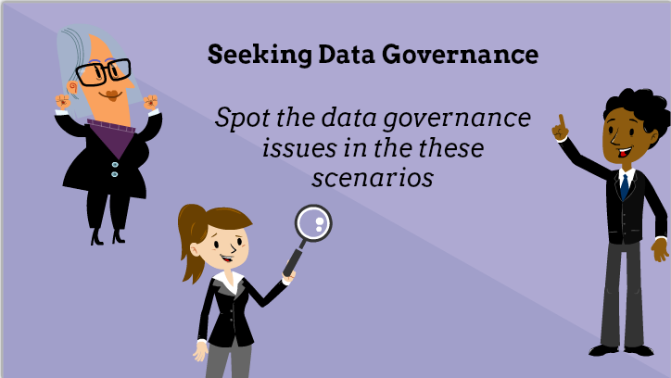
Seeking Data Governance

Slide 8
Scenario: Data Breach Response

Slide 9
Scenario: Data Change

Slide 10
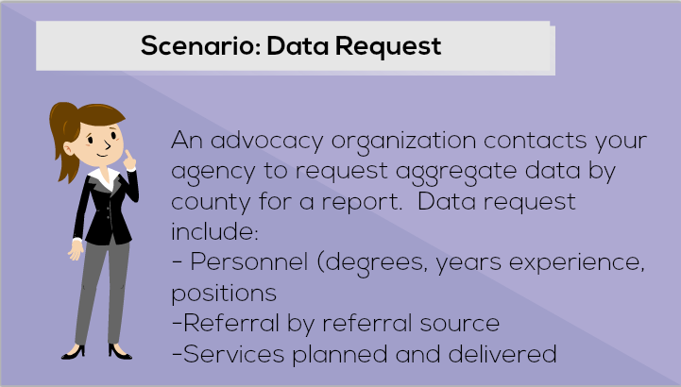
Scenario: Data Request

Slide 11
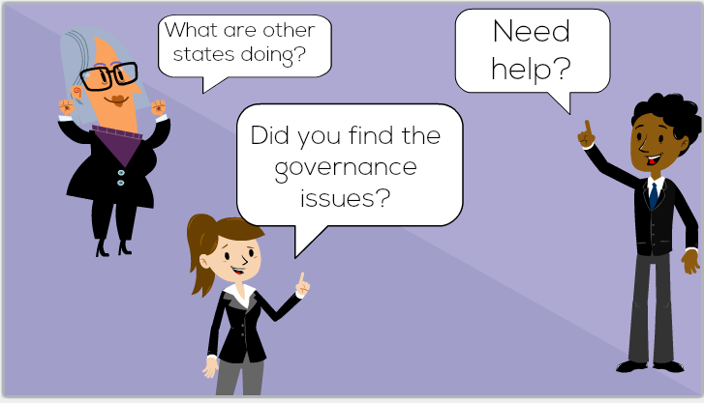
Need Help?

Slide 12
What is Data Governance?
Management of availability, usability, integrity, quality, and security of data
Organizational process and a structure
Establishes responsibility
Creation and enforcement of policies, roles, responsibilities, and procedures
- DaSy Glossary

Slide 13
What is Data Governance?
The overall management of the availability, usability, integrity, quality, and security of data. Data governance is both an organizational process and a structure. It establishes responsibility for data, organizing program area/agency staff to collaboratively and continuously improve data quality through the systematic creation and enforcement of policies, roles, responsibilities, and procedures.
- DaSy Glossary
Notes:
Bruce and Denise

Slide 14
Formal Versus Informal

Slide 15
Formal Data Governance
Establishes data responsibility
Organizes program staff to
improve data quality . . .
through the systematic creation and enforcement of . . .
policies, roles, responsibilities, and procedures

Slide 16
Formal vs. Informal Data Governance
Formal Data Governance
Informal Data Governance
Data use consistent with purpose and vision
Increases
probability of effective data practices
data security
confidence in data and associated processes
Supports
Data integration
Improved data efficiency
Higher quality data
Questionable data quality, security, and usefulness
Difficulty managing data and processes
Unclear data roles and responsibilities of staff (internal and external)
Inappropriate data sharing
Unprepared for data integration opportunities
Increased risks with staff turnover

Slide 17
Why Create Data Governance P&Ps?
Establish common data understanding and consensus
Ensure consistent practices
Record historical processes
Define work
Increase productivity
Creates evaluation standard
“The Lottery” Scenario
Confusion
Clarity

Slide 18
Documenting and Supporting Implementation of Formal Data Governance
Policies and Procedures are at
the center of data governance and management

Slide 19
Data Governance: It is Needed at All Levels
Local Program
District
State
Federal

Slide 20
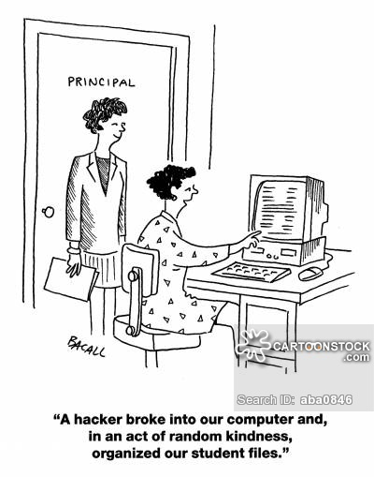
. . . because this won’t happen.

Slide 21
Importance of Data Governance from the Federal Level
Meredith Miceli,
Office of Special Education Programs

Slide 22
OSEP’s Support of Data Governance
Participating in the EDFacts Data Governance Board (EDGB) at US Department of Education
Requiring OSEP-funded data centers to provide technical assistance on data governance topics to States agencies reporting IDEA data

Slide 23
EDFacts Data Governance Board (EDGB) Mission
The EDGB supports data quality and data integrity by identifying common standards, developing operating policies, and implementing processes for managing data. EDGB work is leading to more informed and confident data use.
EDGB accomplishes this by
Inter-office coordination
Timely and effective resolution of data issues
Clear and organized documentation of how data issues are resolved
EDFacts Resource: https://www2.ed.gov/about/inits/ed/edfacts/edfacts-edgb-data-governance.pdf
Notes:
EDFacts Data Governance Board (EDGB)
Established in 2006
intra-agency council with representatives from multiple program offices at ED
resolves issues and creates the policies needed to manage ED’s PreK–12 asset of education data
Why have data governance at ED?
Fosters ED-wide data-driven decision-making
Resolves data ownership issues
Leads to information sharing across program offices
Proactively manages data vulnerabilities
Improves the quality of data collection, reporting, and usage

Slide 24
Benefits of Participation in EDGB:
Facilitates coordination across program offices
Leverages knowledge, expertise, processes, and products from other program offices
Provides opportunities for IDEA and CWDs to be considered when developing data-related policies and procedures
Documents data-related decisions, policies, and processes

Slide 25
Importance of Data Stewardship in Data Governance
All ED offices that steward EDFacts data have a representative on EDGB.
Stewards actively participate in the development and implementation of data management policies and procedures overall and are also responsible for representing their unique set of data in data governance discussions.
OSERS/ OSEP is the steward for 16 EDFacts files and 6 EMAPS data collections.
Notes:
Stewards are offices across the U.S. Department of Education (ED) who support data definition, acquisition, review, as well as data use for a defined set of data.

Slide 26
Importance of Data Governance for Disclosure Avoidance
data governance at ED is working to ensure the security of our data assets
Disclosure Review Board (DRB) is a collaborative council that reviews proposed data releases and disclosure avoidance methodologies by ED’s program offices for consistency and privacy protection standards.
EDFacts resource: https://www2.ed.gov/about/inits/ed/edfacts/ed-disclosure-avoidance-overview.pdf
Notes:
DRB processes include collaborative technical assistance, evaluation, and recommendations to aid ED in releasing as much useful data as possible, while protecting the privacy of individuals and the confidentiality of their data, as required by law.

Slide 27
Supporting Data Governance Work in States
OSEP funds technical assistance to support state data governance work via the DaSy Center:
Provide technical assistance regarding data governance plans with the goal of a fully implemented statewide early childhood longitudinal data system

Slide 28
DATA GOVERNANCE TOOLKIT https://dasycenter.org/data-governance-management-toolkit/

Slide 29
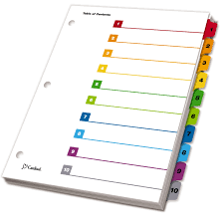
Table of Contents
Introduction
Purpose, Structure, Process
Data Breach Response
Data Quality
Data Security and Access
Data System Changes
Public Reporting
Electronic Communications
Data Requests
Data Partnerships
Data Retention and Destruction (Pending)
Resources (Pending)
https://dasycenter.org/data-governance-management-toolkit/

Slide 30
Each Toolkit Section Contains
Overview
Considerations
Template

Slide 31
Overview
A short description of the data governance topic and how it applies to Part C and Part B 619 programs.

Slide 32
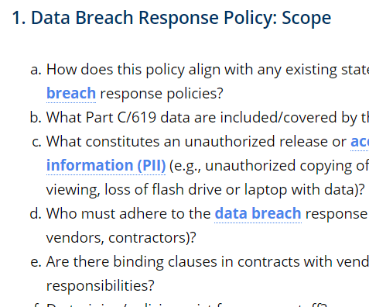
Considerations
Questions to help programs draft policies and procedures for the topic

Slide 33
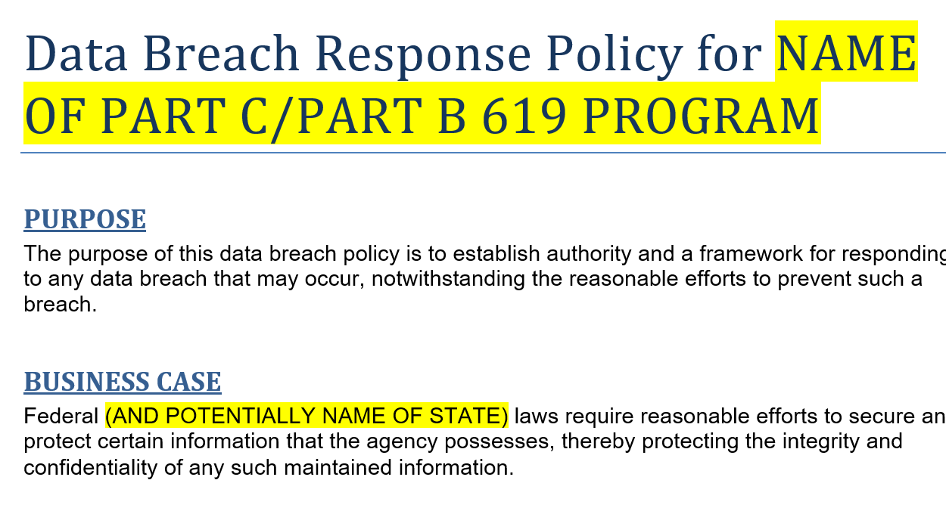
Template
An editable and prepopulated template with language to expedite writing topical policies and procedures.

Slide 34
TOOLKIT ONLINE DEMO
Electronic Communications
https://dasycenter.org/data-governance-management-toolkit/electronic-communications/
Data Partnerships
https://dasycenter.org/data-governance-management-toolkit/governance-of-data-partnerships/

Slide 35
Other Data Governance Resources
SLDS Data Governance Manual Rubric: https://nces.grads360.org/#communities/pdc/documents/13499
SLDS Best Practices Brief: P-20W+ Data Governance: https://nces.grads360.org/#communities/pdc/documents/2717
SLDS Early Childhood Integrated Data System Guide: https://nces.grads360.org/#communities/pdc/documents/8968
Privacy Technical Assistance Center (PTAC) Data Governance and Stewardship: http://ptac.ed.gov/sites/default/files/issue-brief-data-governance-and-stewardship.pdf

Slide 36
Thank you!
Visit the Toolkit at: http://dasycenter.org/data-governance-management-toolkit/
Visit the DaSy Data Governance Framework at: http://dasycenter.org/resources/dasy-framework/data-management/
Visit the DaSy website at: http://dasycenter.org/
Like us on Facebook: https://www.facebook.com/dasycenter
Follow us on Twitter: @DaSyCenter

Slide 37
Acknowledgments
The contents of this presentation were developed under a grant from the U.S. Department of Education, # H373Z120002. However, those contents do not necessarily represent the policy of the U.S. Department of Education, and you should not assume endorsement by the Federal Government. Project Officers, Meredith Miceli and Richelle Davis.

