Slide 1
Examining Data to Identify Meaningful Difference
Tony Ruggiero, DaSy
Robin Nelson, DaSy
Gary Harmon, DaSy/ECTA
Cornelia Taylor, DaSy/ECTA
Improving Data, Improving Outcomes
Arlington, VA
August, 2018

Slide 2
Session Outcomes
Participants will learn:
the importance of determining meaningful differences
the difference between descriptive and inferential statistics
how to use some of these methods through the interactive opportunity

Slide 3
Introduction
What are statistics?
“the science of assembling, classifying, tabulating, and analyzing such facts for data” – Webster’s New World Dictionary
  Statistics are a tool for solving problems
  Usually begins with a question or hypothesis
  Statistical analysis helps to determine if meaningful substantive relationships exist between and among variables

Slide 4
Introduction
The importance of determining meaningful differences
Many people are interested in going beyond descriptive data and want to look at relationships
Certain types of statistics provide the opportunity to account for observed differences
You can have more confidence that your differences are real and not just a result of random fluctuation or guesswork
You can make inferences that generalize to your population

Slide 5
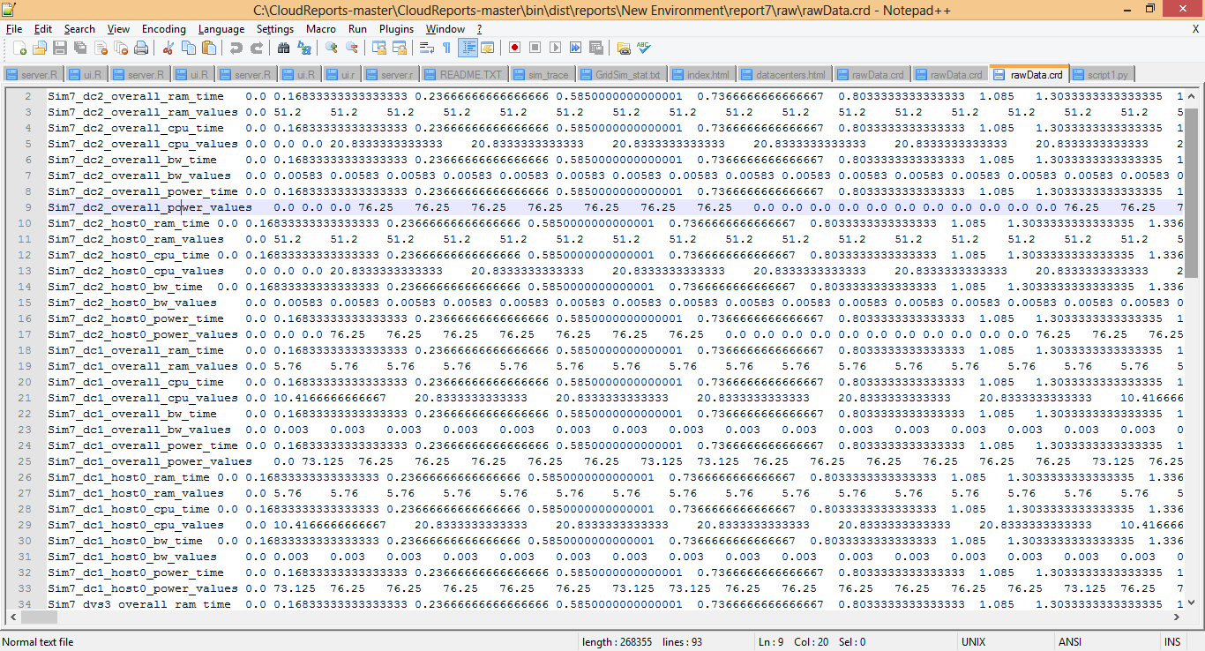
Descriptive Statistics
Data in its raw form can be large and unorganized

Slide 6
Descriptive Statistics
Analysis of data that helps describe, present or summarize data
Through numerical calculations or graphs or tables
Gain valuable insights about your data
  About data quality
  About the kinds of analyses you can and should do.

Slide 7
Inferential Statistics
Inference
Generalization or conclusion about a characteristic of a population
Used to make decisions about degree to which an observed difference is meaningful vs. due to chance

Slide 8
Types of Data
Data
Qualitative
Quantitative
Categorical/Discrete
Ordinal
Continuous
Class rank, socioeconomic status
Age in months, hours of service
Gender,
Service type

Slide 9
Data Transformation
You can always transform continuous data into categorical data
  Age in months into broader age categories
  Income in dollars into income ranges
You can always collapse a large number of categories into a smaller number
Examine the distribution of the data to help make these decisions

Slide 10
Types of Descriptive Statistics
Frequencies, crosstabs
Measures of central tendency
  Describe the central position of a set of data
Measures of variability
  Describe how spread out the data are

Slide 11
Frequencies and Cross-tabs
Frequency (count, percentage)
  16 boys, 62%
  10 girls, 38%
Cross-tabulation (data element by data element)
  12 boys with Communication Delays, 4 Other
  5 girls with Communication Delays, 5 Other

Slide 12
Example of Frequency Table
Ages of Children Enrolled at Happy Valley Preschool
Age | Number | Percent
Three | 34 | 43
Four | 45 | 57
Total | 79 | 100

Slide 13
Example of Cross-Tab
 | OSEP Progress Categories for Outcome 1
Program | a | b | c | d | e | Row total
Children’s Corner | 1 | 1 | 3 | 1 | 8 | 14
Elite Care | 1 | 6 | 2 | 2 | 6 | 17
Community Cares | 1 | 3 | 3 | 11 | 13 | 31
New Horizons | 0 | 1 | 4 | 2 | 3 | 10
Opportunities, Inc. | 0 | 2 | 3 | 2 | 10 | 17
Column total | 3 | 13 | 15 | 18 | 40 | 89

Slide 14
Analyzing Categorical Data
Row percentages – percentages computed with the Row total as the denominator
Column percentages – percentages computed with the Column total as the denominator
Total percentage – percentages computed with the overall total as the denominator

Slide 15
Measures of Central Tendency
Mean = average
  Most popular and well known
  Disadvantage: susceptible to influence of outliers
Median = middle value in a data set with values arranged from low to high
  Think “median of the road”; also 50th percentile
Mode = most commonly occurring value

Slide 16
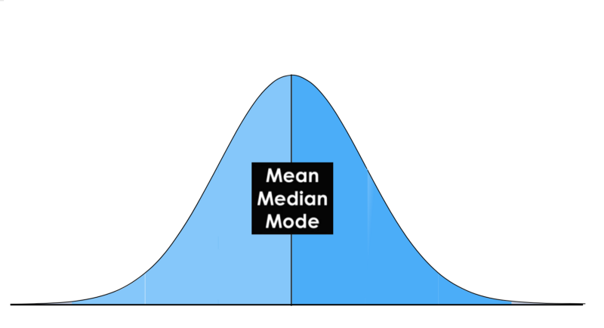
Normal Distribution

Slide 17
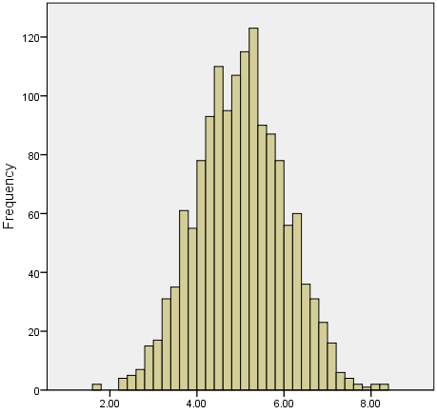
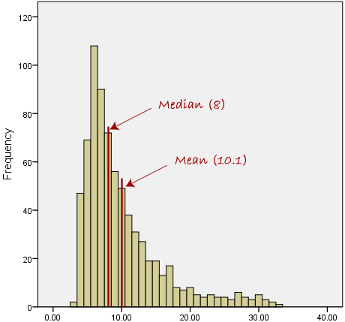
Normal vs. Skewed Distribution

Slide 18
Two sets of data, both with mean =3.75
Percent
Percent

Slide 19


Reasons to Review Distribution
$70K
$75K
$82K
$80K
$76K
$78K
$580 K

Slide 20
When to use each measure (in general)
Type of Data | Best Measure of Central Tendency
Categorical | Mode
Ordinal | Median
Continuous (not skewed) | Mean
Continuous (skewed) | Median

Slide 21
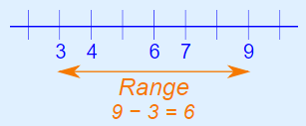
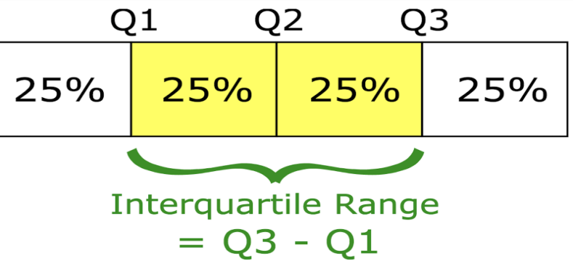
Measures of Variability
Range = difference between the largest and smallest points in your data
Interquartile range = difference between the 75th percentile (Q3)and the 25th percentile(Q1)

Slide 22
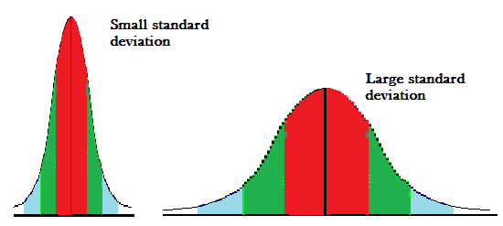
Measures of Variability (continued)
Standard deviation – a measure of how spread out the values are from the mean

Slide 23
Box Plot (Box and Whisker Plot)
Scale
100
Maximum observation
75th percentile
Interquartile Range
Median
+
25th percentile
Minimum observation
0

Slide 24
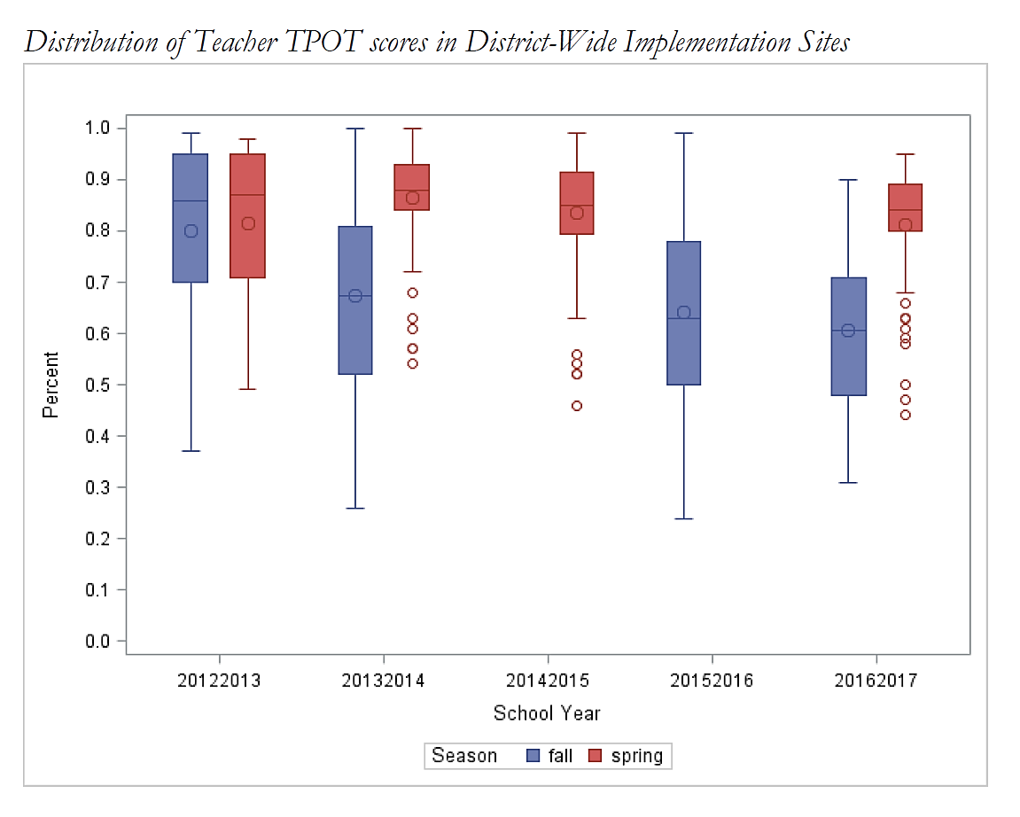
Box Plot Example

Slide 25
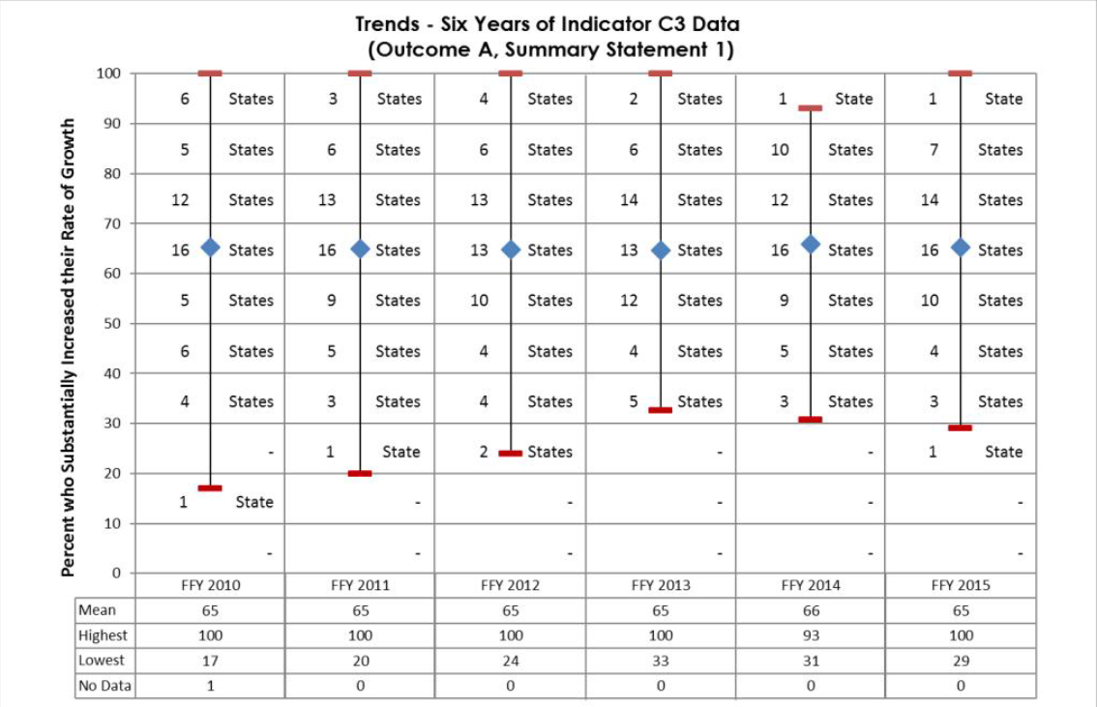
Child Outcomes SS1 by Year

Slide 26
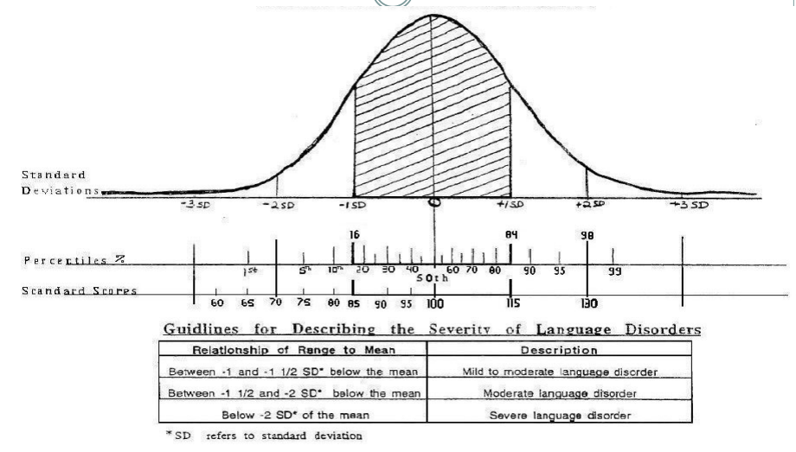
Use of SD in Eligibility Criteria

Slide 27
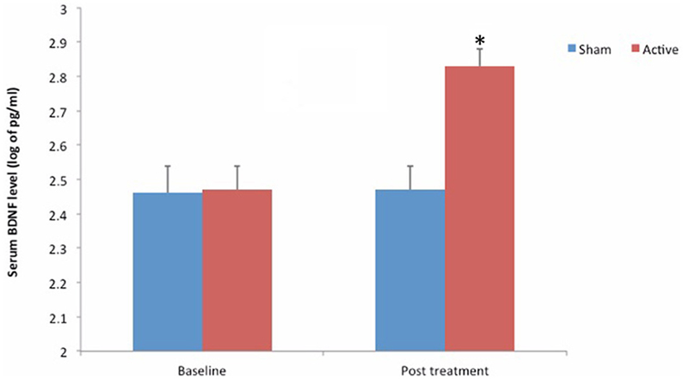
Statistical Testing
Used to make inferences on the data you have
Many different types of statistical tests depending on what you are trying to accomplish
In general, you compute a test statistic and identify the degree to which it is meaningful due to chance
Notes:
GARY

Slide 28
Statistical Testing
You must first figure out what you are testing
Example: Testing Percentage vs. Testing Averages

Slide 29
Testing Percentage
Example: Did significantly more teachers achieve 80% on the fidelity measure in the coaching group compared to the group without coaching?

Slide 30
Testing Percentage – Raw Data
Teacher ID | Coaching? | ≥80% Fidelity?
1 | Y | Y
2 | N | N
3 | N | Y
4 | N | N
5 | Y | Y
6 | Y | Y
7 | N | N
8 | Y | Y
9 | Y | Y
10 | Y | N
11 | N | Y
12 | N | N

Slide 31
Testing Percentage - Summarize
 | 80% or Greater | <80%
Coaching | 5 | 1
No Coaching | 2 | 4

Slide 32
Testing Percentage – Chi-Square
You would then run the appropriate statistical test for a 2x2 table - Chi-Square Test
In this example, the result is NOT significant at the 0.05 level (p = 0.079)

Slide 33
Testing Averages
Example: Was the mean score higher on the fidelity measure in the coaching group compared to the group without coaching?

Slide 34
Testing Averages – Raw Data
Teacher ID | Coaching? | Fidelity Score
1 | Y | 82
2 | N | 67
3 | N | 91
4 | N | 74
5 | Y | 88
6 | Y | 81
7 | N | 42
8 | Y | 92
9 | Y | 84
10 | Y | 77
11 | N | 80
12 | N | 57

Slide 35
Testing Averages - Summarize
 | Mean Fidelity Score
Coaching | 84
No Coaching | 68.5

Slide 36
Testing Averages – 2 Sample T-Test
You would then run the appropriate statistical test to compare means from two different groups (those coached and those not coached) – 2 Sample T-Test
In this example, the result IS significant at the 0.05 level (p = 0.031)

Slide 37
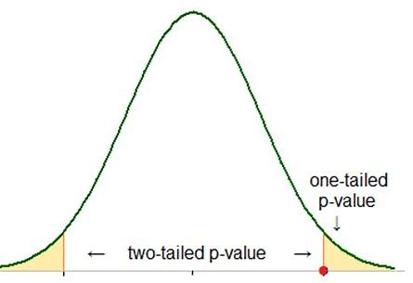
Statistical Testing
Set a criteria for significance and apply it consistently across your analysis
A standard often used is the p-value of <0.05

Slide 38
Statistical Testing
Multiple Testing – when you run multiple statistical tests you increase the probability of labeling a result as statistically different when it could be due to chance

Slide 40
Statistical Testing
Multiple Testing (cont.)
Consider a case where you have 20 hypotheses to test, and a significance level of 0.05.
Example: Comparing Mean Child Outcomes Entrance Ratings and Child Demographics

Slide 41
Statistical Testing
Multiple Testing (cont.)
Test | Dependent Variable | Independent Variable
1 | ECO SE Entrance Rating | Age
2 | ECO SE Entrance Rating | Gender
3 | ECO SE Entrance Rating | Race
4 | ECO SE Entrance Rating | Zip Code
5 | ECO SE Entrance Rating | Disability
6 | ECO SE Entrance Rating | Length in Program
7 | ECO SE Entrance Rating | Time to Start Services
8 | ECO SE Entrance Rating | Number of Services
9 | ECO SE Entrance Rating | Ethnicity
10 | ECO SE Entrance Rating | Language
11 | ECO SE Entrance Rating | Income
… | ECO SE Entrance Rating | …
20 | ECO SE Entrance Rating | Service Coordinator

Slide 42
Probability
What’s the probability of observing at least one significant result just due to chance?

Slide 43
Statistical Testing
64%

Slide 44
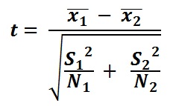
Statistical Testing
Sample Size and Statistical Significance
  In general, important to understand the relationship between sample size (number of individuals in the sample data you have) and the effect it has on detecting a difference during statistical testing
Note Sample Size in Formula!

Slide 45
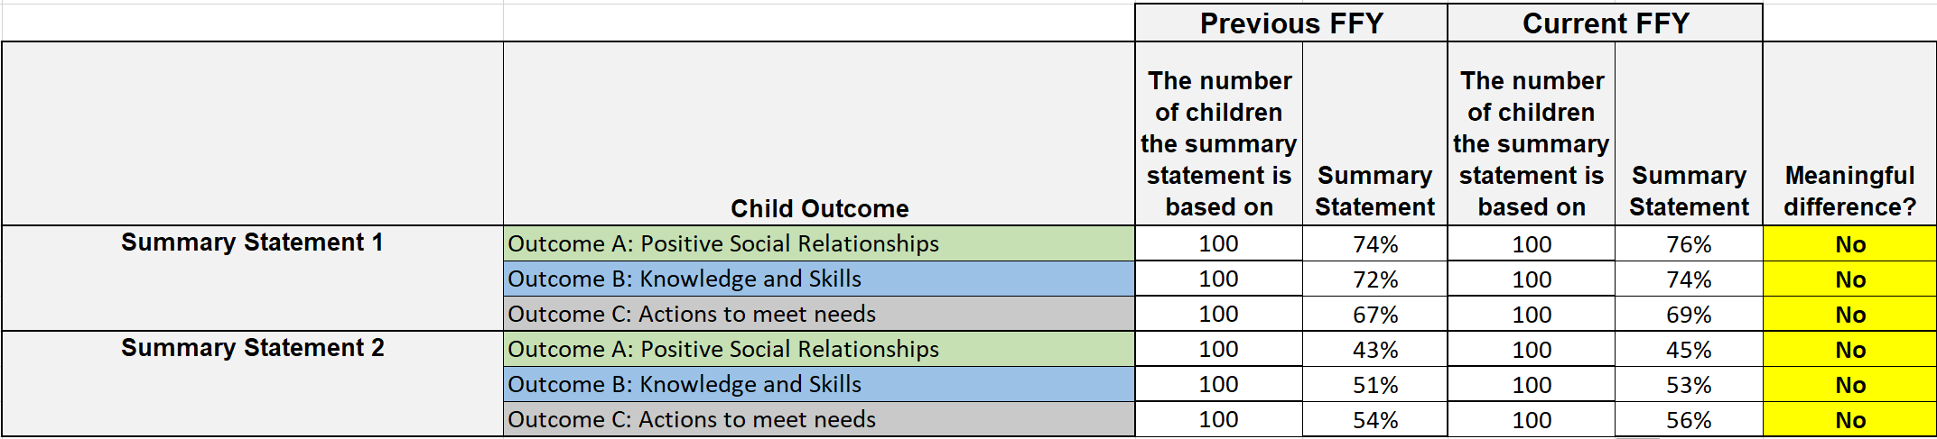
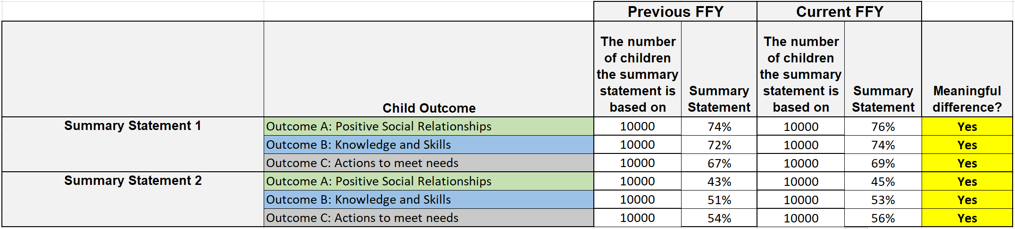
Statistical Testing
Sample Size and Statistical Significance Example
Sample Size = 100
Sample Size = 10,000

Slide 46
Data Activity

Slide 47
Histogram Activity
With the knowledge that this state calculates age at entry by computing the difference between the birth date and the entry date, what transformations had to be made to prep the data into the table on the spreadsheet?
How would you describe the shape of the distribution?
What is the mode of the distribution?
How might presenting the mean of this distribution misrepresent the data?

Slide 48
Data Review 1
 | Progress Categories Outcome 1
Program | a | b | c | d | e | Row percent totals
Children’s Corner | 33% | 8% | 20% | 6% | 20% | 16%
Elite Care | 33% | 46% | 13% | 11% | 15% | 19%
Community Cares | 33% | 23% | 20% | 61% | 33% | 35%
New Horizons | 0% | 8% | 27% | 11% | 8% | 11%
Opportunities, Inc. | 0% | 15% | 20% | 11% | 25% | 19%
Column percent totals | 100% | 100% | 100% | 100% | 100% | 100%
Which program in these data serves the most children?
How does the differing number of children in each program impact interpretation of column percentages?

Slide 49
Data Review 2
 | Progress Categories Outcome 1
Program | a | b | c | d | e | Row percent totals
Children’s Corner | 7% | 7% | 21% | 7% | 57% | 100%
Elite Care | 6% | 35% | 12% | 12% | 35% | 100%
Community Cares | 3% | 10% | 10% | 35% | 42% | 100%
New Horizons | 0% | 10% | 40% | 20% | 30% | 100%
Opportunities, Inc | 0% | 12% | 18% | 12% | 59% | 100%
Column percent totals | 3% | 15% | 17% | 20% | 45% | 100%
If you needed to know the percentage of children in Community Cares who made greater than expected progress should you use the row percentage of column percentage?
If you needed to know the percent of all children that entered and exited at age expectations (progress category ‘e’) that went to Opportunities Inc. would you use a row or column percentage?

Slide 50
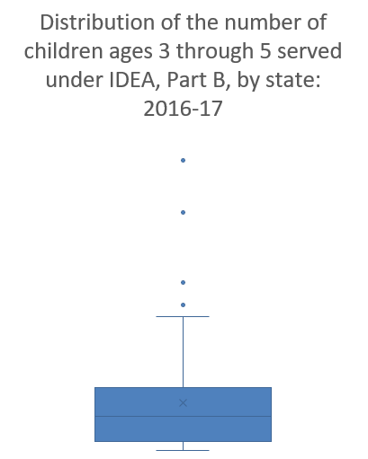
Data Review 3
Are there outliers in these data? Which states?
Are the data skewed? If so, in what direction?

Slide 51
Data Review 4
What is the Interquartile range?
Given the distribution of these data, what should be considered in interpreting any states value in comparison to the average across states?
What might be a transformation that would make these data easier to interpret across states?
Statistic | Value
Minimum | 6
25th Percentile | 2479.25
Median (50th Percentile) | 9540.5
75th Percentile | 17539
Maximim | 80903
Standard Deviation | 15574.37

Slide 52
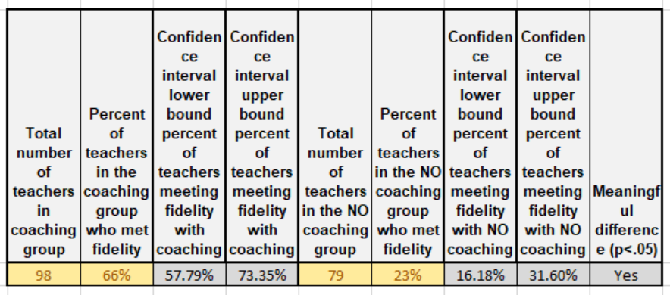
Data Review 5
What happens to the confidence interval if you increase the number of teachers in each group?
How close do the percentages need to be to no longer be statistically significant?
How would you interpret the finding that the teachers with coaching performed statistically significantly better than the teachers with no coaching

Slide 53
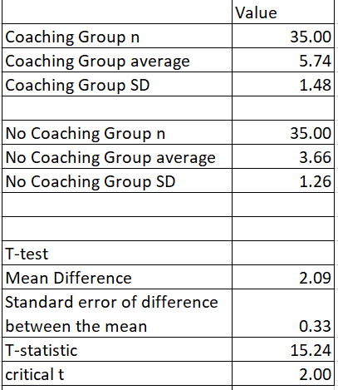
Data Review 6
Looking at the table in the Testing Averages tab, is the difference between the two averages statistically significant?
How would you interpret a statistically significant difference in averages differently than a statistically significant different in the percent of teachers that met fidelity criteria?
Writing over the values in the table, what happens to the critical t when you increase the sample size?

Slide 54
Statistical Testing
Bias and Error
  Random vs. Systematic
    Programs using one assessment always score higher than programs using another assessment (or using same assessment- why higher in one or another? Tony has a great example from DE on TS GOLD)
    Standard measurement is important because it reduces error related to an individuals interpretation of how to use the measurement. How to use an assessment tool and knowing child development (i.e. child outcomes)
Notes:
.

Slide 55
Resources
DaSy Child Outcomes Meaningful Difference Calculator (http://ectacenter.org/eco/pages/childoutcomes-calc.asp )

Slide 56

Data Visualization
DaSy Data Visualization Toolkit at http://dasycenter.org/data-visualization-toolkit/

Slide 57
Final presentation slide
Visit the DaSy website at:
http://dasycenter.org/
Follow DaSy on Twitter:
@DaSyCenter
Visit the ECTA website at:
http://ectacenter.org/
Follow ECTA on Twitter:
@ECTACenter

Slide 58

Thank you
The contents of this tool and guidance were developed under grants from the U.S. Department of Education, #H373Z120002 and #H326P170001. However, those contents do not necessarily represent the policy of the U.S. Department of Education, and you should not assume endorsement by the Federal Government. Project Officers: Meredith Miceli, Richelle Davis, and Julia Martin Eile.

