Slide 1



Let’s Talk Data: Making Data Conversations Engaging and Productive
2018 Improving Data, Improving Outcomes Conference—August 14-16, 2018
Debbie Shaver and Kerry Friedman,
IDC and DaSy

Slide 2
Session Overview
Data Teaming
Supporting Stakeholder Knowledge about Data
Strengthening Data Conversations using the Data Meeting Protocol
Activity: Participate in a Data Meeting
Share-out
Notes:
Set the stage
When and how you might engage in data meetings:
https://dasycenter.org/data-culture-toolkit/
https://dasycenter.org/building-stakeholder-knowledge-toolkit/

Slide 3
Power of Data Discussions
  Engage stakeholders and staff in making thoughtful decisions on policies, practices, and procedures
  Leverage your data to inform resource allocation and target areas for program and service improvement
  Ensure that data have value to the agency
  Build awareness, interest, and skills for the routine use of data
  Support improved data quality
4
Notes:
The WHY

Slide 4
Ready, Set,…. Let’s Talk Data
Identify/Form your data team.
Build stakeholder knowledge about data.
Prepare and achieve a productive data conversation.
!

Slide 5
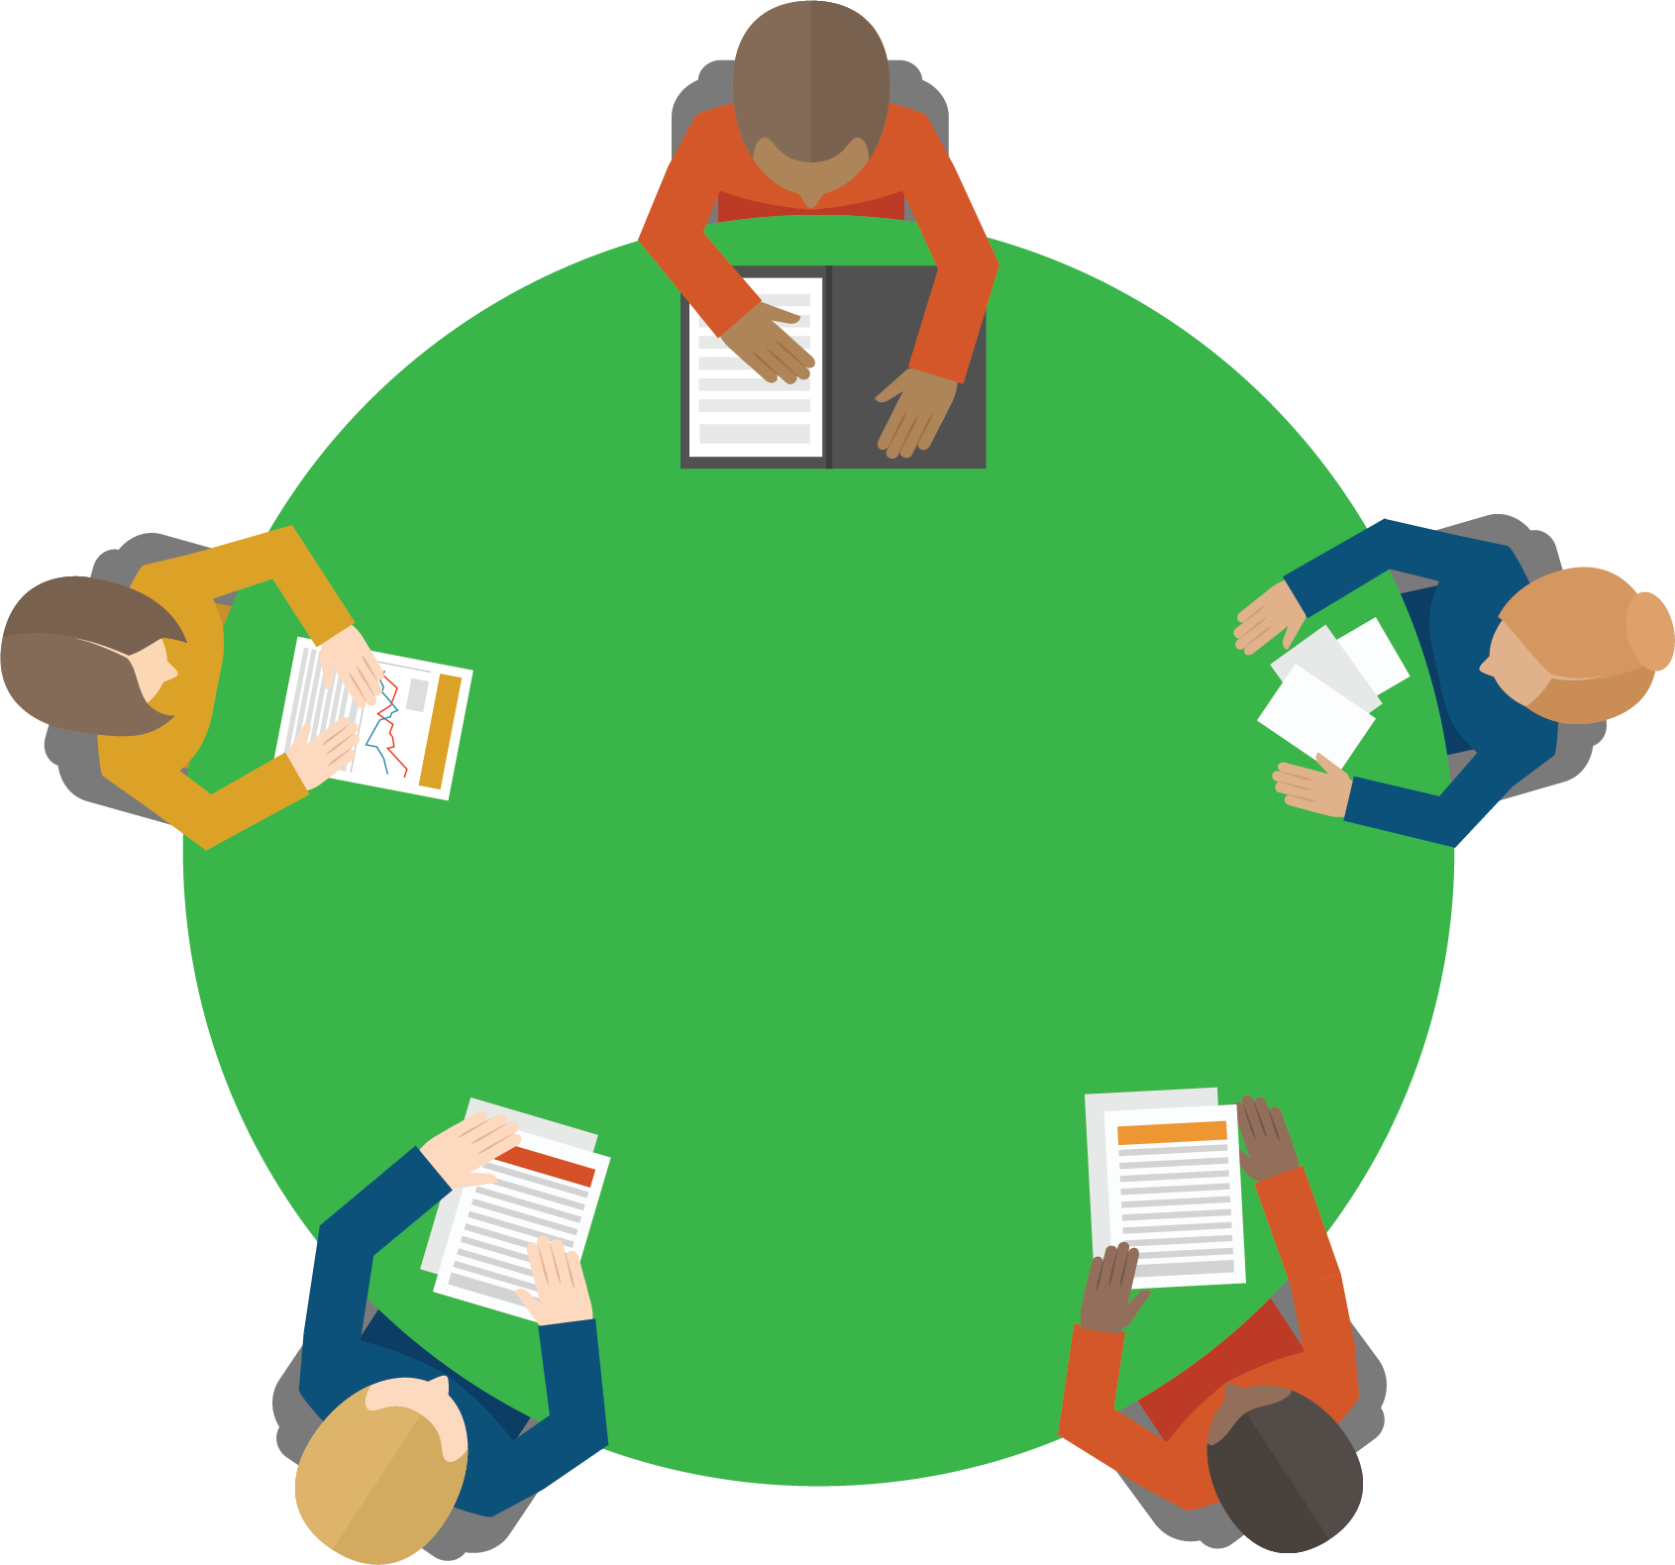
What are Data Teams?
Data Teams are groups of individuals dedicated to using data to plan and make decisions about programs and services.

Slide 6
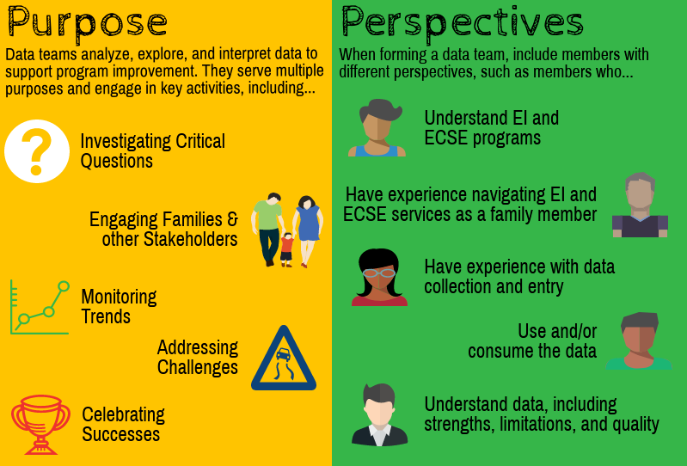
Purpose and Perspectives of a Data Team

Slide 7
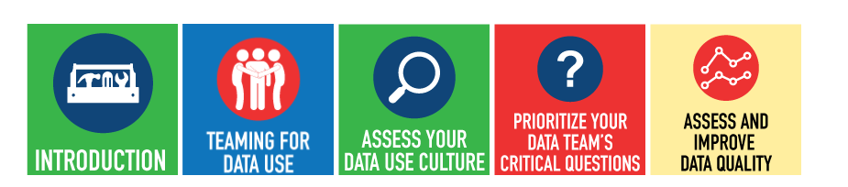
DaSy Data Culture Toolkit
The toolkit is organized around key steps to building a culture of data use in your state or local team. Each step includes an overview, considerations and data team resources, and tips for how to use resources included in each section.

Slide 8
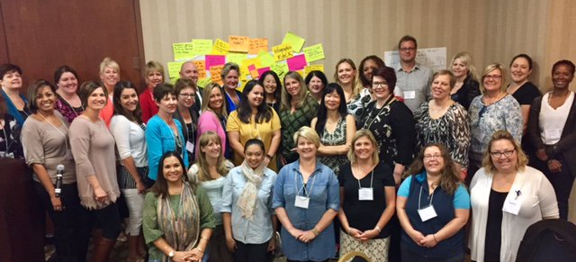
Knowledgeable Stakeholders =
Engaged Stakeholders
Family Data Institute, October 2016, Louisville, KY

Slide 9
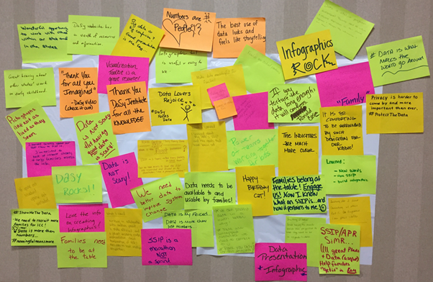
Brainstorming

Slide 10
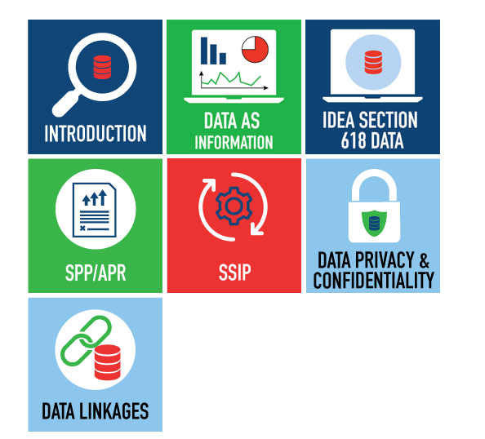
Building Stakeholder Knowledge About Data Toolkit
An orientation to IDEA data and other data-related topics to help stakeholders meaningfully participate in conversations about important programmatic issues and decisions.

Slide 11
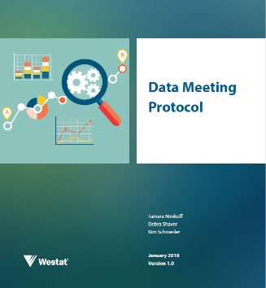
Data Meeting Protocol
Notes:
https://ideadata.org/resources/resource/1758/data-meeting-protocol

Slide 12
Why a Data Meeting Protocol?
Provides a simple structure to guide conversation around data during meetings
Helps groups examine evaluation results and make meaning of the results together
Supports the analysis and use of data to inform continuous improvement

Slide 13
Data meeting protocol process
Before the meeting
Plan and Prepare
During the meeting
Guide participant discussion based on the data
After the meeting
Provide recap and next steps
Key role: Protocol lead
Key role: Facilitator
Key role: Protocol lead
5
Notes:
Before the Meeting
Protocol lead
Has key responsibilities both before and after the meeting
Can be one or more individuals
During the Meeting
Facilitator
Guides participants through the group discussion process during the meeting
Can be internal staff or outside support
Other roles: notetaker, timekeeper
After the meeting
Protocol lead

Slide 14
Protocol steps: Before the meeting
1. Determine the Objective
2. Identify the Data
3. Identify Participants and Key Responsibilities
4. Organize the Data to Present
5. Prepare and Distribute the Agenda
6

Slide 15
Protocol steps: During the meeting
1. Introductions and Key Messages
2. Present the Data
3-5. Discuss the Data
6. Determine Next Steps for the Group
7. Reflect on the Meeting’s Effectiveness
7

Slide 16
Steps 3-5: Discussing the data
3. Discuss Observations of the Data
4. Discuss Interpretations of the Data
5. Discuss Implications of the Data
What do you see?
What do the data tell you?
What are your initial thoughts or reactions?
What are the implications?
What do these data not provide?
What do these data confirm?
What answers are you getting for our original evaluation questions?
So what? Why does this matter?
What does this mean for the work?
8
Notes:
Talk about these three steps for discussing the data.

Slide 17
Protocol steps: After the meeting
1. Distribute Notes From the Protocol Process
2. Confirm Next Steps and Timeline for Additional Actions
9
Notes:
The After Meeting steps are really just good reminders and a clear outline for facilitators and participants to keep process moving forward.

Slide 18
Example 1—Large Group Data Discussion
  A state is evaluating its social-emotional skills development practices in its early intervention programs.
  Evaluation questions:
  Are practitioners improving in their implementation of the practices?
  Are they implementing the practices with fidelity?
  Data source:
  Fidelity observation tool
10
Notes:
D
2 min: slides 9-10
Now it’s your turn to try out those 3 data discussion steps of the Data Meeting Protocol (observe, interpret, discuss implications). We’ll start by working through an example together. For this discussion, let’s think about a state that is evaluating its middle school reading program. Here are some things that we know about the purpose and implementation of the program.

Slide 19
Fidelity of Implementation—Average Scores on Fidelity Assessment (by Program)
Fidelity = 3.5
11

Slide 20
Example 2—Table Data Discussion
  A state is evaluating a new early literacy program in preschool settings.
  Evaluation question:
  What factors are contributing to teachers’ fidelity of implementation?
  Data source: Teacher survey
12

Slide 21
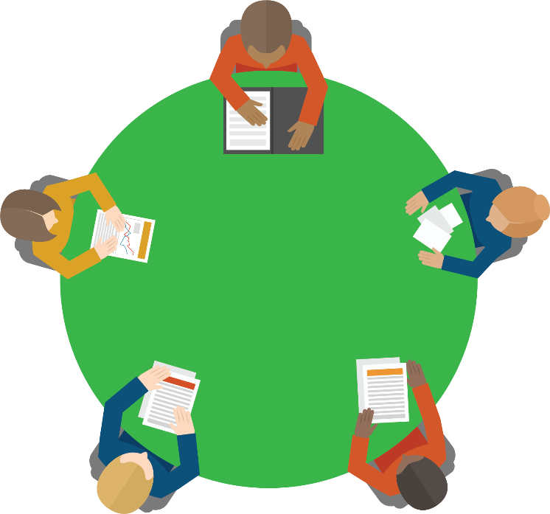
Participate in a Data Meeting
  At each table, participants select a role:
      State data staff
      State early childhood education staff
      Local program administrator
      Parent of a child in a local preschool program
  Assign a facilitator, note-taker, and timekeeper
  Follow the protocol steps 3 to 5 for the data provided.
Notes:
D

Slide 22
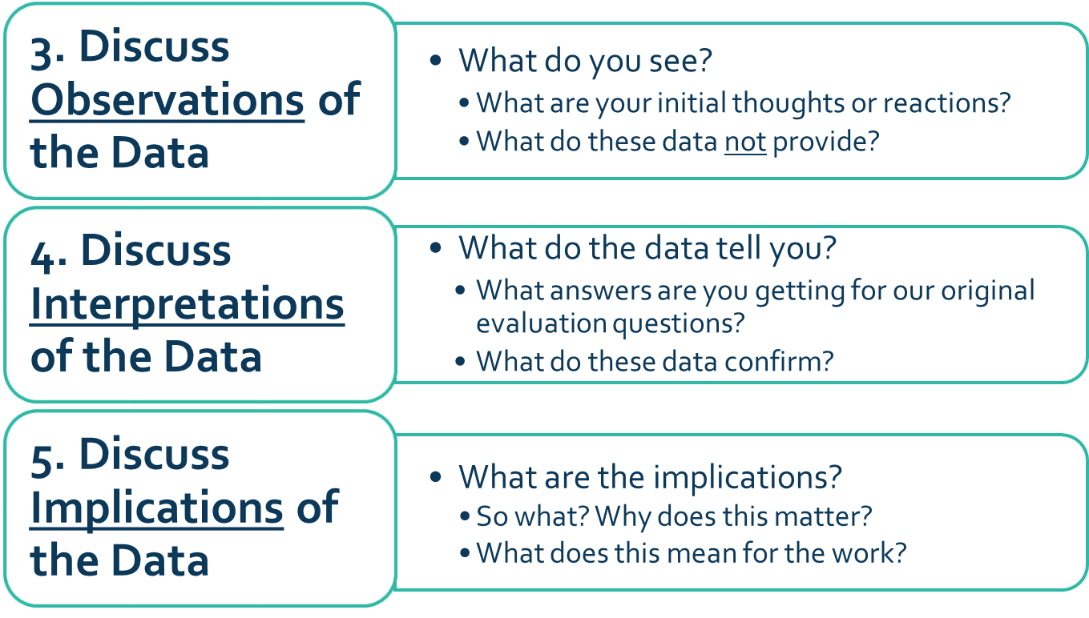
Table Discussions-Teacher Survey Data
Table Discussions—Teacher Survey Data
14

Slide 23
Teacher Survey Results: Percentage of Teachers Who Agreed with Statement
11

Slide 24
Whole Group Sharing
How did the data discussions go?
Which parts of the discussion were easy? Hard?
What surprised you?
15

Slide 25
Application
How might you use the protocol?
Who might you involve in a data discussion meeting?
What data analysis could lend itself to this process?
What else would you need to feel comfortable using the protocol?
15

Slide 26
Resources and Support
Find the Data Meeting Protocol on the IDC website:
    https://ideadata.org/resources/resource/1758/data-meeting-protocol
Relevant toolkits on the DaSy website:
Data Culture: https://dasycenter.org/data-culture-toolkit/
Building Stakeholder Knowledge about Data: https://dasycenter.org/building-stakeholder-knowledge-toolkit/
16

Slide 27



The contents of this presentation were developed under a grant from the U.S. Department of Education, # H373Z120002. However, those contents do not necessarily represent the policy of the U.S. Department of Education, and you should not assume endorsement by the Federal Government.
Project Officers, Meredith Miceli and Richelle Davis.

