Slide 1
Telling your Data Story with an Infographic
Telling your Data Story with an Infographic
Kerry Friedman (DaSy), Patrice Linehan (NCSI), Jenna Nguyen (DaSy), Ashley Furney (CO)
Washington, D.C.
August 2018

Slide 2
Our Time Together…
Introduction to infographics
Process for developing infographics
Introduction to Venngage
Creating your own Infographic
Value of infographics
Resources
Next steps
Notes:
Introduction – Design Principles, Examples, Value (10 min) – Kerry – carousel of infographics in the beginning
Process – guiding people through (20 min) - Ashley
Process for developing infographic vs. process for helping others develop infographics.
What is the information you want to share, who do you want to share it with, how do you want it to be used – list/theme
Activity – piece of paper
Introduction to Venngage (10 min) – Patrice & Jenna
Work on Infographic (40 min)
Value/Reflection of doing this with stakeholders – places in the process where there’s value in this for state. (10 min) – Patrice & Jenna
Point to All the Resources– Patrice & Jenna

Slide 3
What is an Infographic?
http://www.societyofrevellers.com/what-is-an-infographic/
Notes:
Introduction
Key design principles
Examples
Value

Slide 4
Benefits of Infographics
https://visual.ly/community/infographic/technology/infographics-benefits-their-use-online

Slide 5
5 Infographic Design Principles
Communicate one central idea
Communicate the data clearly
Create Levels of Engagement
Make it easy to navigate
Keep it beautiful

Slide 6
Communicate One Central Idea
http://www.rauchfoundation.org/how-we-work/what-we-support/

Slide 7
Communicate Data Clearly
https://dasycenter.org/state-of-the-states-on-linking-data/

Slide 8
Make it Easy to Navigate
https://health.oregonstate.edu/sites/health.oregonstate.edu/files/hallie-ford/images/bleasdale_infographic_predicting_academic_success_in_preschool_and_kindergarten1.jpg

Slide 9
Create Levels of Engagement
https://elearninginfographics.com/wp-content/uploads/How-Far-Behind-Are-We-On-Preschool-Infographic.png

Slide 10
Keep it beautiful
https://www.zerotothree.org/resources/1382-the-word-gap-by-age-3-infographic

Slide 11
Infographic Development
Step 1: Plan
Answer WH questions
Gather data and information that tells the story
Determine visual layout
Step 2: Design
Choose or design a template that matches your vision
Input content (remember to credit your sources)
Get feedback, review and finalize infographic
Step 3: Distribute
Distribute infographic to intended audience(s)
Notes:
Process for developing infographic vs. process for for helping others develop infographic
What is the information you want to share
Who do you share it with?
How do you want it to be used?
Activity – piece of paper

Slide 12
Answer WH Questions
Notes:
Process for developing infographic vs. process for for helping others develop infographic
What is the information you want to share
Who do you share it with?
How do you want it to be used?
Activity – piece of paper

Slide 13
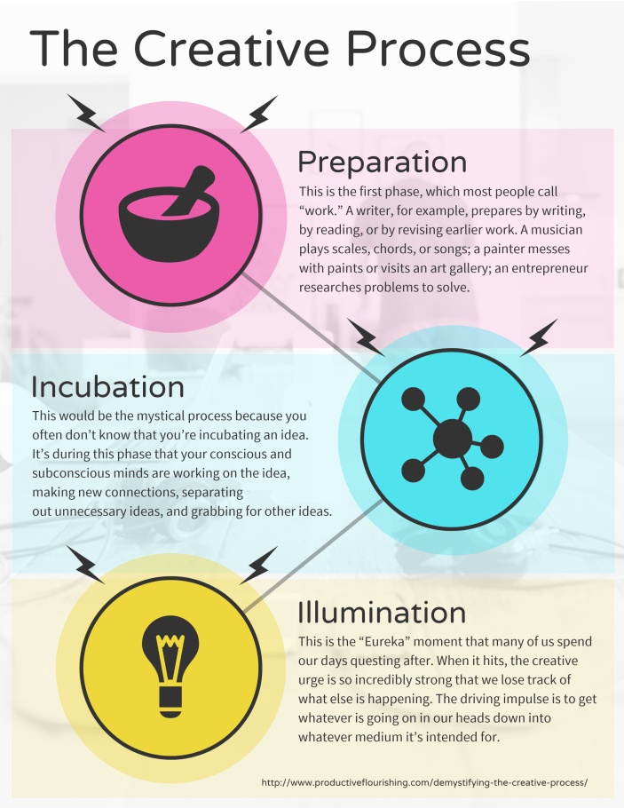
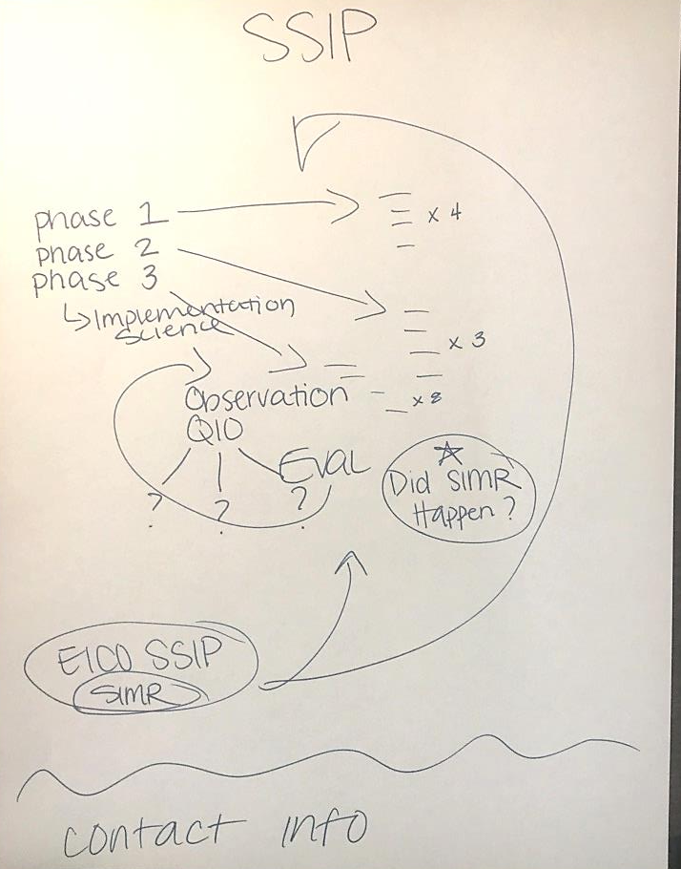
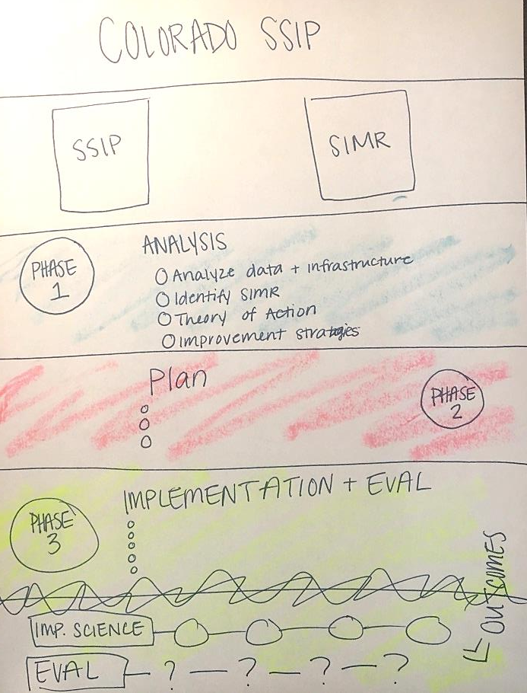
Determine Visual Layout
Scribble Browse Scribble
Notes:
Determining how to organize information on a page
Process for developing infographic vs. process for for helping others develop infographic
What is the information you want to share
Who do you share it with?
How do you want it to be used?
Activity – piece of paper

Slide 14
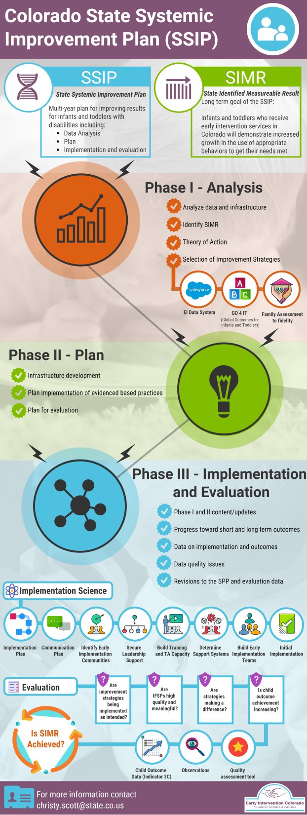
Colorado’s Final Infographic

Slide 15
Let’s Get Started!

Slide 16
Infographic Development
Step 1: Plan
Answer WH questions
Gather data and information that tells the story
Determine visual layout
Step 2: Design
Choose or design a template that matches your vision
Input content (remember to credit your sources)
Get feedback, review and finalize infographic
Step 3: Distribute
Distribute infographic to intended audience(s)
Notes:
Process for developing infographic vs. process for for helping others develop infographic
What is the information you want to share
Who do you share it with?
How do you want it to be used?
Activity – piece of paper

Slide 17
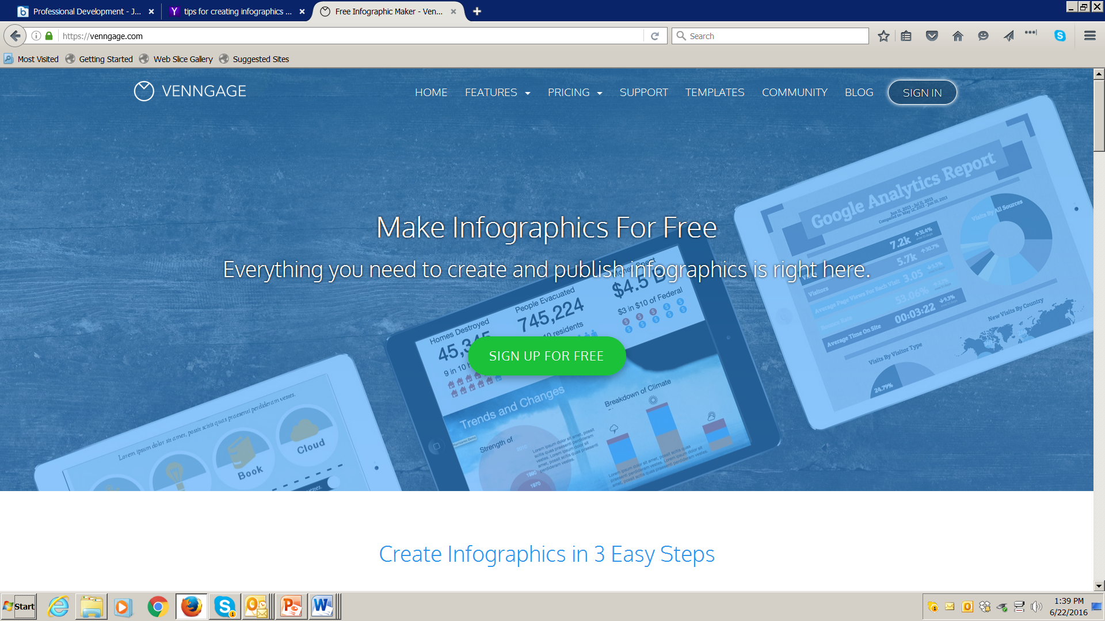
Tutorial for Venngage
Using a free site: www.venngage.com
Notes:
Open a free account & Log in – Will we be able to send participants some instructions to create an account ahead of time or should we open a few accounts to use in addition to the NCSI Communication and Collaboration Team account?

Slide 18
Get Inspired!
Notes:
There are more than 1,000 infographics already created that can inspire you!

Slide 19
Browse the Available Templates
Consider the type of message you want to convey
Select a template from the free options to preview or ‘create’
Watch the ‘onboarding’ videos for help

Slide 20
Add widgets to your Infographic
Drag and drop charts, icons, maps or text onto your infographics.
You can show or hide each category by clicking on the arrows.
Click on any text, image or icon to edit it or double click to edit charts.
Notes:
Click on any text, image or icon to edit it. The settings will appear on the tool bar on top. Double click to edit charts. The chart settings will appear on the right.

Slide 21
Continue to Edit and Refine your Work
Click on any widget to edit.
Use the buttons to edit, copy, and move items to the front/back or to delete them.

Slide 22
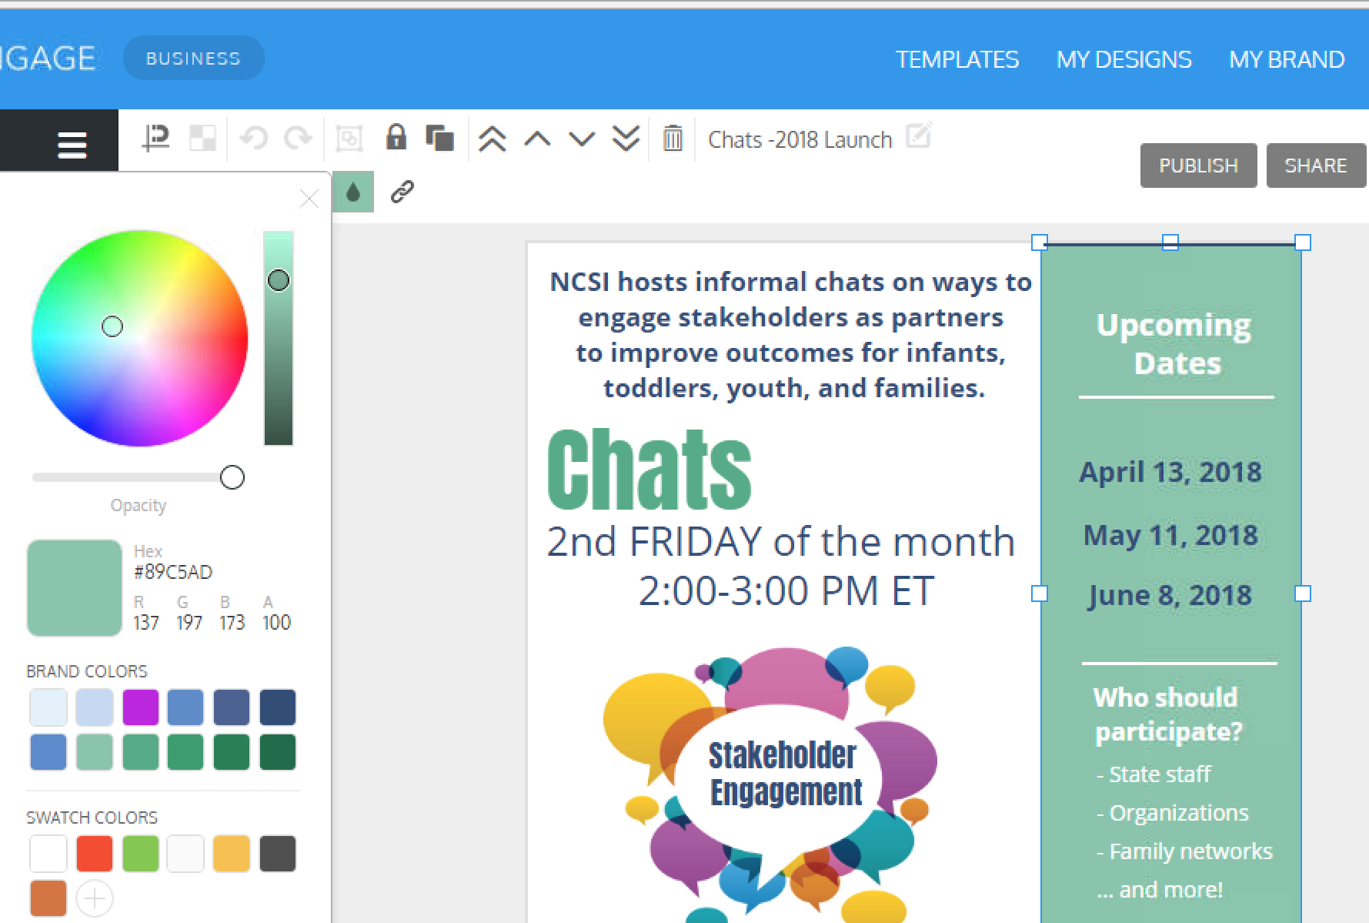
Choose Colors that Brand your Infographic
Notes:
Should we just show the color wheel and branding tools here (left image) or give a more specific example (left image)?

Slide 23
Publish and Share your Infographic
Save your work.
Create and name a folder.
Drag the infographic to the folder.

Slide 24
Let’s Try It!
Work on infographics for 40 minutes
Notes:
Everyone

Slide 25
Let’s Reflect on the Value of Infographics
Combat information overload
Synthesize main ideas
Communicate complex ideas in the content more simply
Develop sharable messages
Use infographics to build interaction
Provide simple, shareable pieces of information
Enable many to take an active role in implementation
Help many to ‘own the change’ and express the ‘what’ and ‘why’ within their own networks
Notes:
Build interaction ...interaction deepens engagement ...engagement builds relationships with the provider
Helps the leaders understand where the ‘connects’ and ‘disconnects’ are from the stakeholder perspective
Helps leaders ‘see’ the most important content from the perspective of the stakeholders
Simple, shareable pieces can help with implementation of EBP, etc.

Slide 26
Value of Involving Stakeholders
Engage stakeholders by working together to develop an Infographic to communicate the value of state work
Create shared vision/goal through collaboration
Ensure that many people understand the content and data
Increase ”buy-in” from program staff and generate enthusiasm
Build support by attracting others to your effort/initiative
Support family-professional partnerships and interagency collaboration (ICC)
Disseminate information to practitioners/families and communicate the value of your work
Reach diverse groups through stakeholders
Notes:
Value/reflection of doing this with stakeholders, places in the process where there’s value in this for state

Slide 27
Example Questions for Engaging Stakeholders in Process
Planning and development
What is the purpose of this infographic (what info, for whom, how?) and how is this meaningful to our state?
What is our story? What change are we hoping to implement and what impact are we hoping to achieve?
What are some longstanding challenges that we have faced and how have we addressed them? What are new barriers/setbacks?
Notes:
Co-creating an infographic can be a conversation starter – above are some example questions. Engage stakeholders in different points of the process – 1) planning, 2) development, 3) review
Question for Ashley and Kerry – could this slide be more appropriately incorporated in the “process” section? Or keep here?

Slide 28
Example Questions for Engaging Stakeholders in Process
Reviewing the end product
Is the infographic sufficient/comprehensive? What about for this audience (providers, families, etc.)? Is a different infographic needed for each audience?
If someone were to pick this up from a table, would they have the basic, essential information to make sense of what’s being presented?

Slide 29
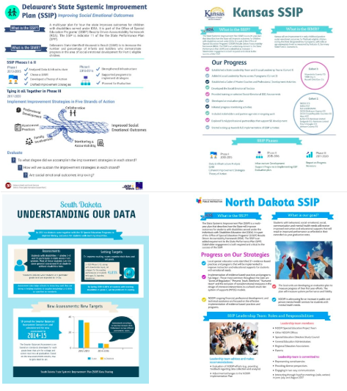
Resources to Support Next Steps
Telling Your SSIP Story in an Infographic: Strategies, Tips, and Examples
DaSy Data Visualization Toolkit
List of tools
Interactive Data Visualization Checklist – Stephanie Evergreen
OSEP Symposium: Conveying Our Stories - Displaying Our Data
Infographics for Impact
Notes:
Add NCSI stakeholder engagement chat

Slide 30
Contact Us
Visit the DaSy website at: http://dasycenter.org/
Follow DaSy on Twitter: @DaSyCenter
Like DaSy on Facebook: https://www.facebook.com/dasycenter
Visit the NCSI website at: http://ncsi.wested.org/
Follow NCSI on Twitter: @TheNCSI
Notes:
UPDATE FOR NCSI

Slide 31
Thank You!
The contents of this presentation were developed under grants from the U.S. Department of Education, # H373Z120002 and H326R140006. However, those contents do not necessarily represent the policy of the U.S. Department of Education, and you should not assume endorsement by the Federal Government. DaSy Center Project Officers: Meredith Miceli and Richelle Davis. NCSI Project Officers: Perry Williams and Shedeh Hajghassemali.

