Slide 1



Engaged Families: Using Data to Make a Difference in Policy and Programmatic Decision-Making
Diana Autin, SPAN Parent Advocacy Network
Siobhan Colgan, ECTA Center
Katrina Martin, DaSy and ECTA Centers
Amy Nicholas, DaSy and ECTA Centers
Improving Data, Improving Outcomes Conference
Arlington, VA/August 14, 2018

Slide 2
Welcome
Who’s in the room?
  Parents and family members
  Parent organizations
  Part C staff
  Part B staff
  Data managers/data role
  State administrators
  SICC or SAP representatives
  National TA center staff
  Federal partners
2

Slide 3
Logistics
Workshop time
  8:30-11:30 a.m.
  One 15-minute break
Restrooms
Parking lot questions
3

Slide 4
Workshop Outcomes
Participants will identify strategies for enhancing family participation in conversations about IDEA Part C and Part B 619 data to support engagement in policy and programmatic decision-making.
Participants will describe how national TA tools and resources can be used within their state contexts to strengthen family and family organization stakeholder engagement in data conversations.
4

Slide 5
Data are collected and can be used to:
Help programs help children and families achieve good outcomes.
Help programs improve their services.
Show policymakers that services make a difference for children and families.
How are families engaged in accomplishing these purposes of data use?
5

Slide 6
IDEA Data Requirements
States receiving funds to implement IDEA are required to collect and report on a variety of data for different purposes, including:
  Section 618
  The State Performance Plan (SPP) and Annual Performance Report (APR)
  Family survey data on helpfulness of EI and parent involvement
Program data are routinely shared with stakeholder groups, e.g., State Interagency Coordinating Councils (SICCs) and State Advisory Panels (SAPs).
Lead agency staff are expected to support stakeholders with using data to participate in conversations about important policy and programmatic issues/decisions.
6

Slide 7
Stakeholder Engagement in the
SSIP Process
Effective FFY13 (submitted April 2015), as part of the SPP/APR, states are required to develop a comprehensive, multi-year SSIP focused on improving outcomes/results for children with disabilities and their families.
Each state has selected an area of focus for the SSIP (referred to as the State-Identified Measurable Result or SiMR), and is now implementing strategies to make progress towards achieving the SiMR and evaluating those efforts.
Stakeholders are required to be involved in all aspects of the SSIP, e.g., reviewing and responding to results data.
7

Slide 8

To effectively serve as program stakeholders, families and family organization representatives need to…
Understand why data are important;
Understand what data are being collected and how those data are used;
Know who is involved in data conversations and their roles in decision-making;
Understand how they are/can be involved in data use; and
Feel comfortable asking questions about data.
8

Slide 9
From: Understanding Data as Information; Serving on Groups Guidebook developed by Wisconsin FACETS, http://www.servingongroups.org/guidebook
1. Planning & Preparing to Use Data
2. Collecting Data
3. Organizing Data
4. Analyzing Data
5. Developing Hypotheses & Making Recommendations
6. Creating an Action Plan
7. Displaying & Sharing Results
8. Continuous Monitoring for Progress & Improvement
Stages of Data Use
9

Slide 10

Workshop Topics
Identifying Technical and Adaptive Solutions
Facilitating Meaningful Data Conversations
Evaluating Engagement Efforts
Debrief/Takeaways
10

Slide 11
Identifying Technical & Adaptive Solutions
11

Slide 12

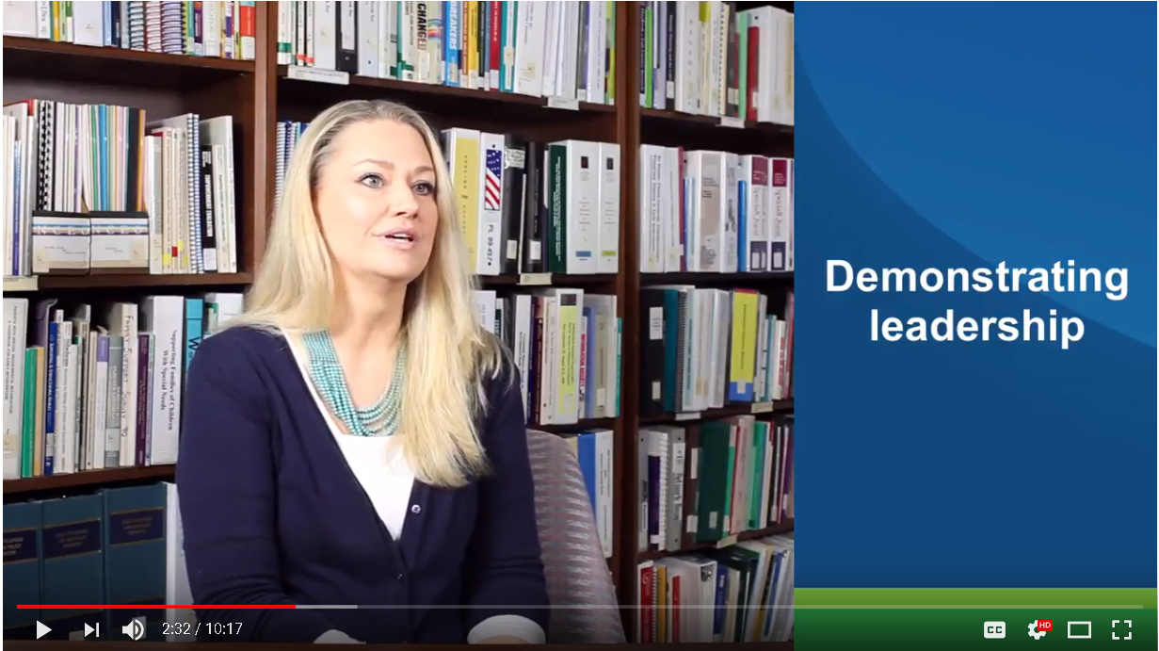
A Family Leader’s Perspective:
“It felt like their meeting.”
12

Slide 13
Leading by Convening:
A Theory of Action
There are both informational and attitudinal barriers to important practice changes.
  Decision makers often lead change through technical strategies, such as information, training, and authority.
  Stakeholders impact the extent of change by exercising adaptive strategies, such as using their influence with other stakeholders (positively or negatively).
Practice change requires both technical information and human approaches.
13

Slide 14
Overcoming Barriers
Technical challenge
  Requires information, knowledge, or tools
Adaptive (Relationship) challenge
  Requires understanding and a willingness to make behavior changes
Source: Heifetz & Linsky (2002), Leadership on the Line
14
Notes:
Diana

Slide 15
Leading by Convening Structure
15
Notes:
Diana
Quick overview of LbC – Habits, elements and depth of interaction

Slide 16
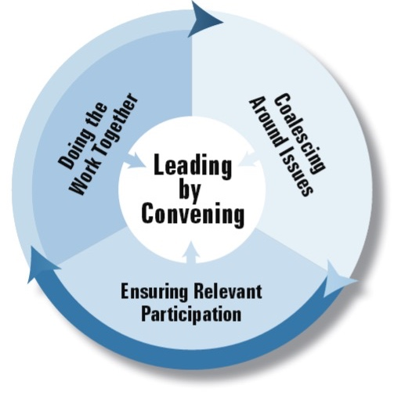
Habit of Interaction
Habits of Interaction
Coalescing Around Issues
Ensuring Relevant Participation
Doing the Work Together
Habits of Interaction
Coalescing Around Issues
Ensuring Relevant Participation
Doing the Work Together
Elements of Interaction
Adaptive
Technical
Operational
Depth of Interaction
Informing
Networking
Collaborating
Transforming
16

Slide 17
Doing the Work Together
17

Slide 18
Family and family organization stakeholders come to the decision-making table with…
Unique life stories that give them motivation to serve as thought leaders and change agents on behalf of all children and families, not just their own.
Different levels of access to information and support.
Different experiences with using data in both their personal and professional lives.
Varied feelings about today’s “data-rich” culture.
18

Slide 19
Most family and family organization stakeholders…
Come to their role with some, or even extensive, experience with using data to inform decisions about their own children.
Are not knowledgeable about all of the different types of data collected by EI and ECSE programs.
Are not familiar with how various types of data are used to make funding and other decisions about program operations, management, and improvement.
19

Slide 20
What might limit engagement?
May be intimated by data or lack confidence in their ability to use it, particularly when large data sets and complex analyses are involved.
May feel hesitant to ask questions and instead rely on others’ interpretations or conclusions because they are unclear about what the data are telling them.
May not understand how to apply their experiences with using data about their own children to using data about the services provided through the state.
20

Slide 21
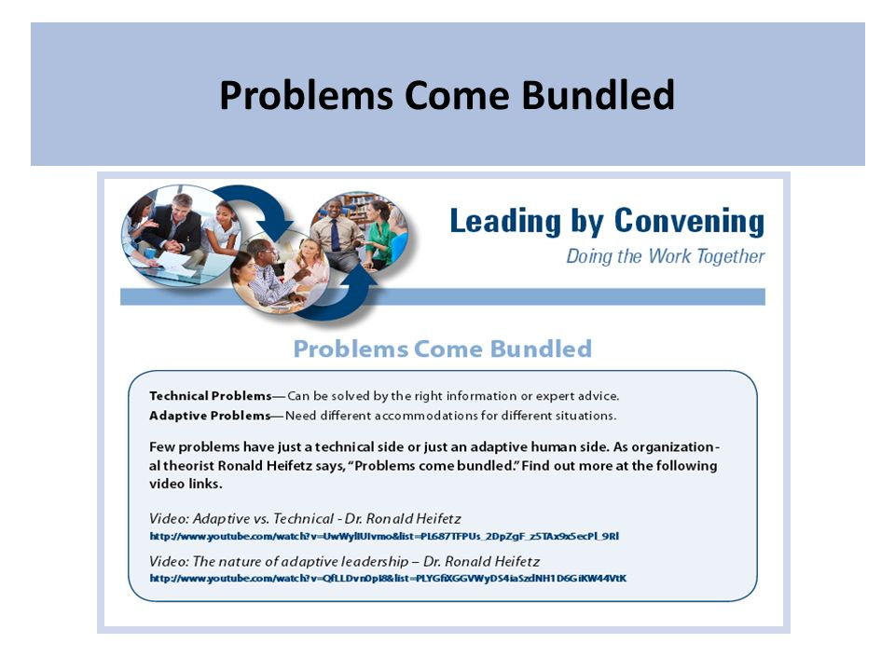
Problems Come Bundled
21

Slide 22
Activity 1: Problems Come Bundled
Each group will focus on one “problem of practice” related to the engagement of diverse family stakeholders in understanding and using policy and programmatic data:
  Individual level
  Program Level
  State Level
Please identify 2 technical and 3 adaptive strategies to address the challenge assigned to your table.
22

Slide 23
Activity 1 Debrief
Which was harder to identify and why?
  Technical solution
  Adaptive solution
Name one adaptive strategy you discussed for the:
  Individual family/provider level
  Program level
  State/policy level
23

Slide 24
Facilitating Meaningful Data Conversations
24
Notes:
Diana to Amy

Slide 25
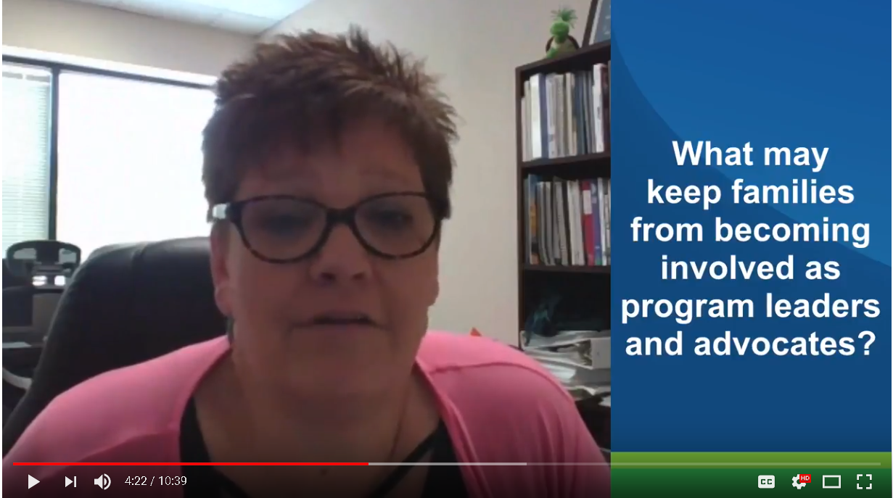
A Family Leader’s Perspective:
“Good luck with that.”
25

Slide 26


Preparing and Engaging Family and Family Organization Stakeholders
Before
During
After
Articulate purpose of the work/ decision/discussion
Describe role of stakeholders
Provide resources to build background knowledge on programmatic data
26

Slide 27
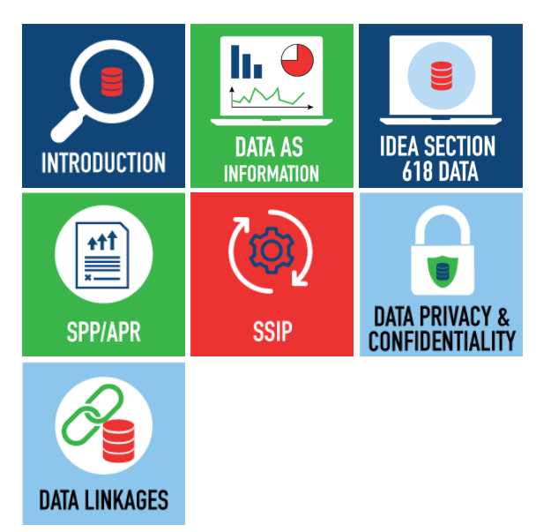

Online Toolkit: Building Stakeholder Knowledge About Data
Provides stakeholders with an orientation to IDEA data and other data-related topics to help them meaningfully participate in conversations about important programmatic issues and decisions.
27

Slide 28
What is included in the toolkit?
Information, activities, and other resources to increase stakeholders’ knowledge and understanding of:
  Data as Information
  IDEA Section 618 Data
  The State Performance Plan/Annual Performance Report (SPP/APR)
  The State Systemic Improvement Plan (SSIP)
  Data Privacy and Confidentiality
  Cross-Program/Agency Data Linkages
28
Notes:
Amy

Slide 29
What information is provided about each topic?
Brief overview of the topic
Key points about the topic that stakeholders need know
A content presentation providing more in-depth information about the topic
Suggestions for how stakeholders can take what they learned about the topic and apply it to their state’s context
Supplemental resources
29
Notes:
Amy

Slide 30
Preparing and Engaging Family & Family Organization Stakeholders
Before
During
Invite unique perspectives
After
Articulate purpose of the work/ decision/discussion
Use group process techniques to ensure each voice is heard
Provide a safe forum to ask questions, share information, and confirm understandings
Describe role of stakeholders
Provide resources to build background knowledge on programmatic data
30

Slide 31
Preparing and Engaging Family & Family Organization Stakeholders
Before
During
Invite unique perspectives
After
Close the loop—communicate decision and provide rationale
Articulate purpose of the work/ decision/discussion
Use group process techniques to ensure each voice is heard
Provide a safe forum to ask questions, share information, and confirm understandings
Describe role of stakeholders
Provide resources to build background knowledge on programmatic data
Identify areas of needed improvement and strategies for addressing those areas in a timely and effective manner
31
Notes:
Amy

Slide 32
Break
32

Slide 33
Activity 2: Facilitating Data Conversations
Think about a stakeholder meeting that you recently facilitated or in which you participated that involved a discussion about data and share your answers to the following questions with your tablemates:
  What went well? Why do you think this was a success?
  What didn’t go well? Why do you think this was a challenge?
Answer the additional prompts assigned to your table to further explore strategies for maximizing family engagement in data conversations. Be sure to assign a recorder and reporter to capture and share highlights of your discussion with the large group.
33

Slide 34
Activity 2 Debrief
Based on your table’s discussion, please share:
One stakeholder group success that resonated among your tablemates
One stakeholder group challenge
One “big idea” about engaging family and family organization stakeholders
34

Slide 35
Let’s Talk Data: Making Data Conversations Engaging and Productive
Thursday, Aug. 16th
10:30 a.m.-12:00 p.m.
Salon J
DaSy & IDC
  Data Meeting Protocol
  Data Visualization Toolkit
  More on the Building Stakeholder Knowledge about Data Toolkit
35

Slide 36
Evaluating Efforts to Engage
Family and Family Organization Stakeholders in Data Use
36

Slide 37
Leading by Convening:
Building Support Through Data Rubric
Designed to support groups in their efforts to deepen collaboration and engagement of stakeholders
Includes criteria and levels of performance to describe the behavior of systems, leaders, and stakeholders
Can be used to assess stakeholder engagement needs and strengths for different groups and identify next steps
37

Slide 38
Building Support Through Data Rubric
38

Slide 39
Taking a Closer Look at Key Actions and Behaviors (Criteria)
Increase the number and types of stakeholders who are “data literate”
Identify the relevant data collection practices and conditions related to the intended outcomes
Reach agreement on relevant data
Identify a strategy (or strategies) and procedures to monitor data changes
39

Slide 40
Levels of Engagement
Informing
  Sharing or disseminating information with others who care about the issue; top-down, one-way communication
Networking
  Asking a select group what they think about this issue & listening to what they say; limited two-way communication
Collaborating
  Engaging a more representative group of stakeholders who care about the issue in trying to working together around the issue to make change
Transforming
  Leading by convening, facilitating deep cross-stakeholder engagement & leadership, sharing leadership, building consensus
40

Slide 41
Activity 3: Using the Building Support Through Data Rubric
Step 1: Individual reflection
  Think individually about your experiences as a member or a convener of a stakeholder group.
  Consider each of the Operational Decisions and Processes along the left-hand side of the chart and each of the levels of engagement.
  Put an X in the appropriate column for each of the rows.
Step 2: Table discussion
  Where do family/family organization stakeholders feel they are on the chart?
  Where do conveners feel they are on the chart?
  What are 1-2 concrete steps that family and family organization stakeholders and conveners can take to get to the next level?
41

Slide 42
Activity 3 Debrief
How similar or different were the ratings on the rubric between family/family organization stakeholders and conveners of stakeholder groups?
What steps did your group come up with as ways to move to the next level?
What other takeaways do you have from this activity?
42

Slide 43
Workshop Takeaways & Next Steps
What’s one important “aha” that you had today?
What is one potential next step that you can take when you get back?
What additional resources or technical assistance would be helpful to you in your role?
43

Slide 44
Resources
Building Stakeholder Knowledge about Data Toolkit: https://dasycenter.org/building-stakeholder-knowledge-toolkit/
Serving on Groups that Make Decisions: www.servingongroups.org
Leading by Convening: https://ncsi.wested.org/resources/leading-by-convening/
Telling Your SSIP Story in an Infographic: https://dasycenter.sri.com/downloads/DaSy_papers/SSIPY511_InfographicGuide.pdf
44

Slide 45
Find Us Online
DaSy website: http://dasycenter.org/
Twitter: @DaSyCenter
ECTA website: http://ectacenter.org/
Twitter @ECTACenter
Center for Parent Information and Resources (CIPR): www.parentcenterhub.org
Twitter: @parentcenterhub
45

Slide 46

Thank you!
The contents of this presentation were developed under grants from the U.S. Department of Education, #H326P120002, #H326P170001, and #H328R130006. However, those contents do not necessarily represent the policy of the U.S. Department of Education, and you should not assume endorsement by the Federal Government. Project Officers: Meredith Miceli, Richelle Davis, Julia Martin Eile, and Carmen Sanchez.
46

