Slide 1
Data Culture: What does it look like in your program?
August 2018 IDIO Conference
Notes:
Intro thru the polling- 10 minutes

Slide 2
Session Objectives
Part C and Part B 619 recognize the important of creating a culture of data use and supporting data teams to effectively use data at the local and state levels.
Hear and share about efforts (and supporting tools) to build a culture of data use and reflect on your program’s data culture.
Notes:
Description: Now more than ever Part C and Part B 619 programs are recognizing the importance of creating a culture of data use and supporting data teams to effectively use data at the local and state levels. Join colleagues from the DaSy Data Culture Learning Community to learn about efforts to build a culture of data use and reflect on your state or program's data culture. Resources including the DaSy Data Culture Toolkit will be discussed.

Slide 3
Introductions
State Panelists
DaSy
Darci Rickson, KS
Brenda Sharp, LA
Lisa Backer, MN
Haidee Bernstein
Denise Mauzy

Slide 4
To the polls…
Get ready! You can participate on either your cell phone or online.
By phone: Open a new text message to 22333, type DASY, send the message.
Online: Enter this URL into your browser: PollEv.com/dasy

Slide 5
What do you think about when you hear “data culture?”

Slide 6
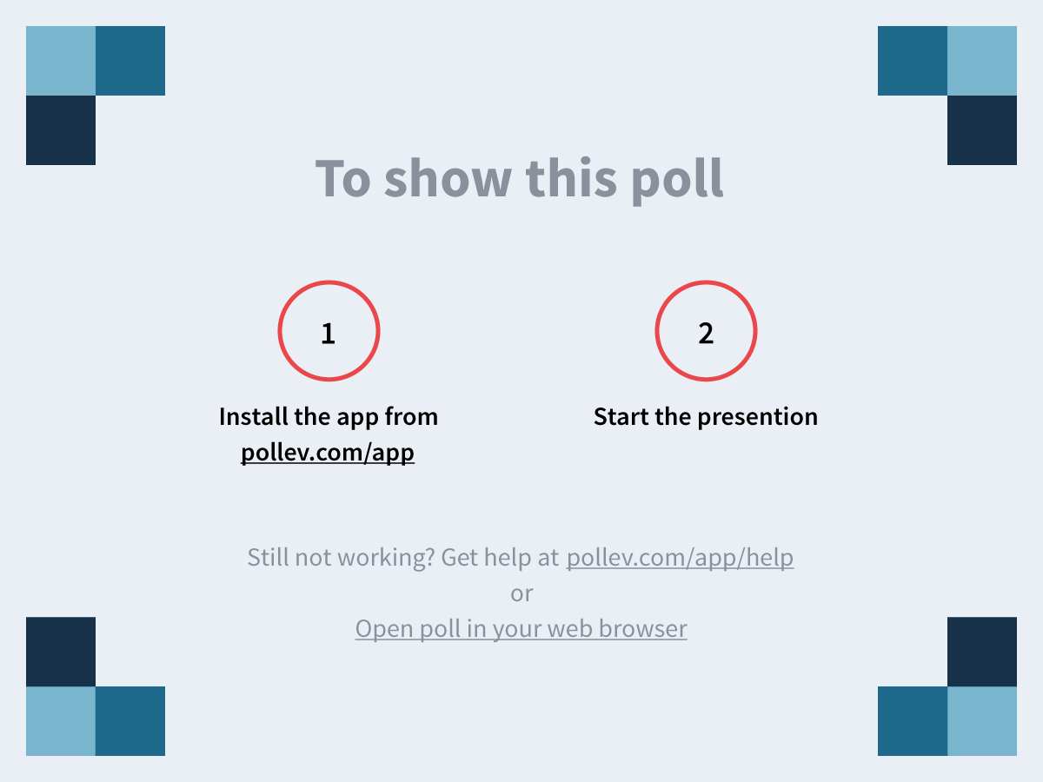
Poll
Notes:
What do you think about when you hear "data culture?" https://www.polleverywhere.com/free_text_polls/HRR0AI6qK3SRnkk

Slide 7
Data Culture Toolkit: Supporting State and Local Data Use

Slide 8
Louisiana: Teaming to Support Data
Brenda Sharp
Notes:
5-7 minutes

Slide 9
General Supervision
Louisiana SiMR: improve child outcomes through supports that are focused on family concerns, priorities and resources and provided through a team-based approach.
Phase III, Year 1—made 2 infrastructure changes that required follow up for implementation fidelity:
Designating availability of a service resource
Changing the child outcome measurement process

Slide 10
Louisiana
Process for review: generate a report at the state level, disaggregate by region, send to regional staff for review and follow up with individual agencies.
Teaming Plan Considerations Worksheet selected for staff discussion on using data for decision making
What we learned
State staff doing all the work
No buy in from agencies
Conversation was perceived as punitive
State staff needed support on using reports

Slide 11
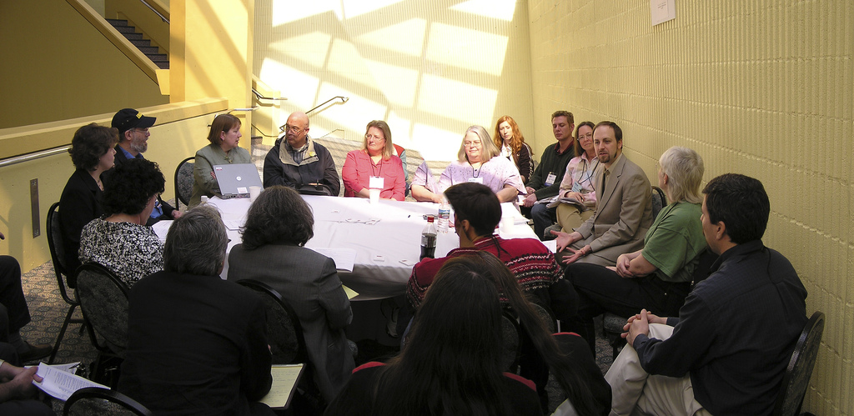
Table Talk
Notes:
15 minutes
Use considerations (handout) and 1 infographic
How might you use this tool?

Slide 12
Minnesota: Assessing Data Use Culture
Lisa Backer
Notes:
10-12 minutes

Slide 13
Formal Strategies: SSIP Infrastructure Analysis
State: DaSY Framework completed by SSIP leadership team during Phase I
Survey of all local ECSE programs (Part C and 619) and leaders using INSPIRE ACTION 1.0 program self assessment

Slide 14
Phase I: Local Program Assessment

Slide 15
INSPIRE

Slide 16
ACTION

Slide 17
Specifics of Data Use
Local program leaders and staff were not choosing to use discretionary time to conduct data analysis.
Some indicated lack of skill.
Few had improvement plans that were data driven.
Comments included a sense from local programs that the number of children in their data sets were too small to use to draw meaningful conclusions.

Slide 18
Less Formal Strategies
Conference evaluations
Regionally Representative Leadership Team
Data reported by Professional Development Facilitators (PDFs)

Slide 19
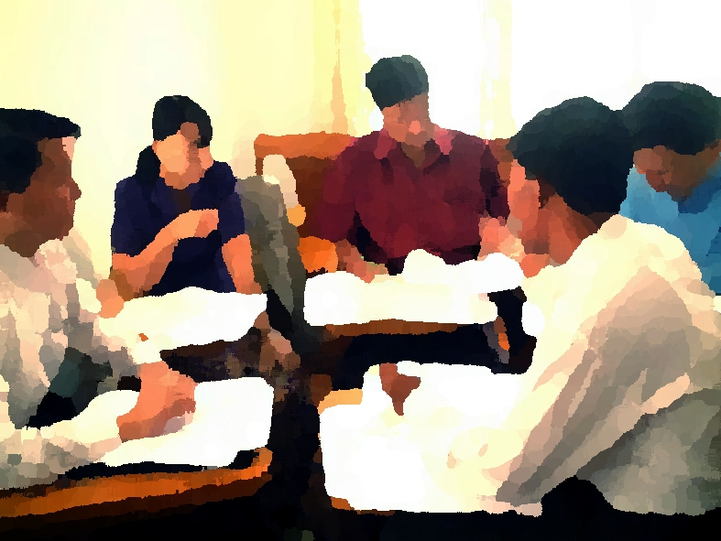
Table Talk
Notes:
15 minutes
Using assessment handout
How might you use this tool?

Slide 20
Kansas: Assessing Data Quality
Darci Rickson
Notes:
15 minutes

Slide 21
Information
Kansas Infant-Toddlers Services – known locally as Tiny-k programs
Part C is administered by the Kansas Department of Health and Environment (KDHE)
10,041 children received early intervention services in calendar year 2017
There are 32 local programs and each program is different

Slide 22
Local Program Database Users
Coordinators
Providers
FSCs
IFSP Users
Data Managers
Notes:
Each of our local programs are as individual as the children they serve.
Many different database users have access to our online database.
Coordinators
Providers
FSCs
IFSP Users
Data Managers
With so many different database users, Kansas has been working on Assessing Data Quality

Slide 23
Assessing Data Quality
Data Quality – data must be consistent and unambiguous to be high quality
Data quality issues are often the result of database merges in which data fields that should be compatible are not due to format inconsistences or communication issues
Data is considered high quality if it “FITS” its intended uses
Notes:
When I was asked to present today on accessing data quality I wanted to make sure that I was talking the same “data language”.
I looked up the meaning of “Data Quality”
Data Quality – data must be consistent and unambiguous to be high quality
Data quality issues are often the result of database merges in which data fields that should be compatible are not due to format inconsistences or communication issues
Data is considered high quality if it “Fits” its intended uses.
What data quality means to me is that you want to keep data clean, clear and simple. Good in gets good out.
The problem is sometimes database are like people and there can be a lot of communication issues.
Have you heard about the 5 Languages of love? It talks about how everyone interprets information differently. Well I feel it is the same for databases.

Slide 24
5 Languages of Data
Completeness
Validity
Timeliness
Consistency
Integrity
Notes:
I feel we need to learn to understand our database’s language to speak it.
I came up with the 5 Languages of Data
Completeness
Validity
Timeliness
Consistency
Integrity
My database might be formatted differently than yours, but for federal reporting purposes they are tracking the same data. Understanding what information your database needs and how that database interprets information will help improve your Data Quality

Slide 25
Communication Issues
Universal statewide IFSP and online database
With an internet connection, the IFSP is entered directly into the database
Without an internet connection, more steps are required to get the IFSP into the database
More people touching the data equals higher probability for errors
Solution: Kansas began creating a downloadable/uploadable IFSP
Notes:
Kansas currently has a Universal State Wide IFSP and online database.
With an internet connection the IFSP is entered directly into the database
Without an internet connection, more steps are required to get the IFSP into the database.
One person might updated the IFSP and another person might input the IFSP into the database.
There might be trouble reading hand writing, transposing numbers or dates.
The information might be entered right away, or it after seeing several children.
Keeping the data accurate and consistent is difficult the more people touching the data and there is a higher probability for errors.
Solution: Kansas began creating a downloadable/uploadable IFSP

Slide 26
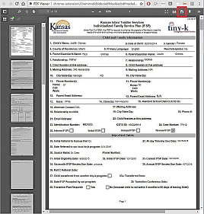
What is a Downloadable IFSP?
The downloadable IFSP is a child specific, electronic, fillable PDF version of our IFSP
The downloadable IFSP was created to enable database users to write or review an IFSP without access to an internet connection
The downloadable IFSP does not update the database until it is uploaded back into the database and finalized

Slide 27
How does the Downloadable IFSP work?
The child specific IFSP is downloaded onto the database users device as an electronic, fillable PDF form
Then the IFSP is reviewed or updated as needed
Next the IFSP is uploaded into the database
Data checks are performed on required fields
When the IFSP is finalized in the database, the new information is updated in the database
A notice will pop-up that the file was successfully uploaded
Notes:
The child specific IFSP is downloaded onto the users device as an electronic, fillable PDF form
Then the IFSP is reviewed or updated as needed
Next the IFSP is uploaded into the database
Data checks are performed on required fields
When the IFSP is finalized in the database, the new information is updated.
A notice will pop up that the file was successfully uploaded

Slide 28
The Downloadable IFSP
ANY QUESTIONS???
Darci.Rickson@Ks.gov

Slide 29
Table Talk
Notes:
10 minutes
Use data quality considerations
How might you use this tool?

Slide 30
Going Forward…
How can DaSy help you?
Notes:
5 minutes

Slide 31
Final presentation slide
Visit the DaSy website at: http://dasycenter.org/
Like us on Facebook: https://www.facebook.com/dasycenter
Follow us on Twitter: @DaSyCenter

Slide 32
Thank you
The contents of this tool and guidance were developed under grants from the U.S. Department of Education, #H373Z120002 and #H326P170001. However, those contents do not necessarily represent the policy of the U.S. Department of Education, and you should not assume endorsement by the Federal Government. Project Officers: Meredith Miceli, Richelle Davis, and Julia Martin Eile.
Notes:
Instructions to presenters: This slide is to be included as the last slide in your deck but you are not expected to show it to the audience. Please be sure to delete these instructions from this slide’s notes page in your presentation.

