Slide 1



Guidance for Implementing Effective Training and TA on the Child Outcomes Summary (COS) Process
Improving Data, Improving Outcomes Conference
Arlington, VA
August 2018

Slide 2
Presentation Team
Katrina Martin
Early Childhood Technical Assistance Center/ Center for IDEA Early Childhood Data Systems
Katrina.Martin@sri.com
Katie McCarthy
Vermont State Agency of Education (Part B 619)
Katie.McCarthy@vermont.gov
Pam Miller
Maryland State Department of Education (Part C and Part B 619)
Pamela.Miller@maryland.gov
Amy Nicholas
Early Childhood Technical Assistance Center/ Center for IDEA Early Childhood Data Systems
Amy.Nicholas@unc.edu
Kellen Reid
Early Childhood Technical Assistance Center/ Center for IDEA Early Childhood Data Systems
Kellen.Reid@unc.edu
Naomi Younggren
Department of Defense (Part C)/ Early Childhood Technical Assistance Center
naomi.younggren@gmail.com

Slide 3
Overview of Session
To provide an overview of the national resources that are available to support COS training and TA, and how they might be incorporated into ongoing professional development (PD).
State presenters will share information about their COS PD systems, including how they are addressing critical staff knowledge and skill development needs and impacts of training efforts on COS data quality.

Slide 4
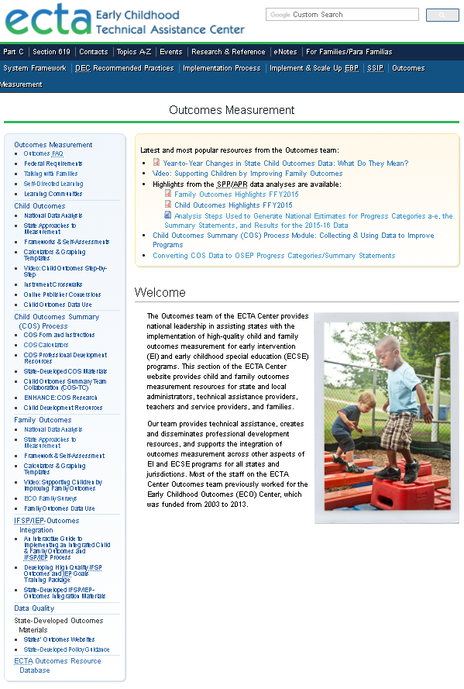

ECTA Center website
We got a makeover!
Outcomes TA provided in collaboration with
http://ectacenter.org/eco

Slide 5
What’s New
Separate sections for child and family outcomes with information organized using the same structure/subpages
  National Data Analysis
  State Approaches to Measurement
  Frameworks & Self-Assessments
  Calculators & Graphing Templates
  Video Overview
  Forms/Instruments
  Data Use
COS process information in its own section
  COS professional development (PD) resources

Slide 6
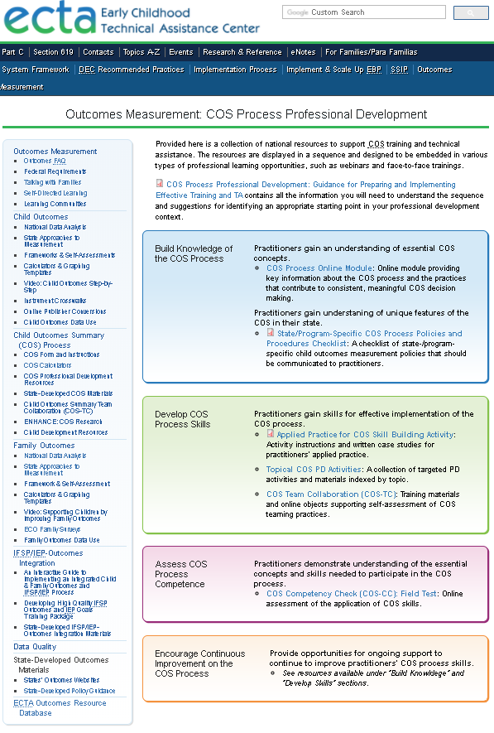
COS PD Guidance and Resources
http://ectacenter.org/eco/pages/cos.asp
4-Part Sequence:
Build Knowledge of the COS Process
Develop COS Process Skills
Assess COS Process Competence
Encourage Continuous Improvement on the COS Process

Slide 7
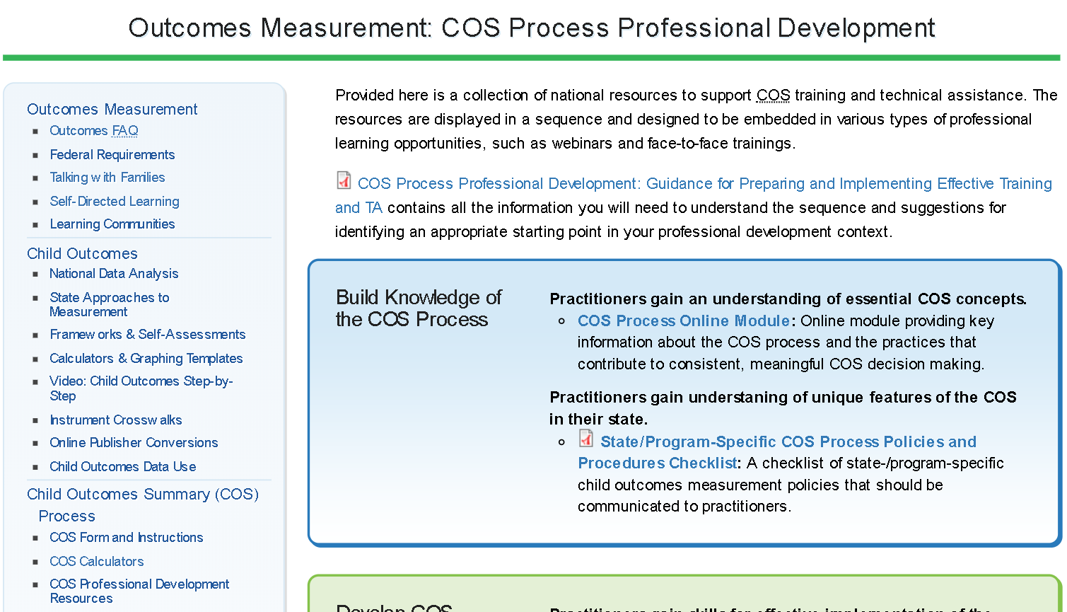
COS Process Professional Development Screenshot

Slide 8
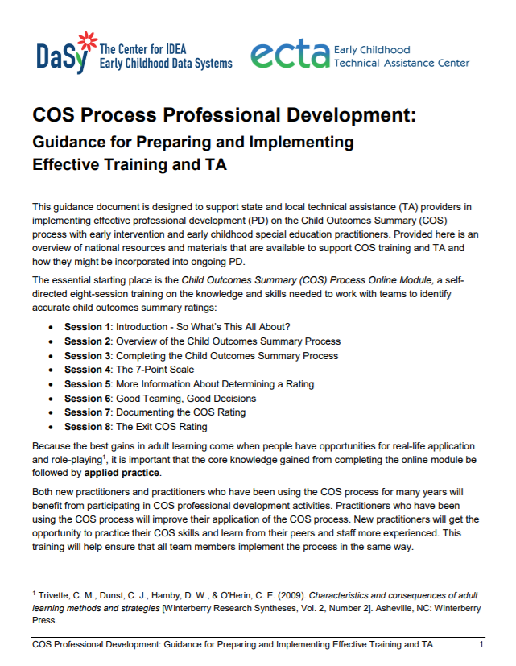
COS Process Professional Development: Guidance for Preparing and Implementing Effective Training and TA
New
Designed to support state and local technical assistance (TA) providers in implementing effective professional development (PD) on COS process.
Compressive list of PD resources
Suggested progression through activities for effective training
Support for where to start planning a PD sequence based on provider characteristics and needs

Slide 9
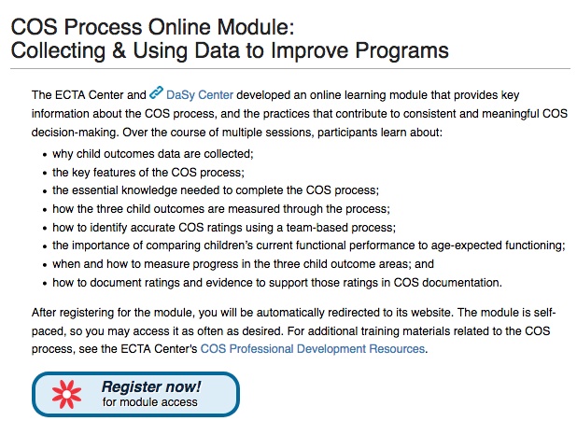
COS Process Online Module

Slide 10
State/Program-Specific COS Process Policies and Procedures Checklist Screenshot

Slide 11
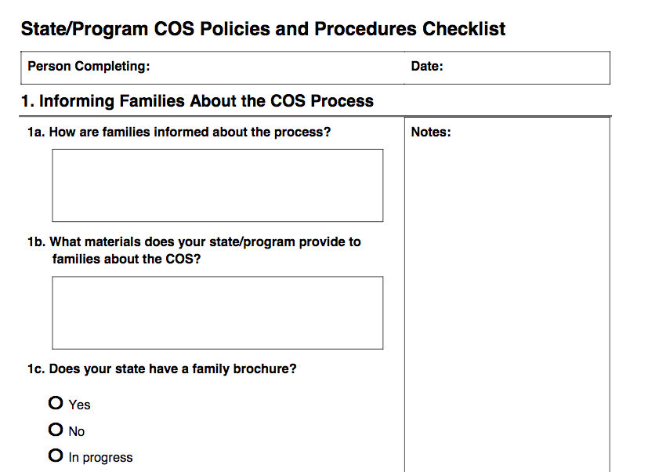
State/Program-Specific COS Process Policies and Procedures Checklist
New
TA providers can use this checklist to ensure that practitioners understand their state or program specific COS policies and procedures.
Informing Families About the COS
Tools Used During the COS Process
Timing of the COS Process
Teaming During the COS Process
Determining and Recording the Rating
Special Circumstances for Exit Ratings
Sharing Local Program and State Data

Slide 12
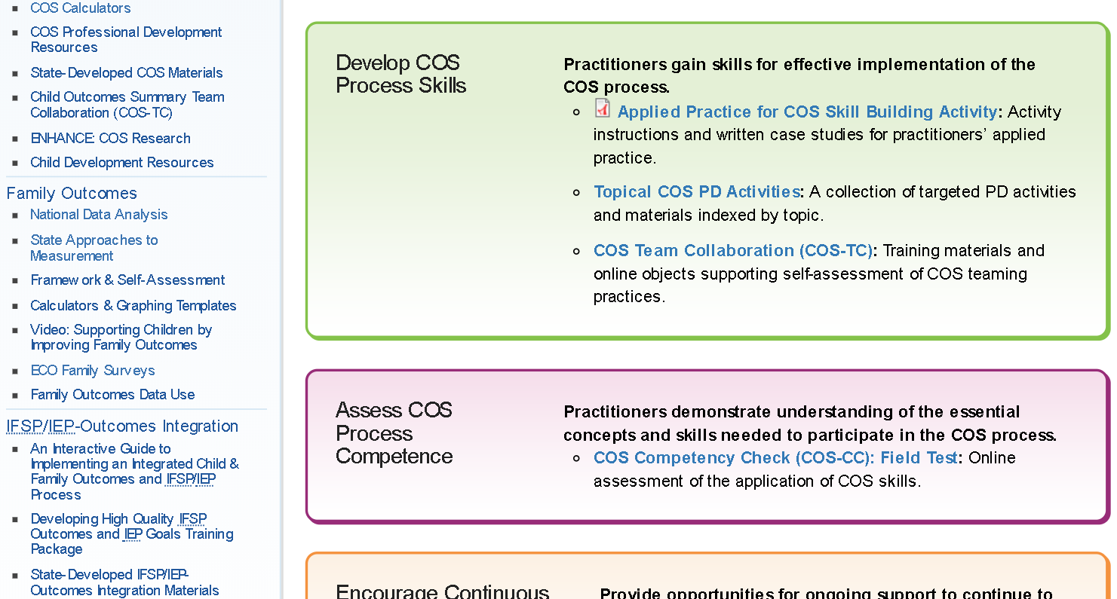
Applied Practice for COS Skill Building Activity Screenshot

Slide 13
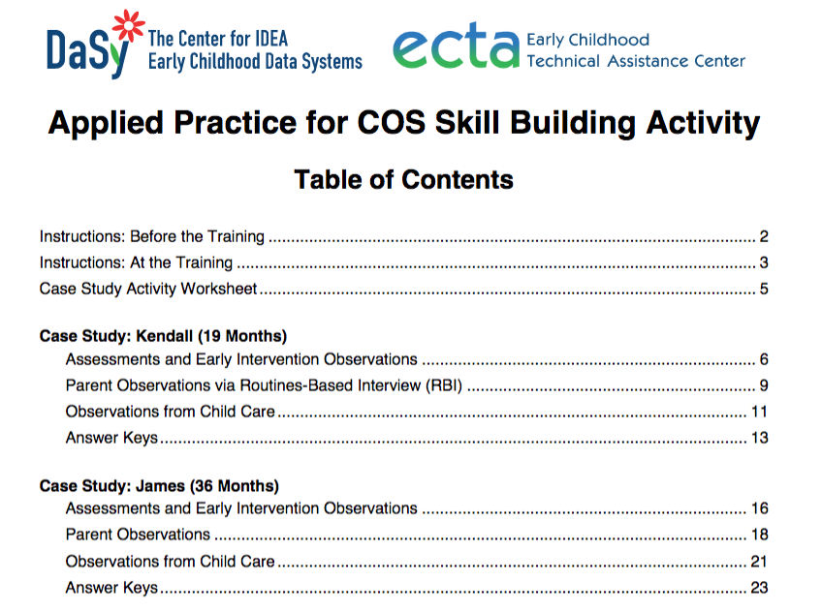
Applied Practice for COS Skill Building Activity
New
Provides activity instructions and written case studies for practitioners’ applied practice. (Alternatively, participants can share case studies about children and families from their own caseload). Practitioners use the case studies to apply their COS process skills to determine one or more outcomes ratings and have an opportunity to ask questions and reflect on the COS process.

Slide 14
Topical COS PD Activities Screenshot

Slide 15
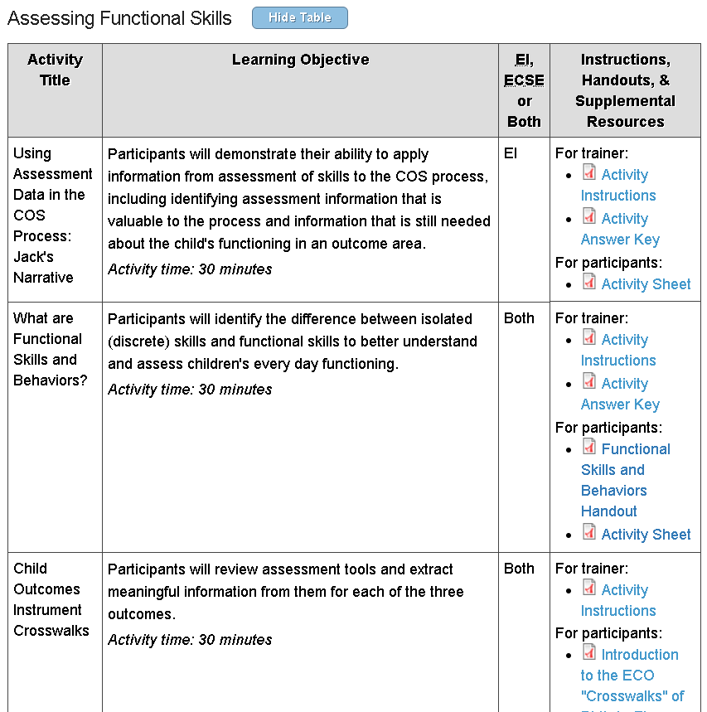
Topical COS PD Activities
Supplemental PD materials organized into COS process topical sections. Each section includes activities (with instructions, handouts, and supplemental resources) that can be used to enhance practitioners' understanding of a particular aspect of the COS process.
General COS Activities
Assessing Functional Skills
Age Anchoring
Using the 7-Point Scale

Slide 16
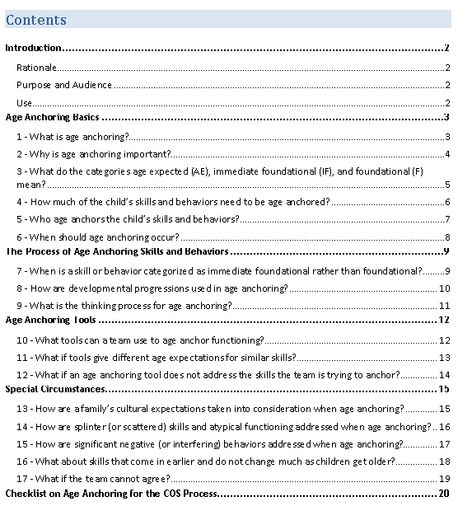
COS Process Age Anchoring Guidance
New
Provides answers to commonly asked questions about age anchoring as it applies to the COS process. Offers guidance on how to accurately age anchor a child’s functional skills and illustrates this guidance through practical examples.

Slide 17
Child Outcomes Summary Team Collaboration (COS-TC) Screenshot

Slide 18
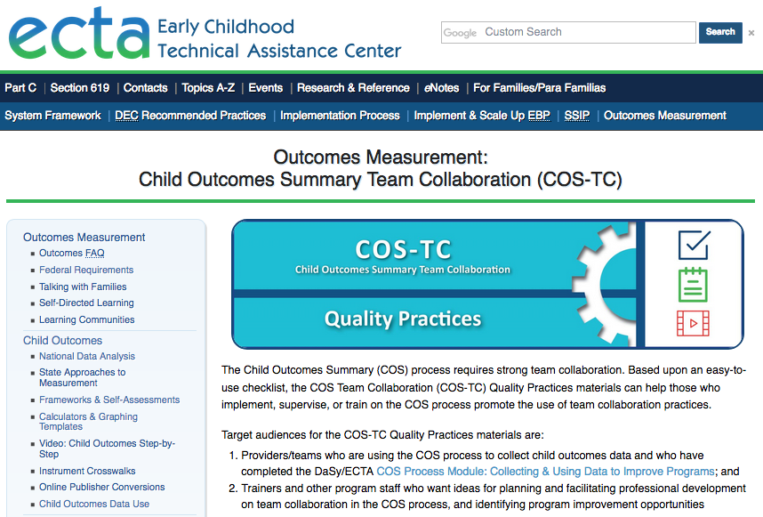
Child Outcomes Summary Team Collaboration (COS-TC)
Supports understanding of quality team collaboration for the COS process, including fostering meaningful family involvement and team interactions. Audiences:
Providers/teams
Trainers who want ideas for planning and facilitating professional development on team collaboration in the COS process

Slide 19
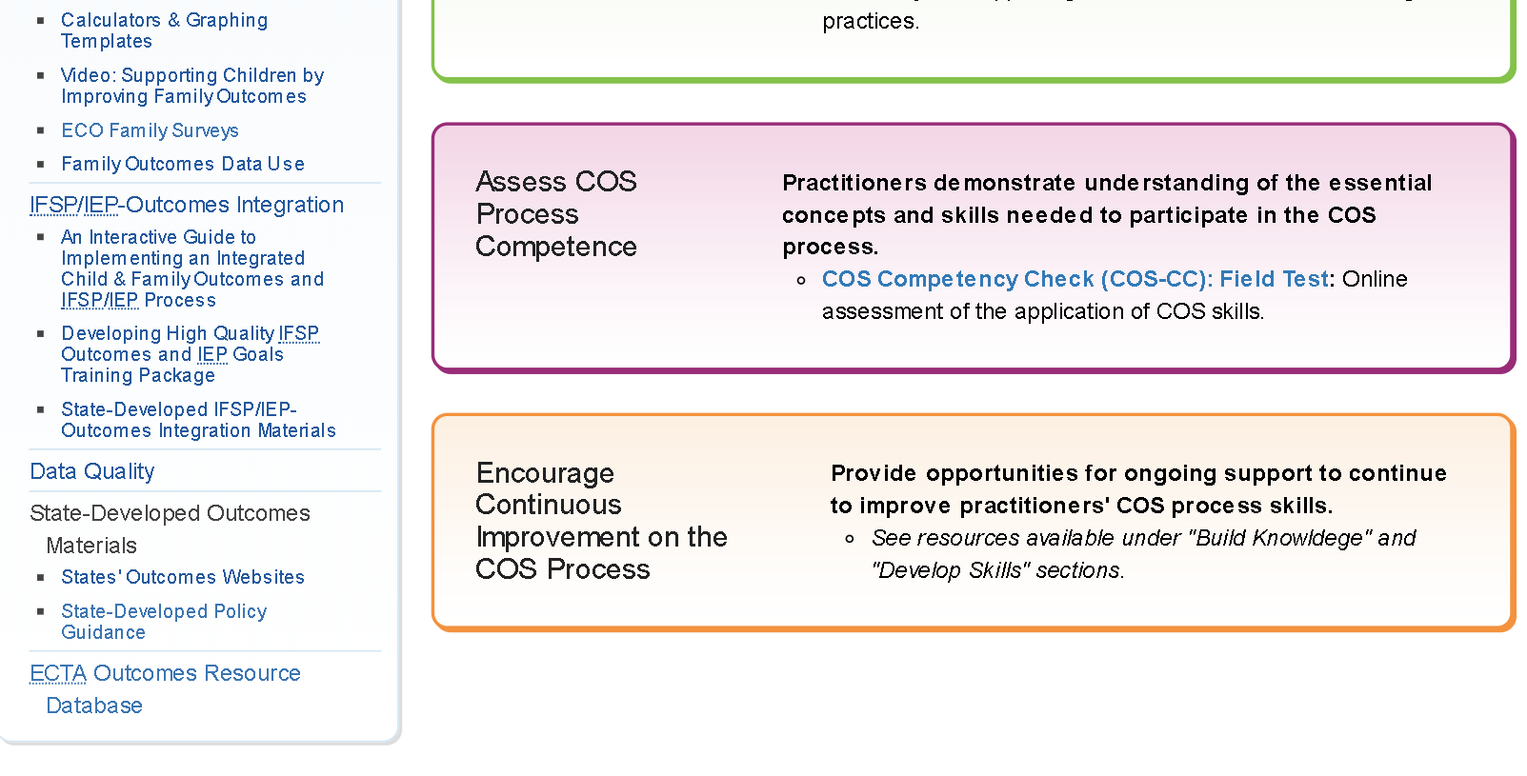
Child Outcomes Summary Competency Check (COS-CC) Screenshot

Slide 20
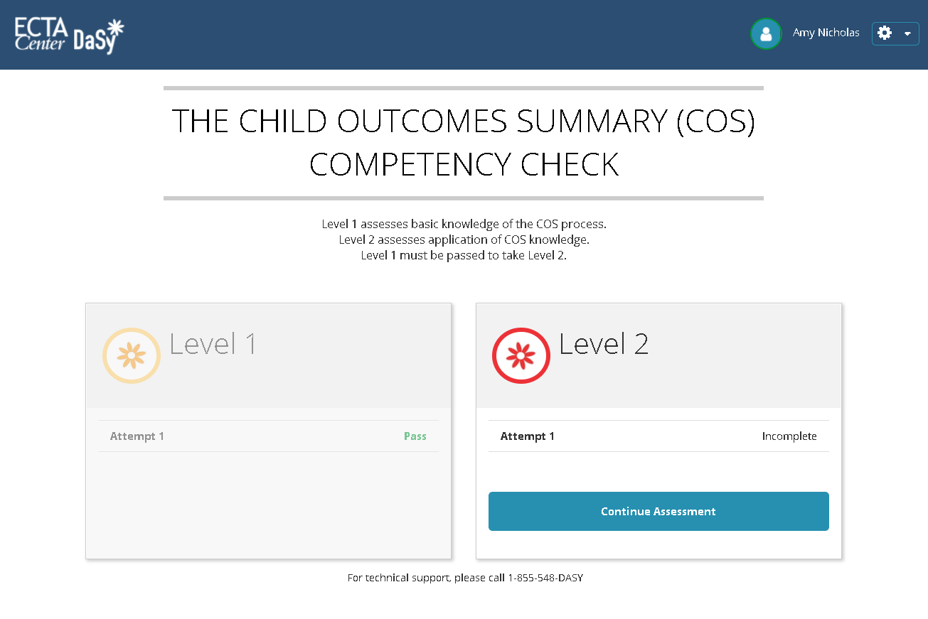
Child Outcomes Summary Competency Check (COS-CC)
An online tool intended to assess early intervention and early childhood special education practitioners’ understanding of the essential knowledge and skills needed to reach accurate ratings of child outcomes using the COS process.
Level 1: ~10 multiple choice items designed to test basic knowledge of the COS process.
Level 2: ~15 items, including a case study with video, designed to test ability to apply knowledge
The COS-CC field test has been completed!
Notes:
Maybe demo?

Slide 21
Number of COS-CC Field Test Participants
 | Level 1: Screener | Level 2: Applied Practice
Individuals serving infants and toddlers 0-3 | 88 | 72
Individuals serving children 3-5 | 39 | 33

Slide 22
Pass Rates by Level and Age Group

Slide 23
Performance on COS Rating Items within Level 2

Slide 24
Encourage Continuous Improvement on the COS Process

Slide 25
State/Program-Specific COS Professional Development
Department of Defense, Part C
Maryland, Part C and Part B 619
Vermont, Part B 619

Slide 26
DoD EDIS
COS PD Journey
Naomi Younggren, Part C Coordinator
25

Slide 27
A Slow and Separate Start
Learned about what others were doing
Reviewed our processes
Became very clear that COS was entirely separate from the IFSP process
Missing data

Slide 28
Popped Up COS Trainings
Popped up emphasis on COS
Provided lots of training, including case study work
Began integrating COS into IFSP by aligning PLOD by 3 Outcomes
Data completeness improved

Slide 29
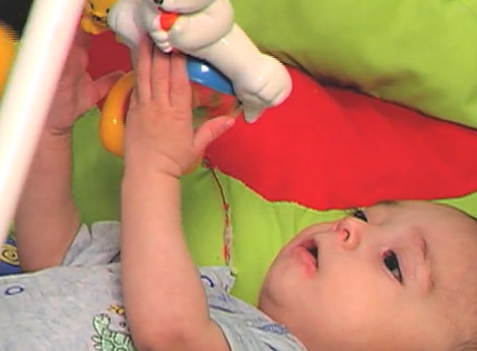
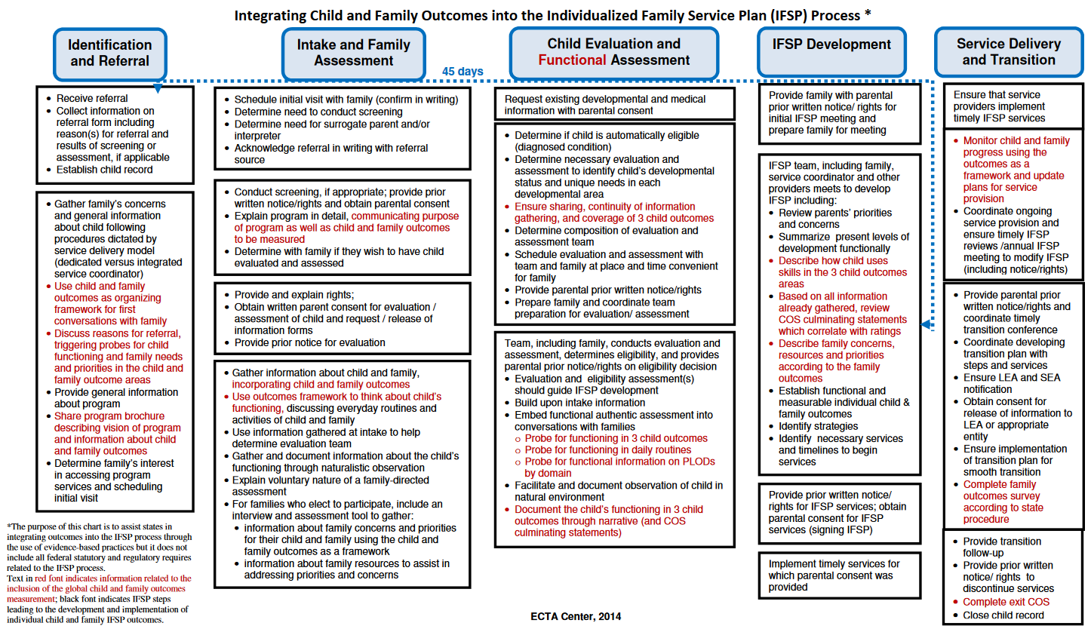
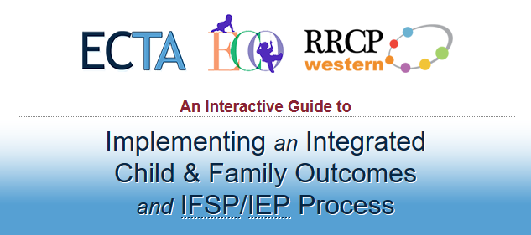
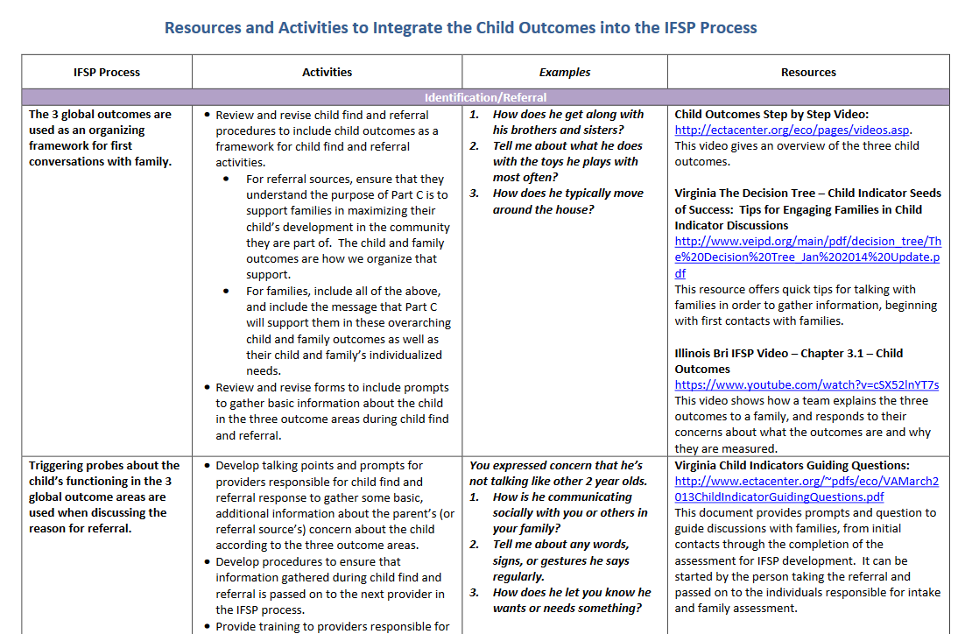
ECTA Center Resources
1
3
http://ectacenter.org/eco/pages/videos.asp
http://ectacenter.org/eco/assets/pdfs/IFSP-OutcomesFlowChart.pdf
2
4
http://ectacenter.org/implementingintegrated/
http://ectacenter.org/eco/assets/pdfs/IntegratingOutcomesintotheIFSP.pdf

Slide 30
Upgraded and Integrated COS
Upgraded and Integrated COS
Added COS ratings as part of IFSP – no separate form unless COS done outside of the IFSP process
COS embedded even at screening, as well as during discussions at time of evaluation (pointing out AE-IF-F)
Engaging families in the process

Slide 31
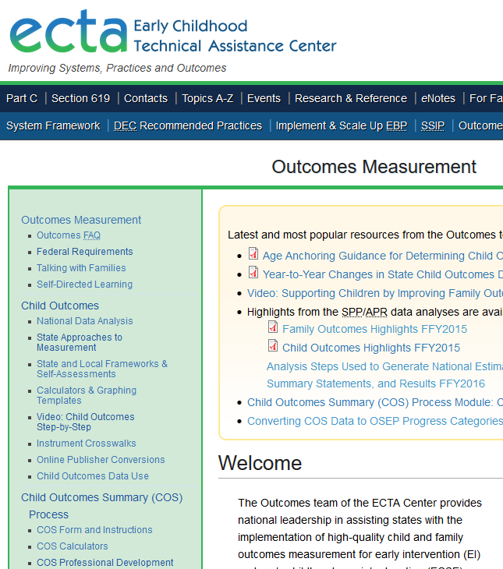
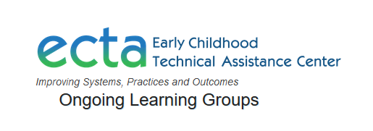
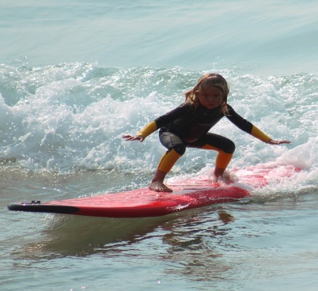
ECTA Center website
http://ectacenter.org/events/communities.asp
http://ectacenter.org/eco/

Slide 32

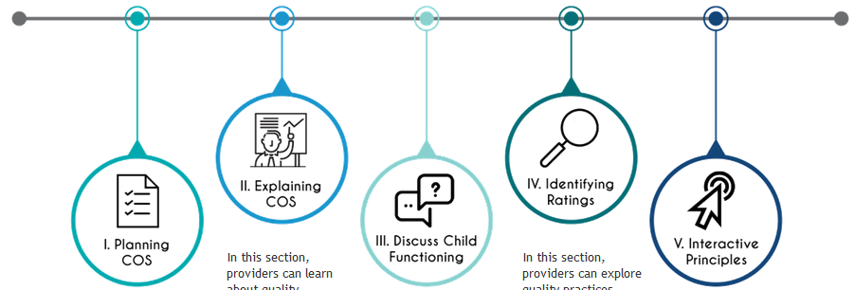
COS-TC Quality Practices
http://ectacenter.org/eco/pages/costeam.asp

Slide 33
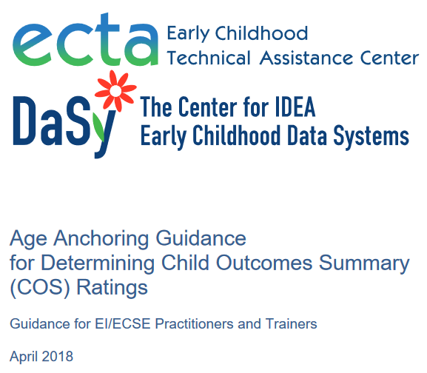
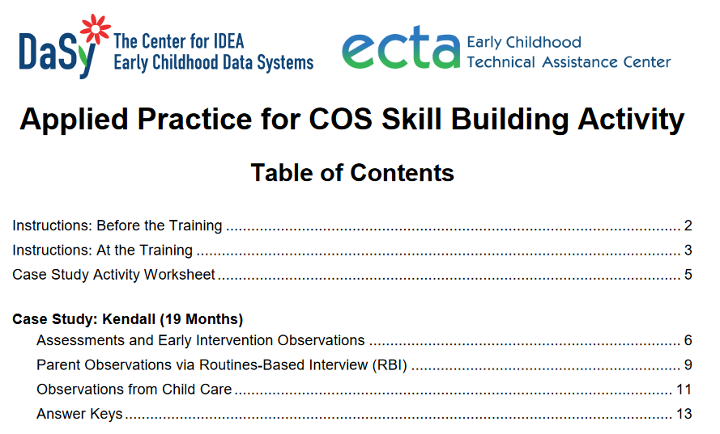
DaSy /ECTA Center Resources
https://dasycenter.org/resources/dasy-products/online-learning/
http://ectacenter.org/~pdfs/eco/COS_Age_Anchoring_Guidance.pdf

Slide 34
Modules & Certification
Further Innovations
Mentoring & Training Hubs
Outcomes Crosswalking
Child-Family Linking Emphasis
Child Outcomes Summary - Competency Check COS-CC

Slide 35


Maryland’s Birth to Kindergarten
Child Outcomes Summary (COS) Process
Professional Development
Pam Miller, Early Childhood Education Specialist

Slide 36
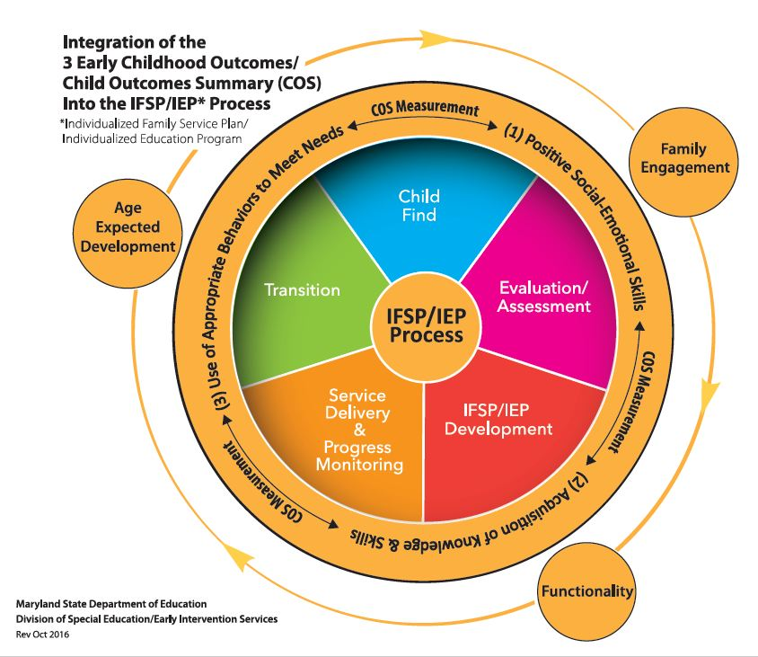
Evolution of COS Process and
COS Professional Development in MD
SFY 2011 - Began using the COS process to measure child outcomes in early intervention
SFY 2012 – Integrated COS process into the IFSP (strengths/needs summary) Birth – 4
SFY 2016 – Began using the COS process to measure child outcomes for preschoolers AND integrated COS process into the IEP (strengths/needs summary), ages 3 to Kindergarten
January 2016 - Issued Child Outcomes Summary (COS) Technical Assistance Bulletin Birth to Kindergarten

Slide 37

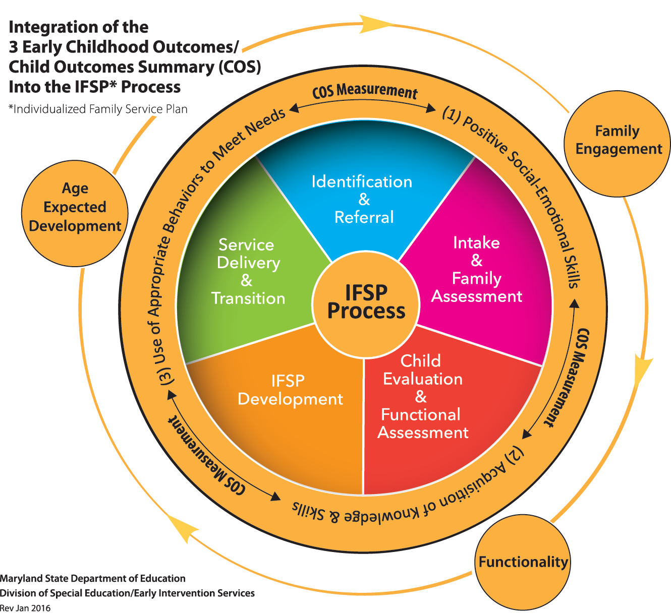
Focus on Fidelity
Driven By the Part C SSIP (SFY 2016)
Discussions with the State Systemic Improvement Plan (SSIP) State Implementation Team (SIT) led to questions about COS practices and ultimately about the quality of our COS data.
SIT determined the need for Landscape Interviews to gather information about local COS implementation practices, specifically related to integration into the IFSP process and fidelity of implementation, in order to identify strengths, gaps, training, and support needs.
Statewide fidelity is critical to ensuring valid COS data.

Slide 38
Focus on Fidelity
Provided the Framework for B-K COS Training and Support (SFY 2017)
Maryland Child Outcomes Summary (COS) Core Components Rationale
Maryland’s Core Components of the Child Outcomes Summary (COS) Process
  Functional Child and Family Assessment
  Age-Anchoring Tools
  COS Rating Prep Tool (AE, IF, F)
  Decision Tree

Slide 39

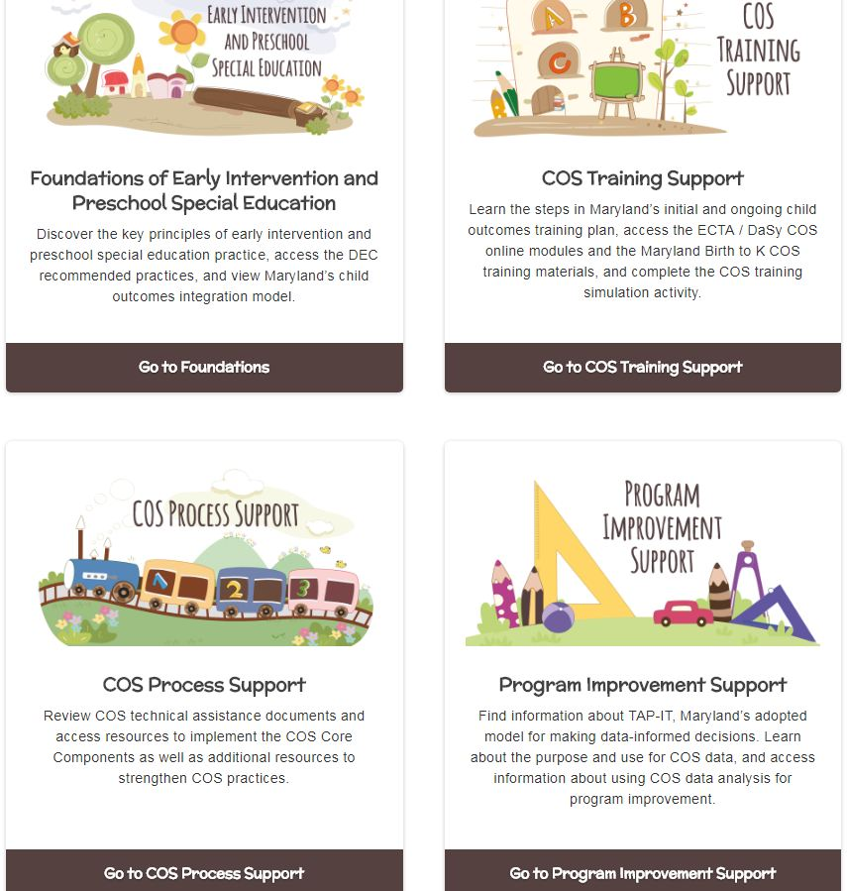
MD B-K Child Outcomes Gateway http://olms.cte.jhu.edu/mdcos-gateway
Guide to Birth to Kindergarten Child Outcomes and Child Outcomes Summary (COS) Process Training and Support
http://olms.cte.jhu.edu/data/ck/sites/4055/files/COS%20B-K%20Training%20Guide%20Nov2017.pdf

Slide 40
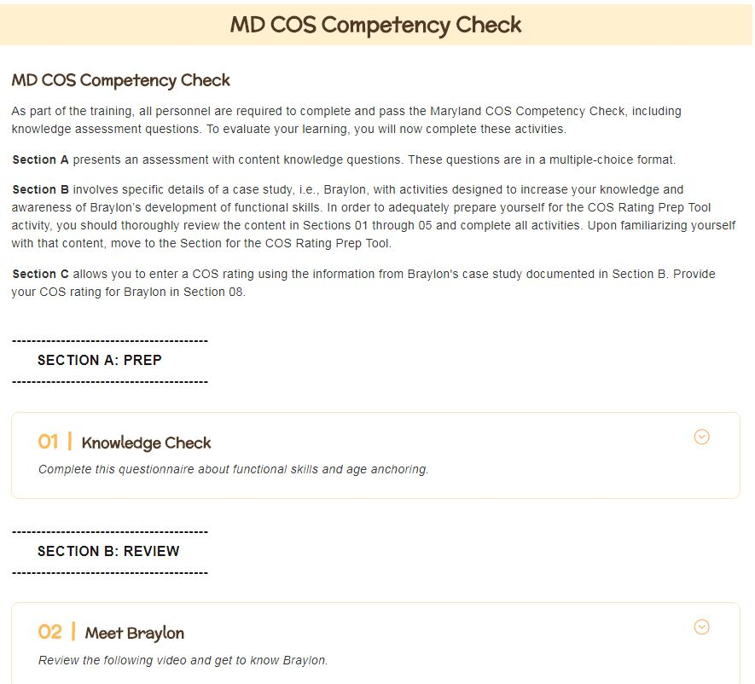
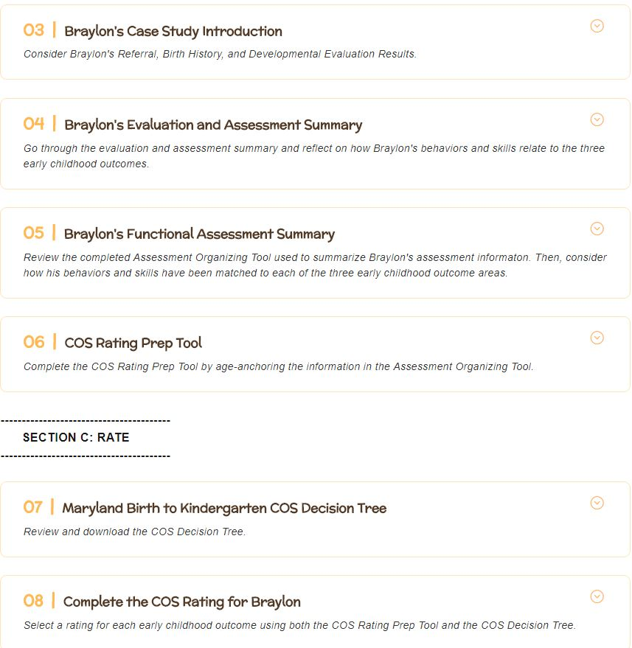
MD COS Competency Check http://olms.cte.jhu.edu/mdcos-gateway-training

Slide 41
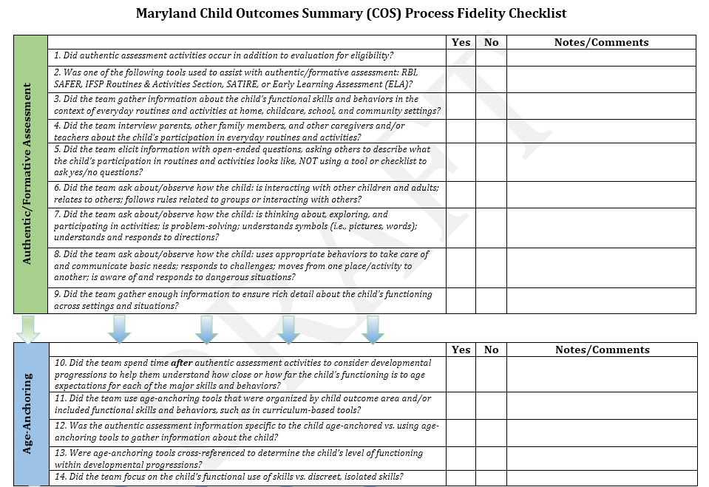
Maryland COS Process Fidelity Checklist

Slide 42
Major Revisions to MD IFSP (10/18)
Overall Shifts in Emphasis
  IFSP Process Guide – Linking Principles and Practices
  Child and Family Assessment
    Natural Routines/Activities and Environments
    Family Resources, Priorities, and Concerns
    Present Levels of Functional Development
      Developing Positive Social Skills and Relationships
      Acquiring and Using Knowledge & Skills
      Using Appropriate Behaviors to Meet Needs
    COS Ratings (including a required Decision Tree Procedural Facilitator)
  Functional, Routines-Based Outcomes & Services

Slide 43
Active Implementation Drivers
Local Implementation Grants
Local System for Implementing Revised IFSP Process and Child Outcomes Process as Intended
Organization/ Infrastructure
Leadership
Staff Competence

Slide 44
Continuous Improvement of the COS Process: Vermont’s Data Days
Katie McCarthy, IDEA Part B 619/Early Childhood Coordinator

Slide 45
Vermont’s COS (ECO)Timeline to Quality
2013
ECO IEP
Compiled Field Notes
2014
Poor Data Quality
Universal PreK
2015
ECTA/DaSy
619 Survey
2016
Practices and Procedures Manual
Training and TA
2017
Data Quality
Self Assessment
Self Assessment
December Data Days
2018
Training and TA Continues
Online COS Module
October ECSE Training

Slide 46
Data Days Objectives
Participants will:
Gain knowledge about how statewide early childhood outcomes data are collected and reported
Learn about critical questions that can drive early childhood outcomes data analysis and use
Be better able to use early childhood outcomes data to sustain improved data quality and decision making at the local level
1
2
3

Slide 47
December Data Days
Sessions
ECTA and DaSY PD Materials
Utilized and Shared
Early Childhood and School Readiness: The Building Block to Discuss- Tony Ruggiero, DaSy
Discovering the Practices and Procedures Manual- Katie McCarthy, VT AOE
Vermont’s Early Childhood Outcomes Practices and Procedures Session -Kellen Reid, DaSy/ECTA
What Can My Data Tell Me? Developing Critical Questions to Guide Early Childhood Program Improvement- Gary Harmon, DaSy/ECTA
Data Quality Matters- Tony Ruggiero, DaSy
ENHANCE Survey
The COS Decision Tree
A Family Guide to Participating in the Child Outcomes Measurement Process
Integrated COS-IEP Flow Chart
COS Modules
COS Teaming and Collaboration (COS-TC)
DaSy’s Critical Questions

Slide 48
Vermont’s Continuous Improvement in 2018 and Beyond
Working with field to expand data knowledge and ensure high quality data.
1. Incorporation of COS Modules into online PD and partnering with Part C
2. October ECSE training
3. Inclusion of new supplemental COS materials
Working with our data team.
SLDS
Partnering with Special Education Data Manager/Business Analyst, Sam Steiner to investigate data
All with a little help from our ECTA and DaSy friends.

Slide 49
What’s Happening in Your State?
Group Polling & Discussion

Slide 50
Group Discussion
Groups: Where in the 4-part PD sequence do you feel you are?
  Building Knowledge of COS Process
  Developing COS Process Skills
  Assessing COS Process Competence
  Encouraging COS Process Continuous Improvement
Discussion:
  As you listened to the state presentations today what resonated with you as a challenge or opportunity to further your work in this area? (Participants discuss in small groups)
  What is one thing that you learned today (tip/ idea/ resource) that you feel will help you progress in this area? (Participants discuss in small groups and write responses on a sticky note and add it to the poster board).

Slide 51

Thank You
The contents of this presentation were developed under grants from the U.S. Department of Education (#s H326P170001, H373Z120002). However, those contents do not necessarily represent the policy of the U.S. Department of Education, and you should not assume endorsement by the Federal Government.

