Slide 1
Improving State Child Find Efforts Through Self-Assessment and Planning
Brenda Wilkins & Jennifer Barrett-Zitkus, OSEP
Evelyn Shaw, ECTA
Margaret Gillis, DaSy
Division for Early Childhood Conference
October 24, 2018

Slide 2
Welcome!
Who is in the room?
Notecards for questions and comments

Slide 3
Agenda
National snapshot
Introduction to the Child Find Self-Assessment
Resources

Slide 4
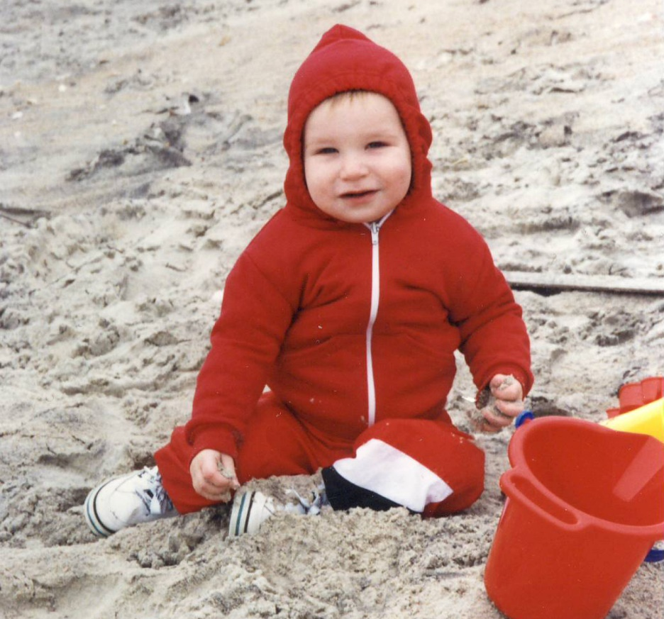
Focusing on Child Find: National Snapshot, Challenges, and Opportunities

Slide 5
National Snapshot: 618 Child Count Data FFY 2016-2017 Toddlers
US and outlying territories: 372,896 total number infants and toddlers with IFSPs *
Birth to one % = 1.24
One to two % = 2.88
Two to Three % = 5.22
Birth to three % = 3.12
*cumulative count is approximately 2 times higher than the point in time child count data

Slide 6
Percentage of population, birth through 2 years (2016-17)

Slide 7
National Snapshot: Child Find Special Populations
Child Maltreatment (Children’s Bureau, 2018; Child Maltreatment, 2016)
  Over 1/4 of victims (28.5%) under age three; children less than one year have the highest victimization rate (24.8 per 1,000 children)
  Voluntary reporting on CAPTA referrals to Part C (National Child Abuse and Neglect Data System or NCANDS) evolving (# of states, additional field)
Neonatal Abstinence Syndrome (NAS)/Prenatal Opioid Exposure
  CNS irritability, digestive tract dysfunction, inability to maintain core body temperature; more likely to be born low birth weight (LBW), increase in short-term (high infant mortality rate) and long-term complications
  NAS has increased signiﬁcantly over time (Lynch et al 2018)
Zika infection during pregnancy (Wheller, Anne C, 2018)
  Microcephaly and other severe brain defects (not always evident at birth but can appear later); other birth defects (e.g. eye defects, hearing loss, and impaired growth)

Slide 8
Division for Early Childhood (DEC) Collaboration
DEC Protection & Well-Being Special Interest Group
Webinars March 2018 (DEC, ECTA, Center for Youth with Multi-System Involvement at Westat and American Institutes for Research)
Presentation at DEC and on-going planning for future events
DEC Position Statement on Low Birth Weight (LBW), Prematurity, and Early Intervention
Approved August 2018
Presentation Thursday from 4:45-5:45 in Universal D1/D2/D3

Slide 9
Opportunities to Strengthen Child Find
Develop systems to better track and improve earlier identification
Close gaps in integrating Part C early identification systems within states and local communities
Reduce gaps in tracking children from concerns to referral, evaluation, and services
Combine developmental monitoring and screening systems to increase earlier identification (more targeted and appropriate referrals) and receipt of early intervention services
(Barger, Rice & Simmons, 2016; Barger et al, 2018)

Slide 10


Child Find System
Child Find System
Coordination with referral sources
Clear and rigorous definition of eligibility
High quality data systems
Evaluation and appropriate identification
Public awareness

Slide 11
Child Find Self-Assessment (CFSA)
Voluntary self-assessment tool to support Part C programs
Collaborative effort with ECTA, IDC and DaSy

Slide 12



Why Focus on Child Find?

Slide 13



Child Find Special Populations
Children who have been maltreated
Children with opioid or other substance exposure
Children exposed to Zika infection
¹
¹ Designed by Icon Pond from Flaticon

Slide 14
How is the CFSA Organized?
Statutory requirements specific to Part C
  Highlights the specific requirements all States must have for a Comprehensive Child Find System.
Child Find Best Practices.
  Evaluates and tracks how a State identifies and implements child find best practices.
  Assist States in identifying evidence-based practices to support their Child Find efforts.
  Child Find special populations.
Technical Assistance and Resources.
  Provides an overview of OSEP funded resources and technical assistance centers that are committed to improving State early intervention and early childhood special education service systems

Slide 15
Section I
Fillable PDF
Highlights requirements
Includes:
  Referral procedures
  Timeline
  Screening procedures (optional)

Slide 16
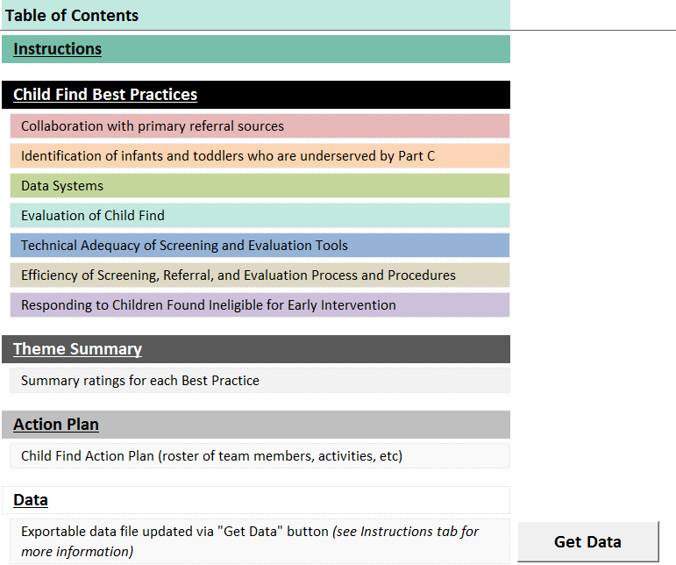
Section II Table of Contents

Slide 17
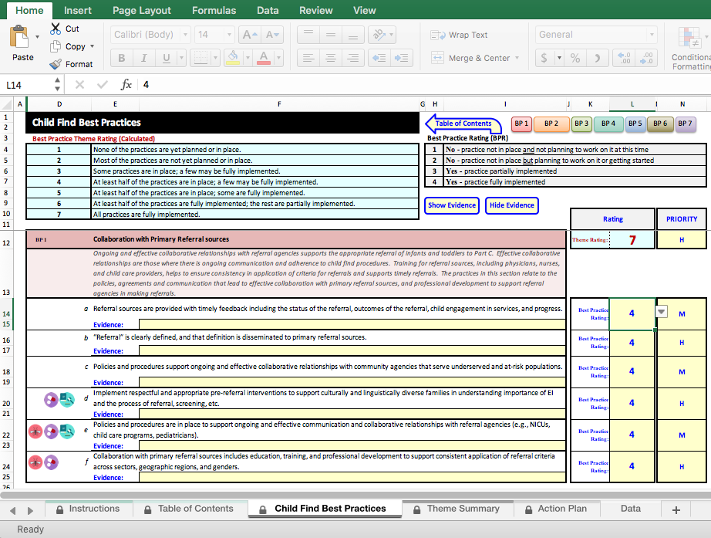
Section II

Slide 18

Section II – Best Practice Ratings
No, practice not in place and not planning to work on it at this time
No, practice not in place but planning to work on it or getting started
Yes, practice partially implemented
Yes, practice fully implemented

Slide 19
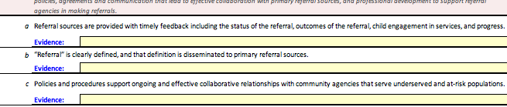
Section II - Evidence
Spaces to provide evidence for each best practice (yellow spaces)
Notes:
Jennifer

Slide 20
Section II – Theme Ratings
None of the practices are yet planned or in place.
Most of the practices are not yet planned or in place.
Some practices are in place; a few may be fully implemented.
At least half of the practices are in place; a few may be fully implemented.
At least half of the practices are in place; some are fully implemented.
At least half of the practices are fully implemented; the rest are partially implemented.
All practices are fully implemented.

Slide 21
Section II

Slide 22
Section II

Slide 23
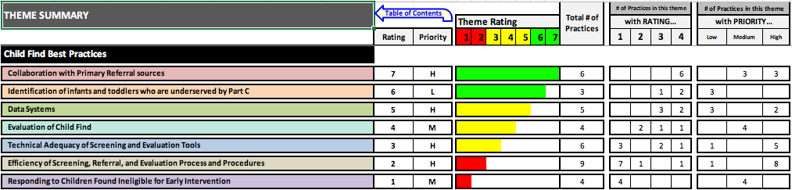
Section II – Theme Summary
Summarizes info for each theme for which all best practices rated
Cannot enter data on this sheet
Colored bars graphically depict theme ratings

Slide 24
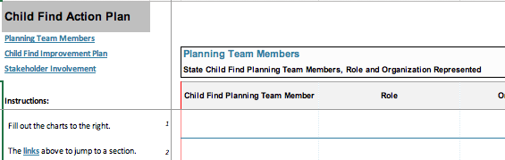
Section II – Action Plan
Space for states to use ratings and priorities to plan next steps
Includes sections for documenting:
  Members of the Child Find planning team
  Child Find improvement plan (e.g., activities, timeline)
  How stakeholders will be involved
Notes:
Jennifer

Slide 25
Development and Timeline to Release
Made revisions based on external review
Currently in pilot with 3 states
Will incorporate input from pilot
Anticipate formal release of tool in Spring

Slide 26

Questions?

Slide 27
Child Find from Your Perspective
How have you experienced or been involved with child find?

Slide 28

Child Find Resources
Child Find

Slide 29
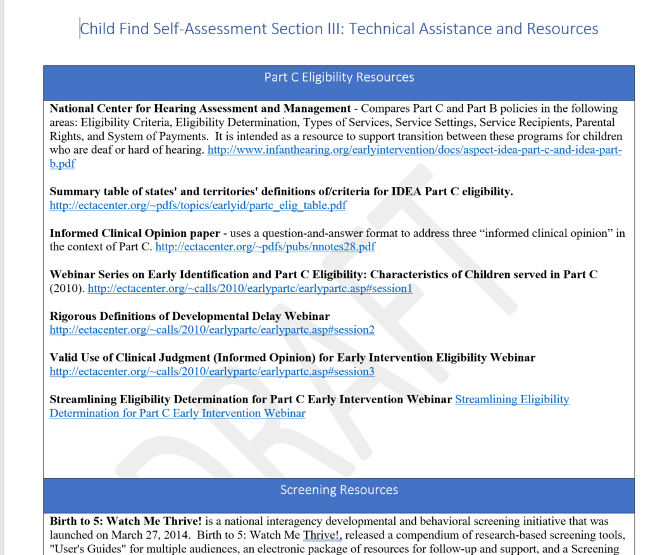
CFSA Section III

Slide 30
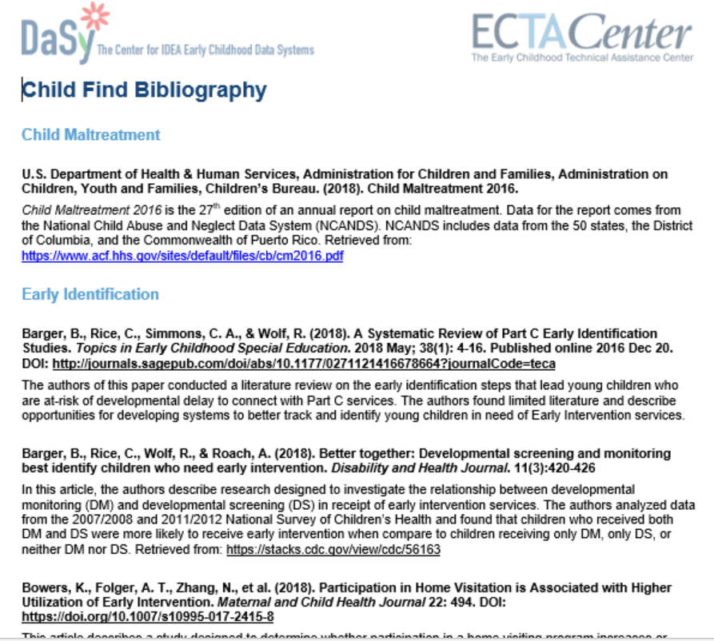
Child Find Bibliography

Slide 31
Additional Resources
Birth to 5: Watch Me Thrive! https://helpmegrownational.org/hmg-partners/watchmethrive/
TA Resources for State Agencies
  Identifying Meaningful Difference in Child Find - Excel Tool https://dasycenter.org/identify-meaningful-differences-in-child-find/
  Child Find Data Special Collection – coming soon to DaSy website
  Child Find Funnel Diagram Tool – coming soon from DaSy
  State and Jurisdictional Definitions Infants and Toddlers with Disabilities Under IDEA Part C – 2018 Update – coming soon from ECTA

Slide 32
Resources
Visit the DaSy website at:
http://dasycenter.org/
Follow DaSy on Twitter:
@DaSyCenter
Visit the ECTA website at:
http://ectacenter.org/
Follow ECTA on Twitter:
@ECTACenter

Slide 33

Thank you
The contents of this tool and guidance were developed under grants from the U.S. Department of Education, #H326P120002 and #H326P170001. However, those contents do not necessarily represent the policy of the U.S. Department of Education, and you should not assume endorsement by the Federal Government. Project Officers: Meredith Miceli, Richelle Davis, and Julia Martin Eile.

