Slide 1
What Might the Future IDEA Data Manager Job Look Like in 10 Years?
August 2018 IDIO Conference
Bruce Bull, DaSy

Slide 2


Audience Roles
Data Managers
Coordinators/Directors
Other?

Slide 3

Position Tenure in Current Position
< 1 year
1-3 years
3-5 years
5-10 years
10-15 years
15-20 years
> 20 years
Longest?

Slide 4
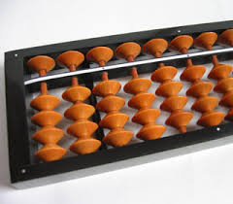
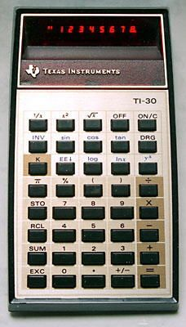
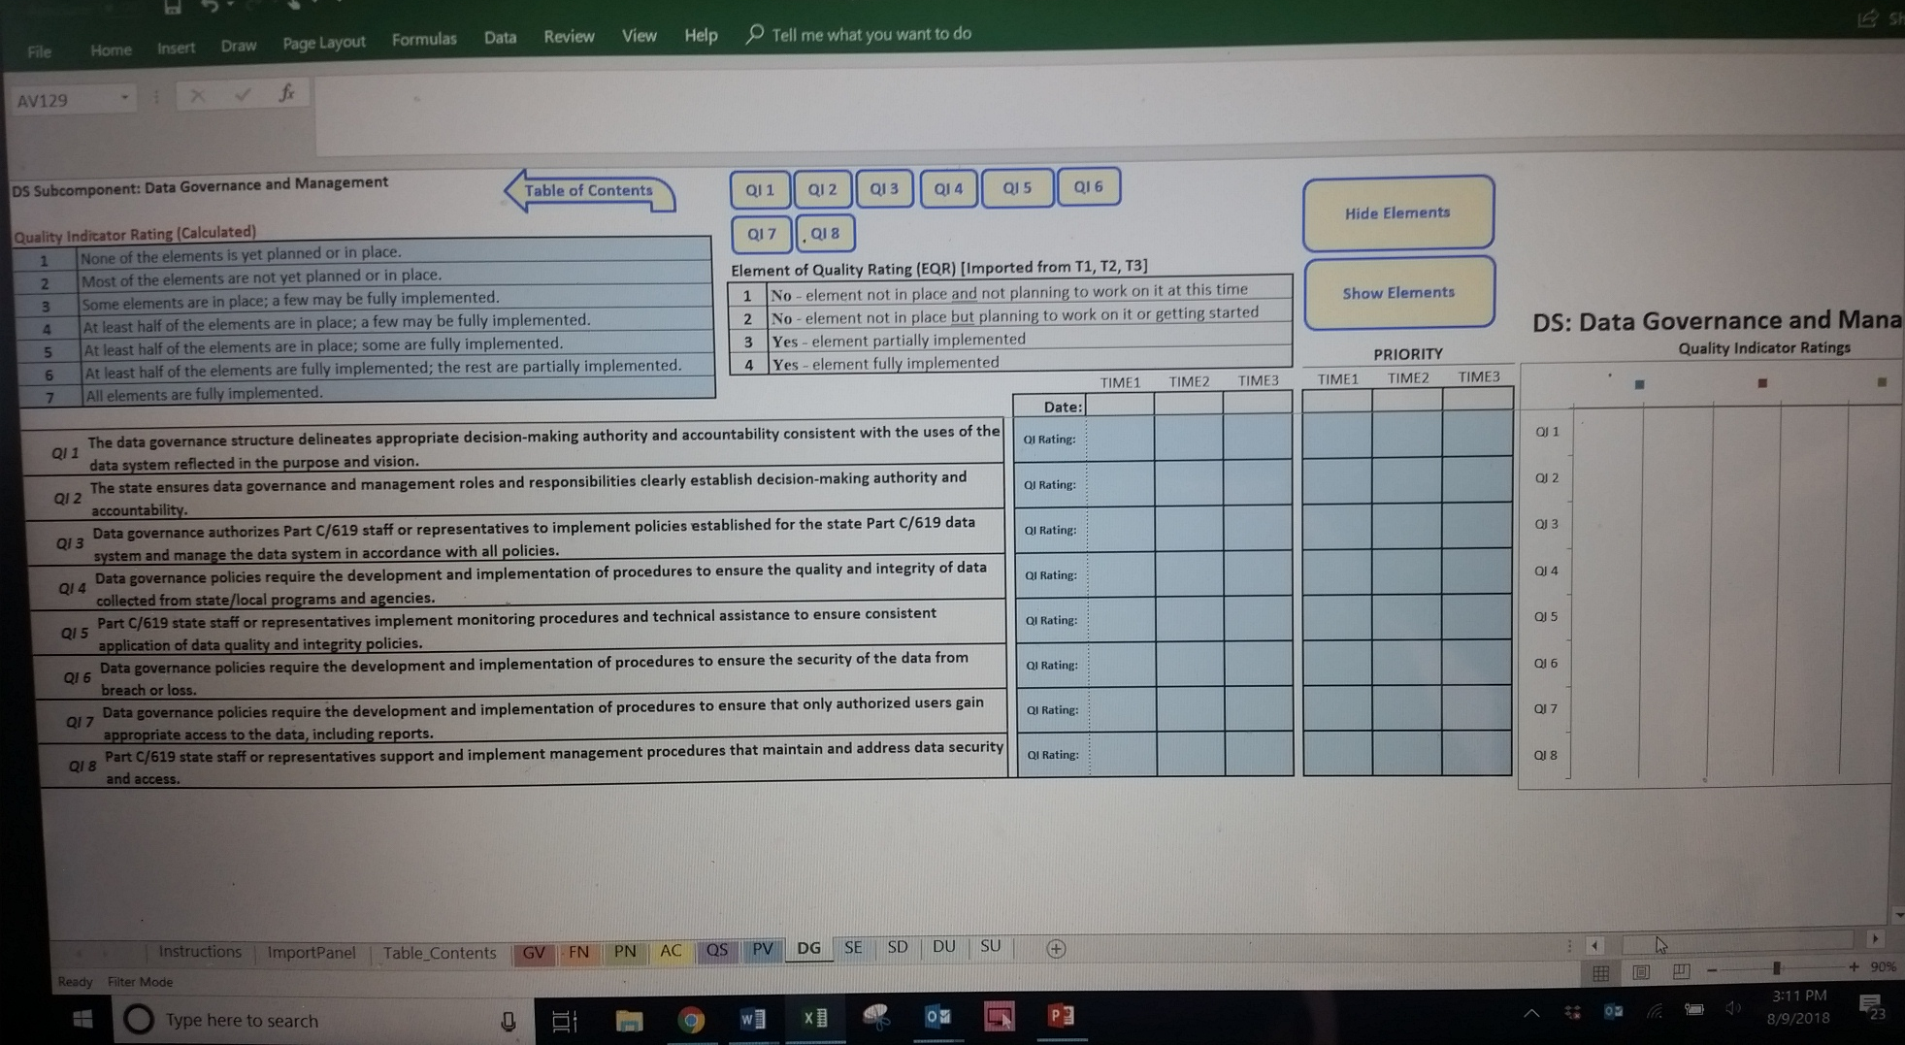
Changes Over Time

Slide 5


Other Advances Are in Store

Slide 6
Adapt

Slide 7
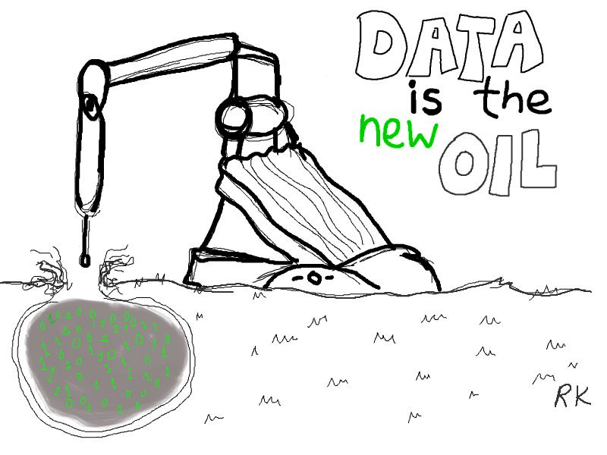
Data is the New Oil
Why AI Is the New Electricity
Andrew Ng
A computer scientist discusses artificial intelligence’s promise, hype, and biggest obstacles.
March 11 2017 by Shana Lynch

Slide 8
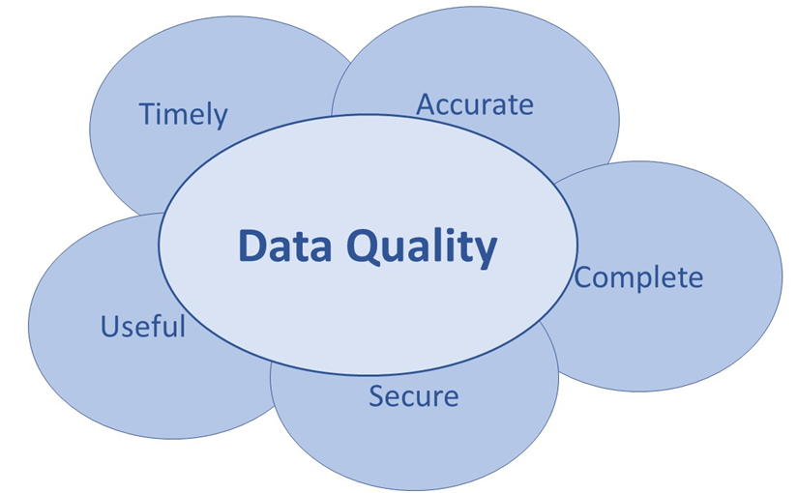
Data Quality

Slide 9


Slide 10
What will IDEA data managers do and need in the exciting and hectic future?

Slide 11
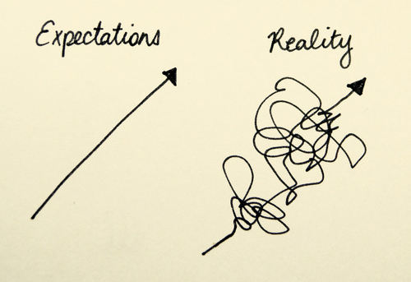
Expectations vs Reality

Slide 12
The Future (Technologically Speaking)
How excited are you?
How concerned are you?
How prepared are you?
How prepared is your agency?

Slide 13
How do we proactively and reactively respond to change?

Slide 14
What People Are Saying
Mark Cuban:
More technological change will come in the next 10 years than in the last 30. And critical thinking will become more valuable. Why? Because when the data is already being “spit out” for you in industries like finance or tech, companies will want employees who are “freer thinkers” and can bring a “different perspective” to the information.

Slide 15
What People Are Saying
Elon Musk holds a similar view.
When seeking innovative and creative solutions to large scale problems, Musk asks employees use first principles method, in which information is boiled down to it's most basic idea and "reason up" from there. First principle thinking is the idea that every-thing we should do is underpinned by a foundational belief, (first principles). Instead of blindly following directions or sticking to a process, a first principle thinker constantly asks, "What's best for the company?" and "Couldn't we do it this other way instead?"

Slide 16
Think Critically

Slide 17
Question Authority
Respectfully: For example,
“What other ways could we also do this?”
“I talked with this another state and they are . . .”
“I read about this other approach . . .”

Slide 18
Coming soon to your future . . .
Shared self driving cars
Virtual banks
Shared office space
Longer retirements
Better health
Virtual education systems
75 billion devices connected to the internet by 2020
More and more and more . . .

Slide 19
Change²
^{Gerd Leonhard, Futurist}

Slide 20
Coming soon to education data . . .
More data
More data efficiency
Higher quality data
More integrated data / connected data systems
More use of big data and AI to personalize learning
More data security risks
More data governance
Faster data systems development life cycle (SDLC)
More and more and more . . .

Slide 21
Coming soon to a job near you . . .
Big (and bigger) data
Business Intelligent (BI) software
Predictive Analysis
Artificial Intelligence (AI)
Internet of Things/people (IOT)
Increased data governance
Evolving data security
Smarter data systems
Increased data linking
Mobile data solutions
Voice activated: data analysis, visualization
Faster data turnarounds
Shorter attention spans
More and more . . .

Slide 22

Looking to the Future

Slide 23
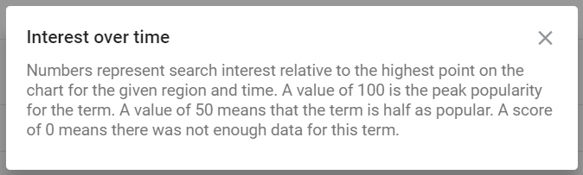
Google Trends

Slide 24
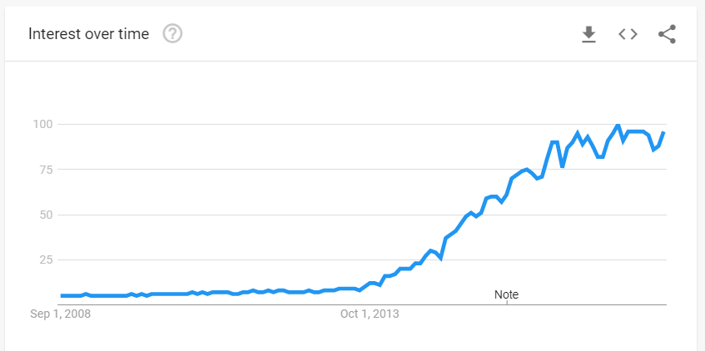
Internet of things + IOT

Slide 25
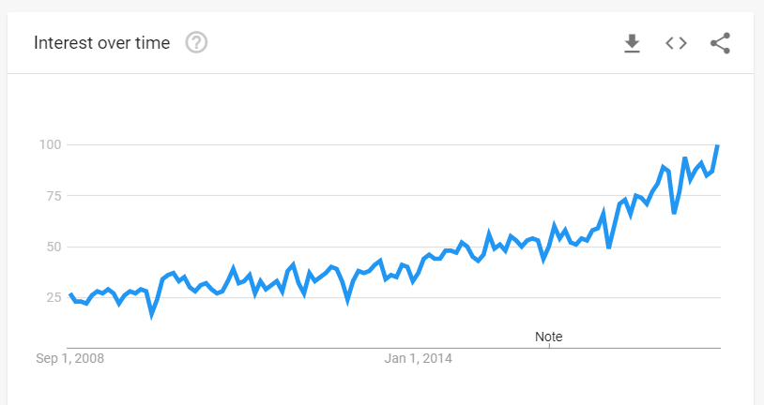
Data Governance

Slide 26
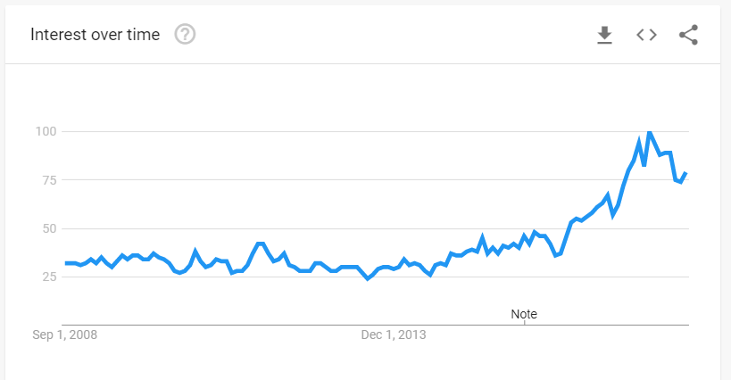
Artificial Intelligence + AI

Slide 27
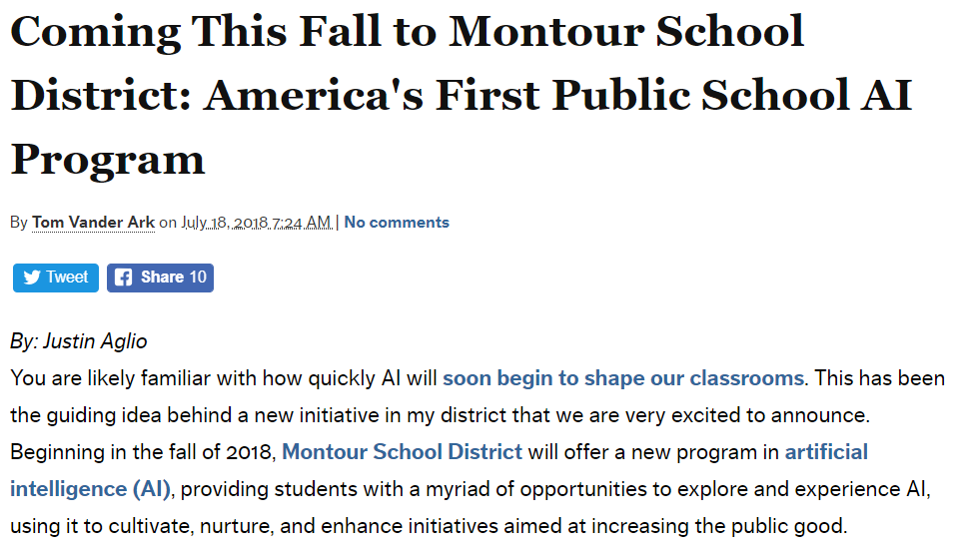
Montour's partners include organizations such as Carnegie Mellon University, Carnegie Learning, AI4All, Visionary Machines LLC, Anki, Aethon, Ascender, Amper Music, Promethean, and more.
Our goal is to empower students to be creators of the future," asserted Mr.Dominic Salpeck, principal, David E. Williams Middle School.

Slide 28
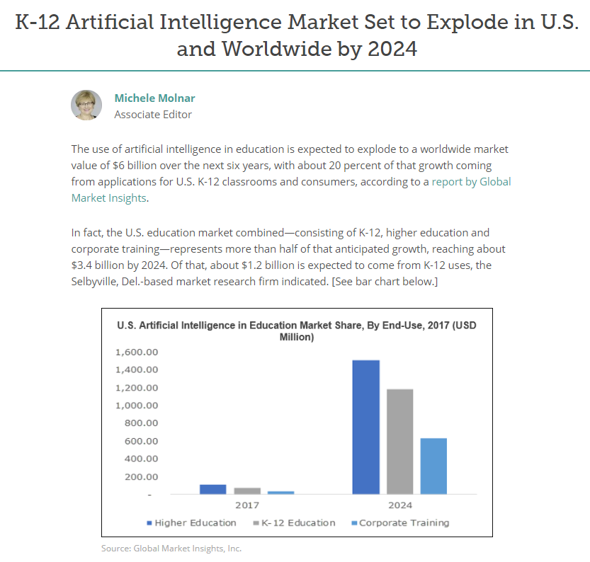
K-12 Artificial Intelligence Market Set to Explode in U.S. and Worldwide Market by 2024

Slide 29
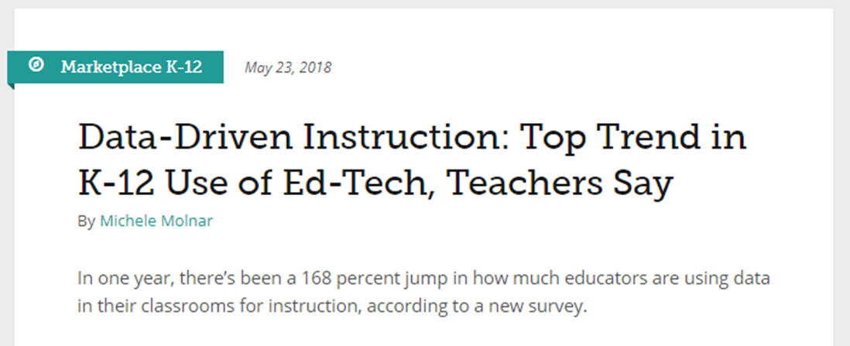
Data-Driven Instruction
How do we take data on data-driven instruction for SWD?

Slide 30
Education Week, June 12, 2018
June 12, 2018 Education Week
A push to use new technology to understand the 'whole child' is sparking privacy fears
Behind the scenes, the software was diligently tracking all that activity, anonymously logging the clicks and keystrokes of Carrell and more than 200,000 other students. As part of an $8.9 million federal grant project, researchers then used machine-learning techniques to search for patterns. Their ultimate goal: improve student learning by teaching the software to pinpoint when children are feeling happy, bored, or engaged.
It’s just one example of a growing push to use educational technology to measure, monitor, and modify students’ emotions, mindsets, and ways of thinking.

Slide 31

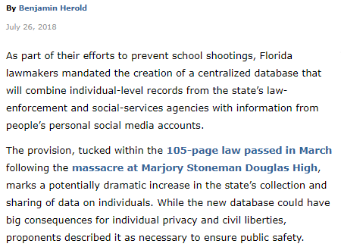
Education Week Digital Directions

Slide 32

Taking it All In

Slide 33
Change and pace of change
What has changed in your position since you’ve arrived?
What do you see changing next?
Reaction to change?
  Personally
  Professionally
  Others reactions

Slide 34
How will talking to your computer change your job?
Alexa, create a list of districts currently late with their verification of data quality assurance letters.
Alexa, update last years data quality assurance letter from me and prepare draft letters with next Monday’s date to all currently late districts.
Alexa, put letters on R drive for my review.

Slide 35
Something to Think About
Consider:
Alexa, run statistical probability package 31-T on final special ed 619 child count data for all year 2022-23 districts.
Alexa, add previous 3 years of final district 619 data to the above. Calculate state mean averages for all years and include in data set.
Alexa, graph all district 619 results using data visualization packages, 619-C, 619-D and EC-6.
Alexa, populate separate district 619 results for special education directors, preschool special ed leads, superintendents, and data stewards.
Alexa, send all district data visualization links for my review.

Slide 36
Measuring the Changes
If we agree that technology is changing our jobs and technology is changing education, then when do we start measuring it?

Slide 37
Integrating Technology
Seems to me, our students’ relationship with technology today is as important to their success as mainstreaming and integration was to that population 30 years ago.

Slide 38
Maybe we should consider collecting data on technology and SWDs . . .
Access to technology
Teachers effectiveness in matching individualized technology with children and students
Training on technology
Effective use of technology
Etc.

Slide 39
Innovate

Slide 40

Tools

Slide 41
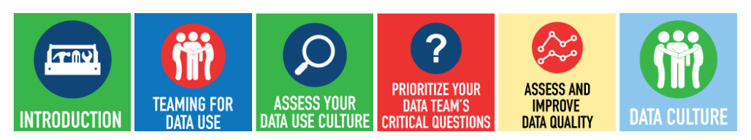
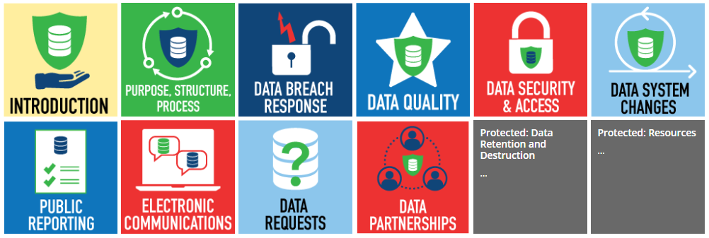
DaSy Tools
Data Culture Toolkit: Supporting State and Local Data Use
Data Governance and Management Toolkit

Slide 42
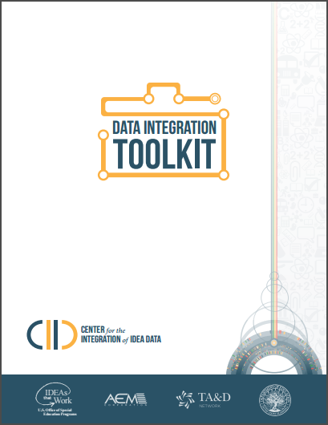
Other Tools
CIID Data Integration Toolkit
Data Governance and Management Toolkit
(There are a lot of tech and data resources out there. Ask.)

Slide 43
Look First to Find and Use

Slide 44

Library as a Resource

Slide 45

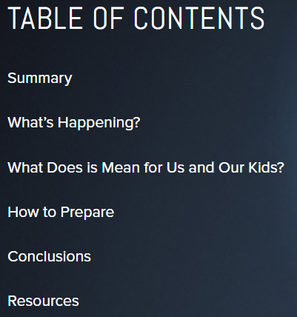
Ask About AI

Slide 46
Stay Informed

Slide 47
IDEA Data Managers will Need to:
Adapt
Think Critically
Question Authority (respectfully)
Innovate
Look First to Find and Use
Stay Informed

Slide 48
IDEA Data Managers will Need to:
Engage with Data Governance
Keep bosses informed
Set aside time to consider future
Stay current (but not bleeding edge)
Watch and learn from other state agencies and other states

Slide 49
IDEA Data Managers will Need to:
Discover new opportunities
Employ human traits in their positions – tech can’t do that
Focus on what can’t be automated
Think 5-10 years out
Embrace technology – but don’t become it

Slide 50
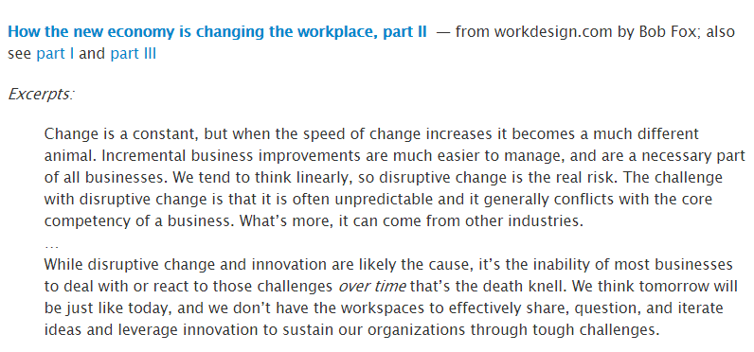
Excerpt from workdesign.com

Slide 51

Overloaded with Questions?

Slide 52
Contact DaSy
Visit the DaSy website at:
http://dasycenter.org/
Like us on Facebook:
https://www.facebook.com/dasycenter
Follow us on Twitter:
@DaSyCenter

Slide 53

Thank you
The contents of this guidance was developed under grants from the U.S. Department of Education, #H326P120002 and #H326P170001. However, those contents do not necessarily represent the policy of the U.S. Department of Education, and you should not assume endorsement by the Federal Government. Project Officers: Meredith Miceli, Richelle Davis, and Julia Martin Eile.

