Slide 1



Preparing and Supporting Emerging Family Leaders

Slide 2

Today’s Presenters/Facilitators
Stephanie Moss
Parent to Parent of Georgia/Region 3 Parent Technical Assistance Center
Email: stephanie@p2pga.org
Amy Nicholas
Early Childhood Technical Assistance Center/ Center for IDEA Early Childhood Data Systems
Email: amy.nicholas@unc.edu
Darla Gundler
Federation for Children with Special Needs/Early Childhood Personnel Center
Email: gundler@uchc.edu
Sherri Williams
Early Childhood Technical Assistance Center
Email: sherri@email.unc.edu

Slide 3
Workshop Purpose
To highlight strategies, practices, and approaches for effectively preparing and supporting new or emerging family leaders to engage in systems-level advocacy and decision-making related to early intervention (EI) and early childhood special education (ECSE) programs.

Slide 4
Workshop Agenda
History and Overview of Family Leadership in EI/ECSE
Policies, Frameworks, and Supports
Families and High-Quality IDEA Early Childhood Systems
Video-Enhanced Activity: Parent Perspectives
National Technical Assistance Resources

Slide 5
From Family Participation to Family Involvement to Family Engagement…What’s the Difference?
In the 1990’s, we called it family participation. Families participated as members of IFSP teams and served on program advisory councils/boards, e.g., State Interagency Coordinating Councils (SICCs).
In the 2000’s, we called it family involvement. “Principles of Family Involvement” was published by the Federal Interagency Coordinating Council (FICC).
In 2016, we started calling it family engagement. The U.S. Department of Health & Human Services & U.S Department of Education published their joint “Policy Statement on Family Engagement from the Early years to the Early Grades.”
Moving from individual child/family advocacy to systems level advocacy.

Slide 6
U.S. Department of Health and Human Services and U.S Department of Education (2016)
Policy Statement on Family Engagement from the Early Years to the Early Grades
Highlights from The Executive Summary: Research and Best Practice
Families have strong and sustained effects on children’s learning, development, and wellness.
Family activities such as reading and talking to young children lead to positive outcomes.
Promoting enriching learning activities in the classroom and in the home contributes to children’s learning and development.
Family well-being is a strong predictor of children’s school readiness, and promoting families’ strengths and resilience through comprehensive services and promising practices such as two- generation approaches support young children.
Strong, positive relationships between families and providers reinforce learning at home and in the community and are enabled by two-way communication and cultural and linguistic responsiveness.
Parents who have more supportive and extensive social networks create more stimulating home environments for their children, communicate better with their children, and feel more confident in their role as parents

Slide 7
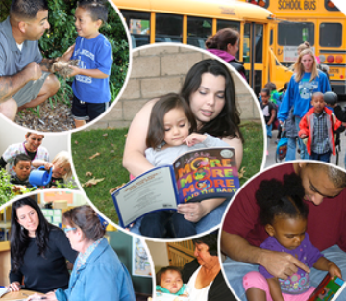
Family Engagement
Family engagement refers to the systematic inclusion of families in activities and programs that promote children’s development, learning, and wellness, including in the planning, development, and evaluation of such activities, programs, and systems.

Slide 8
Families as Leaders & Advocates
Expressing viewpoints
Thinking creatively “outside of the box”
Working toward win-win solutions
Advocating for children, families, practitioners, and systems

Slide 9
Families as Leaders & Advocates (cont.)
Taking advantage of resources from Parent Training and Information Centers
Participating in advocacy and leadership training
Mentoring other families and being mentored by families in advocacy activities
Informing other families about program and community advocacy events and encouraging them to consider participating

Slide 10
Beliefs About Leadership
Leaders are not born – they rise out of a person’s passion for how they want the world to be.
Leadership isn’t a gift – it’s accessible to anyone who wants it.
Leadership isn’t a calling – it’s a matter of listening to a question and trying to come up with an answer.
A leader is anyone who has a very big and compelling story of how it could all turn out.
Source: Serving on Groups That Make Decisions

Slide 11
What Do Family Leaders Need?
Encouragement
Support
Training/Knowledge and Skill Development
Coaching
Mentoring
Follow-Up Support
http://familieslead.org/
Sources: National Center for Deaf Blindness https://nationaldb.org

Slide 12
Shared Decision-Making
“Decision-making means a process of partnering, of shared views and actions toward shared goals…not just a power struggle between conflicting ideas.”
- Dr. Joyce Epstein
Source: Serving on Groups That Make Decisions

Slide 13
Benefits to Shared Decision-Making
For Families
For Professionals
Awareness and input on policies
A feeling on ownership
Shared experiences and connections with professionals and other families
Awareness of family perspectives
Increased confidence and ability to partner with families
Acceptance of family representatives in leadership roles
Source: Serving on Groups That Make Decisions

Slide 14
Policies, Frameworks, and Supports

Slide 15
Federal Laws that Emphasize the Importance of Family Engagement
Head Start Act
Child Care Development Block grant (CCDBG )
Maternal, Infant and Child Health Home Visiting Program
Public Health, Title V
Individuals with Disabilities Education Act (IDEA)
Every Student Succeeds Act (ESSA)

Slide 16
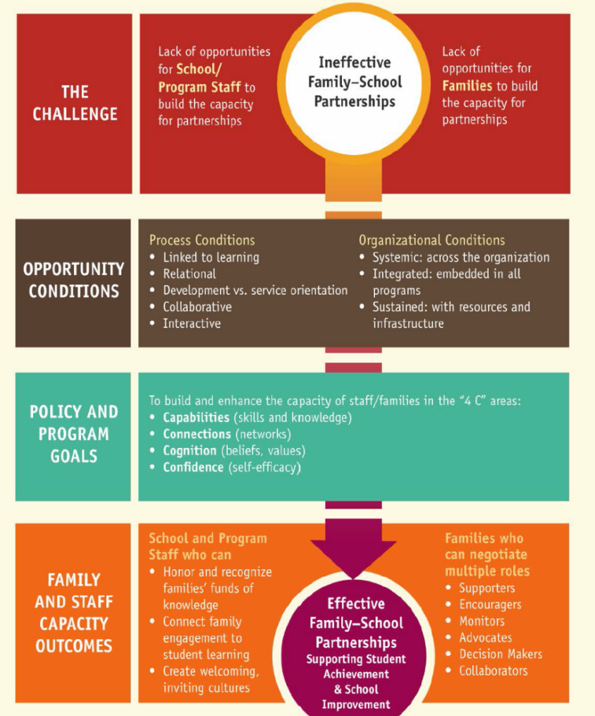
U.S. Department of Education’s Dual Capacity-Building Framework for Family-School Partnerships
Partnering with families in multiple roles:
Supporters
Encouragers
Monitors
Advocates
Decision Makers
Collaborators

Slide 17

U.S. Dept. of Health & Human Services/Dept. of Education
Policy Statement on Family Engagement in the Early Grades
Provides recommendations to early childhood systems and programs on family engagement.

Slide 18
U.S. Office of Special Education Programs (OSEP)
Parent Training and Information Center Priorities
Working with families of infants, toddlers, children, and youth with disabilities, birth to 26
Helping parents participate effectively in their children’s education and development
Partnering with professionals and policy makers to improve outcomes for all children with disabilities

Slide 19
U.S. Office of Special Education Programs (OSEP)
Parent Training and Information Center Priorities (cont.)
To increase parents’ capacity to:
Effectively support their children with disabilities and participate in their children’s education
Communicate effectively and work collaboratively in partnership with early intervention service providers, school-based personnel, related services personnel, and administrators
Resolve disputes effectively
Participate in school reform activities to improve outcomes for children

Slide 20
Families and High-Quality IDEA Early Childhood Systems

Slide 21

High-Quality IDEA Early Childhood Systems
Family engagement cuts across all components of high-quality systems.
Governance
Result
Quality
Standards
Finance
Building
High-Quality
Systems
Implementation
of
Effective Practices
Good outcomes for children with disabilities and their families
Accountability & Quality Improvement
Personnel / Workforce
Data
System
ectacenter.org/sysframe

Slide 22

DEC Recommended Practices (RPs)
www.dec-sped.org/dec-recommended-practices
Offer guidance to families and practitioners about the most effective ways to improve outcomes and promote the development of young children who have or are at risk for developmental delays or disabilities.
8 topic areas:
  Leadership
  Assessment
  Environment
  Family
  Instruction
  Interaction
  Teaming and Collaboration
  Transition

Slide 23
DEC RPs: Family Practices
On-going activities that: 1) promote the active participation of families in decision-making related to their children; 2) lead to the developmental of a service plan; or 3) support families in achieving the goals they hold for their children and the other family members.
Three themes:
  Family-centered practices
  Family capacity building practices
  Family and professional collaboration
F10. Practitioners inform families about leadership and advocacy skill-building opportunities and encourage those who are interested to participate.

Slide 24

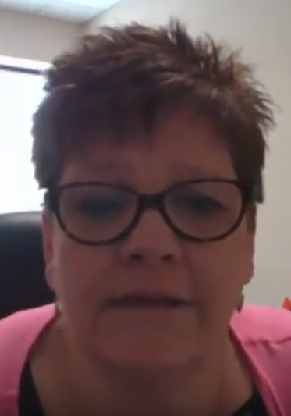
Video-Enhanced Activity

Slide 25
Video Interviews
For each video, record notes about the challenges and/or strategies/solutions shared by the interviewees that fall into the following categories:
  Personal: An opinion, quality, and/or situation that relates to a particular individual rather than to other people.
  Philosophical: An attitude, belief, or presupposition about a situation and/or relationship.
  Knowledge: Awareness or understanding of processes, strategies, technologies, and/or best practices.

Slide 26
Takeaways
Move toward authentic partnerships.
Identify programmatic activities in which families can participate and articulate a clear, intentional clear purpose for their involvement.
Use a variety of methods to Inform families of opportunities to become involved.
Close the loop about decisions.

Slide 27
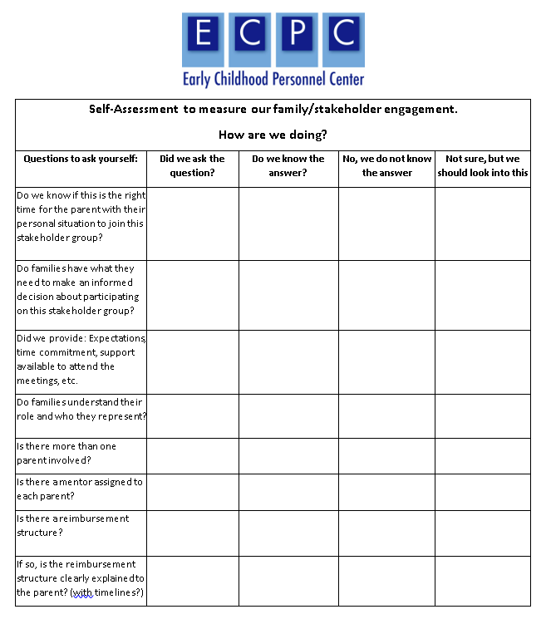
Continuous Improvement
Self-Assessment to Measure Family/Stakeholder Engagement

Slide 28
National Technical Assistance Resources

Slide 29




























No one group can do it alone, so we leverage our resources to partner among national TA centers and organizations.
The Association of University Centers on Disabilities (AUCD)

Slide 30
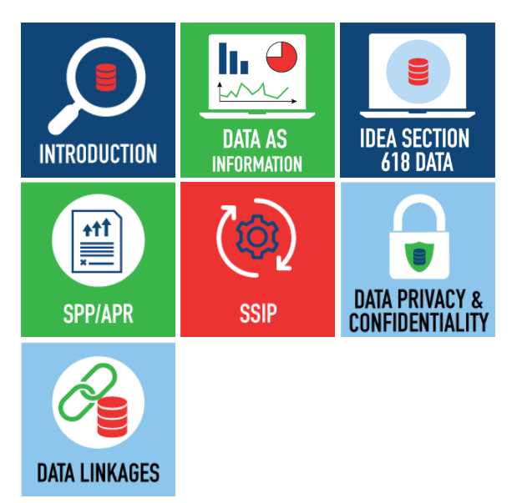

Online Toolkit:
Building Stakeholder Knowledge About Data
This toolkit provides stakeholders with an orientation to IDEA data and other data-related topics to help them meaningfully participate in conversations about important programmatic issues and decisions.

Slide 31
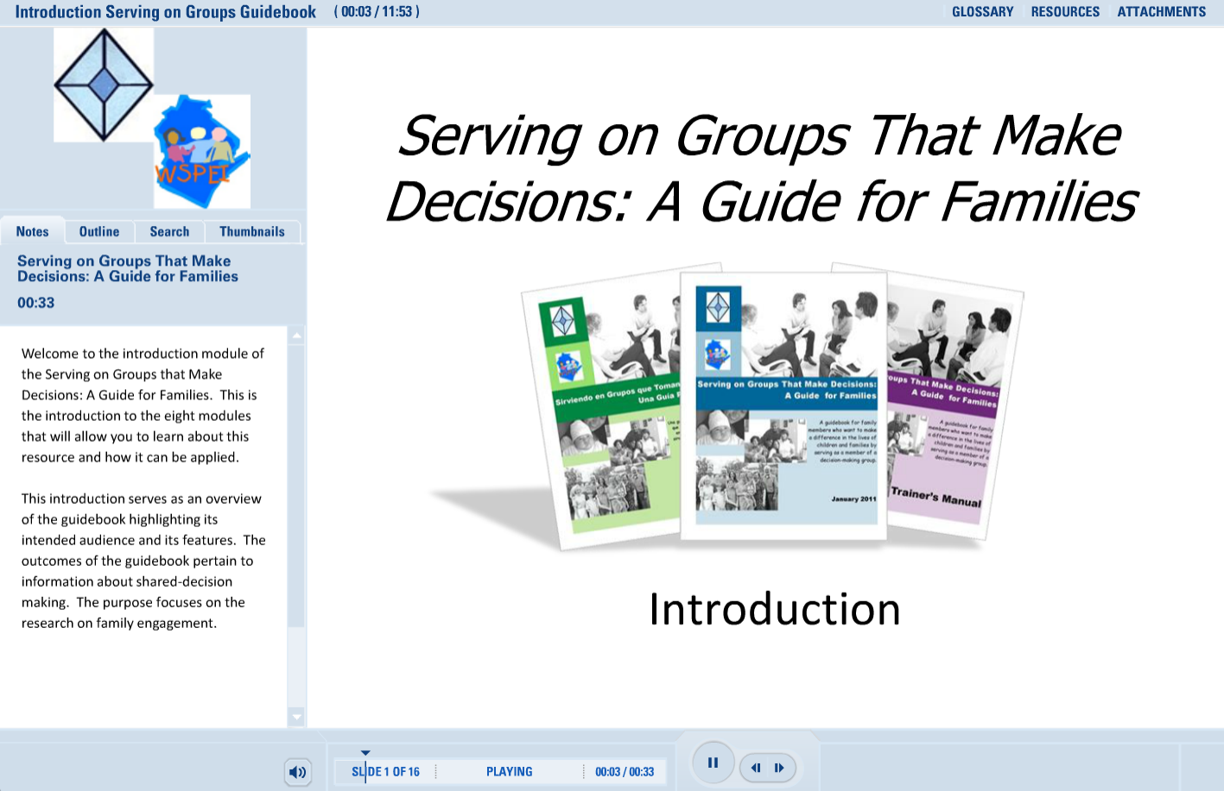

Serving on Groups—Online Module & Book
http://www.servingongroups.org/guidebook

Slide 32

10 Great Things You Will Find on the “CPIR Hub” at parentcenterhub.org
Resources Galore
Buzz from the Hub
Daily Facebook and Twitter Posts
Private Workspaces for Parent Centers
Survey Item Bank
Materials from Other Parent Centers
Buzz from the Hub
Webinars & Webpages on Priority Topics
Central Event Calendars
Who Knows What?

Slide 33
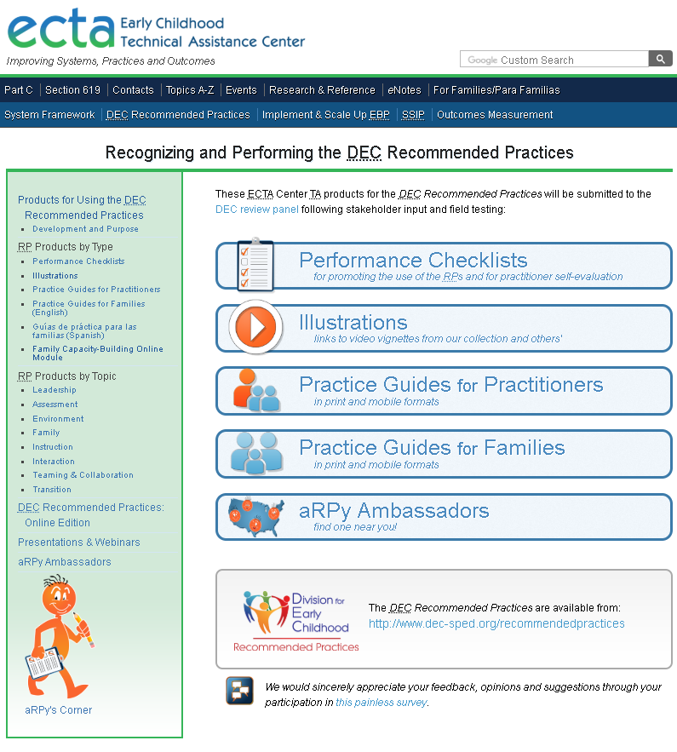
DEC Recommended
Practices
Find products to promote the use of the Recommended Practices at:
http://ectacenter.org/decrp/

Slide 34
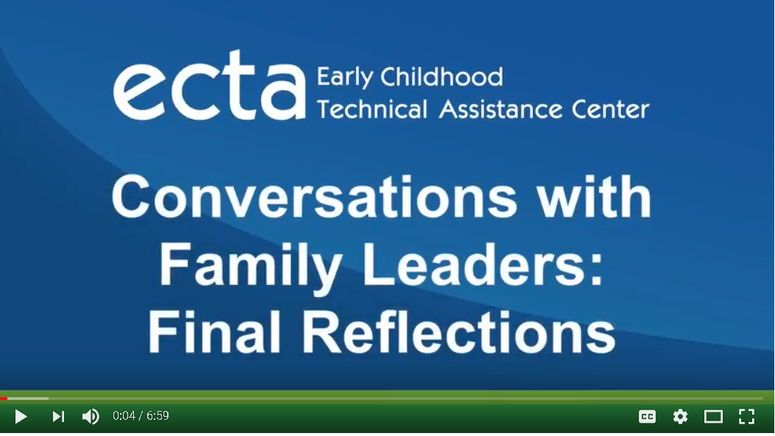
ECTA: Conversations with Family Leaders: Final Reflections (Video)

Slide 35




Resources
The ECTA Center is a program of the FPG Child Development Institute of the University of North Carolina at Chapel Hill, funded through cooperative agreement number H326P170001 from the Office of Special Education Programs, U.S. Department of Education. Project Officer ,Julia Martin Eile.
The DaSy Center is a program of SRI International, funded through cooperative agreement number H373Z120002 from the Office of Special Education Programs, U.S. Department of Education. Project Officers, Meredith Miceli and Richelle Davis.
The Early Childhood Personnel Center is a project of the A.J. Pappanikou Center for Excellence in Developmental Disabilities at the University of Connecticut Health, funded through cooperative agreement number H325B120004 from the Office of Special Education Programs, U.S. Department of Education. Project Officer, Dawn Ellis
Parent to Parent of Georgia is the Region 3 Parent Technical Assistance Center funded through grant number H328R130008 from the Office of Special Education Programs, US Department of Education. Project Officer, David Emenheiser.

Slide 36
Find Us Online
ECTA Center: http://ectacenter.org
DaSy Center: http://dasycenter.org
ECPC: https://ecpcta.org/
Parent to Parent of Georgia: http://p2pga.org/

Slide 37

Thank You
The contents of this presentation were developed under grants from the U.S. Department of Education (#s H326P170001, H373Z120002, H325B120004, H328R130008). However, those contents do not necessarily represent the policy of the U.S. Department of Education, and you should not assume endorsement by the Federal Government.

