Slide 1
Using Data to Answer Critical Questions about EI/ECSE Personnel
Margaret Gillis
SRI International
National Early Childhood Inclusion Institute
May 2018
Notes:
The need to support states in strengthening personnel data.
I want to listen and learn from you.
Focus on data on workforce data. Not going to talk about data from institutions of higher education – very important. But different.

Slide 2
Who is in the room?
Part C state staff?
Part B 619 state staff?
Program Administrators?
Practitioners?
Who else?

Slide 3
Session Objectives
To introduce data states are collecting on personnel
To examine questions states, LEAs, and/or programs may want to answer about their personnel
To promote better understanding of how data can be used to answer critical questions about personnel

Slide 4

What questions could a state or local program ask about personnel that help support inclusion?
Notes:
any information that supports improved personnel in inclusive settings supports improved inclusion (e.g., turnover detracts from program quality, less than fully qualified personnel detracts from quality – for all kids)
A few ideas:
Identify shortages in personnel with specialized training for working with young children with disabilities
Identify rates of turnover among personnel
Identify shortages in personnel who are bilingual

Slide 5
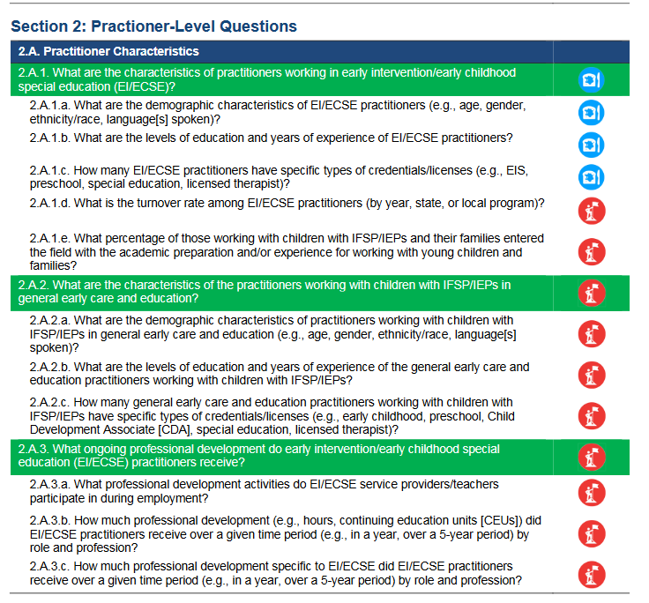
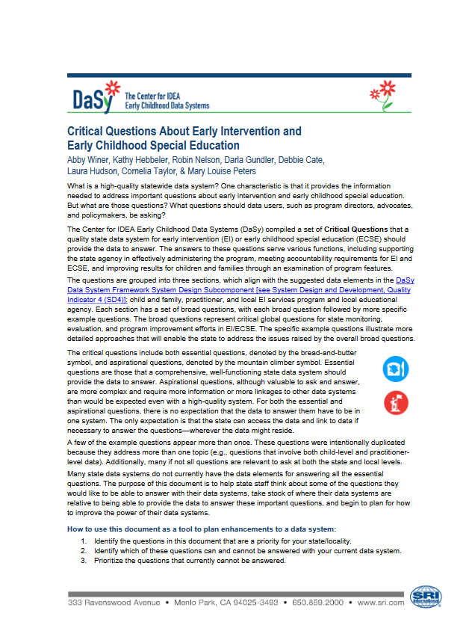
http://dasycenter.org/resources/critical-questions/
Notes:
Bread and butter
Aspirational

Slide 6
Handout – List of Possible Questions
What are your biggest questions on this list?
What is missing?
Notes:
Thank you for your input. We will revisit these questions shortly.

Slide 7

The need to build a “data system”
The hardware, software, and other applications that enable Part C and Section 619 programs to collect data about children, families, workforce, and/or program characteristics (e.g., program quality), as well as the analysis, reporting, and data use practices associated with those data.
System for data
http://dasycenter.org/resources/dasy-framework/
Notes:
You have to build it all. The technology – yes – but also the data collection, capacity to analyze and share out, how to interpret and use. You can’t use what you don’t have. You can’t use what you can’t access.

Slide 8
Functions of a Data System/Uses of Data
Accountability
Program Improvement
Program Operations
Knowledge Development

Slide 9
Functions of a Data System/Uses of Data
Report to funders and other stakeholders to support wisdom of investment, e.g., federal and state reporting
Accountability
Program Improvement
Program Operations
Knowledge Development

Slide 10
Functions of a Data System/Uses of Data
Accountability
Program Improvement
Program Operations
Knowledge Development
Identify strengths and shortcomings; addressing shortcomings

Slide 11
Functions of a Data System/Uses of Data
Accountability
Program Improvement
Program Operations
Knowledge Development
Improve effectiveness and/or efficiency day-to- day management and implementation

Slide 12
Functions of a Data System/Uses of Data
Accountability
Program Improvement
Program Operations
Knowledge Development
Contribute to general understanding of service delivery and outcomes

Slide 13
Questions are the drivers
What data elements to collect
What analyses to run
What tables to produce
Need to design and build the data system based on questions
Notes:
some questions require a sophisticated data system. Some can be answered in Excel. No reason to despair just because a local program does not have a big data system.
Three of the 4 (all except program operations are driven by question) Here is what we have – what can we do with the data we have - starter approach….just not where you want to stay.
But of course, you are not starting from scratch. Most of you have some kind of a data system with some kind of personnel. So

Slide 14
Questions are the drivers
What data elements to collect
What analyses to run
What tables to produce
Need to enhance the data system based on questions
Notes:
Three of the 4 (all except program operations are driven by question) Here is what we have – what can we do with the data we have - starter approach….just not where you want to stay.
But of course, you are not starting from scratch. Most of you have some kind of a data system with some kind of personnel. So

Slide 15
http://dasycenter.org/resources/critical-questions/
Notes:
Bread and butter
Aspirational

Slide 16


http://ectacenter.org/sysframe/
Notes:
What does quality look like in a state system?

Slide 17

“An effective system must coordinate and address state needs for both the number of personnel as well as the degree to which those personnel are supported and qualified for their roles in the service system”
ECTA System Framework
How does leadership build a state system that does that?
How does leadership know if the state system does that?
With
Data

Slide 18
Bottom line:
High quality data on personnel is essential to achieving a system with high quality personnel

Slide 19

What do we know about EC/EI/ECSE Personnel?
Notes:
Let’s dive into a question to see how you might answer it.

Slide 20
Why would you want to know the characteristics of the work force?
What action could you take?
Age?
Race/Ethnicity?
Languages spoken
Preparation?

Slide 21
Professionals have knowledge and skills to implement Recommended Practices
Professionals implement Recommended Practices
Good outcomes for children and families
Other factor
Other factor
Notes:
Professionals having the knowledge and skills is a necessary but not sufficient condition for good outcomes. Implementation science - Multiple influences but professionals have to be knowledgeable. Leadership, caseloads, resources constraints. But having knowledge professionals is critical.

Slide 22
Professionals have knowledge and skills to implement Recommended Practices
What influences
these things?
Professionals implement Recommended Practices
Good outcomes for children and families
Other factor
Other factor

Slide 23
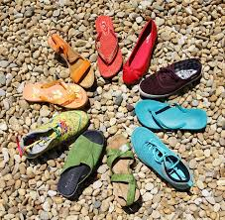
What kind of data are states collecting on personnel?

Slide 24
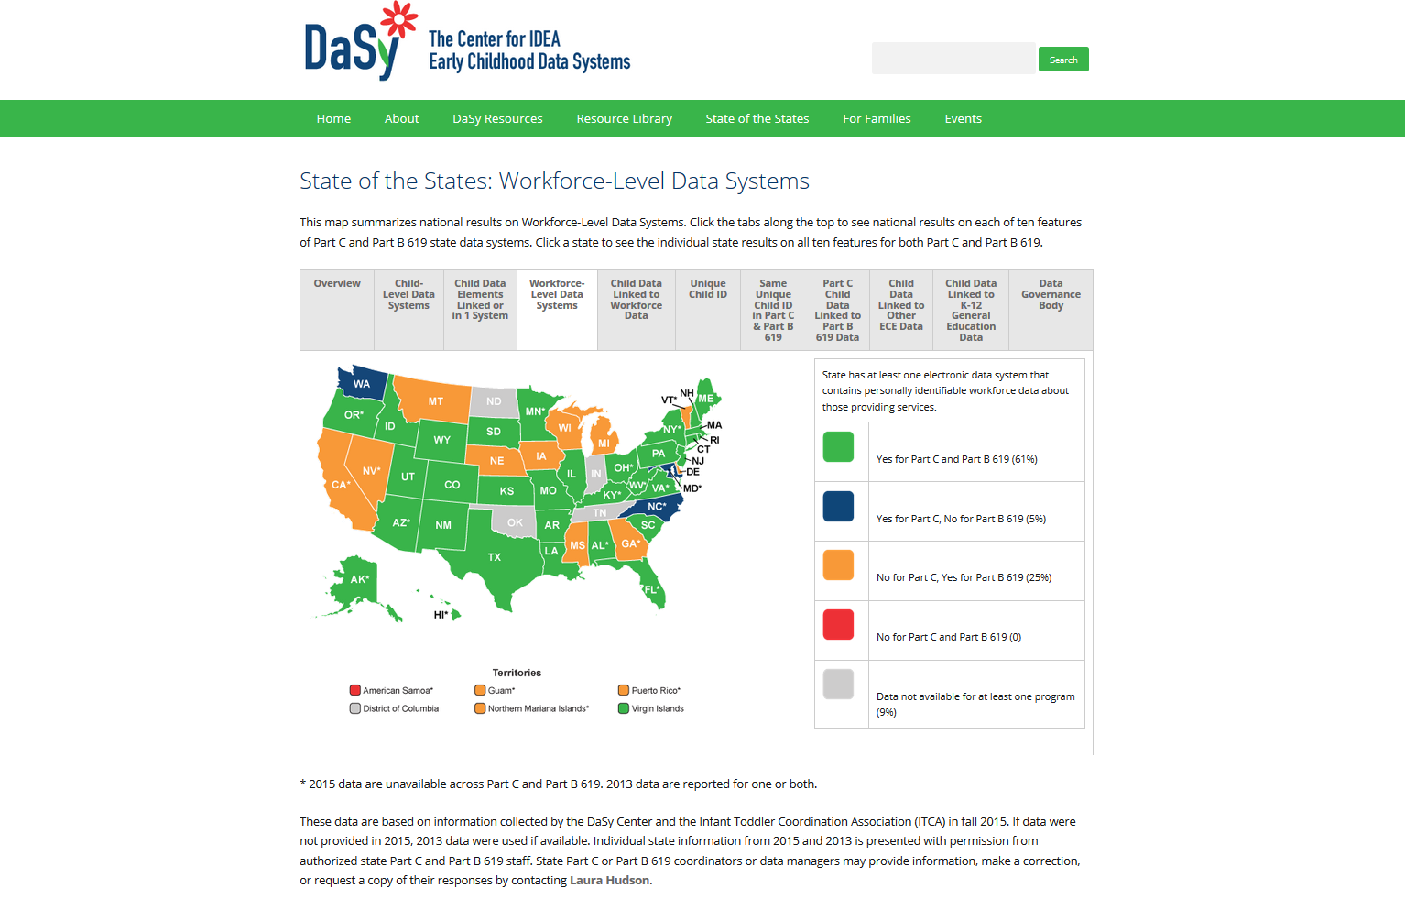
http://dasycenter.org/state-of-the-states-2016/workforce-level-data-systems/

Slide 25
Notes:
If you know what is up there for your state is incorrect, let me know. If you are gray, it means we are missing data or more likely do not have permission to share it. If you are willing to share the data, let me know.

Slide 26
About the ITCA 2015 Data Survey
Data collected through online survey
Conducted survey in 2015
Sent to Part C Coordinators in all states and territories
47 states responded
Percents are percent of states

Slide 27
Early Intervention
72%
31%
49%
At least one data system with data on work force member
Unique identifier for the work force member
Ever linked work force data to child level data

Slide 28
Early Intervention
The majority of states have licensure date. Not many states have demographic data.

Slide 29
About the DaSy Part B 619 survey
Data collected through online survey
  Conducted survey in mid 2013 and fall 2015
  Sent to 619 coordinators in 56 states and jurisdictions, group effort encouraged
Response rates
  2013: 96% (54/56)
  2015: 93% (52/56)
  89% (51 states) answered the survey both years
Percents are percent of states.

Slide 30
Early Childhood Special Education
Majority of states have at least one data system with data on preschool special education teachers.
Little change over time.
7%

Slide 31
Early Childhood Special Education
Majority of states have at least one data system with data on individual related services personnel

Slide 32
Early Childhood Special Education
The majority of states have at least one data system with data on individual general education teachers working with children with IEPs, and there has been little change over time.
Notes:
Doesn’t mean all the general education teachers. Early childhood special education is in Education, State Pre-K also there.

Slide 33
Early Childhood Special Education
Most states reported using a unique identifier for workforce members.
Seven states reported that they used the same unique workforce ID as Part C.

Slide 34
Early Childhood Special Education
More states have data on special education teachers than the other professions.
Licensure is the most common data across states.

Slide 35
Revisiting our questions about personnel

Slide 36
http://dasycenter.org/resources/critical-questions/
Notes:
Bread and butter
Aspirational

Slide 37

How can we use data to answer these questions?

Slide 38
Building a culture of data use
CQs are starter list of questions.
Goal: Data conversations permeate your agency’s day to day work
DEC Recommended Practices
  L12. Leaders collaborate with stakeholders to collect and use data for program management and continuous program improvement and to examine the effectiveness of services and supports in improving child and family outcomes. https://divisionearlychildhood.egnyte.com/dl/tgv6GUXhVo

Slide 39
Working with Data
Let’s work through some data to answer a few critical questions.

Slide 40
Other questions are more complicated
What data might you need to answer this question:
  How many practitioners are in the pipeline who will be prepared to work in inclusive classrooms as compared to the number leaving the field?
What other considerations are needed?
Notes:
Considerations – what happens if your supply won’t meet your demand? Will you pull from other states, recruit more into preparation programs? Helps to have this information in advance so you can plan for it.
For inclusive classrooms – you may need a cross-credential database to be able to look at the general and special education workforce; need to be able to access data on personnel who are non-sped as well as sped

Slide 41
Once you know where you are, you can set goals for where you want to be.

Slide 42
Examples of Personnel indicators
At least 50% of service providers will speak Spanish by 2020.
The state will reduce the turnover rate by 20% by 2020.
At least 75% of practitioners will enter the field with the academic preparation for working with young children and families by 2020.
At least 50% of programs will show growth in the average fidelity score across practitioners 6 months after the initiation of training.
At least 60% of programs have 75% of practitioners implementing at fidelity within 12 months of coaching.
http://dasycenter.org/resources/critical-questions/section-2/
Notes:
Paulsell, D., Austin, A. M. B., & Lokteff, M. (2013)
Measuring implementation of early childhood interventions at multiple system levels (OPRE Research Brief OPRE 2013-16). Washington, DC: Office of Planning, Research and Evaluation, Administration for Children and Families, U.S. Department of Health and Human Services.

Slide 43
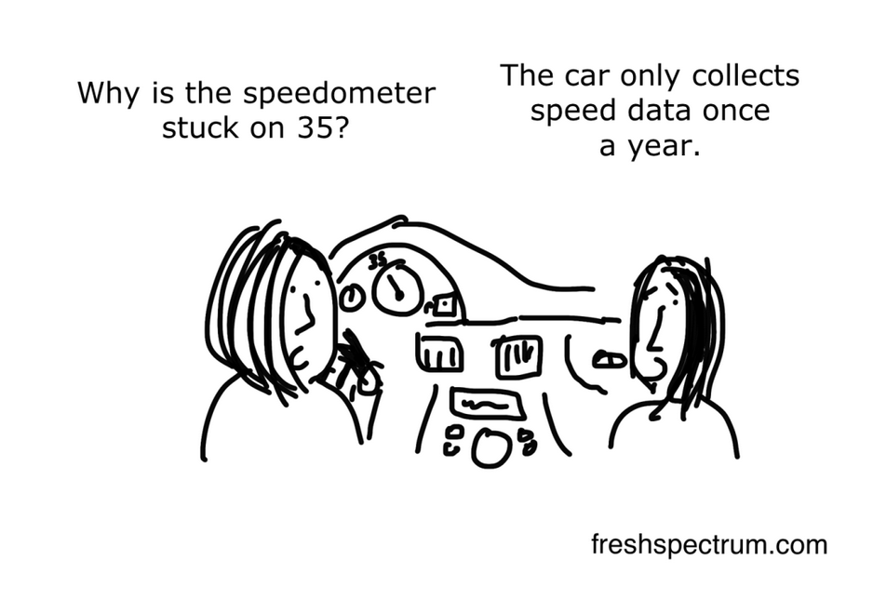
How often do you need data?
Notes:
Need to be current enough for the decisions you want to make from them

Slide 44
Not everything has to be in one of the big state data systems
Some things are time limited (e.g., an initiative).
Some things are spot checks.
  Implementing practice based coaching
Continuous quality improvement vs. a one time evaluation.
For the data elements you don’t have:
  How many of the data elements do you need regularly?
  How many do you need intermittently?

Slide 45
Personnel Data System:
Vision for Every State
Comprehensive set of data elements on personnel (demographics, education, employment start date, additional training, etc.).
All of the data are trustworthy.
All of the data are current.
Coordinator has reasonably easy access to the data and can get analysis completed when they are needed.

Slide 46
For more information
Visit the DaSy website at:
http://dasycenter.org/
Like us on Facebook:
https://www.facebook.com/dasycenter
Follow us on Twitter:
@DaSyCenter

Slide 47

Thank You
The contents of this presentation were developed under a grant from the U.S. Department of Education, # H373Z120002. However, those contents do not necessarily represent the policy of the U.S. Department of Education, and you should not assume endorsement by the Federal Government. Project Officers, Meredith Miceli and Richelle Davis.
Notes:
Instructions to presenters: This slide is to be included as the last slide in your deck but you are not expected to show it to the audience. Please be sure to delete these instructions from this slide’s notes page in your presentation.

