Slide 1
Today’s Word Cloud
Notes:
Session 3 word cloud

Slide 2
Word Cloud from Session 1
Notes:
Cloud from session 1 – How does it compare to today’s cloud?

Slide 3
Evaluating Practice Change and Fidelity Workshop Series
Session 3: What do we do with all this data?
March 1, 2018
Notes:
Today is our 3rd and final session in the Evaluating Practice Change and Fidelity Series: What do we do with all this data? Pulling everything together and preparing for data analysis and use.
This workshop series is sponsored by DaSy and ECTA, in collaboration with IDC and NCSI.

Slide 4
Intended Outcomes of this Session
Participants will increase understanding of strategies for analysis and use of practice change and fidelity data.
Participants will identify clear strategies for improving their evaluation plan that will enable them to effectively evaluate practice change and fidelity.
Notes:
For this session…(1st bullet)
For the series overall, we are aiming for … (2nd bullet)

Slide 5
Agenda
Presentation
Data aggregation and unit of analysis
Pulling it all together
Key Takeaways
Wrapping up and coming soon
Small Group Work
Wrap-Up
Notes:
We will follow a similar structure as we have for each session
To accomplish those outcomes this session we will …

Slide 6
Data Aggregation
Aggregation Method | Considerations
Percentage of practitioners with improved scores | Need to determine criteria for labeling scores as “improved” (e.g., increase of 10 points, moved from “emerging” to “partially implementing”)
Percentage of practitioners meeting fidelity threshold | May take time to see increases in the number of practitioners meeting fidelity; consider combining with analysis of progress toward fidelity
Percentage of programs meeting performance indicator for practitioner fidelity | Need to set criteria for determining whether a program meets a performance indicator for the percentage of practitioners implementing with fidelity (e.g., 75% of practitioners within a program); may take time for practitioners to reach fidelity; consider combining with analysis of progress toward fidelity
Average practitioner change scores | Can be a less reliable method, as variability among scores can range and average can be skewed by outliers
Notes:
Aggregate = summarize
Why is aggregation important? Aggregation helps you concisely summarize your data in to get usable and actionable information across many practitioners and programs. You are collecting lots of data, and it can be overwhelming. Data aggregation helps you whittle all that data down into key pieces of information that help you understand how implementation of evidence-based practices is changing over time, particularly in relation to fidelity.
The prework for this session provided details about each of these ways to aggregate data.
Each of these methods of aggregation can provide information about practice change, when you compare the results across time points.

Slide 7
Unit of Analysis
Practitioner
Coach
Program
Region
State
Notes:
Local program and state staff may look at the data differently to understand trends, including strengths and areas for improvement. Sample questions and sub-questions for many levels were included in the prework.

Slide 8
Example data from the RP²OS-HV for a single practitioner with each item within Interaction Practices displayed
Notes:
This example shows one practitioner’s scores. As you can see, this practitioner has not met the fidelity threshold yet (red line at the 4.0 mark) but has demonstrated growth on each item from the March timepoint to the May timepoint.
The circled bars at the end provides an average for this practitioner across the items in this area of the RP2.
How might a local program use this data?

Slide 9
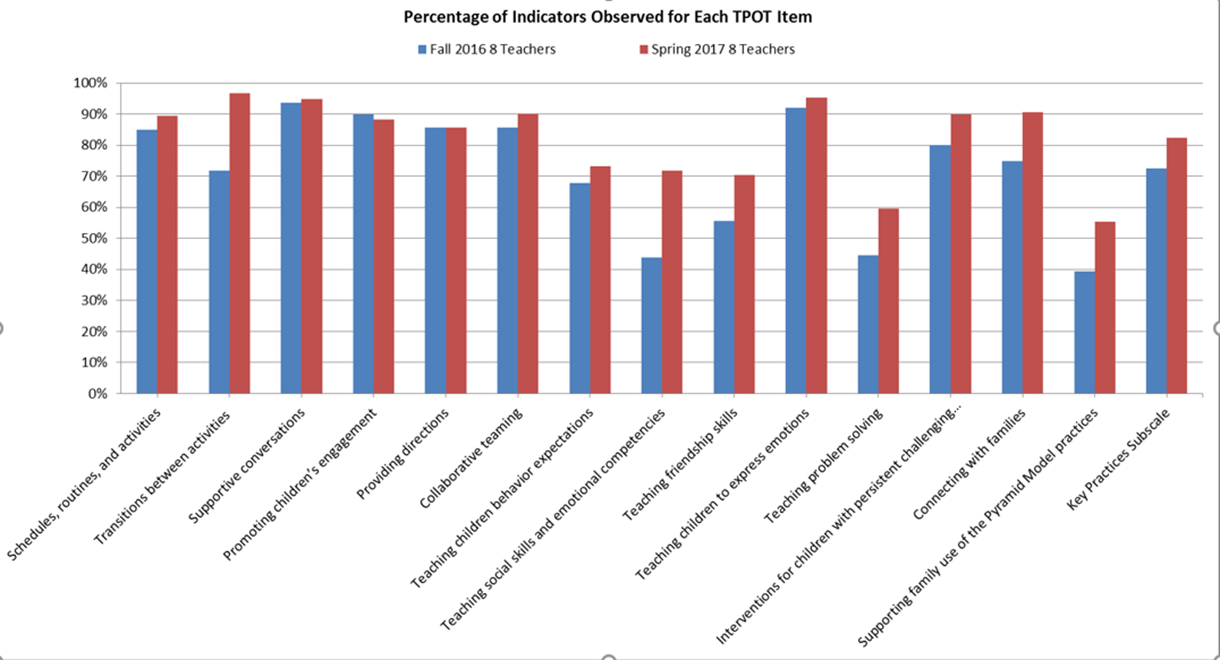
Example data from the TPOT for all practitioners within a local program with average scores for each item displayed
Notes:
This graph shows average scores for one local program on each item on the TPOT.
What does this graph tell you? How might a local program use this aggregated data for the program?
This is too much data to look at for a state. Let’s take the summary score for all practitioners within the program (circled) and see how this compares to other local programs.

Slide 10
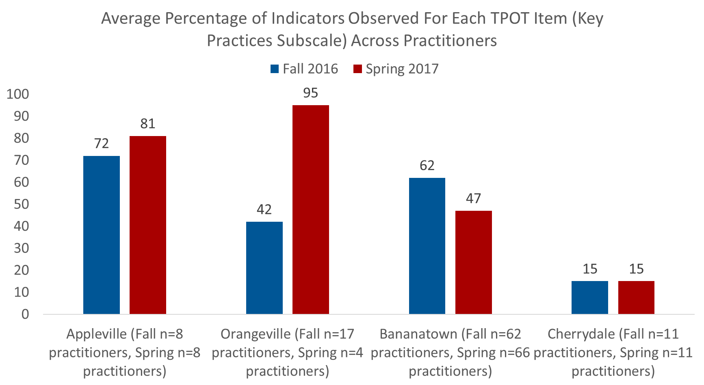
Example data from the TPOT with average total scores for all practitioners in the state displayed by local program
Notes:
This graph shows overall average TPOT scores for all local programs within a state.
What does this graph tell you? How might the state use the data?

Slide 11
Example: Locals select from multiple EBPs
Pyramid Model
Tool: TIPITOS
Fidelity Threshold: 80%
Practitioners implement the evidence-based practice with fidelity
by achieving a score of at least 80% on the fidelity measure associated with the selected EBP
Selected DEC RPs
Tool: State-developed checklist
Fidelity Threshold: 80%
Family-Guided Routines Based Intervention
Tool: Home-based Coaching Checklist
Fidelity Threshold: 80%
Notes:
In many states, local programs can select from multiple evidence-based practices. To be able to roll the data up at the state level, criteria must be set for each evidence-based practice. Additionally, for each practice, you need to ensure the practice and measurement tools are clearly defined and meet the criteria for high quality measurement described in sessions 1 and 2.

Slide 12
Example: Locals select from multiple EBPs – with data!
Pyramid Model
43 of 72 practitioners met fidelity threshold at January timepoint
60%
68% of Practitioners implemented the evidence-based practice with fidelity at the January timepoint.
Selected DEC RPs
80 of 130 practitioners met fidelity threshold at January timepoint
62%
Family-Guided Routines Based Intervention
65 of 76 practitioners met fidelity threshold at January timepoint
188/278 = 68%
86%
Notes:
In this example, the assumption is these are all different practitioners using different EBPs, rather than individual practitioners using multiple EBPs. There is not overlap among the EBPs.
The overall fidelity rate is 68%, but if you look at fidelity for each EBP, you can see some areas of strength and challenge.
What does the overall percentage tell you? Now look at the percentages for each EBP. What does that tell you? How might you use that information?

Slide 13
Pulling it all Together
Evaluation Question:
Are practitioners implementing the evidence-based practices with fidelity?
Are practitioners improving implementation of the practices?
Which regions/programs are reaching high rates of practitioner fidelity? Which ones with low?
Are there specific practices that practitioners are struggling with?
What factors are helping practitioners reach fidelity? What challenges are they facing?
Notes:
Watch for analysis strategies and approaches to presenting data

Slide 14
Example: Data Sources for Evaluating Practice Implementation
Video observation
Interviews of Program Administrators
Are the evidence-based practices being implemented with fidelity?
Practitioner Self Report of Frequency of Practice Use
Focus Groups of Practitioners
Interviews with Coaches

Slide 15
Observation Data by Region
Percentage of practitioners reaching fidelity
75%
(n = 85)
(n = 33)
(n = 31)
(n = 21)

Slide 16
Observation Data by Topic, Program, Coach, and Time Since Initial Training
Percentage of practitioners reaching fidelity
Higher for child interaction, lower for family engagement
Wide range by program (49 to 92%)
Range of 62 to 75% for coaches, with one exception—one coach had 48% of practitioners reach fidelity
Higher for practitioners trained within 3 months

Slide 17
Key Themes from Interviews and Focus Groups—Bright Spots
Practitioners believe that coaches are helping them improve practice
Administrators and practitioners believe practices are important for improving child outcomes
“For the first time, I feel like I have concrete strategies for helping children identify and understand their emotions.”
--A practitioner reflecting on using the practices

Slide 18
Key Themes from Interviews and Focus Groups--Challenges
“The administrator of this program has not been supportive. It’s not that she doesn’t care—she is dealing with crises all the time.”
From a coach interview
More coaching needed
Not all administrators understand or support the practices

Slide 19
Reflections on Example State
Additional analyses, data sources?
Strengths?
Limitations
Notes:
Mention PD, coaching data. Digging deeper into all data

Slide 20
Analysis and Presentation Strategies Used in Example
Data aggregation
Analysis by subgroups, time points
Distribution of data (range, outliers)
Multiple methods
Quantitative
Qualitative
Presentation of data through charts
Quotations
Notes:
Is it equally important to have both quantitative and qualitative data collection methods and data presentation incorporated into the SSIP report? Is there a particular type of data that is universally weighted more heavily?

Slide 21
Qualitative Data
Use qualitative data when
Focus is exploratory, identify questions to ask
Information you want is not easily quantifiable
Need rich, detailed understanding of an issue
Best practices
Alignment with evaluation questions
Planning, training, written procedures
Systematic analysis of data
Notes:
When you want to further explore and better understand findings from quantitative data
Relatively easier to collect, more challenging to analyze; but when collecting, use a structured and systematic approach, e.g., if you’re using meting notes to look at engagement, collaboration within implementation teams, use a standard template for meeting notes.
Quantitative vs. qualitative is not an either/or decision; the use of mixed methods can get at both types of data, and each type of data can complement the other.
Mention word cloud.

Slide 22
Summary of Takeaways Across Series
Alignment, alignment, alignment
Practices = behaviors
Use the same tools and methods to evaluate practice change and fidelity
High quality measurement = meaningful, useful data
Independent observation yields more objective information than practitioners’ self-report
Use multiple methods
Different types of data analysis will be used at different levels
No one way

Slide 23
Key Resources
Building Stakeholder Knowledge about Data (DaSy)
Data Meeting Protocol (IDC)
Telling Your SSIP Story in an Infographic (DaSy, NCSI, ECTA)
Webinar coming April 26
Data Visualization Toolkit (DaSy, NCSI)
Strengthening SSIP Evaluations with Qualitative Methods (DaSy)
Materials from the Evaluating Practice Change and Fidelity Series are posted on the DaSy website: Evaluation of Implementation of EBP Workshop Resources
Notes:
Building Stakeholder Knowledge about Data: This 2018 toolkit provides Part C and Part B 619 stakeholders with an orientation to IDEA data and other data-related topics to help them meaningfully participate in conversations about important programmatic issues and decisions. Can be used as a self-guided manner or facilitated manner.
Data Meeting Protocol: This tool provides a simple structure that state and local teams can use to guide conversations around data. It details steps to follow before, during, and after meetings to support data-informed decision making.
Telling your SSIP Story in an Infographic: guidance on the varied uses for infographics, best practices for creating infographics, and examples of state SSIP infographics. It also offers an exemplar SSIP infographic and instructions for how to access the template through a TA provider.

Slide 24
Thinking About Your April Submission
You have identified changes you want to make to your evaluation plan! Yay!!!
Depending on the type and nature of the change, you don’t necessarily have to have all of this reflected in your April submission.
This is an iterative process.
If you have the capacity, go for it;
If not, be judicious in what you incorporate.
Notes:
Organizational outline, Section F. Plans for Next Year:
Additional activities to be implemented next year, with timeline
Planned evaluation activities including data collection, measures, and expected outcomes
OSEP FAQs, 2016:
Question:
Is a State permitted to significantly modify its evaluation plan once it has been submitted in Phase II?
Answer:
The evaluation plan may be modified as States implement their coherent improvement strategies and evidence-based practices. A State will need to articulate its reasons for making modifications to the evaluation plan. OSEP views Phase II as an implementation plan, with the third element of Phase II serving as the State’s plan for evaluating the activities it will implement that align with the State’s identified improvement strategies, and lead to progress in achieving the SiMR. States should think through reasonable evaluation questions for the first year of implementation to report in Phase III/2017. As strategies are implemented and their results evaluated and considered by the stakeholders, it is reasonable to expect the evaluation plan could evolve.

Slide 25
Follow up TA Support
Follow-up TA Requests
Talk to your breakout group leader(s) for this workshop series
Let us know if you would like to have individualized calls to apply and extend the work to your plan
Small group calls to continue discussion
Contact Betsy Davies-Mercier: Elizabeth.mercier@sri.com
Bring your ideas and thoughts from this series to your state teams and other TA providers

Slide 26
Coming Soon
Email asking you to evaluate this workshop series
We value your feedback!
Potential topics for Coffee Hours
Defining and operationalizing practices
Setting a fidelity threshold
Selecting a fidelity tool
How to improve the quality of self-report data
Using qualitative data in reporting about practices
Notes:
In the evaluation, we will be asking about your interest in topics for coffee hours, plus you can suggest other topics. Please fill out your evaluation to let us know which topics you are interested in.

Slide 27
Small Breakout Group Work
State sharing and discussion
Data aggregation
At what level does aggregation happen?
How do local programs and the state coordinate to aggregate data?
Pulling it all together
What do you want to know from your data and what do you need to answer your questions?
How can data support implementation and improvement?

Slide 28
Additional TA Support
To request follow-up support or individualized TA
Talk to your breakout group leader(s) for this workshop series
Contact Betsy Davies-Mercier:
Elizabeth.mercier@sri.com
Contact your current TA provider
Notes:
We encourage states to seek additional support.

Slide 29
Your Take Aways
What struck you today?
What did this get you thinking about?

Slide 30
Formative Evaluation
What worked well?
What could be improved for future online workshops?
Please also complete the evaluation survey coming via email!

Slide 31
Thank You!
The contents of this presentation were developed under grants from the U.S. Department of Education, # H373Z120002, #H326P120002, H326R140006, and H373Y130002. However, those contents do not necessarily represent the policy of the U.S. Department of Education, and you should not assume endorsement by the Federal Government. Project Officers: Meredith Miceli, Richelle Davis, Julia Martin Eile, Perry Williams, and Shedeh Hajghassemali.

