Slide 1
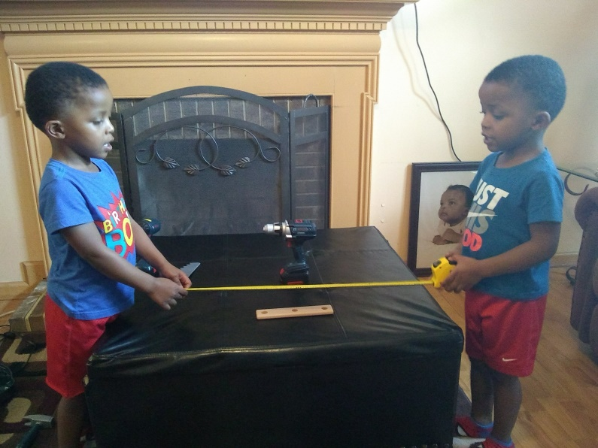
Evaluating Infrastructure Workshop Series
Session 2: How are we measuring?
February 7, 2018
Notes:
Session 2: How are we measuring? Delving deeper into measurement strategies and data sources
This workshop series is sponsored by DaSy and ECTA, in collaboration with IDC and NCSI.

Slide 2
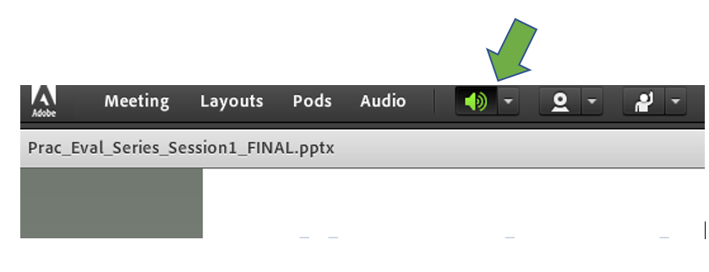
Welcome!
Housekeeping
Did you login by listing your State Program, Name (e.g., ND C, Abby Schachner)?
If not, please update your information in Adobe
If you are with a group, list out who is with you in the chat
Please mute your lines if you are with a group or area with background noise
*6 to mute, #6 unmute
Mute your computer speakers

Slide 3
Intended Outcomes of this Session
Participants will identify appropriate measures/tools, including the System Framework Self-Assessment, that they will use or continue to use in measuring infrastructure change.
Participants will identify clear strategies for improving their evaluation plan that will enable them to effectively evaluate infrastructure improvements.
Notes:
For this session…(1st bullet)
For the series overall, we are aiming for … (2nd bullet)

Slide 4
What’s Up with the Two Workshop Series?
Infrastructure Practices
What are we measuring and why?
Evaluation questions, performance indicators, outcomes
How are we measuring?
Measurement strategies, tools, data sources
What do we do with all these data?
Preparing data for analysis and use
Notes:
Same focus in each of the three workshop sessions, but applied to infrastructure vs. practices.
Infrastructure change and impacts of that change; practice fidelity and practice change.

Slide 5
Agenda
Ground rules
Recap of Session 1 Small Group Discussions
Presentation – Measurement Approaches and Tools
Aligning outcomes & performance indicators to activities and eval questions
Small Group Work – Examples and discussion of measurement approaches and tools
Wrap-Up & Plan for Session 3
Notes:
We will follow a similar structure for each session
To accomplish those outcomes this session we will …

Slide 6
Ground Rules
Share openly (we are not recording)
What is shared in the room, stays in the room
Listen actively
Ask one another questions
Participate to the fullest of your ability
Participate in all 3 sessions
Come prepared , complete pre-work
Let us know your needs – including follow-up or individualized TA
Notes:
Quick reminder of the ground rules

Slide 7
Themes from Session 1 Breakouts
Infrastructure Components Interconnections: Most state teams acknowledge the need to evaluate more than one component of infrastructure
State and local implementation processes: Staff turnover , timeline delays, implementation challenges and the impact on evaluation planning
Shoring up SSIP evaluation plans: Many states plan to review alignment, outcomes vs outputs, and develop new outcomes as appropriate
Small workgroup process: Validation, sharing of ideas, and support for individualized TA…just need more time!

Slide 8
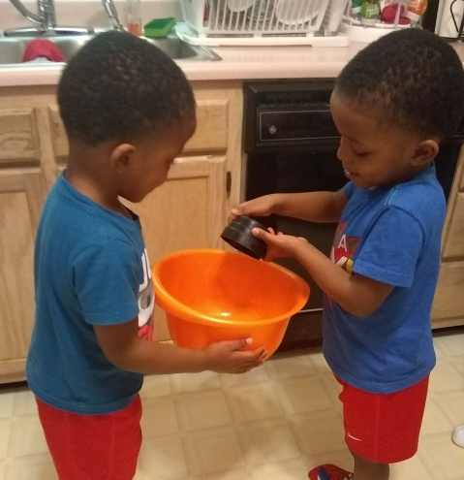
Considerations for Infrastructure Measurement
Broad vs. specific outcome measures
Broad: Self-assessment of progress on indicators of infrastructure
Specific: Measures of specific changes
Consider levels of evidence
Data sources
Data collection strategies
Data collection schedule/frequency
Notes:
In the first session our focus was on outcomes, evaluation questions and performance indicators, and the alignment of those.
Today we’re going to focus on measures/tools and data, and again, making sure that those are aligned with eval questions, outcomes and perf ind.
If you didn’t have enough information on your specific measure(s) when you wrote your performance indicators, you may need to go back and refine those.
Infrastructure: broad: overall systems level
specific changes: changes in knowledge or understanding of the COS process; change in data collection procedures, change in actual data; changes in the use of child-level standards; changes in the amount of $ providers collect by various revenue sources;
Measures of broad change and specific change are not mutually exclusive.
Source of data: Practitioners, program administrators, families, other stakeholders; Consider levels of the system
Data collection methods/strategies: survey, self-rating checklist, interviews, observation, record review
Frequency of data collection – for systems work, consider multiple time points because of the nature of the work
Evaluation design, for example use of comparisons – we’ll explore that more with system self-assessment -- over time or to a standard
Measure: An instrument, device, or method that provides information, often quantifiable data, on an outcome. A measure is a metric for checking progress on an indicator.

Slide 9
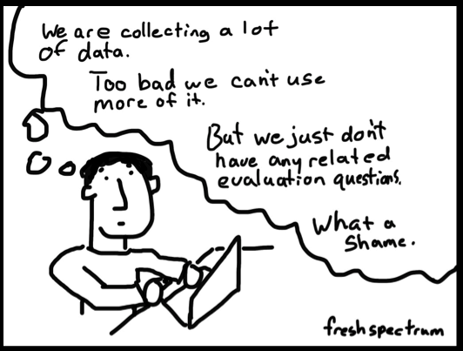
Notes:
http://freshspectrum.com/

Slide 10
Outputs and Outcomes: Levels of Evidence
Outputs
Direct results of activities, products/events, number of client contacts with products/events
Short-term outcomes
Reactions, awareness; learning, knowledge
Intermediate outcomes
Behaviors/actions; organizational or system functioning
Long-term outcomes/impacts
Impact(s) on children/families; impact(s) on system, program sustainability
Notes:
Refresher:
Based on model for evaluating training programs, developed in 1959 and still widely used today
Kirkpatrick, 1959; Guskey, 2006

Slide 11
Framework Structure: Personnel/Workforce
Subcomponent 4
Quality Indicator 7
Element of Quality 1.1a
Element of Quality 1.1b
Quality Indicator 8
Element of Quality 1.2a
Inservice Personnel Development
Notes:
We’re going to look at one approach to evaluating infrastructure using the ECTA/DaSy System framework (and self-assessment).
Let’s first briefly review the structure of the framework.
There are 6 components, e.g., governance, personnel/workforce, data, etc.
Each component may have subcomponents – for example, Personnel/workforce has subcomponents on inservice personnel development, state personnel standards, preservice personnel development, recruitment and retention
A component/subcomponent has quality indicators, and the QI has a number of elements.
Quality Indicator PN7: 8 elements
A statewide system for inservice personnel development and technical assistance is in place for personnel across disciplines.
Quality Indicator PN8: 3 elements
A statewide system for inservice personnel development and technical assistance is aligned and coordinated with pre-service, curricula, EBPs across disciplines.

Slide 12
Tools: Framework Self-Assessments
Change over time: from Time 1 to Time 2
Compare QI ratings, e.g., Time 1 = 3, Time 2 = 5
Compare percent of elements fully implemented, e.g., Time 1 = 20%, Time 2 = 50%
Comparison to a standard
QI rating = 6, at least 50% are fully implemented, the rest are partially implemented
At least 50% of the elements are fully implemented
Quality Indicator rating scale, 1 to 7: none to all fully implemented
Notes:
Quality Indicator rating scale goes from 1 to 7, it’s automatically calculated if you’re using the SA tool;
Looking at progress from baseline to a later point in time: using QI rating or % of elements fully implemented.
Comparison to a standard: What’s that analogous to within the realm of practices – FIDELITY.
If your standard is a QI rating of 7, that’s a pretty high bar, right? It means that all the elements are fully implemented.
Let’s say we don’t think we can meet that – there may be an element that’s partially or completely beyond our control, and/or we may not have sufficient resources.
So we decide we’re going to set it a little lower. There are two examples here – which sets a higher bar/standard?
Bottom line: you have to set a standard that is realistic, doable but still provides the support you’ll need to . . . Consider how good/strong that area of infrastructure needs to be, considering whether it’s standing on it’s own or strengthened by other, related infrastructure, such as governance and accountability.

Slide 13
Use of System Framework Self-Assessment: Change over Time
Outcome Type | Outcome | Evaluation Question(s) | How will we know (Performance Indicator) | Measurement/ Data Collection Method | Timeline/ Measurement Intervals | Analysis Description
Example 1 based on 2 or more ratings looking at change over time.
System-Level Intermediate | The state has an improved system for inservice personnel development and technical assistance (Personnel/Work-force, subcomponent 4). | Has the statewide system for inservice personnel development and technical assistance improved ? | 100% of the QI ratings for the two Quality Indicators (QIs) in the inservice personnel development subcomponent will increase. | System Framework Self-Assessment on f inservice personnel development and technical assistance (Personnel/Work-force, subcomponent 4). | Baseline -2017 Post - 2019 | Compare self-assessment QI ratings from baseline and post, and compute the percent of QI ratings that increased.
Notes:
An example using comparison over time

Slide 14
Use of System Framework Self-Assessment: Comparison to a Standard
Outcome Type | Outcome | Evaluation Question(s) | How will we know (Performance Indicator) | Measurement/ Data Collection Method | Timeline/ Measurement Intervals | Analysis Description
Example 2 based on one or more ratings relative to a criterion/standard – a baseline or pre-rating not required
System-Level Intermediate | The state has a quality system for inservice personnel development and technical assistance. | Does the state have a quality system for inservice personnel development and technical assistance? | 100% of the two Quality Indicators (QIs) for the inservice personnel development subcomponent (Personnel/ Workforce Subcomponent 4) will have a QI rating of 6 or 7. | System Framework Self-Assessment on inservice personnel development (Personnel Workforce component subcomponent | Winter 2018 (may complete additional ratings as needed until performance indicator met) | Compute the percent of the two QI ratings that had a rating of 6 or 7.
Notes:
Make sure you have alignment between outcome, evaluation question, performance indicator and analysis.
You had an example in the pre-work that had several instances of misalignment. So if you’re going to model one, use this one.
The second example we gave you in the pre-work was not aligned; outcome expressed improvement but measurement was in relation to a standard.
And be careful/precise in articulating your measures, particularly if using percent of elements: 50% of all elements across the 2 QIs is not the same as 50% in each QI.
Whatever approach you take, in addition to using the quantitative descriptors in SSIP report, highlight examples of accomplishments/elements achieved.
In Personnel Workforce component, subcomponent 4 addresses In-service Personnel Development, and it has 2 QIs:
QI7 -- A statewide system for in-service personnel development and TA is in place for personnel across disciplines.
QI8 -- A statewide system for in-service personnel development and TA is aligned and coordinated with higher education program and curricula across disciplines.

Slide 15
Considerations for Use of Framework Self-Assessments
Size, scope - knowing where to start
Built-in benchmarks and milestones
Think in terms of incremental progress
Data sources, e.g., stakeholder involvement
Think through the evidence and translate that into a rating
Quality elements are not sensitive to all changes
Notes:
Generally, we recommend completing the SA for an entire component so you can identify strengths and opportunities for improvement and because there are some interrelationships -- but you may know (at a subcomponent level) where you need to focus your efforts.
There is recognition that system change is not simple, it takes a while, so you may have an ambitious outcome in mind, but you can certainly set up key milestones for getting there.
stakeholder involvement – having the right people at the table; from multiple systems, i.e., state and local, as many of the elements speak to what’s happening at the local level.
Quality elements are not sensitive to all changes
Use of the SA helps you address one of the fundamental questions: how is your system different . . .
The ability to report PMs around Infra improvement is important, esp. for Year2 of Phase III.

Slide 16
Other Tools/Approaches
Resource list provided with the pre-work is not comprehensive; provides key resources
Some of those resources, even the self-assessments, can be adapted or form the basis for data collection, e.g., through surveys, interviews or focus groups
Measures of specific change
Notes:
Resource list of tools; used on their own, or adapted for use.
These tool, including the System framework, represent some good thinking from experts in the field, including a number of your colleagues.
You may adapt them to look at specific measures of change, Measures of specific change can help “take the temperature of the system”, inform formative evaluation and address incremental progress.
Measures of broad change and specific change are not mutually exclusive.
specific changes: changes in practitioner use of child-level standards; changes in the number of providers with NPI numbers (in order to bill); changes in the way providers collect various revenue sources; changes in knowledge or understanding of the COS process; change in data collection procedures, change in actual data; impact of a revised monitoring protocol that focuses as much on results as compliance; changes in the way leaders communicate on performance measurement and engage stakeholders;

Slide 17
Key Take-Away Points
There are existing tools you can leverage
Alignment, alignment, alignment
Align measurement & analysis with performance indicator and evaluation question
Relate short-term outcomes to one or more areas of infrastructure
You can evaluate infrastructure based on change or comparison to a standard
Think in terms of incremental progress
There is no one way
Notes:
There are existing tools you can leverage – use as is or adapt or use as basis for other forms of data collection
Align measurement & analysis with performance indicator and evaluation question
Relate short-term outcomes to one or more areas of your infrastructure
You can look at change or comparison to a standard
Think in terms of incremental progress; what’s realistic given where your system is at; identify milestones
There is no one way

Slide 18
Small Breakout Group Work
Work on and discuss example(s)
Discussion questions:
What approaches or tools are you using or thinking about using?
What have you found to be the pros and cons of your approach?
How’s it going? Are you getting the information you want?
What challenges are you experiencing: selection of tool, data source, data collection, etc.?
Notes:
Example on Quality Standards is near the end of these slides. Facilitators may use that to start the discussion, or begin with another example related to the focus area of the breakout group, which could be an example shared by a state based on the pre-work

Slide 19
Breakout Group Instructions
We will go into virtual breakout groups in Adobe Connect
For visual – you will be automatically moved into breakouts through this Adobe Connect room
For audio – you will call into conference line for each specific breakout group (next slide)
Notes:
We will go into virtual breakout groups in Adobe Connect
Stay in this Adobe Connect, will be automatically moved into rooms
Call into conference line for each specific breakout group for audio
Hoping to spend 1 hour in breakout groups, depending on transition time

Slide 20
Breakout Groups
Conference Line: (866) 426-5206
International Dial-in Number: (954) 320-7777
Group 1 - Data Sys & Acct: AL-C, AZ-619, DC-C, IL-C, LA-C, PA-C, SD-C, CO-C
Stay on main conference line
Group 2 - Finance: AZ-C, CT-C, IN-619
Participant code: 473-062-7118#
Group 3 – Personnel PD/TA: CA-C, DE-C, ID-619, VT-C, HI-C, DC-C
Participant Code: 436-859-5038#
Group 4 – Personnel PD/TA: AR-C, OK-C, FL-C
Participant code: 431-458-4964#
Group 5 – Quality Standards: NC-C, ID-C, NM-C, WA-619
Participant code: 724-789-0851#
Group 6 – State/Local Gov Part B: AR-619, IN-C, SC-619, SD-B, TN-C
Participant Code: 419-457-8860#
Group 7 -State/Local Gov: AK-C MT-C, UT-C, WY-C, NE-C
Participant Code: 413-856-7434#
Notes:
All groups, but Group 1 will hang up from the current line and dial back in using the listed participant code
These are preliminary groupings based on information from registration, communication with us or pre-work. If you would like to switch groups let us know. Also everyone is working on more than one area of focus so you are not limited to only discuss the tentative topic for your group – we want these breakouts to meet your needs. This was just a first attempt to create non-arbitrary groups.
If you do not see your state team on the slide, let us know which group you would like to join!
We will then turn on virtual break out rooms in Adobe Connect – you will be able to share screens, etc. that only your group will see

Slide 21
Small Breakout Group Work
Work on and discuss example(s)
Discussion questions:
What approaches or tools are you using or thinking about using?
What have you found to be the pros and cons of your approach?
How’s it going? Are you getting the information you want?
What challenges are you experiencing: selection of tool, data source, data collection, etc.?
Notes:
Example on Quality Standards is near the end of these slides. Facilitators may use that to start the discussion, or begin with another example related to the focus area of the breakout group, which could be an example shared by a state based on the pre-work

Slide 22
Breakout Group Example
Outcome Type | Outcome | Evaluation Question(s) | How will we know (Performance Indicator) | Measurement/ Data Collection Method | Timeline/ Measurement Intervals | Analysis Description
 |  |  |  |  |  | .
Notes:
Facilitators may use their own example(s) in the breakout group, or start with the following example on Quality Standards.
Also consider data source, data collection methods and frequency of data collection, as applicable.
Are there specific measures of change (beyond the self-assessment) that you would be interested in? For example, for formative evaluation?
What are those and what are some options for how to measure them?

Slide 23
OPTIONAL EXAMPLE: Quality Standards: Child Standards
Activity: Revise State’s child level standards to incorporate child social-emotional competencies
QS1. The state has articulated what children under age five, including children with disabilities, are expected to know and do.
QS2. Early childhood programs, including Part C and Section 619, use the child level standards to support the implementation of high-quality practices.
QS3. The state has an infrastructure in place to support the effective use of child level standards.
Notes:
Optional – if you want an example to use to help structure discussion and get small group talking and thinking

Slide 24
OPTIONAL EXAMPLE: Quality Standards: Child Level Standards
Outcome Type | Outcome | Evaluation Question(s) | How will we know (Performance Indicator) | Measurement/ Data Collection Method | Timeline/ Measurement Intervals | Analysis Description
System-Level Intermediate | The state has quality child level standards that incorporate child social emotional competencies and are used to support the implementation of high quality practices. | Does the state have quality child level standards that incorporate child social emotional competencies and are used to support the implementation of high quality practices? | At least 50% of the elements in the three Quality Indicators (QIs) on Child Level Standards (Quality Standards Subcomponent 1) will be fully implemented by March 2018. | System Framework Self-Assessment on Child Level Standards (QI1, QI2, QI3; Quality Standards Subcomponent 1). | March 2018 (may complete additional ratings as needed until performance indicator met) | Compute the percent of all elements in the three Qis that are fully implemented.
Notes:
Optional – if you want an example to use to help structure discussion and get small group talking and thinking
Is the wording of the Performance Indicator precise enough? Does it mean 50% of the combined number of elements across all 3 QIs, or does it mean at least 50% of elements in QI1, in QI2 and QI3?
Given the focus of each QI, does it make sense to address all three at the same time, from an implementation and Time2 evaluation perspective?
If not, how would you approach this subcomponent?
Are there specific measures of change (beyond the self-assessment) that you would be interested in? For example, for formative evaluation?
Discuss measures of specific change in addition to or in lieu of self-assessment.
Also consider data source, data collection methods and frequency of data collection, as applicable.

Slide 25
Quality Standards
Outcome Type | Outcome | Evaluation Question(s) | How will we know (Performance Indicator) | Measurement/ Data Collection Method | Timeline/ Measurement Intervals | Analysis Description
 |  |  |  |  |  | .
Notes:
Optional – if you want an example to use to help structure discussion and get small group talking and thinking
Also consider data source, data collection methods and frequency of data collection, as applicable.

Slide 26
Wrap-Up
Session 3: February 21st from 3:30-5pm Eastern
What do we do with all this data? Pulling everything together and preparing for data analysis and use.
Pre-work - will be sent out next week
Assessing and considering enhancements to your data analysis plans
How do you plan to analyze, use and share your infrastructure evaluation data with programs, state leadership team/stakeholders?
Logistics of collection and management of the data. Who develops reports, how often?
Notes:
Use broadcast message to give at least 5 min warning for wrap-up
Our 3rd and final session for the Infrastructure series will be on February 21st – same time and place/call-in information - and will focus on What do we do with all this data? Pulling everything together and preparing for data analysis and use.

Slide 27
Your Take Aways
What struck you today?
What did this get you thinking about?

Slide 28
Formative Evaluation
What worked well?
What could be improved for next time?

Slide 29
Thank you
See you in 2 weeks!
The contents of this presentation were developed under grants from the U.S. Department of Education, # H373Z120002, #H326P120002, H326R140006, and H373Y130002. However, those contents do not necessarily represent the policy of the U.S. Department of Education, and you should not assume endorsement by the Federal Government. Project Officers: Meredith Miceli, Richelle Davis, Julia Martin Eile, Perry Williams, and Shedeh Hajghassemali.

Slide 30
Slides to Reference If Needed

Slide 31
Quality Indicator Rating Scale
1 | None of the elements are yet planned or in place
2 | Most of the elements are not yet planned or in place
3 | Some elements are in place, a few may be fully implemented
4 | At least half of the elements are in place; a few may be fully implemented
5 | At least half of the elements are in place; some are fully implemented
6 | At least half of the elements are fully implemented, the rest are partially implemented
7 | All elements are fully implemented
Notes:
If needed to reference

Slide 32
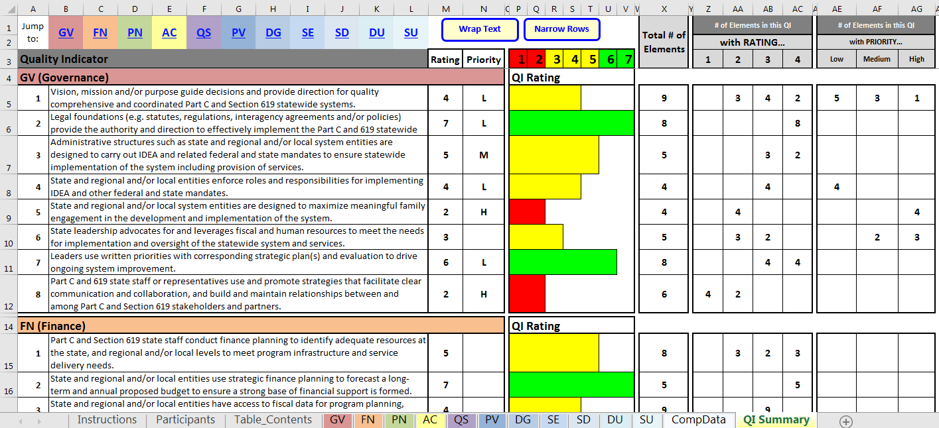
Sample Output from System Framework Self-Assessment

Slide 33
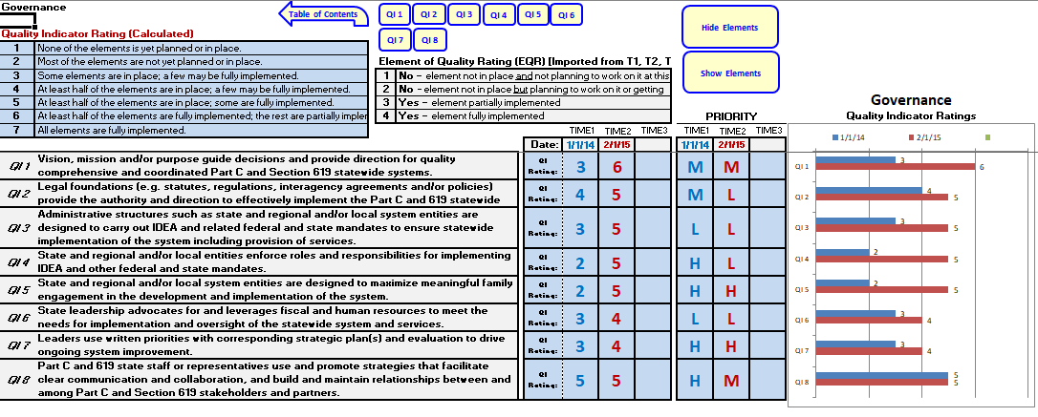
Sample Output from System Framework Self-Assessment Comparison Tool

Slide 34
Use of System Framework Self-Assessment: Comparison to a Standard
Outcome Type | Outcome | Evaluation Question(s) | How will we know (Performance Indicator) | Measurement/ Data Collection Method | Timeline/ Measurement Intervals | Analysis Description
Example 2 based on one or more ratings relative to a criterion/standard – a baseline or pre-rating not required.
System-Level Intermediate | The state has an improved system for inservice personnel development and technical assistance (Personnel/Work-force, subcomponent 4). | Has the statewide system for inservice personnel development and technical assistance improved ? | 90% of the Quality Indicators (QIs) in Personnel/ Workforce Subcomponent 4 (In-service Personnel Development) will have at least 50% of the elements fully implemented by 2018. | System Framework Self-Assessment on the Personnel Workforce component subcomponent 4 (PN4) | Winter 2018 (may complete additional ratings as needed until performance indicator met) | Compute the percent of QI ratings for PN4 that had 50% or more of the elements fully implemented.
Notes:
What’s wrong with this example? Outcome and eval question are not aligned with the performance indicator and measurement/analysis.

